Slide 1

Ozone Season Summary
2010
Sunil Kumar
TAC Meeting, COG
July 13, 2010

Slide 2
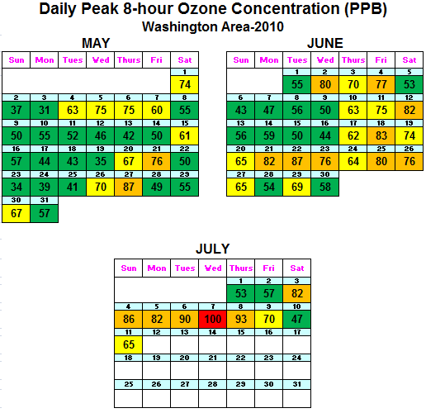
Ozone Season Summary (2010)
Peak 8-Hour Ozone Concentrations (ppb)
Data based on the 8-hour standard set at 75 ppb.
1 Code Red Day
16 Code Orange Days
20 Code Yellow Days
35 Code Green Days
* Analysis is based on draft data until July 12, 2010. Data is subject to change.

Slide 3
2010 Ozone Exceedances
Date | # of Monitors Exceeding | Highest Monitor | Highest Concentration (ppb)
5/21/2010 | 1 | Rockville | 76
5/27/2010 | 4 | HU-Beltsville | 87
6/2/2010 | 1 | HU-Beltsville | 80
6/4/2010 | 1 | HU-Beltsville | 77
6/12/2010 | 1 | Rockville | 82
6/18/2010 | 2 | Franconia | 83
6/21/2010 | 3 | Calvert Co. | 82
6/22/2010 | 5 | HU-Beltsville | 87
6/23/2010 | 1 | Calvert Co. | 76
6/25/2010 | 1 | Prince Georges Co. | 80
6/26/2010 | 1 | HU-Beltsville | 76
7/3/2010 | 3 | HU-Beltsville | 82
7/4/2010 | 5 | River Terrace | 86
7/5/2010 | 3 | Calvert Co. | 82
7/6/2010 | 10 | Prince Georges Co. | 90
7/7/2010 | 13 | McMillan Reservoir | 100
7/8/2010 | 3 | Frederick Co. | 93
* Analysis is based on draft data until July 12, 2010. Data is subject to change.

Slide 4
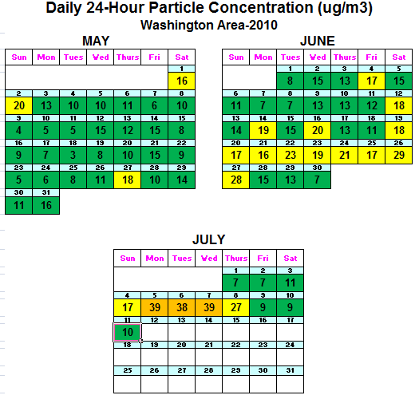
Fine Particle Summary (2010)
24-Hour PM2.5 Concentrations (ug/m3)
Data based on the 24-hour standard set at 35.5 ug/m3.
3 Code Orange Days
18 Code Yellow Days
51 Code Green Days
* Analysis is based on draft data until July 12, 2010. Data is subject to change.

Slide 5
Poor Air Quality Event (July 3 - July 8)
High pressure led to conditions favorable to high ozone
levels.
Winds were light and usually re-circulating polluted air
back into the region.
Clouds were limited, allowing for intense sunlight (and
record temperatures).
The jet stream during this period was flowing from the
South West up into Canada, guiding low pressure
systems to our north where they were unable to clean
out the air mass that remained overhead.

Slide 6
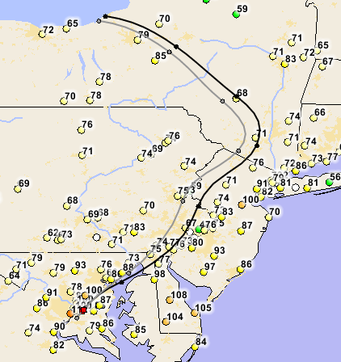
July 7th Code Red
# of Monitors in Exceedance: 13
Maximum 8-Hour Ozone: 100 ppbv
2 Monitors: Code Red
Back Trajectory at 3 PM
(500 &1000 m)

