Slide 1



Greenhouse Gas Protocol
Product/Supply Chain Initiative
Metropolitan Washington Council of Governments (COG) Recycling Committee Meeting
March 18, 2010
1

Slide 2
Outline
Overview of the GHG Protocol Initiative
GHG Protocol Supply Chain Initiative
  Standards Under Development
  Timeline
  Road Testing Process
Impact on Products
  Product Stewardship
  Product Design
  End-of-Life

Slide 3

Greenhouse Gas Protocol Initiative
Convened in 1998 by WRI and WBCSD
A multi-stakeholder partnership of businesses, NGOs, governments and others convened by WRI and WBCSD
Mission: Develop internationally accepted GHG accounting and reporting standards and to promote their use worldwide
Notes:
Unique, transparent process that convenes multiply stakeholders…see more details of when I go over the development process for the new standards
Since being convened, GHG P has published several standards and protocols

Slide 4


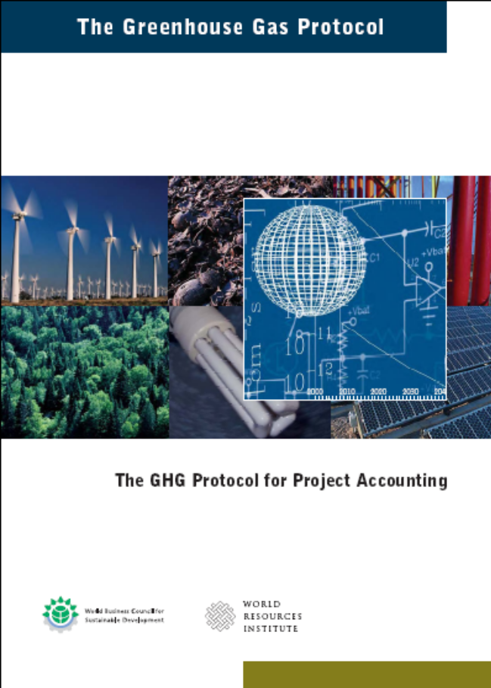

GHG Protocol Publications
Notes:
To date: 2001 and updated in 2004

Slide 5
New Standards in Development:
The Supply Chain Initiative
Scope 3 (Corporate Value Chain)
Accounting & Reporting Standard
Product Life Cycle
Accounting & Reporting Standard
Quantify and report major GHG emissions in the value chain at the company/organization level (scope 3)
To understand, manage, and report GHG emissions across the entire value chain
Build on GHG Protocol Corporate Standard
Quantify and report product-level emissions
To understand, manage, and report the life cycle GHG emissions associated with individual products
Build on existing life cycle assessment standards
5

Slide 6
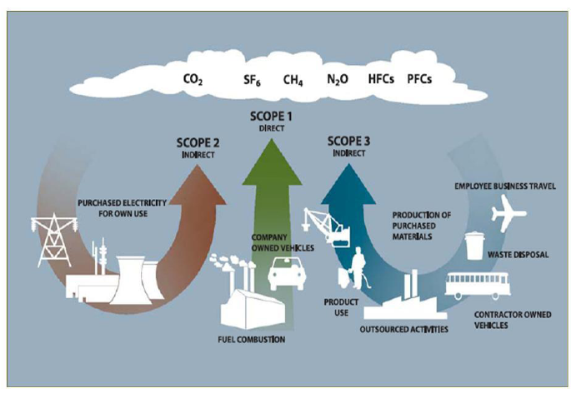
Scope 3 Accounting and Reporting Standard
  Scope 3 emissions = All other indirect emissions upstream & downstream of a company
6
Notes:
Scope 1: All direct emissions owned of controlled by your company
Scope 2: Indirect emissions from purchased electricity, steam, heating
Scope 3:

Slide 7
Scope 3 Accounting and Reporting Standard
Drivers for a new standard:
  Increasing number of companies looking beyond their own boundaries
  Increased awareness and management of climate-related risks along the supply chain
Standard goal: provide a consistent and robust reporting methodology to support GHG emissions transparency and management along the value chain

Slide 8
Cradle to Gate emissions of purchased products and services
Emissions from the company’s operations
Gate to Grave emissions from sold products and services
Purchase
Sale
VALUE
CHAIN
Tier 1 Suppliers
Reporting Company
Raw Materials
Product Distribution
Energy Activities
Product Use
Capital Equipment
Product Disposal
Transportation
Grave
Cradle
Gate
Gate
Scope 2 and 3
Scope 1
Scope 3

Slide 9
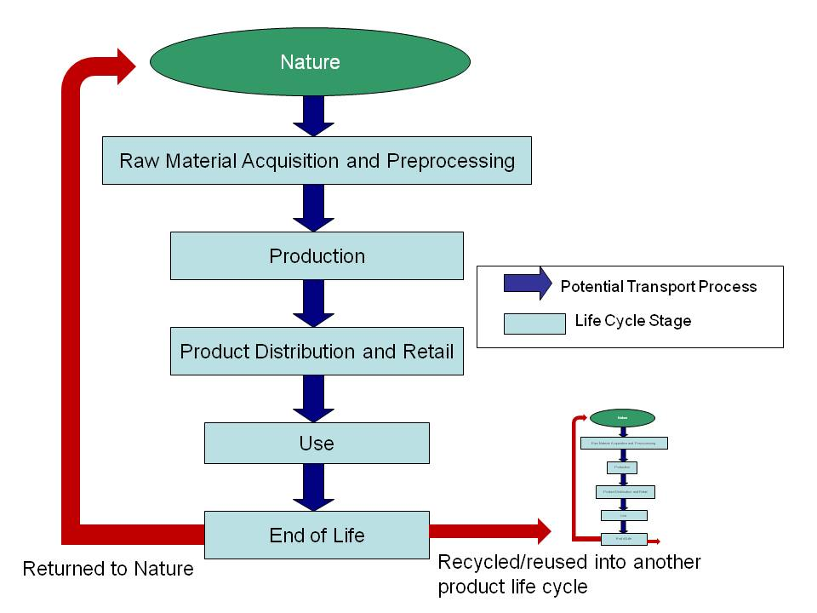
Product Life Cycle Standard
The overarching method for accounting for product GHG emissions is a life cycle approach
9
Notes:
9
How do we develop these standards…

Slide 10
Product Life Cycle Standard
Drivers for a new standard:
  Increased demand for GHG inventory data
    Business-to-business
    Business-to-customer
  Importance of the product life cycle to a company’s supply chain emissions
  Need for an accounting and reporting standard
Standard Goal: Provide a consistent accounting and reporting standard for public disclosure of product-level GHG emissions and ultimately influence decisions to reduce GHG impacts along a product’s life cycle

Slide 11
Product Life Cycle Standard
Business value created through conducting product-level GHG inventories may include:
  Supplier engagement and reduction opportunities
  Tracking reductions through public reporting
  Product differentiation
Does this standard support product labeling? NO
  This standard is general enough to be used for a wide range of products and sectors
  More prescriptiveness is recommended for product comparisons like labeling
Notes:
Product comparisons such as labeling, comparing individual numbers. Many things need to be considered and compared – such as functional units, data quality etc.

Slide 12
Process Structure for Standard Development
WRI/WBCSD Secretariat
Steering Committee (25 members)
Product
Technical Working
Groups
( 100+ members)
Scope 3
Technical Working
Groups
( 60+ members)
Stakeholder Advisory Group (1,000+)
Product Standard
Scope 3 Standard

Slide 13
Timeline
Date | Activity
November 2007 | Survey and consultations to assess need for new standards
September 2008 | Steering Committee Meeting #1 (Washington DC) Technical Working Group Meeting #1 (London)
January 2009 | Working groups begin drafting
March 2009 | Steering Committee Meeting #2 (Geneva)
June 2009 | Technical Working Group Meeting #2 (Washington DC)
August 2009 | Stakeholder webinar and comment period
October 2009 | Steering Committee Meeting #3 (Washington DC)
November - December 2009 | First draft of standards released for stakeholder review Five stakeholder workshops (in Berlin, Germany; Guangzhou, China; Beijing, China; London, UK; Washington, DC, USA) Stakeholder comment period on first drafts
January - June 2010 | Road testing by several companies
Summer/Fall 2010 | Public comment period on second drafts
December 2010 | Finalize Standard Text for Publication
13
Notes:
More details on Road testing after I go over the standards

Slide 14
Road Testing
Unique to other standard development processes
Over 70 companies are completing a road test of one or both of the new standards
  Monthly progress calls, in-person workshop
  Road Testers provide practical feedback on the usability of the standards
This feedback, along with stakeholder comments, will be used to update the standards before the next public comment period

Slide 15
Impact on Products
What impacts do the creation of these standards have on:
  Product Stewardship
  Product Design
  Product End-of-Life

Slide 16
Product Stewardship & Design
Product-centered approach to environmental protection
  Scope 3 goes beyond a companies boundaries to consider the impacts of the products they buy and sell
  Both standards engage suppliers and customers to account for and manage GHG emissions on the product-level
Reductions possible through product innovation
  Smart packaging
  Bio-based materials
  Use-stage energy reductions
Notes:
Product Design key

Slide 17
Product End-of-Life
Supply chain and life cycle approaches draw attention to waste management and recycling
  GHG reductions possible through:
    Using waste in subsequent product systems
    Degradable products and packaging
    Energy recovery
    Recycling/buy-back programs
Data needs to improve end-of-life accounting:
  Recycling rates
  Waste treatment options
  Waste treatment emissions
Notes:
Hopefully companies will engage with you as well to get end-of-life data

Slide 18

Questions?

Slide 19
For More Information
Please visit our website:
http://www.ghgprotocol.org/standards/product-and-supply-chain-standard
  Access to the draft standards and other standard development materials
  Become a stakeholder
    Receive updates on the standard development process
    Submit comments on the next draft
For more information about the GHG Protocol Initiative: www.ghgprotocol.org
Notes:
Particularly if you have expertise in accounting for GHG emissions in your facilities, ideas on how best to quantify emissions from recycling, solid waste management, energy recovery

Slide 20
Thank You
Laura Draucker, PhD
World Resources Institute
ldraucker@wri.org
20

