Slide 1
Update on the TIGER Grant for the TPB Regional Priority Bus Project
Item #16
National Capital Region
Transportation Planning Board
March 17, 2010
Timothy Canan, AICP
Principal Planner
Department of Transportation

Slide 2
On February 17, 2010, Secretary of Transportation, Ray LaHood, announced recipients of $1.5 billion in TIGER Grant funds available through ARRA.
1400 total applications requesting $60 billion received from all 50 states
51 grants awarded amounting to $1.5 billion
(Average award ~ $30 million)
Washington region awarded $58.8 million for portions of a regional bus priority project located in DC, MD and VA
  DC awarded $13.6 million
  MD awarded $14.8 million
  VA awarded $30.4 million

Slide 3
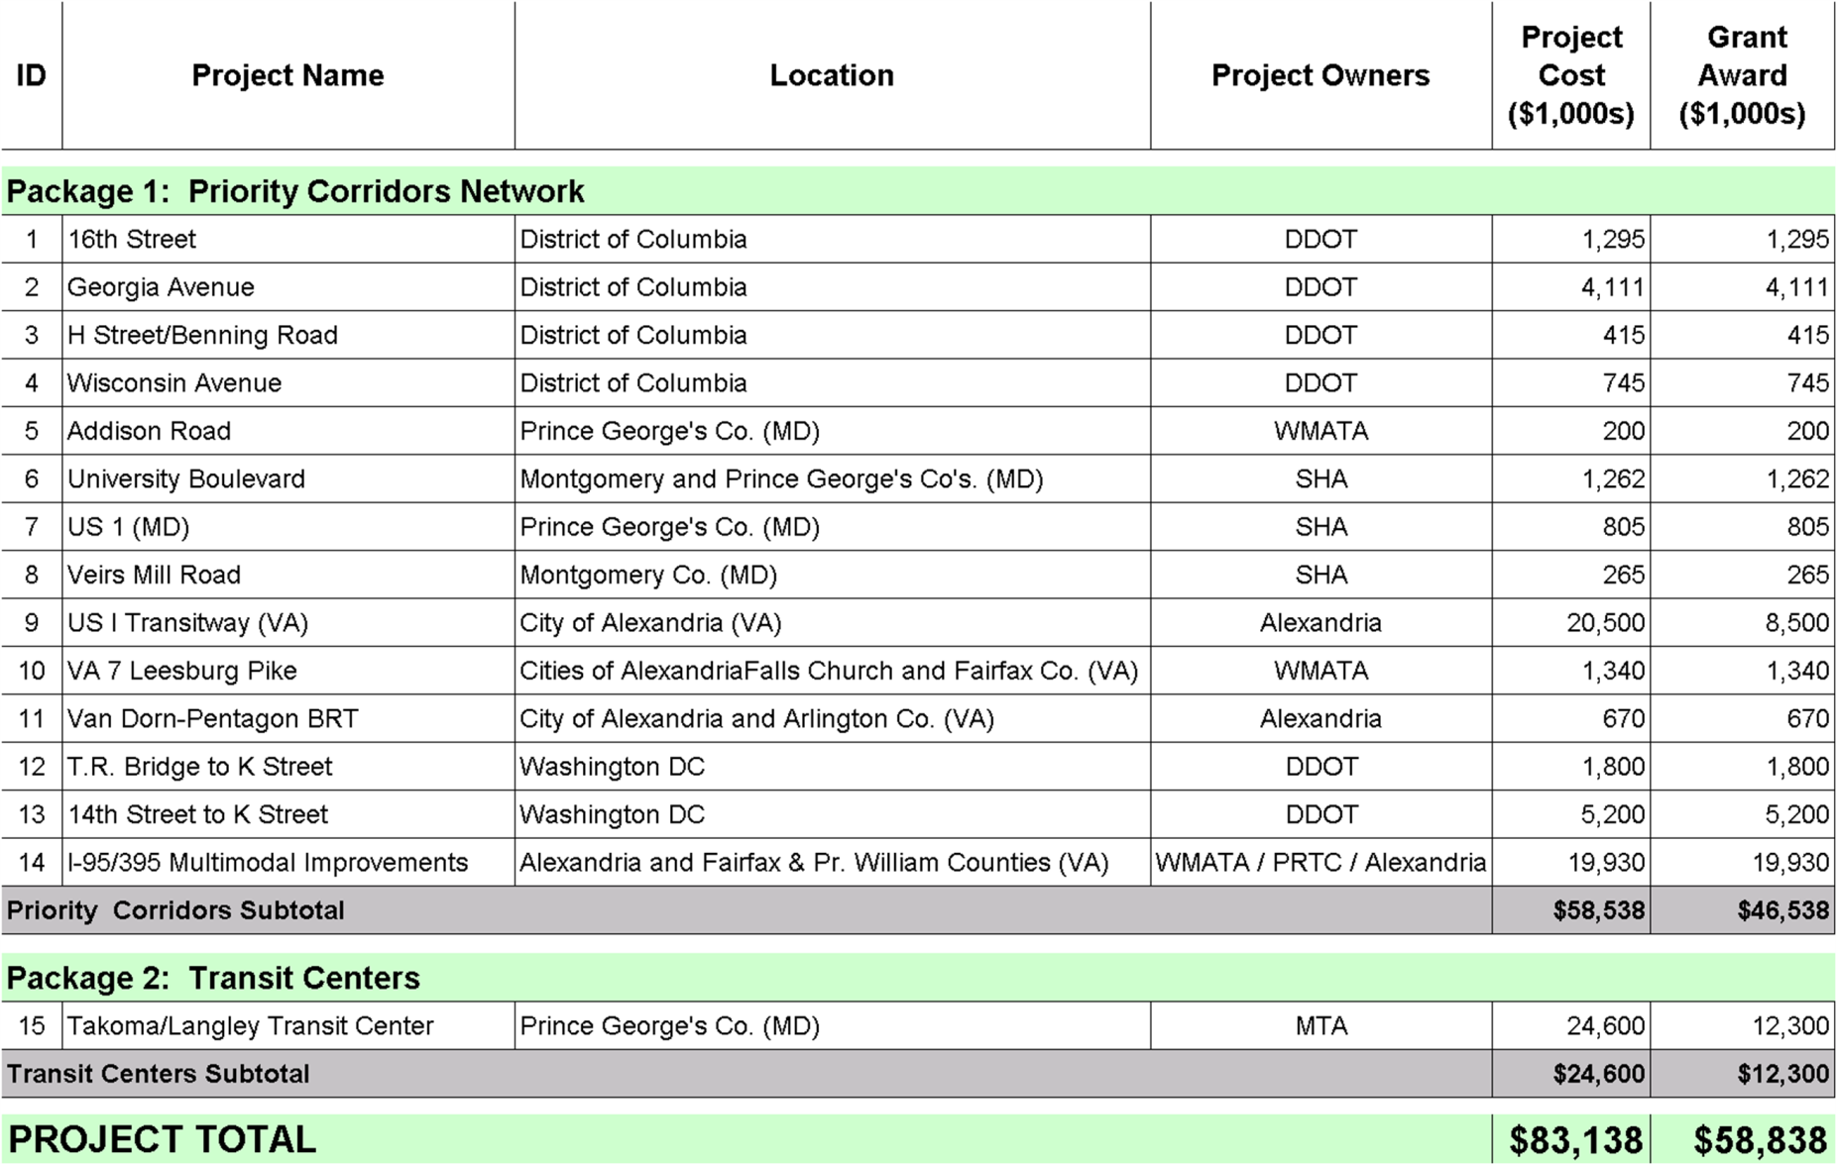
Funded Components for TPB TIGER Project

Slide 4
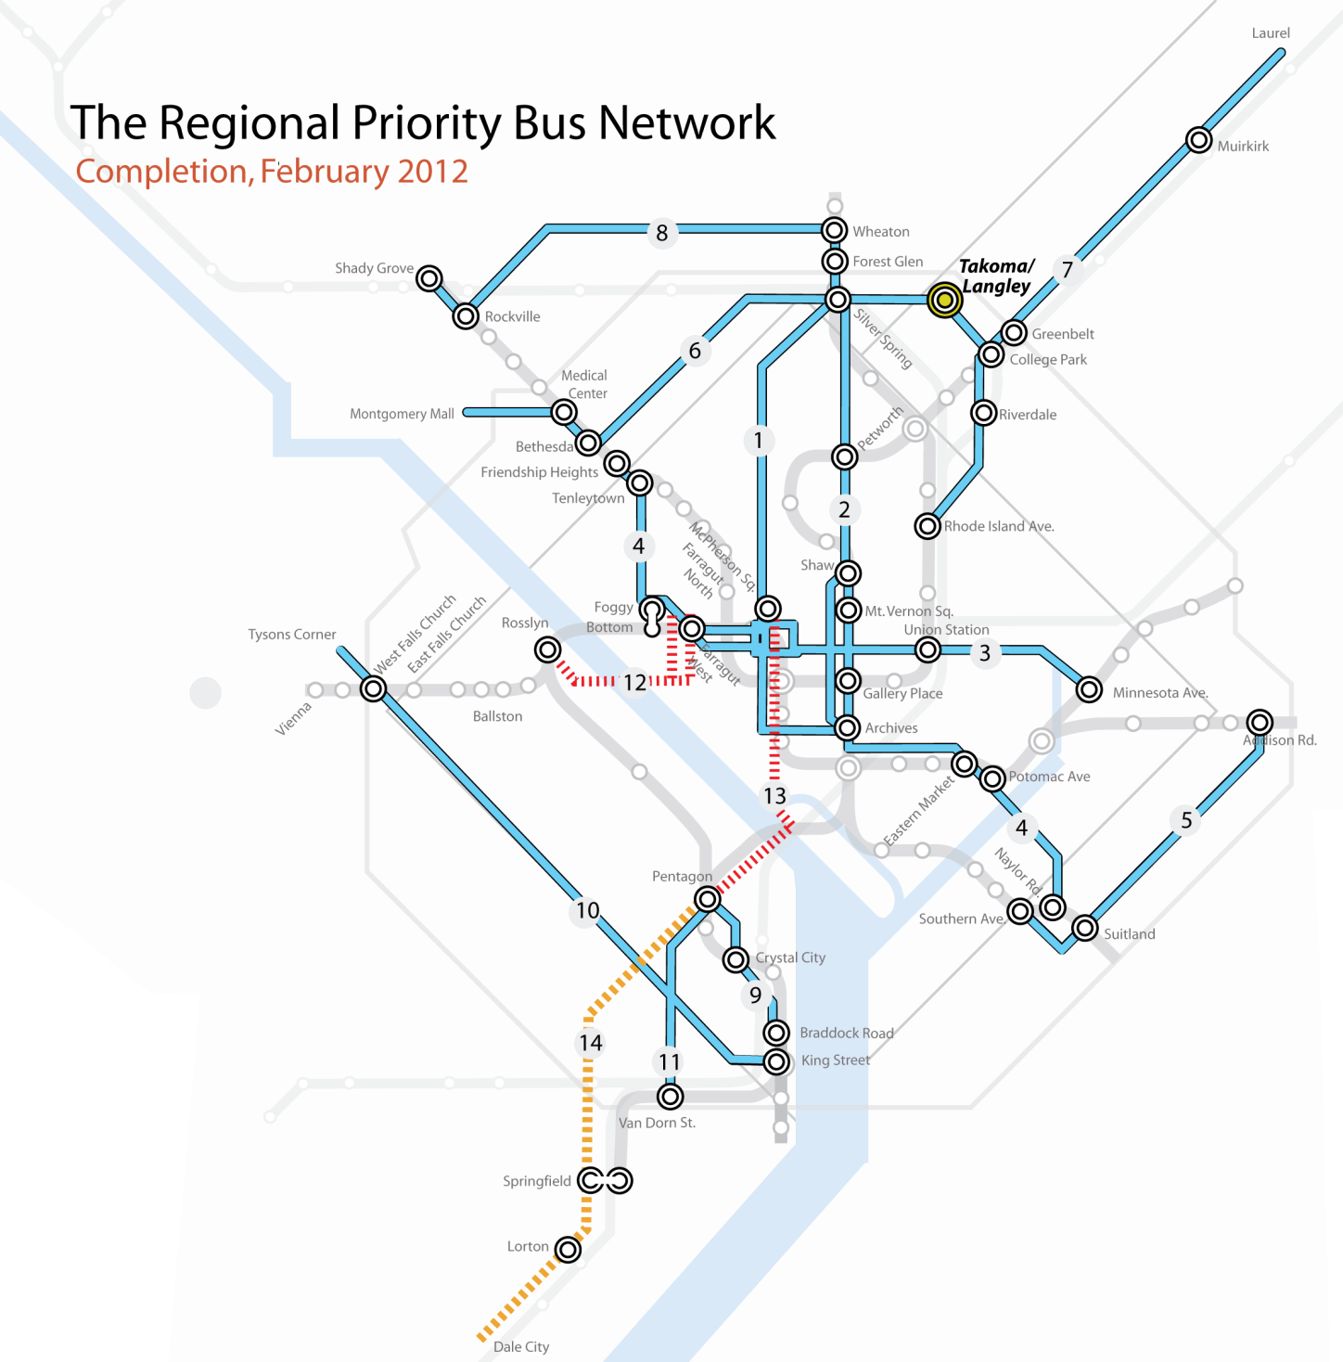
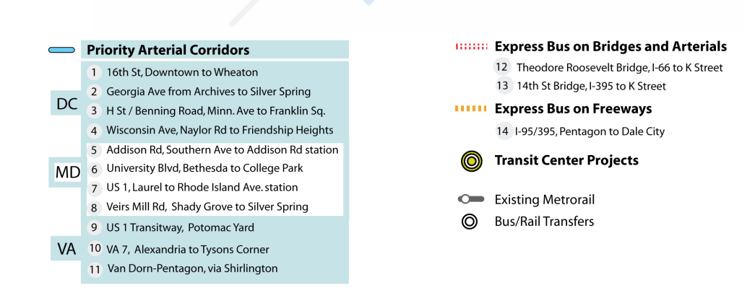
Funded Components

Slide 5
Since Feb. 17 announcement . . .
17 Feb: TIGER award announced at Feb. 17 TPB meeting.
19 Feb: FTA contacted TPB to verbally notify us of the Grant Award and state it will be the modal agency responsible for grant administration.
  FTA project manager to follow-up with TPB within several weeks.
23 Feb: TPB Staff e-mail to Scenario Task Force members to announce Award and inform them that further information will be forthcoming upon receiving more direction from FTA.
5 Mar: TPB Staff suggested to FTA representative at Technical Committee meeting that hiring a consultant for program management support could promote efficiencies and economies of scale in grant administration for TPB and project owners.
Continued . . .

Slide 6
Since Feb. 17 announcement . . . (cont’d)
8 Mar: TPB Staff e-mail to project owners requesting points of contact and encouraging initiation of project scoping in advance of FTA’s formal involvement.
15 Mar: FTA informed TPB staff that development of terms and conditions of grant is still underway, but advised project owners to identify scopes, schedules and budgets for FTA approval by mid-May.
17 Mar: TPB Staff e-mailed project owners to advise them of mid-May FTA deadline for project scopes, schedules and budgets and propose a scoping meeting among project owners, TPB staff and FTA staff on April 15.

Slide 7
What will happen next?
FTA project manager will be named and will follow-up with TPB to define terms and conditions of grant and requirements for project owners.
Project owners will develop scopes, schedules and budgets for all project components for FTA as a prerequisite for grant execution.
Grant execution anticipated mid-May.

Slide 8
Update on the TIGER Grant for the TPB Regional Priority Bus Project
National Capital Region
Transportation Planning Board
March 17, 2010
Timothy Canan, AICP
Principal Planner
Department of Transportation

