Slide 1



Recycling Committee Meeting
July 16, 2009
Introducing the Region’s Newest Single Stream Material Recovery Facility

Slide 2
ABOUT CHRC
Created in June 2002 by the merger of Canusa Corporation’s Fiber Group and Hershman Recycling, Inc.
CHRC brings together more than 135 years of experience in the processing and trading of secondary fiber and other recyclable commodities.
The company has a dozen offices and processing facilities across North America.
CHRC and its partner companies handle over 2.5 million tons per year of fiber and more than 50 million pounds/month of plastics and other commodities.

Slide 3
Canusa Hershman Recycling of VA (CHVA) was created to fill a void and address a need in the marketplace.
A full service company focused exclusively on recycling
State of the art processing technology in the region
Alternative outlet for recyclable materials
Fair value for recyclable commodities
Drive maximum diversion and material value for our customers
We are dedicated to helping our customers achieve maximum cost reductions and refunds for their waste disposal and recycling services whenever possible.

Slide 4
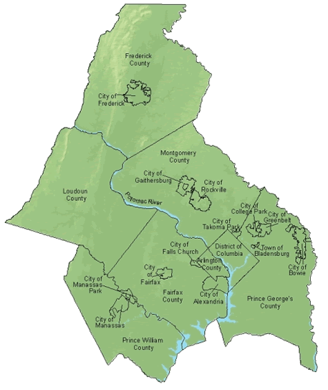
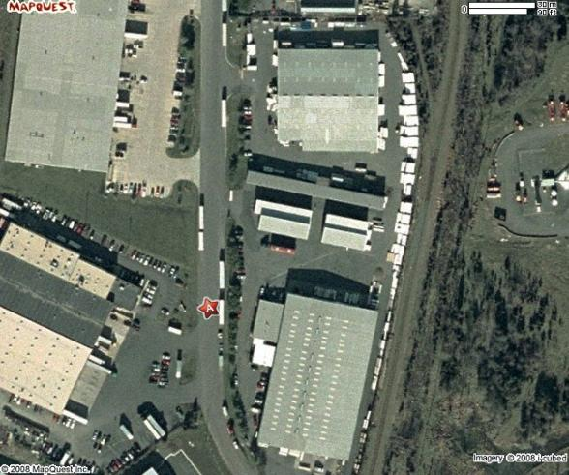
Location
7911 Notes Drive
Manassas, VA 20109
Prince William County

Slide 5
Facility
50 ton per hour of Single Stream processing capacity
State of the art Bollegraaf & TiTech processing technology
4.1 acres / 47,000 sf building
40 employees
$20 million investment in the region
Currently processing 11,000 tons of recyclables per month with the capacity to process up to 20,000 tons per month.

Slide 6
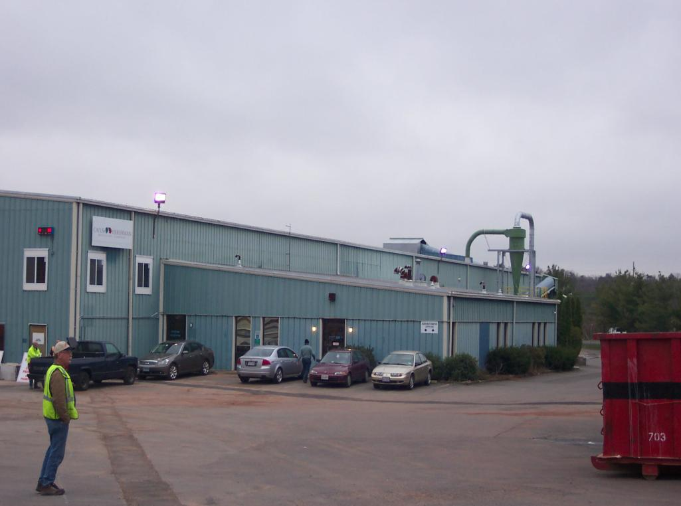

Slide 7
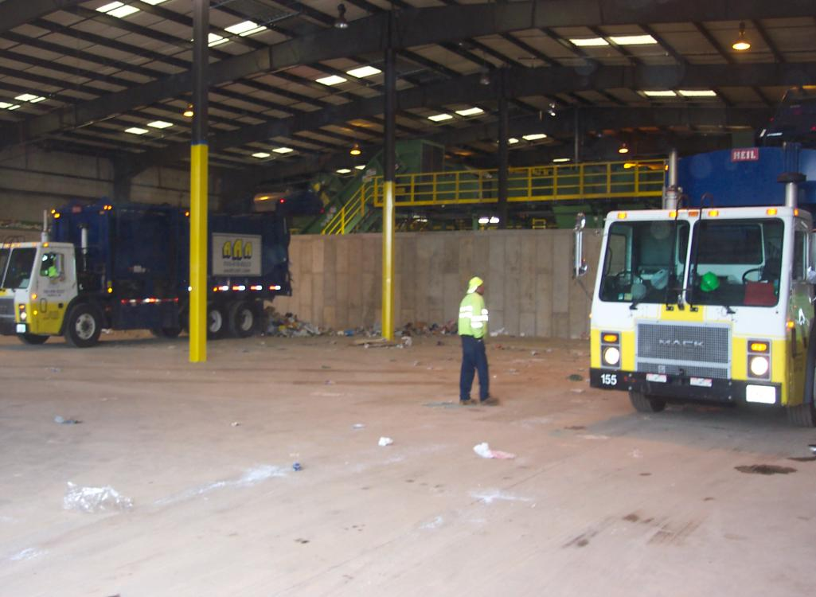

Slide 8
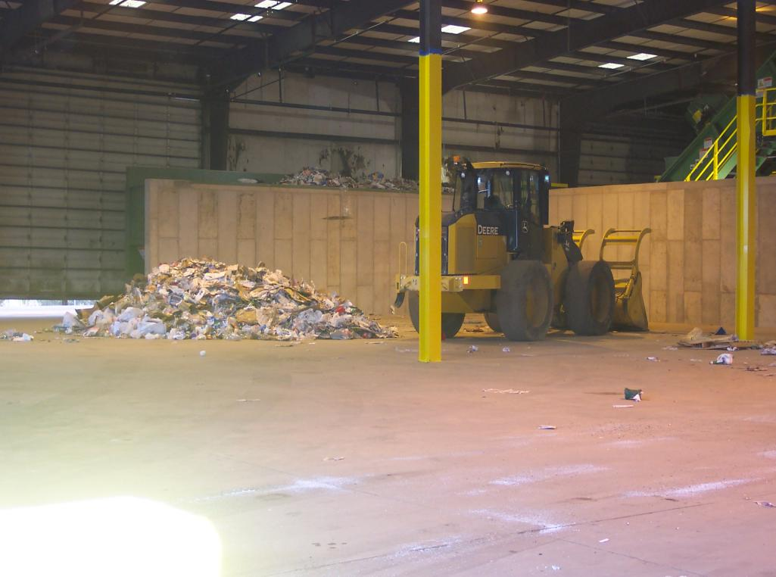

Slide 9
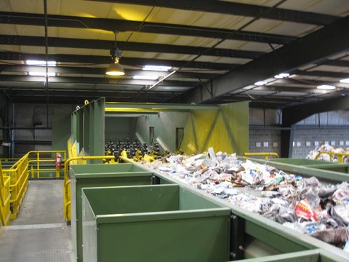

Slide 10
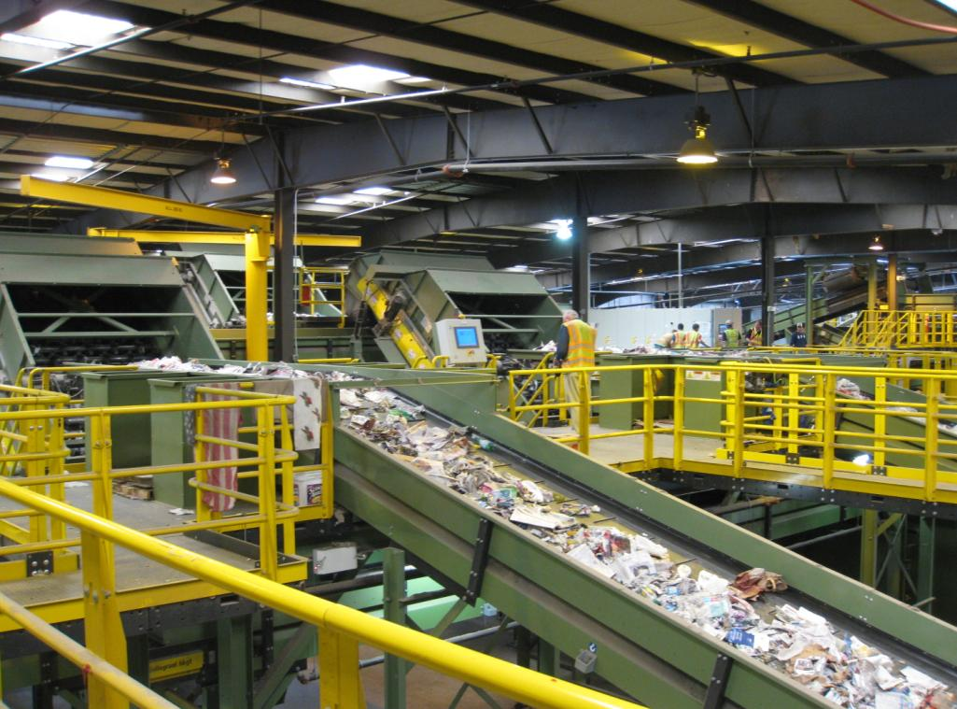

Slide 11
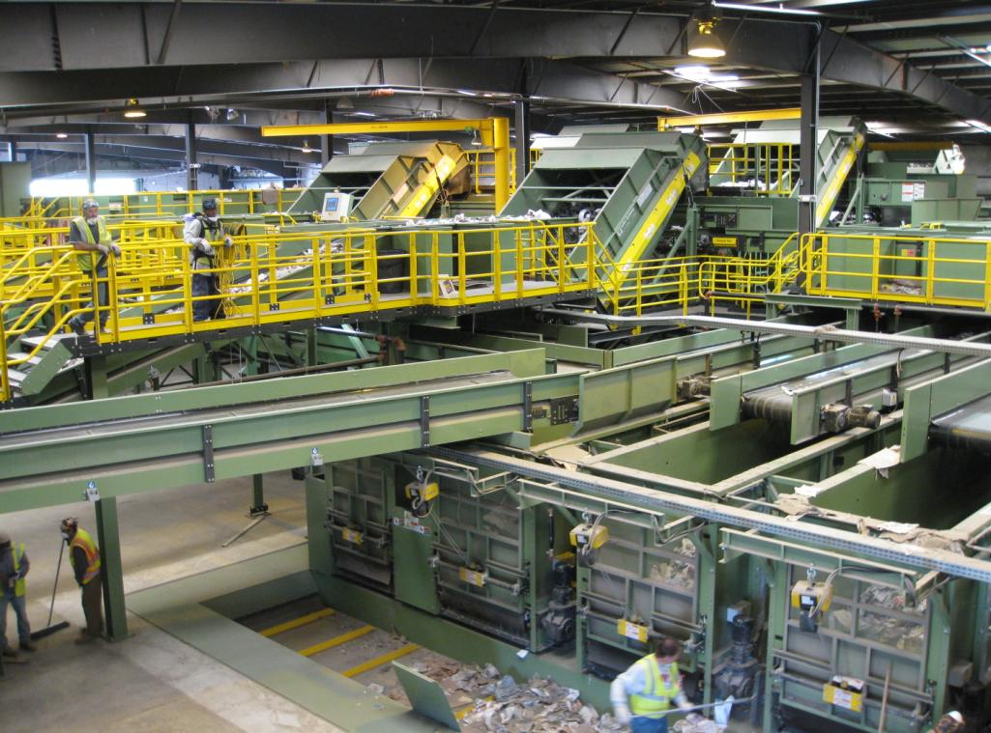

Slide 12
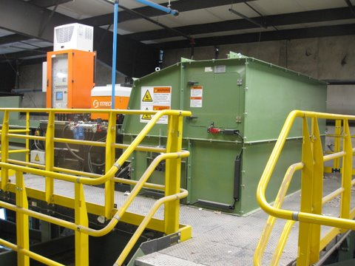

Slide 13
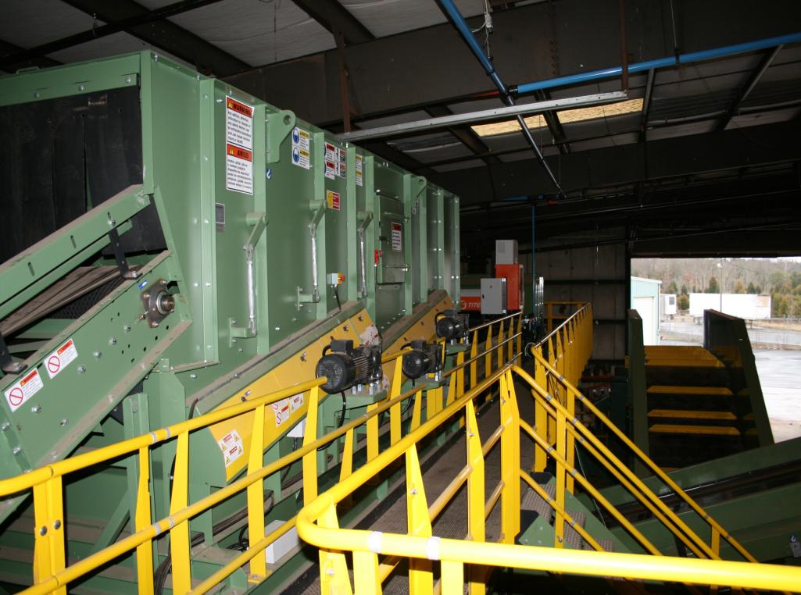

Slide 14
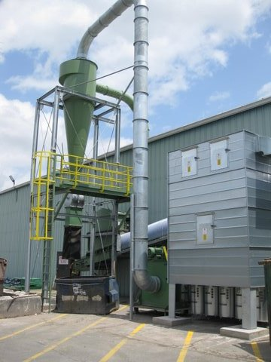

Slide 15
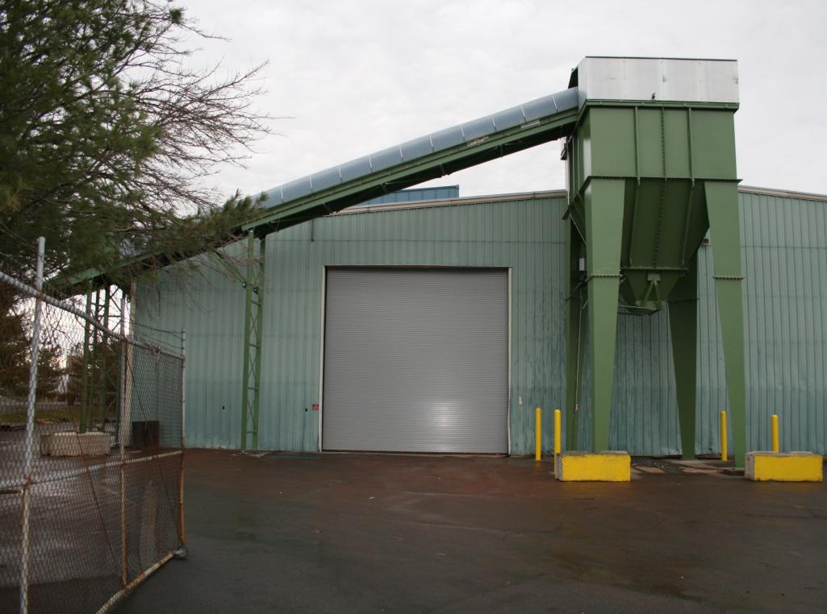

Slide 16
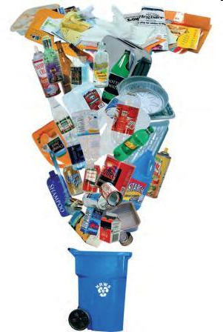
What can be recycled?
ACCEPTABLE
Cardboard
Office Paper (white and colored)
Newspaper and magazines
Junk Mail
Envelopes (manila, regular & windowed)
File Folders
Computer Paper
Post It Notes
Card Stock Paper
Aluminum Cans
Tin Cans
Glass Bottles and Jars
#1 Plastic bottles (Water and soda)
#2 Plastic containers (Milk and detergent)
#3 – 7 Plastic containers (Yogurt and margarine)

Slide 17
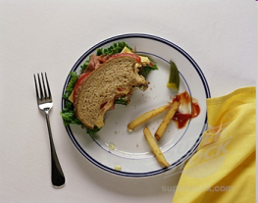
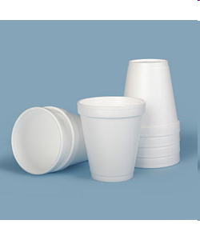
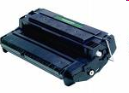
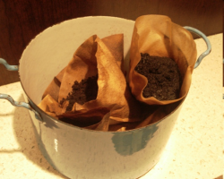



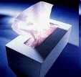
What can not be recycled?
NOT ACCEPTABLE
Food Waste
Styrofoam
Printer Cartridges (toner or inkjet) Coffee Station Waste
Cell phones
Batteries
Computers or other electronics
Bathroom Waste

Slide 18

Benefits of Single Stream Recycling
EASY COLLECTION, GREATER VOLUME & LESS DISPOSAL!
SIMPLIFIES THE RECYCLING EFFORT
SIGNIFICANTLY INCREASES PARTICIPATION
SAVES MONEY ON COLLECTION
ENABLES MAXIMUM DIVERSION
Our single-stream recycling technology offers municipalities a revolutionary program that enables their residents to utilize one receptacle for virtually all of their recyclables. This greatly reduces collection costs by optimizing routes and eliminating the need for specialized collection vehicles. Additionally, diversion rates typically increase 35% over traditional multi-receptacle recycling programs which greatly reduces a community’s waste disposal costs and accelerates their efforts to achieve recycling goals.

Slide 19
QUESTIONS?

Slide 20
Contacts
Jonathan Sloan
President
(p) 410-319-0319 x107
(e) jsloan@chrecycling.com
Tim Horchar
Market Development Manager
(p) 410-319-0319 x115
(e) thorchar@chrecycling.com

