Slide 1
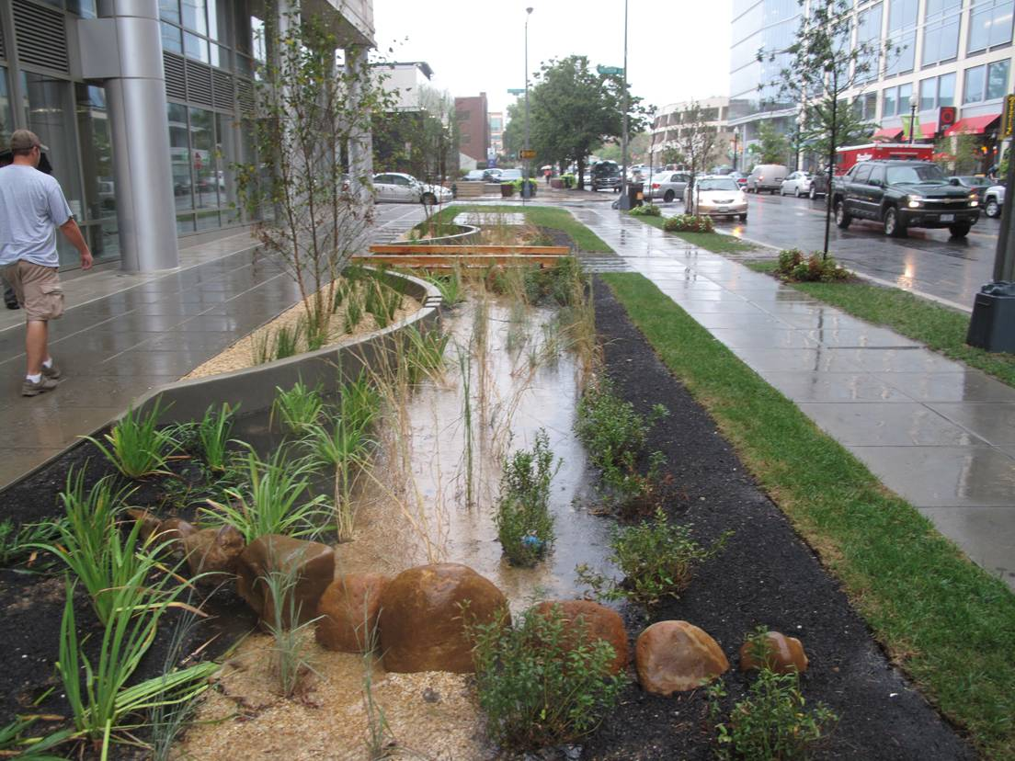
Briefing on a Draft Green Streets Policy for the National Capital Region
Item 11
Michael Farrell
COG/TPB Staff
Transportation Planning Board
January 15, 2014

Slide 2
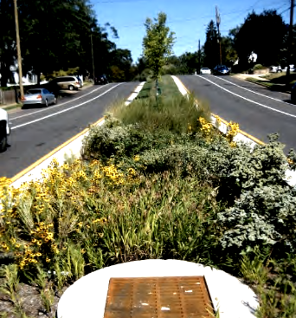
The Green Streets Package
Draft Green Streets Policy for the National Capital Region
Supporting Materials:
  Attachment A: Green Streets Guidance
  Attachment B: Green Streets Resources
  Inventory of Green Streets Policies in the Washington Region

Slide 3
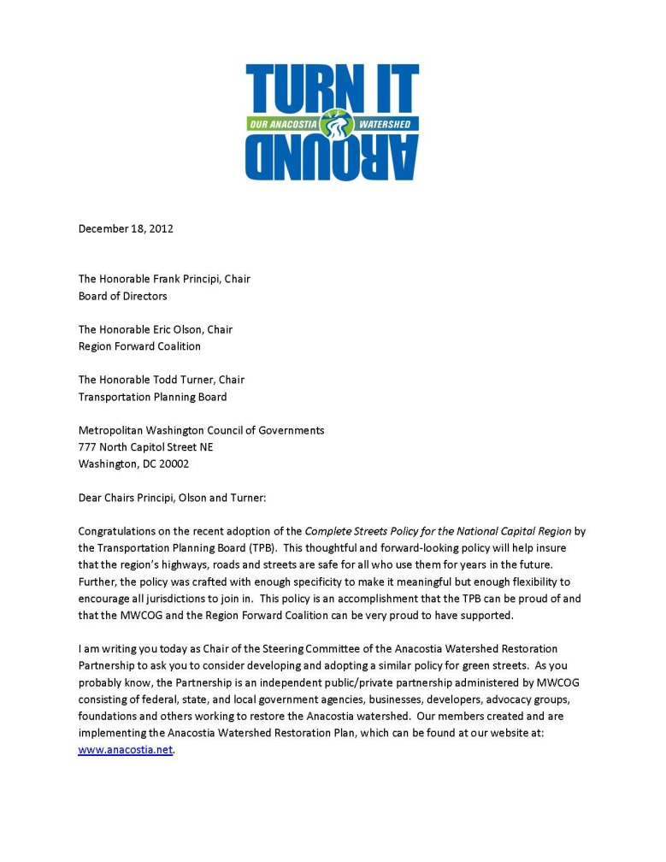
Background on Request for TPB to Look at Green Streets
December 18, 2012 letter from Anacostia Watershed Restoration Partnership
Offered congratulations on the regional Complete Streets policy
Suggested development of a similar Green Streets policy
  Cited Prince George’s County Complete Streets/Green Streets policy as an example

Slide 4
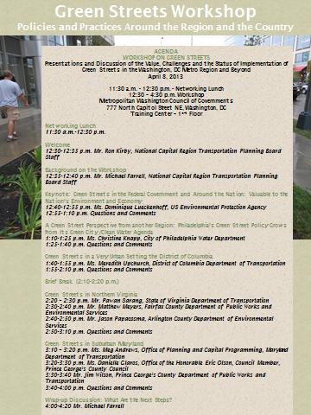
Development Process
Transportation and Environment Programs staff worked together on a draft Green Streets policy
Regional Inventory of Green Streets Policies*
  Shows policies relating to Green Streets in the TPB member jurisdictions
  Identified context and resources for a regional policy
Green Streets Workshop April 8th
  90 people attended
  Provided technical input
    *Source: COG’s Climate Energy and Environment Policy Committee (CEEPC) Annual Survey and pertinent websites (January and August 2013)

Slide 5
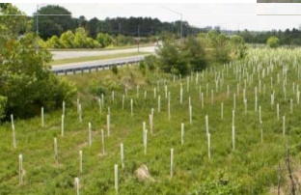
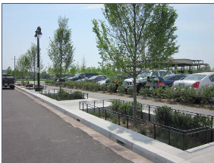
Review Process
  Review Period: September-December 2013
  Committees briefed
    TPB Technical Committee 9/6, 11/1
    Anacostia Watershed Management Committee 9/12
    Bicycle and Pedestrian Subcommittee 9/17
    Climate Energy and Environmental Policy Committee 9/25
    Citizens Advisory Committee 10/10
  Comments received from stakeholders
DTP and DEP Staff revised draft Policy based on comments

Slide 6
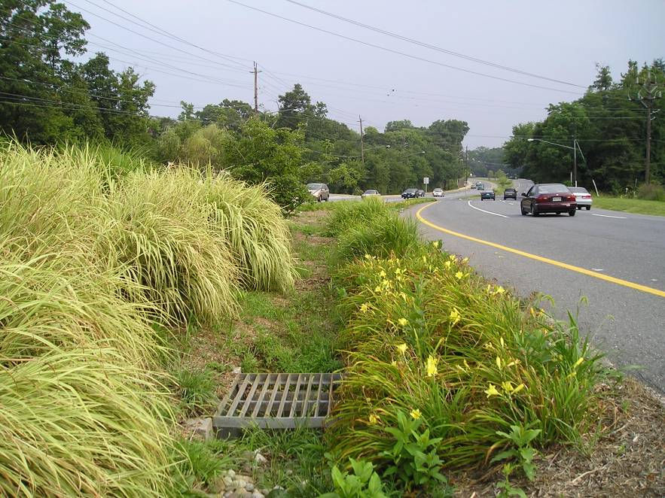
Draft Green Streets Policy for the National Capital Region
Purpose similar to TPB’s Complete Streets Policy for the National Capital Region (May 2012)
  Promote the adoption of Green Streets policies and practices by the TPB member jurisdictions and agencies
  Provides resources and examples

Slide 7
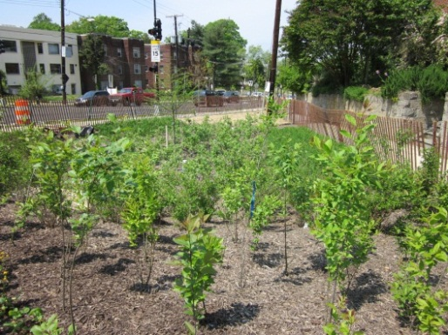
Definition of Green Streets
  “Green Streets are an alternative to conventional street drainage systems designed to more closely mimic the natural hydrology of a particular site by infiltrating all or a portion of local rainfall events. A green street uses trees, landscaping, and related environmental site design features to capture and filter stormwater runoff within the right of way, while cooling and enhancing the appearance of the street.”

Slide 8
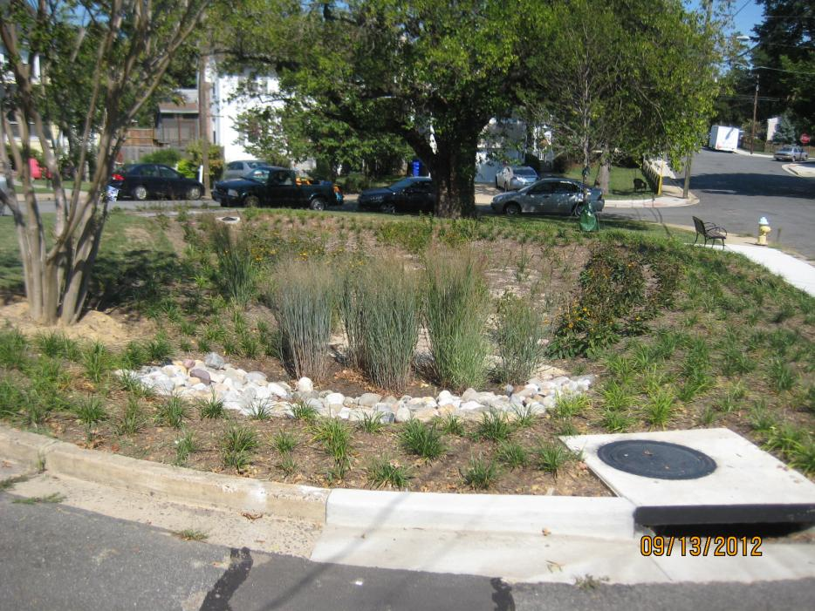
Policy Statement
“The National Capital Region Transportation Planning Board endorses the concept of Green Streets and strongly encourages its member jurisdictions and agencies that do not already have a Green Streets policy, or who are revising an existing policy, to adopt a Green Streets policy that includes common elements that the TPB believes reflect current best practices, such as the attached A: Green Streets Guidance and B: Green Streets Resources.”

Slide 9
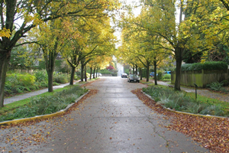
Attachment A: Green Streets Guidance
Elements of an ideal policy
    Includes a vision for how and why
    Covers all transportation facilities.
    Applies to both new and retrofit projects
    Makes any exceptions specific
    Use latest and best design standards
    Context sensitive
    Performance standards
    Specific next steps for implementation
Sample Policy Statement
  Beginning on the effective date of this policy, all (insert jurisdiction or agency) financed and approved transportation projects in (insert Jurisdiction or Agency) shall, where practicable, use trees, landscaping and related environmental site design features to capture and filter stormwater runoff within the right of way, in a manner appropriate to the function and context of the facility.

Slide 10
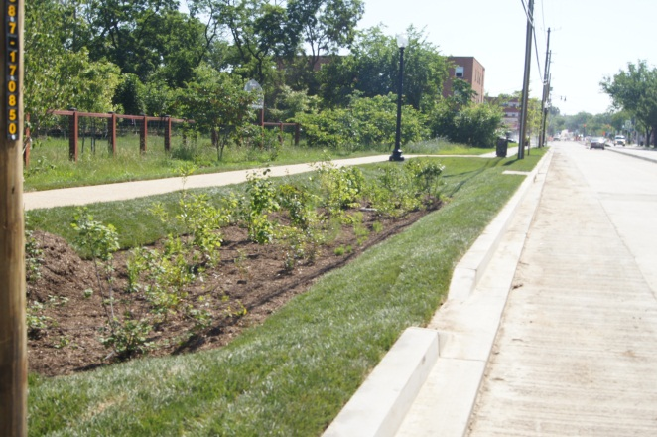
Attachment B: Green Streets Resources
Purpose:
  Aid to local governments in drafting their own Green Streets principles, standards and procedures
Includes:
  Definition of Green Streets
  Benefits
  Sample Treatments
  Sample Policies
  Guidebooks, Standards and Manuals
  Other resources

Slide 11
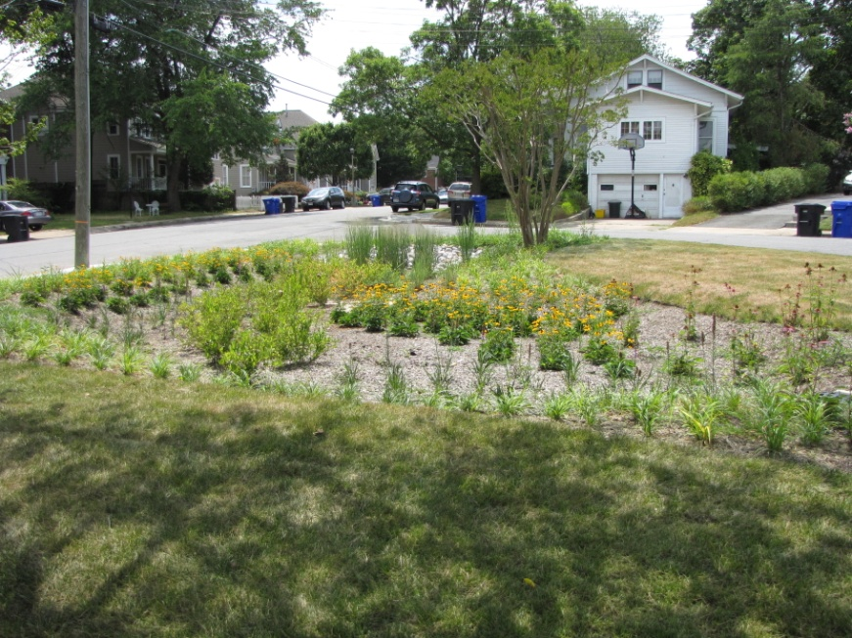
Follow-On Actions
Documentation and Reporting
  Within six months of adoption, conduct a survey of TPB member jurisdictions and agencies within six months and every two years thereafter
  Within two years, include information on the Green Streets features of transportation projects in the regional information clearing house
Promotion
  Within six months of adoption, sponsor training on Green Streets

Slide 12
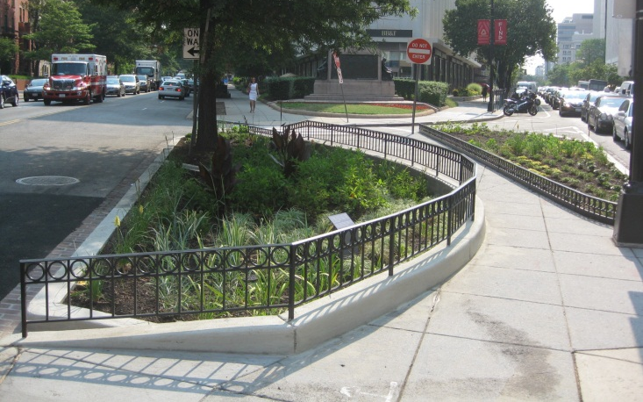
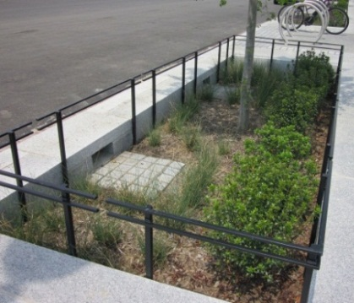
Next Steps
Presented Today for TPB Review and Comment
Anticipate approval by TPB at February 19th meeting

Slide 13
Michael J. Farrell
Senior Transportation Planner
Metropolitan Washington Council of Governments
202-962-3760
mfarrell@mwcog.org

