Slide 1

Commuter Connections FY 2014 Work Program
ITEM #12
National Capital Region Transportation Planning Board
February 19, 2013

Slide 2


Definition from Strategic Plan
Network of public and private transportation organizations, including COG, state funding agencies, and local organizations, that work together to assist and encourage people in the Washington region to use alternatives to the single-occupant automobile.

Slide 3

Benefits of Commuter Connections
Jurisdictions
  Helps reduce and manage commuter congestion, goods movement, tourist travel, sustainability
  Helps reduce emissions
  Supports local efforts to attract and retain employers
Employers
  Recruitment/Retention
Workers
  More commute options
  Reduced stress/costs/time
  Improved quality of life

Slide 4
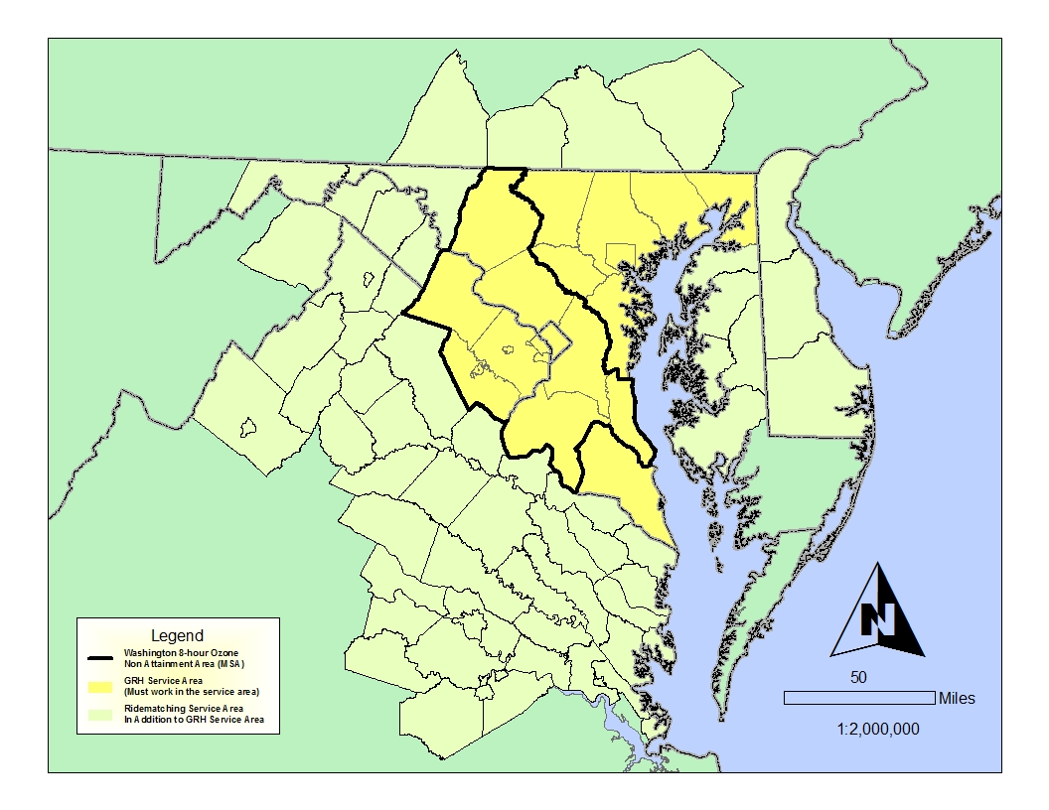
Geographic Areas Serviced by Commuter Connections

Slide 5

MSA Rankings for Carpooling and Transit Use
Metropolitan Statistical Area | Total Workers | % Carpool | % Transit
NYC/Long Island/N NJ/PA | 8,719,316 | 7.4% | 30.3%
LA/Long Bch/Santa Ana | 5,816,255 | 11.4% | 6.1%
Chicago/Naperville/Joliet | 4,422,844 | 9.1% | 11.5%
Dallas/Ft. Worth/Arlington | 2,945,976 | 11.4% | 1.6%
Washington DC Metro | 2,795,375 | 11.1% | 13.9%
Philadelphia Metro Area | 2,751,491 | 8.9% | 9.2%
Houston Metro Area | 2,581,559 | 12.6% | 2.7%
Atlanta Metro Area | 2,494,475 | 10.9% | 3.6%
Miami Metro Area | 2,479,021 | 10.1% | 3.8%
Boston Metro Area | 2,277,958 | 8.1% | 11.9%
San Francisco-Oakland | 2,056,454 | 10.4% | 14.5%
US Census Bureau; American Community Survey; 2005 – 2009 5 year data set; generated by Clara Reschovsky using American Fact Finder; http://factfinder.census.gov

Slide 6

Commuter Connections Daily Program Impacts
Measure | Reductions
Vehicle Trips | 126,000
Vehicle Miles of Travel | 2,400,000
Nitrogen Oxides (NOx) | 0.9 Tons
Volatile Organic Compounds (VOC) | 0.5 Tons

Slide 7
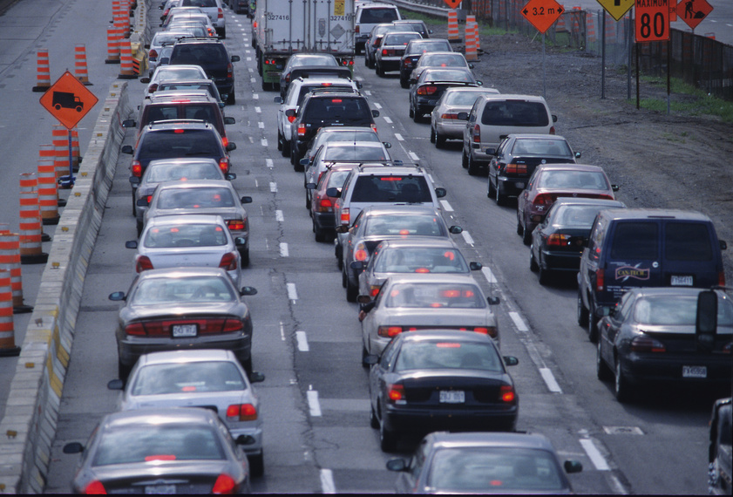
Commuter Connections’ Role in the Regional Planning Process
The TPB is required by Federal regulations to approve a congestion management process which includes TDM as part of t metropolitan transportation plan.
  Commuter Connections constitutes the major demand management component of the region’s congestion management process.

Slide 8

Commuter Connections’ Role in the Regional Planning Process
Commuter Connections also provides transportation emission reduction measure (TERM) benefits for inclusion in the air quality conformity determination approved by the TPB. This is part of the annual update of the region’s Constrained Long Range Plan (CLRP) and Transportation Improvement Program (TIP).

Slide 9

Cost Effectiveness of Commuter Connections
Cost per Vehicle Trip $0.14
  Reduced
Cost per Vehicle Mile of $0.01
  Travel Reduced
Cost per ton of NOx $20,000
  Reduced
Cost per ton of VOC $33,000
  Reduced

Slide 10

Proposed FY 2014 CCWP Budget
Program | Cost FY13 | Cost FY14
Commuter Operations | $480,686 | $498,653
GRH | $651,112 | $676,360
Mass Marketing | $2,582,130 | $2,669,994
Program Evaluation | $850,000 | $445,000
Employer Outreach | $590,855 | $609,848
GRH Baltimore | $170,000 | $150,000
TOTAL | $5,324,783 | $5,049,855

Slide 11
Proposed FY 2014 CCWP Budget
Overall 5% decrease from FY 2013
Budget Breakdown: $5,049,855
  COG/TPB Staff & Overhead: $1,495,129 or 30% of the overall budget
  Private Sector Services: $2,544,043 or 50% of the overall budget
  Local Jurisdiction Pass-Thru: $433,304 or 9% of the overall budget
  Direct Costs: $577,379 or 11% of the overall budget

Slide 12

What’s New In FY 2014 CCWP
Regional TDM Marketing
  Commuter Connections’ 40th Anniversary
Monitoring and Evaluation
  2013 State of the Commute final Technical Report and General Public Report preparation
  2013 GRH Applicant Surveys final reports for both DC and Baltimore region’s
  2013 Bike to Work Day Participant Survey and Report

Slide 13
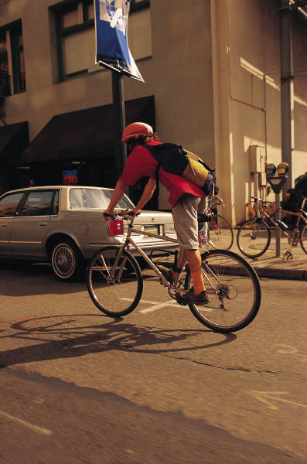
What’s New In FY 2014 CCWP- continued
Employer Outreach database analysis
Employer Telework Data Collection (MD)
2014 draft TERM Analysis Report
Employer Customer Satisfaction Survey and Report

Slide 14

Next Steps
State funding agencies have provided comments and approved draft 2014 CCWP.
Commuter Connections Subcommittee reviewed draft CCWP on November 20th and a comment period was established and the document was endorsed on January 15th
Tech Committee received a briefing of the Work Program on February 1st and will be briefed again on March 1st.
TPB received draft of the FY 2014 CCWP for today’s meeting the document was released for public comment at the CAC meeting last Thursday. The TPB will be asked to approve the FY 2014 CCWP at its March meeting.

Slide 15
Next Steps - continued
TIP adjustments, if any, will be made and funding commitments secured by June.
Program begins July 1.

Slide 16
Questions?
Nicholas W. Ramfos
Director, Commuter Connections
nramfos@mwcog.org
Or
202-962-3313

