Slide 1

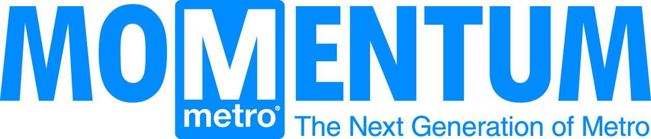
Washington Metropolitan Area Transit Authority

Slide 2
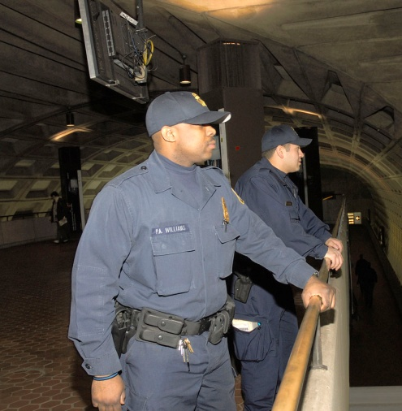
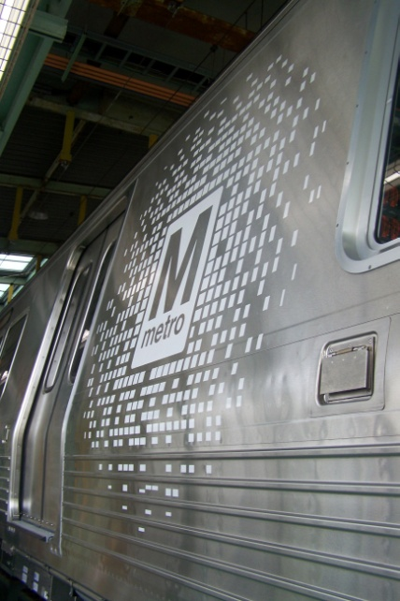
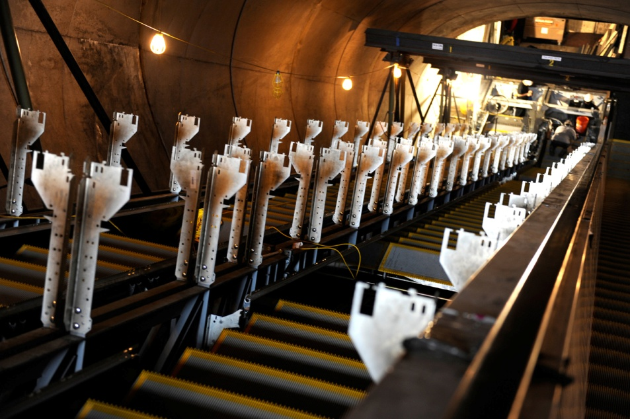
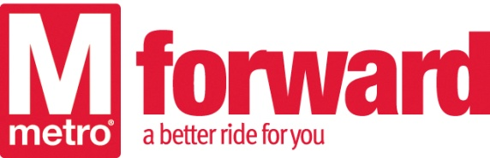
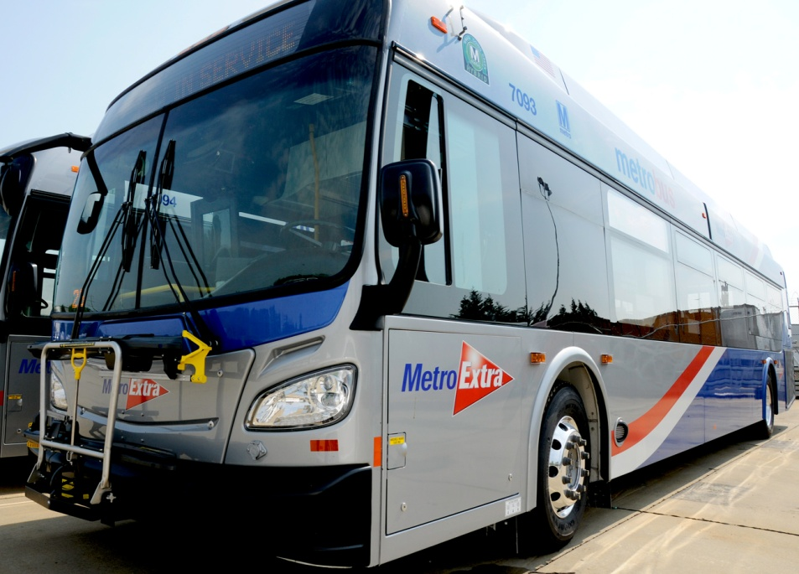
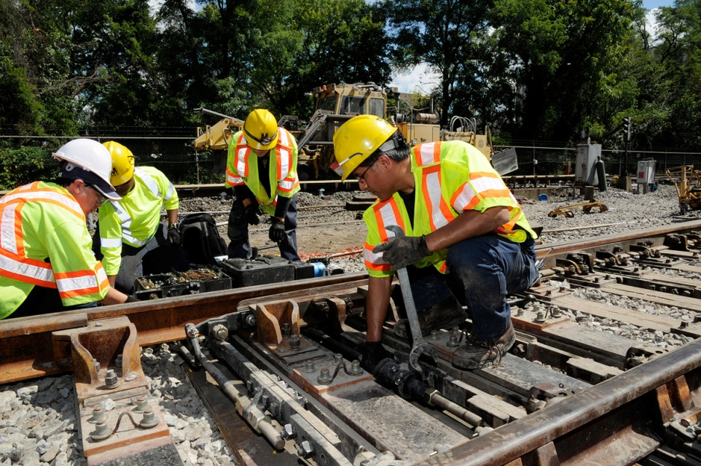
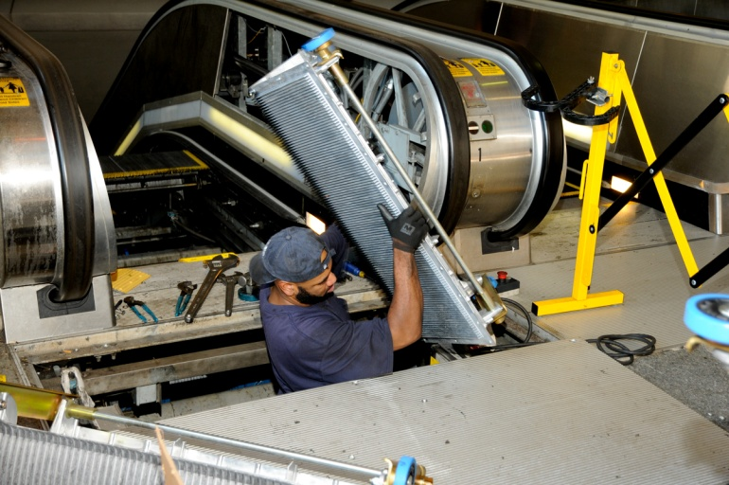
Rebuilding the Foundation
Metro Forward: $5 billion, six-year investment program

Slide 3
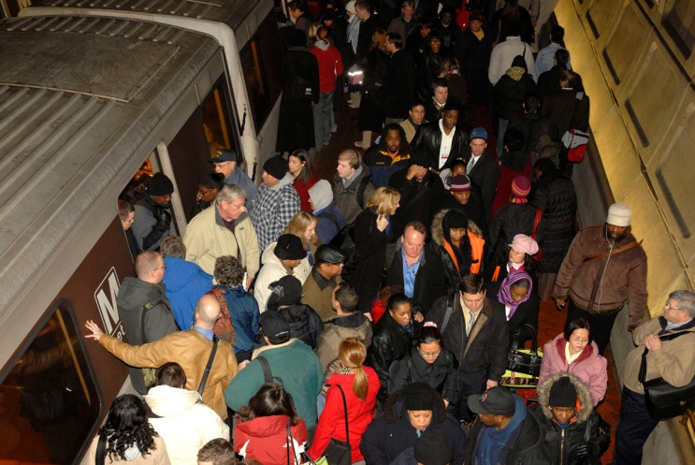
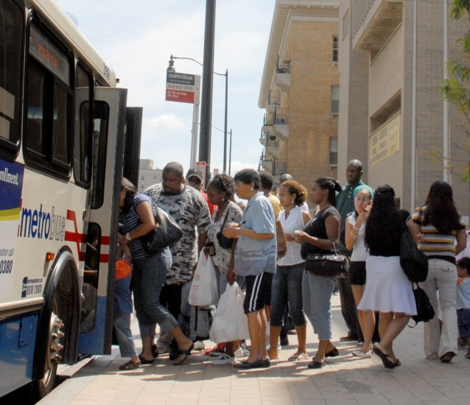
Why Momentum?
It’s About Choices
Core of rail system is already strained
Some buses, platforms and railcars are standing room only
Region will face continued growth
  30% increase in population
  40% increase in employment
No funding for any expansion beyond the Silver Line

Slide 4
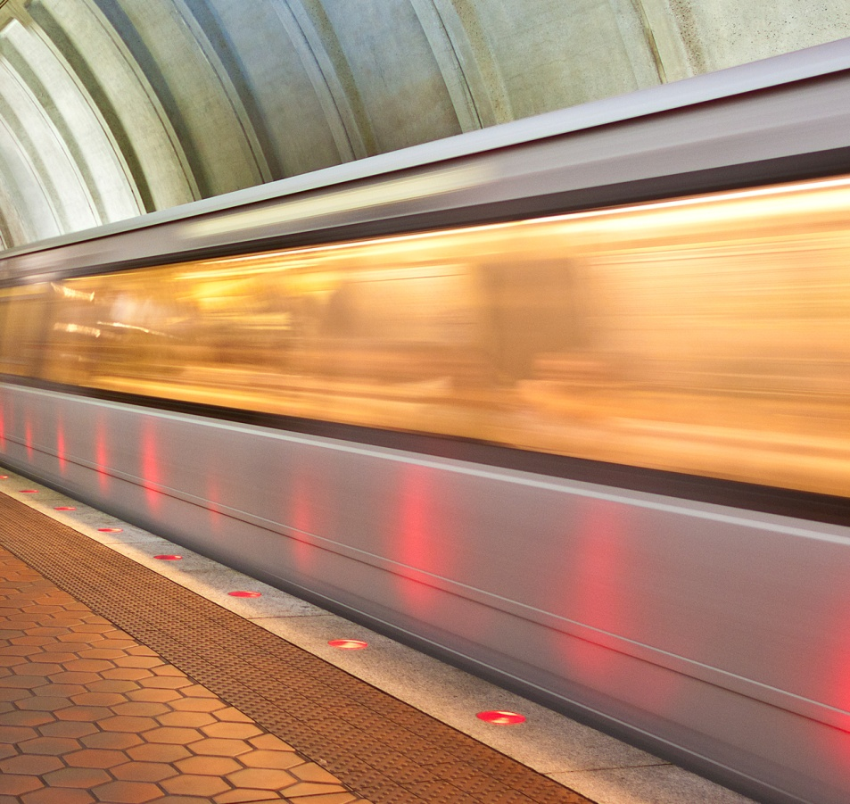
The Way Forward
Strategic Goals:
Build and maintain a premier safety culture and system
Meet or exceed customer expectations by consistently delivering quality service
Improve regional mobility and connect communities
Ensure financial stability and invest in our people and assets

Slide 5
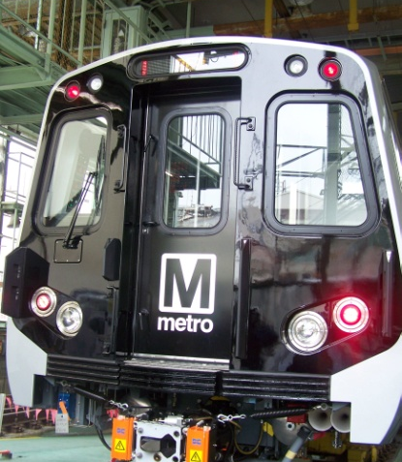
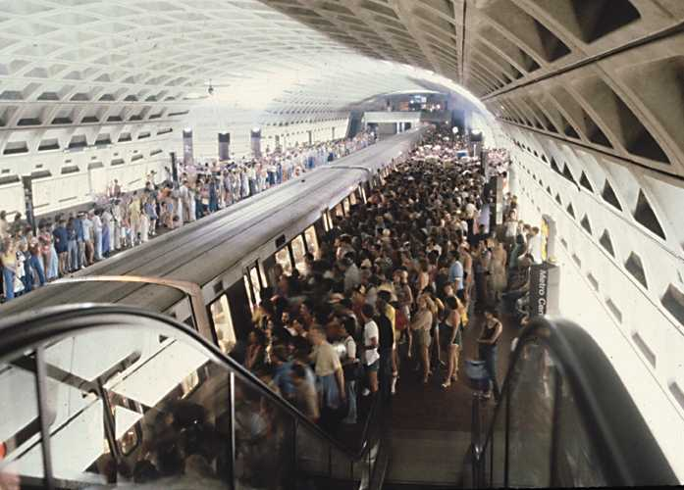
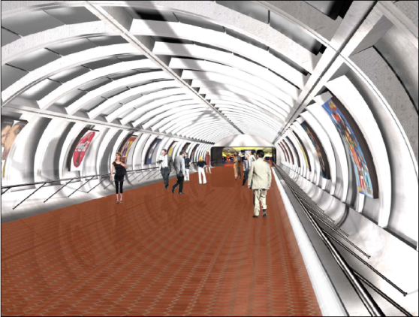
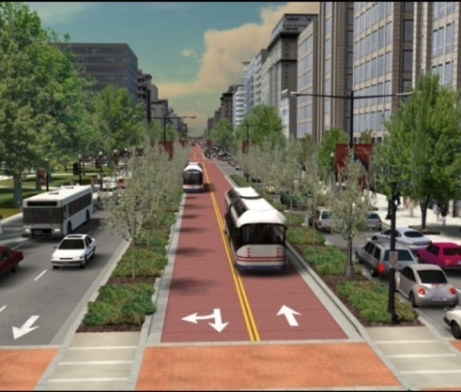
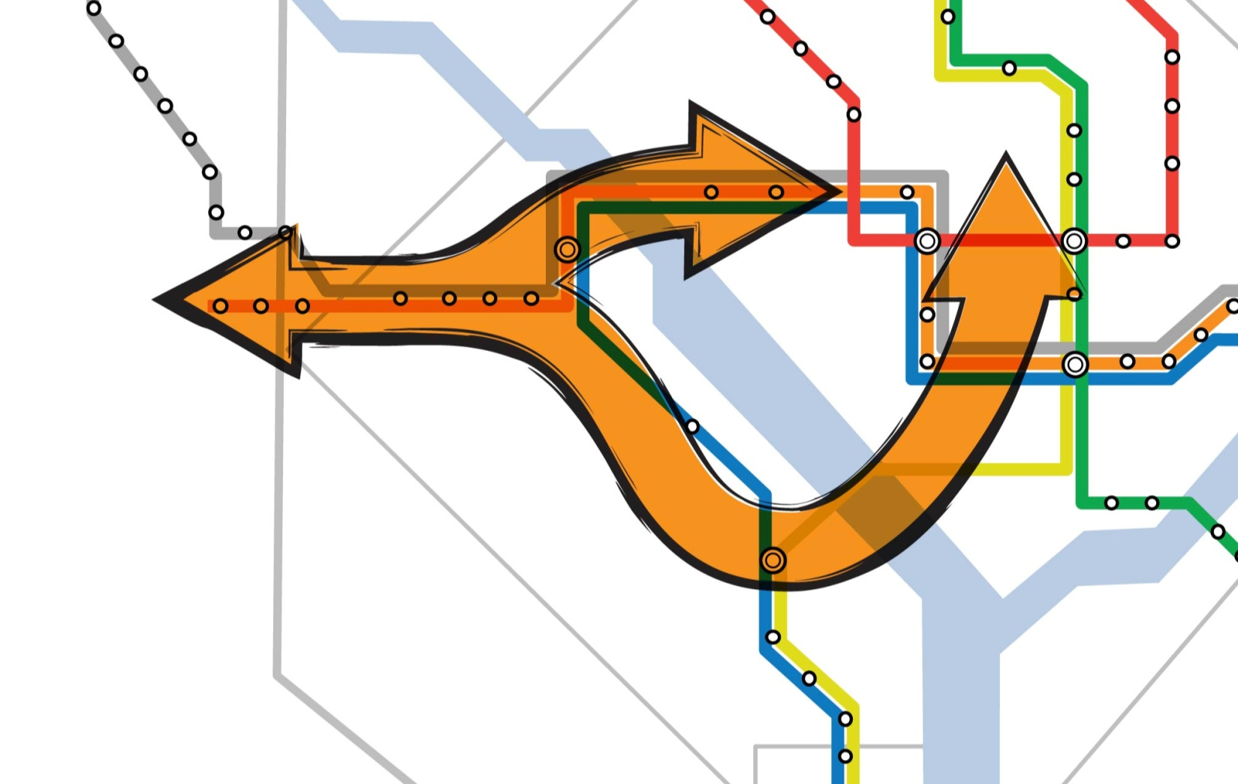
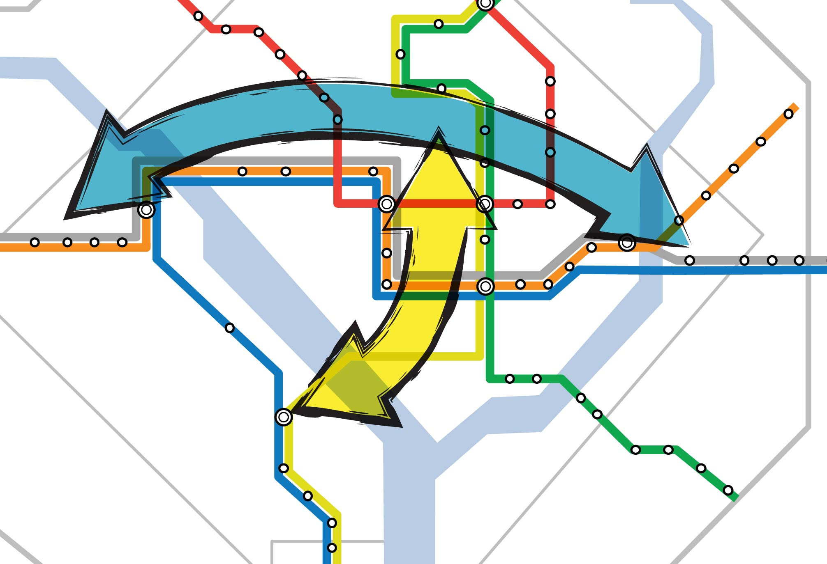
Next Generation of Metro: Core
100% 8-car trains
More station capacity
Underground pedestrian links
Complete Priority Corridor Network
Provide new direct connections between lines
Add new tunnels through downtown

Slide 6
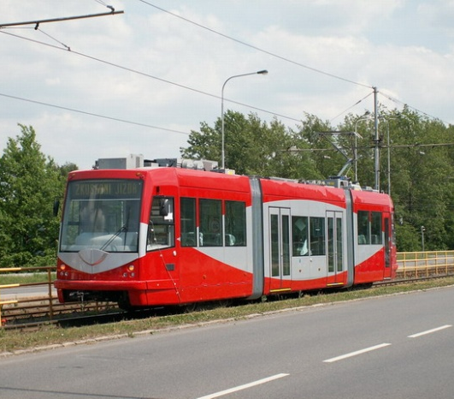
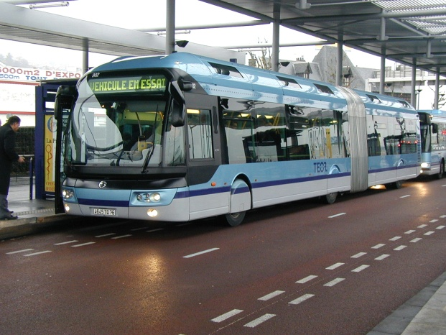
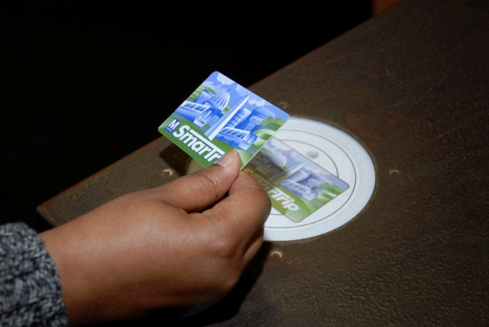
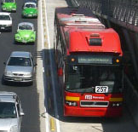
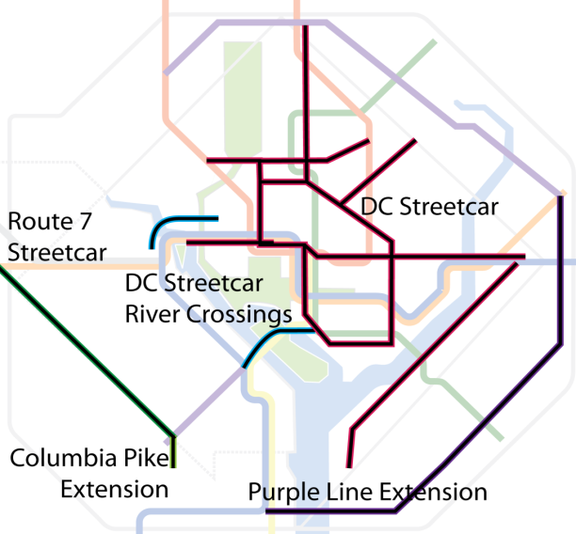
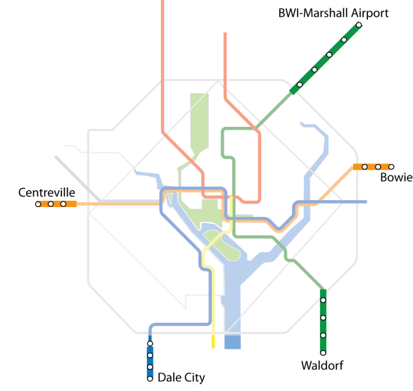
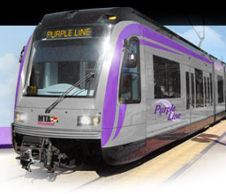
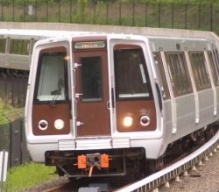
Next Generation of Metro: Connect
Transit priority on congested roadways
Seamless connections including fares, information, and services
Connect communities with high quality BRT, LRT, or streetcar
Extend system beyond end of line stations with BRT, LRT, or Metrorail

Slide 7
Questions For Stakeholders
Which priorities support business growth?
Which investments deliver improved service to more customers?
How do we strengthen the core to enable future expansion?
Which communities are most in need of enhanced Metro connectivity?
How will adequate funding be identified to sustain and grow the system?
When will reliable funding for Metro become a regional priority and what form will it take?

Slide 8
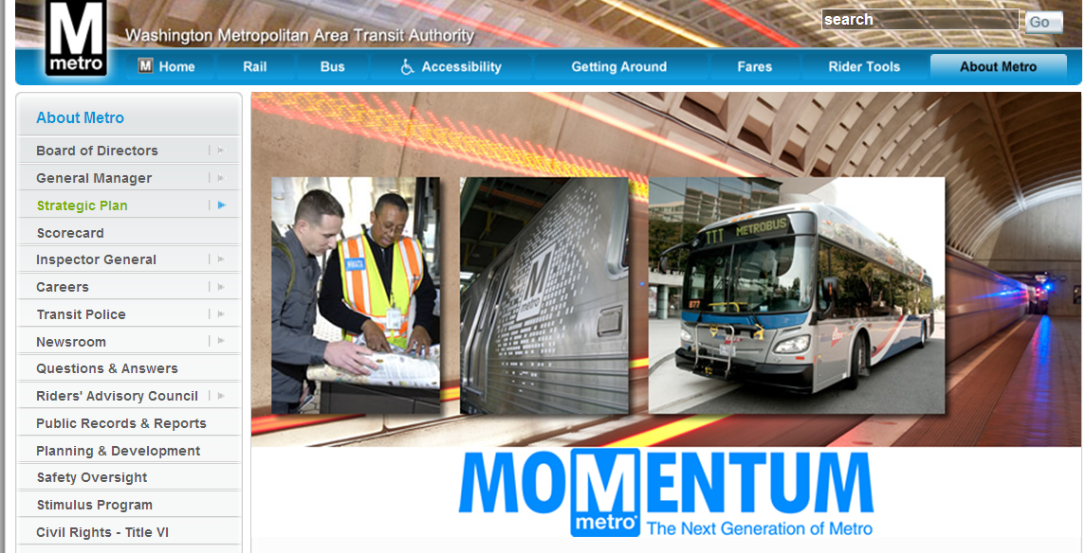
Join the Conversation!
wmata.com/momentum

