Slide 1
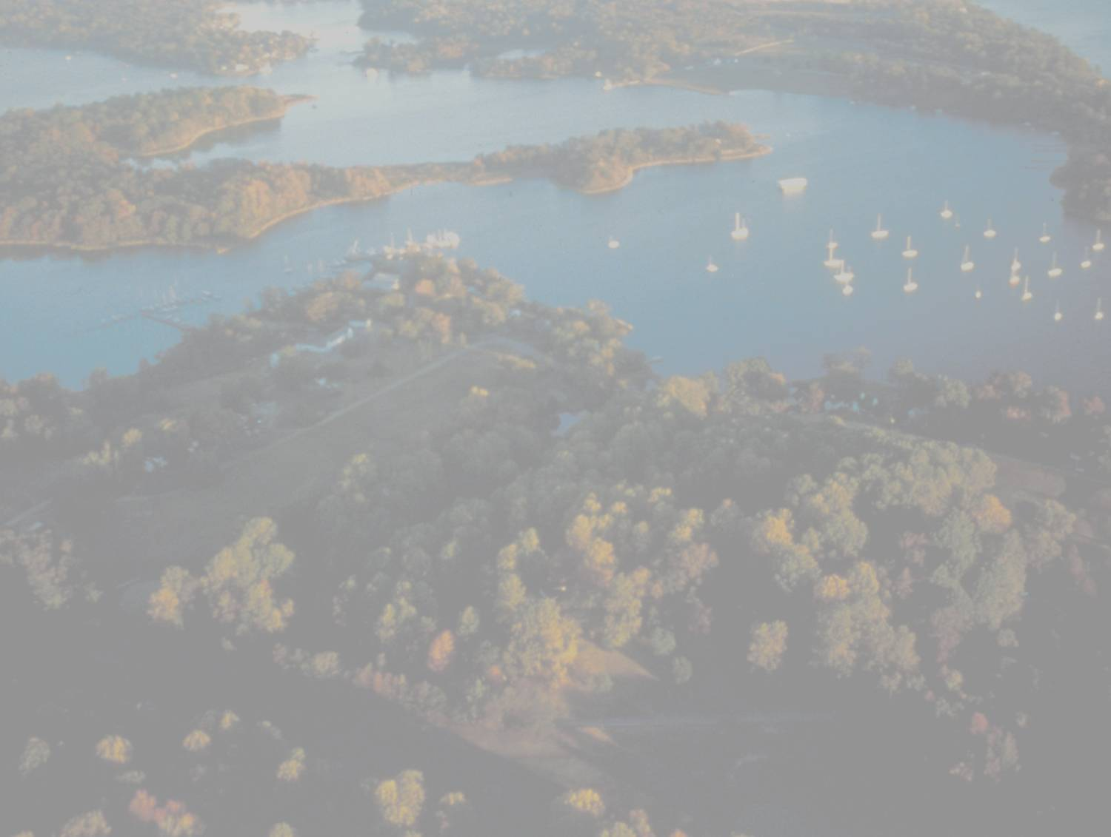
Current Planning for 2017
Mid-Point Assessment
Gary Shenk
COG
10/4/2012
presentation credit to
Katherine Antos and the WQGIT ad hoc planning team

Slide 2
Big Picture Question
Where do we as a Partnership want to be in 2017 and 2025?

Slide 3
What is the Midpoint Assessment?
Ultimate Goal:
  Ensure Partnership has all practices in place by 2025 to attain water quality standards in the Bay
How?
  Take stock of latest science, data, tools (including models), BMPs, and lessons learned from progress to date
  Findings from Midpoint Assessment will help jurisdictions to prepare for the Phase III WIPs, which will guide milestones and implementation between 2018 and 2025

Slide 4
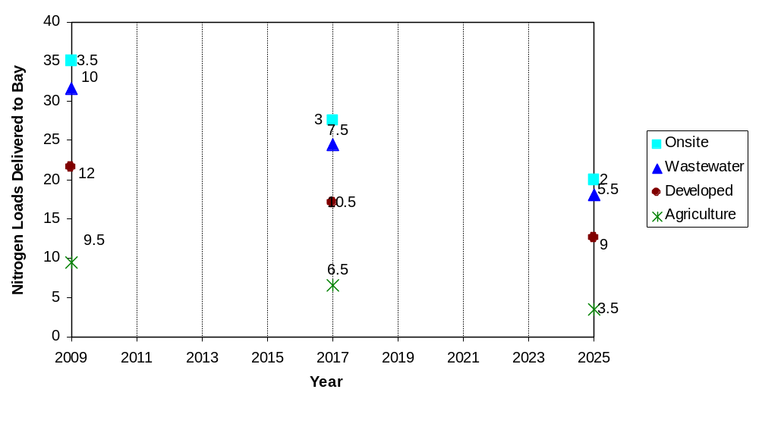
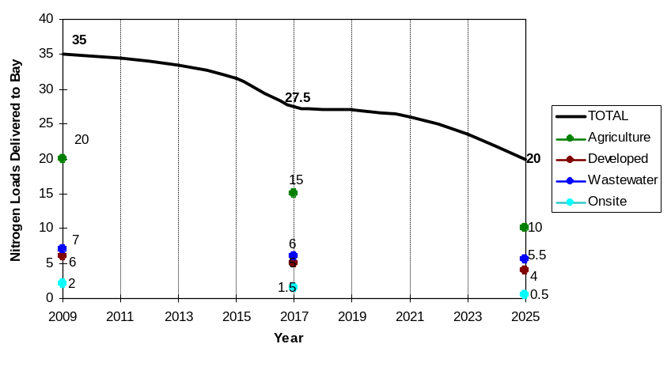
Staged Implementation
Propose new legislative authorities
Implement regulatory controls
Propose increased budget to legislature
Increased program budget
Examples of Some Planned Controls
Rulemaking
Increased controls
35
26
20
Interim
Targets
Final
Targets
Milestones for Assessing Progress
Stage 1 Implementation
Stage 2 Implementation
Source: Presentation to PSC in October 2009

Slide 5
More Detail on 2017 Questions
What is the midpoint assessment?
  How does it relate to the 60% by 2017 goal?
  How does it relate to the accountability framework from the Bay TMDL?
  Who is the lead for the midpoint assessment and related deliverables?
  What is the approximate schedule?
What are the Partners’ priorities for the midpoint assessment?
  How do they relate to the Guiding Principles
  How big of an effect
  How tough to implement
  Any downsides
Guiding Principles – What are they and how will they be applied?

Slide 6
Working Draft of Guiding Principles
Keep the focus on implementation and maintain stable tracking and reporting through 2017
Enhance decision support and assessment tools to enable successful engagement of local partners
Incorporate verification of practices into existing accountability tools and reporting protocols
Address emerging issues that may impact current strategies and future plans
Prioritize midpoint assessment actions and adaptive management to ensure Phase III WIPs meet water quality goals

Slide 7
How Does the Midpoint Assessment Relate to the 60% goal?
Moving Forward on Parallel Tracks
2010
Implementing 60% by 2017
Midpoint Assessment
2010: Phase I WIPs
2011 & 2012: Phase II WIPs
2012-2013 Milestones
2014-2015 Milestones
2016-2017 Milestones
Annual progress runs
Tracked using Watershed Model Phase 5.3.2, with some refinements to include innovative new BMPs as possible (including from panels)
2012: Gather Partnership input and set priorities
As directed by WQGIT, gather data, develop methods
As appropriate, refine and test tools
Set planning targets for Phase III WIPs
Develop Phase III WIPs and 2018-2019 milestones
2017

Slide 8
Who has the Lead?
Deliverable | Proposed Lead
Midpoint Assessment Priorities | Water Quality Goal Implementation Team (WQGIT)
Midpoint Assessment Guiding Principles | Principles’ Staff Committee, with input from WQGIT and Management Board
Midpoint Assessment Deliverables | CBP Partnership. Specific roles for Workgroups, Modeling Team, etc.
2-Year Milestones | Bay Jurisdictions, Federal Agencies
Phase III Watershed Implementation Plans | Bay Jurisdictions, with input from local partners
Any Possible Revisions to Bay TMDL | U.S. Environmental Protection Agency
Note: Partnership members in addition to the lead may contribute to deliverables

Slide 9

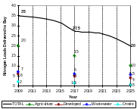
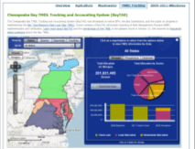

How Does the Midpoint Assessment Relate to the Accountability Framework?
1. Watershed
Implementation
Plans identify
Components of Bay TMDL Accountability
Framework
nutrient and sediment targets that meet water quality standards.
2. 2-Year
Milestones
with programmatic and pollutant reduction commitments
3.Track and
Assess
Progress
implementing WIPs and milestones
4. Federal Actions
if insufficient
Watershed Implementation Plans or 2-year milestones
Source: Chesapeake Bay TMDL Section 7
9

Slide 10
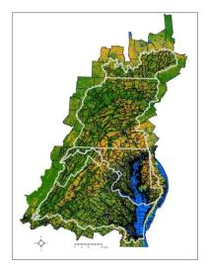
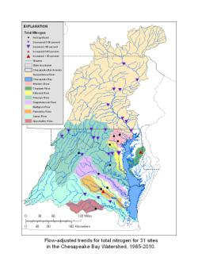
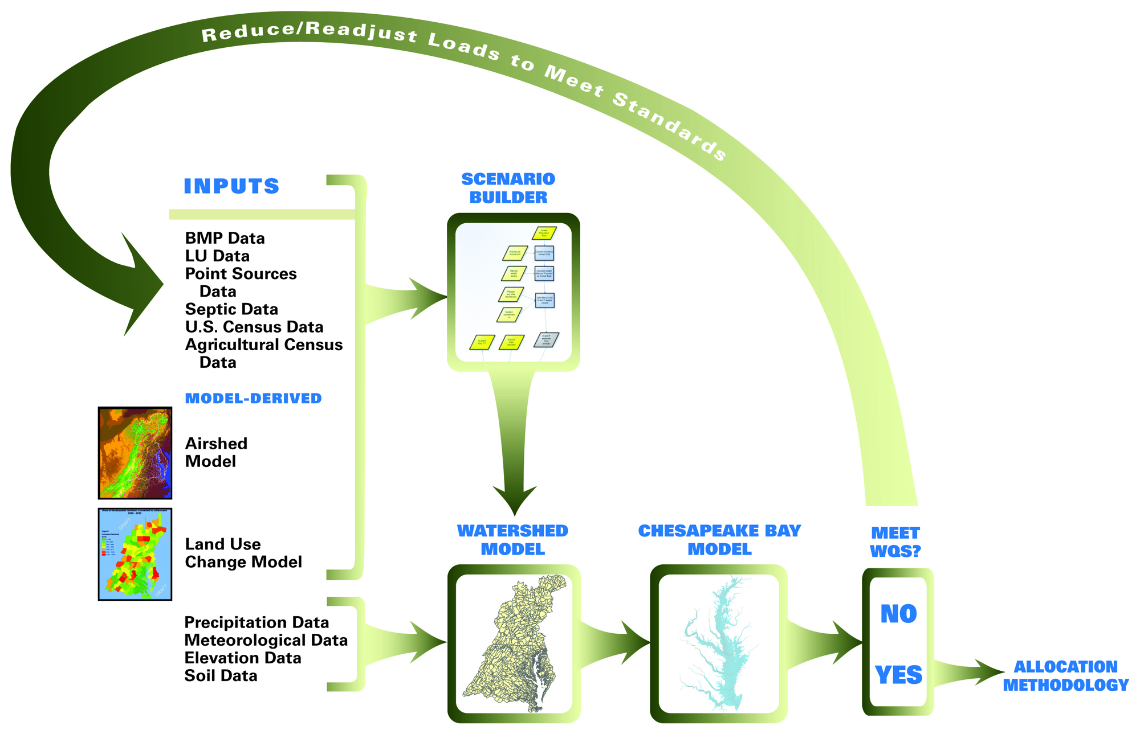



Framework Informed by Decision Support and Assessment Tools
CAST
Land Change Model
1. Watershed
Implementation
Plans identify
Watershed Model
nutrient and sediment targets that meet water quality standards.
2. 2-Year
Milestones
Monitoring Data
with programmatic and pollutant reduction commitments
Scenario
Builder
3.Track and
Assess
Progress
implementing WIPs and milestones
BayTAS
NEIEN
4. Federal Actions
if insufficient
Watershed Implementation Plans or 2-year milestones
10

Slide 11
Some frequently-voiced priorities
Local Relevance
Greater Clarity
Revised land use data set
Incorporate local data
Updated and more BMP effectiveness estimates
Revise model calibration method

Slide 12
Some frequently-voiced urban priorities
Local data
Revised land use data set
  More land use types
  More data sources
Look at more local scale effects
  low-order stream simulation
  Connected impervious

Slide 13
Who has the lead?
WQGIT
Modeling
Workgroup
STAR
WQGIT

Slide 14
BMP Effectiveness Estimation Process
New BMP
Water Quality Goal Team
“Approved BMP list”
Watershed Model
Source Workgroup
Review by:
Source Workgroup
Watershed Technical Workgroup
Water Quality Goal Team
Expert Panel

Slide 15
Expert Review Panels; planned or active
Agriculture Workgroup
  Nutrient Management
  Poultry Litter
  Conservation Tillage
  Cover Crop Panel
  Manure Treatment Technologies
  Animal Waste Storage Systems
  Manure Injection/Incorporation
  Cropland Irrigation Management

Slide 16
Expert Review Panels; planned or active
Forestry Workgroup
  Riparian Buffers
  Urban Tree Planting
  Forest Management
  Urban Filter Strips and Upgraded Stream Buffers:

Slide 17
Expert Review Panels; planned or active
Urban Stormwater Workgroup
  Stormwater
  Stream Restoration
  LID and Runoff Reduction
  Urban Fertilizer Management
  Erosion and Sediment Control
  Illicit Discharge Elimination
  Impervious Disconnect
  Floating Wetlands
  MS4 Minimum Management Measures

Slide 18
Working Draft of Schedule
(Dates Subject to Change)
Input for the midpoint assessment from WQGIT, WQGIT Workgroups, Modeling Workgroup, others
  Identification of topics (August 2012)
  Priorities (September 18, 2012)
Partnership development of Guiding Principles:
  August and September: Discussion and feedback solicited from WQGIT
  September 12: Discussion and feedback solicited from Management Board
  September 27: Deadline for Management Board comments on Principles
  October, TBD: Introduce Guiding Principles to PSC
  Key question: will these Principles help the Partnership set priorities?
WQGIT Meeting to set priorities, flesh out schedule and develop work plan for midpoint assessment (October 22-23, 2012)
  Use of draft versions of Guiding Principles to scope extent of the midpoint assessment
PSC approval of the Guiding Principles (Winter 2013)

Slide 19
Working Draft of Schedule
(Dates Subject to Change)
BMP expert panel and workgroup findings and recommendations (2012 and on)
As appropriate, refinements to decision support tools (2012 and on)
Partnership testing of these refinements and, as appropriate, tool modifications in response to this testing (Partners have suggested at least 6 months)
Development of Phase III Planning Targets, as necessary
Development of draft and final Phase III WIPs that will guide implementation between 2018 and 2025, upon receipt of Phase III WIP planning targets
  Some Partners have indicated need 18 months between completion of any model updates and submission of Phase III WIPs
  In 2010 letter, EPA stated draft Phase III WIPs due June 1, 2017 and final due November 1, 2017
EPA revisions, as appropriate, to the Bay TMDL

