Slide 1

Item #4
Ozone Season Summary
2012
Sunil Kumar
ACPAC
September 10, 2012

Slide 2
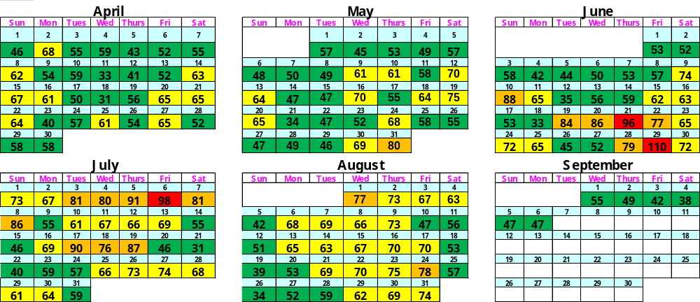
Ozone Season Summary
[As of September 6, 2012]
Peak 8-Hour Ozone Concentrations (ppb)
Since April 1, 2012, there
have been:
3 Code Red Days
16 Code Orange Days
59 Code Yellow Days
81 Code Green Days
Analysis is based on draft data until September 6, 2012. Data is subject to change.

Slide 3
2012 Ozone Exceedances (As of September 6)
Date | # of Monitors Exceeding | Highest Monitor | Highest Concentration (ppb)
5/31/2012 | 1 | Calvert | 80
6/10/2012 | 8 | McMillan | 88
6/19/2012 | 5 | Arlington | 86
6/20/2012 | 8 | Alexandria | 86
6/21/2012 | 9 | Alexandria / Franconia | 96
6/22/2012 | 2 | Southern Maryland | 77
6/28/2012 | 2 | McMillan Reservoir | 79
6/29/2012 | 13 | Calvert | 110
* Analysis is based on draft data until September 6, 2012. Data is subject to change.

Slide 4
2012 Ozone Exceedances (As of September 6)
Date | # of Monitors Exceeding | Highest Monitor | Highest Concentration (ppb)
7/03/2012 | 3 | Prince Georges | 81
7/04/2012 | 2 | Prince Georges | 80
7/05/2012 | 6 | Calvert | 91
7/06/2012 | 7 | Franconia | 106
7/07/2012 | 5 | Prince Georges | 81
7/08/2012 | 7 | Prince Georges | 86
7/17/2012 | 7 | Prince Georges | 90
7/18/2012 | 1 | Prince Georges | 76
7/19/2012 | 8 | Prince Georges | 87
8/01/2012 | 1 | Franconia | 77
8/24/2012 | 2 | Long park | 78
* Analysis is based on draft data until September 6, 2012. Data is subject to change.

Slide 5
What Caused Ozone Episodes ?
High pressure system continuing for several days caused
the following in our region -
  Warm air
  Limited winds
  Limited or no clouds
  Favorable meteorological conditions for ozone production
Most of the days winds came from Ohio River Valley and beyond bringing ozone and its precursors (VOC & NOx) into our region.
Local production of ozone combined with its transport from
outside the region caused significant ozone build-up
resulting in exceedances of ozone standard (75 ppb) on
those days.

Slide 6
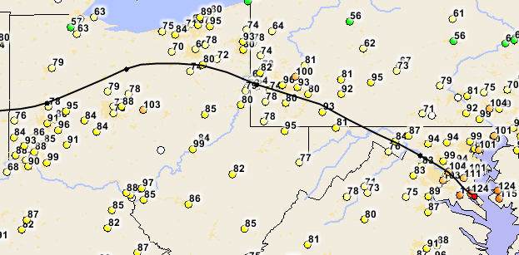
Ozone & Precursor Transport - June 29th Code Red
Winds came into Washington region from several polluted areas including the Ohio River Valley
1-Hour Avg Ozone concentrations at 1:00PM
(Avg of 12 PM – 1 PM)

Slide 7
Ozone Exceedance Trend
* 2012 analysis is based on draft data as of September 6, 2012 and is subject to change.

Slide 8
Ozone Design Value Trend
8

Slide 9
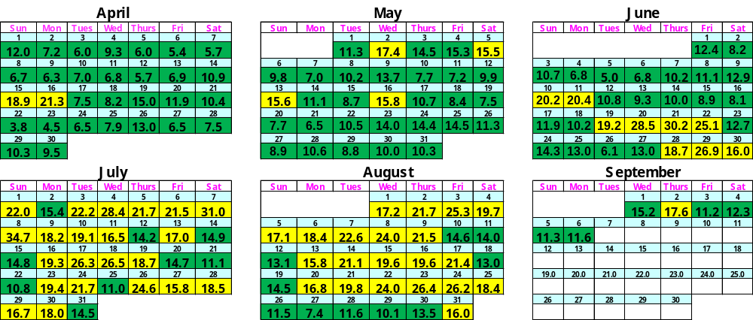
Fine Particle Summary
[As of September 6, 2012]
24-Hour PM2.5 Concentrations (ug/m3)
Since April 1, 2012, there have been:
59 Code Yellow Days
100 Code Green Days
* Analysis is based on draft data until September 6, 2012. Data is subject to change.

Slide 10
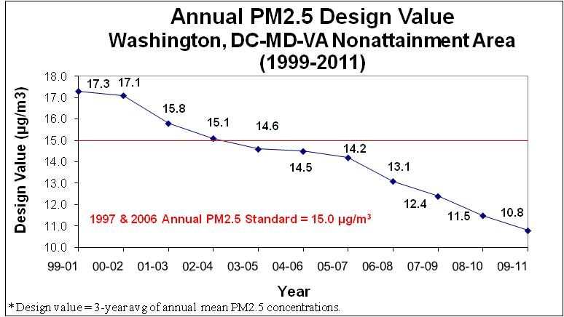
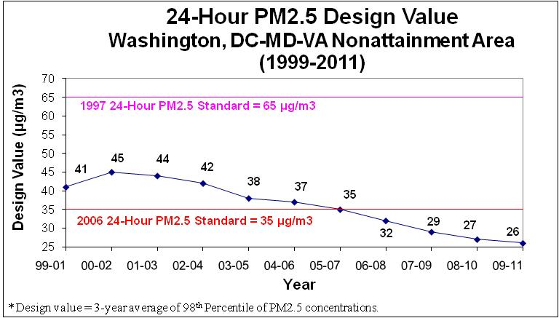
PM2.5 Design Value Trend

Slide 11
2012 Summer
&
Historical Temperatures
(Metro Washington Region)

Slide 12
Sources & Period of Weather Data
National Climatic Data Center (NCDC) – A Division of NOAA
  Dulles & National airports – 1963-2012 & 1946-2012
  Maryland & Virginia - July & Jan-July avg (1895-2012)
US Historical Climatology Network (US HCN) – A NCDC Project to detect regional climate change
  Dulles & National airports – 1963-2012 & 1946-2012
  Maryland & Virginia - July & Jan-July avg (1895-2012)

Slide 13
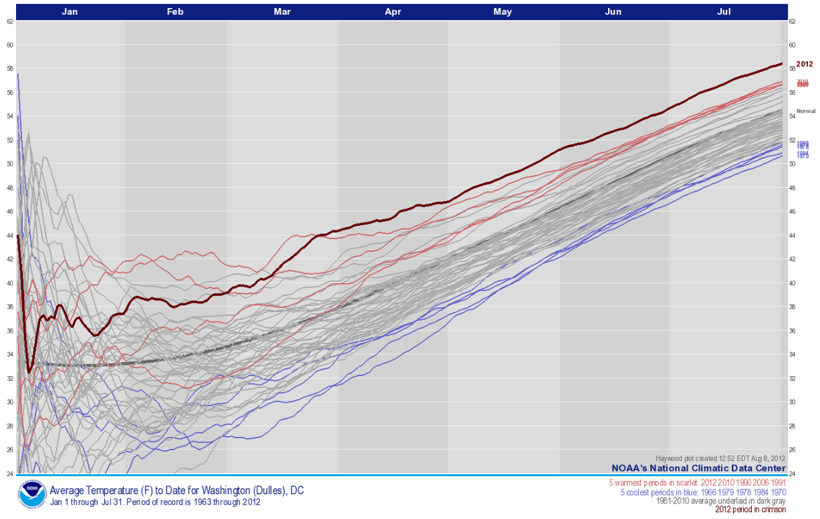
Long-Term Temperature Trend - Dulles
July 2012 – Warmest July on record (1963-2012)
http://www.ncdc.noaa.gov/img/haywood/jul/janjul.USW00093738.png

Slide 14
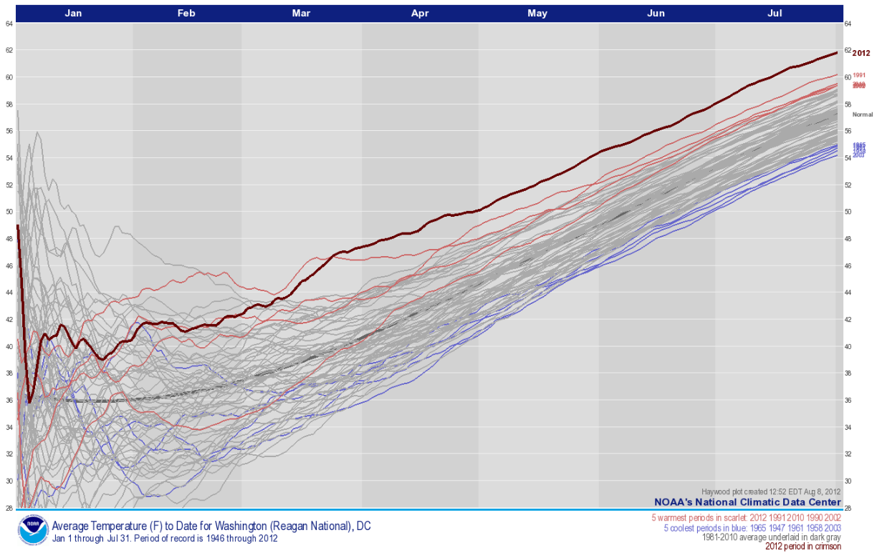
Long-Term Temperature Trend - National
July 2012 – Warmest July on record (1946-2012)
http://www.ncdc.noaa.gov/img/haywood/jul/janjul.USW00013743.png

Slide 15
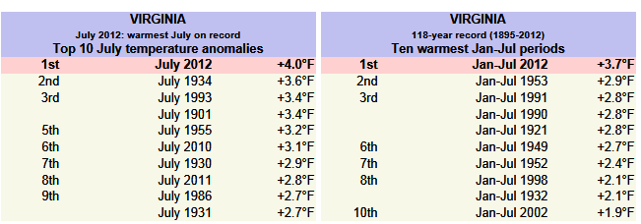
Long-Term Temperature Trend - Virginia
July 2012 – Warmest July on record (1895-2012)
Jan-July 2012 - Warmest Jan-July period on record (1895-2012)
4 out of top 10 warmest July occurred after 1990
http://www.ncdc.noaa.gov/sotc/national/2012/7/supplemental/page-2/#VA

Slide 16
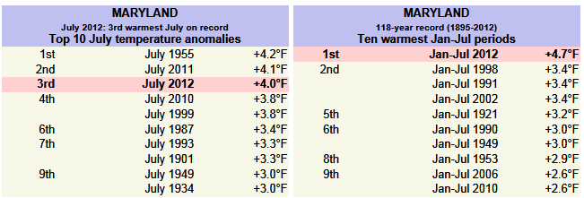
Long-Term Temperature Trend - Maryland
July 2012 – 3rd warmest July on record (1895-2012)
Jan-July 2012 – Warmest Jan-July on record (1895-2012)
5 out of top 10 warmest July occurred after 1990
http://www.ncdc.noaa.gov/sotc/national/2012/7/supplemental/page-2/#MD

Slide 17
Conclusion
July 2012 & Jan-July Avg 2012 periods – One of the warmest periods on record since 1895
4-5 out of top 10 warmest July & Jan-July avg periods occurred after 1990 (last 22 years)
High temperatures during summer becoming more frequent and common

