Slide 1
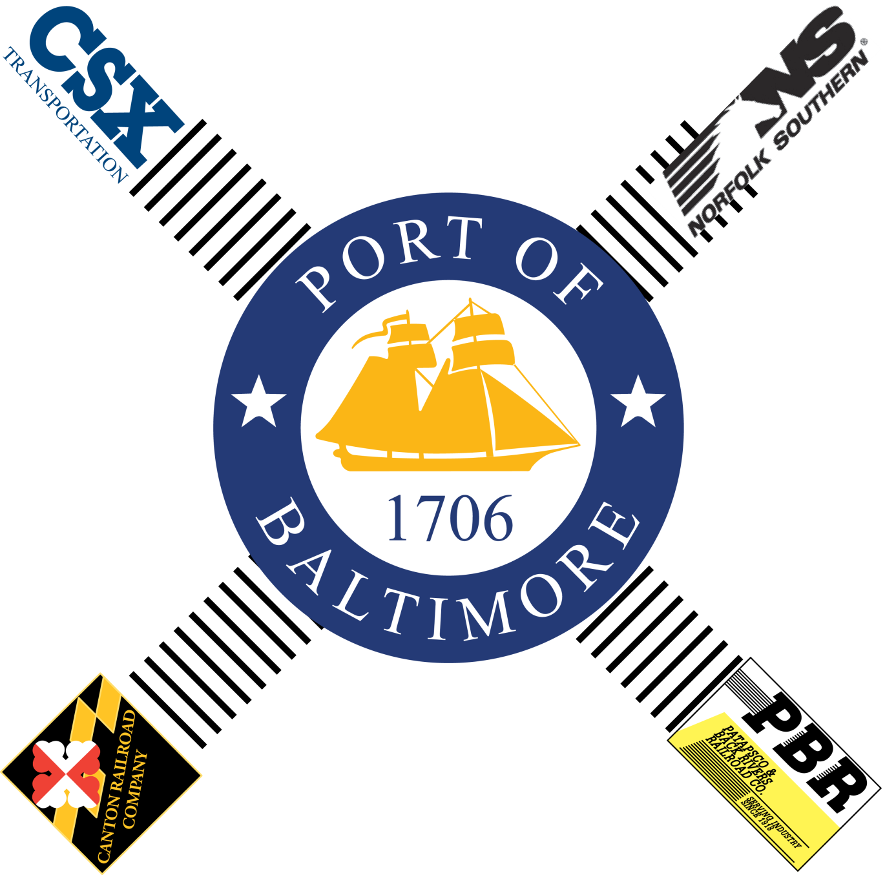

Rail-Served Properties
Inventory & Opportunities
Analysis Study
Port of Baltimore
Presentation to the National Capital Region Transportation Planning Board Freight Subcommittee
February 2, 2012

Slide 2
POB Rail-Served Properties Inventory & Opportunities Analysis Study
Agenda
Project Description
Stakeholders
Project Study Area
Inventory & Database
Railroad Operations
Opportunities Analysis
Next Steps

Slide 3
Project Description
Identify and Evaluate Rail-served properties around the Port of Baltimore in order to understand rail utilization and capacity opportunities.
Task 1- Mobilize Project and Identify Stakeholders
Task 2- Identify Geographic Boundary and Develop Matrix of Rail Served Properties
Task 3- Develop Opportunities Narrative
Task 4- Develop an Electronic Database of Property Information

Slide 4
Stakeholders
This team effort has included guidance and input from the following project partners:
    Baltimore Metropolitan Council (BMC) – FY11/FY 12 UPWP Funds
    Baltimore Development Corporation (BDC)
    Maryland Department of Transportation (MDOT)
    Maryland Department of Business and Economic Development (DBED)
    Maryland Port Administration (MPA)
    Baltimore City DOT
    Railroads

Slide 5
Definition of Project Study Area
The Project Team assembled information on rail served properties from DBED, CSX, BDC, and MDOT
Properties were plotted based on proximity within the Study Area, and analyzed within important rail locations (MIZOD, Foreign Trade Zones, Enterprise Zones and Port Locations).

Slide 6
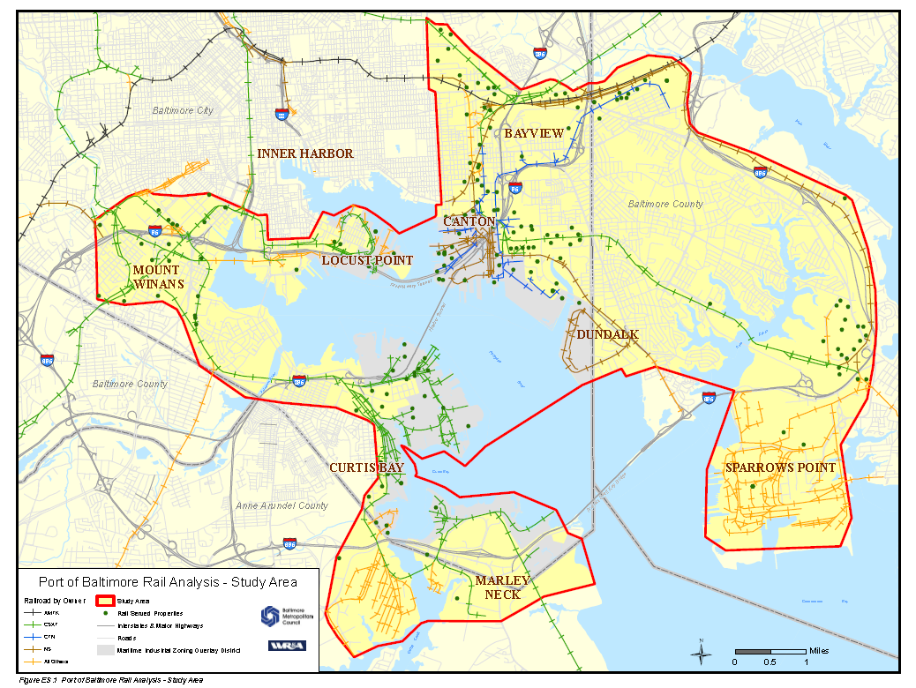
Project Study Area

Slide 7
Database & Minimum Attribute Information
Fields to be used in the layer
  Property ID
  Address Information
  Name of Property Owner
  Block and Lot
  Zoning
  Acreage
  Age and Square feet of structure
  Rail Provider
  Rail Information – Active/Condition/Maintenance responsibility/Cost to connect/Distance from Rail
  Data Source

Slide 8
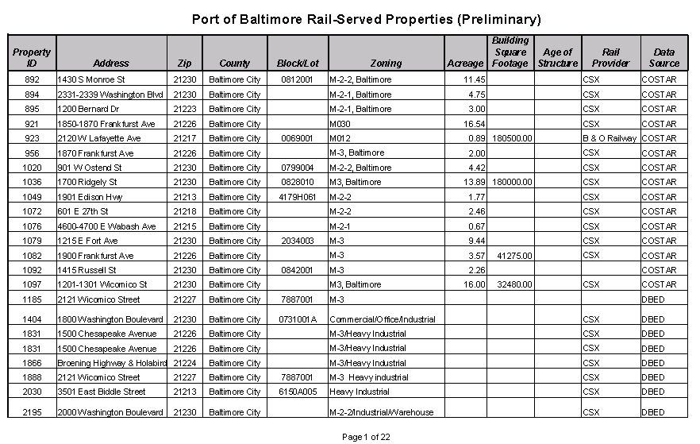
Rail-Served Properties Sample Report

Slide 9
Railroad Operator Stakeholder Outreach
Each railroad serves different users roughly grouped under manufacturing, intermodal, and warehousing/distribution
  P&BR serves manufacturing operations, a few warehousing/distribution operations, and has the capability in space requirements, track capacity and experience of handling unit trains of bulk materials.
  The Canton RR serves more warehousing/distribution operations, only a few manufacturing operations.
  NS serves more bulk freight and intermodal operations, relatively few warehousing/distribution operations, and only one manufacturing operation
  CSXT serves the largest number of shippers in the port area with an almost equal distribution among bulk freight, intermodal, manufacturing, and warehousing/distribution operations

Slide 10
Railroad Operators Stakeholder Outreach
Actual track inspections and acquisition and analysis of track inspection reports were not performed as part of this project. The following will be applied to the spreadsheets:
  Track conditions considered “Good” if the track is in service, “Fair” if the track has been out of service but left in place, or “Removed.”
  A generic cost to rehabilitate tracks in “Fair” condition was used.
  A generic cost to reconstruct was applied to locations where track has been removed.

Slide 11
Opportunities Analysis
Industrial Market Opportunities Analysis
  Component of freight rail opportunities analysis
  Important to understand industrial market, as industrial users most likely to demand rail access
  Determining target industries offers insight to land use planning considerations
  Tied to geographic and business/market opportunities

Slide 12
Opportunities Analysis
Increasing Goods Movement in Baltimore
  Port recently exceeded previous record for container traffic
    Over 630,000 containers from year ending March 2011
    Container traffic growth area compared to more traditional strengths in forest products, bulk commodities, automobiles and roll-on/roll-off cargo
  Port outperformed competition in New York, Norfolk and Philadelphia
    Percentage and absolute tonnage growth higher in 2010
    Attributed to gains in import and export of bulk commodities (export coal, import iron ore, and import salt in particular)

Slide 13
Opportunities Analysis
Investments Enhancing Baltimore’s Competitive Position Related to Panama Canal Expansion
  Construction of 50-foot berth and associated Cranes at Seagirt Marine Terminal
    Result of partnership between MPA and Ports America
    Will position Baltimore among first two East Coast ports with depths to handle larger ocean vessels (Norfolk is only East Coast port that already has such depths)
  CSX National Gateway project will provide double stack container efficiencies to points south and west

Slide 14
Opportunities Analysis
Baltimore’s Industrial Market
  Rebounding from economic downturn
    Increased activity at Port of Baltimore generating demand for warehouse space
  Features lower vacancy rate than in region
  Absorbed 133,000 square feet of industrial space in the first quarter of 2011, representing 63% of city-wide absorption
  Contains 23% of region’s warehouse space
  Vacancy rate for warehouse lower than all industrial spaces, indicative of demand for warehousing

Slide 15
Opportunities Analysis - Findings
Rail-served industrial properties are a unique resource - need to preserve properties as well as the rail access to these properties
Rail access offers unique opportunities for warehouse distribution centers to take advantage of dual rail and water access
Maintaining opportunities for industrial development through the Baltimore City Zoning process
Rail likely to become more important in the future as transportation costs rise over the long-term

Slide 16
Project Deliverables
Geospatial Database & Technical Memorandum
Opportunities Analysis Report
Temporary website http://snowserver.enterinfo.com/RailServedProperties
Preliminary Report (Excel Spreadsheet) with rail-served properties and key data elements

Slide 17
Next Steps
Data: While considerable effort was expended to obtain the current data, the Project’s time and scope did not allow for more in-depth research of the properties.
Maintenance: The data needs to be updated on a periodic basis.
Web Site: The current web site is temporary.
Opportunities Analysis: Share data/report with economic development staff at state/local level.

Slide 18
Next Steps
Form a project working group
Identify agency/staff lead for next phase
Identify/secure funding for updates, maintenance, marketing

Slide 19
THANK YOU!

