Slide 1
National Capital Region
Freight Plan 2010
Item #8
Transportation Planning Board
July 21, 2010
Victor Weissberg (Freight Subcommittee Chairman)
Karin Foster (TPB staff)

Slide 2
TPB Vision
TPB Vision, which was adopted on October 21, 1998, includes:
  Policy Goal 2, which states that “... the region will develop, implement, and maintain an interconnected transportation system that enhances quality of life and promotes a strong and growing economy throughout the region…”; and
  Policy Goal 2, Objective 5: “Efficient and safe movement of people, goods, and information, with minimal adverse impacts on residents and the environment”; and
  Policy Goal 8, Strategy 5: “Develop a regional plan for freight movement”

Slide 3
TPB Freight Subcommittee
TPB Freight Subcommittee Kick-off April 2008
5 Objectives of Freight Subcommittee
  Provide a voice for freight in transportation planning
  Recognize freight’s role in economic development
  Recognize freight’s role in the multimodal system
  Coordinate transportation and land use planning
  Recognize how freight can reduce air quality impacts
Notes:
May 2007 Freight Study was done for TPB
Recommended to establish Freight Subcommittee, hire staff, etc.

Slide 4

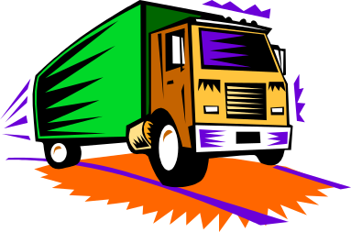
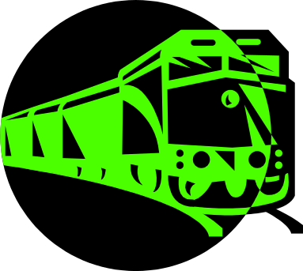
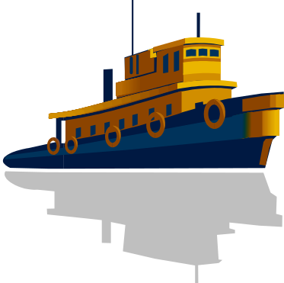
What is Freight?
Freight: Goods and cargo transported for pay
Story of freight is the story of our economy
  Economic growth->more demand->more goods
  ↑ trucks, ↑ rail,↑ air cargo, ↑water
Washington region: A consumer region

Slide 5
Notes:
USDOT BTS (bureau trans statistics), measures movement of freight. Measure of transportation services output next to GDP, a measure for economic health.
The freight transportation index consists of:
-for-hire trucking (parcel services are not included),
-freight railroad services (including rail-based intermodal shipments such as containers on flat cars),
-inland waterway traffic,
-pipeline movements (including principally petroleum and petroleum products and natural gas),
-air freight.
The index does not include international or coastal steamship movements, private trucking, courier services, or the United States Postal Service.

Slide 6
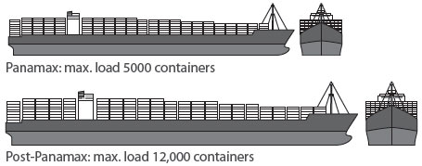
Plugged into Global Economy
Panama Canal 2014
  5,000 to 12,000 containers
  Shipper Route Selection
  Growth in intermodal (container) shipment
  New relationships between port, rail, truck
  Greater potential truck to rail diversions
  “Last-mile” by truck
Notes:
Influence shipper route selection
-At present Port of Virginia is the only East Coast Port that can accommodate the 50ft depth of the larger ships

Slide 7
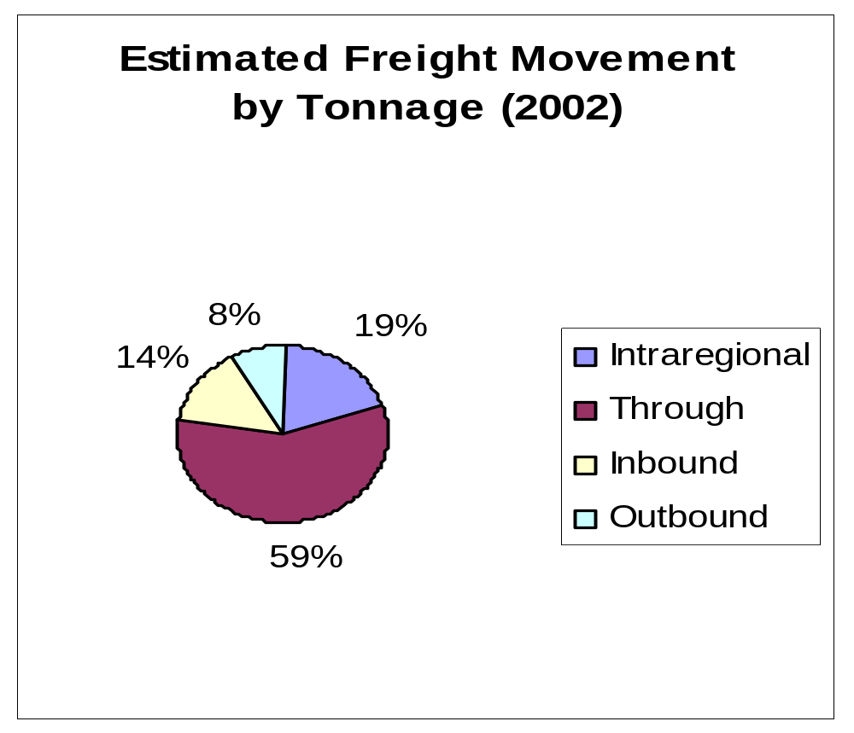
Washington Region
(Highway and Rail)
Notes:
(Source: Cambridge Systematics for MWCOG. Estimates are based on two sources: Inbound, Outbound, and Intraregional numbers are based on 2002 FAF data. Through traffic is based on 2003 estimate in Draft Maryland Freight Profile, 2007.)

Slide 9
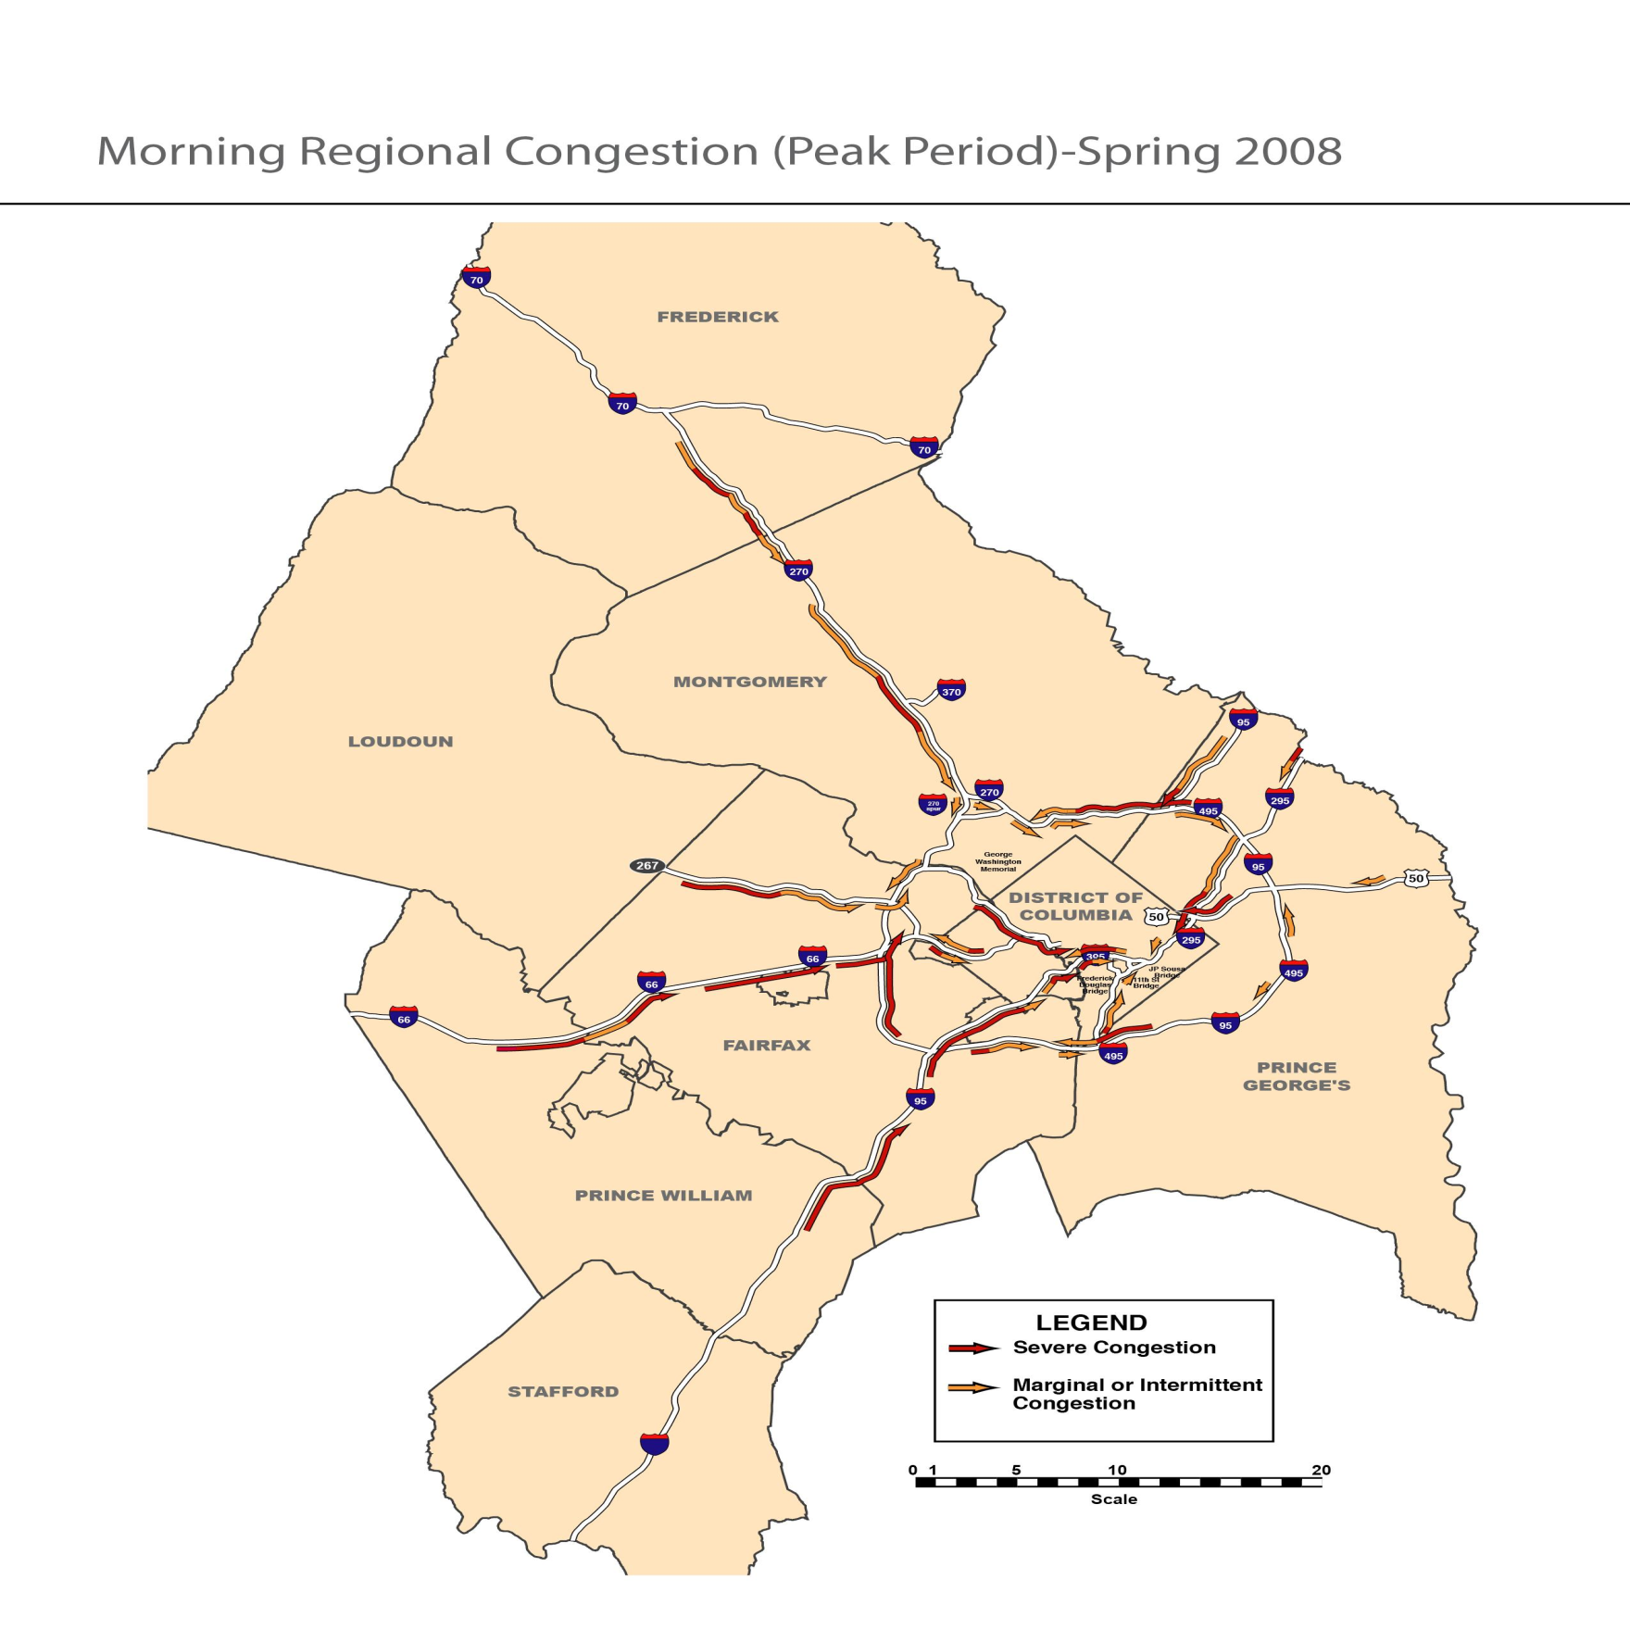
17.9%
16.5%
6.7%
9.5%
10.3%
8.5%*
11.7%
3%*
Truck % Key
VA* | ≥ Class 5 Vehicles
MD | ≥ Class 4 Vehicles
All %s are two-way averages
10.5%*
(Sources: Truck % Data from 2008 MDOT and 2007 VDOT Count Data, Aerial Data from Skycomp, Spring 2008)
Notes:
Highlight the % for Frederick County

Slide 10
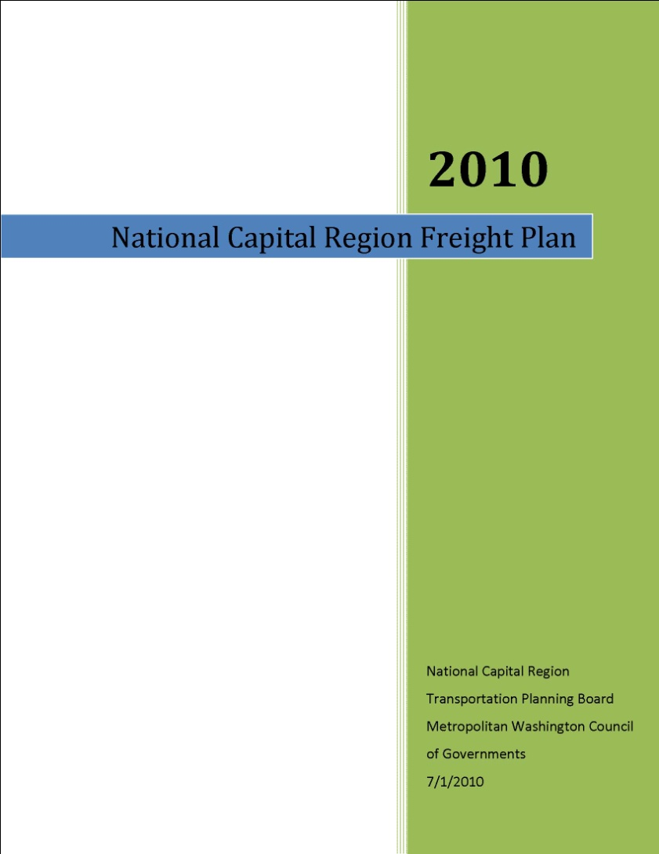
Freight Planning Context
First Freight Plan for Region
  Input from Freight and Technical Subcommittees
  SAFETEA-LU & Freight
  Integrate freight into a comprehensive transportation paradigm
  Incorporate freight into livability/sustainability discussion
-Planning Context
-TPB Freight Program
-Current Freight
-Future Freight
-Land Use/Environment
-Safety/Security
-Freight Project Database
-Best Practices
-Key Findings/
Recommendations
Notes:
-Part of process to integrate freight into a comprehensive transportation paradigm
-We are beginning to integrate freight into livability and sustainability discussion

Slide 11
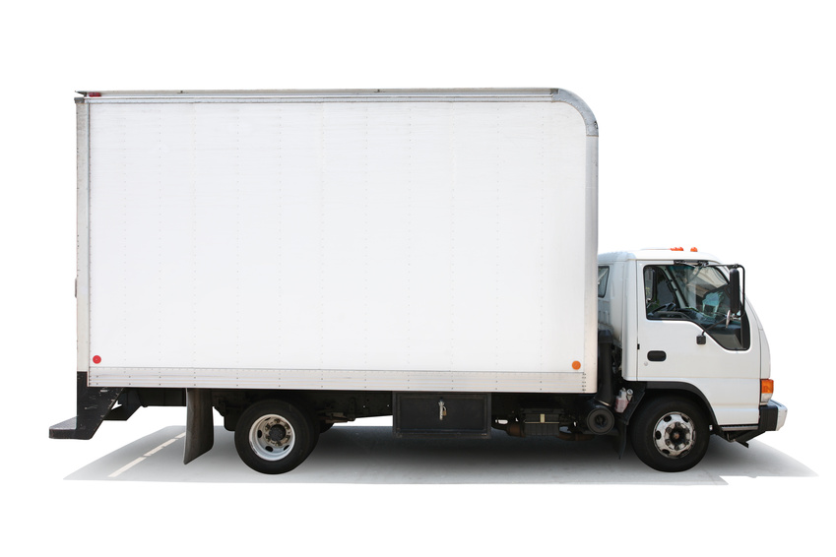
Trucking in the Region
Trucks carry the majority goods/tonnage to, from, and within the region (76 percent)
COG/TPB forecasts increased volumes in 2030 (from 2002)
  Heavy truck 38%
  Medium truck 47%
Households ↑ 43% more 2030 from 2002
Employment ↑ 45% more jobs 2030 from 2002

Slide 12
Truck Freight Issues
Congestion→ Diminishes productivity and increases cost of operations, drivers must be paid for time spent making deliveries and in traffic
Economy
Commercial loading zones
Truck driver shortage
Roundabouts
Notes:
ATRI Top Industry Issues Survey among truckers. (2009 Critical issues in trucking industry survey and report)
1. Economy
Government Regulation
Fuel issues
Congestion
Hours-of-Service
TRB study surveyed motor carriers to quantify the impacts of traffic congestion. Results indicated that motor carriers placed a premium of travel time savings during congested conditions of $144 to $193 per hour. Examples of fixed costs that may increase with congestion include: 1) Idle dock labor awaiting delayed trucks; 2) The need to dispatch additional equipment and drivers to maintain service levels to other customers; 3) The increasing opportunity costs of drivers and equipments that could be generating additional revenue. (Source: Cited in American Transportation Research Institute, An Analysis of the Operational Costs of Trucking Study, December 2008).
-The roundabout must be large enough to accommodate the turning radius of the truck. One option for doing this is through the use of a truck apron, which is part of the center island where the truck wheels can track.
-Smaller roundabouts not only present turning radius issues, but also allow passenger cars to navigate through them very rapidly (almost traveling through the roundabout in a straight line). This does not give a slow moving truck driver a chance to react to a fast moving car. By the time a truck driver lets out the clutch, here comes a car.
-A similar problem is that there must be sufficient visibility for a truck driver to see oncoming traffic well in advance. If he cannot see traffic approaching because the entry road into the roundabout isn’t visible, a slowly accelerating truck can quickly get caught pulling out in front of a faster moving car.
-They are much slower to accelerate through the roundabout and must use both lanes to get around the roundabout.

Slide 13
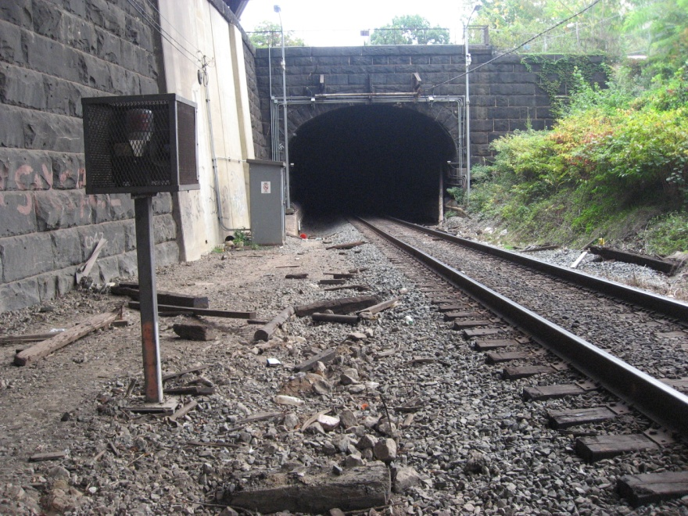
Freight Rail
In anticipation of economic growth
  CSX National Gateway
  NS Crescent Corridor
Passenger rail interaction
  - Provide speed, signal, and capacity improvements that support freight and VRE, MARC, Amtrak
CSX Virginia Avenue Tunnel (West View)
Notes:
CSX National Gateway
-Mid-Atlantic to Mid-West 61 projects, clearance of obstructions to allow for double-stacked trains
-13 projects fall within our region
-Virginia Avenue Tunnel is the largest project/bottleneck in our region, est cost of $160M
Norfolk Southern Crescent Corridor
-N-S corridor from New Jersey to Louisiana, clearance of obstructions to allow for double-stacked trains
-Track improvements, Crescent Corridor west of our COG region in Virginia, follow 81

Slide 14
Freight Rail Issues
Capacity: Doublestack and doubletrack
Improvements must be made to modernize track conditions
  Positive benefits for freight and passenger rail
Difficult to fund complex/expensive projects
Notes:
Between 1980 through 2006, the nation’s railroad container shipments were the fastest growing segment of traffic on the rail system.
(Association of American Railroads, Railroad Facts Draft National Rail Plan 2009.)

Slide 15
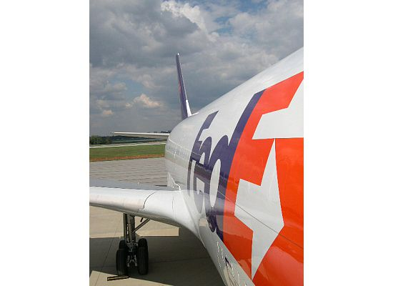
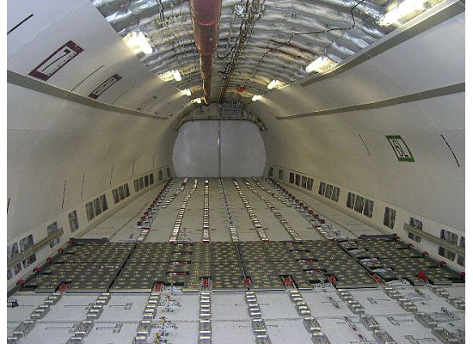
Air Cargo
Air cargo tonnage to grow nearly 500 percent in 2030 from 2003 levels (FHWA)
Commodities high in value, light weight, time sensitive

Slide 16
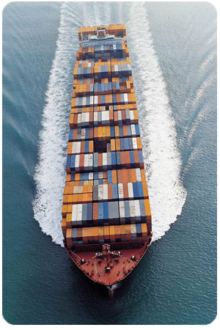
Maritime Freight
Barge
Ports
Barge movements on Potomac and Anacostia Rivers
Transport petroleum, construction aggregates, rock, sand
1 million tons of goods, worth $69M are moved by water annually (FHWA)
Port of Baltimore
Port of Virginia-Hampton Roads
Notes:
Barge companies
Vulcan
Norfolk Tug
64 Express

Slide 17
Freight and Environment
Land use and zoning decisions
  Influence where to expect freight traffic
At present, there are no medium and heavy truck fuel economy standards
  Congress has charged NHTSA to finalize a rule to implement a truck fuel efficiency program by September 2012

Slide 18
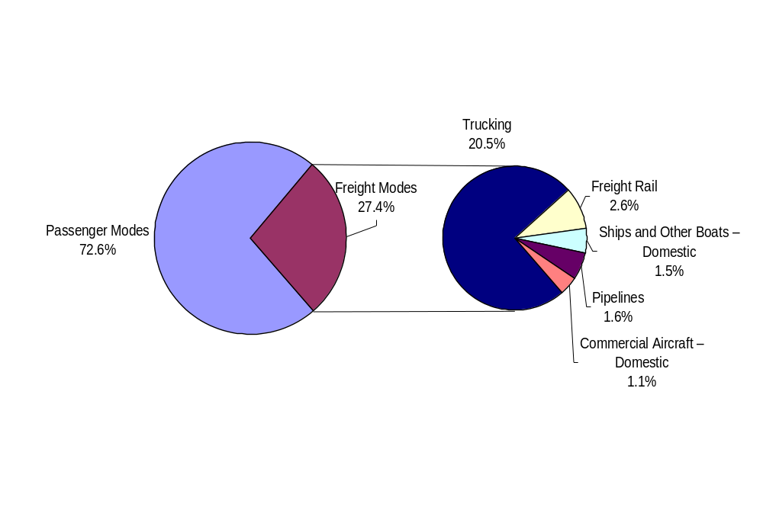
Transportation GHG
(Source: Federal Highway Administration, Office of Planning, Environment, and Realty, Robert Ritter, Freight and Climate Change, presented to FHWA Talking Freight, June 17, 2009)
Notes:
Trucks represent the mode with the greatest potential to impact GHG levels

Slide 19
Regional Benefits of Rail Projects
 | VMT Reductions in 2020 (million truck-miles) | CO₂ Reductions in 2020 (tons CO₂)
National Gateway | 12.3 | 16,687
Crescent Corridor | 15.8 | 23,762
Source: Freight Emissions Analysis, TPB Staff
Assumption: Full project completion in 2020
Notes:
Assumptions
-Full completion for both the National Gateway and Crescent Corridor is 2020.
-National Gateway project reduction information was presented cumulatively from 2012 to 2021, and staff assumed a linear increase in benefits to estimate annual benefits in 2020. The Crescent Corridor benefits were presented annually for full development. It was assumed that the Crescent Corridor project will be completed by 2020.
-The trucks which would be removed from the highway as a result of the projects would be primarily long-haul and thus would travel the entire length of highway in the region. For example, CSX estimates that 140,000 trucks would be removed from I-270 from 2012-2021. This analysis assumes that all of those trucks are traveling the entire length of I-270.
The CO2 emissions rate for heavy-duty diesel trucks is 1360.4 g/mi

Slide 20
Freight Database
Database represents compilation of projects beneficial to freight movement in our region
  Rail: 41 Projects
  Highway: 61 Projects
Projects drawn from existing documents
  Sources: CLRP, MDOT MRP, MAROPs, CSX, NS
Source for future Freight Subcommittee efforts to prioritize and present list of top projects (Report p74-85)
Notes:
-Some in CLRP, funded, scheduled to be built, Dulles Access Road widen 4 to 6 lanes
-Other under construction, ICC
-Others no funding, Virginia Avenue Tunnel

Slide 21
Recommendations to
Guide Freight Program
Continue and enhance;
Regularly update the TPB;
Special outreach;
Jurisdiction-level freight profiles;
Explore new data;
Freight Forum to raise awareness; and
Encourage freight and passenger rail coordination

Slide 22
Thank You
Karin Foster

