Slide 1
CLRP Aspirations Scenario
Preliminary Results
TPB SCENARIO STUDY
Michael Eichler
Department of Transportation Planning
Presentation to the TPB Technical Committee
January 8, 2009

Slide 2
The Two Scenarios
What Would it Take?
CLRP Aspirations
Starts with COG regional CO₂ goals and assesses what scales and combinations of interventions will be necessary to achieve the goal for the transportation sector.
Draws on past studies and public outreach to provide an ambitious yet attainable vision of land use and transportation for the 2010 CLRP update and to eventually serve as an unconstrained long range plan.
Notes:
Been several months since been briefed on the scenario study—so to refresh memory on the current tasks.

Slide 3
Aspirations Scenario: The Starting Point
Baseline
Round 7.2 Cooperative Forecast
2008 CLRP
RMAS Land Use/Transportation Scenarios
More Households Scenario
Households In Scenario
Jobs Out Scenario
Region Undivided Scenario
Transit-Oriented Development Scenario
Variably Priced Lanes Scenarios
Public Outreach/Feedback on Previous Scenarios

Slide 4
Developing the Aspirations Scenario
Goal: To move jobs and housing closer together to create highly accessible and developed areas, and achieve more efficient transportation systems
Land Use
Decisions
Pricing
Options
Supportive
Transit
Concentrating projected growth in activity centers and existing/planned transit stations
Consistent review and refinement by planning directors
Address congestion through pricing of new and/or existing lanes
Provide alternatives through enhanced transit
Use menu of transit options from past scenarios
Connect activity centers
Review by Regional Bus Subcommittee

Slide 5
Scenario Criteria
“Within Reach”
1. Land use shifts should be within reach for inclusion in the COG Cooperative Forecast
2. Transportation projects should be financially within reach through developer contributions and pricing.

Slide 6
Consultation with Local Jurisdictions
In order to make sure the scenario was aspirational while still being “within reach”, we:
1. Conducted 10 individual jurisdiction meetings with both land use and transportation planners in Alexandria, Arlington, DC, Fairfax, Frederick, Loudoun, Montgomery, Prince George’s, Prince William and VDOT
2. Collected specific comments and incorporated changes into the TAZ-level land use shifts and transit network.

Slide 7
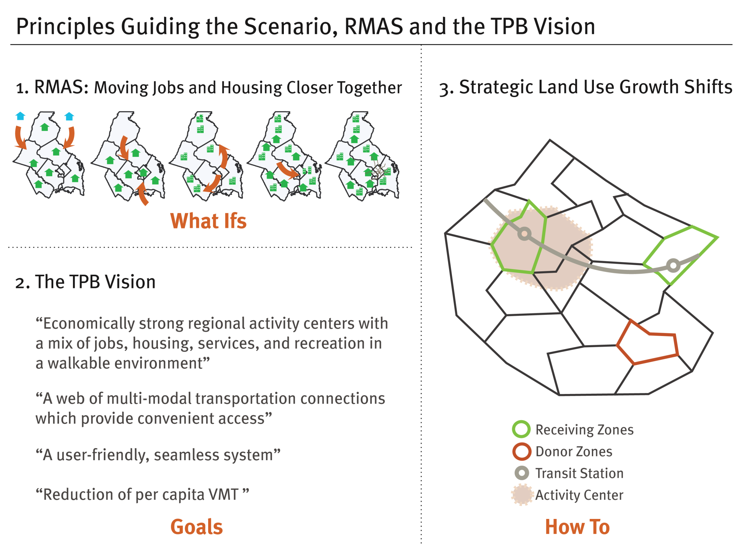

Slide 8
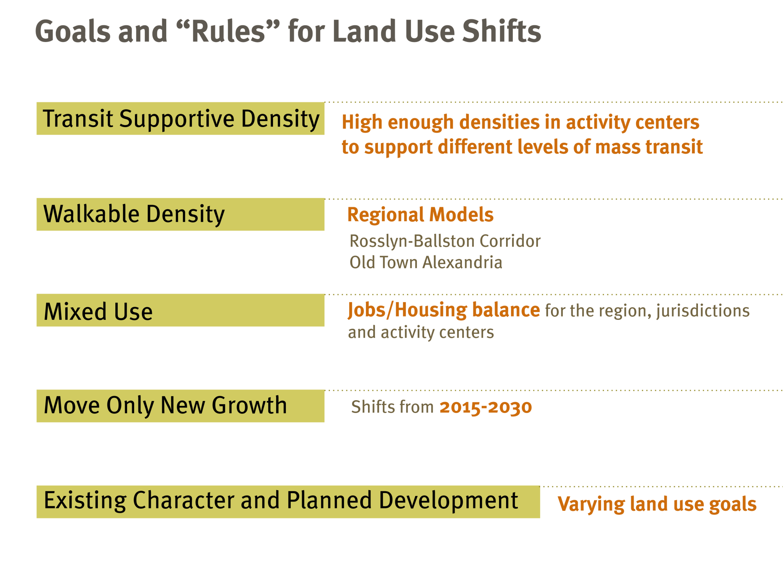

Slide 9
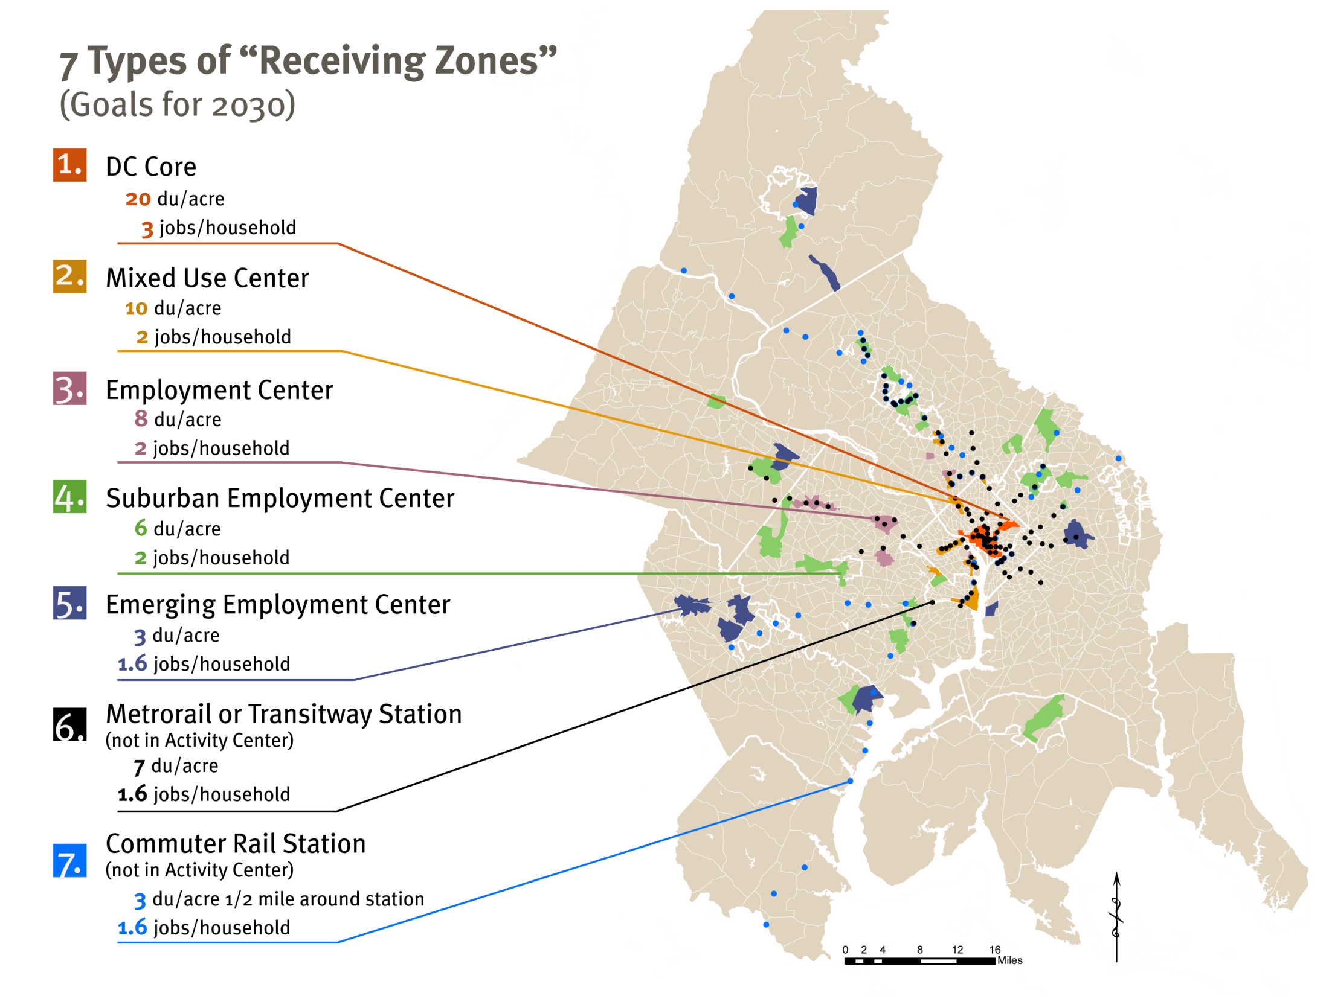

Slide 10
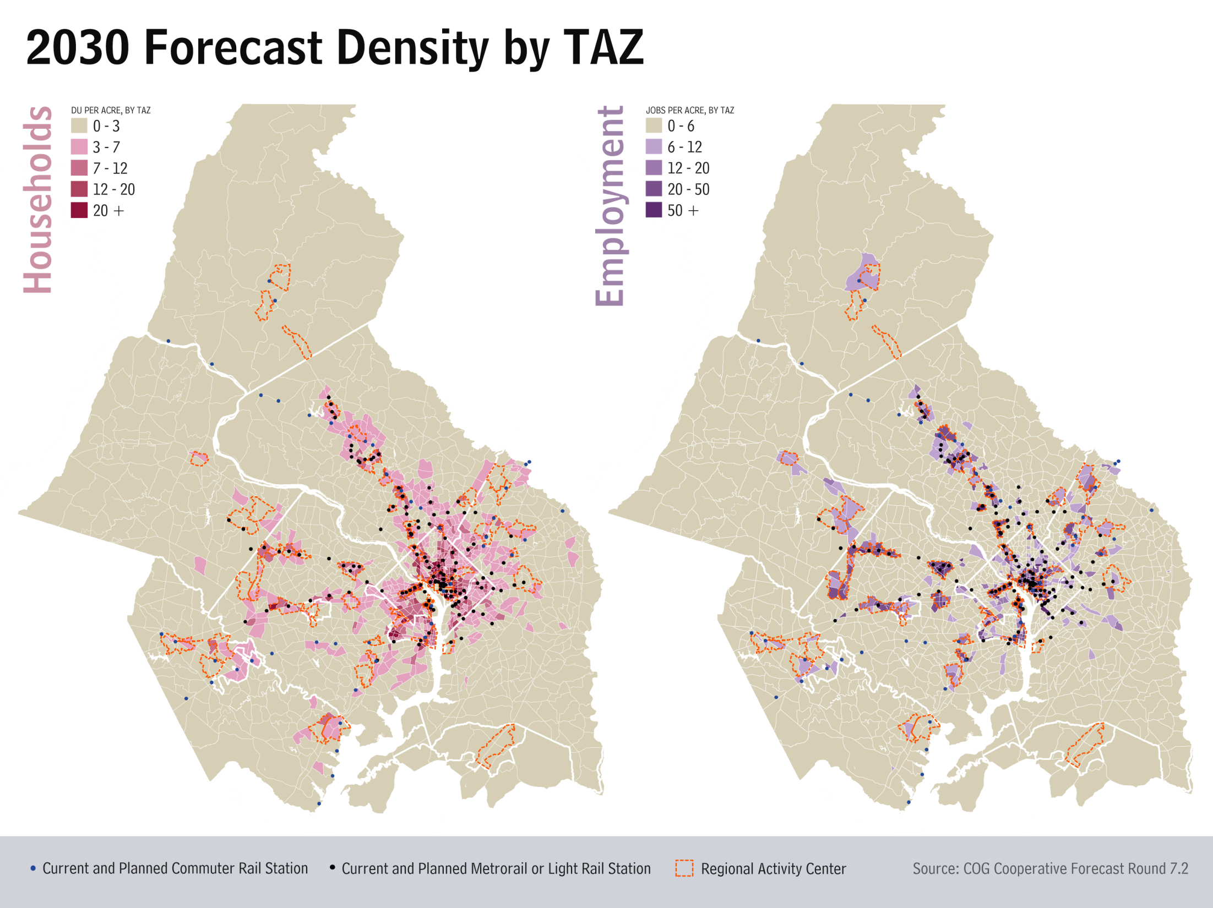

Land Use Component – By The Numbers
Households
  Scenario relocates 205,000 households to activity centers and transit station areas
    57% of those “at play” between 2015 and 2030
    8.2% of the region’s 2030 total
Jobs
  Scenario shifts 240,000 jobs to activity centers and transit station areas
    35% of those “at play” between 2015 and 2030
    5.6% of the region’s 2030 total

Slide 11
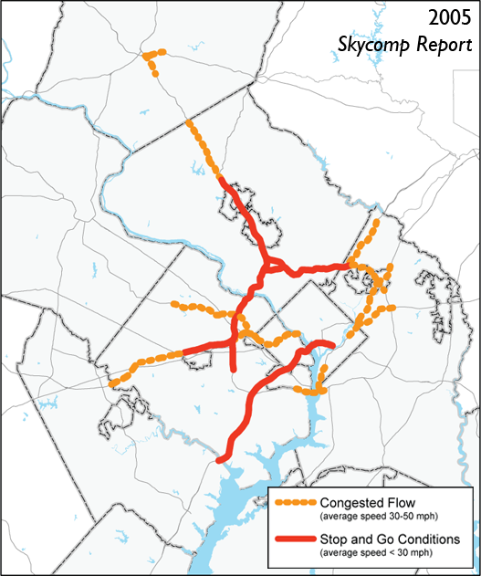
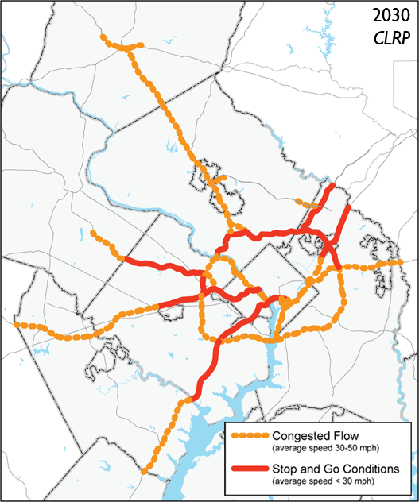
Transportation Component: Existing Conditions
Freeway system is currently congested and the extent of the congestion will increase by 2030.

Slide 12
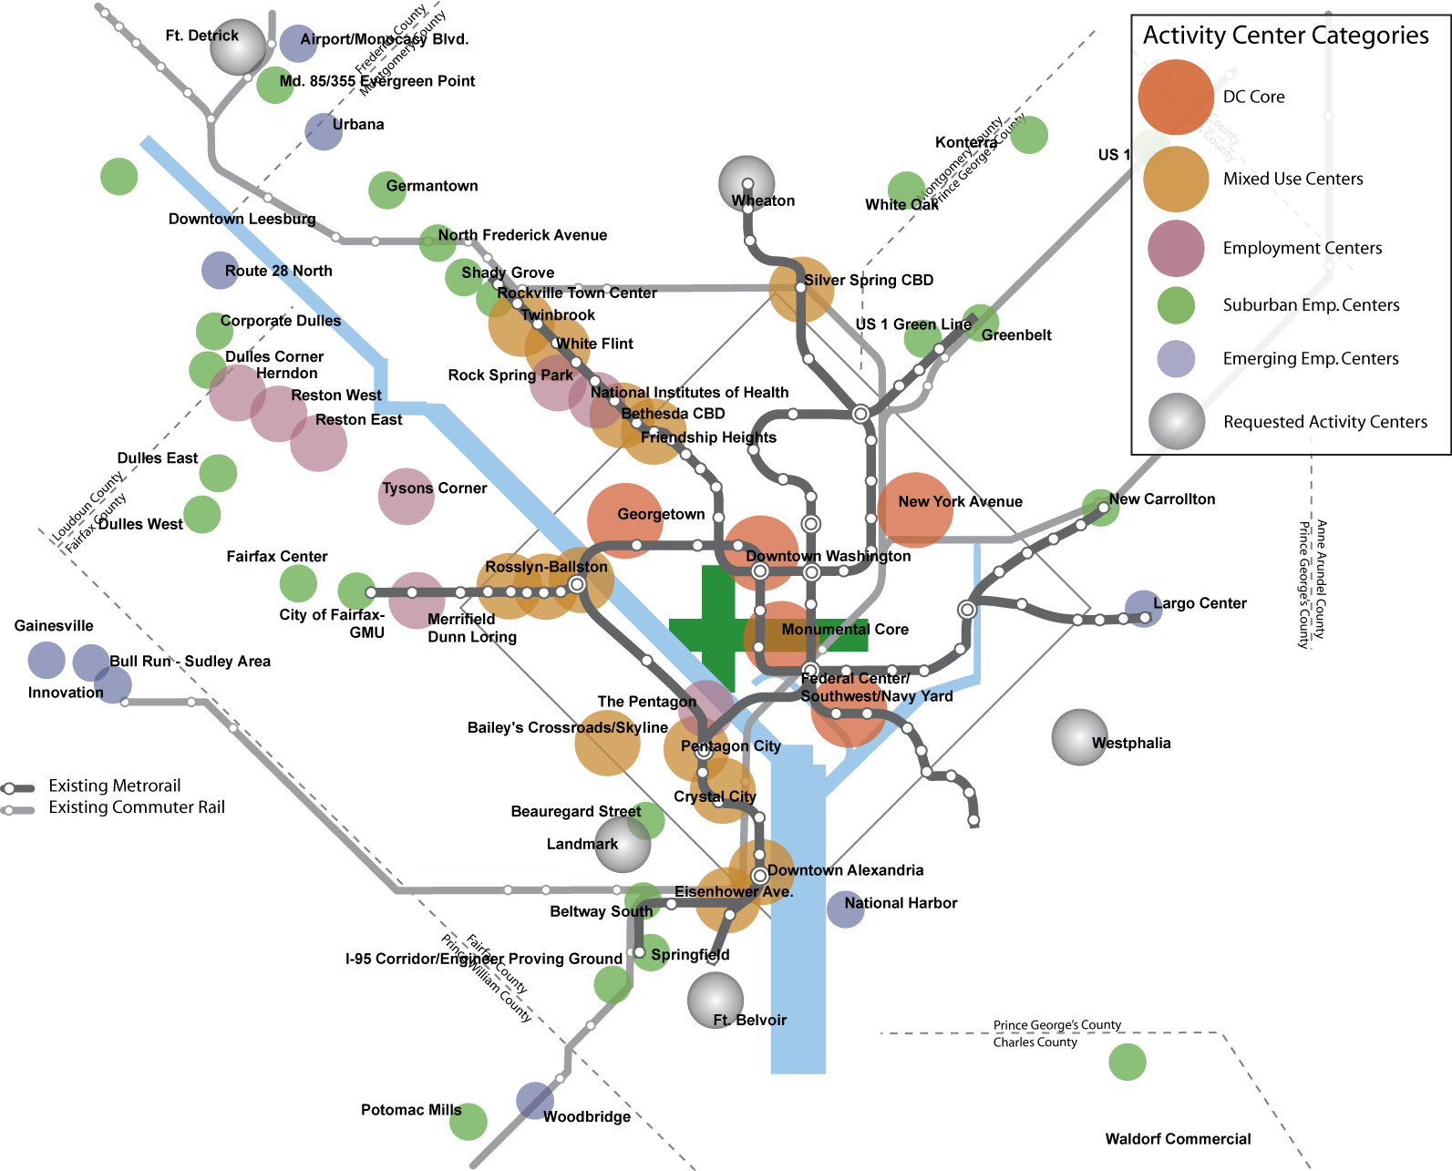
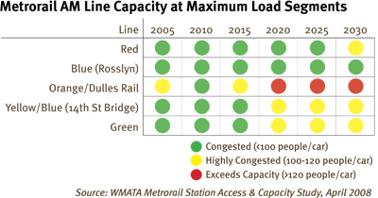
Transportation Component: Existing Conditions
Existing system of activity centers and high quality transit shows mis-match. Many transit stations without activity and many activity centers without high-quality transit.

Slide 13
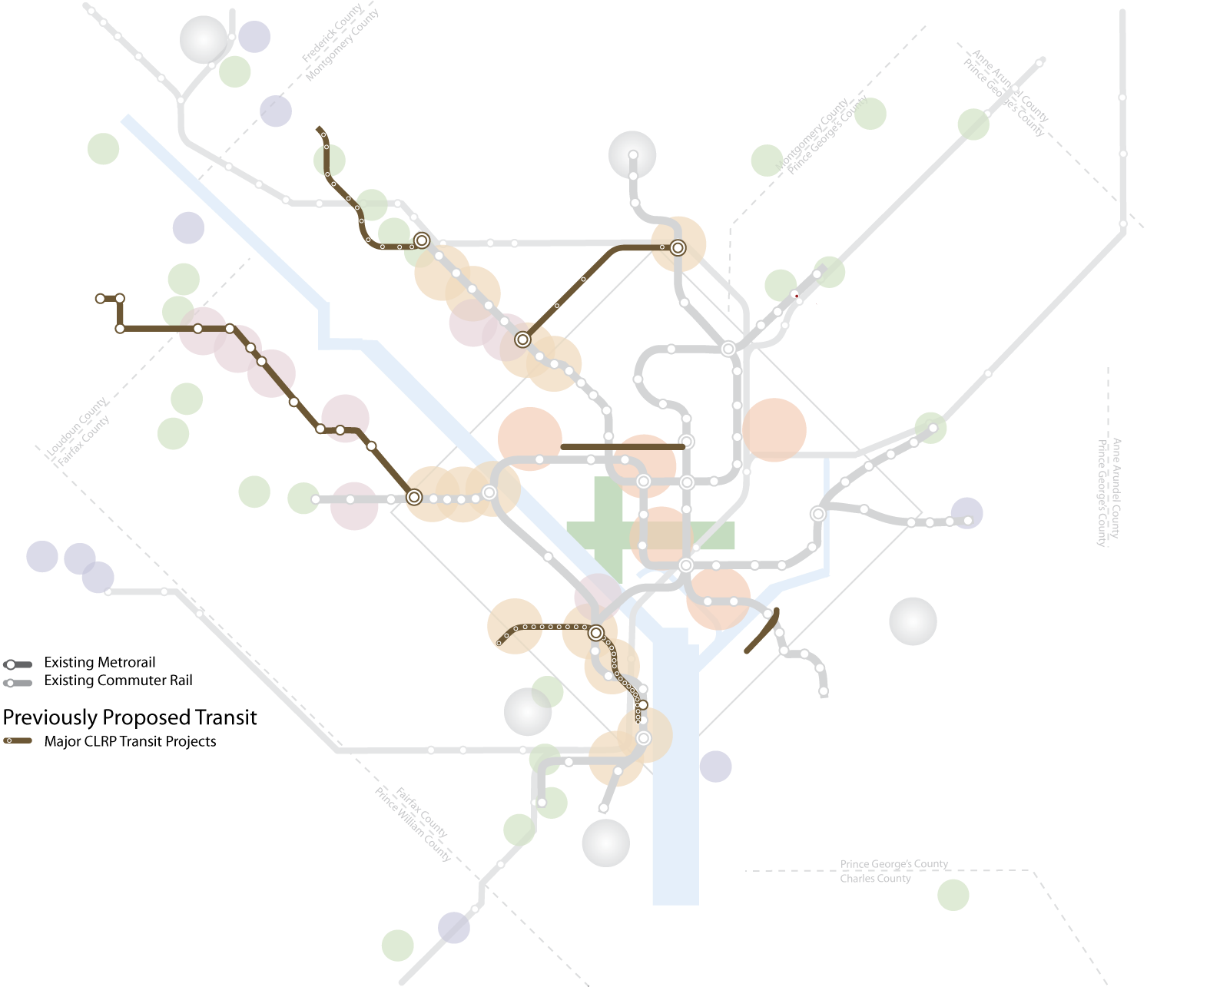
CLRP Projects Included in the Baseline
The transit projects in the CLRP work to address some of these concerns.
Corridor Cities Transitway
Purple Line
K Street Transitway
Dulles Metrorail
Columbia Pike Streetcar
Anacostia Streetcar
Crystal City/Potomac Yard Transitway

Slide 14
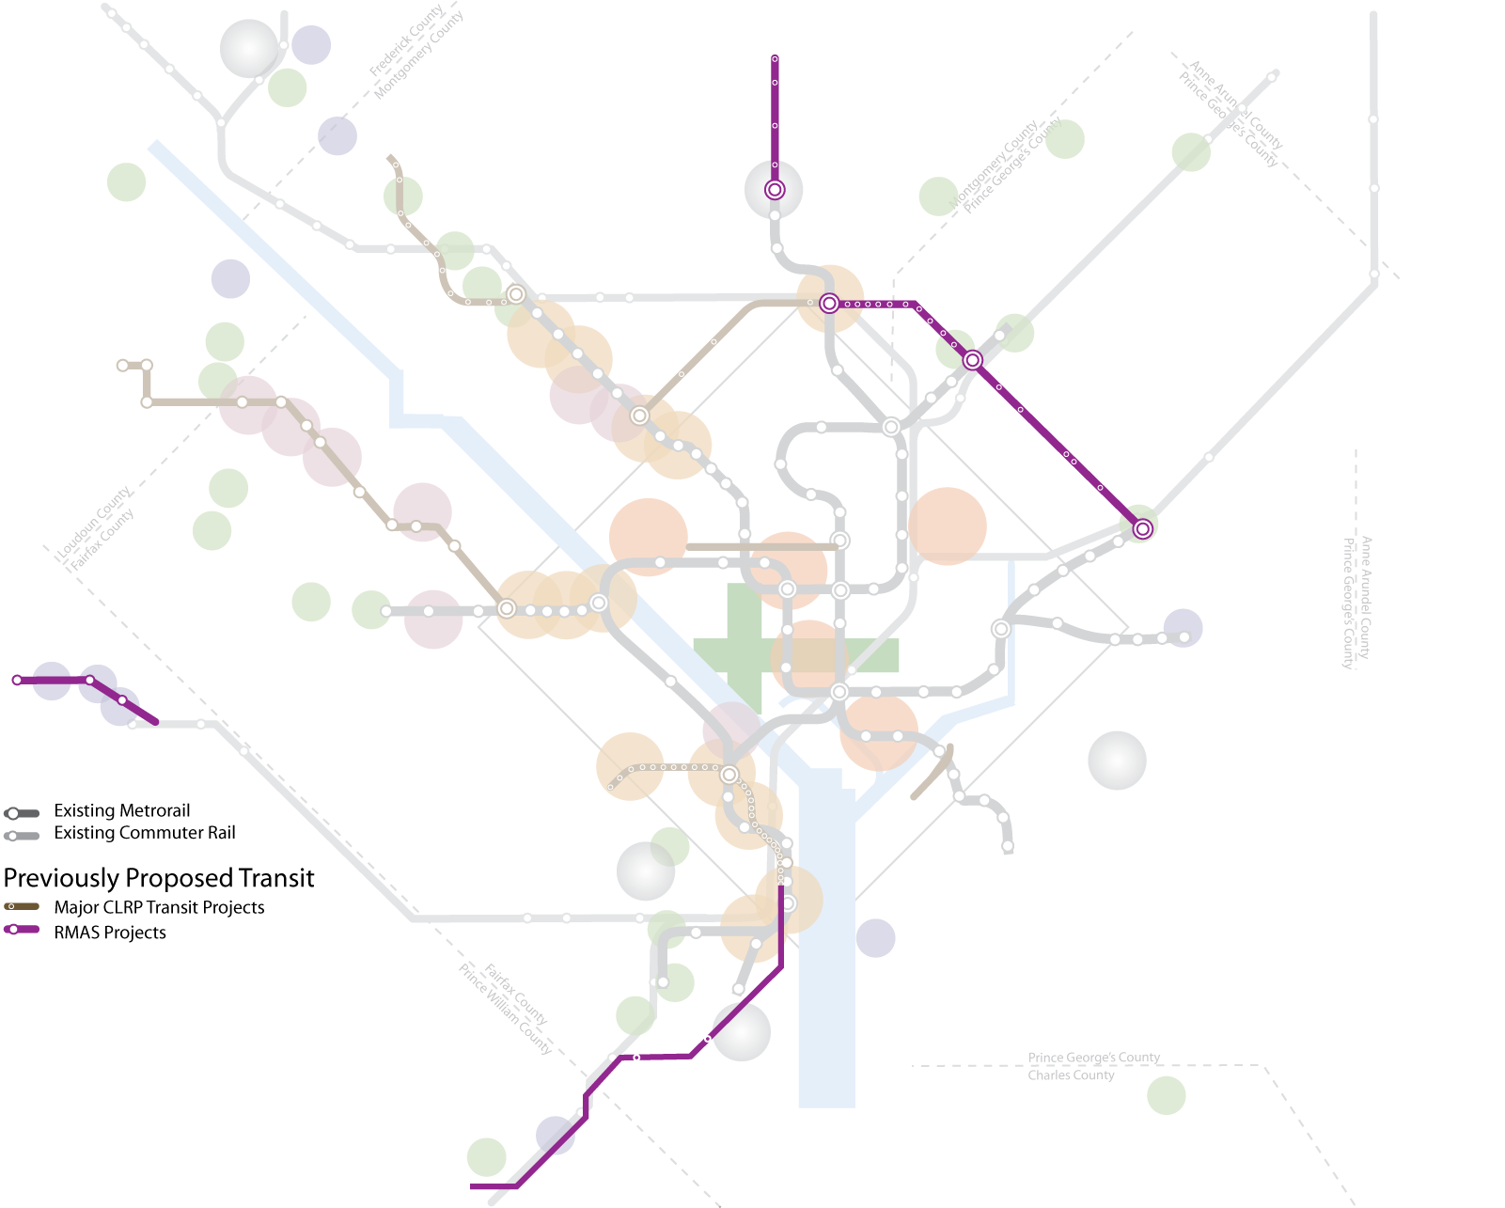
RMAS Projects Included in the Scenario
Additional projects evaluated under RMAS should be carried forward, with minor modification to provide transit service to additional activity centers.
Georgia Ave Transitway
Extend Purple Line to New Carrollton
VRE Extension to Haymarket
US 1 Transitway

Slide 15
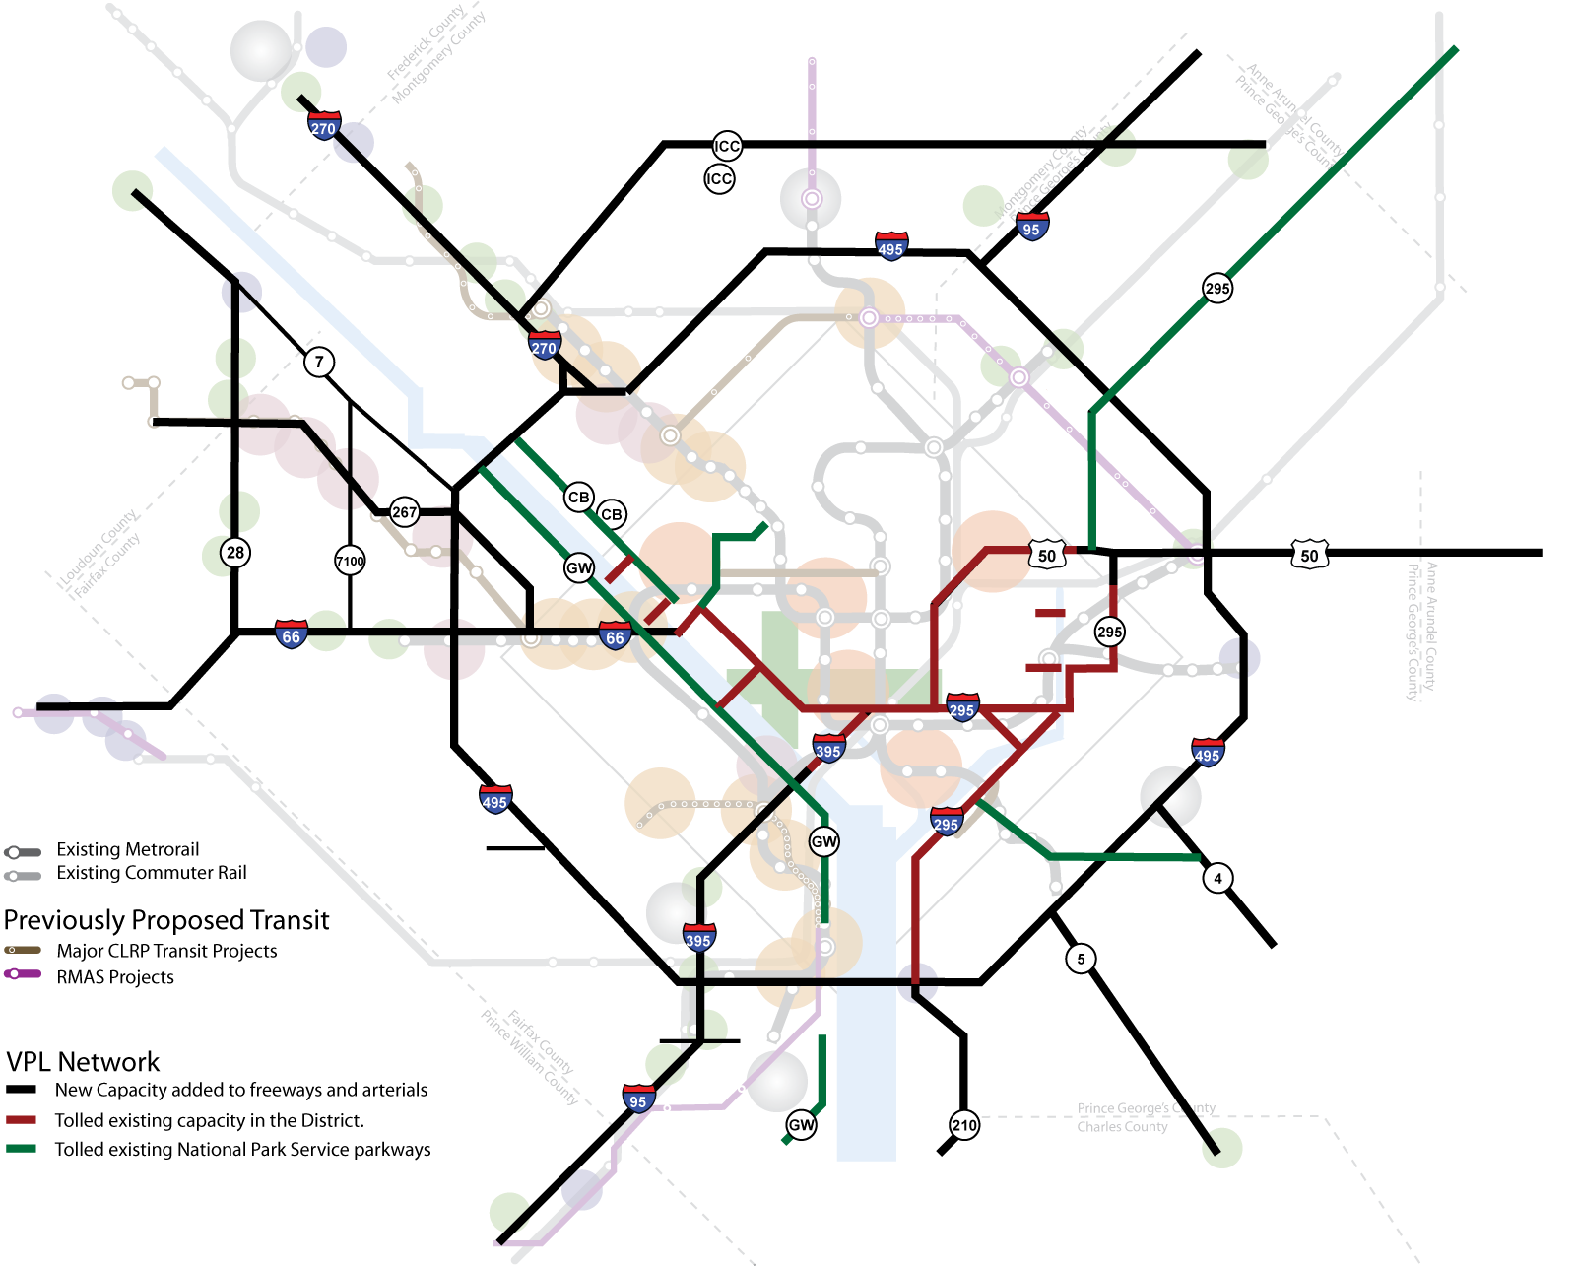
Network of Variably Priced Lanes
A value pricing study completed by the TPB in February of 2008 evaluated a regional network of variably priced lanes, made up of new capacity and selected existing facilities.

Slide 16
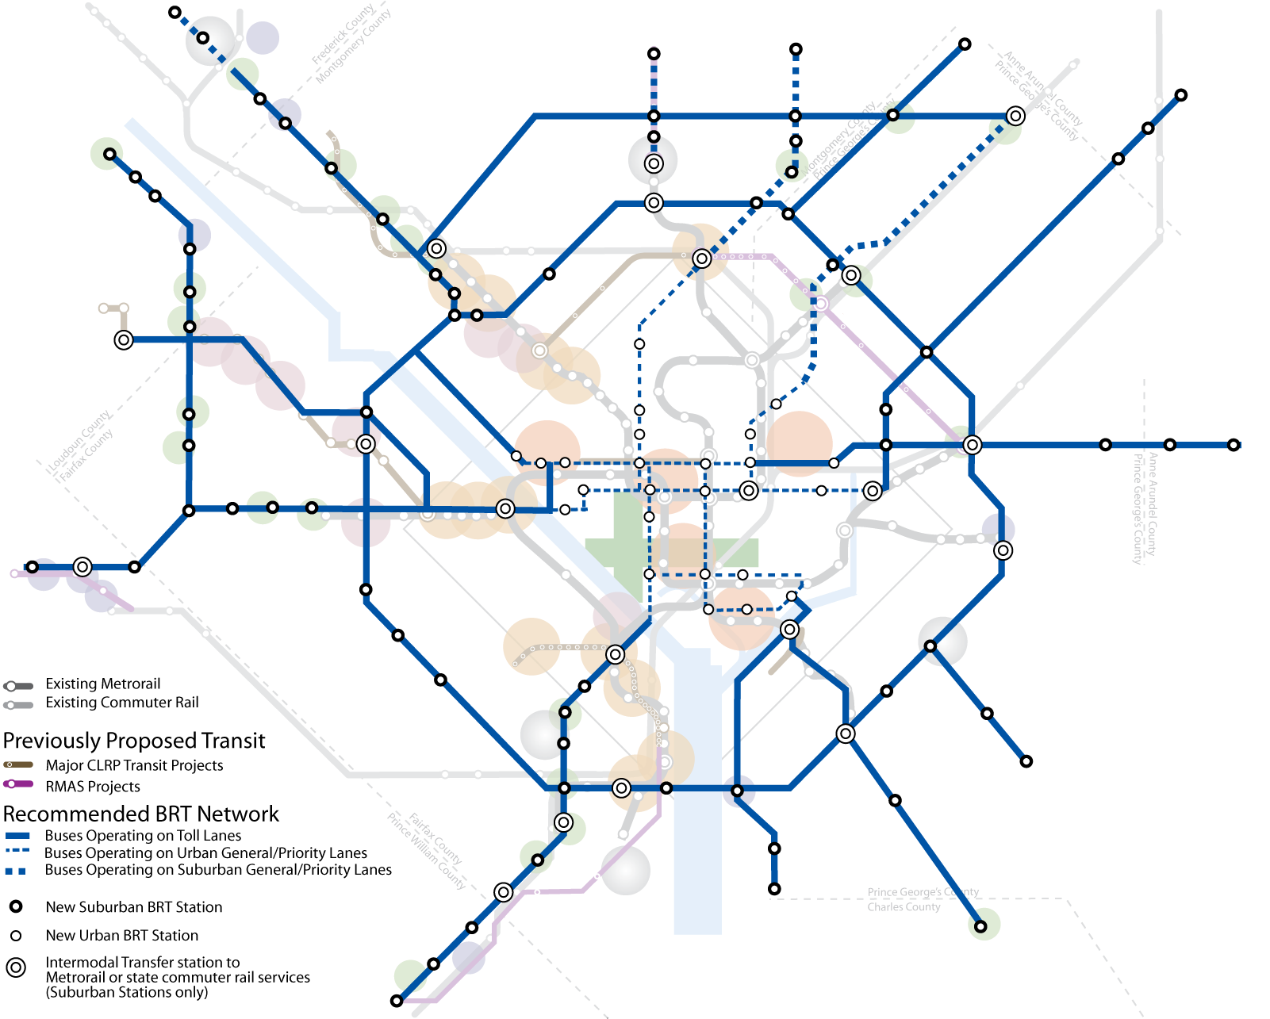
BRT Network for Scenario Study
A regional network of BRT operating mostly on the priced lanes will provide high-quality transit service to nearly all activity centers in the region.

Slide 17
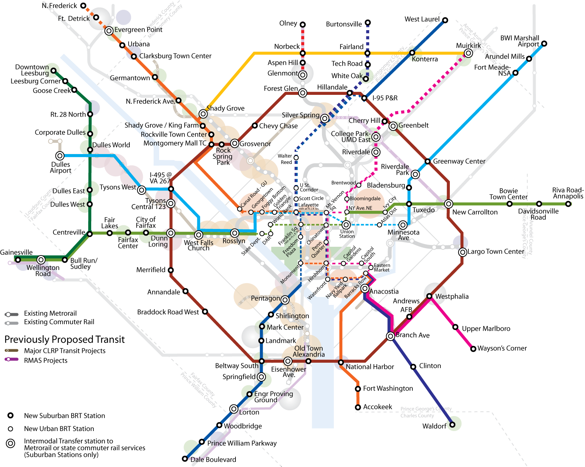
BRT Network Routes to and through the Core
This network will provide another layer of high-quality transit on top of existing and proposed transit services.

Slide 18
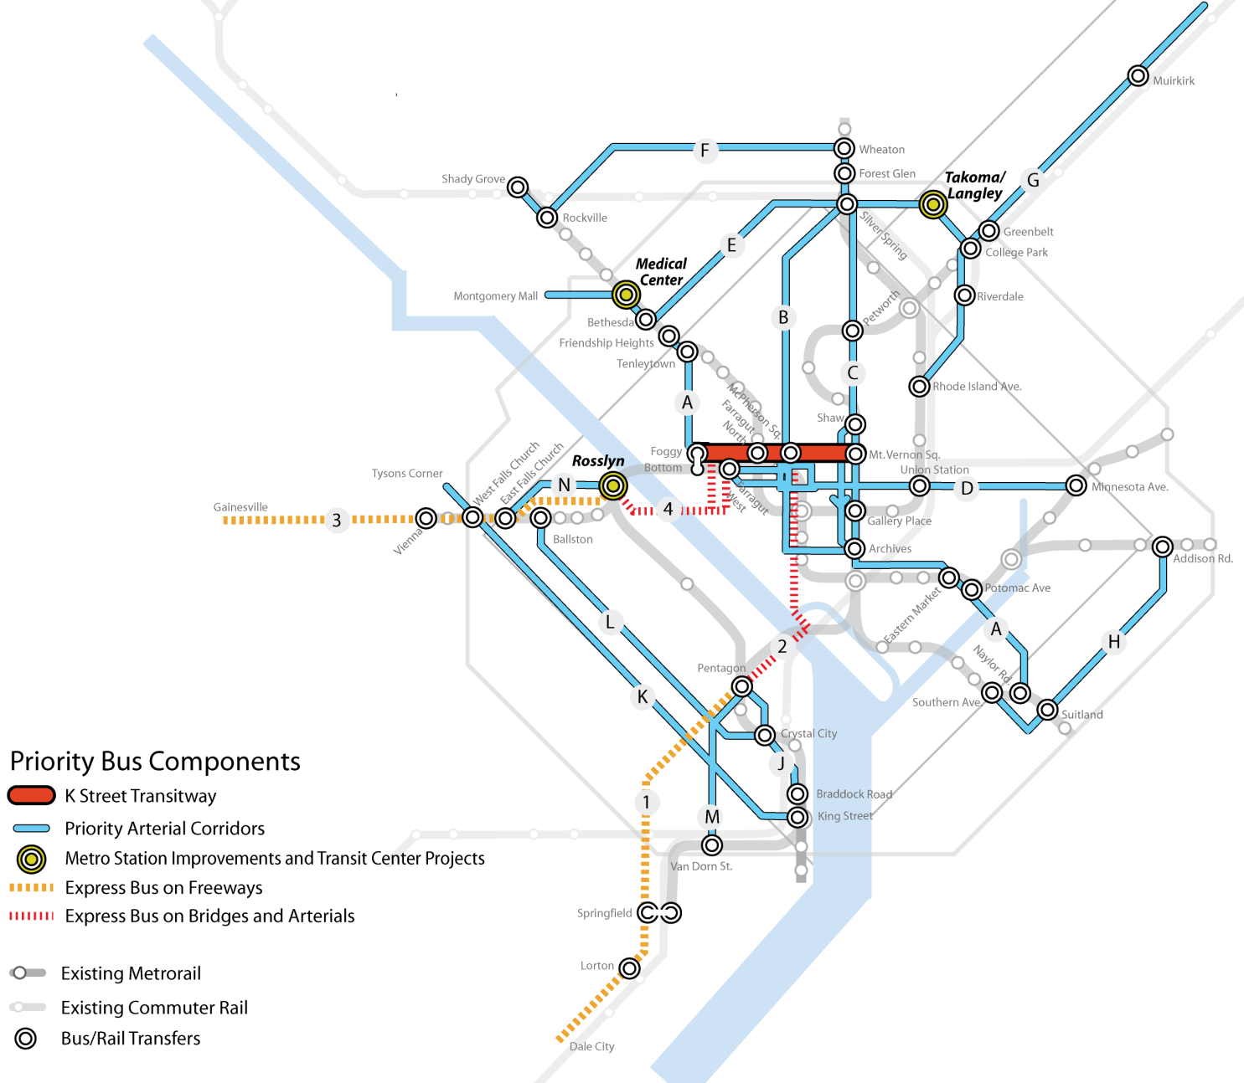
TIGER Grant Application First Step to Regional Network
TPB TIGER Grant application, submitted Sept 15, 2009, to act as first step towards this regional network.

Slide 19
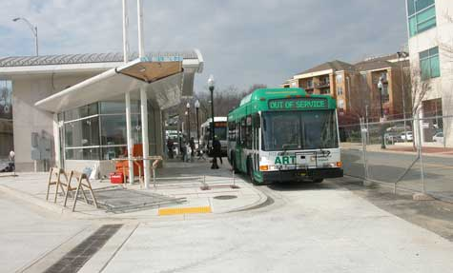
BRT to Provide Rail-Like Level of Service
Transit Speeds
  45 MPH on toll lanes
  15 MPH on priority corridors
Headways
  10 minutes, peak
  30 minutes, offpeak
Fare Structure
  Same as current services
Will complement existing services
  No replacement of current commuter bus services with BRT routes.
BRT complemented by 15 activity center circulator systems with 10-minute headways
  Added to activity centers without high quality local bus transit.
The Shirlington Transit Station in Arlington, VA.

Slide 20
Transportation Component – By The Numbers
Highways
  Scenario creates a 1,600-mile regional priced lane network
    150 priced lane miles in the CLRP
    350 lane miles converted from HOV lanes
    650 new lane miles
    500 lane miles converted from GPLs (DC, Parkways)
  Priced lanes target speed: 35 to 45 MPH.
Transit
  Scenario creates regional BRT system of nearly 500 miles
    138 BRT stations located in the core, activity centers and existing parking facilities
    Plus an additional 140 miles of circulator service

Slide 21
Preliminary Results: Driving Increases
Toll network adds to regional freeway capacity, increasing auto-mobility.
2008 CLRP for 2030 vs Aspirations Scenario for 2030

Slide 22
Preliminary Results: Congestion Decreases
Average speeds increases, reducing total travel times and delay.
2008 CLRP for 2030 vs Aspirations Scenario for 2030

Slide 23
Preliminary Results: Transit, Bike-Walk Increase
Moving jobs and households closer together increases bike and walk trips.
New regional BRT system makes transit a more viable option.

Slide 24
!!!
Notable Results
2.2% increase in Households, yet only a 1% increase in motorized trips.
  Concentrating households in activity centers provides more bike and walk options.
HOV use virtually unchanged.
  Could be result of large increase in transit service.
Total VMT increase of 2.5%, but VMT per Capita only increased 0.3%.
  VMT increase due mostly to increase in households.

Slide 25
Preliminary Costs and Revenue Estimates
$
$
Annual Revenues*
  Toll Lane Network: $3 billion
    In line with results from 2006 pricing study
  Transit Network: $100 million
    Rough estimate, assumes $2.50 average fare
Capital Costs
  Toll Network: $50 billion
    From 2006 pricing study
    Can be reduced by $10 billion if interchanges not serving activity centers are replaced by slip ramps.
  Transit Network: $2 billion
Operating Costs
  Toll Network: Incorporated in capital costs
  Transit Network: $250 million
A sketch analysis suggests annual revenues approximately equal annualized costs, as with previous pricing study.
*Does not include potential tax-increment financing (value capture) revenues.
Costs in 2010 $

Slide 26
Topics for Further Investigation
?
?
How does toll lane speed impact network?
  Increase target speed for toll lanes.
  Should increase tolls, increase congestion, reduce regional VMT. Impact on total revenue unknown.
What would be the effect of reducing the number of new lane miles?
  For example, convert toll network from “add-two” to “add-one-take-one” or price more existing lanes.
  Will reduce construction costs while increasing toll rates, revenues and congestion, and reducing VMT.
What is the effect of changing transit service levels?
  Explore viability of transit use for both peak and off-peak travel (all trip purposes) by reducing headways.

Slide 27
Next Steps
Briefing on status and preliminary analysis results to Scenario Study Task Force and TPB on January 20, including demand, cost, air quality.
2. Further analysis, refinements, sensitivity testing and benefit-cost analysis, with regular briefings, February to May.
3. Final report, June.

