Slide 1

Georgetown University Move Out Drive
2009
Bill Del Vecchio, Waste and Recycling Manger
Jess Belue Buckley, Hall Director

Slide 2
WHY A MOVE OUT DRIVE?

Slide 3



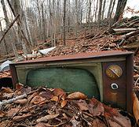
environment
Notes:
We have 300-350 tons of trash every month.

Slide 4
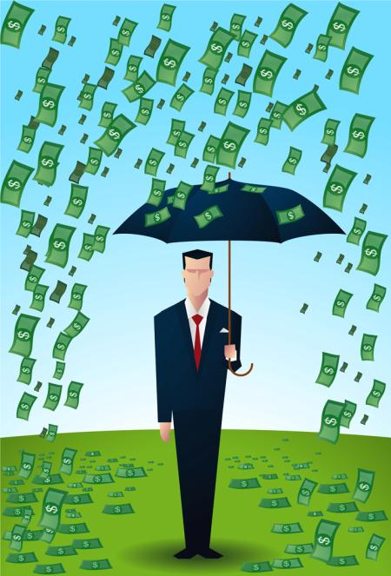
economy

Slide 5
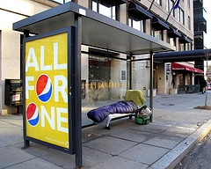
community
Notes:
That’s money we’re literally throwing away

Slide 6
The process
Gather planning team
Determine collection sites
Assess local needs
Coordinate volunteer process
Organize pick up and transportation
Advertise
Carry out
Evaluate

Slide 7
Planning team
Team needs to have people with …
Interests in economy, environment, and social justice components of project. Triple bottom line of sustainability.
Access to areas for collection and pick-up.
Connection with potential volunteer groups.
Connection with needs of community.
Ability to design publicity campaign.
Time to research and plan.

Slide 8
Collection sites
Points to consider for sites
Ease of access for residents
Ability to lock or coordinate certain hours of collection
Ability to staff the location
Accessibility of location both for people and for carts/trucks

Slide 9
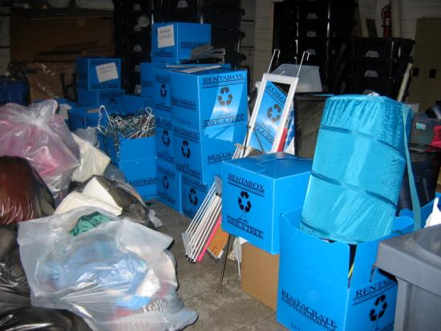
Assess Local Needs
What can people donate that is actually needed?
Start with larger organizations -- United Way, Capital Area Food Bank, and Good Will
Others will follow, such as KEYS Foundation for the Homeless, Home Stretch, The Alternative House, Martha’s Table

Slide 10
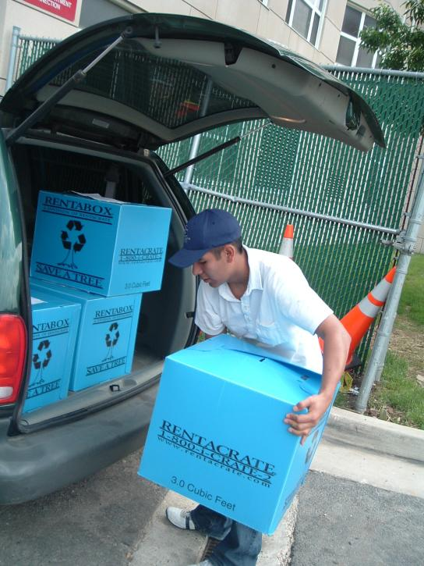
Coordination of Volunteers
Find those with hours to give – school conduct offices, Scouts, churches, high schools
Designate one volunteer coordinator
Arrange in manageable periods of time
Explain what is needed ahead of time
Make training easy –maps, instructions, tools should be ready
Have staff ready to finish what does not get done

Slide 11
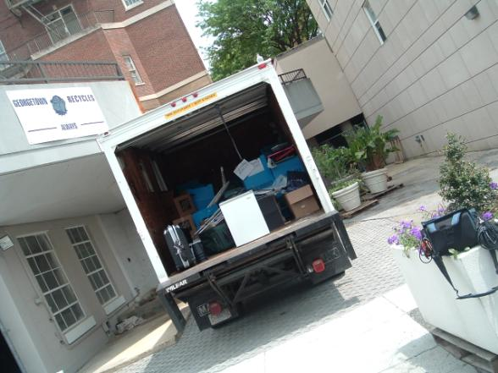
Organize pick-up and transport
When, where, who, and how?
Consider rental trucks
Can’t take something yourself? Ensure the organizations can pick up.

Slide 12
Advertise
Key to collecting what you want in the condition you want it
Use e-mail, facebook, local businesses, connections from the planning team
Advertise to the people, at the location of pick up, and when the location is complete

Slide 13
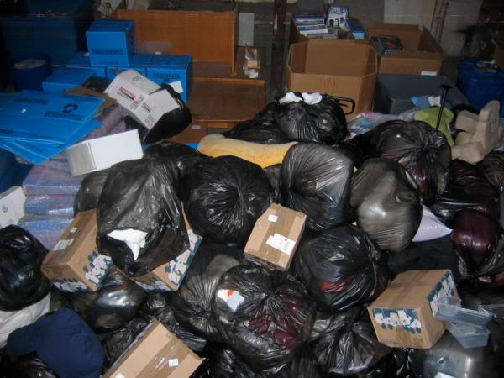
Carry out
Length of drive determined by needs of community
Need coordinators to direct volunteers as necessary

Slide 14
Evaluate
Talk with planning team and partners
Did we reduce trash?
Could others use what was collected?
Did we meet our other goals?

Slide 15
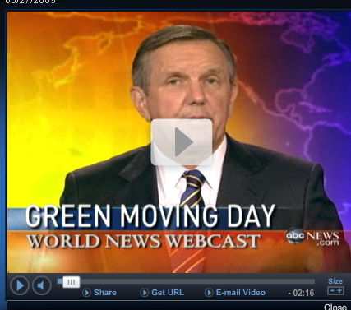
Move out in the news
http://abcnews.go.com/video/playerIndex?id=7689931

Slide 16
Contact
Bill Del Vecchio,
wad6@georgetown.edu
Jess Belue Buckley,
jb577@georgetown.edu

