Slide 1
The Chesapeake Bay Program Partnership’s Watershed Model
Gary Shenk
Presentation to COG
10/4/2012

Slide 2
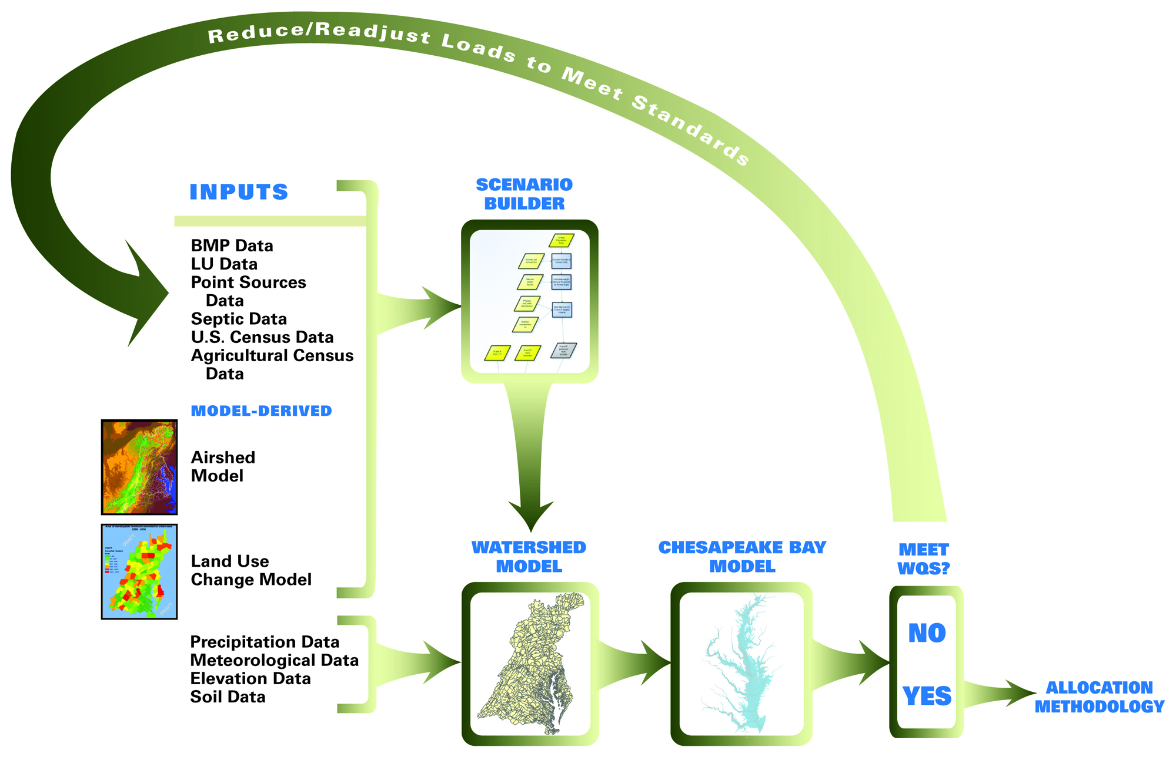
Chesapeake Bay Partnership Models

Slide 3





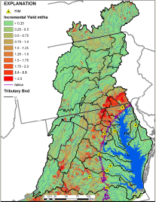
CBP Modeling Tools
NEIEN
CAST
Interaction
Tools
Decision
Models/
Databases
Bay WQSTM
Related
Tools
sparrow

Slide 4
How the Watershed Model Works
Calibration Mode
Annual, monthly, or
daily values of
anthropogenic factors:
Land Use Acreage
BMPs
Fertilizer
Manure
Tillage
Crop types
Atmospheric deposition
Waste water treatment
Septic loads
Hourly or daily
values of
Meteorological
factors:
Precipitation
Temperature
Evapotranspiration
Wind
Solar Radiation
Dew point
Cloud Cover
Daily flow, nitrogen,
phosphorus, and
sediment compared
to observations
over 21 years
HSPF

Slide 5
Each segment consists of 30 separately-modeled land uses:
How the Watershed Model Works
Regulated Pervious Urban
Regulated Impervious Urban
Unregulated Pervious Urban
Unregulated Impervious Urban
Construction
Extractive
Combined Sewer System
Wooded / Open
Disturbed Forest
Corn/Soy/Wheat rotation (high till)
Corn/Soy/Wheat rotation (low till)
Other Row Crops
Alfalfa
Nursery
Pasture
Degraded Riparian Pasture
Afo / Cafo
Fertilized Hay
Unfertilized Hay
  Nutrient management versions of the above
Plus: Point Source and
Septic Loads, and
Atmospheric
Deposition Loads
Each calibrated to nutrient and
Sediment targets
5

Slide 6

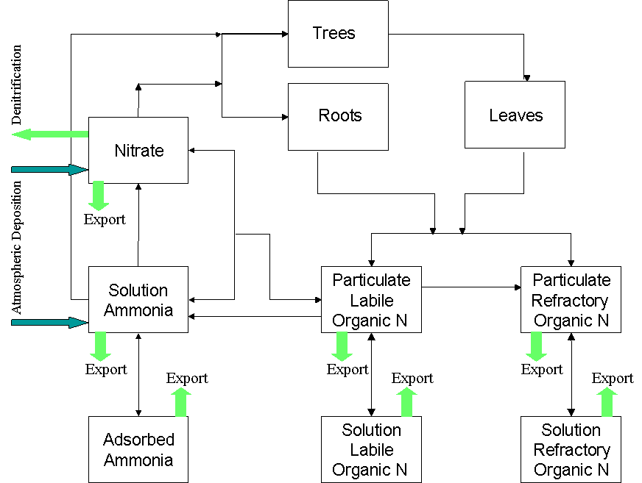
How the Watershed Model Works
Fertilizer
Manure
Atmospheric deposition
Precipitation
}
Management filter
Runoff
Hydrology
submodel
Sediment
submodel
Phosphorus
submodel
River
hourly
Nitrogen
submodel
Buffers
wetlands

Slide 7
Two Separate Segmentation Schemes
A land use within a land segment has the same inputs
  atmospheric deposition
  fertilizer
  manure
  precipitation
Land segmentation driven by availability of land use data
Land segments determined by
  County lines
  Rainfall Variances
  Federal / Non-Federal

Slide 8
Phase 5 river segmentation
A river segment gathers inputs from the watershed and has one simulated river
Consistent criteria over entire model domain
  Greater than 100 cfs
    or
  Has a flow gage

Slide 9
How do we calibrate?
Reasonable values of sediment, nitrogen, and phosphorus
River Reach
Observations of flow, sediment, nitrogen, and phosphorus
Notes:
The Chesapeake Bay Program’s application of HSPF simulates water, nutrients and solids with a 1-hour time step.
The illustration above gives an overview of the solids processes in HSPF.
Each hour that it rains, based on real weather data, rainfall energy causes sediment to be detached from the soil matrix. This detached sediment is then available for washoff into the river.
The river simulation then transports, settles, and scours sediment on an hourly basis.

Slide 10
Average Targets
Land Use TN TP
Forest 2.0 0.15
Harvested Forest 20.0 0.80
Crop 23.0 2-2.5
Hay 6.0 0.4-0.8
Pasture 4.5 0.7
Urban 9.3 1.5
Extractive 12.5 3.5
Nursery 240 85
Vary spatially according to input/output

Slide 11
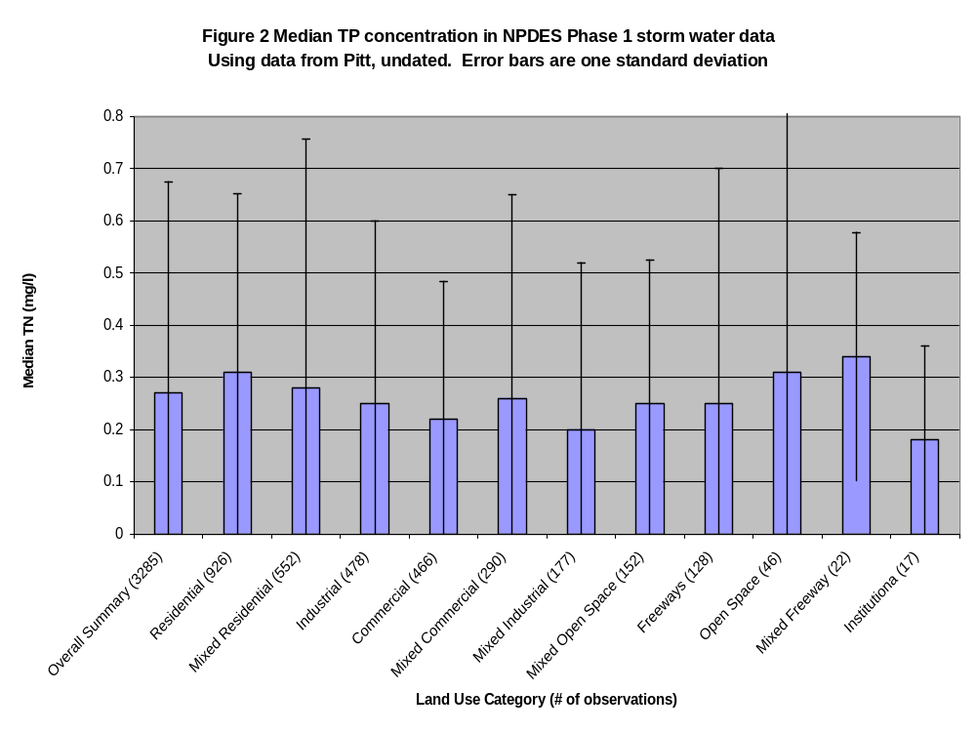
TP

Slide 12
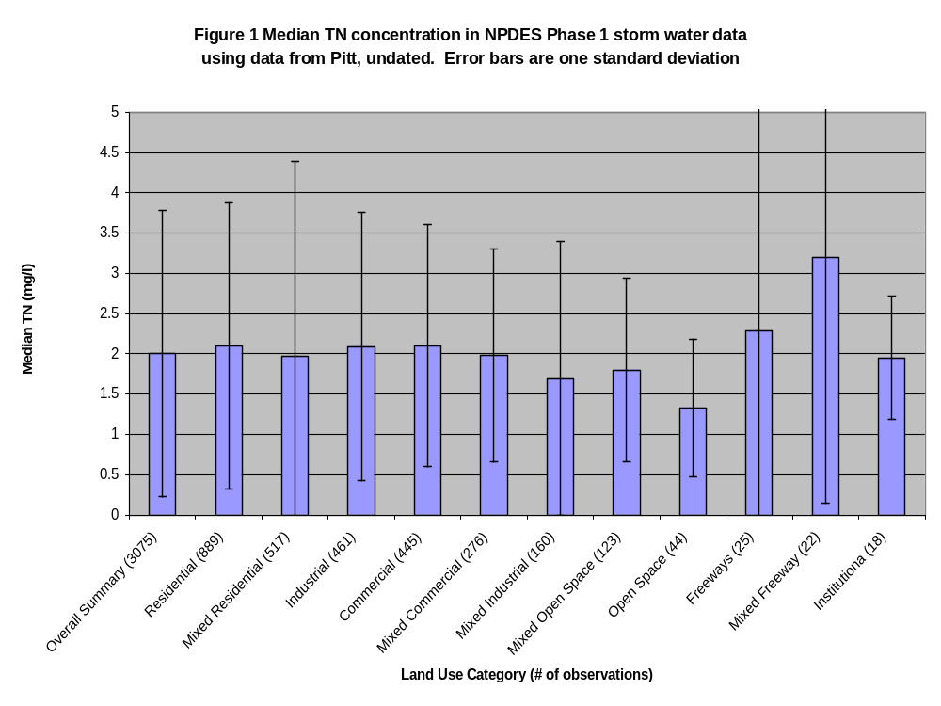

Slide 13
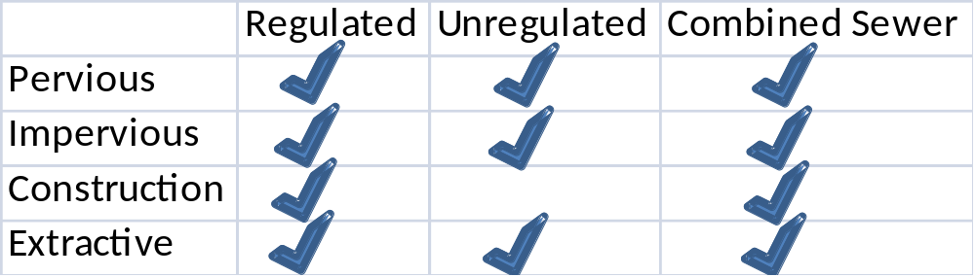
Developed Land Uses
Regulated vs Unregulated normally corresponds to MS4 and non-MS4. Loading rates are identical so these categories are a convenience for the state partners.
Combined Sewer land uses have zero loads. The loads from WWTPs and CSOs in combined sewer areas are in the model, so including these would be double counting
Also broken out as Federal / Non-Federal
Determined directly from the CBP Land Data Team analysis at roughly 10 year increments
13

Slide 14
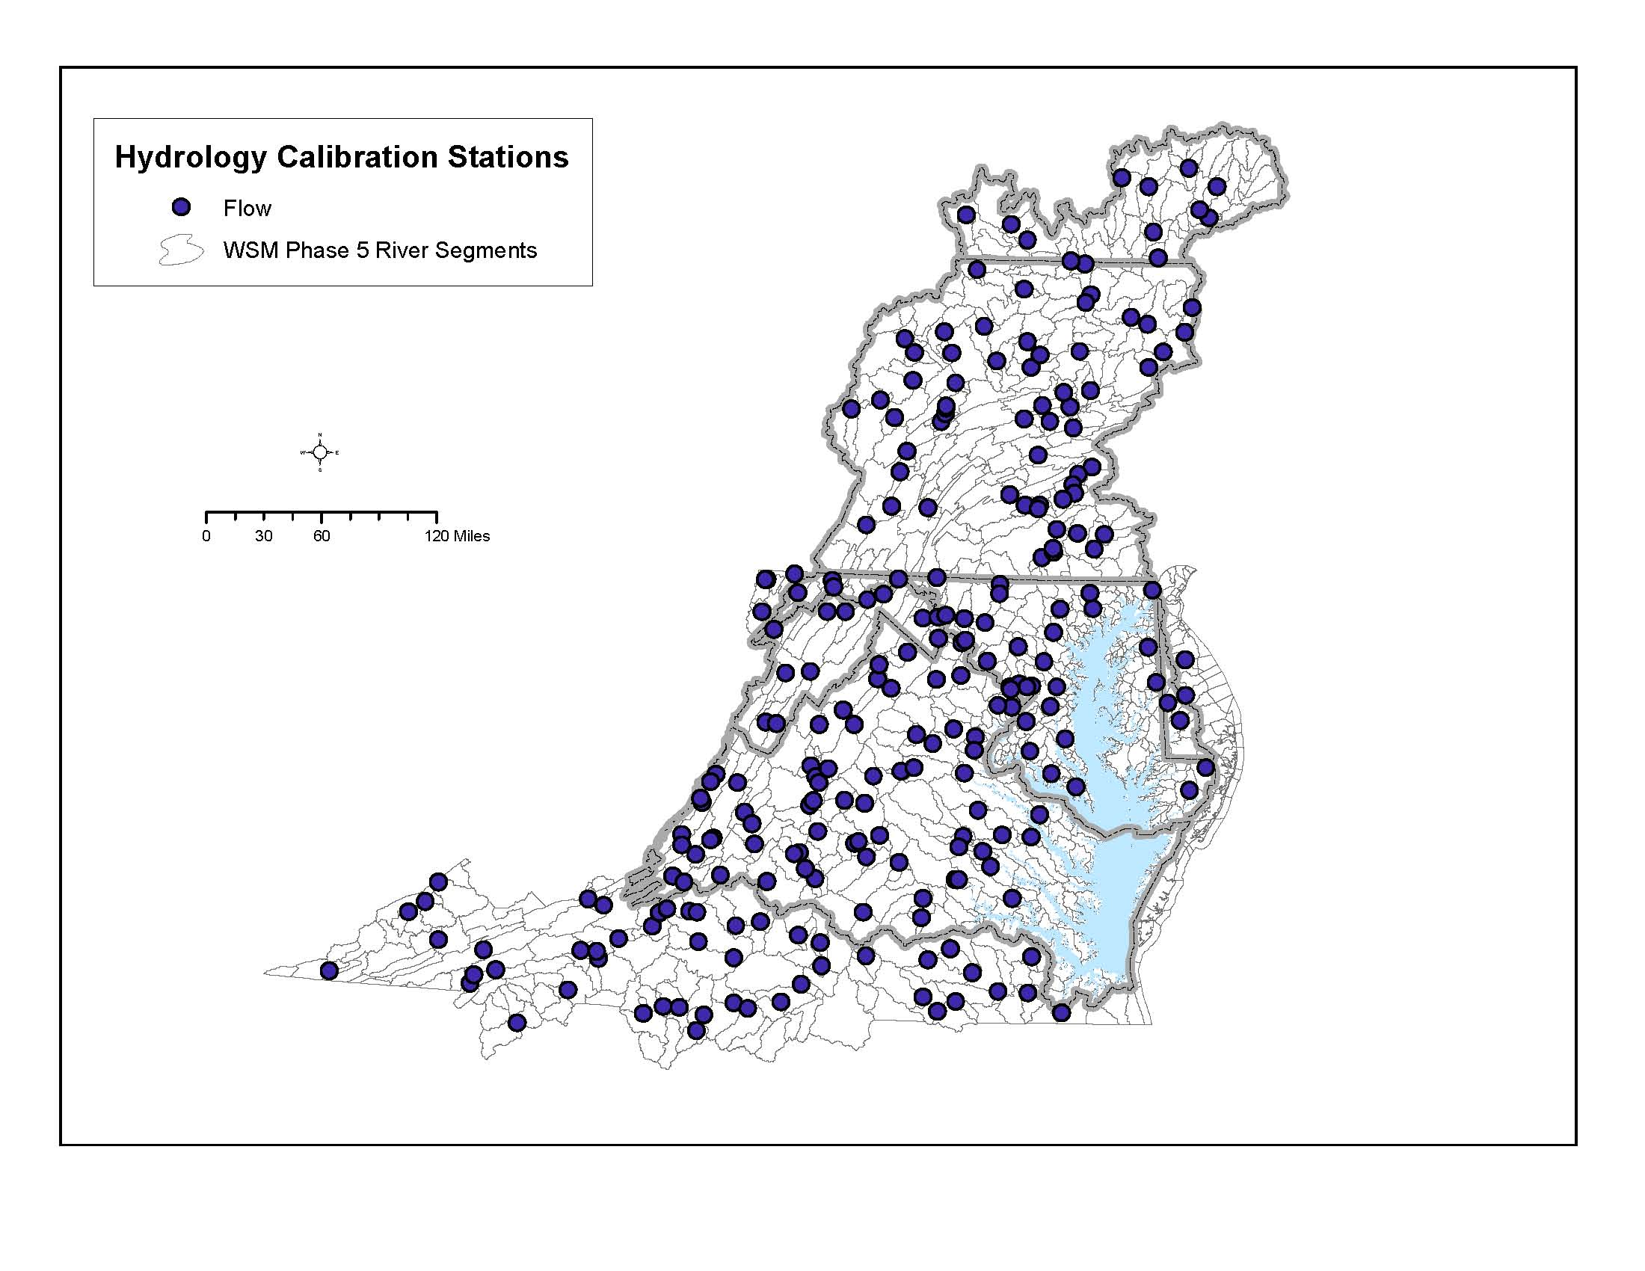

Slide 15
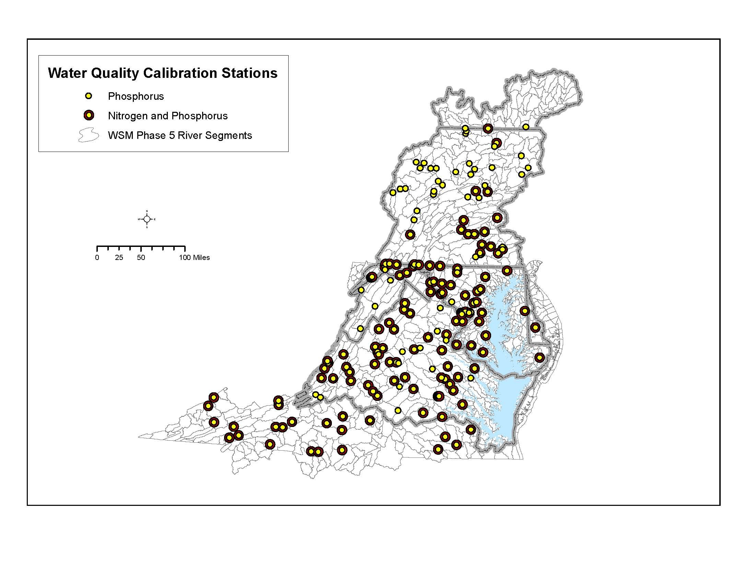
15

Slide 16
How the Watershed Model Works
Scenario Mode
Constant values of
anthropogenic factors:
Land Use Acreage
BMPs
Fertilizer
Manure
Tillage
Crop types
Atmospheric deposition
Waste water treatment
Septic loads
Hourly or daily
values of
Meteorological
factors:
Precipitation
Temperature
Evapotranspiration
Wind
Solar Radiation
Dew point
Cloud Cover
Run for 1984-2000
Average 1991-2000
For ‘flow-normalized average annual loads’
HSPF

Slide 17

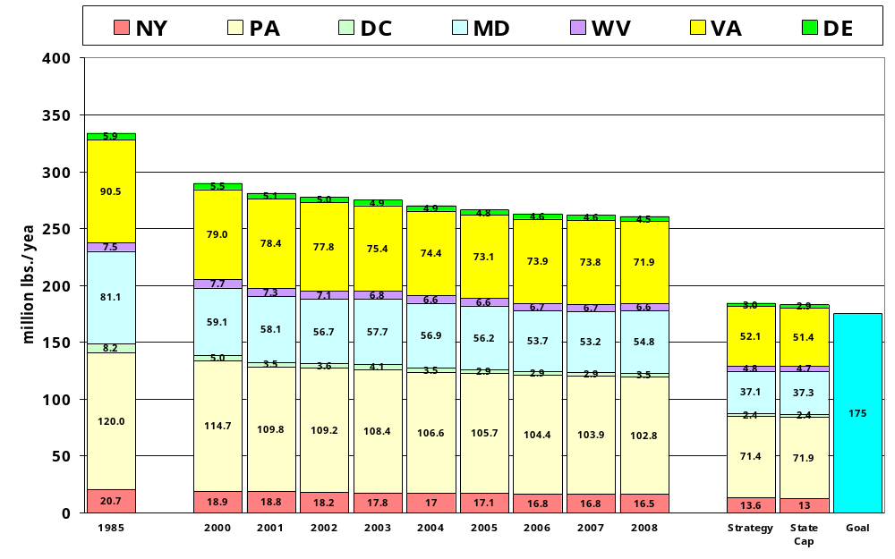
Nitrogen Loads Delivered to the Chesapeake Bay By Jurisdiction
Point source loads reflect measured discharges while nonpoint source loads are based on an average-hydrology year
Phase 4.3 Data
333.9
289.9
281.1
277.7
275.1
270.2
266.3
262.9
261.9
260.7
184.4
183.1
175
17

Slide 18
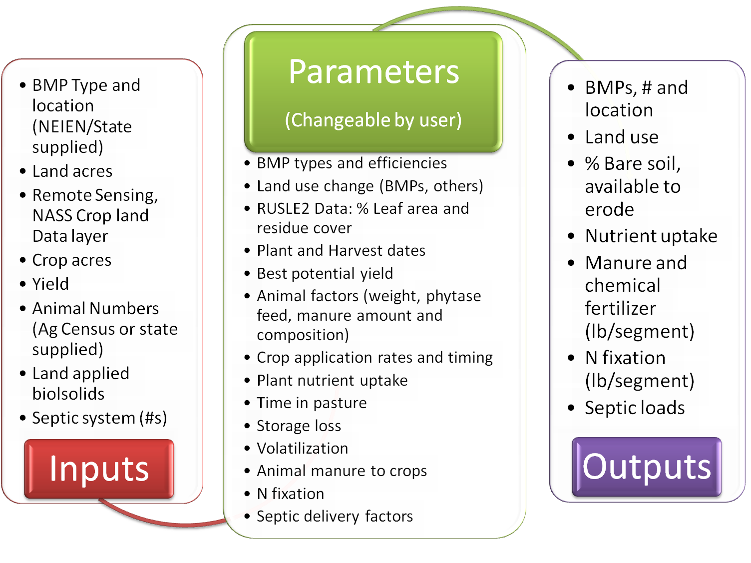
Scenario Builder

Slide 19
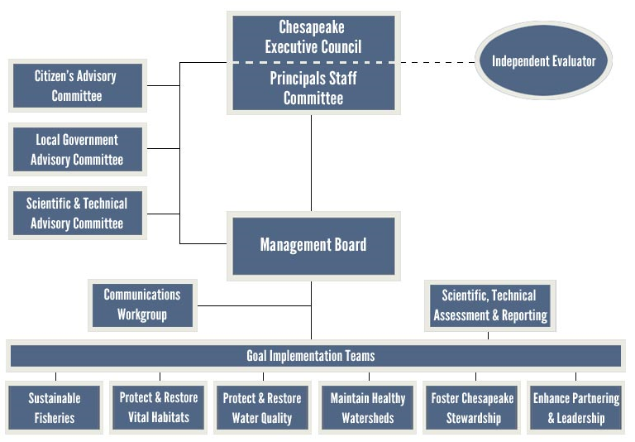
Chesapeake Bay Program Partnership

Slide 20
Chesapeake Bay Program Partnership
Watershed Technical Workgroup
Agriculture Workgroup
Urban Stormwater Workgroup
Forestry Workgroup
Sediment Workgroup
Ad-Hoc Panels
Modeling Workgroup

Slide 21
Agricultural Workgroup
Federal
  USDA, EPA
State
  Chesapeake Bay Commission, Delaware Department of Agriculture, Maryland Department of Agriculture, NY DEC, PA Department of Environmental Protection, Pennsylvania Department of Environmental Protection, Pennsylvania State Conservation Commission, VA DCR, VA DEQ, West Virginia Department of Agriculture, WV DEP
University
  Chesapeake Research Consortium, Cornell University, Penn State University, University of Delaware, University of Maryland, West Virginia University
Industry Groups
  Delaware Maryland Agribusiness Association, Delaware Pork Producers Association, Delmarva Poultry Industry, Inc., MD Farm Bureau, VA Farm Bureau, VA Grain Producers Producers Association, Virginia Agribusiness Council, Virginia Poultry Association, U.S. Poultry & Egg Association,
Local organizations
  Cortland County Soil and Water Conservation District, Lancaster County Conservation District, Madison Co. SWCD, Upper Susquehanna Coalition
NGOs
  American Farmland Trust, Environmental Defense Fund, Keith Campbell Foundation for the Environment, MidAtlantic Farm Credit, PA NoTill Alliance

Slide 22
One Ad-Hoc Subgroup of the Agricultural Workgroup
Mid-Atlantic Water Program, U.S. Department of Agriculture-Natural Resources Conservation Service, Virginia Department of Conservation and Recreation, Virginia Department of Forestry, Pennsylvania State Conservation Commission, Pennsylvania Department of Conservation and Natural Resources, Pennsylvania Department of Environmental Protection, Maryland Department of Agriculture, Maryland Department of Natural Resources, Maryland Department of the Environment, University of Maryland Cooperative Extension, University of Maryland-College Park, Delaware Department of Agriculture, Delaware Department of Natural Resources and Environmental Control, Delaware Maryland Agribusiness Association, West Virginia Department of Agriculture, West Virginia Department of Environmental Protection, Cacapon Institute - West Virginia, New York Department of Environmental Conservation, Upper Susquehanna Coalition, American Farmland Trust, Chesapeake Bay Commission, U.S. Forest Service, U.S. Fish and Wildlife Service, U.S. Geological Survey, U.S. Environmental Protection Agency, Keith Campbell Foundation for the Environment, Pinchot Institute, Piedmont Environmental Council

Slide 23
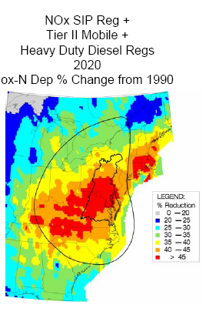
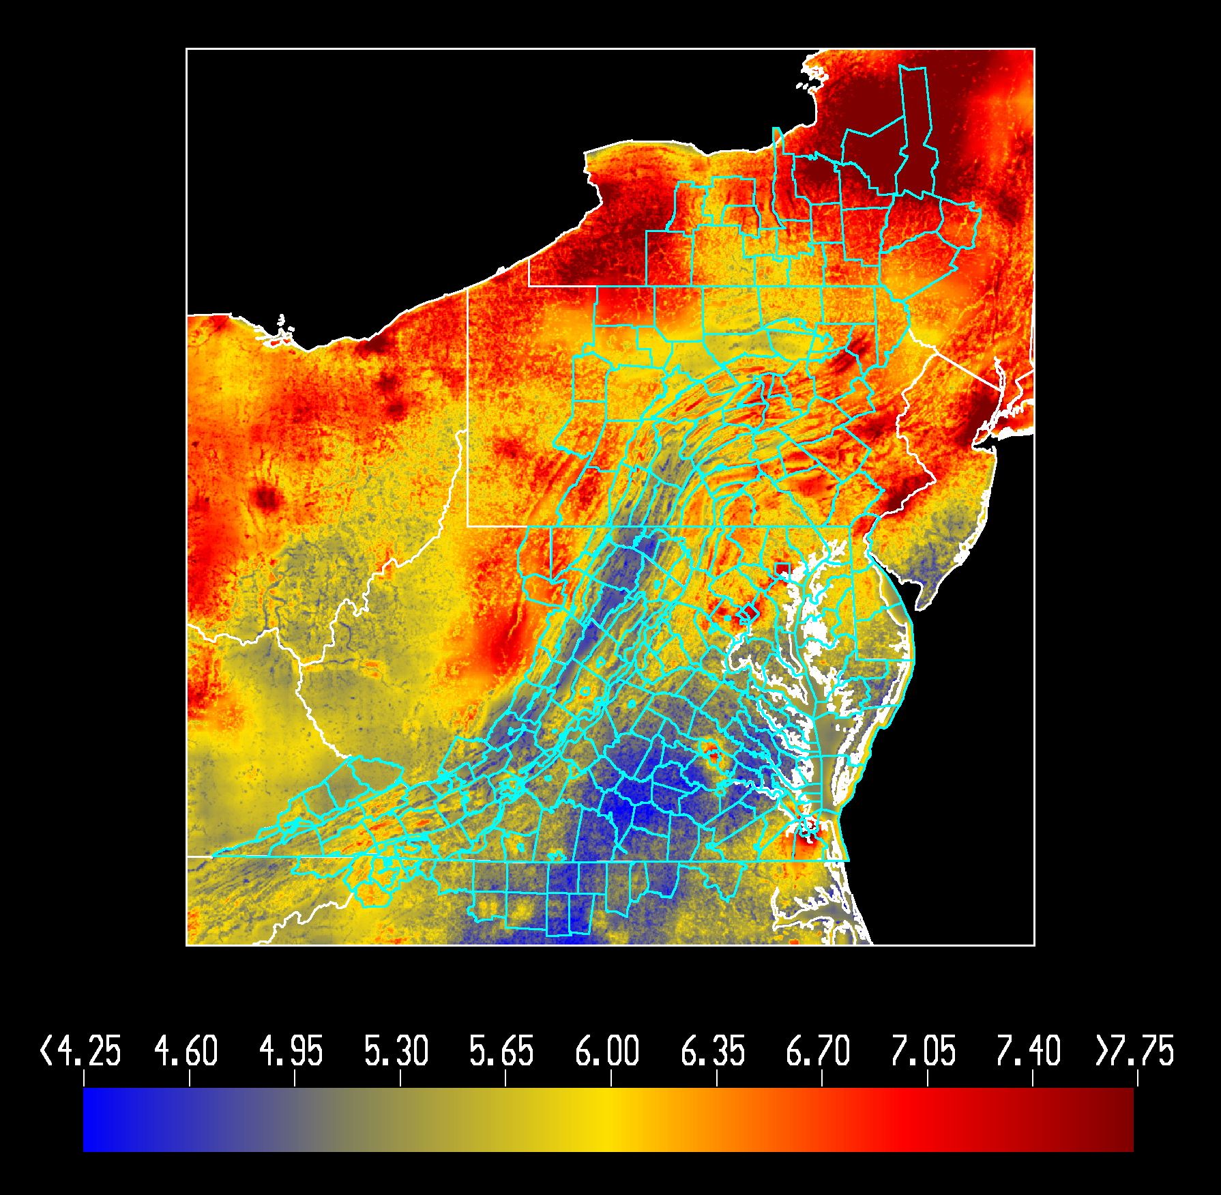
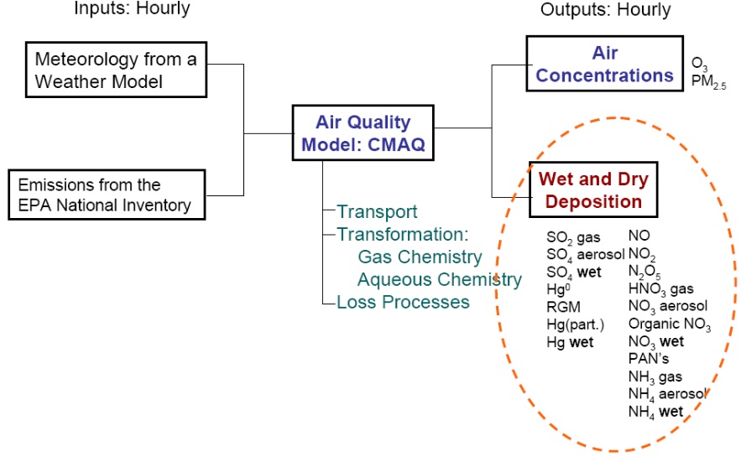
Atmospheric Deposition Estimates
Combining a regression model of wetfall deposition...
…with CMAQ estimates of dry deposition for the base…
…and using the power of the CMAQ model for scenarios.
23

Slide 24
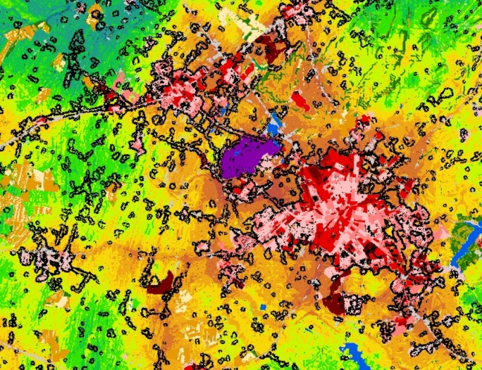
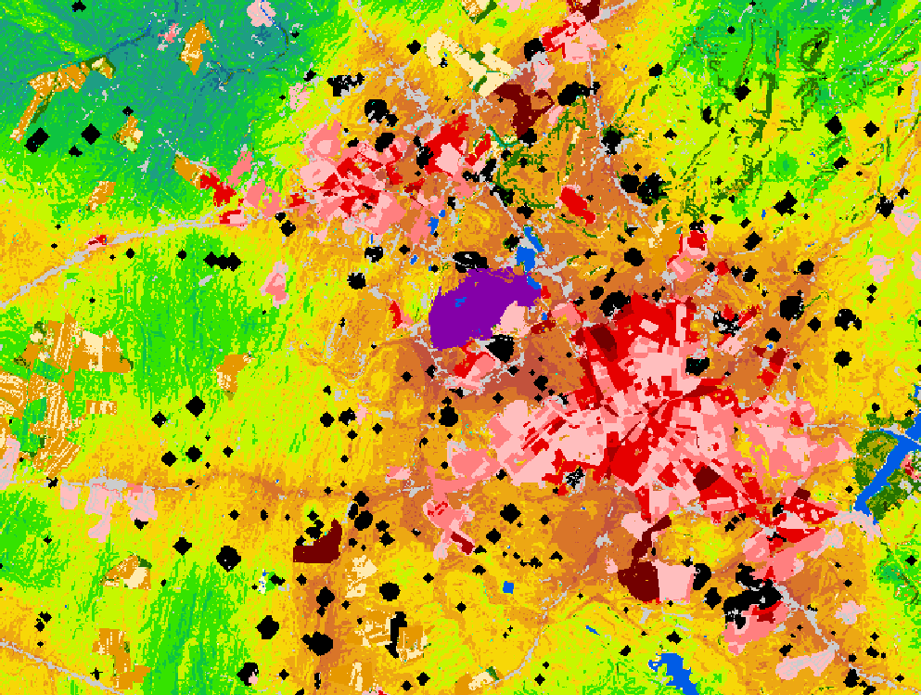
Land Change Modeling at the CBP
1980s – 1990s – simple empirical relationships
CBLCM
  v1 – Sleuth
  V2 –empirical relationships
  V3 – Patch-based growth
    Existing Lu/Lc
    Topographic/Geologic data
    Population Projections
Probability
surface

Slide 25
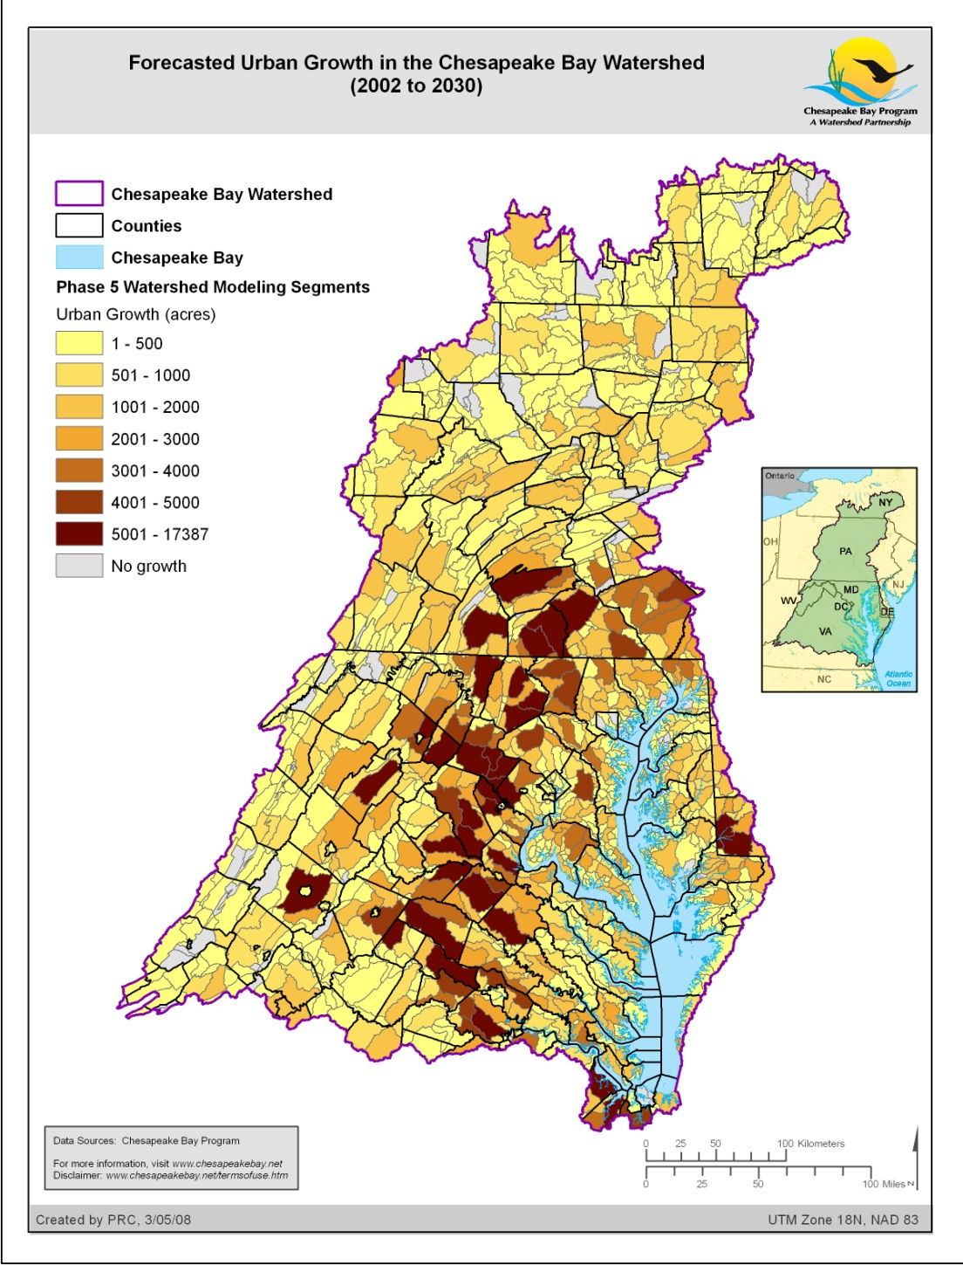
Forecasted Urban Growth (2000 to 2030)
Notes:
Version 3 of the “Trend” or “Business as Usual” land change forecast for 2030 by Phase 5 Watershed modeling segment.
Example output of forecasted urban growth in acres from the CBLCM for Bay watershed counties. Darker areas show the highest relative levels of urban growth. Generally, the high growth counties fall along the major transportation corridors such as I-95, I-66, and I-81.
The yellow square box identifies the extent of the close-up perspective provided in the next slide.

Slide 26
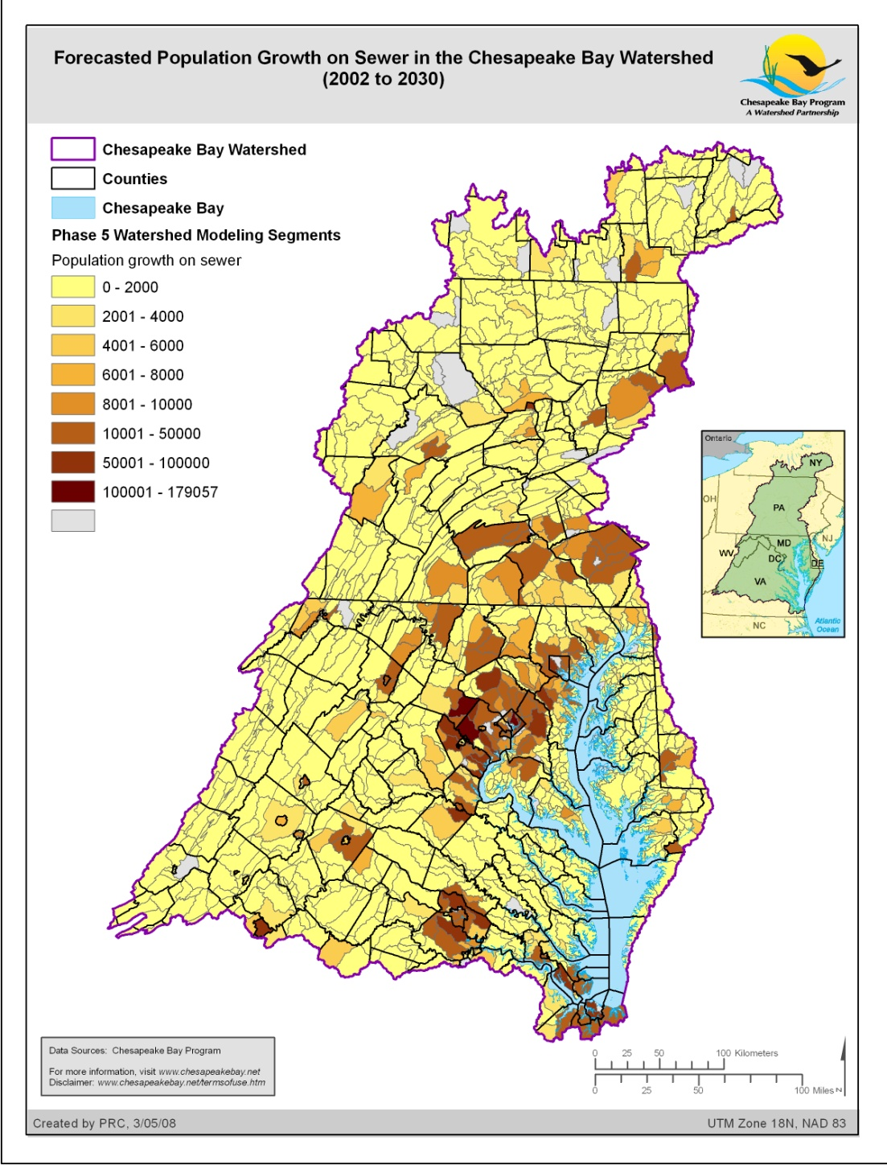
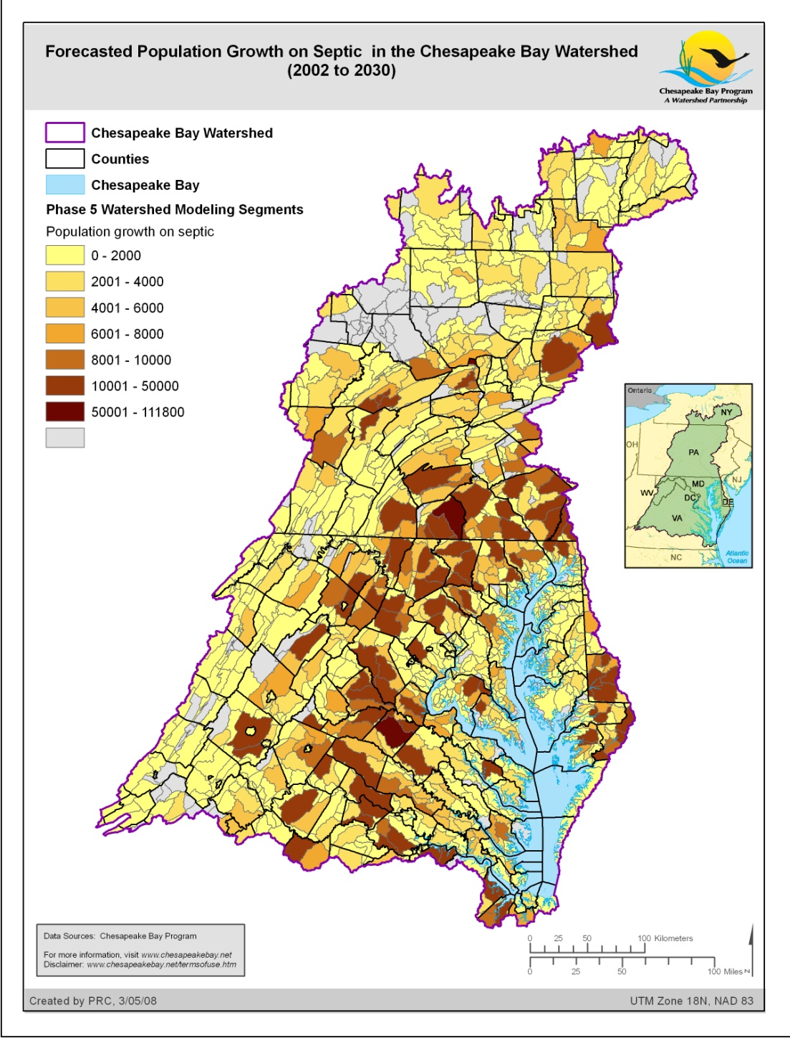
Forecasted Population Growth on Sewer vs. Septic (2000 to 2030)
Notes:
Version 3 of the “Trend” or “Business as Usual” land change forecast for 2030 by Phase 5 Watershed modeling segment.

Slide 27
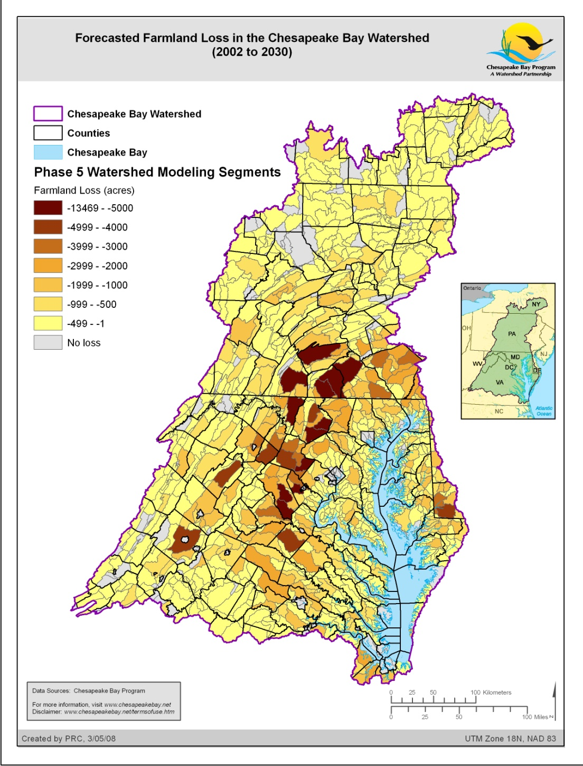
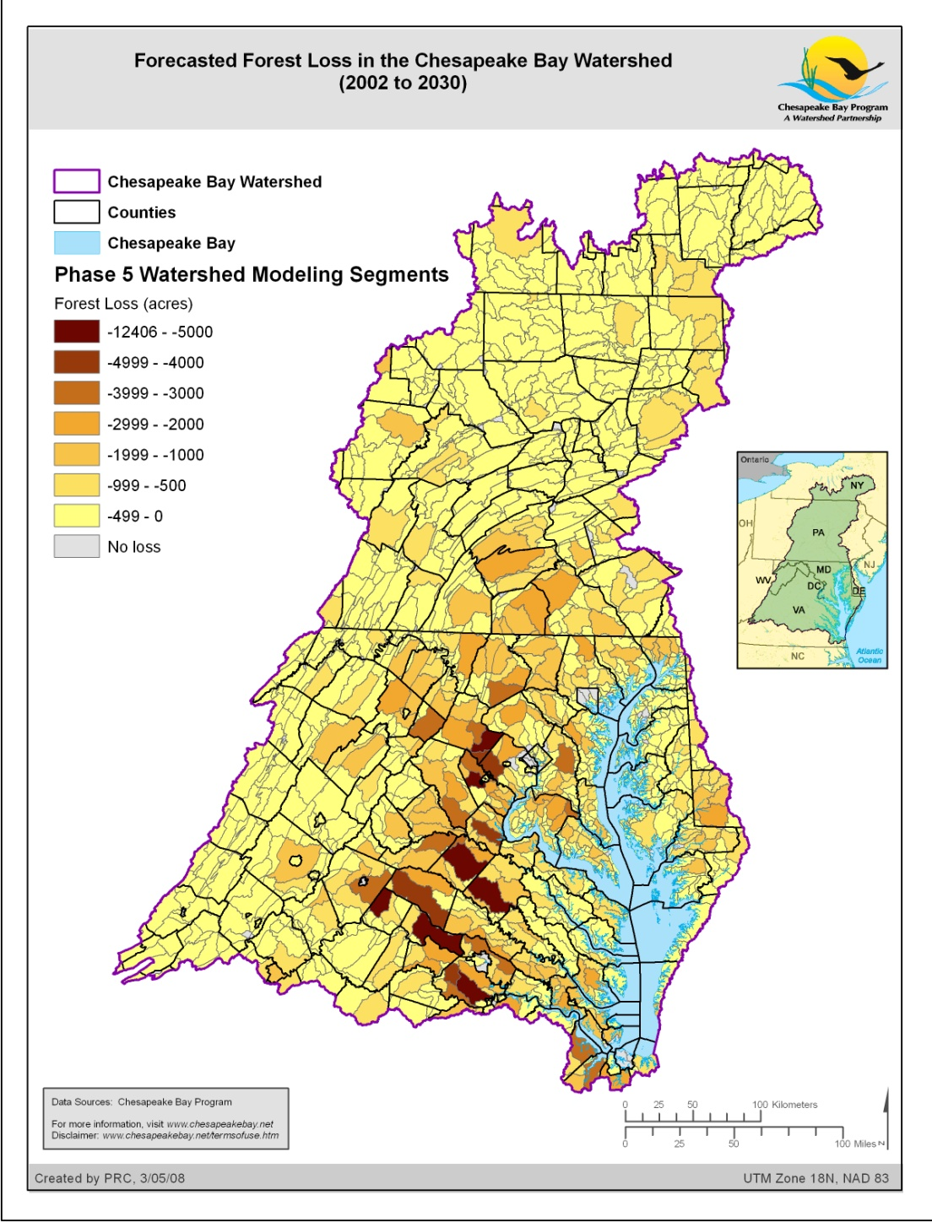
Farmland and Forest Land Loss (2000 to 2030)
Notes:
Version 3 of the “Trend” or “Business as Usual” land change forecast for 2030 by Phase 5 Watershed modeling segment.

Slide 28
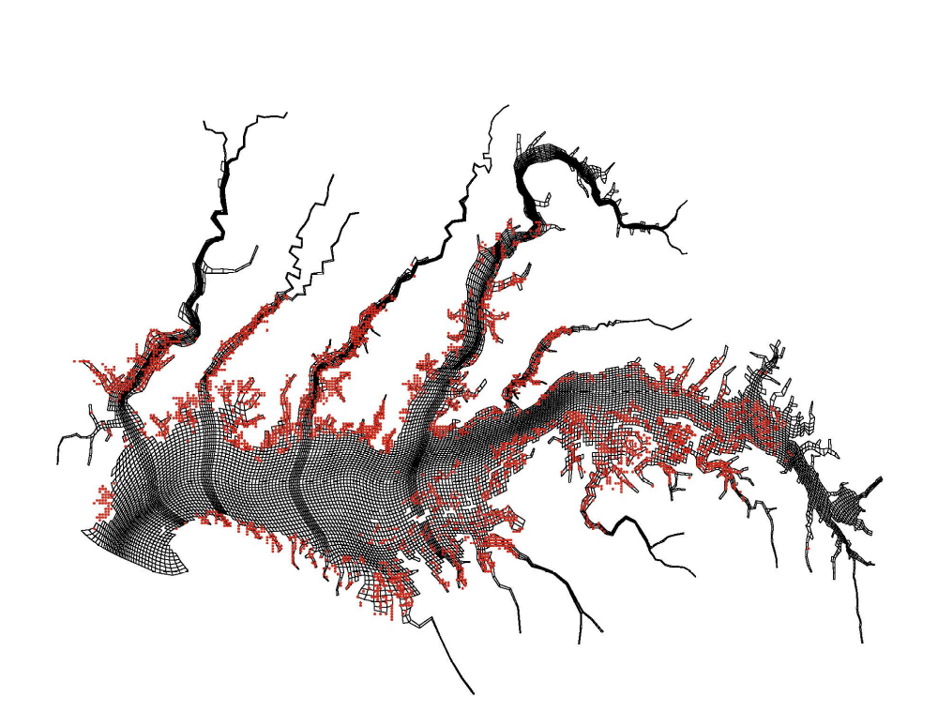
Estuarine Model
57,000 cells
sub-hour hydrodynamics
oysters
menhaden

Slide 29
Chesapeake Bay Partnership Models
Use in the TMDL

Slide 30
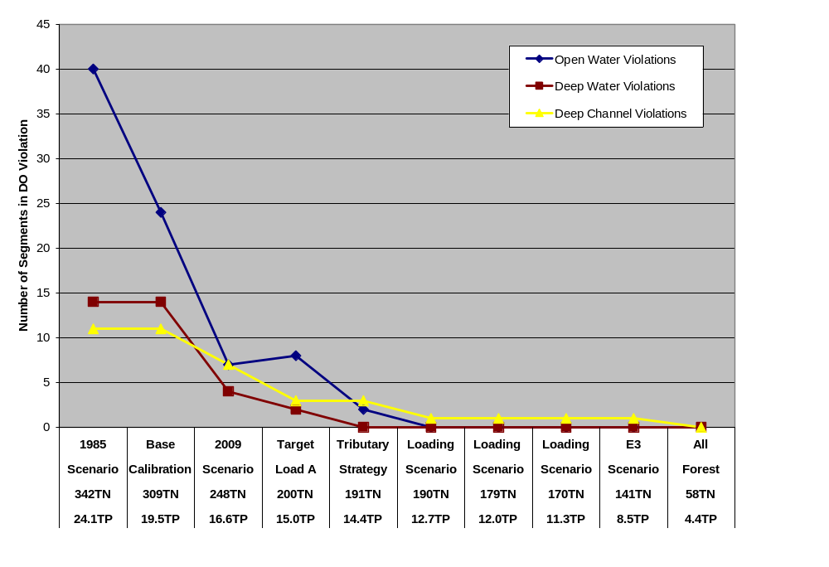
Use of modeling suite in the Chesapeake TMDL
Basin-wide load is
190 N and 12.7 P (MPY)
Notes:
30

Slide 31
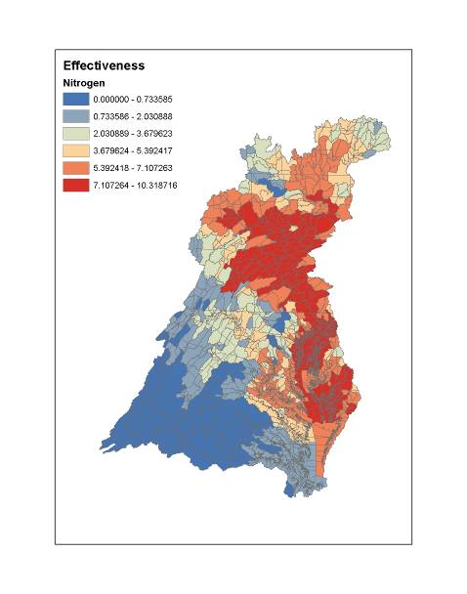
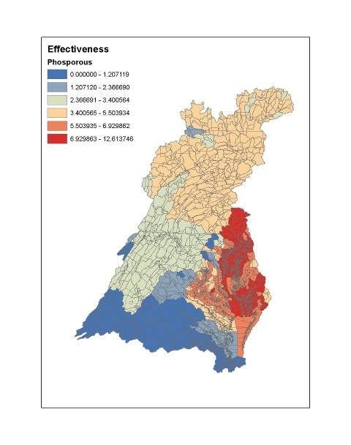
Nutrient Impacts on Bay WQ

Slide 32
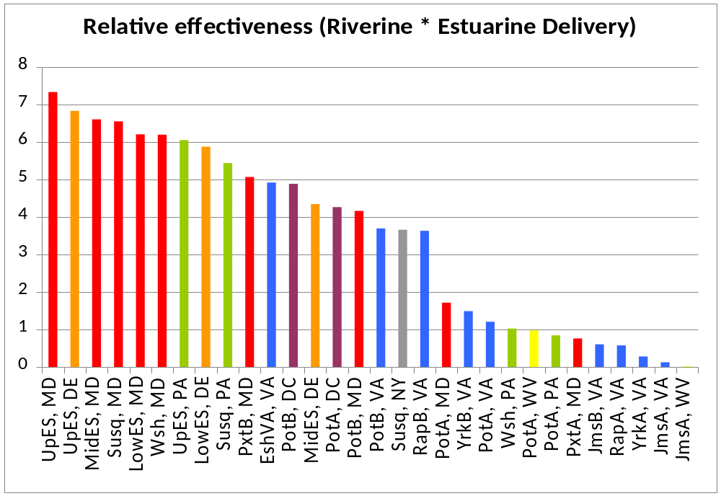
Major River Basin by Jurisdiction Relative Impact on Bay Water Quality

Slide 33
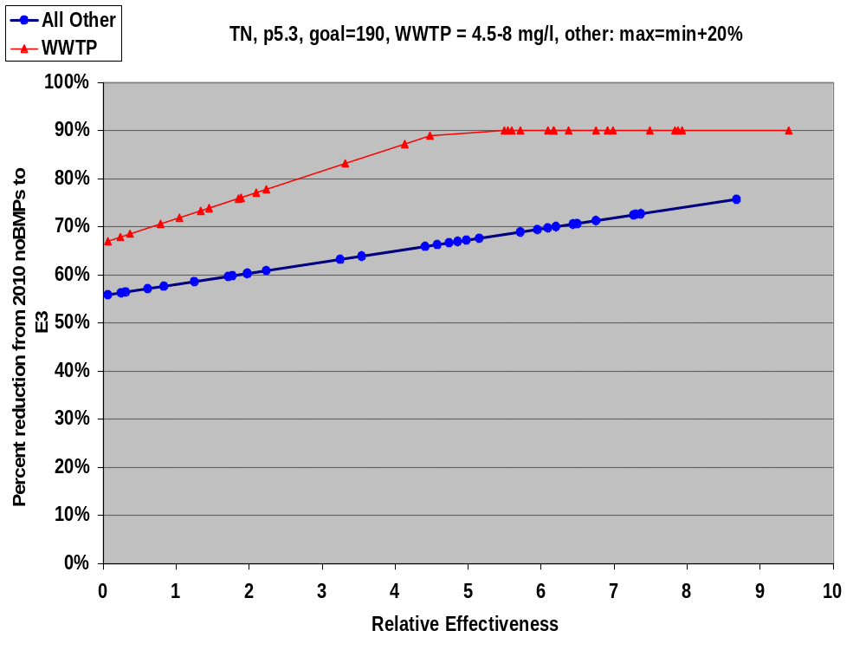
4.5 mg/l
Wastewater Loads
All other sources
8 mg/l
20 percent slope
Allocation Method Agreed to by Majority of Principals’ Staff Committee Members

Slide 34
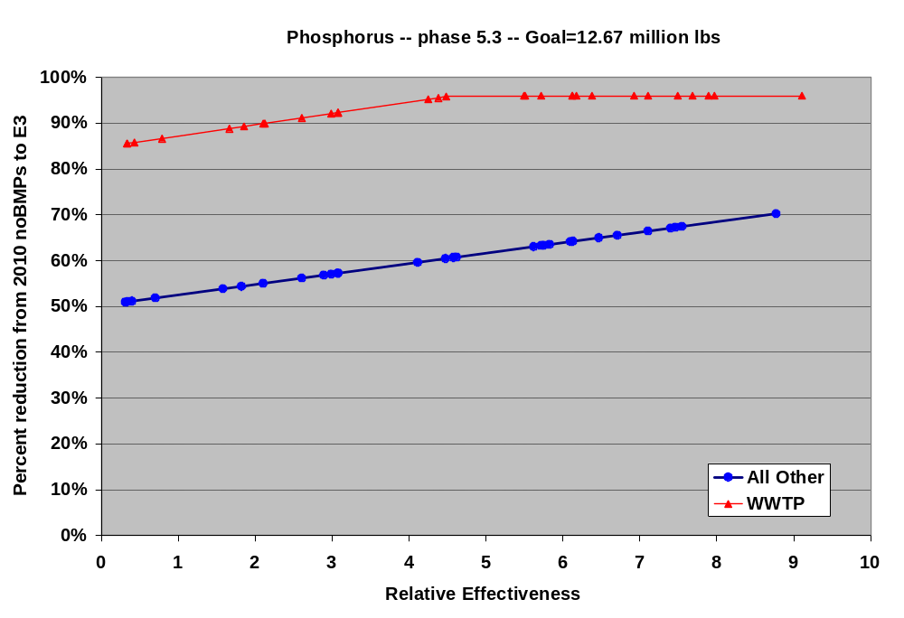

Slide 35
Pollution Diet
by River
Pollution Diet
by State

Slide 37
Chesapeake Bay WWTP +CSO Loading Trends and WIP Loads
Notes:
Part One: Ecosystem Health uses monitoring data gathered by Bay Program partners to assess the overall health of the Bay ecosystem over a one-year period.
Where possible, data are compared to existing goals that measure progress toward restoring a healthy Bay. By presenting data in this manner, watershed residents can better understand the health of the Bay relative to what is needed for a balanced ecosystem.
In the Water Quality and Habitats sections of this presentation, individual parameters are averaged together to provide an overall health assessment for each priority area. In the Fish and Shellfish section, however, independent data about individual species cannot be combined to provide an overall assessment of the health of Bay fisheries. As ecosystem-based goals are defined in the future, we will compare annual data to population targets needed for a restored Bay system.
Annual assessments of water quality parameters are affected by freshwater flow to the Bay. High flow years contribute to decreasing water clarity and potentially affect dissolved oxygen and chlorophyll. A three-year assessment that helps to remove the impacts of annual weather-driven events (such as drought and high flow years) is also depicted in this presentation.
Indicator charts featured on light green backgrounds and including a summary graph icon in the lower right hand corner (e.g. a bar chart showing the summary score for a priority area) are considered “reporting-level” indicators and were featured and/or discussed in the Chesapeake Bay 2005 Health and Restoration Assessment Part One: Ecosystem Health (available at www.chesapeakebay.net/assess).
Indicator charts featured on light tan backgrounds and including a “supporting indicator” label in the lower right hand corner are related to the reporting-level indicators for diagnostic purposes or to provide additional details.
Expanded analysis and interpretation of data as well as the methods used to compile the reporting-level indicator graphs can be found at www.chesapeakebay.net/assess/methods.
For information about the work being done to restore Bay ecosystem health, please refer to the companion Power Point presentation, Part Two: Restoration Efforts, or the report, Chesapeake Bay 2005 Health and Restoration Assessment Part Two: Restoration Efforts , available at www.chesapeakebay.net/assess.
For information about various factors impacting the health of the Bay and its watershed, please refer to the companion Power Point presentation, Part Three: Factors Impacting Bay and Watershed Health .

Slide 38
Wastewater + CSO TN Load Contributions Among All Sources
Notes:
Part One: Ecosystem Health uses monitoring data gathered by Bay Program partners to assess the overall health of the Bay ecosystem over a one-year period.
Where possible, data are compared to existing goals that measure progress toward restoring a healthy Bay. By presenting data in this manner, watershed residents can better understand the health of the Bay relative to what is needed for a balanced ecosystem.
In the Water Quality and Habitats sections of this presentation, individual parameters are averaged together to provide an overall health assessment for each priority area. In the Fish and Shellfish section, however, independent data about individual species cannot be combined to provide an overall assessment of the health of Bay fisheries. As ecosystem-based goals are defined in the future, we will compare annual data to population targets needed for a restored Bay system.
Annual assessments of water quality parameters are affected by freshwater flow to the Bay. High flow years contribute to decreasing water clarity and potentially affect dissolved oxygen and chlorophyll. A three-year assessment that helps to remove the impacts of annual weather-driven events (such as drought and high flow years) is also depicted in this presentation.
Indicator charts featured on light green backgrounds and including a summary graph icon in the lower right hand corner (e.g. a bar chart showing the summary score for a priority area) are considered “reporting-level” indicators and were featured and/or discussed in the Chesapeake Bay 2005 Health and Restoration Assessment Part One: Ecosystem Health (available at www.chesapeakebay.net/assess).
Indicator charts featured on light tan backgrounds and including a “supporting indicator” label in the lower right hand corner are related to the reporting-level indicators for diagnostic purposes or to provide additional details.
Expanded analysis and interpretation of data as well as the methods used to compile the reporting-level indicator graphs can be found at www.chesapeakebay.net/assess/methods.
For information about the work being done to restore Bay ecosystem health, please refer to the companion Power Point presentation, Part Two: Restoration Efforts, or the report, Chesapeake Bay 2005 Health and Restoration Assessment Part Two: Restoration Efforts , available at www.chesapeakebay.net/assess.
For information about various factors impacting the health of the Bay and its watershed, please refer to the companion Power Point presentation, Part Three: Factors Impacting Bay and Watershed Health .

Slide 39
Chesapeake Bay Septic System Nutrient Loading Trends and WIP Loads
Notes:
Part One: Ecosystem Health uses monitoring data gathered by Bay Program partners to assess the overall health of the Bay ecosystem over a one-year period.
Where possible, data are compared to existing goals that measure progress toward restoring a healthy Bay. By presenting data in this manner, watershed residents can better understand the health of the Bay relative to what is needed for a balanced ecosystem.
In the Water Quality and Habitats sections of this presentation, individual parameters are averaged together to provide an overall health assessment for each priority area. In the Fish and Shellfish section, however, independent data about individual species cannot be combined to provide an overall assessment of the health of Bay fisheries. As ecosystem-based goals are defined in the future, we will compare annual data to population targets needed for a restored Bay system.
Annual assessments of water quality parameters are affected by freshwater flow to the Bay. High flow years contribute to decreasing water clarity and potentially affect dissolved oxygen and chlorophyll. A three-year assessment that helps to remove the impacts of annual weather-driven events (such as drought and high flow years) is also depicted in this presentation.
Indicator charts featured on light green backgrounds and including a summary graph icon in the lower right hand corner (e.g. a bar chart showing the summary score for a priority area) are considered “reporting-level” indicators and were featured and/or discussed in the Chesapeake Bay 2005 Health and Restoration Assessment Part One: Ecosystem Health (available at www.chesapeakebay.net/assess).
Indicator charts featured on light tan backgrounds and including a “supporting indicator” label in the lower right hand corner are related to the reporting-level indicators for diagnostic purposes or to provide additional details.
Expanded analysis and interpretation of data as well as the methods used to compile the reporting-level indicator graphs can be found at www.chesapeakebay.net/assess/methods.
For information about the work being done to restore Bay ecosystem health, please refer to the companion Power Point presentation, Part Two: Restoration Efforts, or the report, Chesapeake Bay 2005 Health and Restoration Assessment Part Two: Restoration Efforts , available at www.chesapeakebay.net/assess.
For information about various factors impacting the health of the Bay and its watershed, please refer to the companion Power Point presentation, Part Three: Factors Impacting Bay and Watershed Health .

Slide 40
Septic System TN Load Contributions Among All Sources
Notes:
Part One: Ecosystem Health uses monitoring data gathered by Bay Program partners to assess the overall health of the Bay ecosystem over a one-year period.
Where possible, data are compared to existing goals that measure progress toward restoring a healthy Bay. By presenting data in this manner, watershed residents can better understand the health of the Bay relative to what is needed for a balanced ecosystem.
In the Water Quality and Habitats sections of this presentation, individual parameters are averaged together to provide an overall health assessment for each priority area. In the Fish and Shellfish section, however, independent data about individual species cannot be combined to provide an overall assessment of the health of Bay fisheries. As ecosystem-based goals are defined in the future, we will compare annual data to population targets needed for a restored Bay system.
Annual assessments of water quality parameters are affected by freshwater flow to the Bay. High flow years contribute to decreasing water clarity and potentially affect dissolved oxygen and chlorophyll. A three-year assessment that helps to remove the impacts of annual weather-driven events (such as drought and high flow years) is also depicted in this presentation.
Indicator charts featured on light green backgrounds and including a summary graph icon in the lower right hand corner (e.g. a bar chart showing the summary score for a priority area) are considered “reporting-level” indicators and were featured and/or discussed in the Chesapeake Bay 2005 Health and Restoration Assessment Part One: Ecosystem Health (available at www.chesapeakebay.net/assess).
Indicator charts featured on light tan backgrounds and including a “supporting indicator” label in the lower right hand corner are related to the reporting-level indicators for diagnostic purposes or to provide additional details.
Expanded analysis and interpretation of data as well as the methods used to compile the reporting-level indicator graphs can be found at www.chesapeakebay.net/assess/methods.
For information about the work being done to restore Bay ecosystem health, please refer to the companion Power Point presentation, Part Two: Restoration Efforts, or the report, Chesapeake Bay 2005 Health and Restoration Assessment Part Two: Restoration Efforts , available at www.chesapeakebay.net/assess.
For information about various factors impacting the health of the Bay and its watershed, please refer to the companion Power Point presentation, Part Three: Factors Impacting Bay and Watershed Health .

Slide 41
Septic N Load (lbs/yr) at the edge of drain field
= Pop *8.91586 (lbs/person, yr) *BMP Efficiency (%)
Septic N Load (lbs/yr) at the edge of stream
= Pop *8.91586 *BMP Efficiency (%) * Pass-through rate (%)
Phosphorus is assumed to be 100% attenuated by soil.
Septic BMP load reductions
Connection 100%
Denitrification 50%
Pumping 5%
Septic Nitrogen Load Calculation
Notes:
Part One: Ecosystem Health uses monitoring data gathered by Bay Program partners to assess the overall health of the Bay ecosystem over a one-year period.
Where possible, data are compared to existing goals that measure progress toward restoring a healthy Bay. By presenting data in this manner, watershed residents can better understand the health of the Bay relative to what is needed for a balanced ecosystem.
In the Water Quality and Habitats sections of this presentation, individual parameters are averaged together to provide an overall health assessment for each priority area. In the Fish and Shellfish section, however, independent data about individual species cannot be combined to provide an overall assessment of the health of Bay fisheries. As ecosystem-based goals are defined in the future, we will compare annual data to population targets needed for a restored Bay system.
Annual assessments of water quality parameters are affected by freshwater flow to the Bay. High flow years contribute to decreasing water clarity and potentially affect dissolved oxygen and chlorophyll. A three-year assessment that helps to remove the impacts of annual weather-driven events (such as drought and high flow years) is also depicted in this presentation.
Indicator charts featured on light green backgrounds and including a summary graph icon in the lower right hand corner (e.g. a bar chart showing the summary score for a priority area) are considered “reporting-level” indicators and were featured and/or discussed in the Chesapeake Bay 2005 Health and Restoration Assessment Part One: Ecosystem Health (available at www.chesapeakebay.net/assess).
Indicator charts featured on light tan backgrounds and including a “supporting indicator” label in the lower right hand corner are related to the reporting-level indicators for diagnostic purposes or to provide additional details.
Expanded analysis and interpretation of data as well as the methods used to compile the reporting-level indicator graphs can be found at www.chesapeakebay.net/assess/methods.
For information about the work being done to restore Bay ecosystem health, please refer to the companion Power Point presentation, Part Two: Restoration Efforts, or the report, Chesapeake Bay 2005 Health and Restoration Assessment Part Two: Restoration Efforts , available at www.chesapeakebay.net/assess.
For information about various factors impacting the health of the Bay and its watershed, please refer to the companion Power Point presentation, Part Three: Factors Impacting Bay and Watershed Health .

Slide 42
Septic Nitrogen Pass-Through Rate
State | Pass-Through Rate | 2011_# Systems
DE | 40% | 21,735
DC | 40% | -
MD | 30% | 241,893
MD | 50% | 159,783
MD | 80% | 48,630
NY | 40% | 96,810
PA | 40% | 526,721
VA | 40% | 535,351
WV | 40% | 62,695
Notes:
Part One: Ecosystem Health uses monitoring data gathered by Bay Program partners to assess the overall health of the Bay ecosystem over a one-year period.
Where possible, data are compared to existing goals that measure progress toward restoring a healthy Bay. By presenting data in this manner, watershed residents can better understand the health of the Bay relative to what is needed for a balanced ecosystem.
In the Water Quality and Habitats sections of this presentation, individual parameters are averaged together to provide an overall health assessment for each priority area. In the Fish and Shellfish section, however, independent data about individual species cannot be combined to provide an overall assessment of the health of Bay fisheries. As ecosystem-based goals are defined in the future, we will compare annual data to population targets needed for a restored Bay system.
Annual assessments of water quality parameters are affected by freshwater flow to the Bay. High flow years contribute to decreasing water clarity and potentially affect dissolved oxygen and chlorophyll. A three-year assessment that helps to remove the impacts of annual weather-driven events (such as drought and high flow years) is also depicted in this presentation.
Indicator charts featured on light green backgrounds and including a summary graph icon in the lower right hand corner (e.g. a bar chart showing the summary score for a priority area) are considered “reporting-level” indicators and were featured and/or discussed in the Chesapeake Bay 2005 Health and Restoration Assessment Part One: Ecosystem Health (available at www.chesapeakebay.net/assess).
Indicator charts featured on light tan backgrounds and including a “supporting indicator” label in the lower right hand corner are related to the reporting-level indicators for diagnostic purposes or to provide additional details.
Expanded analysis and interpretation of data as well as the methods used to compile the reporting-level indicator graphs can be found at www.chesapeakebay.net/assess/methods.
For information about the work being done to restore Bay ecosystem health, please refer to the companion Power Point presentation, Part Two: Restoration Efforts, or the report, Chesapeake Bay 2005 Health and Restoration Assessment Part Two: Restoration Efforts , available at www.chesapeakebay.net/assess.
For information about various factors impacting the health of the Bay and its watershed, please refer to the companion Power Point presentation, Part Three: Factors Impacting Bay and Watershed Health .

Slide 43
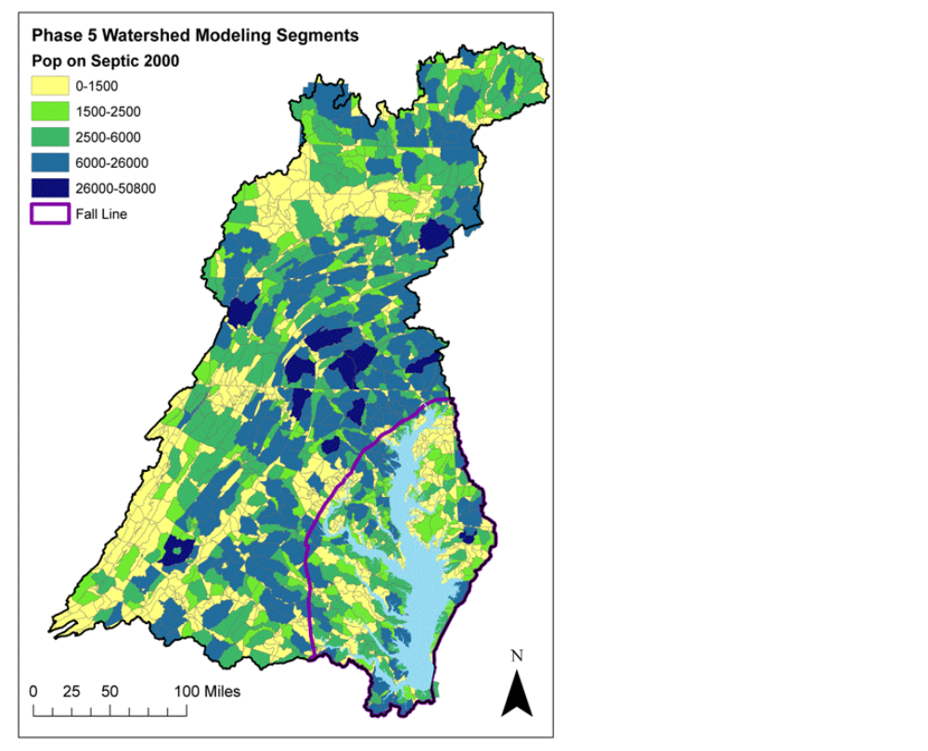
Notes:
Part One: Ecosystem Health uses monitoring data gathered by Bay Program partners to assess the overall health of the Bay ecosystem over a one-year period.
Where possible, data are compared to existing goals that measure progress toward restoring a healthy Bay. By presenting data in this manner, watershed residents can better understand the health of the Bay relative to what is needed for a balanced ecosystem.
In the Water Quality and Habitats sections of this presentation, individual parameters are averaged together to provide an overall health assessment for each priority area. In the Fish and Shellfish section, however, independent data about individual species cannot be combined to provide an overall assessment of the health of Bay fisheries. As ecosystem-based goals are defined in the future, we will compare annual data to population targets needed for a restored Bay system.
Annual assessments of water quality parameters are affected by freshwater flow to the Bay. High flow years contribute to decreasing water clarity and potentially affect dissolved oxygen and chlorophyll. A three-year assessment that helps to remove the impacts of annual weather-driven events (such as drought and high flow years) is also depicted in this presentation.
Indicator charts featured on light green backgrounds and including a summary graph icon in the lower right hand corner (e.g. a bar chart showing the summary score for a priority area) are considered “reporting-level” indicators and were featured and/or discussed in the Chesapeake Bay 2005 Health and Restoration Assessment Part One: Ecosystem Health (available at www.chesapeakebay.net/assess).
Indicator charts featured on light tan backgrounds and including a “supporting indicator” label in the lower right hand corner are related to the reporting-level indicators for diagnostic purposes or to provide additional details.
Expanded analysis and interpretation of data as well as the methods used to compile the reporting-level indicator graphs can be found at www.chesapeakebay.net/assess/methods.
For information about the work being done to restore Bay ecosystem health, please refer to the companion Power Point presentation, Part Two: Restoration Efforts, or the report, Chesapeake Bay 2005 Health and Restoration Assessment Part Two: Restoration Efforts , available at www.chesapeakebay.net/assess.
For information about various factors impacting the health of the Bay and its watershed, please refer to the companion Power Point presentation, Part Three: Factors Impacting Bay and Watershed Health .

Slide 44

Notes:
Part One: Ecosystem Health uses monitoring data gathered by Bay Program partners to assess the overall health of the Bay ecosystem over a one-year period.
Where possible, data are compared to existing goals that measure progress toward restoring a healthy Bay. By presenting data in this manner, watershed residents can better understand the health of the Bay relative to what is needed for a balanced ecosystem.
In the Water Quality and Habitats sections of this presentation, individual parameters are averaged together to provide an overall health assessment for each priority area. In the Fish and Shellfish section, however, independent data about individual species cannot be combined to provide an overall assessment of the health of Bay fisheries. As ecosystem-based goals are defined in the future, we will compare annual data to population targets needed for a restored Bay system.
Annual assessments of water quality parameters are affected by freshwater flow to the Bay. High flow years contribute to decreasing water clarity and potentially affect dissolved oxygen and chlorophyll. A three-year assessment that helps to remove the impacts of annual weather-driven events (such as drought and high flow years) is also depicted in this presentation.
Indicator charts featured on light green backgrounds and including a summary graph icon in the lower right hand corner (e.g. a bar chart showing the summary score for a priority area) are considered “reporting-level” indicators and were featured and/or discussed in the Chesapeake Bay 2005 Health and Restoration Assessment Part One: Ecosystem Health (available at www.chesapeakebay.net/assess).
Indicator charts featured on light tan backgrounds and including a “supporting indicator” label in the lower right hand corner are related to the reporting-level indicators for diagnostic purposes or to provide additional details.
Expanded analysis and interpretation of data as well as the methods used to compile the reporting-level indicator graphs can be found at www.chesapeakebay.net/assess/methods.
For information about the work being done to restore Bay ecosystem health, please refer to the companion Power Point presentation, Part Two: Restoration Efforts, or the report, Chesapeake Bay 2005 Health and Restoration Assessment Part Two: Restoration Efforts , available at www.chesapeakebay.net/assess.
For information about various factors impacting the health of the Bay and its watershed, please refer to the companion Power Point presentation, Part Three: Factors Impacting Bay and Watershed Health .

Slide 45
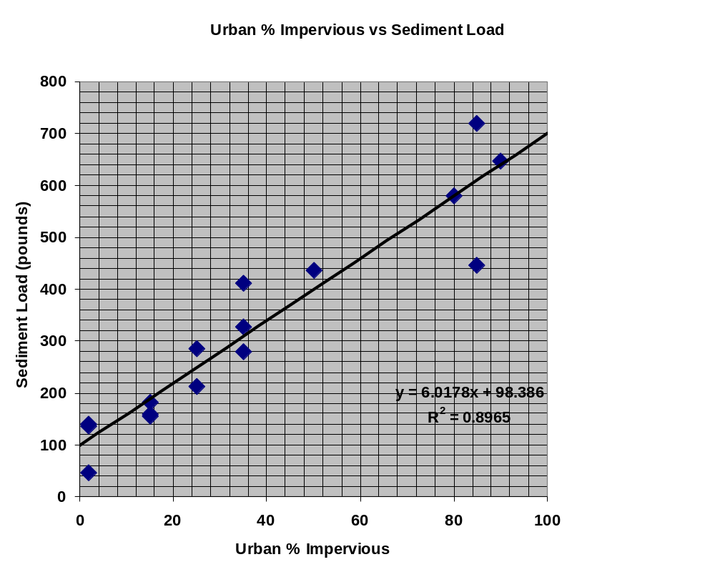
Urban Sediment Targets
Sediment load for several urban land use types were compiled for sites in the mid-Atlantic and Illinois. Langland and Cronin (2003)
When plotted against ‘typical’ impervious percents for those urban land use types, the relationship is striking.
By setting pervious urban at the intercept and impervious urban at the maximum, the land use division within each particular segment determines the overall load according to the above relationship.

