Slide 1

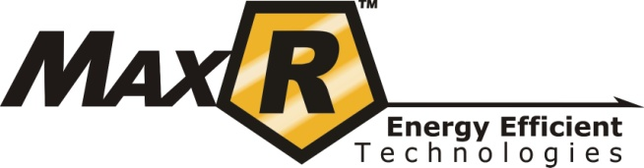
HVAC & Refrigeration Restoration and Efficiency
OHIO DEPARTMENT OF TRANSPORTATION
District 4
Akron, Ohio
©2011 Trans Bio Energy, LLC. All rights reserved.
Do not reproduce, reuse or distribute without permission.

Slide 2
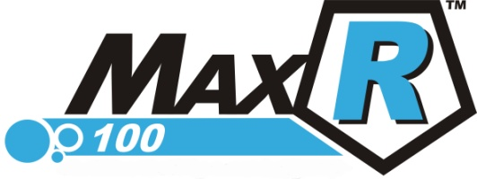
Reconditions, restores and maintains efficiency by improving the heat transfer in condenser and evaporator coils in air conditioning, heat pump and refrigeration systems.
Proven Energy Efficiency and Restoration Technology for Air Conditioning & Refrigeration Systems
©2011 Trans Bio Energy, LLC. All rights reserved.
Do not reproduce, reuse or distribute without permission.
Notes:
MaxR100™ re-conditions, restores and maintains efficiency in air-conditioners, chillers & refrigeration systems, resulting in the reduction of kWh consumption.
MaxR100™ is an intermetallic compound that forms a permanent bond to metal surfaces. This action removes oil fouling, changes the thermal nature of the metal and lowers the boiling point of the refrigerant gas, resulting in a more efficient operating system with substantial savings in energy costs.
MaxR100™ forms a protective molecular layer that will NOT change mechanical tolerances. MaxR100™ contains no elements of the Halogen group, particularly Chlorine, Fluorine, nor Sulfur or Phosphorous. MaxR100™ does NOT contain PTFE (Teflon®) or any other particulate. MaxR100™ will NOT contaminate waste oil.
Review before/after test results to get an indication of what benefits MaxR100™ will produce for you. MaxR100™ is easy to apply, but must be installed by a licensed HVAC contractor for the warranty to be valid. MaxR100™ Benefits: Provides "like-new" equipment performance Outstanding anti-friction protection in compressors Produces substantial energy savings Reduces maintenance & downtime Results in quieter running equipment Does not affect manufacturer's warranty Softens and conditions seals Reduces oxidation within the system Subtantially protects mechanical parts

Slide 3
MaxR 100 is an inter-metallic compound that by it’s nature bonds with metal surfaces -- restoring cooling systems to “like new” condition, creating substantial energy savings and improving energy efficiency by as much as 6% or more in newer units and 15-25% in older equipment through reduced run time and kWh consumption.
Improves compressor operation, reduces vibrations and lowers the sound level (decibels), resulting in an extended life of the compressor and improved performance of the unit.
MaxR 100 is not an additive or lubricant. It is an organometallic, ester-bonding compound that is made from naturally occurring elements.
What is MaxR100?
©2011 Trans Bio Energy, LLC. All rights reserved.
Do not reproduce, reuse or distribute without permission.
Notes:
MaxR100™ re-conditions, restores and maintains efficiency in air-conditioners, chillers & refrigeration systems, resulting in the reduction of kWh consumption.
MaxR100™ is an intermetallic compound that forms a permanent bond to metal surfaces. This action removes oil fouling, changes the thermal nature of the metal and lowers the boiling point of the refrigerant gas, resulting in a more efficient operating system with substantial savings in energy costs.
MaxR100™ forms a protective molecular layer that will NOT change mechanical tolerances. MaxR100™ contains no elements of the Halogen group, particularly Chlorine, Fluorine, nor Sulfur or Phosphorous. MaxR100™ does NOT contain PTFE (Teflon®) or any other particulate. MaxR100™ will NOT contaminate waste oil.
Review before/after test results to get an indication of what benefits MaxR100™ will produce for you. MaxR100™ is easy to apply, but must be installed by a licensed HVAC contractor for the warranty to be valid. MaxR100™ Benefits: Provides "like-new" equipment performance Outstanding anti-friction protection in compressors Produces substantial energy savings Reduces maintenance & downtime Results in quieter running equipment Does not affect manufacturer's warranty Softens and conditions seals Reduces oxidation within the system Subtantially protects mechanical parts

Slide 4
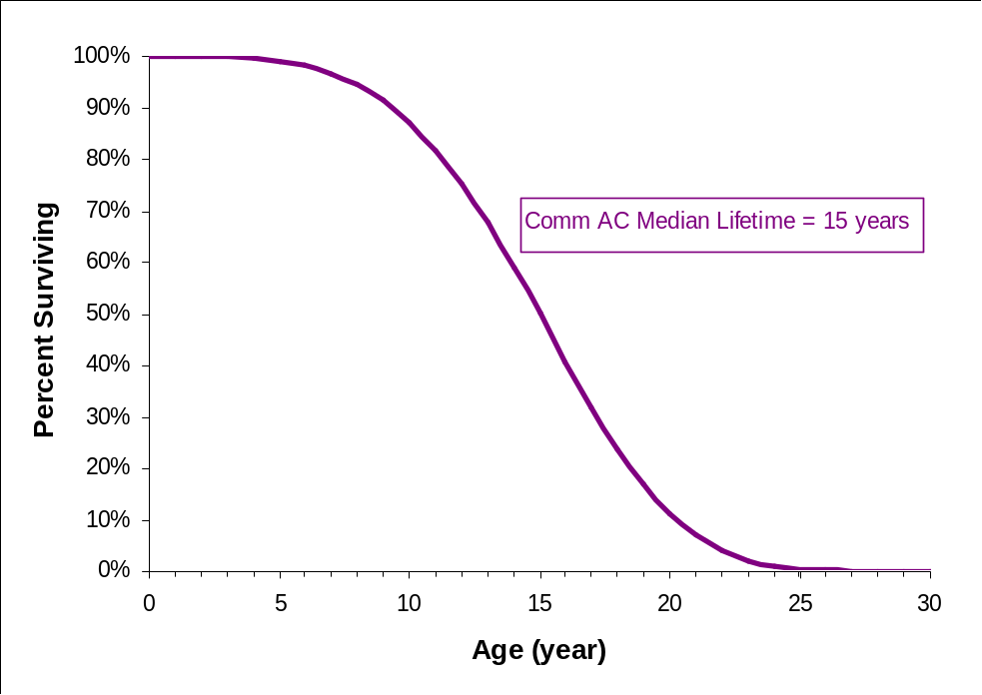
SERVICE LIFE OF AIR CONDITIONING EQUIPMENT
Median age of 15 years based on 1999 ASHRAE HVAC Applications Handbook
Survival function based on Weibull probability distribution
  5% of population retired by 8th year
  90% of population retired by 21st year
©2011 Trans Bio Energy, LLC. All rights reserved.
Do not reproduce, reuse or distribute without permission.

Slide 5

MaxR100 CYCLE of EFFICIENCY IMPROVEMENT
Phase 1
Equipment benchmarked
Poor heat transfer
Phase 2
Removal of oil fouling factor
Phase 3
Lower kW /ton
Improved Efficiency
Total BTUH increased
Inter-metallic Bonding
Longer run hours
Increase in kW/ton
Latent heat BTUH increased
Lower thermostat settings
Higher thermostat settings
Increased kW /ton
Plaque and varnish continues to be removed
Integration period
©2011 Trans Bio Energy, LLC. All rights reserved.
Do not reproduce, reuse or distribute without permission.

Slide 6
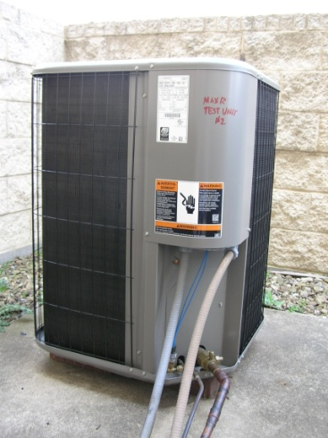
Mechanical Reconditioning HP 9
Placed in Service October 2009
Phase 1
Average kW/ton .58
Phase 2
Phase 3
Average kW/ton .53
34,559 BTU/Hour
EER 5.42
37,420 BTU/Hour
EER 5.81
COP 1.59
COP 1.70
11,136 Latent BTU/Hour
16,621 Latent BTU/Hour
INTEGRATION
©2011 Trans Bio Energy, LLC. All rights reserved.
Do not reproduce, reuse or distribute without permission.

Slide 7
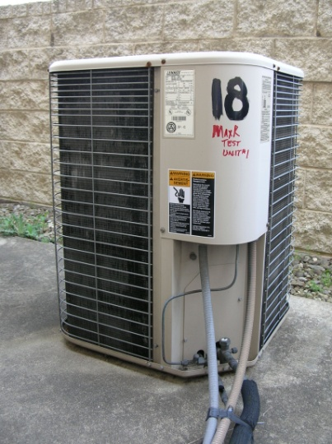
Mechanical Reconditioning HP 18
Placed in Service 1995
Phase 1
Average kW/ton .63
Phase 2
Phase 3
Average kW/ton .54
Latent BTU/Hour 14,283
37,438 BTUH
EER 5.35
43,209 BTUH
EER 6.09
COP 1.57
COP 1.78
Latent BTU/Hour 22,676
INTEGRATION
©2011 Trans Bio Energy, LLC. All rights reserved.
Do not reproduce, reuse or distribute without permission.

Slide 8
Restores lost efficiency – resulting in less energy consumption to reach set point and shorter run times.
Reconditions the unit – allowing the system to operate at or near original specification which reduces equipment wear and extends the service life of the unit.
Maintains performance – the molecular bonded layer of MaxR100 compound left behind inhibits the buildup of oil fouling moving forward.
©2011 Trans Bio Energy, LLC. All rights reserved.
Do not reproduce, reuse or distribute without permission.
Notes:
MaxR100™ re-conditions, restores and maintains efficiency in air-conditioners, chillers & refrigeration systems, resulting in the reduction of kWh consumption.
MaxR100™ is an intermetallic compound that forms a permanent bond to metal surfaces. This action removes oil fouling, changes the thermal nature of the metal and lowers the boiling point of the refrigerant gas, resulting in a more efficient operating system with substantial savings in energy costs.
MaxR100™ forms a protective molecular layer that will NOT change mechanical tolerances. MaxR100™ contains no elements of the Halogen group, particularly Chlorine, Fluorine, nor Sulfur or Phosphorous. MaxR100™ does NOT contain PTFE (Teflon®) or any other particulate. MaxR100™ will NOT contaminate waste oil.
Review before/after test results to get an indication of what benefits MaxR100™ will produce for you. MaxR100™ is easy to apply, but must be installed by a licensed HVAC contractor for the warranty to be valid. MaxR100™ Benefits: Provides "like-new" equipment performance Outstanding anti-friction protection in compressors Produces substantial energy savings Reduces maintenance & downtime Results in quieter running equipment Does not affect manufacturer's warranty Softens and conditions seals Reduces oxidation within the system Subtantially protects mechanical parts

Slide 9
Typical Impact of MaxR100 Product on Equipment Performance
√ Increases heat transfer capability (thermal conductivity)
√ Reduces the boiling point of the refrigerant
√ Increases the overall efficiency of the heat exchange system
√ Reduces run time by reaching set point quicker
√ Reduces kWh consumption
√ Extends Unit Service Life
MaxR100 can also be installed in new equipment as a preventative measure to protect the system from future oil fouling.
©2011 Trans Bio Energy, LLC. All rights reserved.
Do not reproduce, reuse or distribute without permission.
Notes:
MaxR100™ re-conditions, restores and maintains efficiency in air-conditioners, chillers & refrigeration systems, resulting in the reduction of kWh consumption.
MaxR100™ is an intermetallic compound that forms a permanent bond to metal surfaces. This action removes oil fouling, changes the thermal nature of the metal and lowers the boiling point of the refrigerant gas, resulting in a more efficient operating system with substantial savings in energy costs.
MaxR100™ forms a protective molecular layer that will NOT change mechanical tolerances. MaxR100™ contains no elements of the Halogen group, particularly Chlorine, Fluorine, nor Sulfur or Phosphorous. MaxR100™ does NOT contain PTFE (Teflon®) or any other particulate. MaxR100™ will NOT contaminate waste oil.
Review before/after test results to get an indication of what benefits MaxR100™ will produce for you. MaxR100™ is easy to apply, but must be installed by a licensed HVAC contractor for the warranty to be valid. MaxR100™ Benefits: Provides "like-new" equipment performance Outstanding anti-friction protection in compressors Produces substantial energy savings Reduces maintenance & downtime Results in quieter running equipment Does not affect manufacturer's warranty Softens and conditions seals Reduces oxidation within the system Subtantially protects mechanical parts

Slide 10
The Cost of Doing Nothing
Operation and maintenance of inefficient equipment increases operating costs!
Higher energy bills
Maintenance expense
Down time
Expensive replacement costs
©2011 Trans Bio Energy, LLC. All rights reserved.
Do not reproduce, reuse or distribute without permission.
Notes:
MaxR100™ re-conditions, restores and maintains efficiency in air-conditioners, chillers & refrigeration systems, resulting in the reduction of kWh consumption.
MaxR100™ is an intermetallic compound that forms a permanent bond to metal surfaces. This action removes oil fouling, changes the thermal nature of the metal and lowers the boiling point of the refrigerant gas, resulting in a more efficient operating system with substantial savings in energy costs.
MaxR100™ forms a protective molecular layer that will NOT change mechanical tolerances. MaxR100™ contains no elements of the Halogen group, particularly Chlorine, Fluorine, nor Sulfur or Phosphorous. MaxR100™ does NOT contain PTFE (Teflon®) or any other particulate. MaxR100™ will NOT contaminate waste oil.
Review before/after test results to get an indication of what benefits MaxR100™ will produce for you. MaxR100™ is easy to apply, but must be installed by a licensed HVAC contractor for the warranty to be valid. MaxR100™ Benefits: Provides "like-new" equipment performance Outstanding anti-friction protection in compressors Produces substantial energy savings Reduces maintenance & downtime Results in quieter running equipment Does not affect manufacturer's warranty Softens and conditions seals Reduces oxidation within the system Subtantially protects mechanical parts

Slide 11

Economics of Equipment Replacement and Cost of Energy
Drive the Need for Installation
Potential Implementation Options:
- State of Ohio DAS Master Maintenance Agreement
Index No. MMA632W
- Utilize Current Certified HVAC or Refrigeration Contractor in cooperation with
Trans Bio Energy, LLC Installation Program
©2011 Trans Bio Energy, LLC. All rights reserved.
Do not reproduce, reuse or distribute without permission.

Slide 12
Economics of Equipment Replacement and Cost of Energy
Drive the Need for Installation
- Identify federal, state, and local utility incentives and rebates (http://www.dsireusa.org)
- SAO Performance Contract Project – No Out-of-Pocket Project Costs
Leverage bond/third party state financing such as the Ohio Air Quality
Development Authority*
  or
  Leverage third party private financing
  - Self funded
  - Creation of Potential Carbon Credits as Cash Flow
*The Ohio Air Quality Development Authority (OAQDA) is a non-regulatory agency created by the Ohio General Assembly in 1970. Using the tool of conduit financing, OAQDA qualifies projects for tax exemptions if the projects contribute to better air quality.
http://www.ohioairquality.org/lenders/oaqda_program_overview.asp
Potential Funding Sources:
©2011 Trans Bio Energy, LLC. All rights reserved.
Do not reproduce, reuse or distribute without permission.

