Slide 1
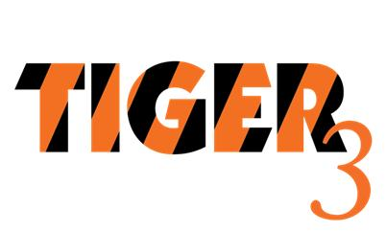

FY 2011 TPB TIGER Grant Application
TPB Technical Committee
Eric Randall
September 9, 2011

Slide 2
Agenda & Structure of Presentation
FY 2011 TIGER Grant Program
Review of TPB’s Concept for the FY 2011 TIGER Grant
USDOT Guidance on Grant Proposals
Review of Proposed Projects
Timeline / Next Steps

Slide 3
FY 2011 TIGER Discretionary Grant Program
Notice of Funding Availability (NOFA) published July 1.
  Pre-application due: October 3
  Application: October 31
Eligible Projects
  Capital improvements that are ready for implementation
  “the result of a planning process which coordinated transportation and land use planning decisions and encouraged community participation.”
  “demonstrate strong collaboration among a broad range of participants.”

Slide 4
Criteria for the
Selection of Projects to Include in the TPB’s FY 2011 TIGER Application
Small-scale, innovative transportation capital projects
  Pedestrian, bicycle, streetscape or other circulation improvements to improve access to rail stations (within ½ mile).
  Located in an existing, underutilized, or emerging employment or housing center
  Demonstrate support and coordination with development in the center (e.g., including private matching funds).
  Balanced regional growth.
  Replicable examples that are innovative in design, concept, or implementation.
Multimodal, multijurisdictional, multi-partnered and difficult to implement under other “modal” funding sources.

Slide 5
Keys to Competitive Applications
Leveraging Investment / Highly Competitive Projects
Application Pitfalls

Slide 6
Leveraging Investment / Highly Competitive Projects
Matching state and local funds with private funds helps demonstrate commitment = more competitive
  First round: TIGER grantees delivered $4.5 billion in matching funding for TIGER’s $1.5 billion
Projects that are ready to move to construction quickly are given priority
Multimodal projects, coordinated investment from other sources and programs
  New partnerships, multi-jurisdictional cooperation
  Public-private partnerships
  Support key national priorities
  Non-traditional or hard to fund projects

Slide 7
Application Pitfalls
Public-private projects must demonstrate significant public benefits
Priorities/outcomes not aligned with selection criteria
Project readiness / where is project in the NEPA process
Insufficient matching funds, lack of demonstration
Non-construction requests: O/M assistance, ROW
Grouping unrelated projects

Slide 8
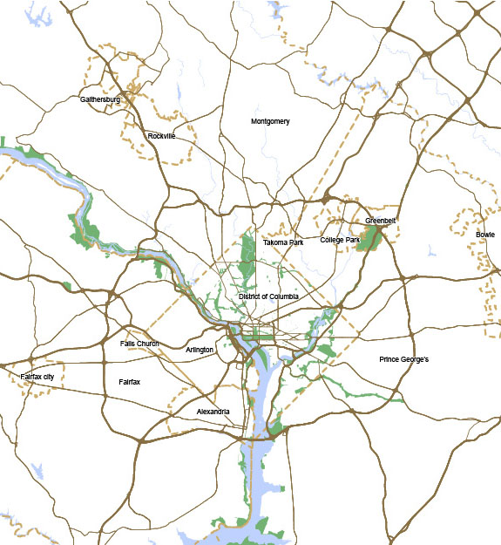
Proposed Projects
VRE Stations

Slide 9
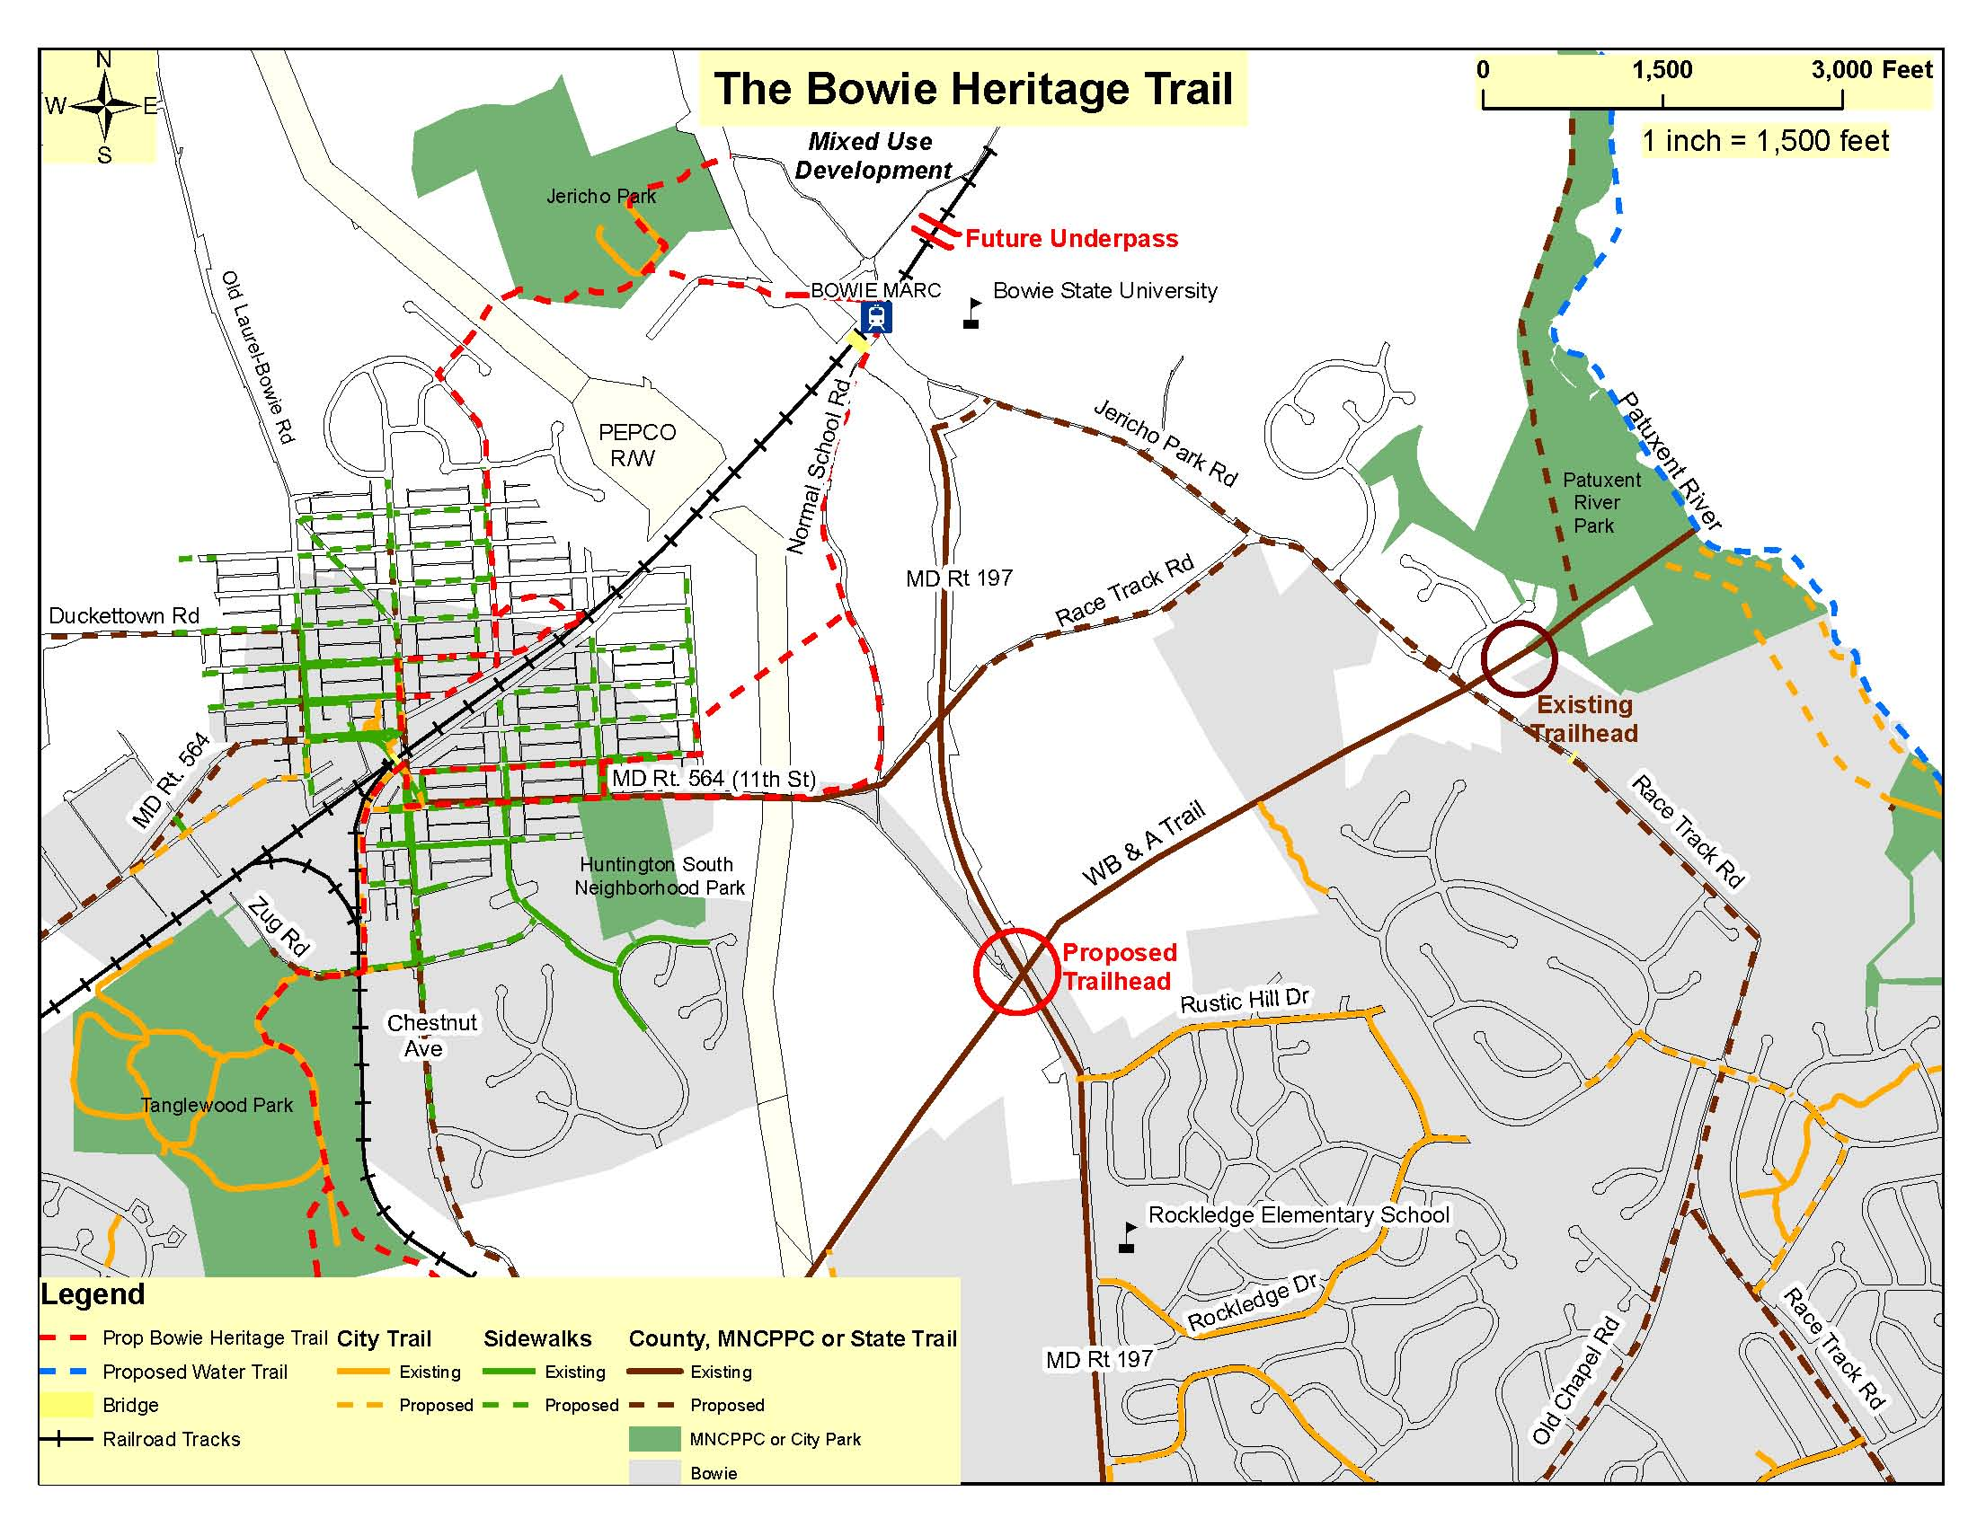
City of Bowie (Placeholder)
The Bowie Heritage Trail
The Bowie Heritage Trail - Completion of the remaining 50 percent engineering plans for Phase 1 in Old Town Bowie and preliminary engineering of a trail underpass of Maryland Route 197, connecting Normal School Road to the MARC train station.
Funding:
  Federal: ?
  Match: ?
  Total: ~$3 million

Slide 10
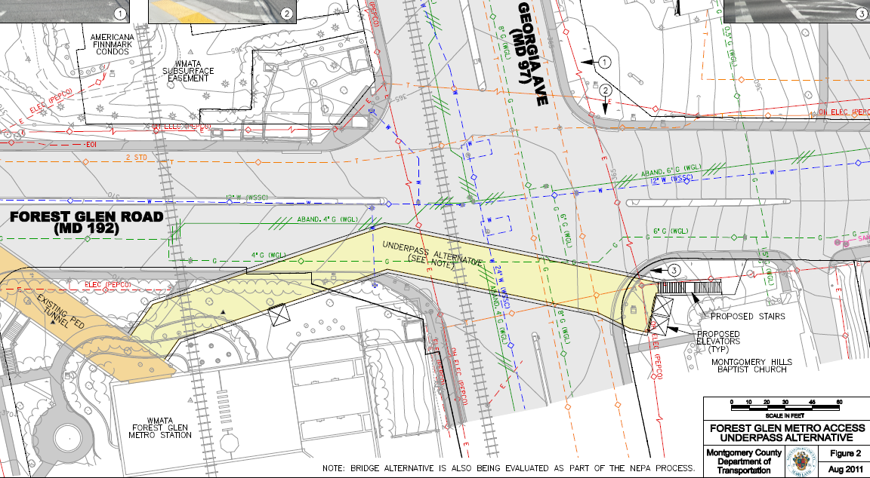
Montgomery County
Forest Glen Underpass Project
Construct a pedestrian/bicyclist underpass underneath Georgia Avenue (MD 97) linking Forest Glen Metrorail Station to the sidewalk serving Holy Cross Hospital; construct one elevator to connect the street level directly to the Forest Glen Metrorail Station mezzanine; and establish bikeshare stations.
Funding:
  Federal: $14,400,000
  Match: $3,600,000 (20 %)
  Total: $18,000,000

Slide 11
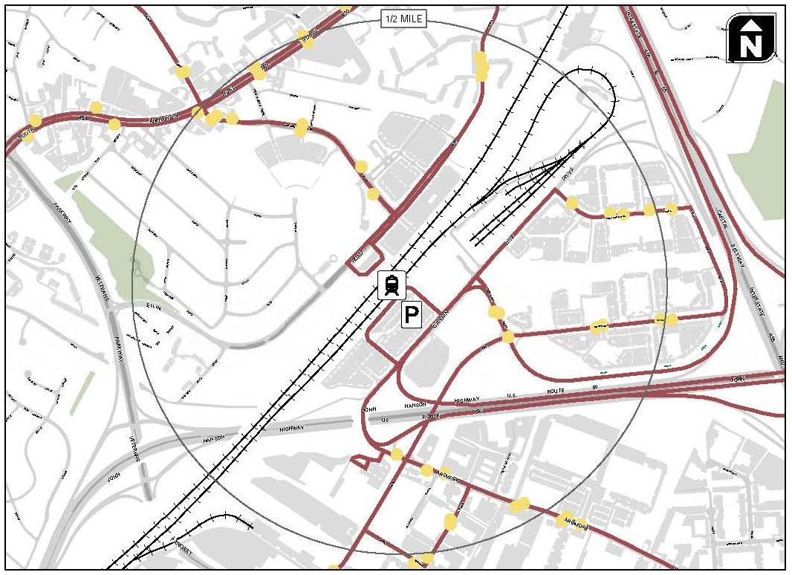
Prince George’s County
Pedestrian Safety Measures for New Carrollton Metro Station
This project would include sidewalk and crossing improvements and signal timing changes. These improvements will greatly enhance the pedestrian and bicycle access in and around the station and make it more suitable for planned transit oriented development, the top priority station for TOD in the County.
Funding:
  Federal: $653,600
  Match: $263,400 (20 %)
  Total: $917,000

Slide 12
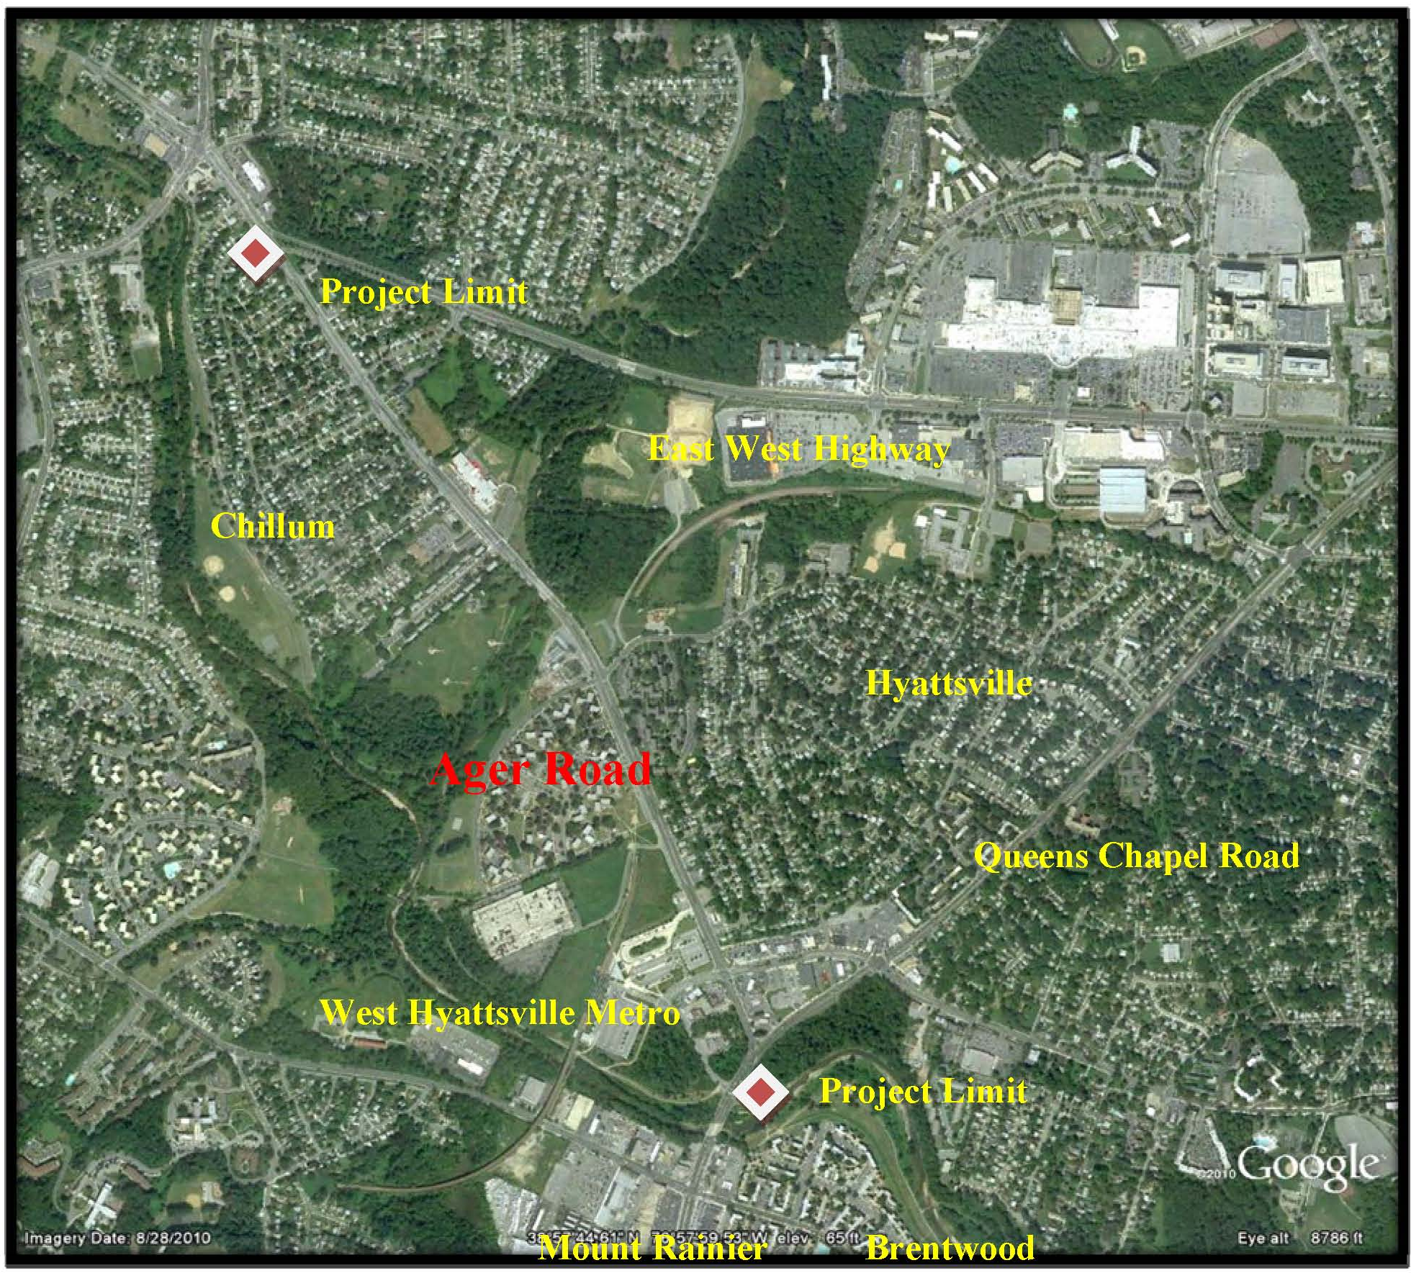
Prince George’s County
West Hyattsville Metro Station/Ager Road Improvements
This project will implement bicycle and pedestrian improvements. The Ager Road portion will provide a complete green street, provide for pedestrian and bicycle facility upgrades, transit improvements, improved low maintenance landscaping, and community and traffic signing.
Funding:
  Federal: $5,320,000
  Match: $1,867,500 (26 %)
  Total: $7,187,500

Slide 13
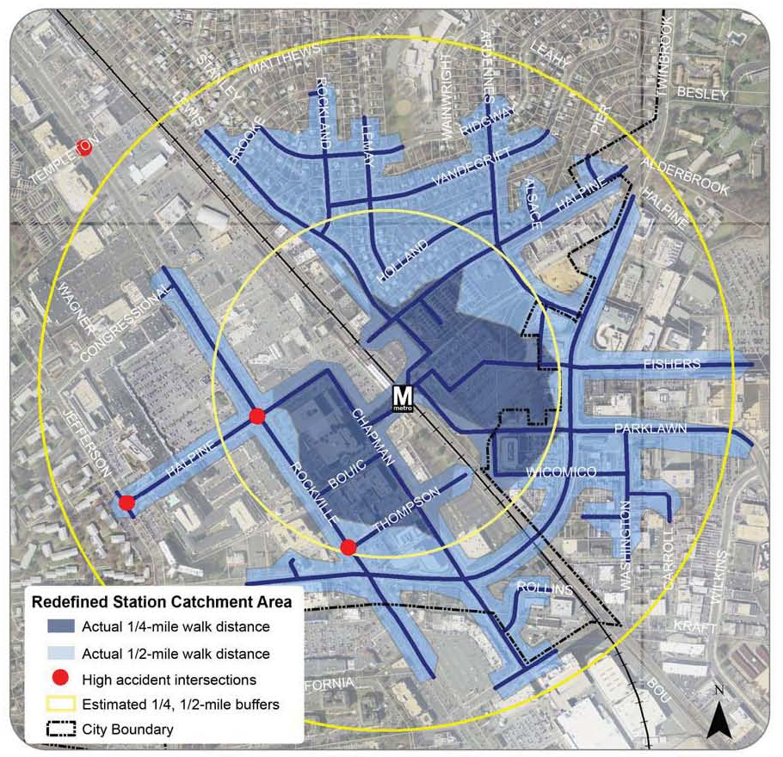
City of Rockville
Safer Walkways to Transit: Twinbrook Metro Station
This project is located entirely within the ½ mile radius around the Twinbrook Metrorail station. The project will include improvements such as providing pedestrian refuge islands, curb extensions, additional pedestrian-scale lighting, etc.
Funding:
  Federal: $855,360
  Match: $213,840 (20 %)
  Total: $1,069,200

Slide 14
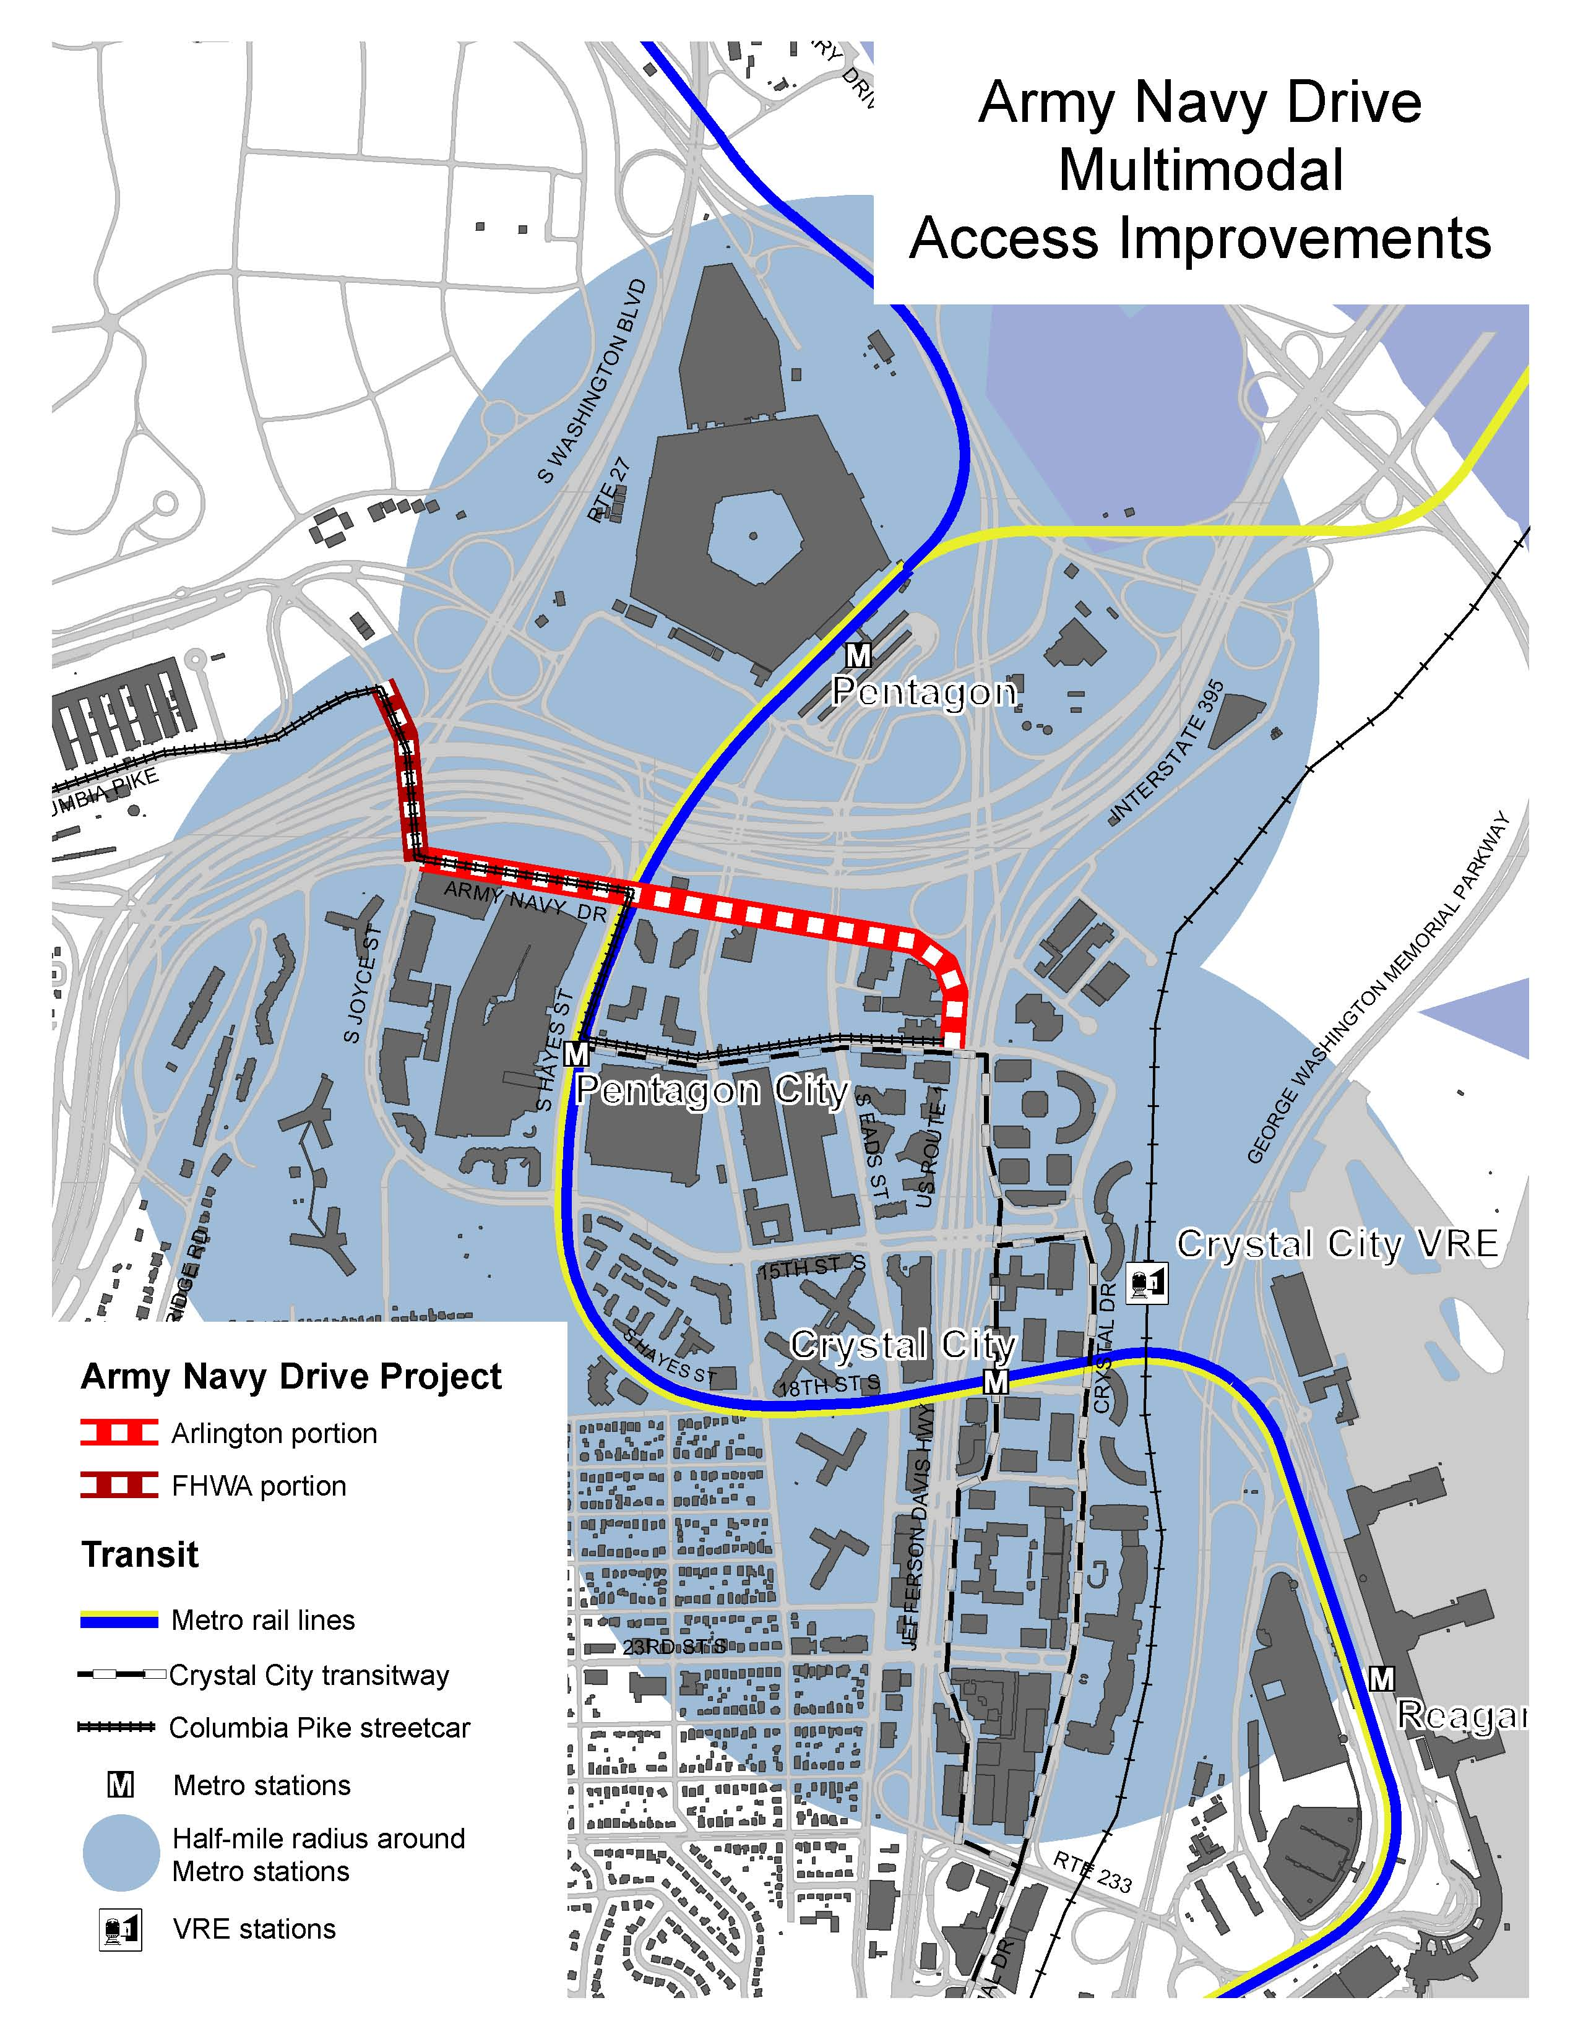
Arlington County
Army Navy Drive Multimodal Access Improvement Project
The project re-conceives 3,300 feet of Army Navy Drive, providing a wider, safer sidewalk, and a physically separated two-way cycle track. The project includes 10 new bikeshare stations.
Funding:
  Federal: $4,887,564
  Match: $2,011,400 (29 %)
  Total: $6,898,964

Slide 15
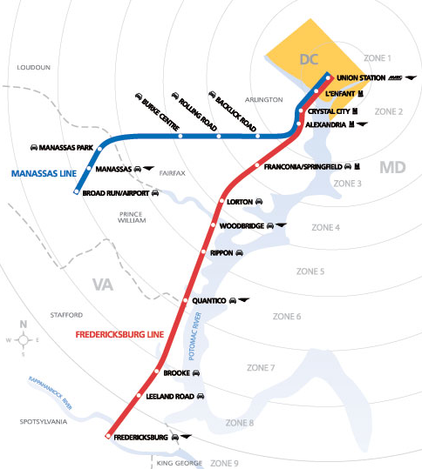
Virginia Railway Express
Bicycle Lockers at VRE Stations
The project will add bicycle lockers to VRE stations in Fairfax and Prince William Counties, and the Cities of Manassas and Manassas Park.
Funding:
  Federal: $209,600
  Match: $52,400 (20 %)
  Total: $262,000

Slide 16
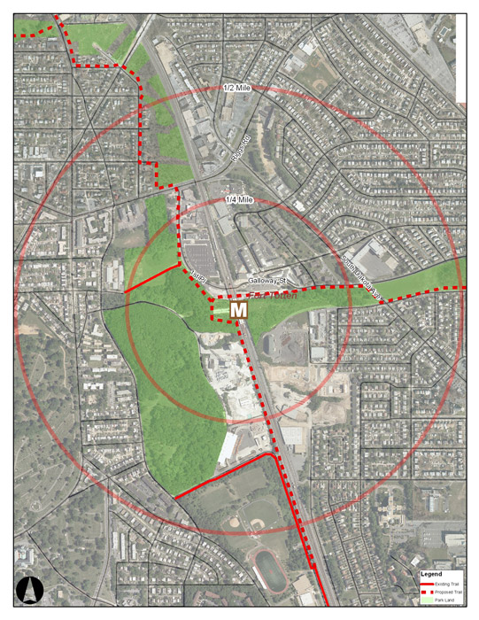
District of Columbia
Fort Totten Access Improvement Project
The project will improve accessibility and safety for pedestrians by rebuilding sidewalks and curbing, installing new lighting, and providing wayfinding signage.
Funding:
  Federal: $2,824,000
  Match: $706,000 (20 %)
  Total: $3,530,000

Slide 17
FY 2011 TPB TIGER Application
Funding Summary for Proposed Projects
District of Columbia
  Federal: $2,824,000
  Match: $706,000 (20 %)
  Total: $3,530,000 (9 %)
Maryland:
  Federal: $21,296,460
  Match: $5,985,240 (22 %)
  Total: $27,281,700 (72 %)
Virginia
  Federal: $5,097,164
  Match: $2,063,800 (29 %)
  Total: $7,160,964 (19 %)
TOTAL:
  Federal: $29,217,624
  Match: $8,755,040 (23.1 %)
  Total: $37,972,664

Slide 18
Finalizing the FY 2011 TPB TIGER Application
Still working to refine scope and cost information among project proposers and supporting agencies. (Required for TPB mail-out on September 14).
Staff Observations:
Cost of Projects
  USDOT announced “sweet spot” of $10 - $25 million. Average grant in TIGER II was $13. 25 million, median grant $10. 5 million.
  TPB goal for application was $18-$20 million (TIGER $14-$16M)
    now at 200% of goal!
Application “Story”
  Need project information to prepare complete, compelling, and competitive grant application: leveraging private development, serving special populations, improving safety, etc.

Slide 19
Proposed Projects – Issues / Concerns
Applicant | Project | Issues / Concerns
City of Bowie | Bowie Heritage Trail | Not currently viable. Only design/engineering proposed (City can only match this). Additional funds needed for construction.
Montgomery County | Forest Glen | Very large project cost of $18M, just under 50% of proposal. Includes $1.5M ROW acquisition.
Prince George’s County | New Carrollton | Area in transition. Concern that prospective development plans are in progress, final street plans not known.
Prince George’s County | West Hyattsville / Ager Road | Reconstructing Ager Road as a green street has significant costs of $6M, may extend beyond TPB application concept.
City of Rockville | Twinbrook | Finalizing project with partner agencies.
Arlington County | Army Navy Drive | Highly-developed area, but with stronger local match (29%).
VRE | Bicycle Lockers | Very small project.
District of Colombia | Fort Totten | Added at last minute. Need more narrative information.

Slide 20
Timeline for TPB Proposal for
FY 2011 TIGER Funding
Next Steps:
September 14: Finalize project costs and construction schedule.
September 17: Collect Benefit-Cost Analysis data and perform analysis.
October 7: Draft application narrative and BCA review.
October 14: Assemble application.
Milestones:
September 21: TPB approval of recommended projects and pre-application package.
October 3: Pre-application due.
October 19: TPB approval of final application package.
October 31: Final application due.

