Slide 1

Item #2
Ozone Season Summary
2010
Sunil Kumar
ACPAC Meeting, COG
September 13, 2010

Slide 2
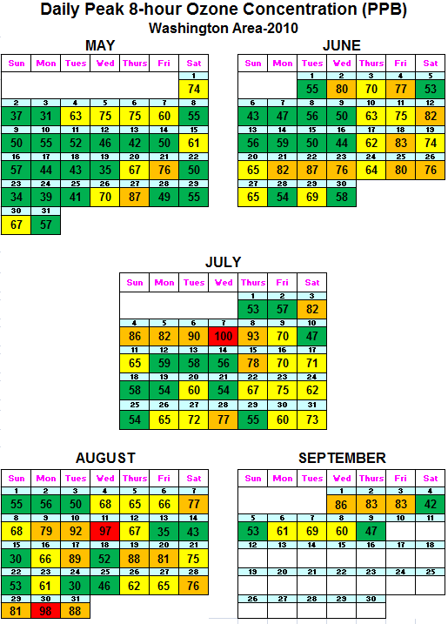
Ozone Season Summary (2010)
Peak 8-Hour Ozone Concentrations (ppb)
Data based on the 8-hour standard set at 75 ppb.
3 Code Red Days
30 Code Orange Days
43 Code Yellow Days
56 Code Green Days
* Analysis is based on draft data until September 10, 2010. Data is subject to change.

Slide 3
2010 Ozone Exceedances
Date | # of Monitors Exceeding | Highest Monitor | Highest Concentration (ppb)
5/21/2010 | 1 | Rockville | 76
5/27/2010 | 4 | HU-Beltsville | 87
6/2/2010 | 1 | HU-Beltsville | 80
6/4/2010 | 1 | HU-Beltsville | 77
6/12/2010 | 1 | Rockville | 82
6/18/2010 | 2 | Franconia | 83
6/21/2010 | 3 | Calvert Co. | 82
6/22/2010 | 5 | HU-Beltsville | 87
6/23/2010 | 1 | Calvert Co. | 76
6/25/2010 | 1 | Prince Georges Co. | 80
6/26/2010 | 1 | HU-Beltsville | 76
7/3/2010 | 3 | HU-Beltsville | 82
7/4/2010 | 5 | River Terrace | 86
7/5/2010 | 3 | Calvert Co. | 82
7/6/2010 | 10 | Prince Georges Co. | 90
7/7/2010 | 13 | McMillan Reservoir | 100
7/8/2010 | 3 | Frederick Co. | 93
7/16/2010 | 3 | Aurora Hills | 78
Date | # of Monitors Exceeding | Highest Monitor | Highest Concentration (ppb)
7/28/2010 | 1 | HU-Beltsville | 77
8/7/2010 | 1 | River Terrace | 77
8/9/2010 | 1 | HU-Beltsville | 79
8/10/2010 | 11 | River Terrace | 92
8/11/2010 | 10 | Calvert Co. | 97
8/17/2010 | 6 | Aurora Hills | 89
8/19/2010 | 4 | River Terrace | 88
8/20/2010 | 6 | McMillan Reservoir | 81
8/28/2010 | 1 | Aurora Hills | 76
8/29/2010 | 2 | River Terrace | 81
8/30/2010 | 10 | Calvert Co. | 98
8/31/2010 | 8 | McMillan Reservoir | 88
9/1/2010 | 5 | McMillan Reservoir | 86
9/2/2010 | 4 | Frederick Co. | 83
9/3/2010 | 1 | Frederick Co. | 83
* Analysis is based on draft data until September 10, 2010. Data is subject to change.

Slide 4
August 28th to September 3rd Poor Air Quality Event
Week long high pressure & temperature event.
Limited clouds allowed for intense sunlight (and record temperatures.
Usually re-circulating light winds kept bringing polluted air back into the region.
All three factors above led to conditions favorable to high ozone levels.

Slide 5
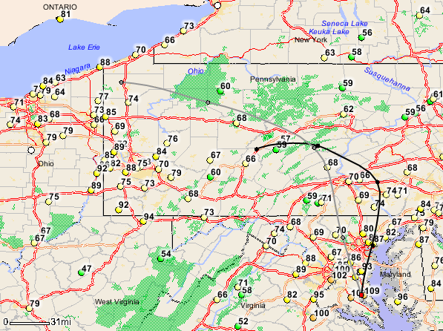
August 30th Code Red
Wind Trajectory at 3 PM (August 30th)
(500 &1000 m)
# of Monitors in Exceedance: 10
1 Monitor in Code Red (Calvert Co., MD)
Maximum 8-Hour Ozone: 98 ppb (Calvert Co., MD)

Slide 6
Ozone Exceedance Trend
* 2010 analysis is based on draft data as of 09.10.10 and is subject to change.

Slide 7
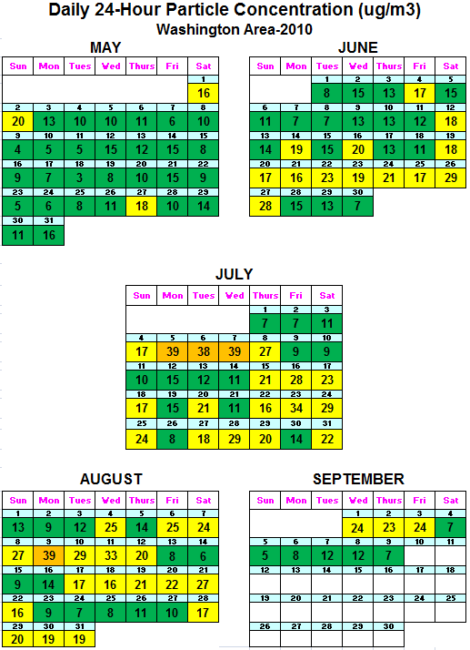
Fine Particle Summary (2010)
24-Hour PM2.5 Concentrations (ug/m3)
Data based on the 24-hour standard set at 35.5 ug/m3.
4 Code Orange Days
51 Code Yellow Days
77Code Green Days
* Analysis is based on draft data until September 10, 2010. Data is subject to change.

