Slide 1
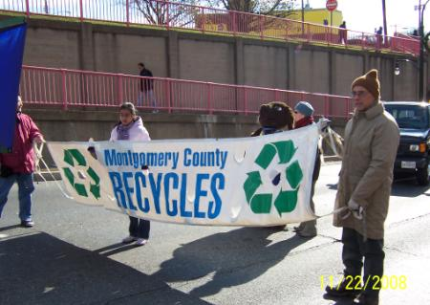
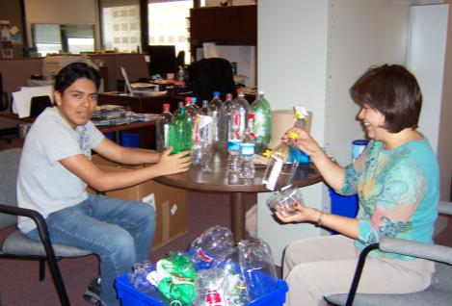
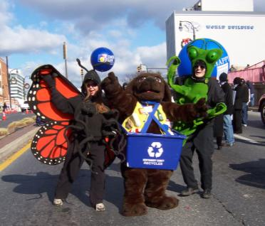
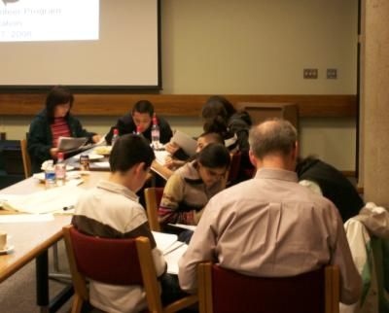
Montgomery County, Maryland
Division of Solid Waste Services
Recycling Volunteer Program
COG Recycling Committee
July 16, 2009

Slide 2
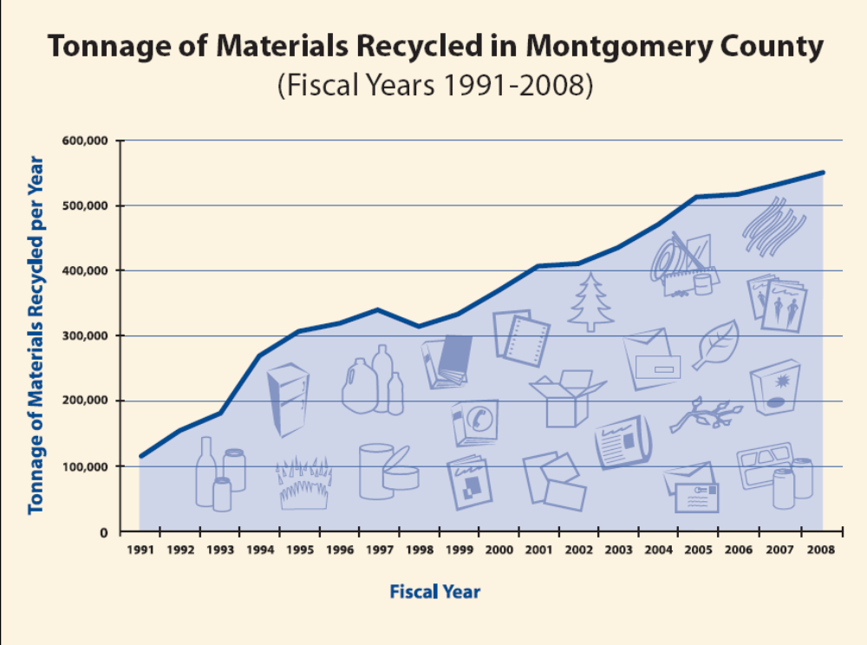
1,249,376 tons of waste generated during Fiscal Year 2008
FY08 Tons Recycled = 553,501 tons

Slide 3
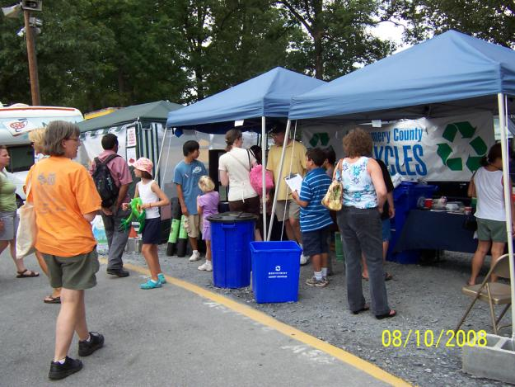
Recycling Volunteer Program Overview
Began July 1991
1,950 people completed training
15,000 hours of
volunteer service
provided
635,000 personal
contacts made
Over $350,000 in
direct services value to Montgomery County

Slide 4
Number of Hours of Service Contributed by Volunteers

Slide 5
Value of Service Contributed by Volunteers

Slide 6
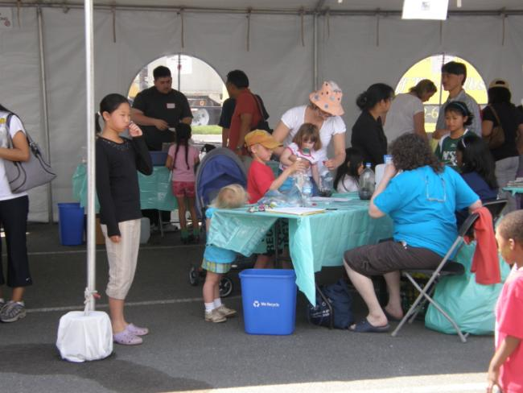
Recycling Volunteer Program FY09
178 active volunteers
1,247 hours of service
22,931 contacts made
$31,187 in direct
service value
70 community events
6 volunteer recruitment events reaching 551 prospect volunteers

Slide 7
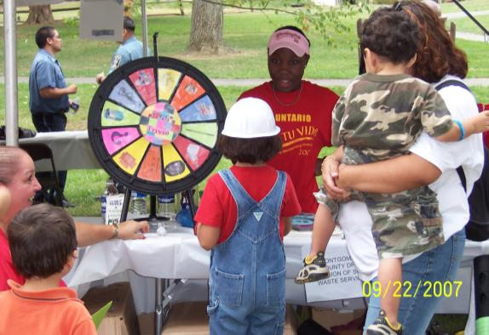
Volunteer Opportunities
Speaker’s Bureau
Fairs and Festival
Outreach
Volunteer Team Leader
Composting and Grasscycling Outreach
Office Assistance
Neighborhood Outreach: Block and Building Recycling Captain
Multi-lingual Speakers
Special Projects

Slide 8
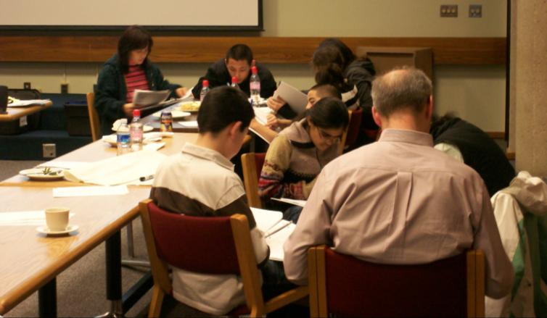
Best Practices
Orientation required for
new volunteers
  Volunteer handbooks
  Handouts
  List of contacts

Slide 9
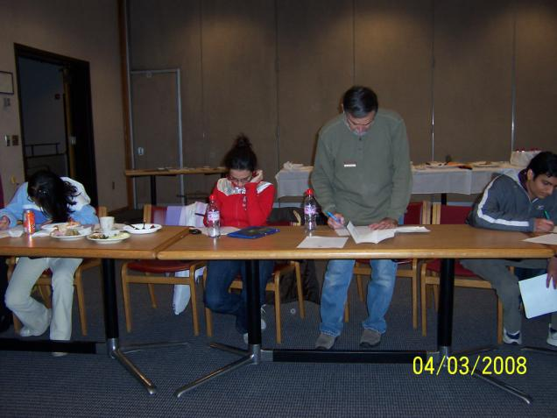
Best Practices
Ongoing volunteer
development
  Difficult situations
  Customer service
  Presentation skills
  Recycling updates
  Lead volunteer
Staff training required for staff working with volunteers

Slide 10
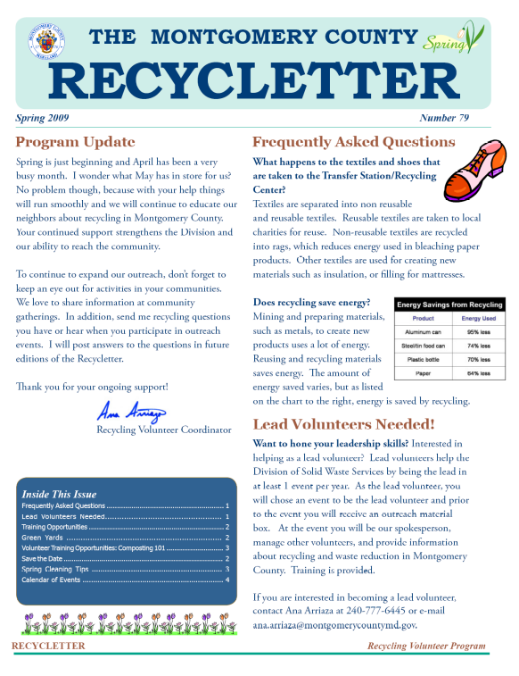
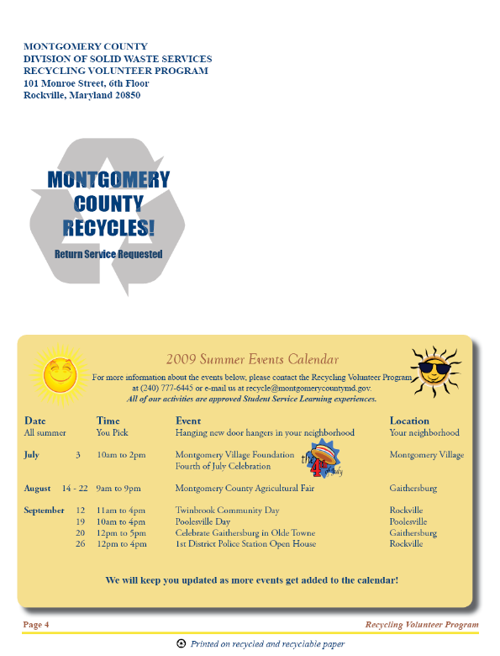
Best Practices
Regular communication
  Emails
  Newsletter
  Phone Calls
  Social Website

Slide 11
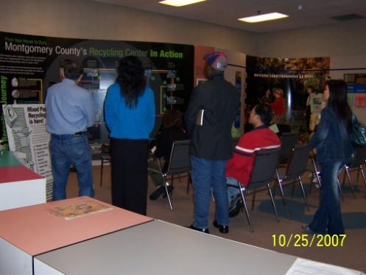
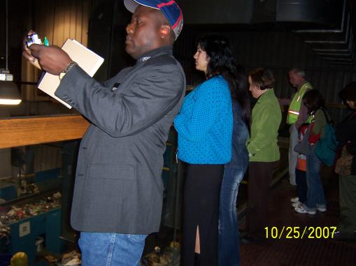
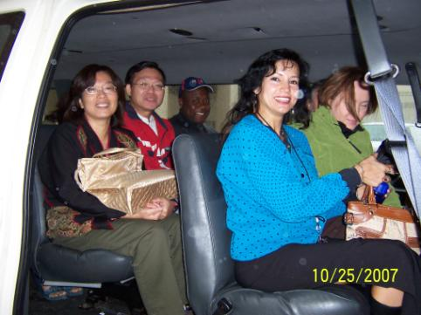
Best Practices
Field Trips
  County Facilities
  Recycling Related Sites

Slide 12
Best Practices
Recruitment of diverse volunteers
  Age
  Multiple languages
Evaluation
  After trainings
  After volunteers participate in activities
Supplies
  T-shirt
  Name badge
  Forms (sign-in sheets and SSL forms)

Slide 13
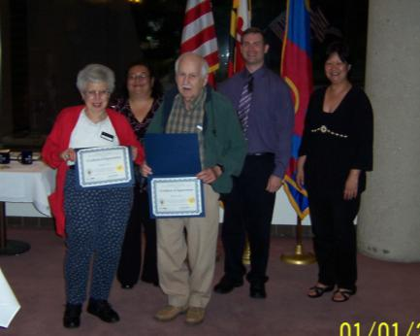
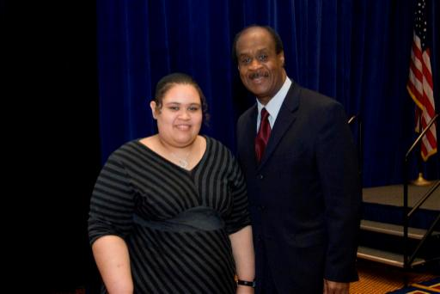
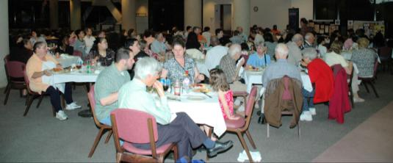
Best Practices
Appreciation and Recognition
  Annual recognition and
  appreciation ceremony
  Thank-you notes
  Outstanding volunteers recognized during annual recycling awareness week awards ceremony
  Service pins

Slide 14
Questions
Montgomery County, Maryland
Department of Environmental Protection
Division of Solid Waste Services
101 Monroe Street, 6th Floor
Rockville, Maryland 20850
(240) 777-6400 phone; (240) 777-6465 fax
Website:www.montgomerycountymd.gov
Email: recycle@montgomerycountymd.gov

