Slide 1
Review of MOVES2010 Local Data Inputs
Sunil Kumar
MOVES Task Force Meeting
MWCOG
January 19, 2010

Slide 2
MOVES2010 – Change in Formats of Some Inputs
I/M Program
  Significant change in input data format.
  Data format now consistent with other inputs.
  New format means states need time to develop.
  I/M emissions effects not available for diesel vehicles and continuous I/M inspection frequency in MOVES2010.
Fuel Supply & Fuel Formulation
  Option to provide state developed fuel formulation in addition to numerous fuel formulations available in model database.

Slide 3
MOVES2010 – Change in Formats of Some Inputs
Zone Road Activity (Custom Domain Only)
  Allocation of total VMT for each road type to different zones within a custom domain.
  Only 1 zone can be modeled within a custom domain in MOVES2010.
Month, Day, and Hour VMT Fractions
  New inputs
  Allows user allocation of total VMT to different months, days (weekday/weekend), and hours.
  Draft MOVES2009 model had these in-built.

Slide 4
Meteorology – COG Mob6 Vs. MOVES Default
Ozone Season Day Analysis
  COG Mob6 Meteorology:
    Hourly temperature & relative humidity from top 10 8-hour ozone days from IAD and DCA during 2002-2004.
  MOVES Default Meteorology:
    Hourly temperature & relative humidity for 3 different ozone season periods (May-Sep, Jun-Aug, July) from 1997 8-hour ozone NAA counties. This was developed from MOVES default database, which contains 30 year avg. (1971-2000) hourly met data for 12 months and for each county in the country.

Slide 5
Meteorology – COG Mob6 Vs. MOVES Default
Annual Analysis
  COG Mob6 Meteorology:
    3 year avg. (2002-2004) hourly temperature & relative humidity for 12 months from IAD and DCA.
  MOVES Default Meteorology:
    Hourly temperature & relative humidity for 12 months from 1997 PM2.5 NAA counties. This was developed from MOVES default database, which contains 30 year avg. (1971-2000) hourly met data for 12 months and for each county in the country.

Slide 6
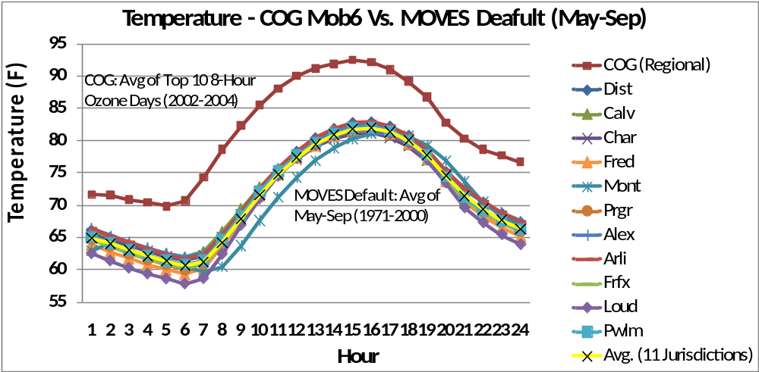
Temperature – COG Mob6 Vs. MOVES Default
Ozone Season Day Analysis

Slide 7
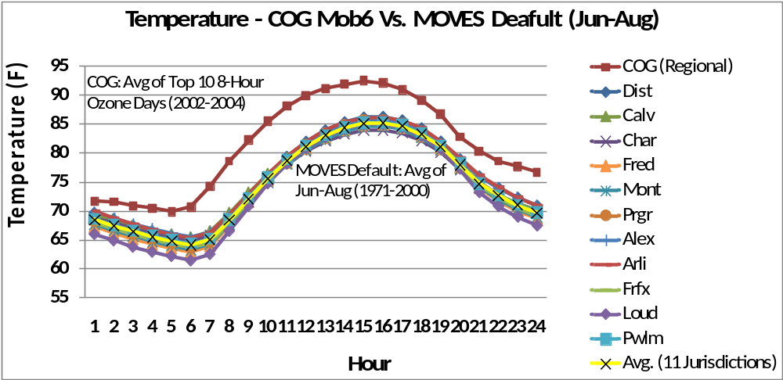
Temperature – COG Mob6 Vs. MOVES Default
Ozone Season Day Analysis

Slide 8
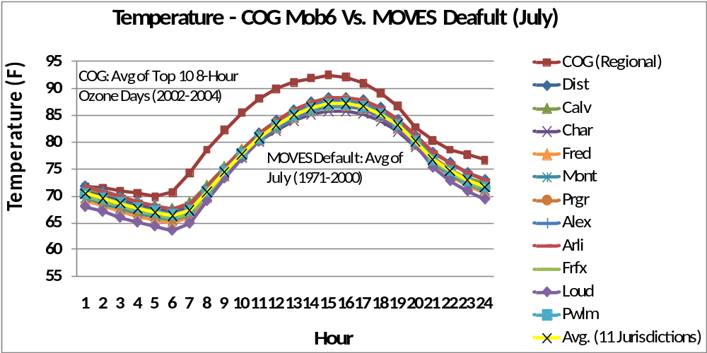
Temperature – COG Mob6 Vs. MOVES Default
Ozone Season Day Analysis

Slide 9
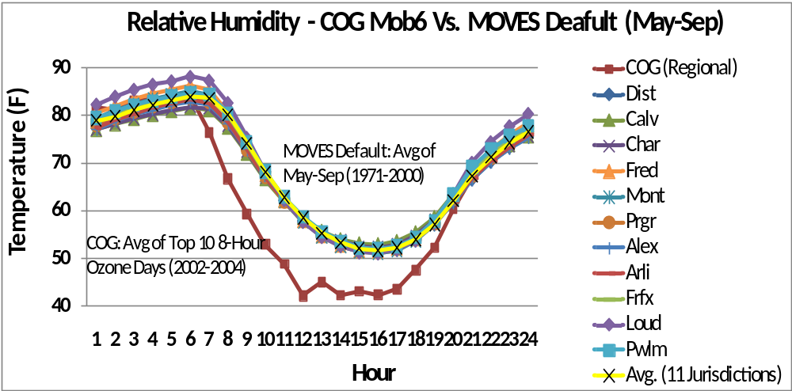
Relative Humidity – COG Mob6 Vs. MOVES Default
Ozone Season Day Analysis

Slide 10
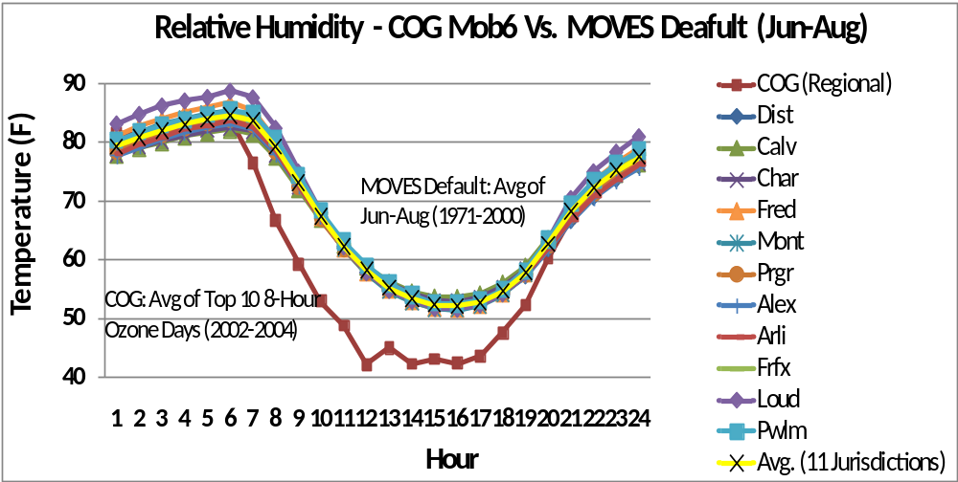
Relative Humidity – COG Mob6 Vs. MOVES Default
Ozone Season Day Analysis

Slide 11
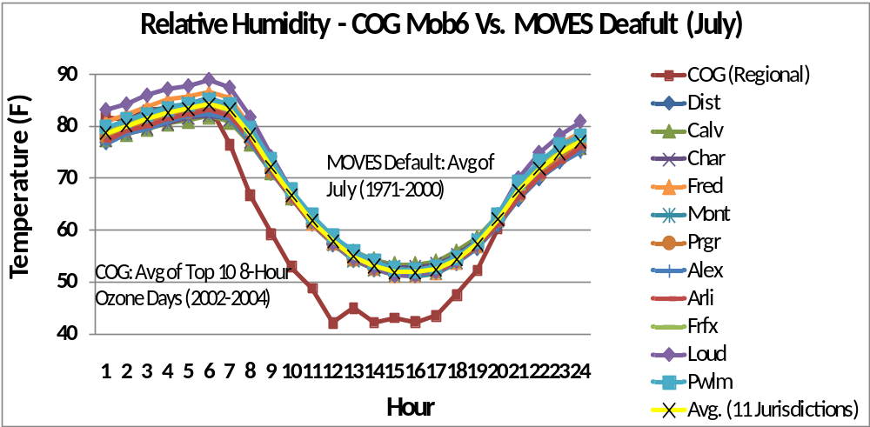
Relative Humidity – COG Mob6 Vs. MOVES Default
Ozone Season Day Analysis

Slide 12
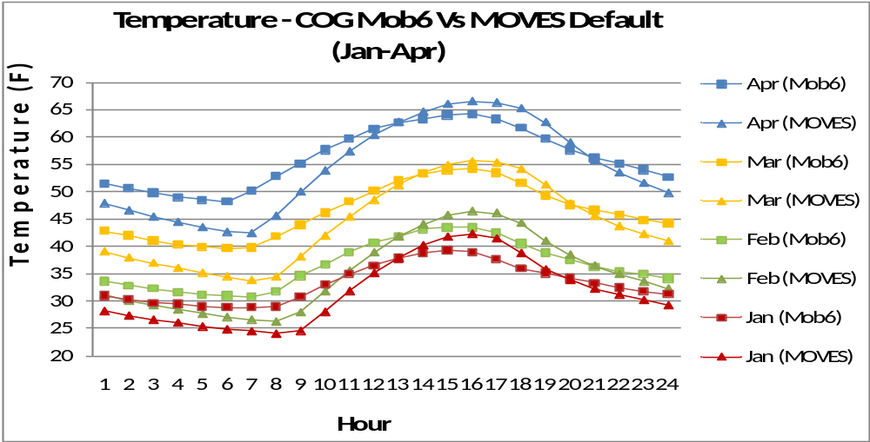
Temperature – COG Mob6 Vs. MOVES Default
Annual Analysis

Slide 13
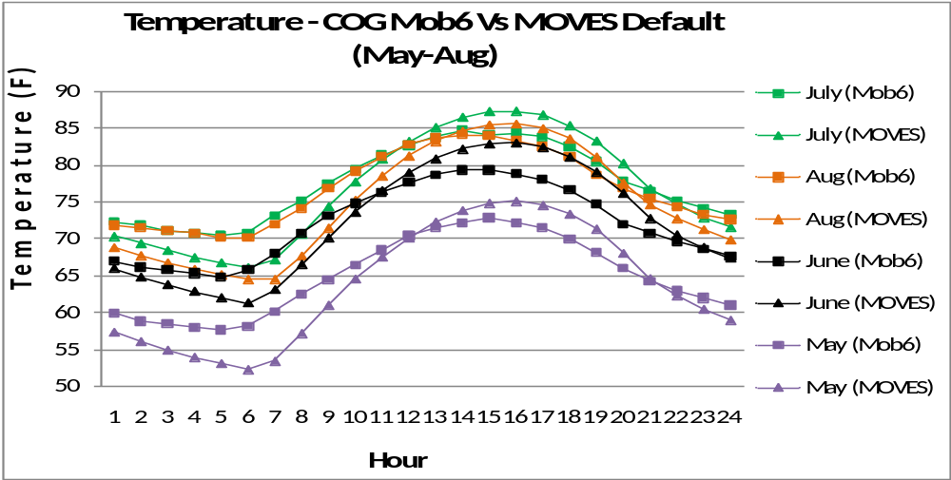
Temperature – COG Mob6 Vs. MOVES Default
Annual Analysis

Slide 14
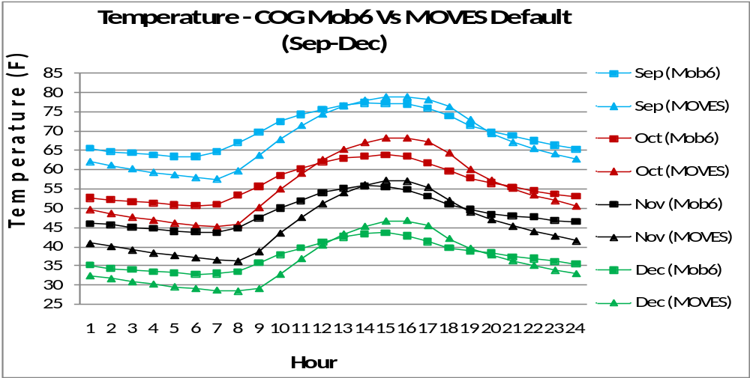
Temperature – COG Mob6 Vs. MOVES Default
Annual Analysis

Slide 15
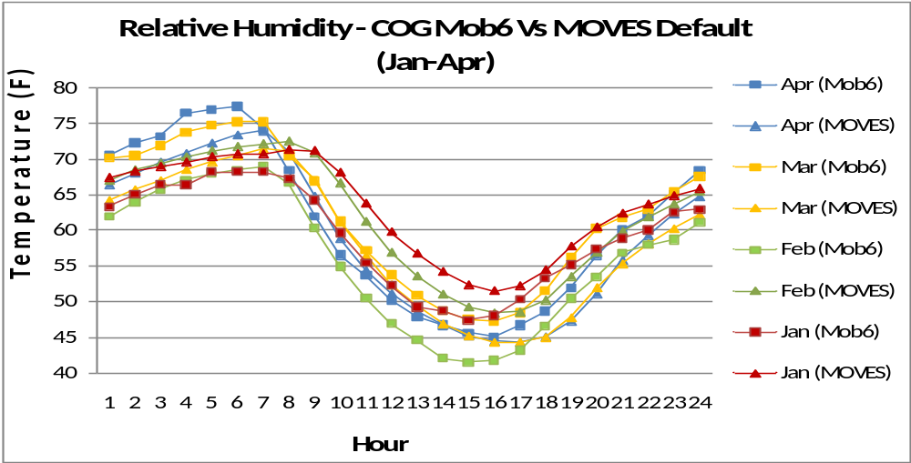
Relative Humidity – COG Mob6 Vs. MOVES Default
Annual Analysis

Slide 16
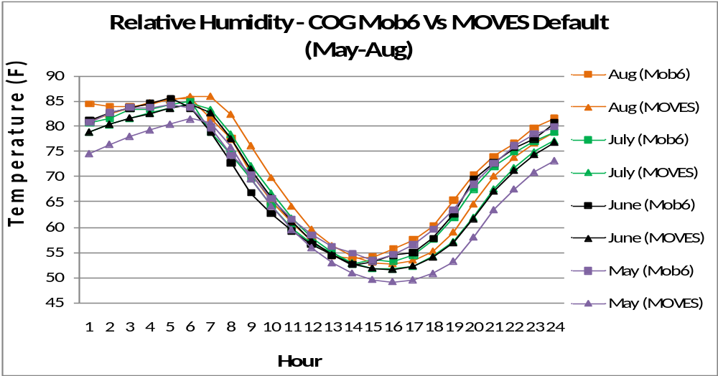
Relative Humidity – COG Mob6 Vs. MOVES Default
Annual Analysis

Slide 17
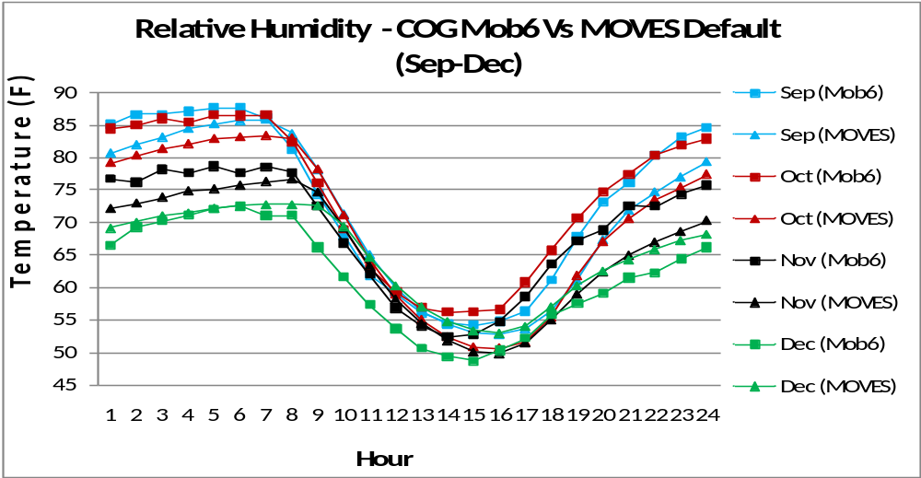
Relative Humidity – COG Mob6 Vs. MOVES Default
Annual Analysis

Slide 18
Summary
COG Mob6 Vs. MOVES Default Meteorology
Ozone Season Day Temperature
COG Mob6 temp higher than MOVES default in all 3 periods (May-Sep, Jun-Aug, July).
Ozone Season Day Relative Humidity
COG Mob6 relative humidity lower than MOVES default in all 3 periods (May-Sep, Jun-Aug, July).
Annual Temperature
COG Mob6 temp higher during most hours than MOVES default in all 12 months.
Annual Relative Humidity
COG Mob6 relative humidity higher than MOVES default in all months except Dec, Jan, and Feb.

