Slide 1
Potomac River Water Quality:
A New Method to Quantify Loads and Long-Term Nutrient and Sediment Trends
Joel Blomquist
Materials provided by
Robert Hirsh and Douglas L. Moyer
U.S. Department of the Interior
U.S. Geological Survey
U.S. Department of the Interior
U.S. Geological Survey

Slide 2
Points of Discussion
Introduce a new method for analysis
Highlight results from Susquehanna River
Provide an overview of an upcoming USGS report
Future plans in the Potomac
Answer questions and discuss water-quality monitoring, analysis, and reporting in the region

Slide 3
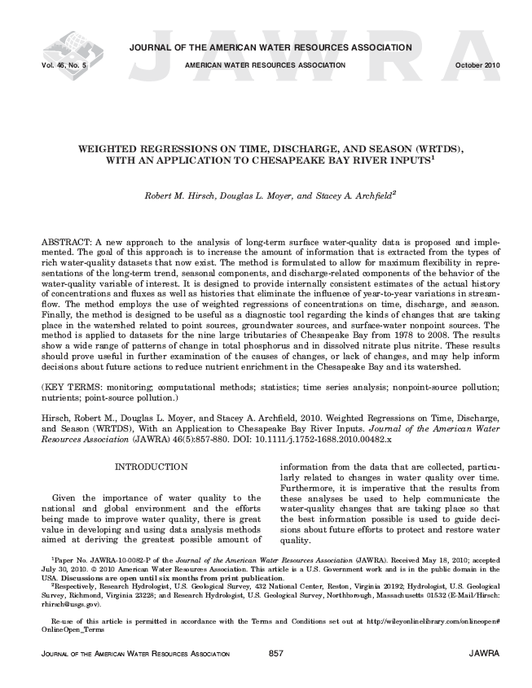
NEW METHODOLOGY
Weighted Regression on Time, Discharge, and Season (WRTDS)
Addresses both the Technical and Management Concerns

Slide 4
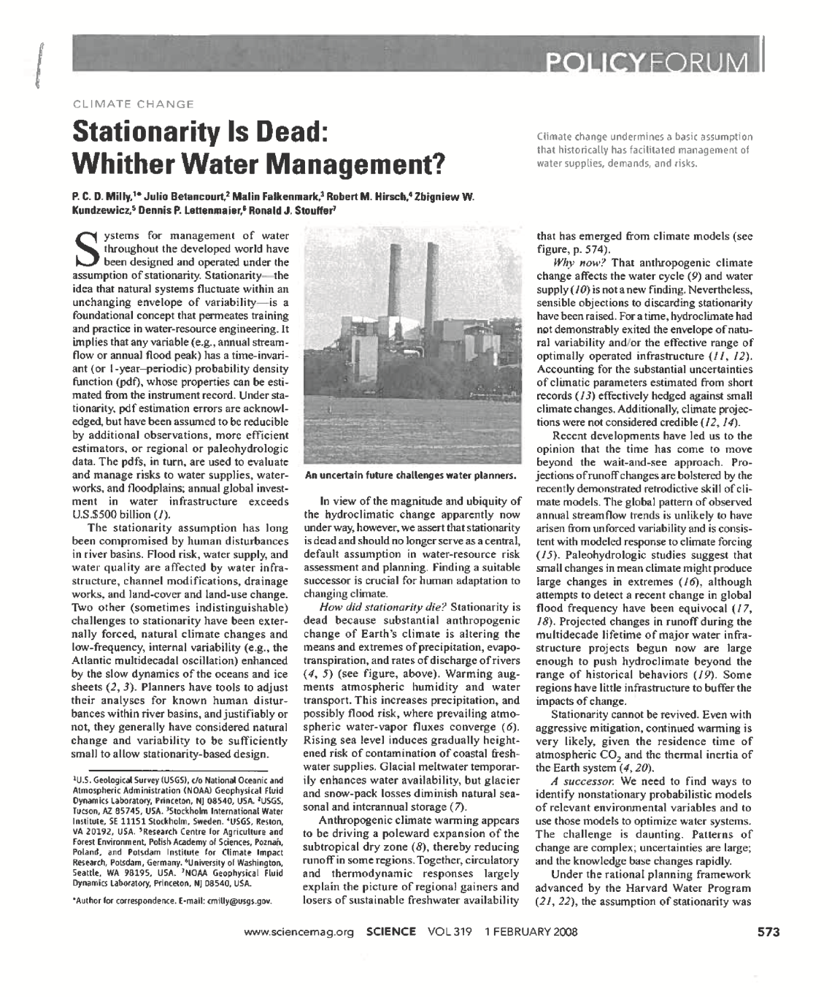
TECHNICAL CONCERNS
Assumption of stationarity
Complexity of concentration-discharge relation

Slide 5
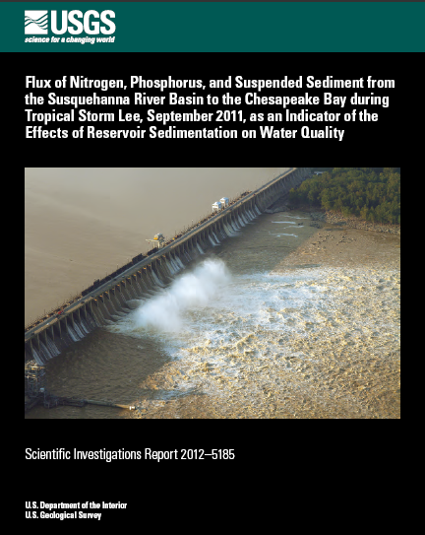

Results of data analysis on Nitrogen, Phosphorus, and Suspended Sediment fluxes from the Susquehanna River to the Bay in Tropical Storm Lee, 2011
Based on a report by:
Robert M. Hirsch,
Research Hydrologist, USGS
Notes:
I to provide you with some key highlights of a recent USGS report from Bob Hirsch.

Slide 6
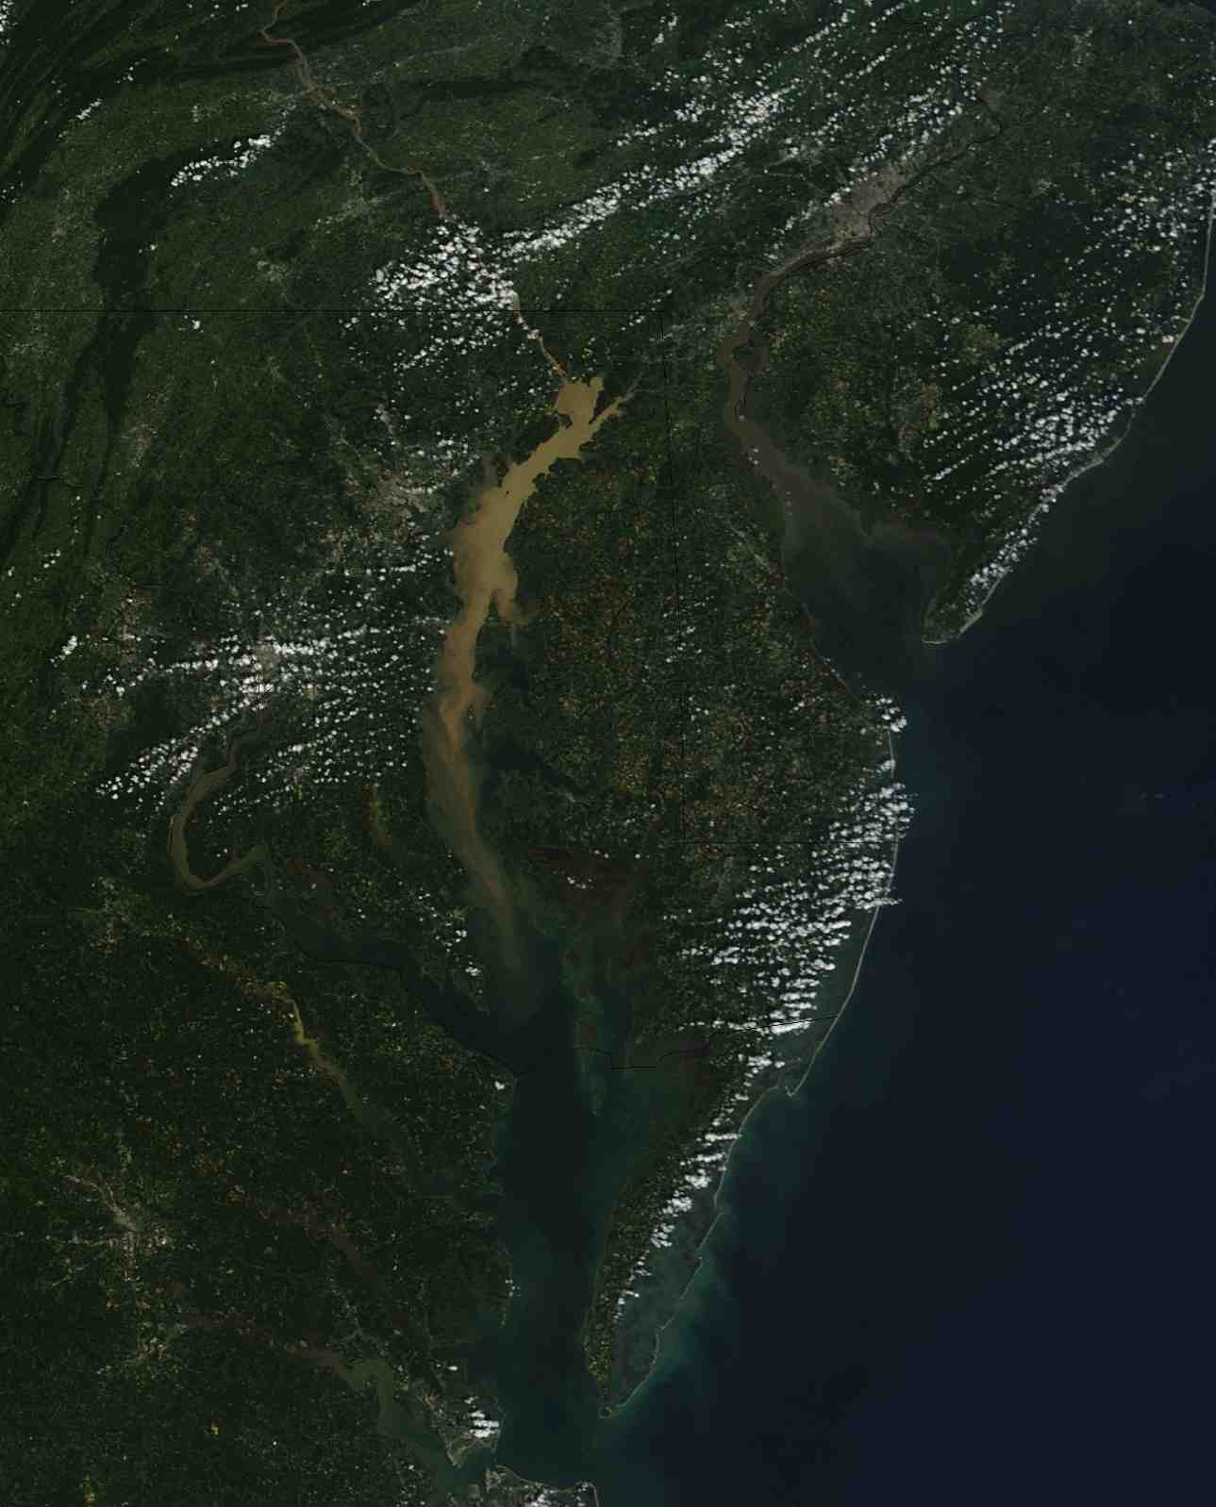
Report
TS Lee
Loads
Influence of reservoirs
Photo credit: NASA MODIS, Sept. 13, 2011
Notes:
The report covers three main items:
Analysis of N, P, and S loads from the Susquehanna River associated with TS Lee.
Also looked at the also longer term changes in loads to help assess the influence of the reservoirs on the lower Susq river on sediment storage. Being the largest river flowing in the Chesapeake Bay, this site as am important impact on conditions in the upper Bay.
Overall, Sus provides about ½ the river flow, 41 percent of the N, 25% of P and 27% of the sediment load during the 1990’s
TS Lee produced had a large amount of rainfall that resulted in scouring of sediment from the reservoirs on the lower Susq River and resulted in a sediment plume extending to near the mouth of the Potomac River, nearly 100 miles (see figure).
The report focusing on the N, P and sediment loads from the Susq River, we did NOT do analysis for other sites, given this was mostly an event that hit the Susq.

Slide 7
 | T.S. Lee as a % of 2011 | T.S. Lee as a % of last decade | T.S. Lee as a % of full record (1978)
Time | 2% | 0.2% | 0.06%
Flow | 12% | 1.8% | 0.6%
Total Nitrogen | 31% | 5% | 1.8%
Total Phosphorus | 61% | 22% | 9%
Suspended Sediment | 78% | 39% | 22%
Notes:
Look at TS Lee compared to 2011 and last decade, and since 1978
First column shows how much TS Lee influenced the year. While it only accounted for a relatively short period of time (a week) of high flow due to the storm, just over 30% of the N for the entire year came in, about 60 percent of the P , and almost 80 percent of the sediment. You can also see results compared to the last 10 years and since we have been monitoring (1978). So it had a very large delivery of nutrient and sediment loads to the upper Bay. The upper bay experienced a loss of SAV in Susq flats and loss of some oyster beds due to burial by sediment.

Slide 8
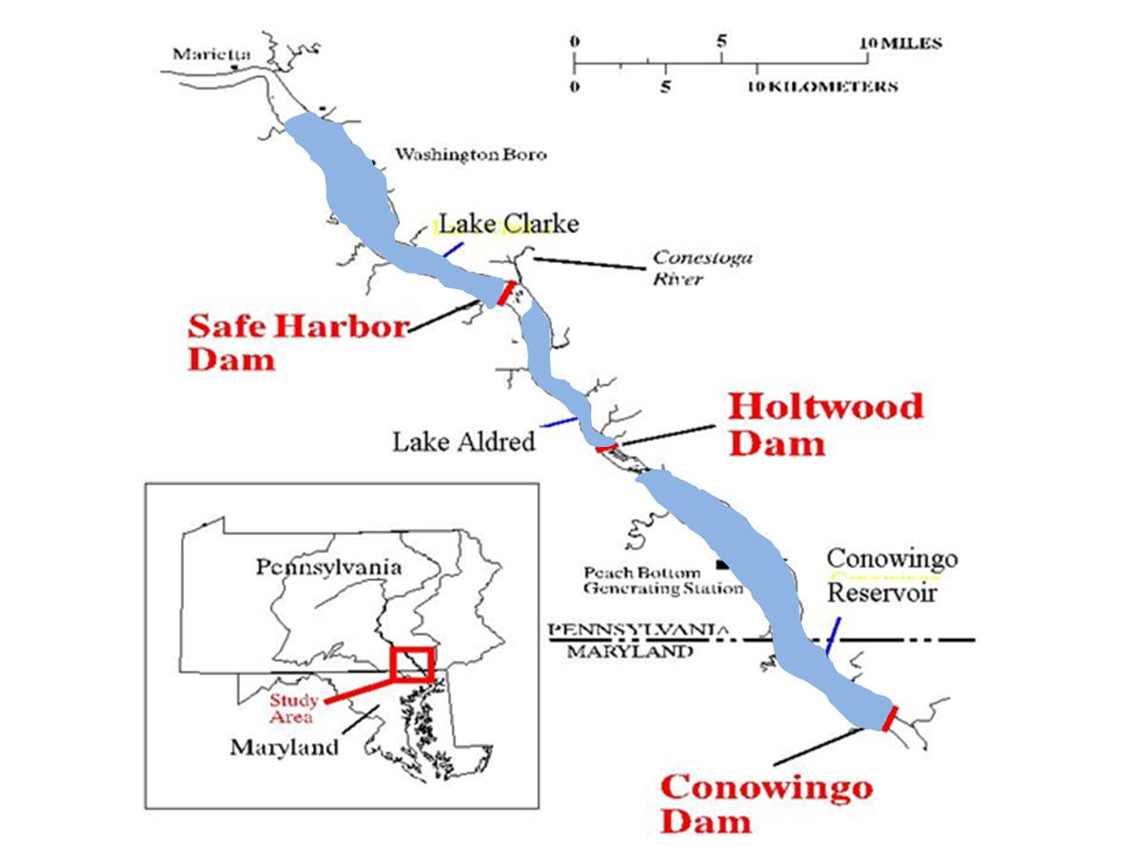
Notes:
We wanted to better understand how much sediment may have been trapped or eroded from the Reservoir System on the Lower Susq River.
USGS looked at the information to see if nutrient and sediment loads to the bay are changing as the Lower Susquehanna River Reservoir System reaches its sediment storage capacity.
USGS has done previous studies of the influence of the reservoirs on sediment delivery to the Bay. The upper most reservoirs, above Safe Harbor and Holtwood dams have reached their sediment storage capacity. Surveys of the Conowingo Reservoir shows it is on a trajectory to reach capacity. Here is a slide of this…

Slide 9
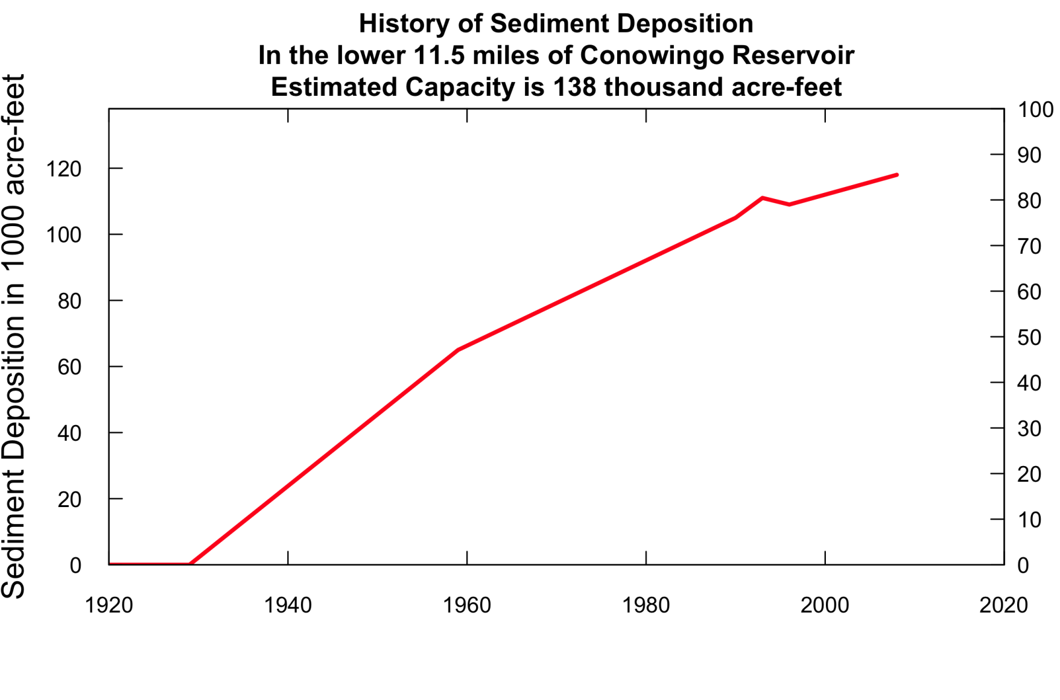
Percent of capacity
Source: Langland, 2009, USGS
http://pubs.usgs.gov/sir/2009/5110/
Notes:
This slide shows how much sediment is being deposited since the Conowingo Reservoir was build in 1929 . The history of sediment storage in the lower Susquehanna River has been the topic of a number of studies (Langland, 2009; Langland, 1998; Langland and Hainly, 1997) and they all point to the same general conclusions: The pools behind the dams (in total) are on a long-term trajectory towards filling. Langland and Hainly (1997) describes the history of deposition in Lakes Clarke and Aldred and concludes that both of them are in "long-term equilibrium." This means that taken as an average over several years there is no net change in sediment stored in these two reservoirs.
The most recent bathymetric survey in 2008 indicates that 118,000 acre feet of storage (86 percent of capacity) have been lost to sediment deposition. The axis on the right shows percent of storage capacity. At the time that Langland and Hainly's 1997 report was written (15 years ago), the time to fill the reservoirs was estimated at 17 to 20 years in the absence of more scour-producing floods making it between 2015 to 2020. Once they reach their capacity, sediment and associated P loads into the Bay are expected to increase but there would not be much effect on nitrogen since it is mostly dissolved in water.
A major finding of this report is that sediment and phosphorous loads from the Susquehanna River are already increasing due to the loss of sediment storage capacity in the reservoirs. As the reservoirs fill, there is less chance to trap sediment coming from upstream areas and also more sediment gets scoured out during storm events. Let me show you results for Phosphorous, sediment and Nitrogen.

Slide 10
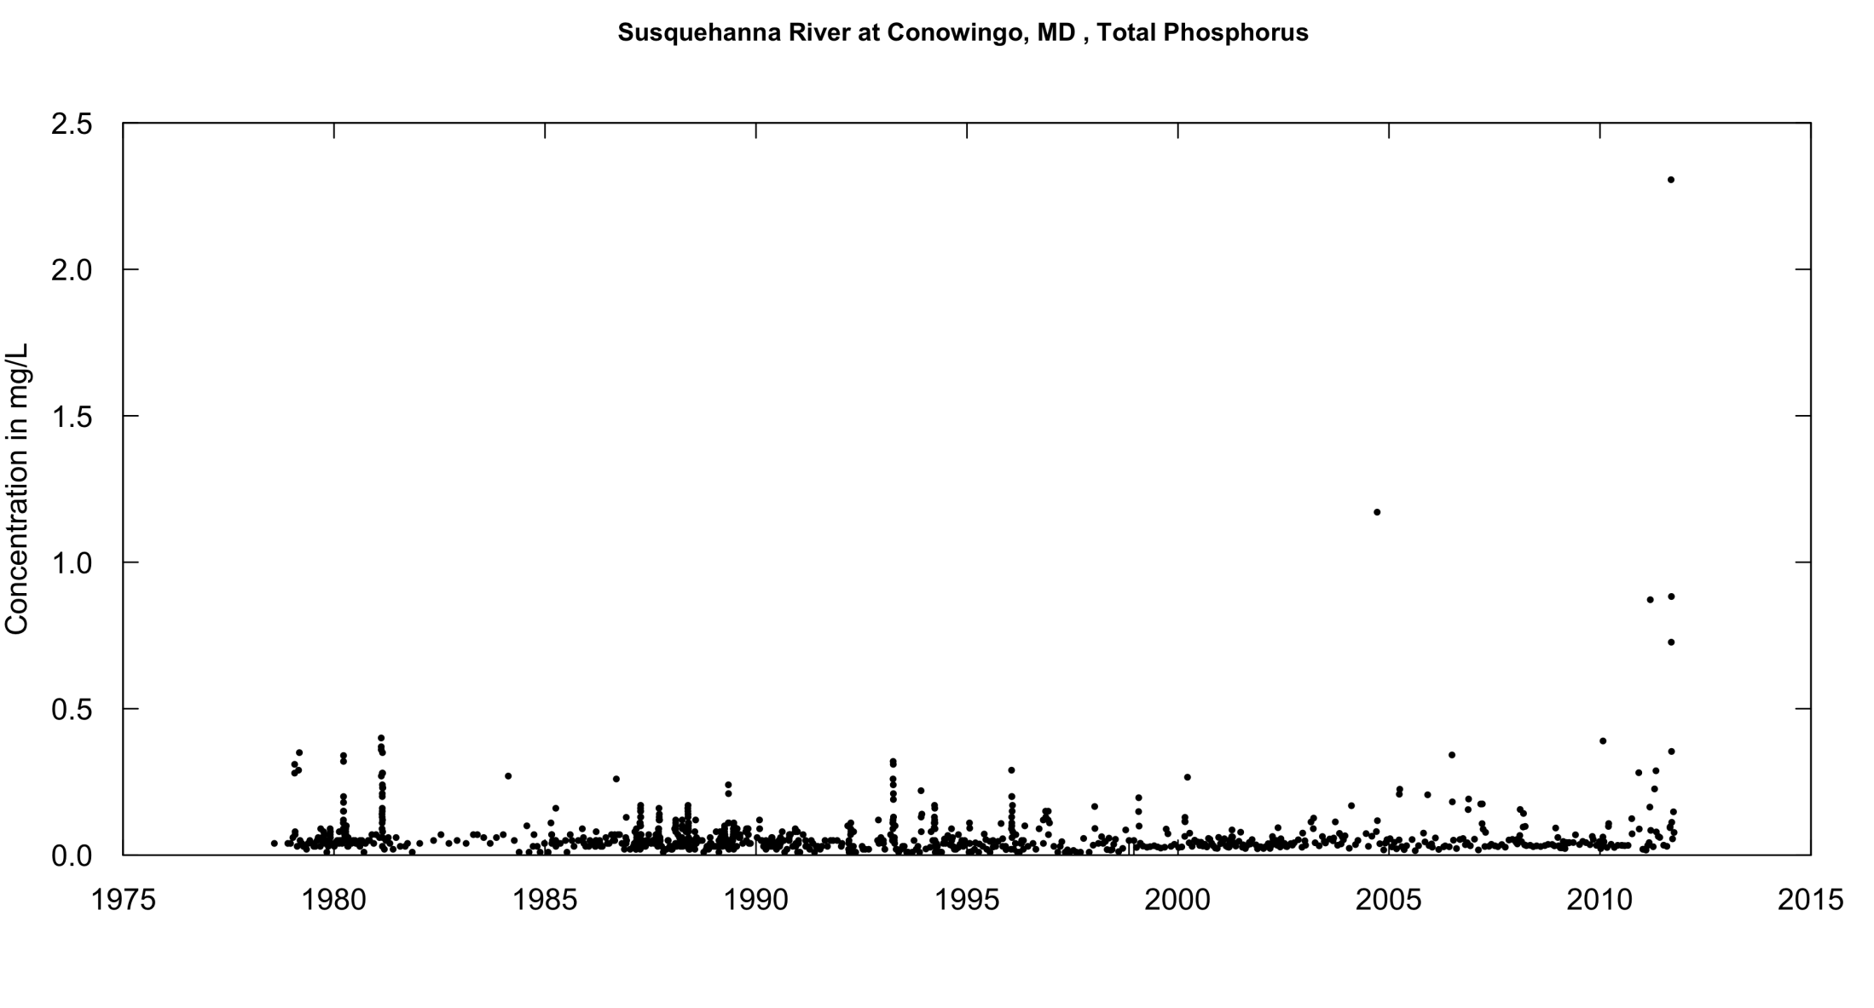
Two techniques to estimate trends:
Concentration or “levels in water”
Flux/loads or “total amount”(new technique)
Both adjust for variability in flow
Notes:
We have two techniques to look at trends. One is looking at changes in concentrations or the levels of P, N or Sediment in the water. Below is a plot for all the TP concentrations we have collected at the Susq at Conowingo site. Our latest update for trend in TP concentration through 2010 showed not significant change both in the long term and over the past 10 years. We are working on the 2011 update now.
In this report, the method that is used to construct load estimates is “Weighted Regressions on Time, Discharge, and Season” (WRTDS) which is described by Hirsch and others (2010). The history of total nitrogen flux (or load). Flow-normalized flux provides a way of evaluating the changing behavior of system in a manner that removes the effect of year-to-year variations in streamflow, but preserves the effect of the normal seasonal and random components of the streamflow record.

Slide 11
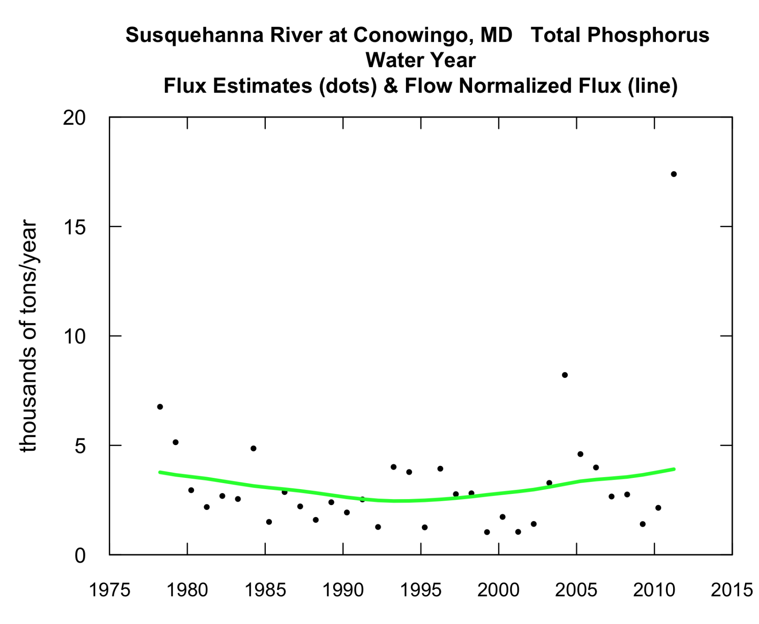
Annual Load of Phosphorus
(In 10³ tons/yr)
Flow
Normalized
Load
Up 55%
Since 1996
Notes:
Estimated annual flux of total phosphorus, by water year for the Susquehanna River at Conowingo, MD (shown as points). Estimates are based on WRTDS smoothing. Also shown, as the green curve, are the flow-normalized flux values. The figure shows the large amount of annual variation in flux, with 2004 and 2011 standing out as having very high values. The flow-normalized record (shown in green) is indicative of the long-term change in the behavior of the system. It shows a period of decreased flow-normalized flux through about 1993, and since that time it has increased from about 2500 tons/year to about 3900 tons/year. Since 1996 the flow-normalizied load (or flux) has increased 55%. These steady increases reflect the fact that over time, the concentrations for the highest discharge values have been rising sharply.

Slide 12
Messages about TP and Sediment
Concentrations are relatively stable at moderate and low flows, increasing during storms
2011: highest recorded loads for TP and sediment
Loads risen since mid-1990s: TP: 55%: Sed: 97%
Conowingo Reservoir not trapping as much sediment
Upstream river sites show TP decreases
Practices are working in many areas of Susq. but may be counter balanced by reservoir filling.
Notes:
The concentrations of TP and sediment are relatively stable at moderate and low flows but increasing during storms
In 2011 we had the highest loads of TP and Sediment since we started monitoring in 1978
Loads began to rise in the mid-1990s: TP up 55% and sediment up 97%
Due to reservoirs not trapping as much sediment.
Upstream of the reservoirs we are seeing decreasing TP concentration and loads. We can still conclude that practices in many areas of the basin are working but may be counter balanced by the reservoir filling.

Slide 13
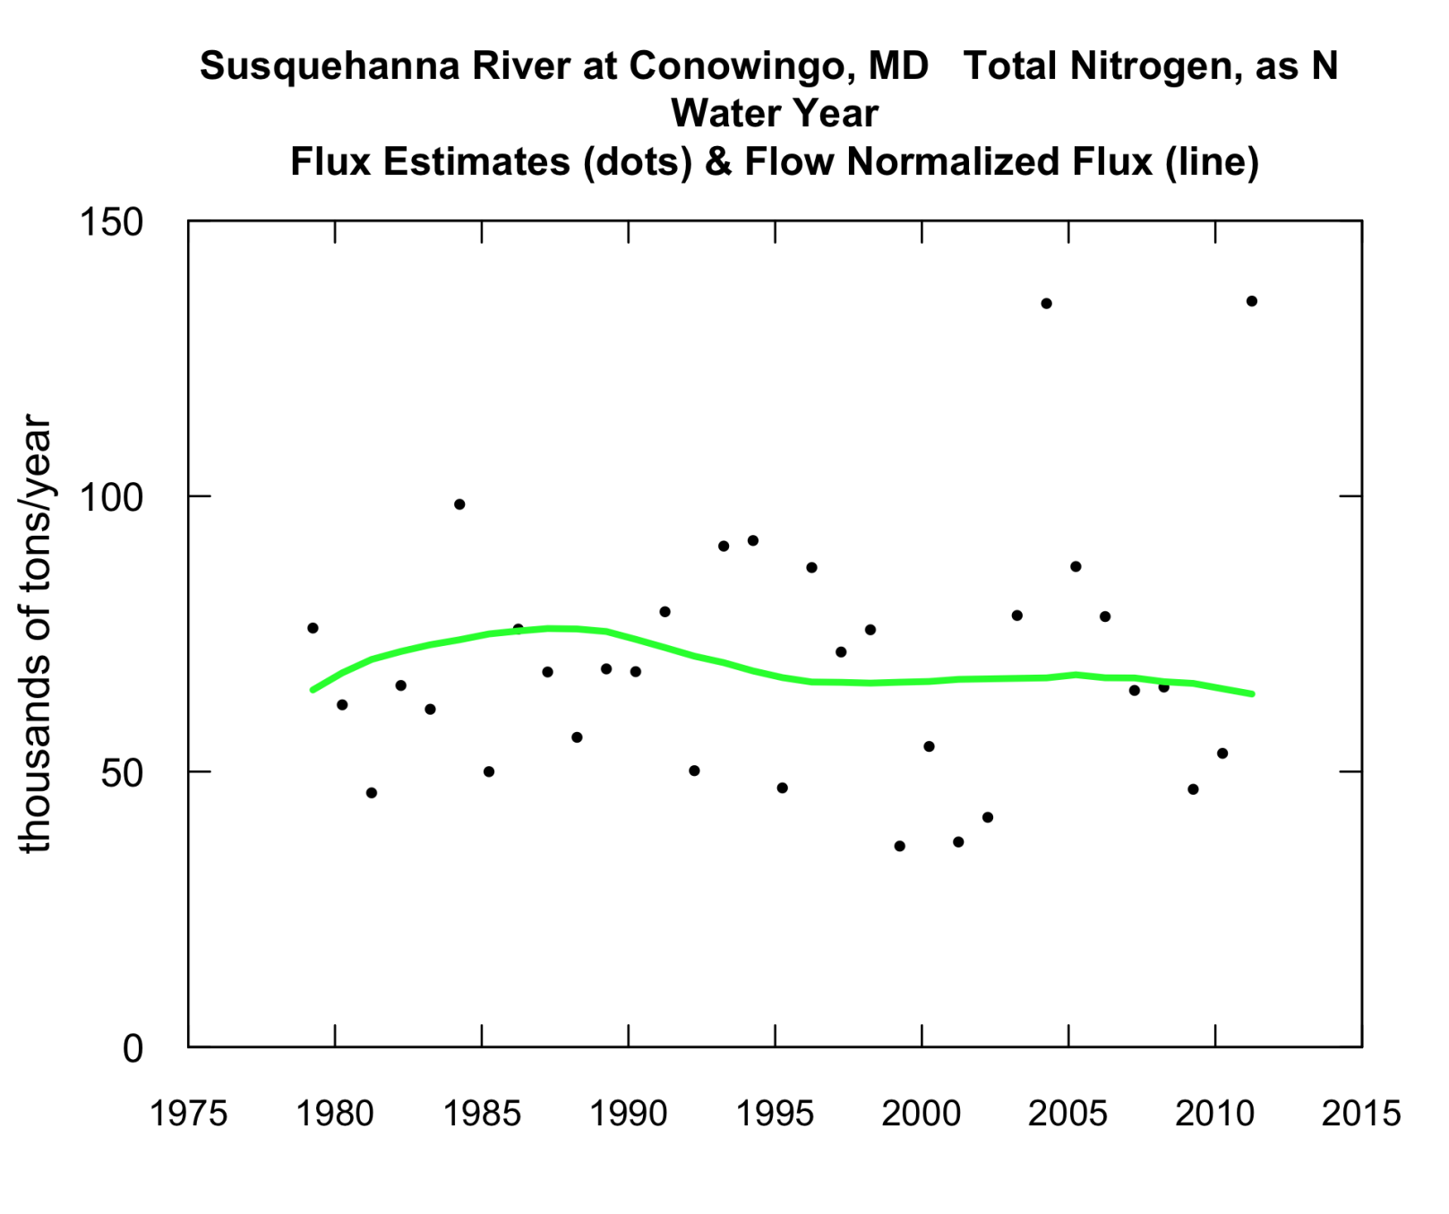
Annual Load of Nitrogen
(In 10³ tons/yr)
Flow
Normalized
Load Change
Since 1996
-3%
Notes:
Variability in TN is not as extreme because most of N dissolved in water and not associated with sediment. The overall trend has been a decline in total nitrogen flux. There has been an overall 16 percent decrease since 1987 and about a 3% decline since 1996.

Slide 14
Take home messages: TN
Total Nitrogen concentrations are continuing to decline at most discharges, but some increase during storms.
2011 was near record, and load getting more variable over time.
Flow-normalized flux continues to decline.
-Down about 3% since 1996.
-16 % since mid 1980s
-Management practices working

Slide 15
Potential impacts when Conowingo reaches capacity
 | Change since 1996 | Predicted change when reservoirs “filled”
TN | -3% | +2%
TP | +55% | +70%
SS | +97% | +250%
Notes:
First column shows what we have seen since 1996. Langland predicted when the reservoirs reach there sediment storage capacity we will see these increases. We are currently at about 85% of storage in the Conowingo so we are on our way to seeing these predicted changes.

Slide 16
Implications:
As the reservoirs fill:
  This leads to more frequent scour of sediment/TP
  Decrease in the amount of sediment and TP that can be trapped
Increase in sediment and phosphorous loads
Upstream practices to reduce P and sediment may be counter balanced by reservoir effects
More difficult to achieve standards in upper Bay
  Water clarity most impacted; less for DO
Notes:
Success in reductions of fluxes of nitrogen, phosphorus and sediment from the parts of the Susquehanna watershed that lie upstream of the reservoirs may be counterbalanced by changes in the deposition and scour processes in the reservoirs. The net result could be an increase in the average fluxes of phosphorus and sediment to the Bay. Nitrogen will likely not change. Upstream practices to reduce P and sediment may be counterbalanced by the reservoirs letting more loads into the Bay. Will make it more difficult to achieve water-quality standards in the upper bay but that may be most associated with clarity and SAV. Since TN is still decreasing may not have a significant impact on DO.

Slide 17
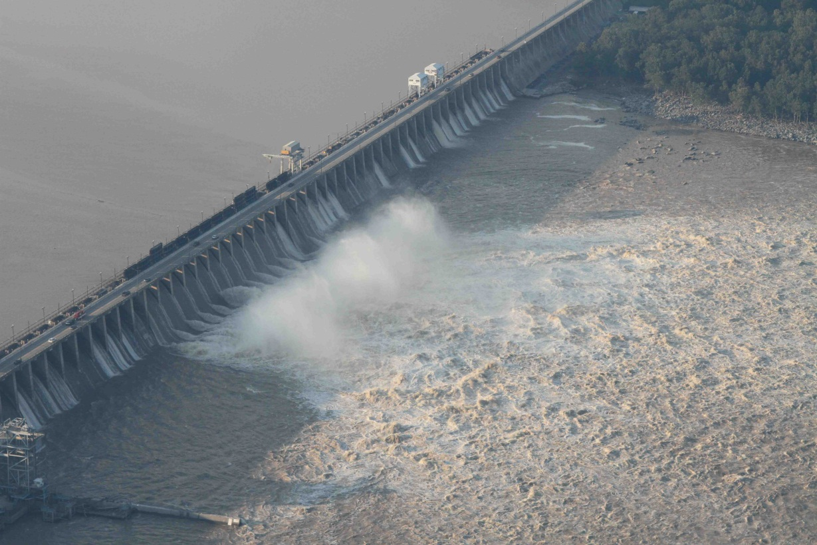
Next steps and Questions
  USACE study on options addressing reservoirs
Nutrient and sediment allocations
  2017 assessment of TMDL
New USGS report on trend in loads
chesapeake.usgs.gov
Notes:
The USACE in cooperation with..has already begun a study on options for addressing sediment storage capacity of the reservoirs. The results of the study are expected in 2014 (need to check?)
The information from the USGS report and upcoming USACE study will have to be considered for the mid-point assessment of the Bay TMDL in 2017.
USGS will also be putting out report on trend in loads for other sites. USGS examined the change in load using WRDTS, which is a newer technique. Previous techniques examined the change in concentrations. The USGS will have another report in fall, 2012 on applying the change in load technique at additional sites in the Bay watershed. The USGS will be working with CBP partner on how to best use and communicate these findings.

Slide 18
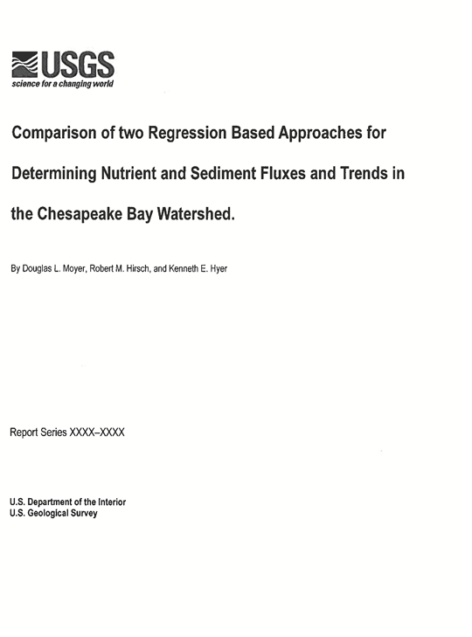
Publication
Draft report has been completed and has gone through technical and editorial review.
The report should be approved and ready for release near the end of the calendar year.
The report is fairly technical which will impede consumption of the new trends in load results, so…..

Slide 19
Evolution of CB Trend Methods: 2008
Doug Moyer, VAWSC, Ken Hyer, VAWSC
Joel Blomquist, MDWSC, Mike Langland, PAWSC
Greg Schwarz, OWQ NAWQA Bob Hirsch, NRP
Gary Shenk, USEPA CBP
Evaluation Objectives
Increase relevancy of USGS trends to CBP questions
Better link USGS trends to CBP goals (i.e. TMDL)
Continue/improve CBP’s/USGS’s confidence in load and trend methodology

Slide 20
Current Study: Moyer, Hirsch, & Hyer
OBJECTIVE:
Evaluate the performance of ESTIMATOR and WRTDS in reproducing nutrient and sediment concentrations and loads and determine which model ultimately ensures the highest level of accuracy in annual load estimates provided to the Chesapeake Bay Program.
QUESTIONS:
What are the differences in functional form and model construction?
Which model reproduces discrete observations with the greatest accuracy and least bias?
How different would the historical estimates of load been had WRTDS been used instead of ESTIMATOR?
What are the trends in annual nutrient and sediment loads and how do they compare to ESTIMATOR concentration trends?

Slide 21
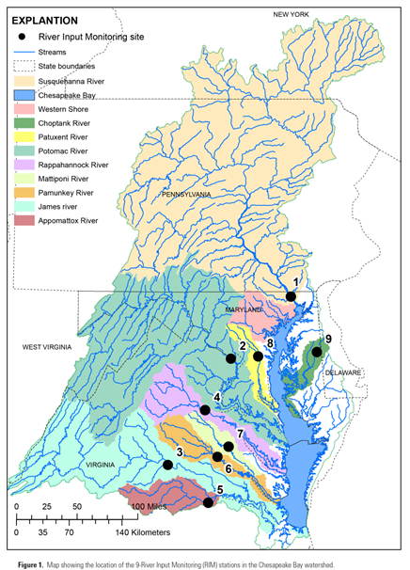
Chesapeake Bay: River Input Monitoring Stations
Stations:
Susquehanna Pamunkey
Potomac Mattaponi
James Patuxent
Rappahannock Choptank
Appomattox
Why these stations:
Greater than 75% of the land area
Vast majority of the total discharge from the nontidal areas passes these stations
Robust datasets: nearly 30 years of monitoring with total observations ranging from 600 to 1,400
Constituents:
Total Nitrogen
Nitrate
Total Phosphorus
Orthophosphorus
Suspended Sediment
Therefore 9RIM * 5 Constituents = 45 possible analytical combinations

Slide 22
Question 1: Functional form and determination of model coefficients
 | ESTIMATOR | WRTDS
Variables | Q, Time, and Season | Q, Time, and Season
Determination of model coefficients | 9-year moving windows | One model for each Q and t combination (~Daily)
Data used in regression | All for specified period | Determined based on weight rankings of observations
Ideal dataset | 5 to 25 years | >25 years
C vs. Q C vs. Time | Constrained to Linear and/or Quadratic | Free form
C vs. Season | Fixed magnitude oscillation | Variable magnitude oscillation
Trends | Flow adjusted concentration (%) | Flow normalized concentration and load (units and %)
Estimate Uncertainty | Yes – Confidence intervals and hypothesis testing | No – Not computed

Slide 23
Major Comparison Conclusions
We have shown:
For the majority of the combinations, ESTIMATOR and WRTDS produce nutrient and sediment loads that are comparable in accuracy and bias.
However, WRTDS produces nutrient and sediment loads that are considerably more accurate and less biased for 15 of the 45 combinations with complex concentration-discharge relations.
Out of 85 possible combinations for trend, there are 10 where the percent change in CONCENTRATION is in the opposite direction of the percent change in LOAD

Slide 24
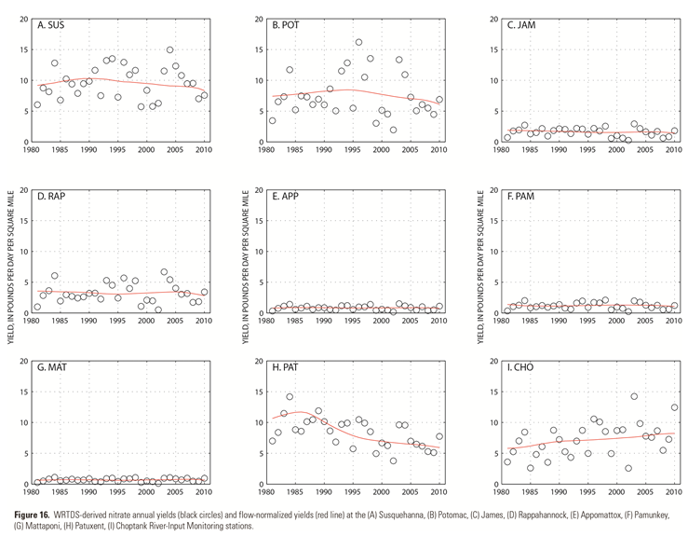
Trends in Annual Load (Yield)
With WRTDS, we now can communicate how annual loads have changed once the year-to-year variation in Q has been removed
SUS
POT
JAM
RAP
APP
PAM
Example: Nitrate
Determine trend in flow-normalized load for:
1985 to 2010
2001 to 2010
MAT
PAT
CHO
Black Circles = Annual Yield Red Line = Flow Normalized Load

Slide 25
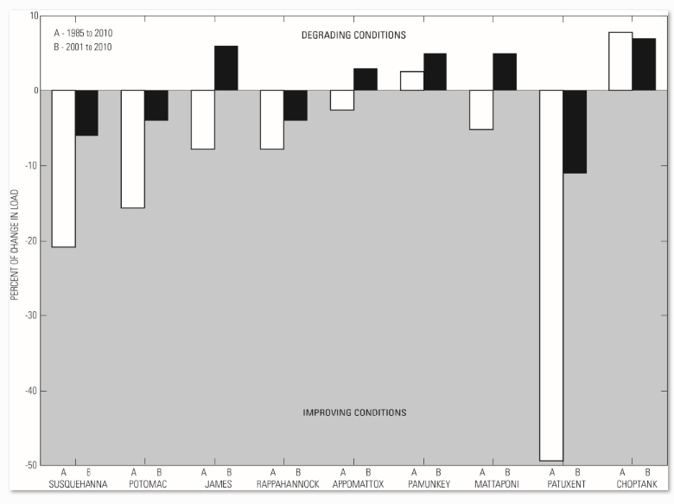
Trends in Annual Loads
Two Time periods:
1985 to 2010
(white bars)
2001 to 2010
(black bars)

Slide 26
Trend in Concentration vs. Trend in Load
Now, a challenge for the NTN is to communicate two different types of trend results
Our goal is to explain how these trends should be interpreted and why trends in concentration may differ in direction compared to trends in load

Slide 27
Trend in Concentration vs. Trend in Load
Trend in concentration (flow-adjusted) provides information on how BMPs have influenced instream concentrations at a given point.
  Great information for local water-quality and standards attainment
  Determined based on patterns in the majority of observed water-quality data (often low to intermediate Q)
Trend in load (flow-normalized) provides information on how BMPs have influenced the downstream transport of mass.
  Great information for managers trying to reduce the mass delivered to the tidal portions of the Bay.
  Determined based on patterns in the highest load samples (~10 percent of the observations)

Slide 28
Trend in Concentration vs. Trend in Load
TIME PERIOD | TRENDS IN SAME DIRECTION | TRENDS IN OPPOSITE DIRECTIONS
TOTAL NITROGEN
1985 to 2010 | 9 | 0
2001 to 2010 | 9 | 0
TOTAL PHOSPHORUS
1985 to 2010 | 7 | 2
2001 to 2010 | 6 | 3
SUSPENDED SEDIMENT
1985 to 2010 | 2 | 2
2001 to 2010 | 9 | 0

Slide 29
Trends Agree
High Q
Example where trend in concentration and trend in load are in the same direction (NITRATE)
Categorize water-quality observations based on 3 discharge conditions:
High
Intermediate
Low
Int. Q
ESTIMATOR trend in concentration indicates improving conditions (total reduction of approx. 16%)
WRTDS trend in load indicates improving conditions (total reduction of approx. 16%)
Low Q

Slide 30
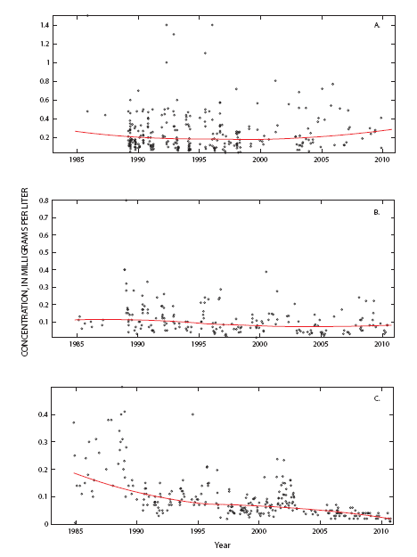
Trends Disagree
High Q
Example where trend in concentration and trend in load are in opposite direction (TOTAL PHOSPHORUS)
Int. Q
ESTIMATOR trend in concentration indicates improving conditions (total reduction of approx. 60%)
WRTDS trend in load indicates degrading conditions (total increase of 10%)
Low Q

Slide 31
Next Steps
Compare WRTDS load and flow normalized results from the 9-RIM stations to CB Watershed Model results. Link WRTDS results to CBP nutrient and sediment goals (2012-2013)
Continue effort to develop method for quantifying uncertainty associated with WRTDS estimates (2013)
Work with CBP to better integrate nontidal nutrient and sediment load and trend results into the current tidal-waters assessment methodology
Determine how WRTDS and ESTIMATOR results are integrated at the 9-RIM stations
Develop a strategy for utlizing our data-analysis tools at the rest of the NTN stations, Pilot this activity in the Potomac River Basin

