Slide 1
  Draft Sustainable Communities
  Climate Adaptation Guidebook
  Kate Marshall, SRA International, Inc.
  (703) 284 6234, kate_marshall@sra.com

Slide 2
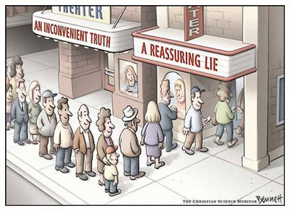
Guidebook Purpose

Slide 3
Guidebook Development
November: draft guidebook developed
December: MWCOG review of guidebook
January-March: EPA review of guidebook
April: final revisions to guidebook
May: final guidebook

Slide 4
Guidebook Structure
Introduction
Section 1: Plan for Climate Change
Section 2: Consider Regional Approaches
Section 3: Protect Vulnerable Areas from Development
Section 4: Protect People and Assets in Vulnerable Areas
Section 5: Encourage Sustainable Growth in Appropriate, Less-vulnerable Areas

Slide 5
Guidebook Structure – Major Changes from Draft
Introduction
Greater focus on smart growth planning principles, document purpose
Section 1: Plan for Climate Change
Rewritten to provide:
  Overview of NOAA roadmap for climate change vulnerability planning
  Summary of MWCOG’s climate change vulnerability planning process
Section 2: Consider Regional Approaches
Added information from Fall 2011 MWCOG sector meetings to bring local element into guidebook earlier
Section 3: Protect Vulnerable Areas from Development
Section 4: Protect People and Assets in Vulnerable Areas
Section 5: Encourage Sustainable Growth in Appropriate, Less-vulnerable Areas

Slide 6
Section 1: Roadmap for Identifying
Climate Change Vulnerabilities
Getting Started
Define community goals and objectives and highlight priority issues and drivers for consideration throughout the assessment
Hazards Profile
Explore relevant hazards, climate trends, and potential impacts as a starting point for considering community vulnerabilities
Infrastructure Profile
Identify the strengths and vulnerabilities of the built environment
Societal Profile
Evaluate strengths and vulnerabilities of the local population
Ecosystem Profile
Consider the strengths and vulnerabilities of important natural resources
Taking Action
Explore opportunities and challenges for risk reduction through education, planning, and regulatory processes

Slide 7
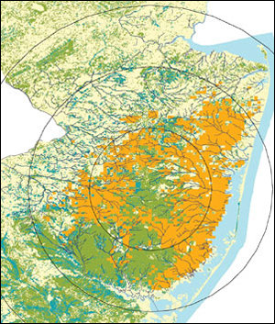
Section 1: Making Decisions with Imperfect Data
Planning Areas that have…
 | Low Vulnerability | High Vulnerability
High Risk | May be priority planning areas | Should be priority planning areas
Low Risk | Are unlikely to be priority planning areas | May be priority planning areas

Slide 8
Section 2: Regional Approaches
Land Use
Regional Land Use Planning for Climate Change
Data Consolidation and Distribution
Transportation
Increase Regional Transportation Resiliency through Smart Growth
Develop a Regional Risk-Based Approach to Identify Transportation Investments
Water
Use a Watershed Framework to Enhance Regional Water Resource Management
Develop a Regional Stormwater Management Strategy

Slide 9
Section 2: Regional Approaches
Examples of regional approaches identified at Fall 2012 MWCOG sector meetings:
Define expected climate impacts across the region (e.g. GIS data for sea level rise, average seasonal changes in temperature, stormwater projections)
Develop cost-benefit analyses of business-as-usual compared with smart growth land use planning
Coordinating across jurisdictions to develop consistent strategies for increasing roadway connectivity

Slide 10
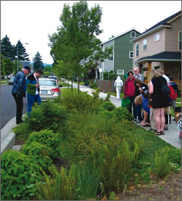
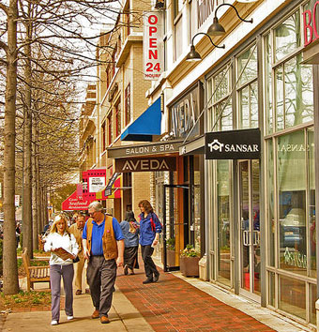
Sections 3-5: Making the “climate connection”
Climate adaptation planning is a natural extension of long-term land use planning
Focus on use of existing processes and tools for adaptation planning
Three primary types of approaches:
  Protect vulnerable areas from
  development
  Protect people and assets in vulnerable
  areas
  Encourage sustainable growth in appropriate, less-vulnerable areas

Slide 11
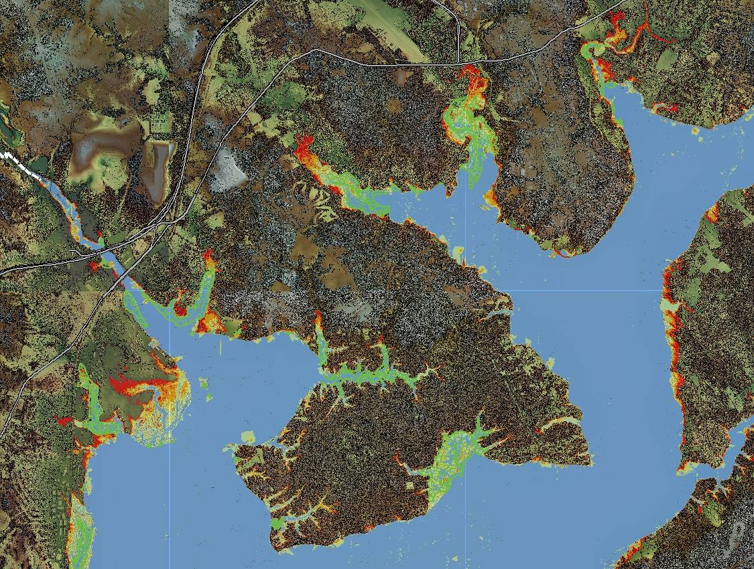
Section 3: Protect vulnerable areas from development
Identify areas in the
community that:
Have limited or no development
Have a higher vulnerability and risk
to climate changes
Protect these areas from
future development
Evaluate development incentives in vulnerable areas
Adopt protective regulations for vulnerable areas
Direct development away from vulnerable areas on large sites
Purchase and transfer of development rights
Establish fund to purchase/acquire land in vulnerable areas

Slide 12
Example Approach: Evaluate development incentives provided in vulnerable areas
Review financial incentives and regulatory policies
Revise policies and incentives that inappropriately encourage development in vulnerable areas
Adjust for future development
  Link incentives to the comprehensive plan
  Draft regulatory incentives to protect vulnerable areas
  Analyze public funding dedicated to new projects located in vulnerable areaa

Slide 13
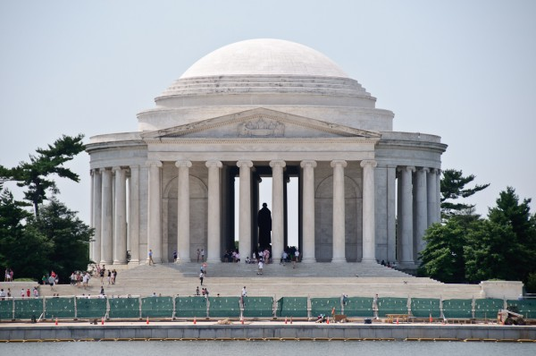
Section 4: Protect people and assets in vulnerable areas
Identify vulnerable areas in the community
Traditional approaches:
Engineered protective structures
Retrofitting buildings
Softer techniques to increase resiliency
Relocating people or assets
Smart growth approaches:
Improve stormwater management approaches
Adapt zoning and building codes to evolving risks
Create special taxing and assessment districts to fund the protection of buildings and infrastructure
Amend non-conforming use provisions to allow safer, sustainable redevelopment in vulnerable areas
Identify transportation system vulnerabilities
Implement integrated heat island reduction strategies
Use non-structural flood mitigation measures for buildings

Slide 14
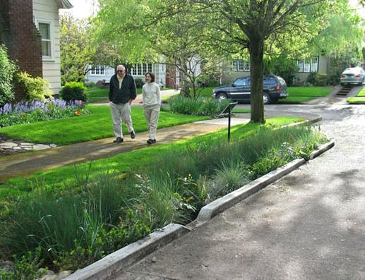
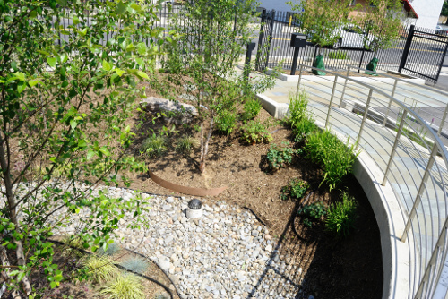
Example Approach: Implement integrated heat island reduction strategies
Urban forestry
Require cool technologies
  Reflective roofing and green roofs
  Pervious and light-colored pavement
Green building standards
Building codes
Community involvement
Improved street design
Maintenance plans

Slide 15
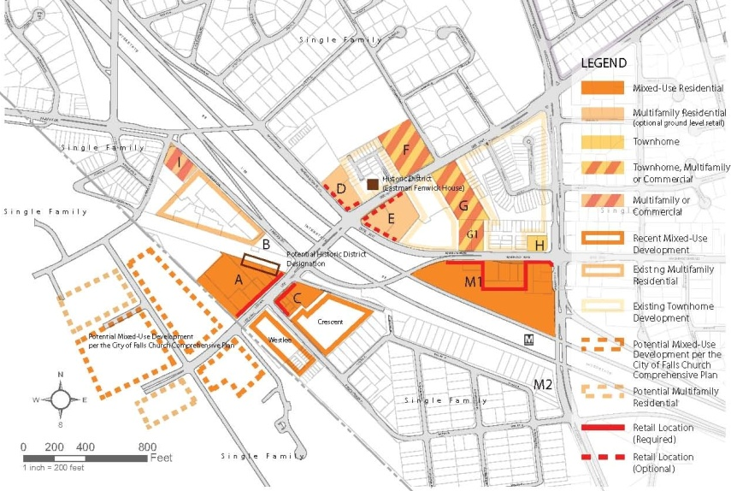
Section 5: Encourage sustainable growth in appropriate, less-vulnerable areas
Identify areas in the community expected to be less-vulnerable to climate change
Compare less-vulnerable areas against areas prioritized for future development
Determine whether any changes are required
Encourage development in these areas
  Promote infill development
  Remove roadblocks to development in
  appropriate areas
  Adopt complete streets design standards
  Upgrade building code requirements
  Incorporate passive survivability into new
  and existing projects

Slide 16
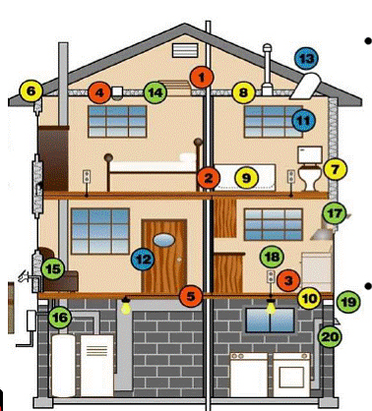
Example Approach: Upgrade building code requirements
Incorporate weather and climate vulnerable design criteria established in vulnerability assessment process
Establish zoning areas with heightened building code requirements
Create incentive programs tied to
voluntary higher standards
Consider adopting stretch or reach
codes (International Green Construction
Code)
Adopt ordinances that give greater
flexibility to building and zoning
departments to approve projects
certified under a third party system
Incorporate passive survivability goals

Slide 17
  Discussion
  Reactions to the Guidebook
  What aspects of the guidebook are most interesting or useful?
  Has this process helped you think about:
    Changing any of your current policies?
    Reprioritizing your local investments?
    Implementing any specific approaches?
    Coordinating with other jurisdictions?

