Slide 1
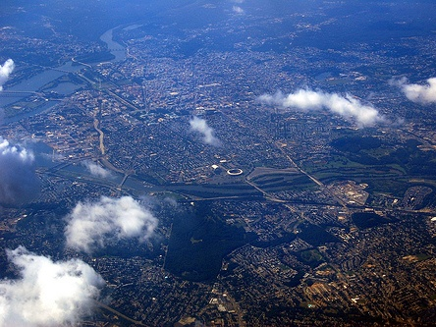
The Regional Big Picture
Preparing to Conduct Outreach
For the 2010 Constrained Long-Range Plan
Presentation to the TPB Access for All Advisory Committee
November 19, 2009

Slide 2


Why are we here?
We’re putting together a new long-range plan and 6-year program
We’re planning to conduct public outreach
Planning Schedule:
  Project submissions in February
  Approval in July

Slide 3
The Planning Cycle

Slide 4
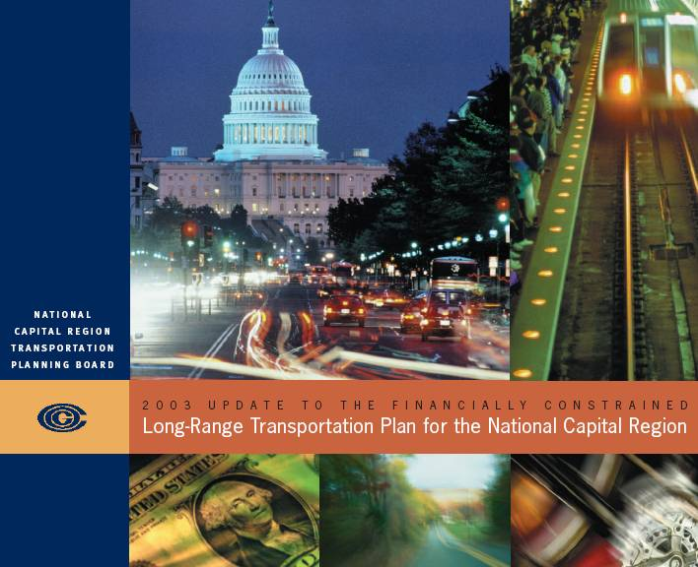
What is the Constrained
Long-Range Plan?
20-30 years
NOT a wish list
  Only includes projects that can be “reasonably anticipated” to be funded
  Reflects the region’s priorities
Projects must be in the CLRP in order to qualify for federal funds
CLRP must “conform” to regional air quality goals

Slide 5


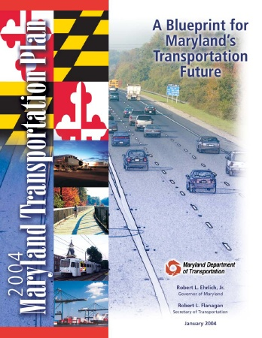
State Long-Range Plans
Virginia
  VTrans2025
  TransAction 2030
  State Highway Plan
Maryland
  Maryland Transportation Plan (MTP)
District of Columbia
  Strategic Transportation Plan

Slide 6
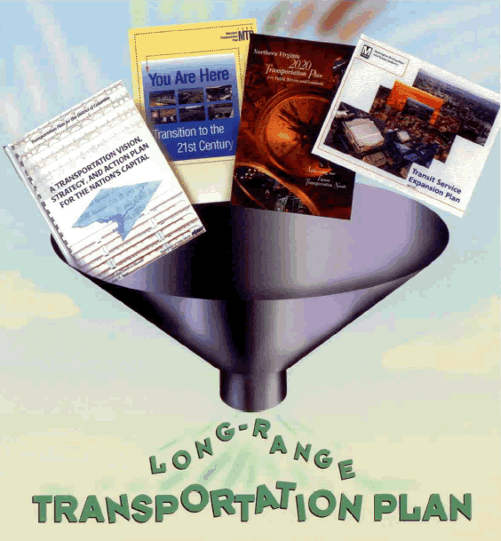
Financial Constraint
The CLRP puts a financial squeeze on state and other unconstrained long-range plans.

Slide 7
6-Year Programming
Varies in every state
But in every state:
  - Every new program begins with last year’s program.
  - The DOTs take the lead.
  - State legislatures approve funding.

Slide 8
The TPB’s 6-Year Transportation Improvement Program (TIP)
Virginia
SYIP
Maryland
CTP
D.C.
CIP
WMATA
CIP
Other 6-year programs
The Regional TIP

Slide 9

What’s different about this year’s cycle?
CLRP horizon extending to 2040
New regional financial analysis
2040

Slide 10
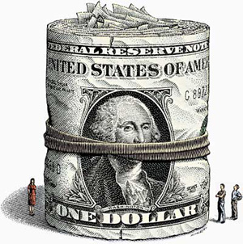
The Financial Landscape

Slide 11
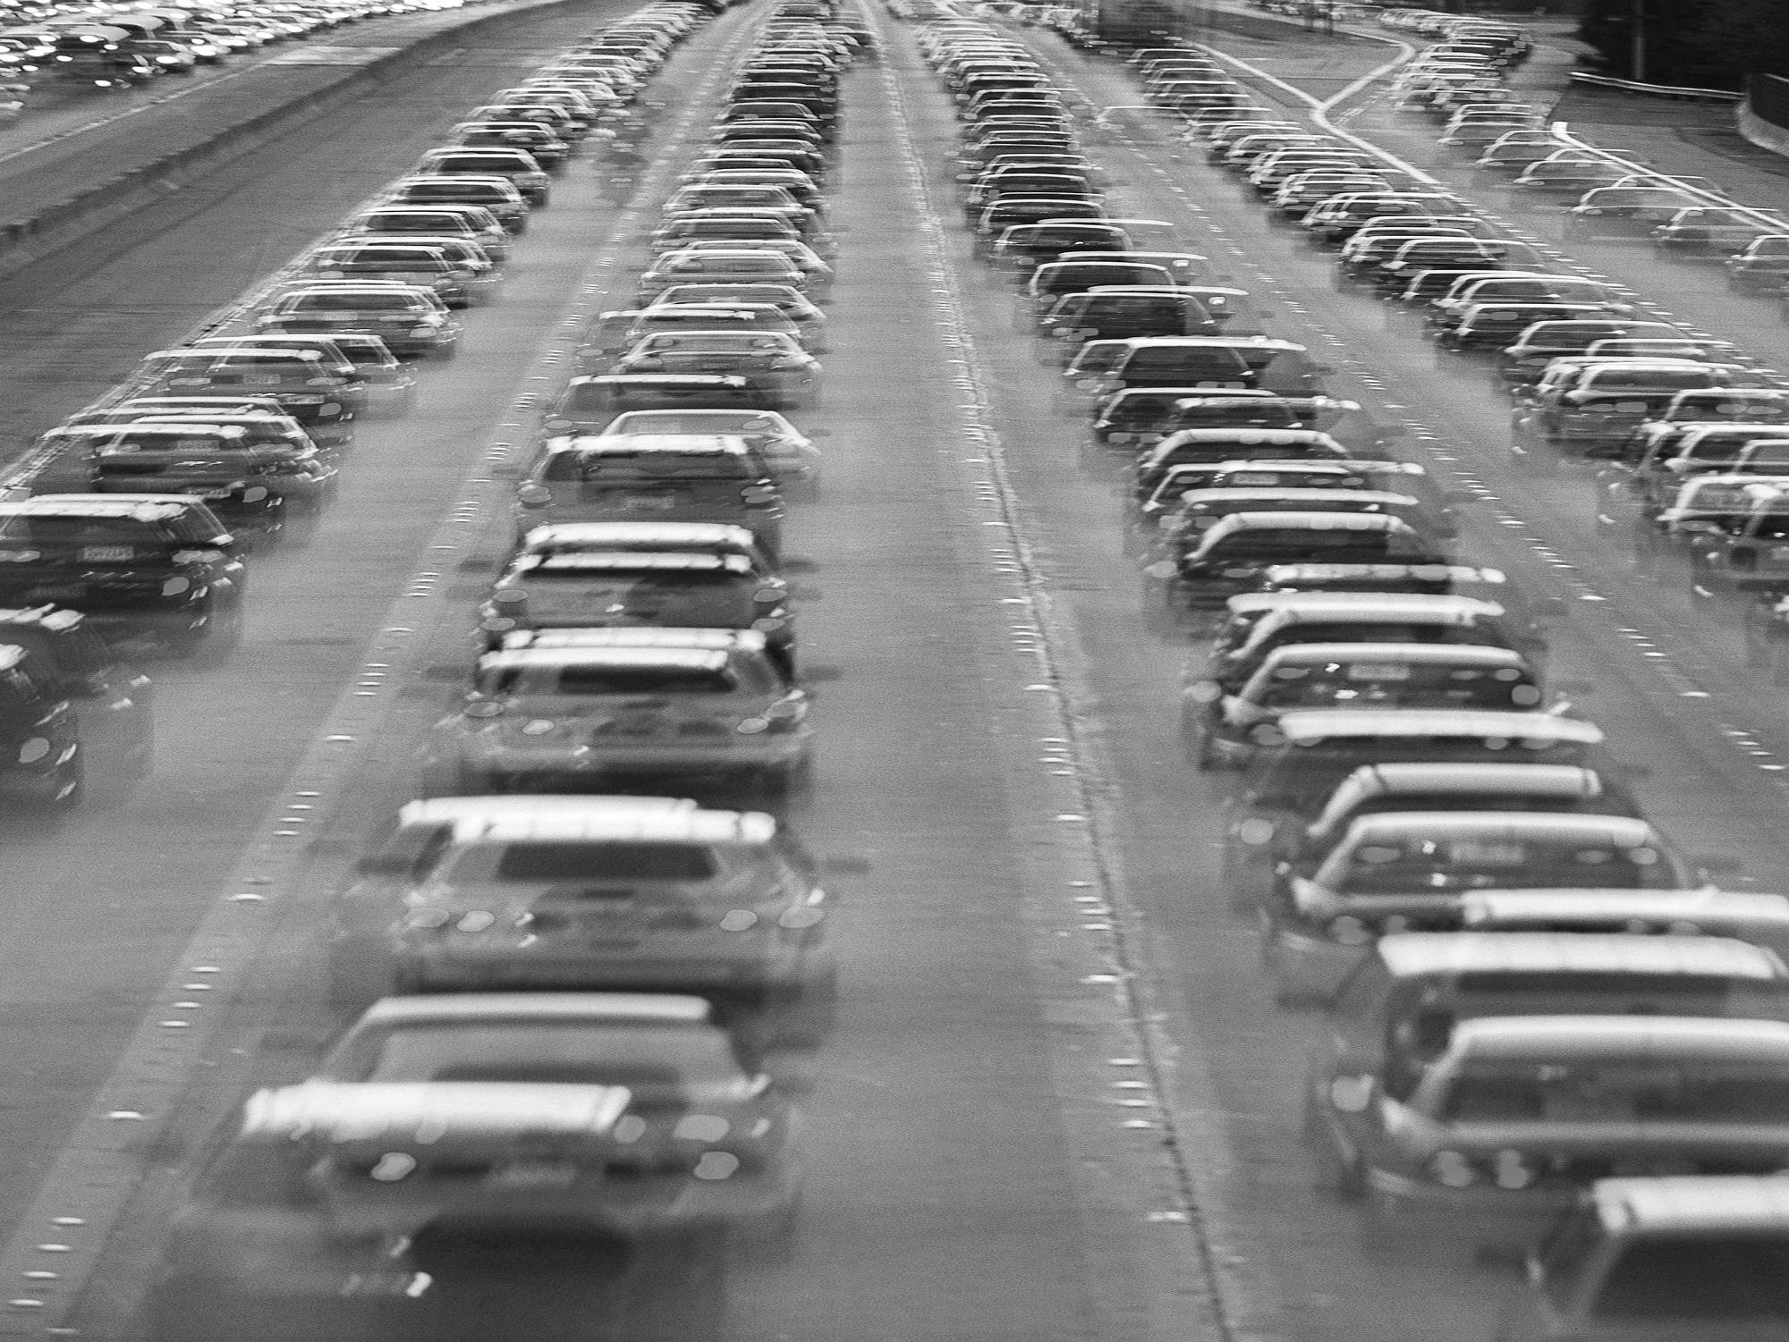
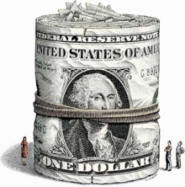
Needs are growing
Expected increases by 2030:
Population: 24%
Jobs 28%
Driving (VMT): 21%
Lane miles of congestion: 30%
New lane miles: 12%

Slide 12
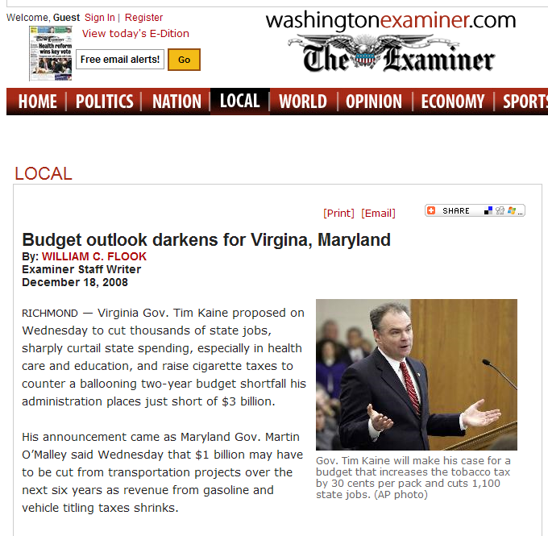
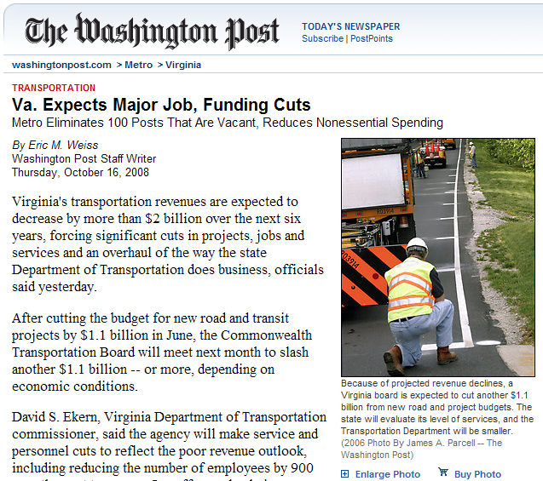
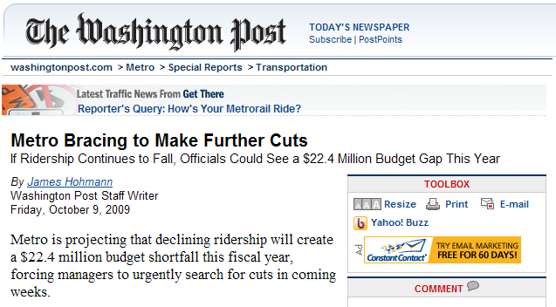
The Recession’s Impact
The recession has hit hard

Slide 13

Six-year programs are stagnant
No new projects were included in the FY 2010-2015 TIP and 2009 CLRP approved in July…
… Just delays and
project cuts!
(The Purple Line and Return to L’Enfant are being added this fall)
13

Slide 14
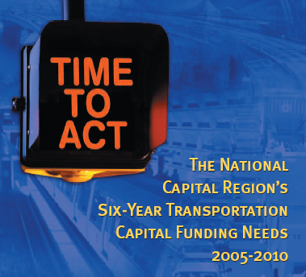
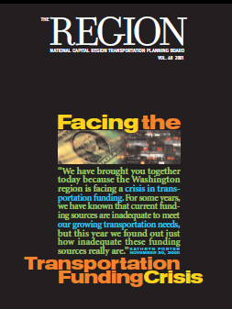
But the long-term financial shortfall is an old story…
… in good times and bad!

Slide 15
Maintenance & operations eating up most long-term funding
New Roads and Transit
30%
Operations & Preservation
70%

Slide 16
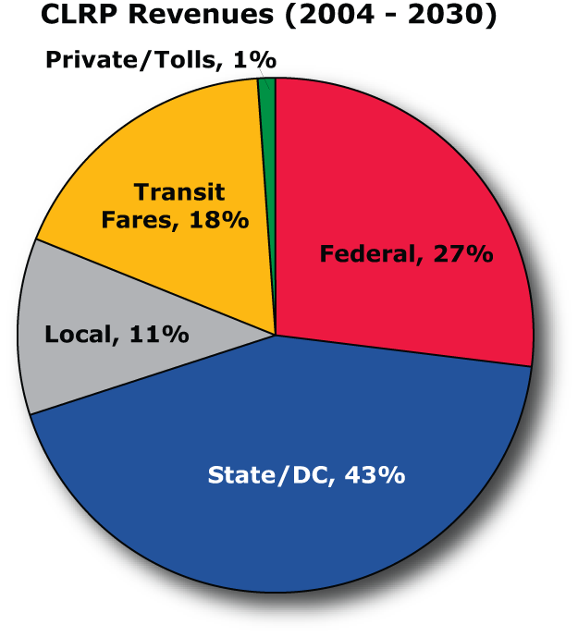
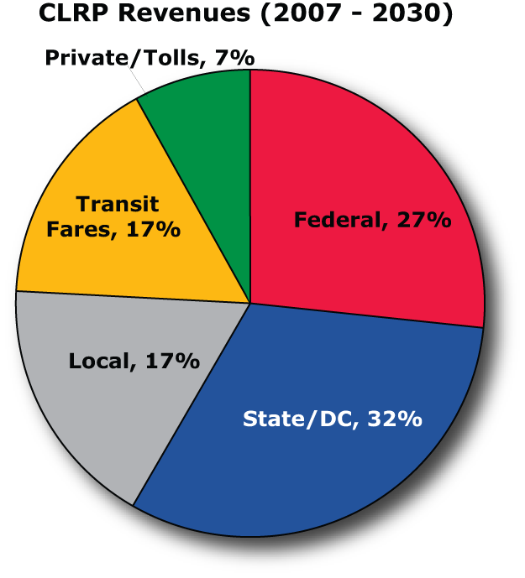
Toll revenue getting more important
$3.8 billion per year
$4.5 billion per year

Slide 17
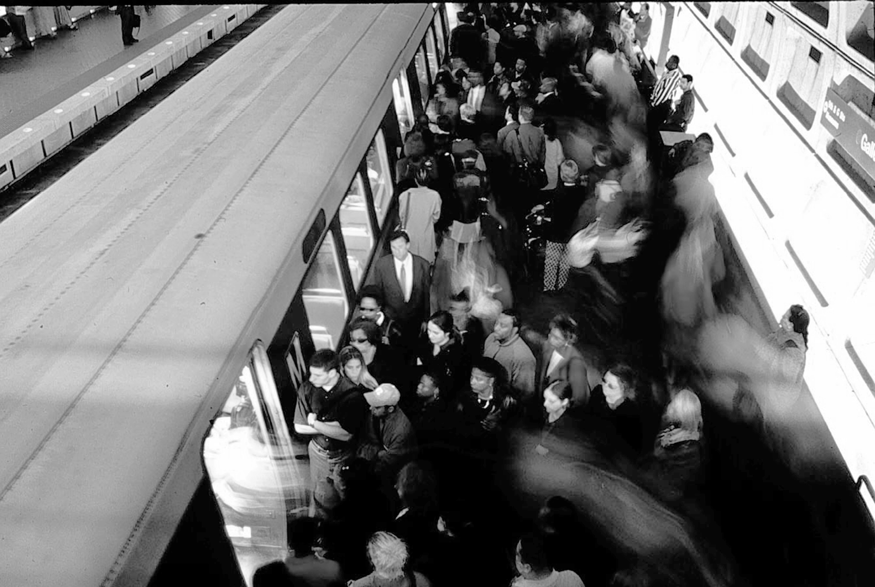
Metro’s needs are acute
Davis bill : $3 billion over 10 years
Needs: $11 billion over 10 years

Slide 18
Emerging context, new opportunities

Slide 19

Upcoming Federal Surface Transportation Legislation
Focus on Metropolitan Planning Organizations?
New funding options:
  Increase gas tax?
  Replace/augment the gas tax?

Slide 20

Proposals to address climate change
Mandated regional climate change goals?
Possible funding opportunities

Slide 21
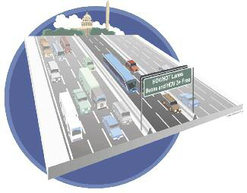
New opportunities for road pricing?

Slide 22
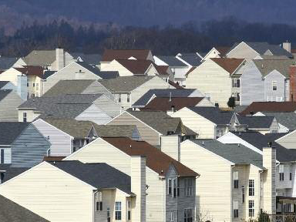
Cross-cutting challenges
Housing…
Safety…
Water …
… plenty of others

Slide 23
The TPB: Getting Ready for New Opportunities

Slide 24
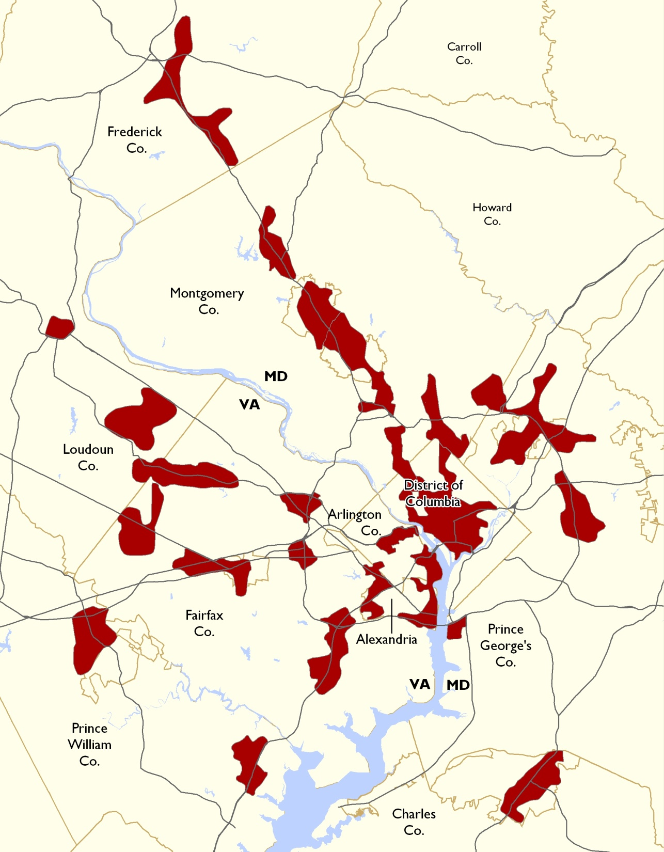

Examining alternatives through scenario analysis
.

Slide 25
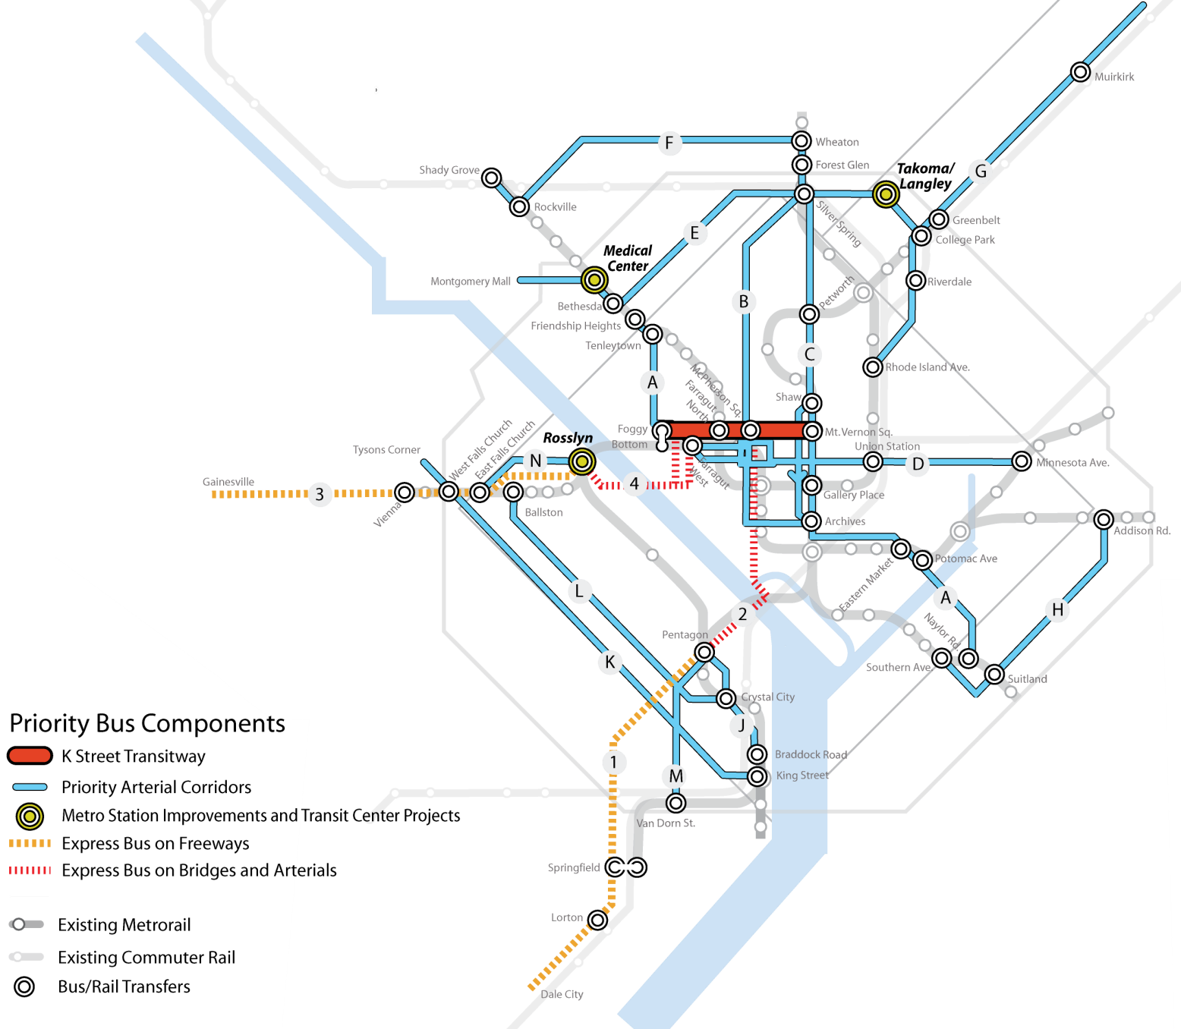
TIGER application demonstrated regional cooperation
  Federal grant request of $280 million
  20 projects

Slide 26
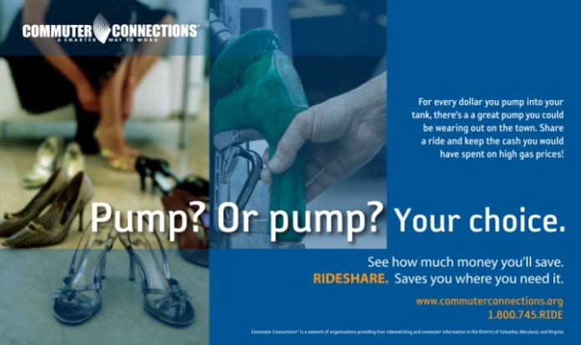

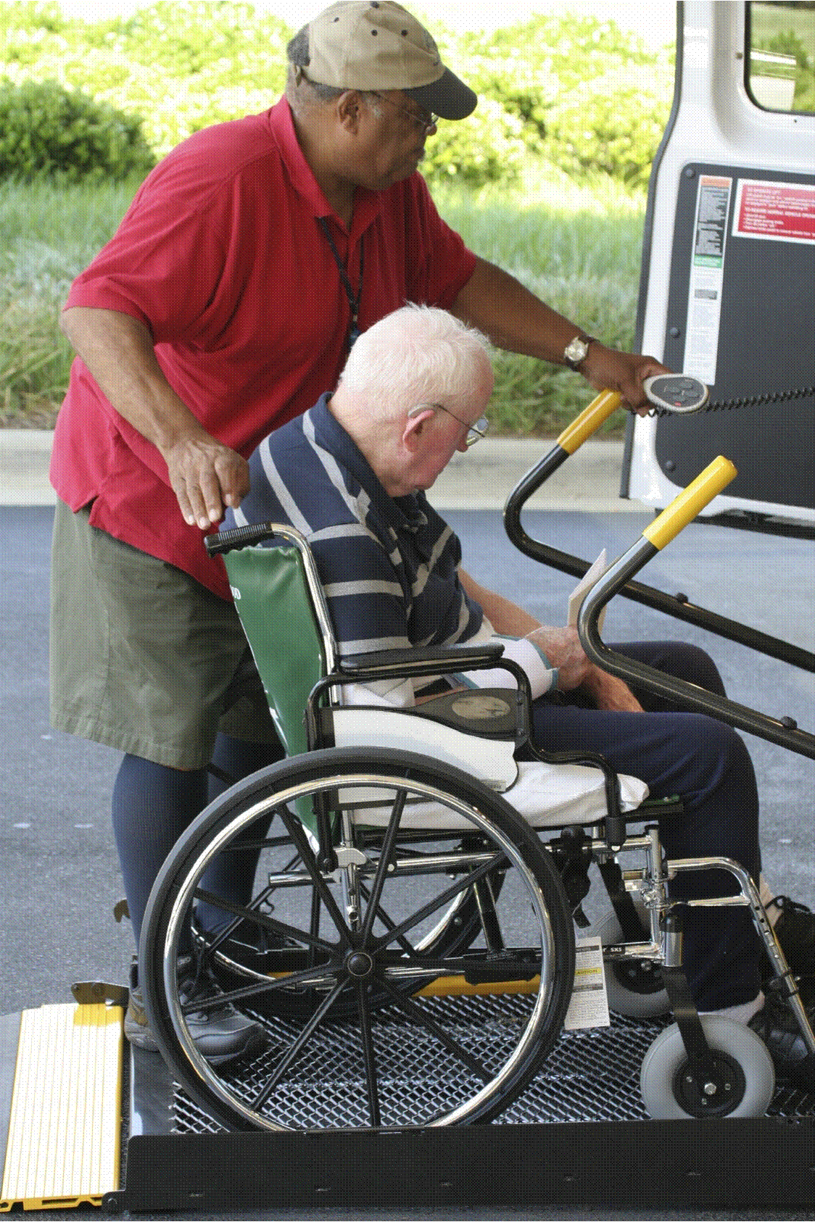
A range of regional programs
Commuter Connections
MATOC
Access for All
Bike/ped planning

Slide 27
The elements of an outreach strategy
Why conduct outreach for the CLRP?
What issues should we discuss with the public?
Who should we reach out to?
When should we conduct outreach?
How can we address a variety of audiences?

