Slide 1
QECBs
COG Energy Advisory Committee
January 17, 2012

Slide 2
IRS Circular 230 Disclosure
This presentation was not intended or written to be used, and it cannot be used by any taxpayer, for the purpose of avoiding penalties that may be imposed on the taxpayer under U.S. Federal tax law.

Slide 3

Pleased to meet you
The Energy Programs Consortium (EPC) is a consulting group that is a joint venture of NASCSP, representing the state weatherization and community service programs directors; NASEO, representing the state energy policy directors; NARUC, representing the state public service commissioners; and NEADA, representing the state directors of the Low-Income Home Energy Assistance Program.
The QECB Program began in 2010, when EPC began tracking QECB utilization and talking to issuers about issues, questions, concerns and obstacles encountered along the way.
We work closely with NASEO and receive funding from the Energy Foundation. DOE has expressed an interest in supporting direct technical assistance.

Slide 4


What is a QECB?
A qualified energy conservation bond (QECB) is a federally subsidized bond that may be issued for a variety of uses that tend to promote the conservation of energy.
A tool…and something of an odd duck.

Slide 5

What kind of subsidy do QECBs get?
QECBs are a type of “tax credit bond”. You may be familiar with the more common Build America Bonds.
Tax credit bonds are subject to many of the same rules as traditional tax-exempt bonds, but the interest is taxable.
Tax credit bonds can be issued to provide the holder of the bond with a federal tax credit. Until early 2010, QECBs could only be issued this way, and very few of them were issued.
Some tax credit bonds give issuers the option to receive a direct cash payment from the U.S. Treasury in lieu of providing the bond holders a federal tax credit (sometimes referred to as “direct pay,” “cash pay” or “direct subsidy” bonds). QECBs can now be issued as direct subsidy bonds.

Slide 6

How much subsidy do QECBs get?
QECB issuers receive a check equal to 70% of the interest on your QECBs OR, if lower than your interest rate, the maximum rate set by Treasury (the “qualified tax credit rate”).
You can look up the most up to date rate (as well as historical rates) at:
  https://www.treasurydirect.gov/GA-SL/SLGS/selectQTCDate.htm.

Slide 7

For how long can an issuer get the subsidy?
The maximum maturity for tax credit bonds is also set by Treasury periodically.
Historically, QECB issuers have been allowed 12 to 19 year maturities.
In the previous example, that would amount to $378,000 (12 years) to $598,500 (19 years) of direct subsidy from the federal government to your jurisdiction.
The most up-to-date maturity (along with historical maturities) can be found on the tax credit rate lookup page (see slide 6).
There is currently no cut-off date by which allocations must be used.

Slide 8

DC Area Allocations
Washington, DC was allocated $6,140,000 of QECBs and is considering an issuance.
Virginia was allocated $80,600,000, completed its sub-allocations to municipalities and counties with populations of 100,000 or more in proportion to population, and is considering its options.
Maryland was allocated $58,445,000 and completed its sub-allocations. To date, at least $6,515,000 of QECBs have been issued in Maryland (for energy efficiency improvements to schools) .
.

Slide 9
What types of projects can be financed with QECBs?
The most popular project type has been capital expenditures to reduce energy consumption in publicly-owned buildings by at least 20%.
Capital investments into production of renewables have also been popular. Covered facilities include: wind, closed-loop biomass, open-loop biomass, geothermal or solar energy, small irrigation power, landfill gas, trash, qualified hydropower and marine and hydrokinetic production.
Recently there has been more interest in issuing QECBs for “green community programs” (including the use of loans or other repayment mechanisms to implement them).
We have also seen public education campaigns.
Other options include research facilities and grants, certain demonstration projects and mass commuting projects.

Slide 10

Example: Large Solar & Wind Issuance
Issuer: Los Angeles Department of Water & Power
Amount Issued: $131 million
Use of Bond Proceeds:
  Pine Tree Wind Turbine Expansion Project – 10 wind turbines (15MW total added)
  Pine Tree Solar Project – PV generator targeted at 10MW at 34.5kV output); will generate 20 GWh per year
  Adelanto Solar Project – PV generator targeted at 10MW at 4.16kV output; will generate 20 GWh per year

Slide 11
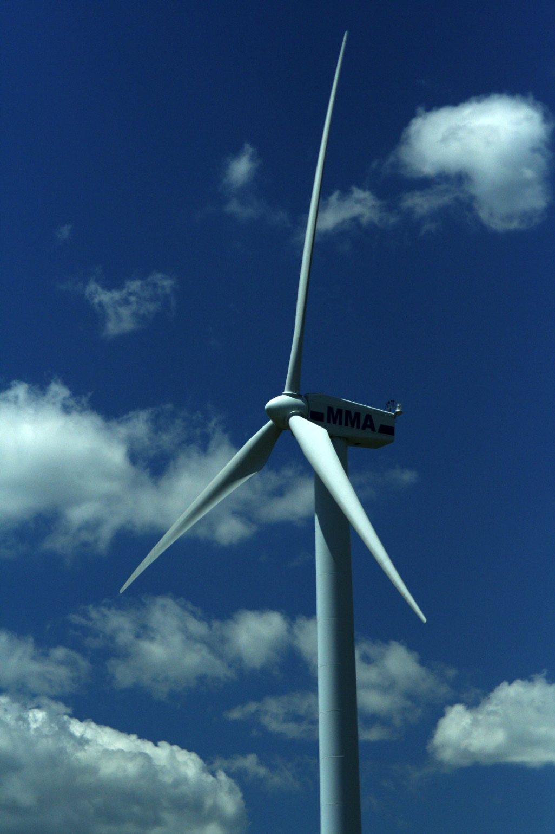
Example: Small Wind Issuance
Issuer: Scituate, MA
Amount Issued: $1.5 million
Use of Proceeds: One 1500 KW
wind turbine

Slide 12

How popular are QECBs?
At least 97 projects in 23 states have been funded with QECBs to date.
Known bond volume totals $609 million; more bonds may be issued but not yet known (particularly if they were sold through private placement).

Slide 13
Barriers to Issuance
Poor credit rating of potential issuers
Lack of appetite for debt
Bond caps
Lack of familiarity with bonds generally or QECBs
Lack of available projects
Lack of guidance from Treasury about key legal questions

Slide 14
Treasury Guidance
The U.S. Treasury has not yet issued regulations or other guidance clarifying ambiguities in the original authorizing provision.
Important questions include the definition of the term “green community programs” (which is not provided in the statute) and the proper methodology for calculating energy savings.
The Clean Economy Center is spearheading an effort to obtain such guidance. For more information, contact me or Colin Bishopp at colin.bishopp@cleaneconomycenter.org.

Slide 15
Where can I find more information?
The NASEO website has a variety of resources, including documents other states have used and the EPC QECB memo which contains information about all known issuances.
  http://www.naseo.org/resources/financing/qecb/index.html
DSIRE has a QECB page with links to relevant statutory provisions and IRS guidance.
  http://www.dsireusa.org/incentives/incentive.cfm?Incentive_Code=US51F&re=1&ee=1
The Department of Energy’s website has resources including a QECB Primer and webinars.
  http://www1.eere.energy.gov/wip/solutioncenter/financialproducts/m/qecb.html

Slide 16
Questions?
Please keep in touch.
Elizabeth Bellis
Director, QECB Program, Energy Programs Consortium
Email (best): ebellis@energyprograms.org
Phone: (917) 370-7916

