Slide 1

National Capital Region Land Conservation Act
Presentation to the
Metropolitan Washington Council of Governments
“Washington must be the most beautiful city in the world … it is now a beautiful city, but there are many other beautiful cities in the world. The most beautiful city will not be entirely man-made city. It must be favored with natural and scenic advantages in justifying the highest place. Parks must be provided where the people will have the opportunity for recreation and for contact with nature.”
Editorial – 1930

Slide 2
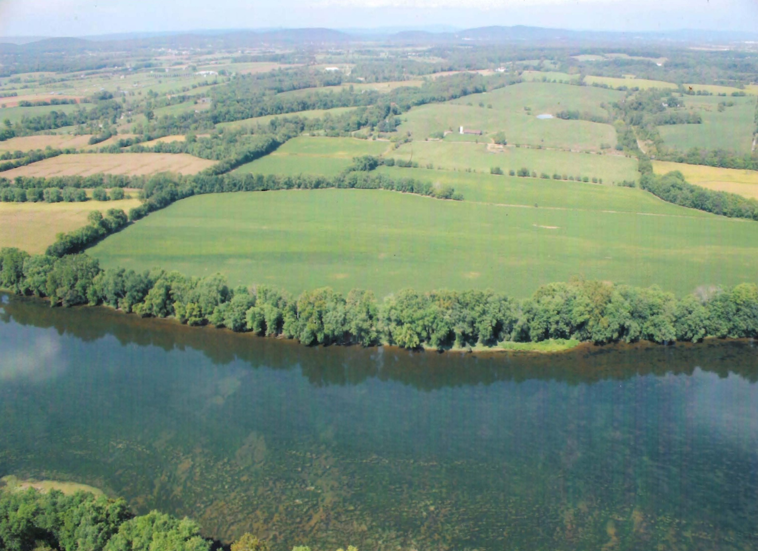
Need and Purpose:
  Open space and public access to nature is critical to regional livability ; need will grow as regions expands
  and densities increase
  -- The region’s public places high values on open space and accessibility
  --- Federal stimulus $ needed for State and local government to acquire lands in region given high cost
  -- Need to protect drinking water supplies – according to NRC – protecting and managing forests in source watersheds s the most effective and efficient strategy

Slide 3
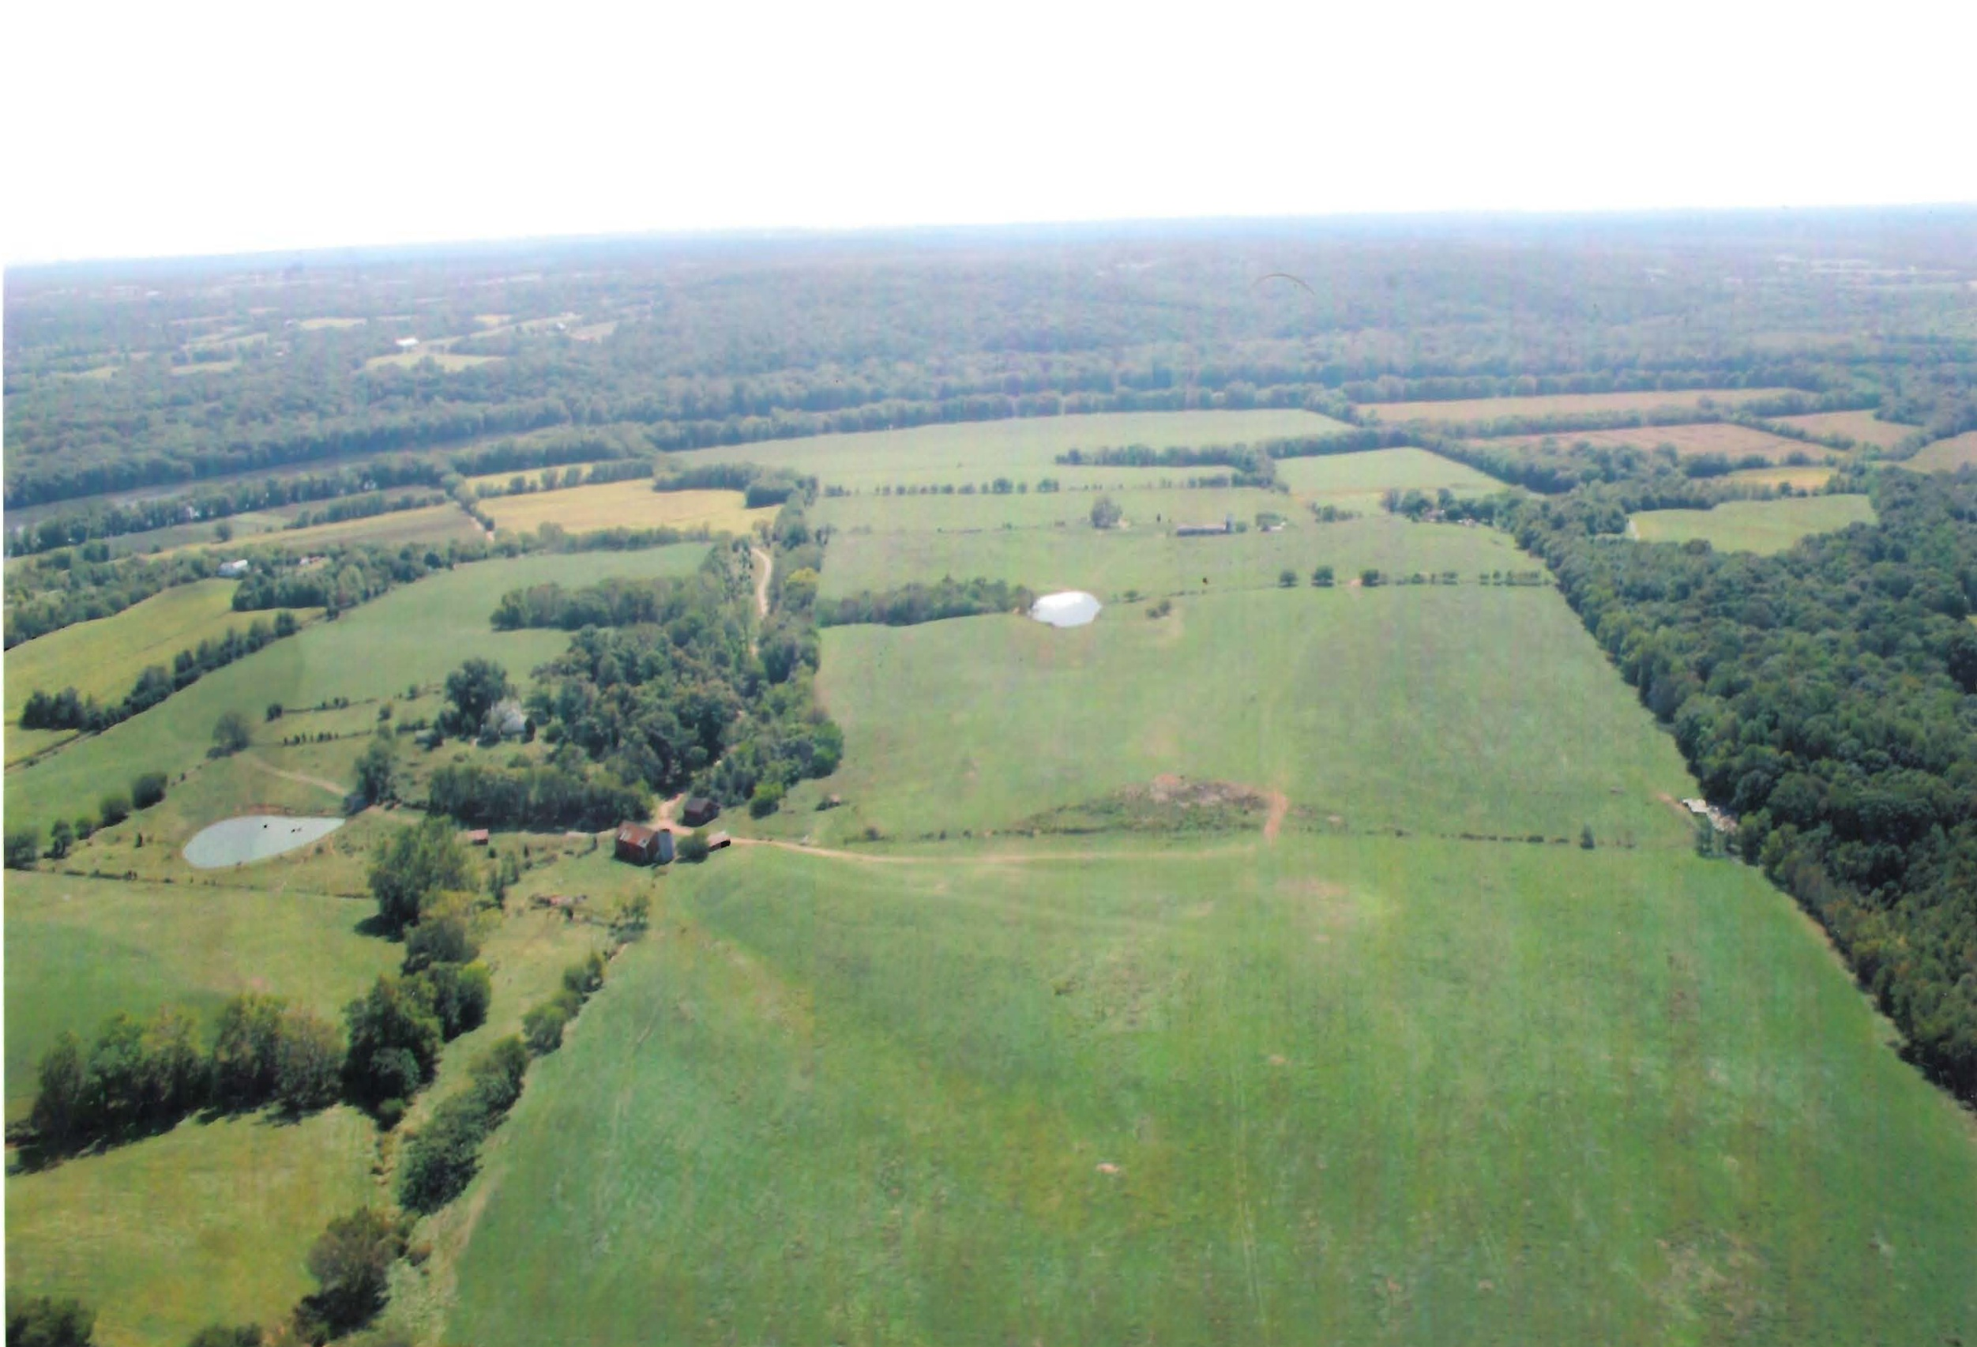

Slide 4
Elements of the Act:
  Authorizes appropriations of $50M/yr. for 5 years
  Up to 50-50 cost share --- leverage to obtain $’s from non federal sources
  Only for land acquisition and related costs
  Criteria for grant awards established in Act
  Eligibility – VA, MD, WVA and DC and local governments in Washington DC MSA as defined by Census – scope will grow as region expands
  Administered by USDI

Slide 5
Qualifying Lands:
  Recreational parks - Fish and wildlife habitats
  Open Space - Watershed protection
  Green space corridors - Historic preservation
  Agriculture - Sensitive environments
  Forests - Public recreation (e.g.
  trails, boat launching sites)

Slide 6
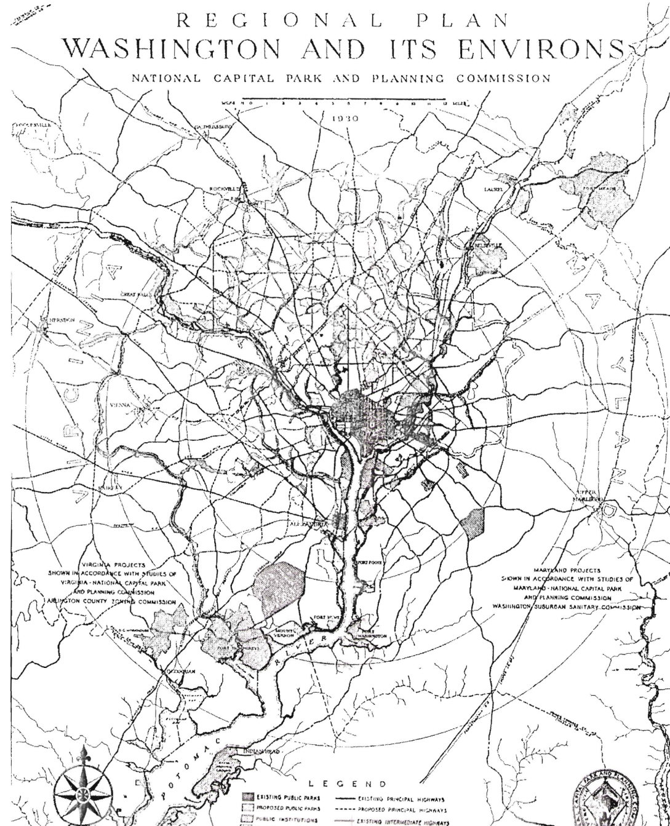
Why Capper Cramton?
  Federal commitment to providing parkland and other public lands in Washington DC and environs from the early 1900’s established in law and Federal policy
  Act developed from 1925 to 1930. National model of enlightened land use planning, environmental protection, parkland and parkway development.
  Used to define the character of DC and region
  Created an effective devise by which to implement regional plans under NCPC leadership
  US, MD and - to lesser extent VA - made good use of the authority through the 1960’s
  Statute is still in place

Slide 7
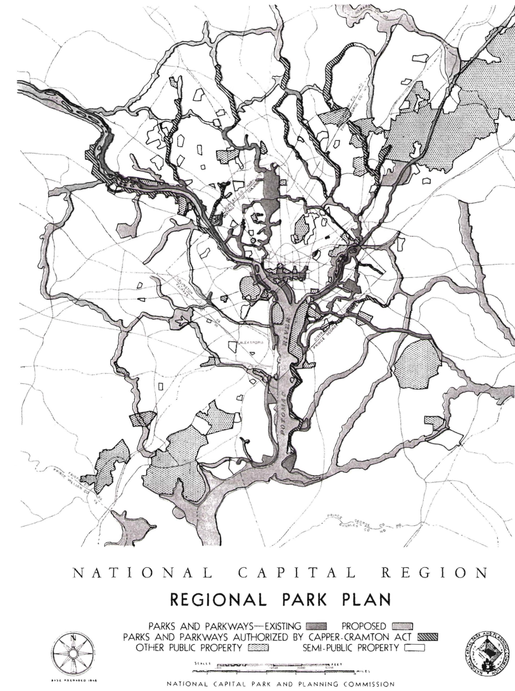

Slide 8
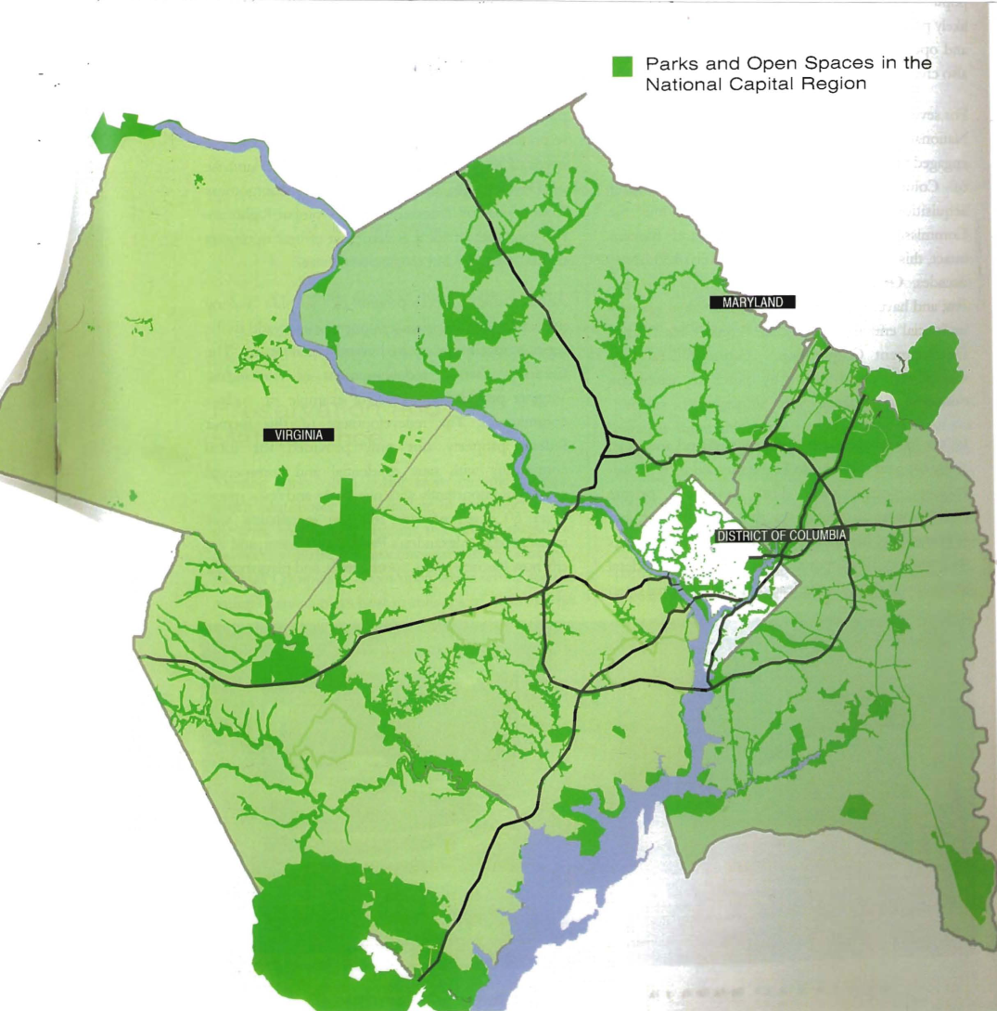

Slide 9
HR 2986 – Authored and Introduced by Rep. Moran - VA
Co – sponsors:
  Norton -- DC
  Wolf, Wittman, Connolly -- VA
  Hoyer, Van Hollen, Edwards -- MD
S 1525 – Introduced by Sen. Ben Cardin – MD
Co-sponsors:
  - Webb, Warner – VA
  - Milkulski - MD

Slide 10
Relationship to other National, Regional and Local Priorities
  Land conservation goals in President Obama’s Executive Order # 13508
  Land conservation goals agreed to by the Chesapeake Bay signatory states (2009)
  Implementation of Greater Washington 2050 Coalition Goals (2009)
  Elements of National Capital Planning Commission’s Comprehensive Plan (2004)
  Assistance to municipalities and regional agencies in implementing their respective open space plans (e.g. Alexandria, NVRPA)

Slide 11
Supporters
Diversity of National, Regional and Local
groups
  Environmental, conservation, and historical
  Business (e.g. Washington Board of Trade)
  Governors of VA and MD
  Northern Virginia Regional Commission
  Several Virginia municipalities (e.g. Arlington, Alexandria, Falls Church, Fauquier)

