Slide 1

Bay Program Developments
Presentation to
Water Resources Technical Committee
Nov. 8, 2012

Slide 2
Bay TMDL Schedule
2010
December 31 – EPA Issued final Bay TMDLs in Federal Register
2011
November 1 – States/DC submitted draft Phase II WIPs
December 31 – Bay States completed first set of 2-Year Milestones (2010-2011)
2012
January - States/District submitted final 2012-2013 milestones to EPA
March 30 - States/District submitted final Phase II WIPs to EPA
2017
Mid-Course Assessment -- EPA to assess implementation progress (60% of full WIP implementation to be achieved by this date)
States to submit Phase III WIPs to EPA: draft by June 1, final by November 1 (dates in flux)
EPA to determine whether to revise TMDL allocations
2025
100% of WIP implementation to be achieved Bay-wide

Slide 3
Mid-Course Assessment Guiding Principles
Keep the focus on implementation and maintain stable tracking and reporting through 2017 (parallel tracks)
Enhance decision support and assessment tools to enable successful engagement of local partners
Incorporate verification of practices into existing accountability tools and reporting protocols
Address emerging issues that may impact current strategies and future plans
Prioritize midpoint assessment actions and adaptive management to ensure Phase III WIPs meet water quality goals

Slide 4
Water Quality GIT Meeting Oct. 22-23
What Was Discussed
What changes should be made in TMDL toolbox (primarily models)
Set priorities for CBP workgroups and CBP staff
Set schedule for producing Phase III WIPs
  2017 (or maybe 2018) – need to work backward from this data;
  allow adequate time for review, model calibration, etc.

Slide 5
Water Quality GIT Meeting Oct. 22-23
What Wasn’t Discussed
Changes to allocation methodology
Change in schedule
Need for use attainability analysis

Slide 6
Proposed Watershed Model Changes
Redo Land Use – incorporation of local data, increase in # of urban classes
Re-examine base loading rates
  Rationale for new land use classes
Re-examine regionalization factors
Continue expert panel process for new, updated BMPs

Slide 7
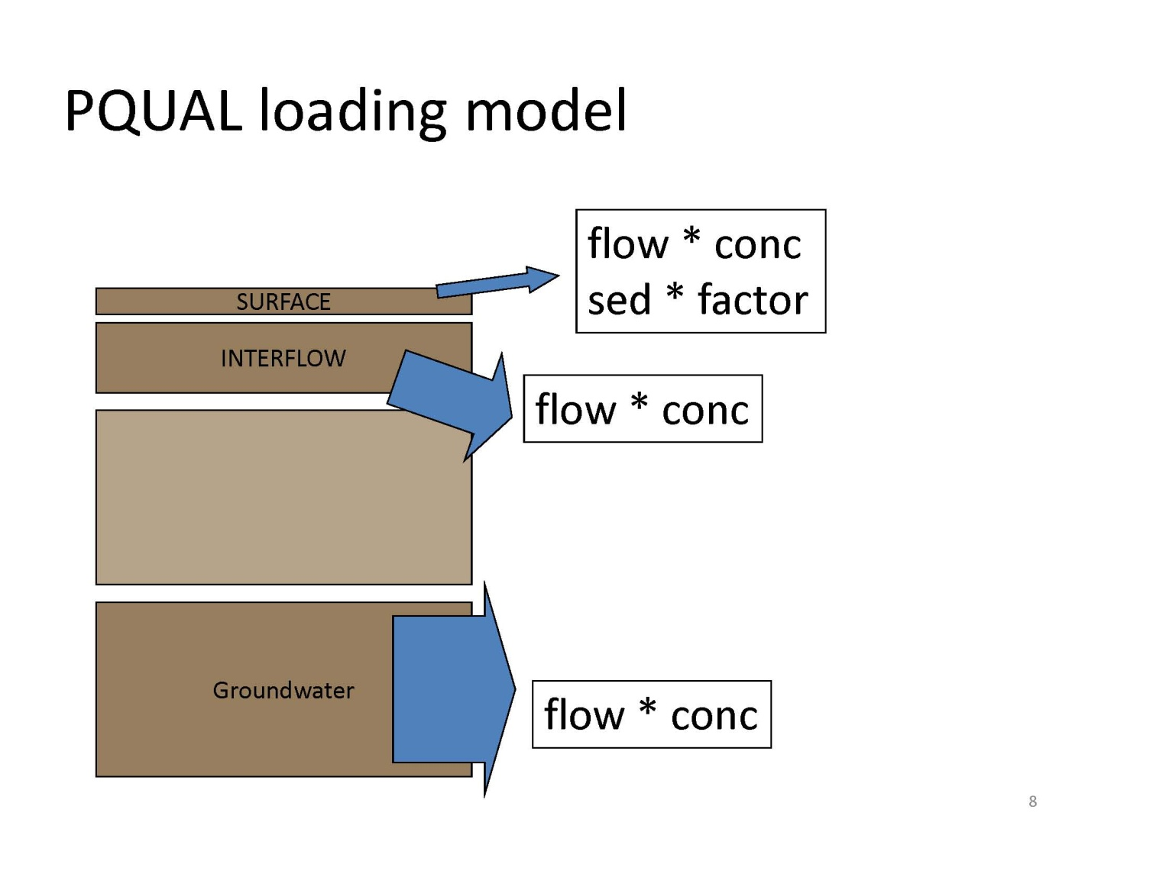
Shift to simpler loading model

Slide 8
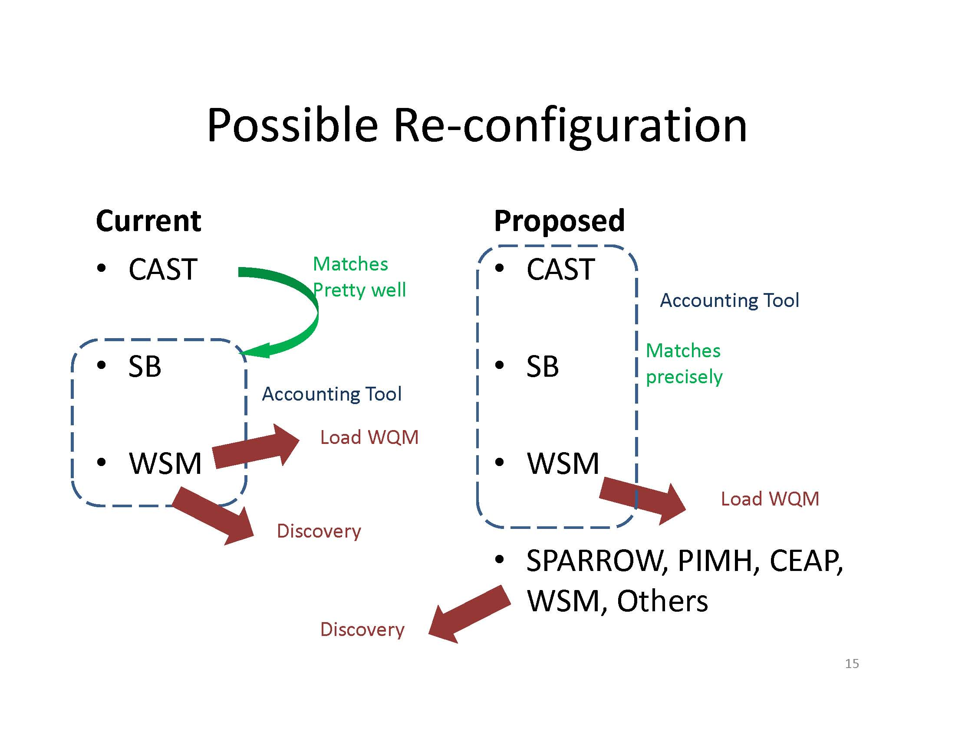
Make MAST/CAST
/VAST the accounting tool for
TMDL

Slide 9
Next Steps
MAST/CAST/VAST regional library
Tap into local land use data
Explore data behind regionalization factors
Look at our own Chain Bridge monitoring data as check on Bay Program modelling data

