Slide 1

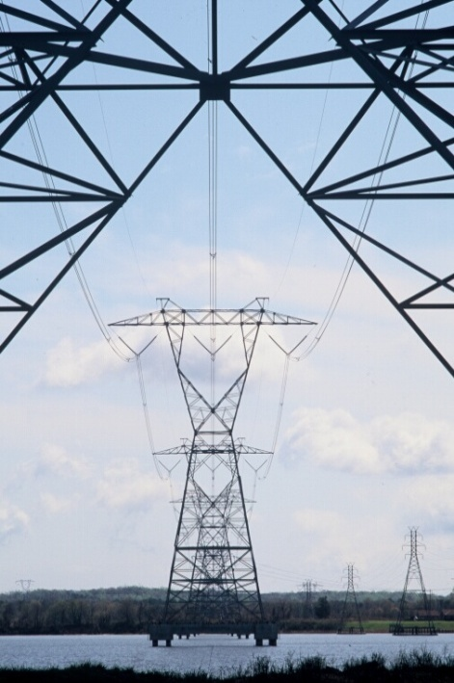
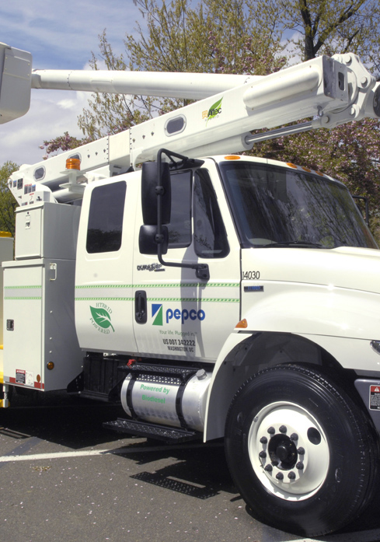
Pepco MD & Pepco DC
Renewable Portfolio Standard Requirements

Slide 2
Renewable Energy – Maryland and the District
In Maryland and the District, the law directs electric suppliers to buy renewable energy credits (RECs) – not renewable energy itself – in amounts sufficient to meet each year’s Renewable Portfolio Standard (RPS)
A “REC” is a credit associated with the verified production of one megawatt hour of electricity from a renewable energy facility
If a supplier does not purchase enough RECs in any given year, it must pay an alternative compliance fee to make up the difference
The sellers of electricity in each jurisdiction must meet their portion of that year’s RPS requirement based on their percentage of load in each jurisdiction

Slide 3
Pepco and the RPS Standard
Pepco is a supplier of electricity in both jurisdictions
Because of deregulation and customer choice, Pepco supplies electricity to some but not all of its customers – it’s called Standard Offer Service (SOS)
HOWEVER, Pepco does not own generating stations, so how can it provide SOS and meet RPS standards?
Pepco buys the electricity needed to supply SOS customers from other electricity suppliers, through auctions supervised by the PSC
The SOS supply purchased through those auctions includes the costs of RPS compliance
The generators that provide electricity for Standard Offer Service supply must either buy their share of RECs, or pay an alternative compliance fee

Slide 4
RPS Facts – Maryland and the District
RECs are classed as either Tier I or Tier II
Tier I includes wind and solar, among other technologies
Tier II chiefly means large hydro and solid waste
Tier II is to be phased out over time
Most facilities can be located in and around the 13-state PJM region – not just Maryland or the District
Solar requirements are “carved out” of the total RPS requirements – a special subset of RECs just for solar, called “SRECs”
Both Maryland and the District have moved to limit SREC eligibility to solar facilities located within the State/District
New Maryland legislation just proposed by Governor O’Malley would create a new subset of Tier I RECs, this time for offshore wind facilities

Slide 5
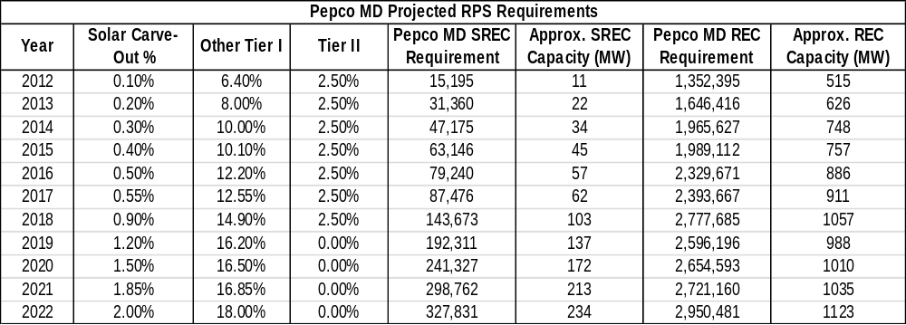
Pepco MD RPS Requirements

Slide 6
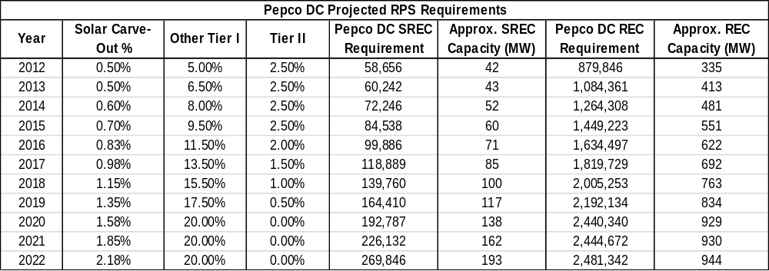
Pepco DC RPS Requirements

Slide 7
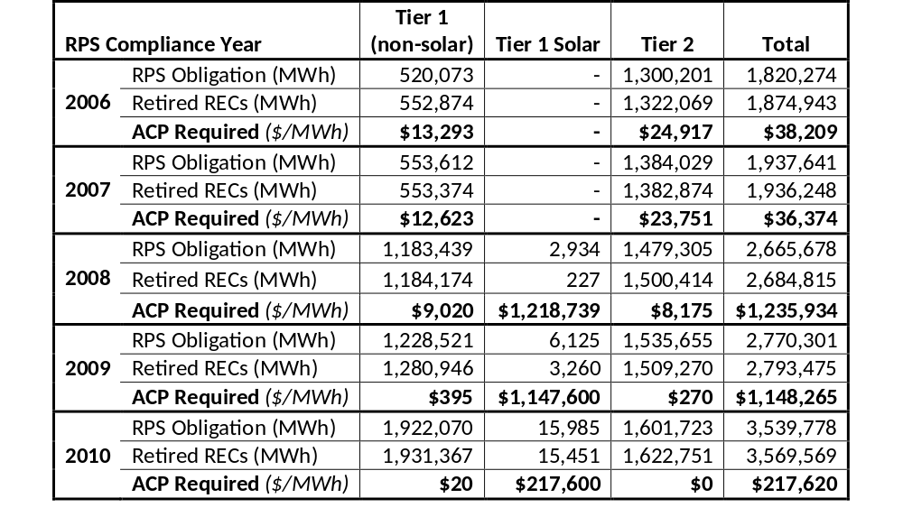
MPSC Slide on Maryland RPS Compliance

Slide 8
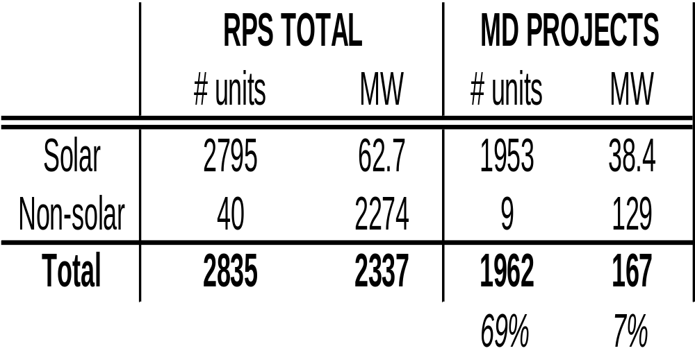
MPSC Slide on Renewable Resources
Since the inception of Maryland’s RPS (2007), 2337 MW have been registered

Slide 9
What Else is PHI Doing on Renewable Energy?
In Delaware, PHI utility Delmarva Power buys RECs directly to meet RPS requirements
Delmarva Power entered into long-term contracts with Maryland and Pennsylvania wind farms that are operational
Delmarva Power is working with Bloom Energy to build a large scale fuel cell generation project in Delaware
Delmarva Power is working with developers on large scale solar projects in Delaware
PHI utility Atlantic City Electric helped pioneer the offshore wind renewable energy credit carve out in New Jersey, which Governor O’Malley has incorporated into his offshore wind bill
PHI subsidiary Pepco Energy Services provides energy savings and renewable energy solutions as part of its services to commercial and government customers
Pepco and Delmarva Power MD are looking into the feasibility of proposing utility-owned, large scale solar projects to the MPSC. However, the SOS procurement process complicates the subject

Slide 10
QUESTIONS?

