Slide 1

Pedestrian and Bicycle Safety Education Campaign
Review of the FY 2012 Campaign and Planning for FY 2013
Transportation Planning Board
Item #11
October 17th, 2012
Jeff Dunckel
Pedestrian Safety Coordinator, Montgomery County
Chair, Bicycle and Pedestrian Subcommittee

Slide 2
Regional Traffic Fatalities
Total = 287
*2011 Preliminary data – MHSO, VDMV, DDOT, Montgomery County
Notes:
Corrected since March 28th press release, which omitted some data.

Slide 3
Traffic Fatality Trends
*2011 Preliminary data – MHSO, VDMV, DDOT, Montgomery County
Notes:
Corrected since March 28th press release, which omitted some data.

Slide 4
Pedestrian & Bicyclist Fatalities by Jurisdiction
Jurisdiction | 2006 | 2007 | 2008 | 2009 | 2010 | 2011* | TOTAL
District of Columbia | 17 | 27 | 15 | 16 | 16 | 13 | 95
Charles County | 2 | 6 | 1 | 3 | 3 | 9 | 24
Frederick County | 4 | 1 | 0 | 1 | 4 | 0 | 10
Montgomery County | 18 | 18 | 19 | 15 | 14 | 11 | 95
Prince George’s County | 20 | 29 | 41 | 23 | 23 | 30 | 166
Arlington County | 1 | 1 | 1 | 4 | 1 | 5 | 13
City of Alexandria | 1 | 2 | 0 | 0 | 2 | 2 | 7
Fairfax County | 20 | 17 | 4 | 11 | 13 | 10 | 75
City of Fairfax | 0 | 1 | 0 | 2 | 0 | 1 | 4
City of Falls Church | 0 | 0 | 0 | 0 | 2 | 0 | 2
Loudoun County | 1 | 3 | 0 | 1 | 2 | 3 | 10
City of Manassas | 0 | 1 | 0 | 0 | 0 | 0 | 1
City of Manassas Park | 0 | 0 | 0 | 0 | 0 | 0 | 0
Prince William County | 7 | 5 | 6 | 6 | 6 | 1 | 31
Total | 91 | 111 | 87 | 82 | 86 | 85 | 533
*2011 Preliminary data – MHSO, VDMV, DDOT
Notes:
*2011 Preliminary data, MHSO, VDMV, DDOT

Slide 5
What is Street Smart?
Street Smart focuses on Education through Mass Media
  One media campaign for one media market
  http://bestreetsmart.net
Concentrated waves of Radio, Transit, Cable, and Internet advertising designed to change driver, pedestrian, and cyclist behavior
Since Fall 2002
Supported by concurrent law enforcement
Funded by:
  Federal Funds administered by the States
  WMATA
  TPB Member Governments
FY 2013: $63k from COG dues, replaces local gov’t contributions
  1.2 cents per capita from all vs. 5 cents per capita from some
Total Budget $623,000, compared to $634,000 in FY 2012

Slide 6
Street Smart Funding, 2002-2013 (in thousands)
Source | Oct-02 | Apr-04 | Jun-05 | Mar-06 | Mar-07 | FY 2008 | FY 2009 | FY 2010 | FY 2011 | FY 2012 | FY 2013
DDOT | $100 | $100 | $100 | $100 | $100 | $200 | $200 | $200 | $200 | $200 | $200?
DCMPD |  |  | $80 |  | $30
Maryland SHA | $115 | $100 | $58 | $50 | $100.1 | $130.3 | $130 | $143 | $100 | $120 | $120
Virginia SHSO | $100 | $100 | $75 | $100 | $75 | $100 | $100 | $100 | $110 | $116.616 | $90
WMATA |  |  |  |  |  | $150 | $150 | $150 | $150 | $150 | $150
Local Gov’t | $100 | $90 | $80 | $91.3 | $113.7 | $158.5 | $120.6 | $54.8 | $37.8 | $47.3 | $63.344*
Private |  |  |  |  | $10
Grand Total | $415 | $390 | $393 | $341.3 | $428.8 | $738.8 | $700.6 | $658.7 | $597.8 | $633.916 | $623.344
 | *COG dues

Slide 7
Street Smart Advisory Group
Works with consultant, TPB staff to plan campaign timing, strategy
Reviews and approves all creative materials
Coordinates with local law enforcement
Membership
  Previously consisted of representatives of funding agencies – States, WMATA, some TPB Member Jurisdictions
  Now open to all agencies paying COG dues
  Letters inviting all jurisdictions to participate went out in May

Slide 8
Street Smart Advisory Group Membership List
October-12
Agency | Representative | Title
State and Regional
District of Columbia Department of Transportation | George Branyan | Pedestrian Program Manager
Maryland Office of Highway Safety | Cristina Sinz | CTSP - State Highway Administration District 3
Virginia Department of Motor Vehicles | Bob Weakley | Grants Manager
Virginia Department of Transportation/NOVA District | Cindy Engelhart | District Bicycle and Pedestrian Coordinator
WMATA | Kristin Haldeman | Manager, Access Planning and Policy Analysis
MWCOG | Jeanne Saddler | Director, Office of Public Affairs
Local - MD
Bladensburg
Bowie | Todd Turner | Mayor, City of Bowie
Charles County
College Park
Frederick
Frederick County
Gaithersburg
Greenbelt
Montgomery County | Jeff Dunckel | Pedestrian Safety Coordinator
Prince George's County DPW&T | Victor Weissberg | Special Assistant to the Director
Rockville
Takoma Park
Local - VA
Alexandria | Carrie Sanders | Principal Transportation Planner
Arlington County | David Goodman | Bicycle & Pedestrian Programs Manager
Fairfax
Fairfax County | Chris Wells | Pedestrian Program Manager
Falls Church | Wendy Block Sanford | Transportation Program Manager / Principal Planner
Loudoun County | Arkopal Goswami | Senior Transportation Planner
Manassas
Manassas Park
Prince William County | Monica Backmon | Regional Planner

Slide 9
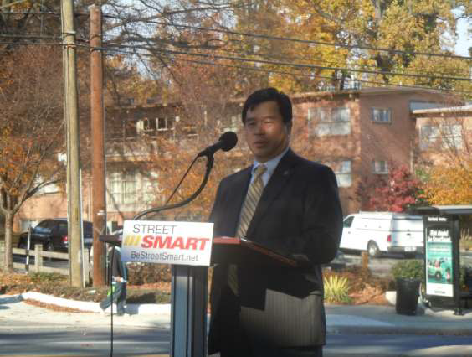
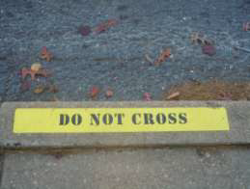
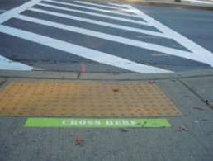

Fall 2011
November 14 Press Event @ Piney Branch Road in Montgomery County
  Coverage Reached 900,000 People
November Media
  “Giant Pedestrian Safety Problem”
  2 weeks radio
  1 month transit ads
Law enforcement
  October 18 Best Practices in Pedestrian Enforcement Workshop

Slide 10
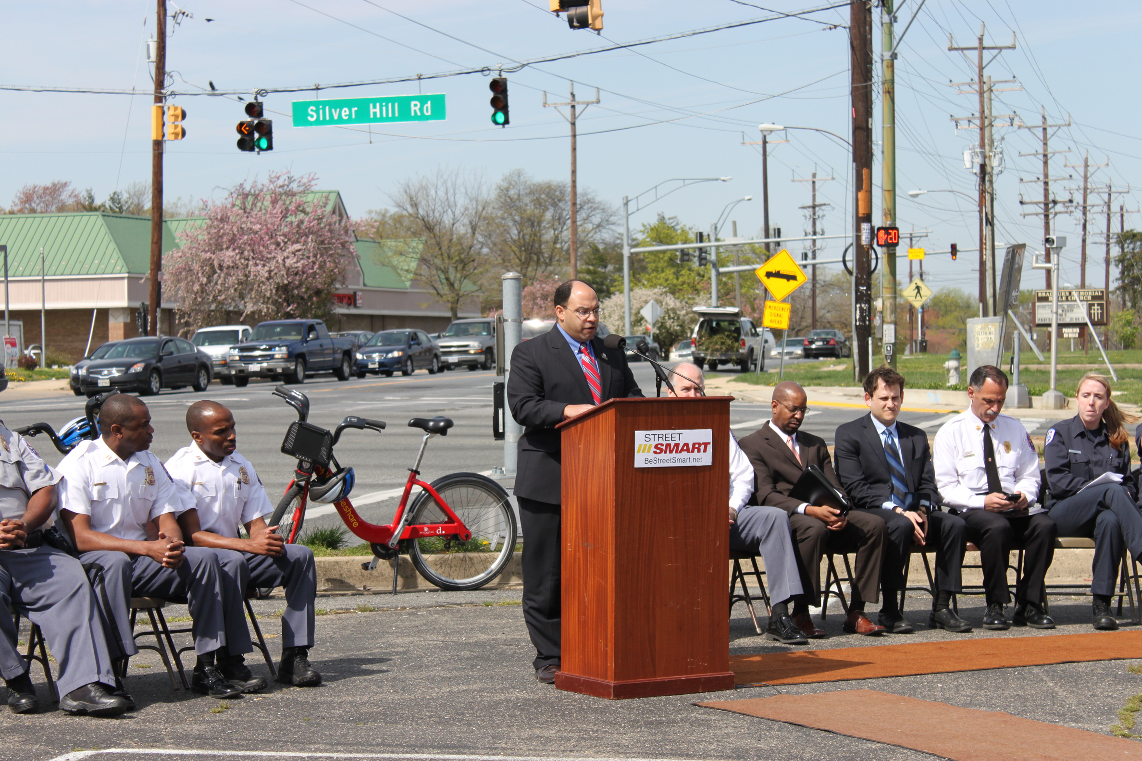
Spring 2012 Campaign
March 18 – April 14
  $218,000 media budget
  Four weeks Cable TV, Outdoor
  Two weeks Radio
    Weighted Wednesday – Sunday, 3 pm – 8 pm
  Press Event
    March 28th, 11:30 a.m., in District Heights, MD
    Followed by live enforcement - Intersection of Silver Hill Road and Marlboro Pike
    Covered on WJLA 7, WUSA 9, WTOP
  Law Enforcement in High-Incidence Areas
    Prince George’s, Montgomery, Capitol Heights, District of Columbia, Arlington, City of Fairfax, Prince William, others
Notes:
Street Smart Pedestrian Safety Campaign Kick-off Event
Wednesday, March 28, 2011
11:30 a.m.
The Honorable Todd Turner
Chairman, National Capital Region Transportation Planning Board
Mark Magaw
Chief of Police, Prince George’s County, MD
Brian Young
District Engineer, Maryland State Highway Administration
Sam Zimbabwe
Associate Director of Planning, Policy and Sustainability,
District of Columbia Department of Transportation
Marc S. Bashoor
Fire Chief, Prince George’s County Fire/EMS Department
Stephanie Buffum or Amy Gunn
Firefighter/Medic, Prince George’s County Fire/EMS Department

Slide 11


Spring 2012 Ads
Example Ad (Bus Side):
Radio Ad:
http://www.bestreetsmart.net/
Notes:
Bus King, Bus Card

Slide 12
Evaluation
Outreach success
  Estimated $1 million value in PSA’s, donated media space, “earned media”
Law enforcement
  3933 Citations and 2088 warnings issued during the campaign
  See Annual Report for more details
Pre and post-campaign web-based surveys of area motorists
    Awareness of messages, law enforcement, self-reported behaviors
    Shows that people remember the messages, and where they heard them
Regional Fatalities and Injuries
  Pedestrian & Bicyclist
Complementary Local “Three E” program results
  Example: Montgomery County Pedestrian Safety Initiative

Slide 13
Long Term Results
Surveys show improvement over past ten years
  Message Awareness
  Perceived Law Enforcement
  Reported pedestrian, driver behavior
Safety Data Results are Mixed
  Pedestrian and Bicyclist Fatalities and Injuries are stable
  Motorized Fatalities and Injuries are falling
  Proportion of Pedestrian & Bicyclist Fatalities and Injuries is rising
  Some jurisdictions have seen improvement. For example,
Montgomery County Pedestrian Safety Initiative
  Comprehensive Engineering, Enforcement & Education Program
  Uses the Street Smart materials, hosts press event
  $4 million/year budget, mostly engineering at high-crash locations
  Reduced pedestrian fatalities, serious injuries

Slide 15
Next Steps
New Project Consultant – Sherry Matthews Inc.
  Submitted the most highly rated among eight proposals
  Long history of public safety campaigns for TX DOT, others
  Met with Advisory Group
  Developing proposal for FY 2013
    Fresh data on target demographic in the Washington Region
    Fresh creative and media approach
    Promote partnership with local three “E” efforts
Fall Campaign: November 2012
  Loudoun County has volunteered to host Fall 2012 Press Event
    November 14

Slide 16
Appendix - Data Slides

Slide 17
Injury Trends: 1999-2010
Sources: MDSHA Maryland Highway Safety Office; DDOT 2010 Safety Facts, Virginia Department of Motor Vehicles CAP (Centralized Accident Processing) System

Slide 18
Pedestrian Injuries in the Washington Region
Sources: MDSHA Maryland Highway Safety Office; DDOT 2010 Safety Facts, Virginia Department of Motor Vehicles CAP (Centralized Accident Processing) System

Slide 19
Bicyclist Injuries in the Washington Region
Sources: MDSHA Maryland Highway Safety Office; DDOT 2010 Safety Facts, Virginia Department of Motor Vehicles CAP (Centralized Accident Processing) System

Slide 20
Daily Walk Trip Share by Jurisdiction (All trips)
(1994 – 2007/2008)
Source: 1994 and 2007/2008 TPB Household Travel Survey

Slide 21


Evaluation Results:
Spring 2012 Campaign Survey
PROvuncular
Research & Strategic Insight
Marketing Communications

Slide 22
Survey Methodology
  Web-based standard pre/post-test survey with a sample size of N = 500 per survey.
  Pre-survey week of March 19, 2012.
  Post-survey week of May 6, 2012.
  50-50 males–females
  Sampled from COG membership footprint
  All participants are active drivers.
  Margin of error is +/- 4%.

Slide 23
Enforcement
Respondents were asked: “Have you recently seen or heard about police efforts to enforce pedestrian safety laws?”
  The general audience showed a 10% increase in enforcement awareness from pre- to post-surveys going from 32% to 42%.
  Males 18-34 showed sustained
  high awareness from pre- to
  post-surveys.
Increase of
10 points

Slide 24
Enforcement
    Target audience of males aged 18-34 believed driver, bicyclist enforcement increased
Increase of
7 points
Increase of
7 points

Slide 25
Behaviors
    Self-reported risky behaviors show improvement of pedestrian behaviors among 18-34 males while driver behavior remained flat.
      Failed to yield to pedestrians:
      Pre 26% - Post 25%
      Jaywalked:
      Pre 40% - Post 31%
      Did not wait for walk sign:
      Pre 44% - post 35%
Decrease of
9 points
Decrease of
9 points

Slide 26
Message Awareness
    Awareness of the primary enforcement message “Obey pedestrian and traffic safety laws or get tickets, fines or points” increased among the target audience in the post survey.
Increase of
7 points
Increase of
5 points
    .

Slide 27
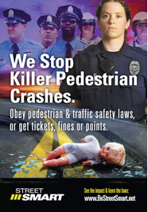
Message Awareness
    When asked have you seen this ad, respondents showed significant recall in the post-survey indicating awareness of the outdoor advertising.
Increase of
13 points
Increase of
8 points

Slide 28
Progress over time
    The Street Smart Program has been conducting pre- and post-surveys since 2002. During the past 10 years, some questions have been consistently asked in the same manner so we’ve been able to do some comparisons.
    Total Net Awareness (combined awareness of all campaign messaging):
Increase of
24 points

Slide 29
Progress over time
    Observations of pedestrians who “frequently” jaywalk:
Decrease of
7 points

Slide 30
Progress over time
    Observations of drivers who “frequently” do not yield to pedestrians:
Decrease of
14 points

Slide 31
Progress over Time
    Awareness of police efforts to enforce pedestrian traffic safety laws:
Increase of
18 points

