Slide 1

National Capital Region
Transportation Planning Board
The 2010 Financially Constrained
Long-Range Transportation Plan
And FY 2011-2016 Transportation Improvement Program
TPB Technical Committee
November 5, 2010
Item # 3

Slide 2

2010 CLRP and FY 2011-216 TIP
What Shapes the Plan?
How Does the Plan Perform?
Financial Summary of the TIP

Slide 3
What Shapes the Plan?
Land Use Forecasts
Financial Constraint
Transit Fares and Constraint
Significant Changes to Expansion Projects

Slide 4
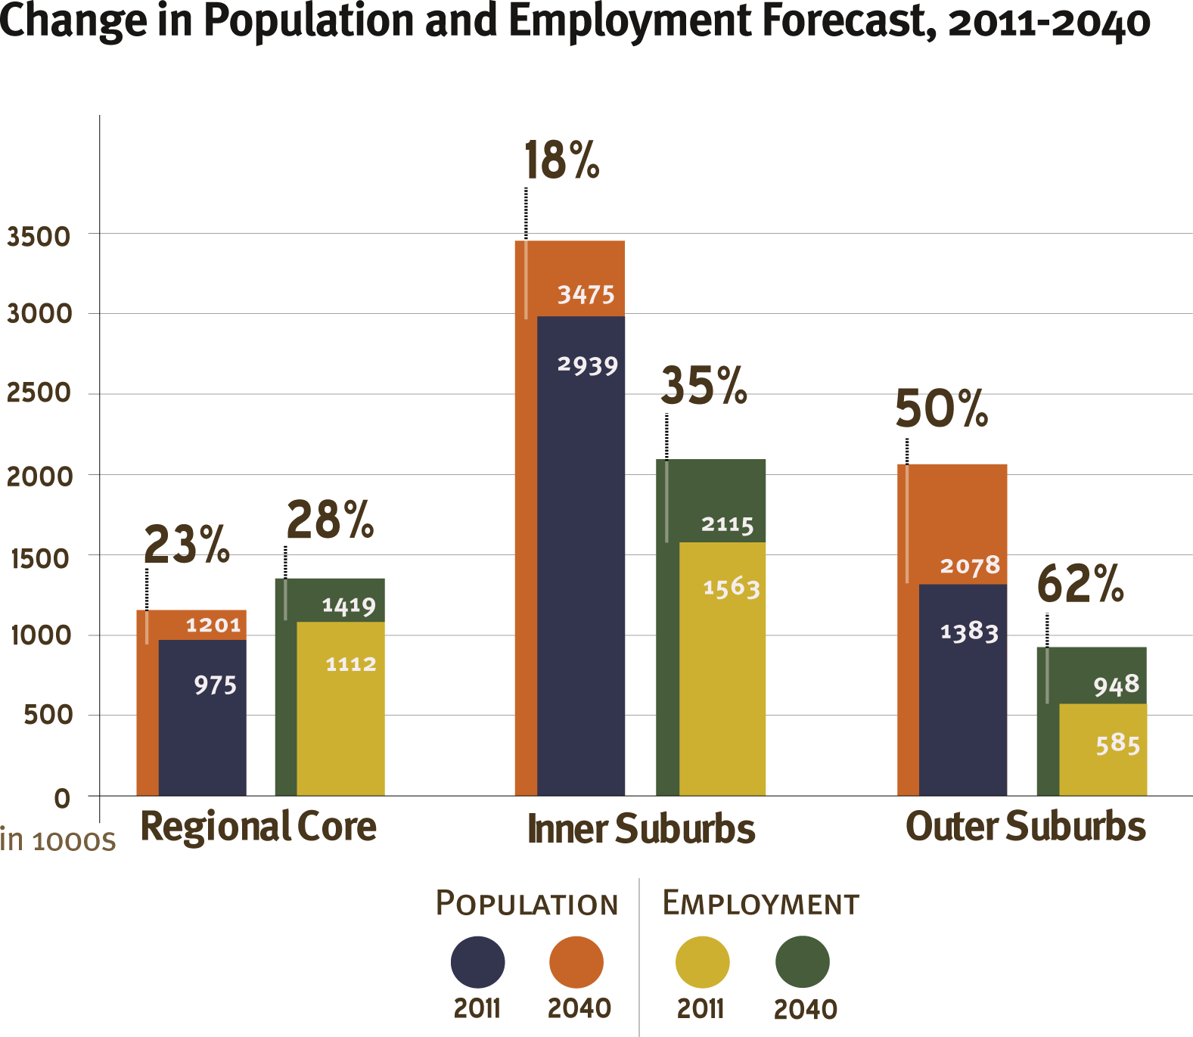
What Shapes the Plan?
Land Use Forecasts
Fastest growth rate seen in the Outer Suburbs
Change in Population and Employment Forecast, 2011-2040

Slide 5
What Shapes the Plan?
Financial Constraint
$222.9 Billion
CLRP Revenues 2011-2040
CLRP Expenditures 2011-2040
Federal
State/DC
Local
Transit Fares
Private/Tolls
Transit Expansion
Transit Operations/Preservation
Highway Expansion
Highway Operations/Preservation

Slide 6
What Shapes the Plan?
Financial Constraint
14%
13%
36%
43%
43%
51%
2006 CLRP
2010 CLRP

Slide 7
What Shapes the Plan?
Transit Fares and Constraints
Transit fares increased in 2010.
Federal and local funding for Metro Rehabilitation expires in 2020.
Transit ridership will be
constrained at 2020 service levels.

Slide 8
What Shapes the Plan?
Significant Changes
New Projects in the District of Columbia
DC Streetcar Project
- Complete in 2015
- $183.8 million (capital) + $4.8 million/year (operating)
Bike Lane Pilot Project
- Complete in 2010
- $1.2 million
- not analyzed for conformity impacts
St. Elizabeth’s Campus Access Improvements
- Complete 2016
- $158.2 million
Glover Park Streetscaping/Wisconsin Ave. NW Reconfiguration
- Complete 2011
- $4.7 million

Slide 9
What Shapes the Plan?
Significant Changes
New and Restored Projects in Maryland
I-70 Interchange at Meadow Road
- Complete in 2016
- $27 million
MD 3, Robert Crain Highway from US 50 to the Anne Arundel County Line
- Complete in 2030
- $399 million
MD 28, Norbeck Road/MD 198, Spencerville Road from MD 97 to I-95
- Complete 2025
- $352 million

Slide 10
What Shapes the Plan?
Significant Changes
Modifications to Existing Projects in Maryland
I-270 from Shady Grove Metro Station to I-70
Extended along US 15 from I-70 to Biggs Ford Road
- Complete in 2030
- $3.4 billion
A-305, Mid-County Highway from MD 355 Stringtown Road
Extended from Stringtown Road to MD 27
- Complete in 2012
- $12million

Slide 11
What Shapes the Plan?
Significant Changes
Projects Delayed or Removed in Maryland
Projects delayed 10 years or more:
MD 4, construct interchange at Westphalia Rd. - 2020
MD 2/4, construct 3 lanes from MD 765 to MD 2/4 at Lusby - 2040
Projects removed from the CLRP:
I-95/495 interchange at Greenbelt Metro
US 29 Columbia Pike, upgrade from Sligo Creek Pkwy to Howard Co line
US 301, upgrade and widen from north of Mount Oak Road to US 50

Slide 12
What Shapes the Plan?
Significant Changes
Modification to Existing Project in Virginia
VA 411, Tri-county Parkway from VA 234 to Loudoun County line
Extended from Loudoun County Line to US 50
- Complete in 2035

Slide 13
What Shapes the Plan?
Significant Changes
Projects Delayed or Removed in Virginia
Projects delayed 10 years or more:
US 1, bus right turn lanes from VA 235 N to I-95 – 2035
VA 7/US 15 Bypass, widen to 6 lanes from VA 7 W to US 15 S - 2035
US 15 (James Madison Highway), widen to 4 lanes from US 29 to I-66 - 2040
Tri-County Parkway, construct 4 lanes from I-66 to US 50 - 2035
VA 7, widen to 8 lanes from Dulles Toll Rd to I-49 - 2025
VA 7 Bypass, widen/upgrade to 6 lanes from US 15 S to VA 7/US 15 E - 2035
Projects removed from the CLRP:
I-95, construct interchange at VA 7900 (Franconia-Springfield Pkwy)
US 1, widen to 6 lanes from Stafford Co line to Joplin Rd
VA 7, widen to 6 lanes from Rt 9 to Market St
US 15 (James Madison Hwy), widen to 4 lanes from VA 234 to Loudoun Co line
VA 28 (Centreville Road), widen to 6 lanes from NCL Manassas Park to Old Centreville Rd
US 50, widen to 8 lanes from I-66 to WCL Fairfax City
VA 7100 (Fairfax Co Pkwy), widen to 6 lanes from VA 636 to VA 640
VA 7100 (Fairfax Co Pkwy HOV), construct 2 lanes from VA 640 to VA 7900
VA 234 (Manassas Bypass), widen/upgrade to 6 lanes from VA 234 (South of Manassas) to I-66 - 2040

Slide 14
How Does the Plan Perform?
Some of the key goals from the TPB’s Vision and COG’s Region Forward and Climate Change Reports include:
Reduce Vehicle Miles Traveled (VMT) per capita
Reduce congestion on the region’s highway and transit systems
Meet federal air quality standards and reduce mobile-source NOx, VOC and PM emissions
Reduce mobile-source greenhouse gas emissions
Increase accessibility to jobs
Increase rate of construction of bicycle and pedestrian facilities

Slide 15
How Does the Plan Perform?
Reduce VMT per capita
Percent Change
43%
24%
VMT
per capita
Transit Work Trips
Vehicle Work Trips
VMT
4%
Change in Travel Forecasts 2011-2040

Slide 16
How Does the Plan Perform?
Reduce Congestion
Percent Change
38%
22%
11%
VMT
New Lane Miles
Lane Miles
of Congestion
(AM Rush Hour)
Change in Travel Forecasts 2011-2040

Slide 17
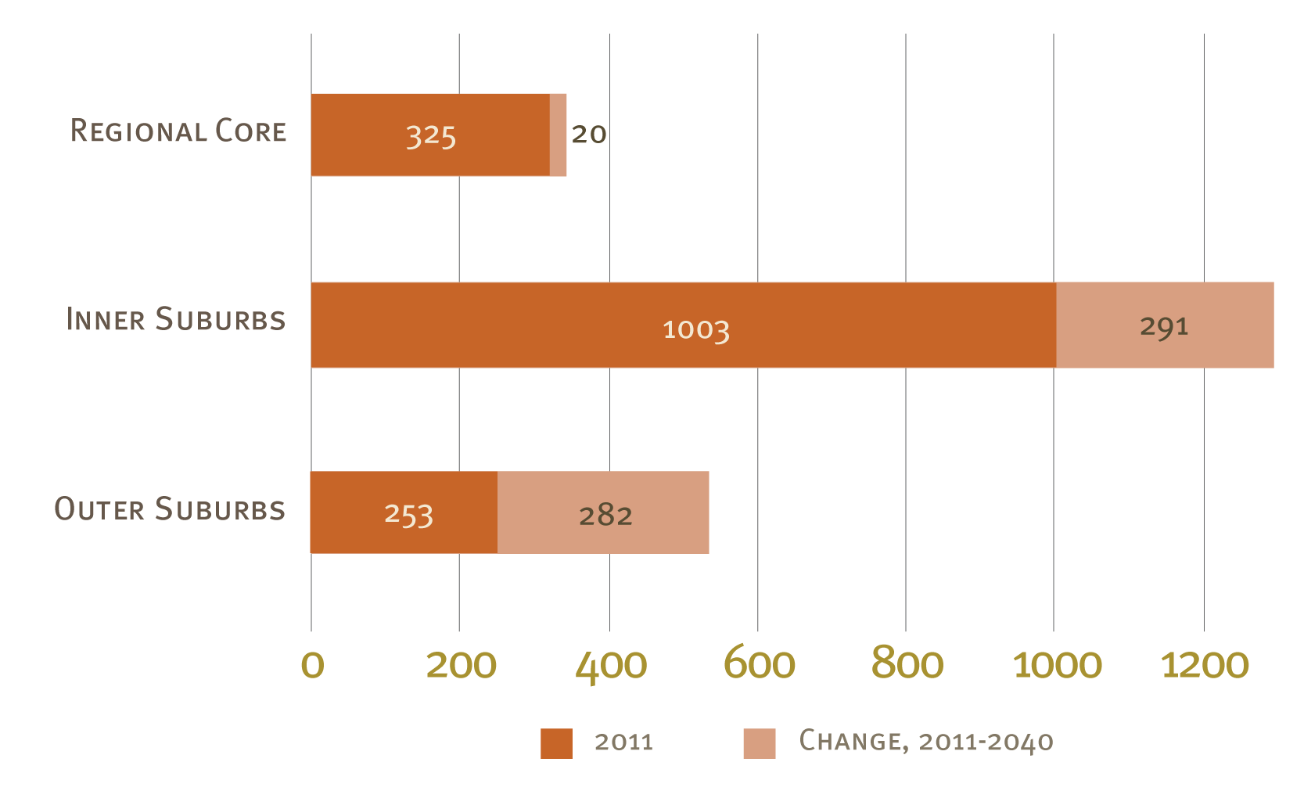
How Does the Plan Perform?
Reduce Congestion
Metro can accommodate growing ridership until 2020. Service levels are then capped through 2040, resulting in high levels of congestion.
Highway Lane Miles of Congestion (AM rush hour)

Slide 18
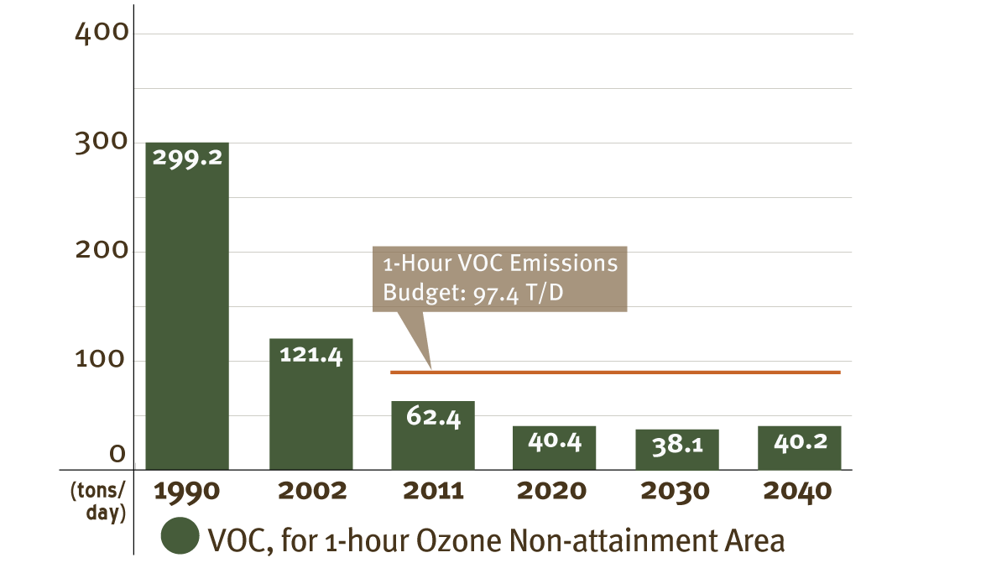
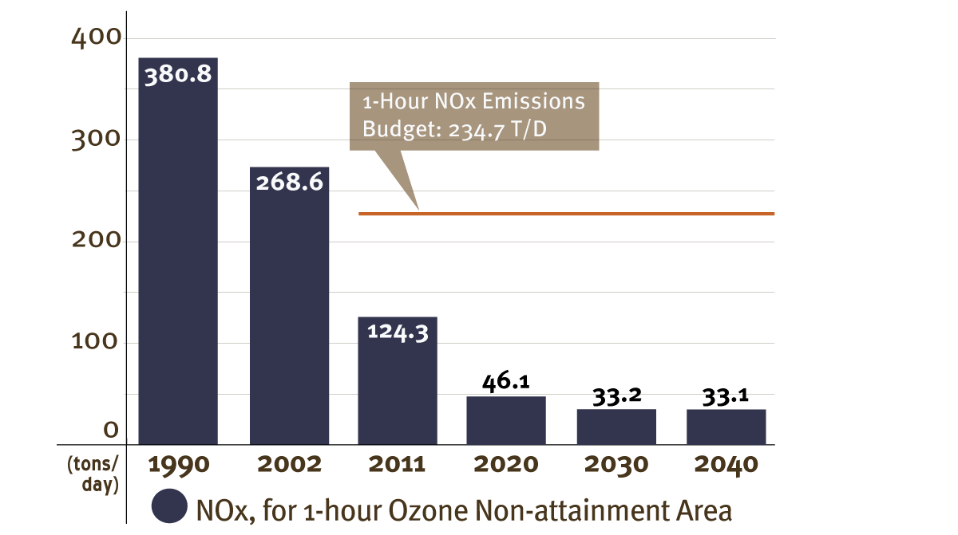
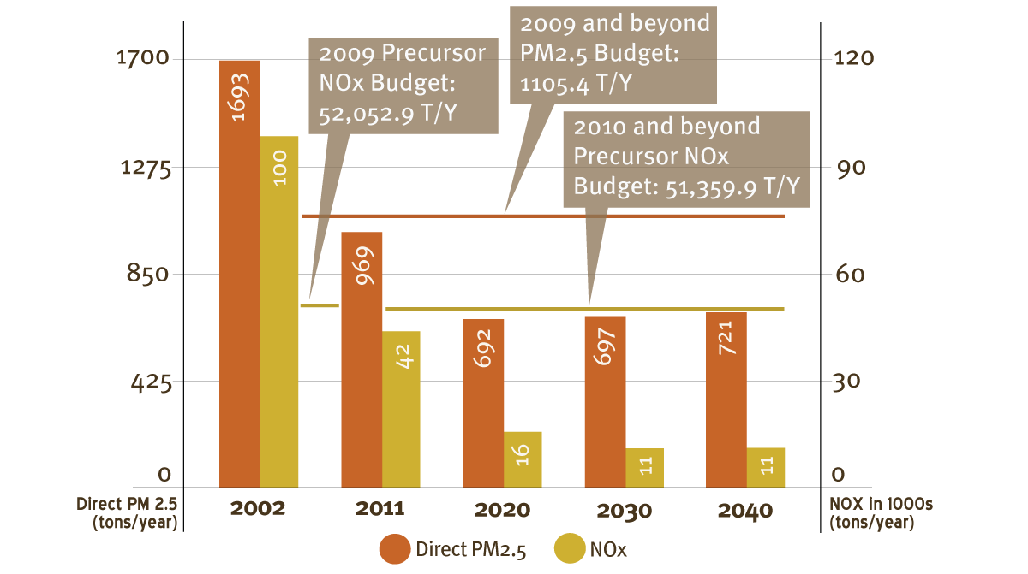
How Does the Plan Perform?
Meet Federal Air Quality Standards
The CLRP meets federal air quality standards for VOC, NOx, PM and Precursor NOx.

Slide 19
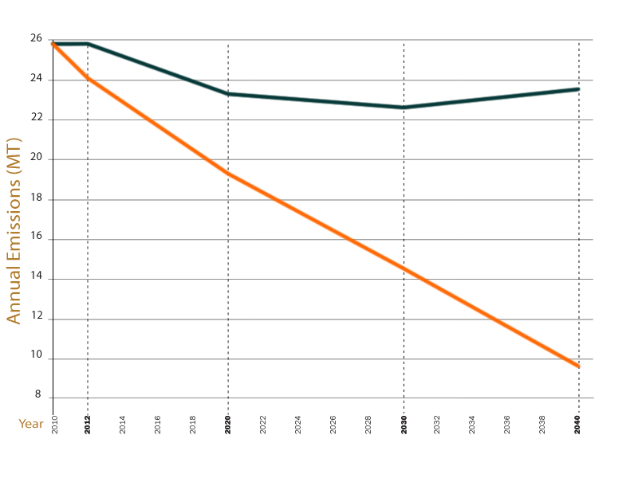
How Does the Plan Perform?
Reduce Mobile-Source Greenhouse Gas Emissions
23.5
9.6
2012
2020
2030
2040
COG Goals
2010 CLRP

Slide 20
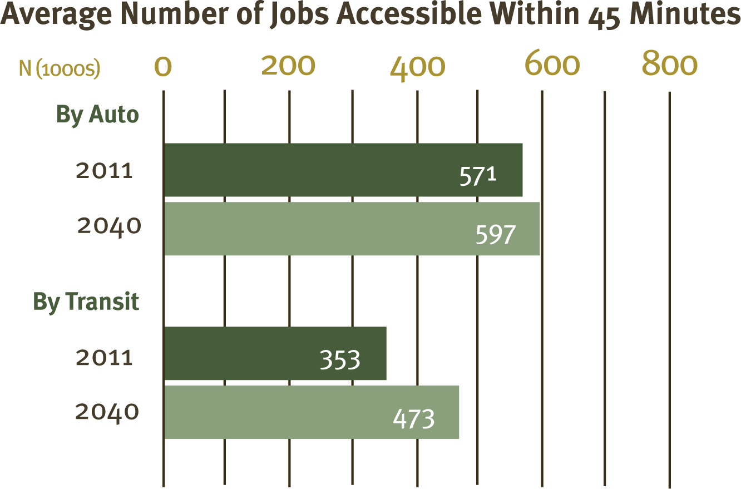
How Does the Plan Perform?
Increase Accessibility to Jobs
Average Number of Jobs Accessible Within 45 Minutes

Slide 21
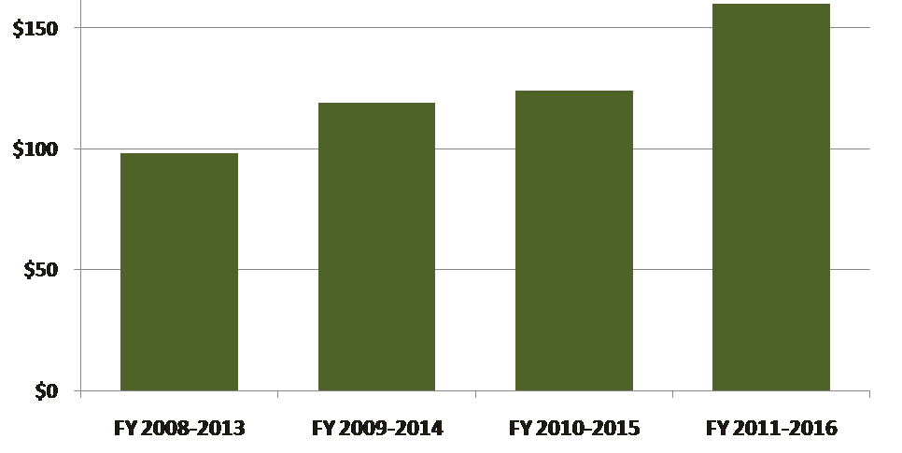
How Does the Plan Perform?
Increase Construction of Bike/Ped Facilities
Funding for Bicycle and Pedestrian Projects in the TIP has increased each year.
In Millions
$160
$119
$124
$98
Does not account for road and transit projects that include accommodations for bicycles and pedestrians.

Slide 22
Summary of the FY 11-16 TIP
Funding Compared to Previous TIPs
Cost (in Billions)

Slide 23
Summary of the FY 11-16 TIP
Funding by Jurisdiction/Agency
$15.98 Billion

Slide 24
Summary of the FY 11-16 TIP
Funding by Source
$15.98 Billion

Slide 25
Summary of the FY 11-16 TIP
Funding by Project Type
$15.98 Billion

