Slide 1

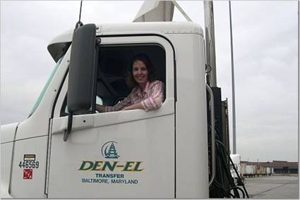
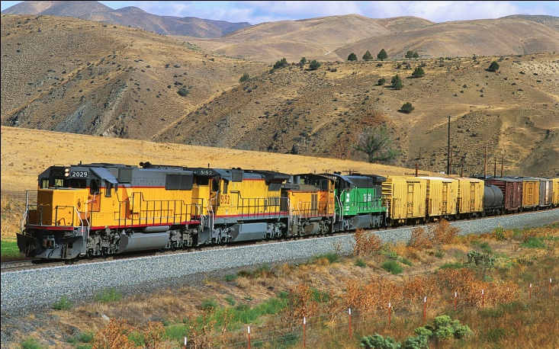
Freight Plan Workshop
March 11, 2010

Slide 2
Discussion Outline
Freight Plan Context
Overview of Document Structure
Define Freight Subcommittee Objectives
Review “Best Practices”
Freight Project Database

Slide 3
Freight Issues are on the Federal Radar
Federal MPO Certification Process (April 2010)
  Includes review of MPO Freight Efforts (new)
  FHWA State and MPO Freight Plan templates
SAFETEA-LU MPO freight planning references
  Increase accessibility to mobility and people with freight;
  Enhance the integration and connectivity of the transportation system…for people and freight
Anticipate more freight in upcoming successor legislation
Notes:
Federal Certification:
P. Freight Planning
How does the MPO explore the need for enhanced intermodal connectivity by identifying major facilities serving air, rail, transit, and freight and demonstrating the linkages between these modes?
How does the MPO assess the future demand placed on intermodal links and identify specific projects to facilitate access to these facilities?
What process does the MPO use to identify and analyze existing and projected goods movement in the region?
Are freight shippers engaged in the development of the LRTP, TIP, and other MPO products?

Slide 4
Document Structure
9 Chapters
Intro/Planning Context/Freight Program
Current/Forecast Freight Conditions
Land Use and Environment
Safety and Security
Freight Project Database
Best Practices

Slide 5
Freight Subcommittee Objectives
Freight Subcommittee established April 2008
Yet to Define as a Freight Subcommittee our Objectives
Examples:
  To Provide a Voice to Freight Community in Transportation Planning (BMC)
  Understand and address issues of concern to the freight community (ARC)
  Improve movement of goods in the region by encouraging cooperative and expedient multi-modal shipments of goods (ARC)
  Improve the physical characteristics of the transportation system for freight-related transportation between shipping and receiving points (ARC)

Slide 6
Group Objectives?

Slide 7
Best Practices
Defined as process or activity anticipated to be effective in achieving overall Freight Program objectives.
Best Practice are ones that Freight Subcommittee should find substantially beyond debate-agreement.
Established 3 thus far…Freight Subcommittee input to come up with more.

Slide 8
Best Practice 1
Jurisdictions should have one or more staff persons responsible for freight planning in the jurisdiction.
  The jurisdictional staff person(s) assigned to freight should be sufficiently knowledgeable on freight issues to effectively work with their jurisdiction’s freight stakeholders.
  Each jurisdiction should identify a freight liaison to coordinate planning with the Transportation Planning Board (TPB) and Freight Subcommittee.
Notes:
At regional level, we’re thinking counties and states

Slide 9
Best Practice 2
Jurisdictional transportation plans should specifically address freight movement issues.
  Each jurisdiction should prepare a freight profile to advise further integration of freight into local plans.
  Jurisdictional plans should address development-related freight issues, such as off-road loading facilities, in accordance with published national standards.
  Jurisdictional plans should consider truck movement within the jurisdiction, including consideration of issues such as truck routing, on-street loading zones and delivery space, and truck parking.
  Incorporate truck transportation and commercial loading zones in zoning for new construction projects.
  Jurisdictions should coordinate jurisdictional-level zoning efforts with state and federal departments of transportation who make decisions on transportation projects.

Slide 10
Best Practice 3
Regional freight planning activities should be sustained to assist state and local freight integration efforts.
  Coordinate a regional Focus on Freight Forum to draw attention and public awareness to freight issues.
  Prepare a brochure to summarize the Freight Program objectives and to serve as a freight educational handout.
  Continue to analyze regional freight flows in the National Capital Region.

Slide 11
Additional Best Practices?

Slide 12
Freight Project Database
Highway and Rail Projects
Source Documents
  Constrained Long Range Plan, scheduled and funded projects submitted by MPO jurisdictions
  CSX National Gateway
  NS Crescent Corridor
  Draft MDOT MRP
  I-95 MAROPs

Slide 13
Highlight Top 10 “Freight” Projects
Why? When funding becomes suddenly available, such as TIGER grant, we need strong projects, with recognized support.
  Bicycle/Pedestrian Plan Top 10
8 Truck/2 Rail

Slide 14
Top 10 Criteria
Truck
  Connectivity for Freight
  Safety
  Security
  Quality of Service
Rail
  Connectivity for Freight
  Mobility Efficiencies
  Safety
  Security
  Quality of Service
Notes:
And share list with MMTA, VMTA, ATA

Slide 15
Additional Criteria?

Slide 16

Thank you!
Karin Foster, kfoster@mwcog.org

