Slide 1
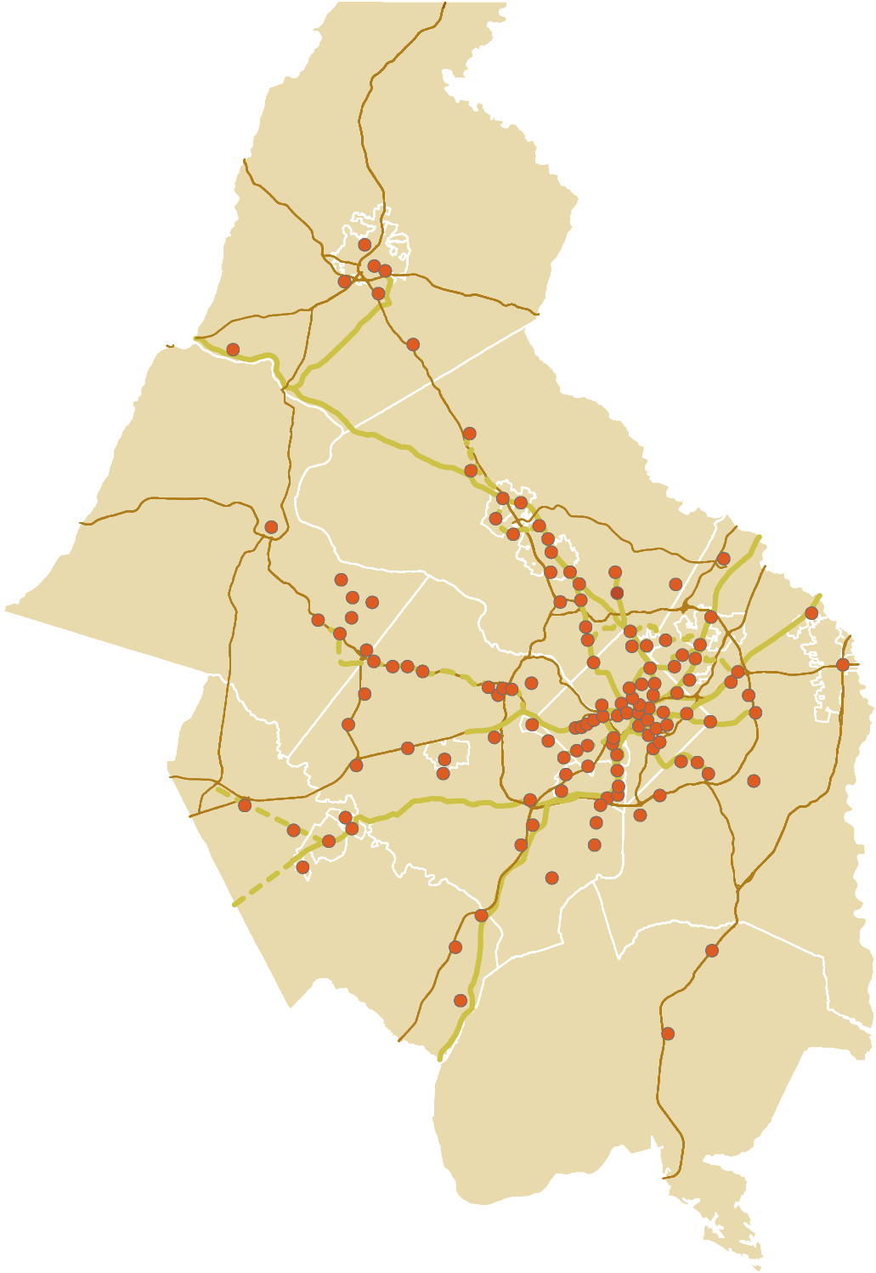

2012 Activity Center Update
September 19, 2012
Transportation Planning Board
Sophie Mintier, COG/DCPS Staff
Notes:
1

Slide 2
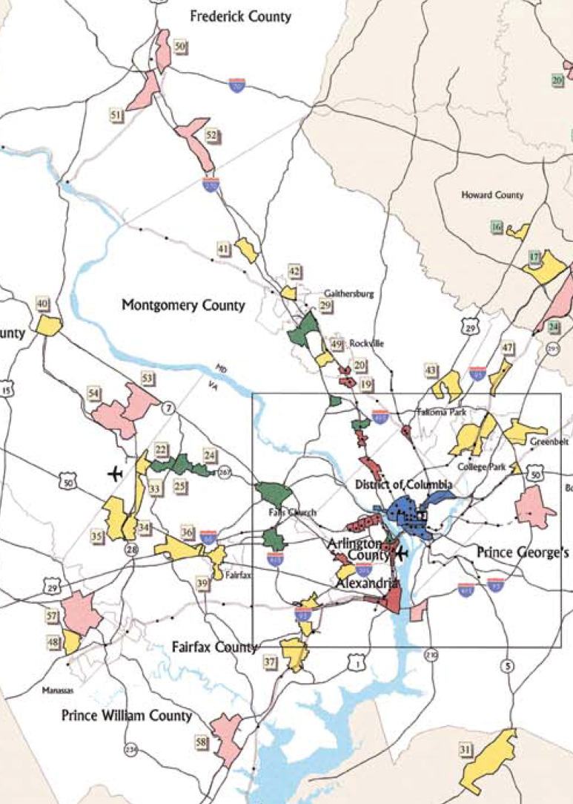
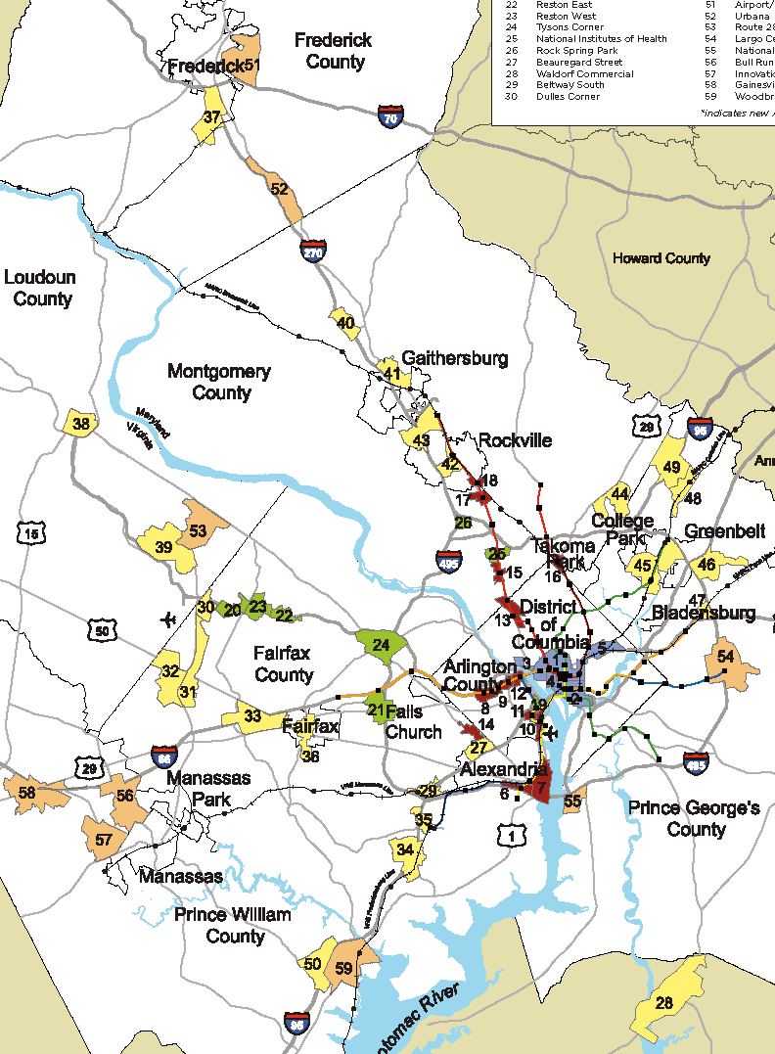
Activity Centers – Past
Based on Cooperative Forecasting Results
First map released in 2002; minor update in 2007
2002 – 58 centers
2007 – 59 centers
Notes:
2

Slide 3
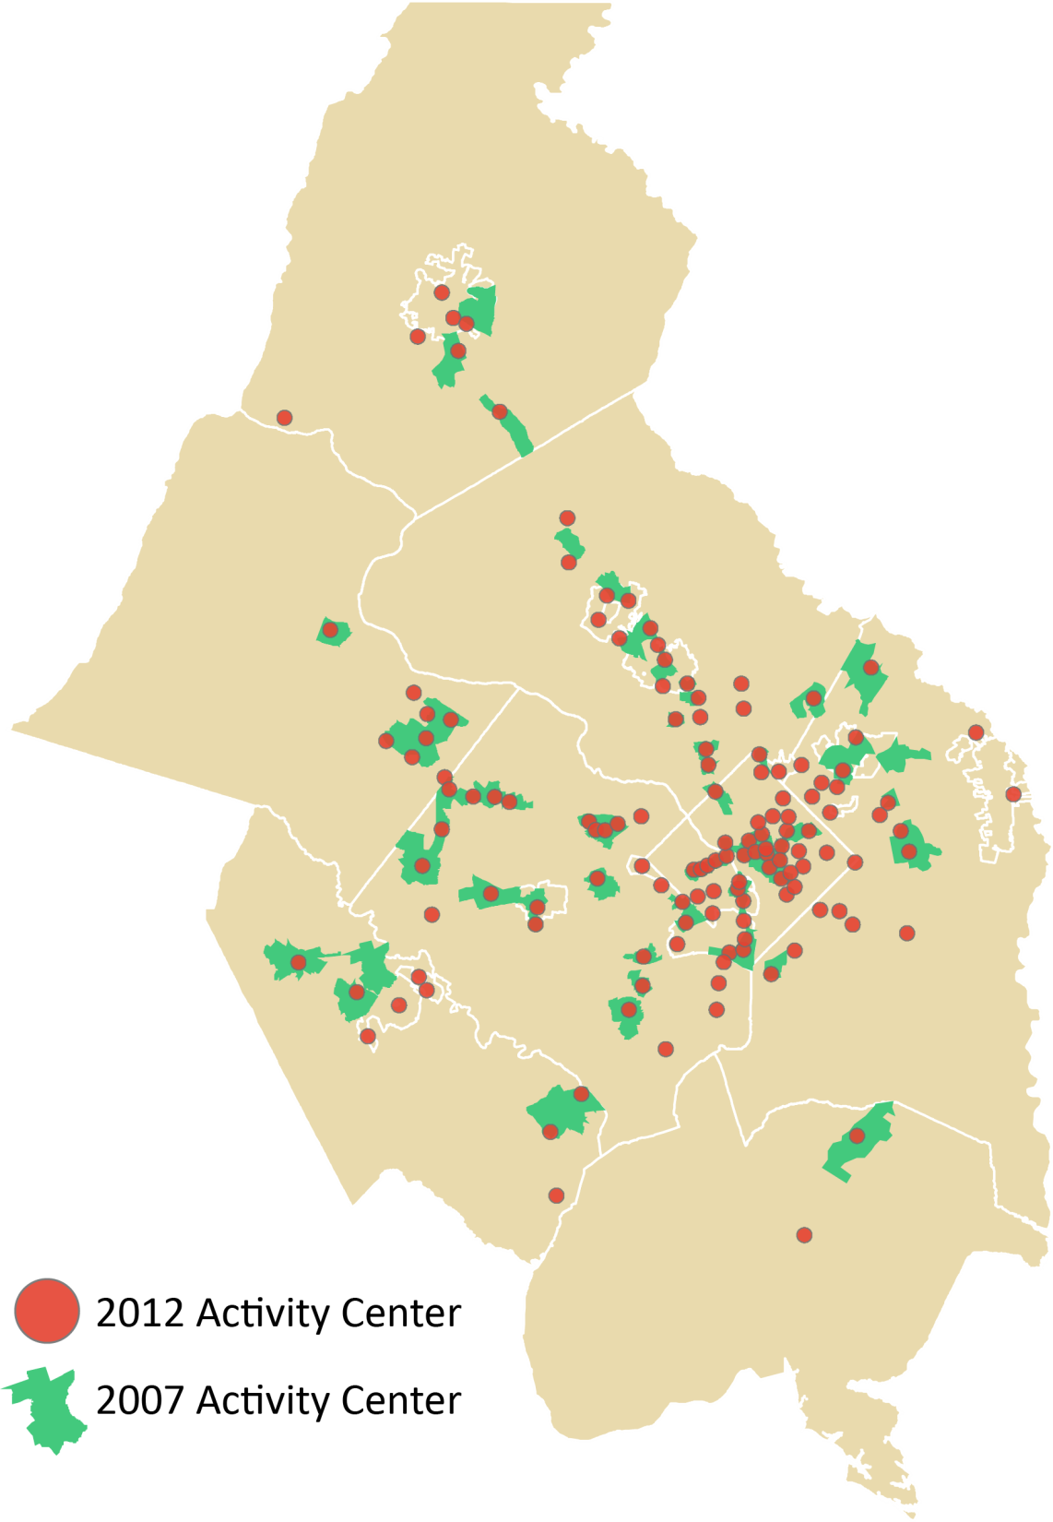
Activity Centers - Now
Selected using new approach
Major changes for 2012 update
136 centers
Notes:
3

Slide 4
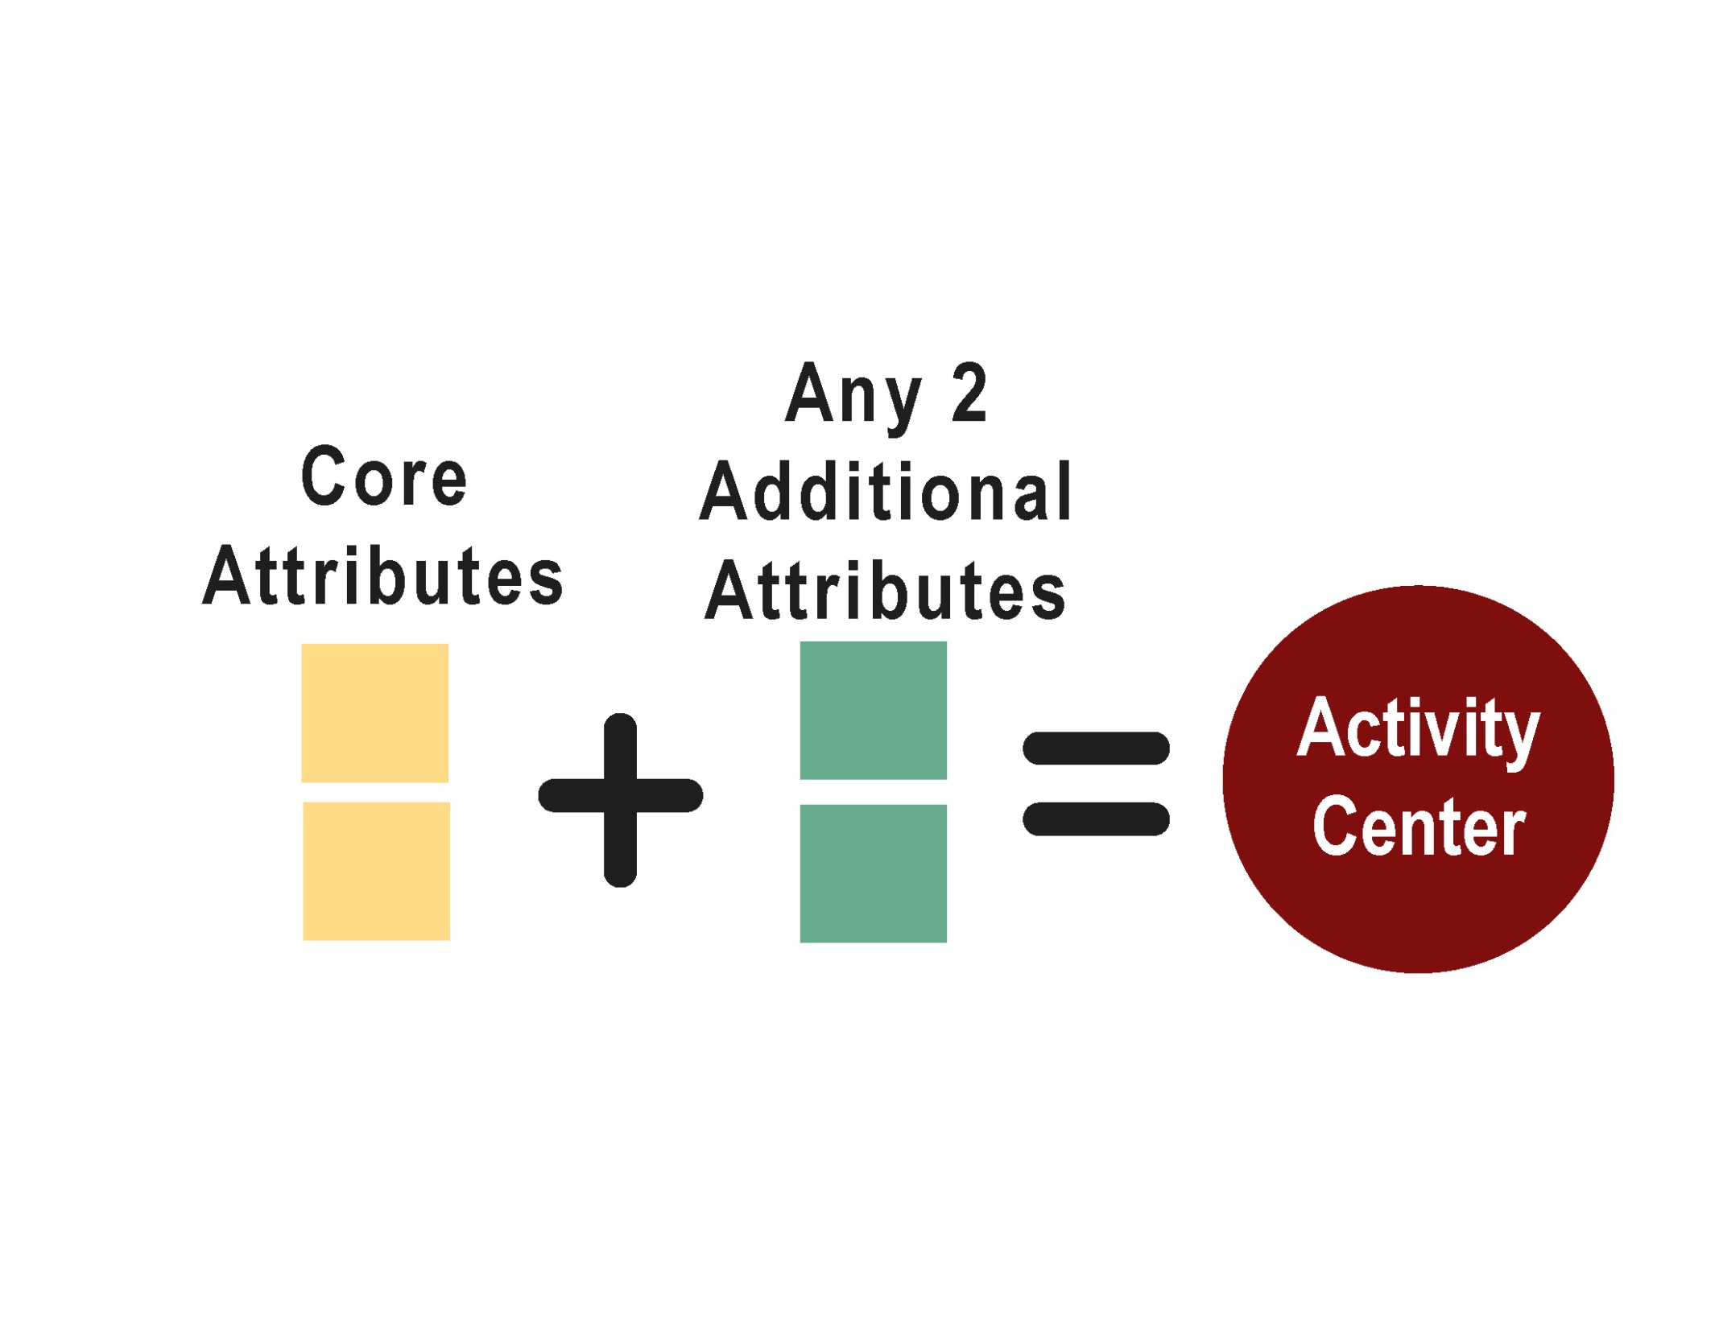
Attribute Menu to Identify
Activity Centers
Notes:
4

Slide 5
Core Attributes (both required)
Policy: Designated as a center or priority growth area in locally-adopted land use plan
Density: By 2040, has a persons per acre density (employment + population) within top half of densities in the jurisdiction
Notes:
5

Slide 6
Additional Attributes (any 2 required)
Intersection Density: At least 55 intersections/square mile
Transit Capacity: Existing high-capacity transit, planned transit in CLRP, or planned transit with local funding
Land Use Mix: Mixed-use development designation in land use plan/zoning ordinance
Housing & Transportation Affordability: Combined housing
& transportation costs don’t exceed 45% of regional median income
Notes:
6

Slide 7
Key Changes/Outcomes
Involved Local Planning Departments in Center Selection
  Worked one-on-one with every jurisdiction
Aligned with Local Planning
  Picks up places local governments have designated as significant
Most Centers are Mixed-Use
  Shift from primarily employment-focused centers to majority mixed-use centers
Notes:
7

Slide 8
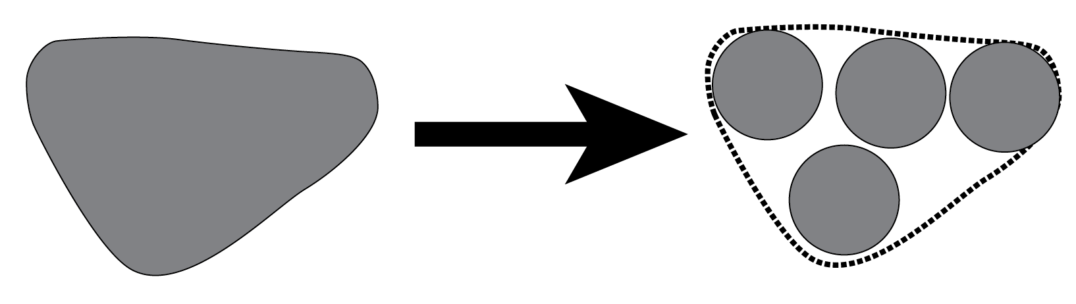
Key Changes/Outcomes
More, but Smaller Centers
  2007 Centers: 59
  2012 Centers: 136 – occupy less total land area than previous centers
  Most fall within old center boundaries
  Better scale for implementation
Notes:
8

Slide 9
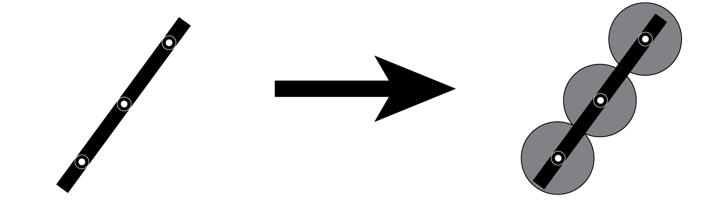
Key Changes/Outcomes
More Aligned with Major Transportation Infrastructure
  Many additional rail stations included in centers
  67% of 2012 centers served by rail transit by 2040
  (vs. 50% of 2007 centers)
Notes:
9

Slide 10
Key Applications
How Activity Centers will be used
Technical:
  Growth forecasts
  Transportation modeling
  Demographic analysis
Policy:
  Priority growth areas
  Monitor progress on Region Forward
  Inform planning, development, grantmaking activities
  Prioritize locations for investment – e.g. Activity Center Strategic Investment Plan, Transportation Priorities Plan
Notes:
10

Slide 11
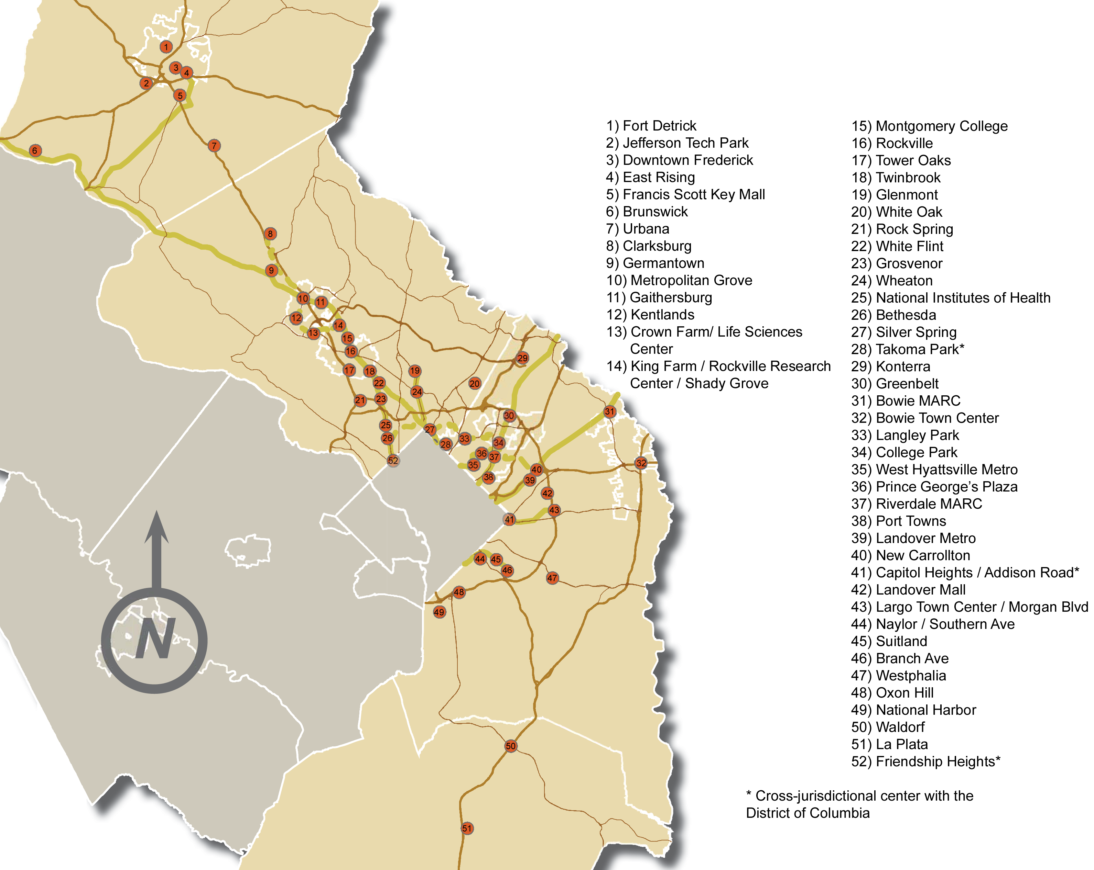
Maryland Centers
Notes:
11

Slide 12
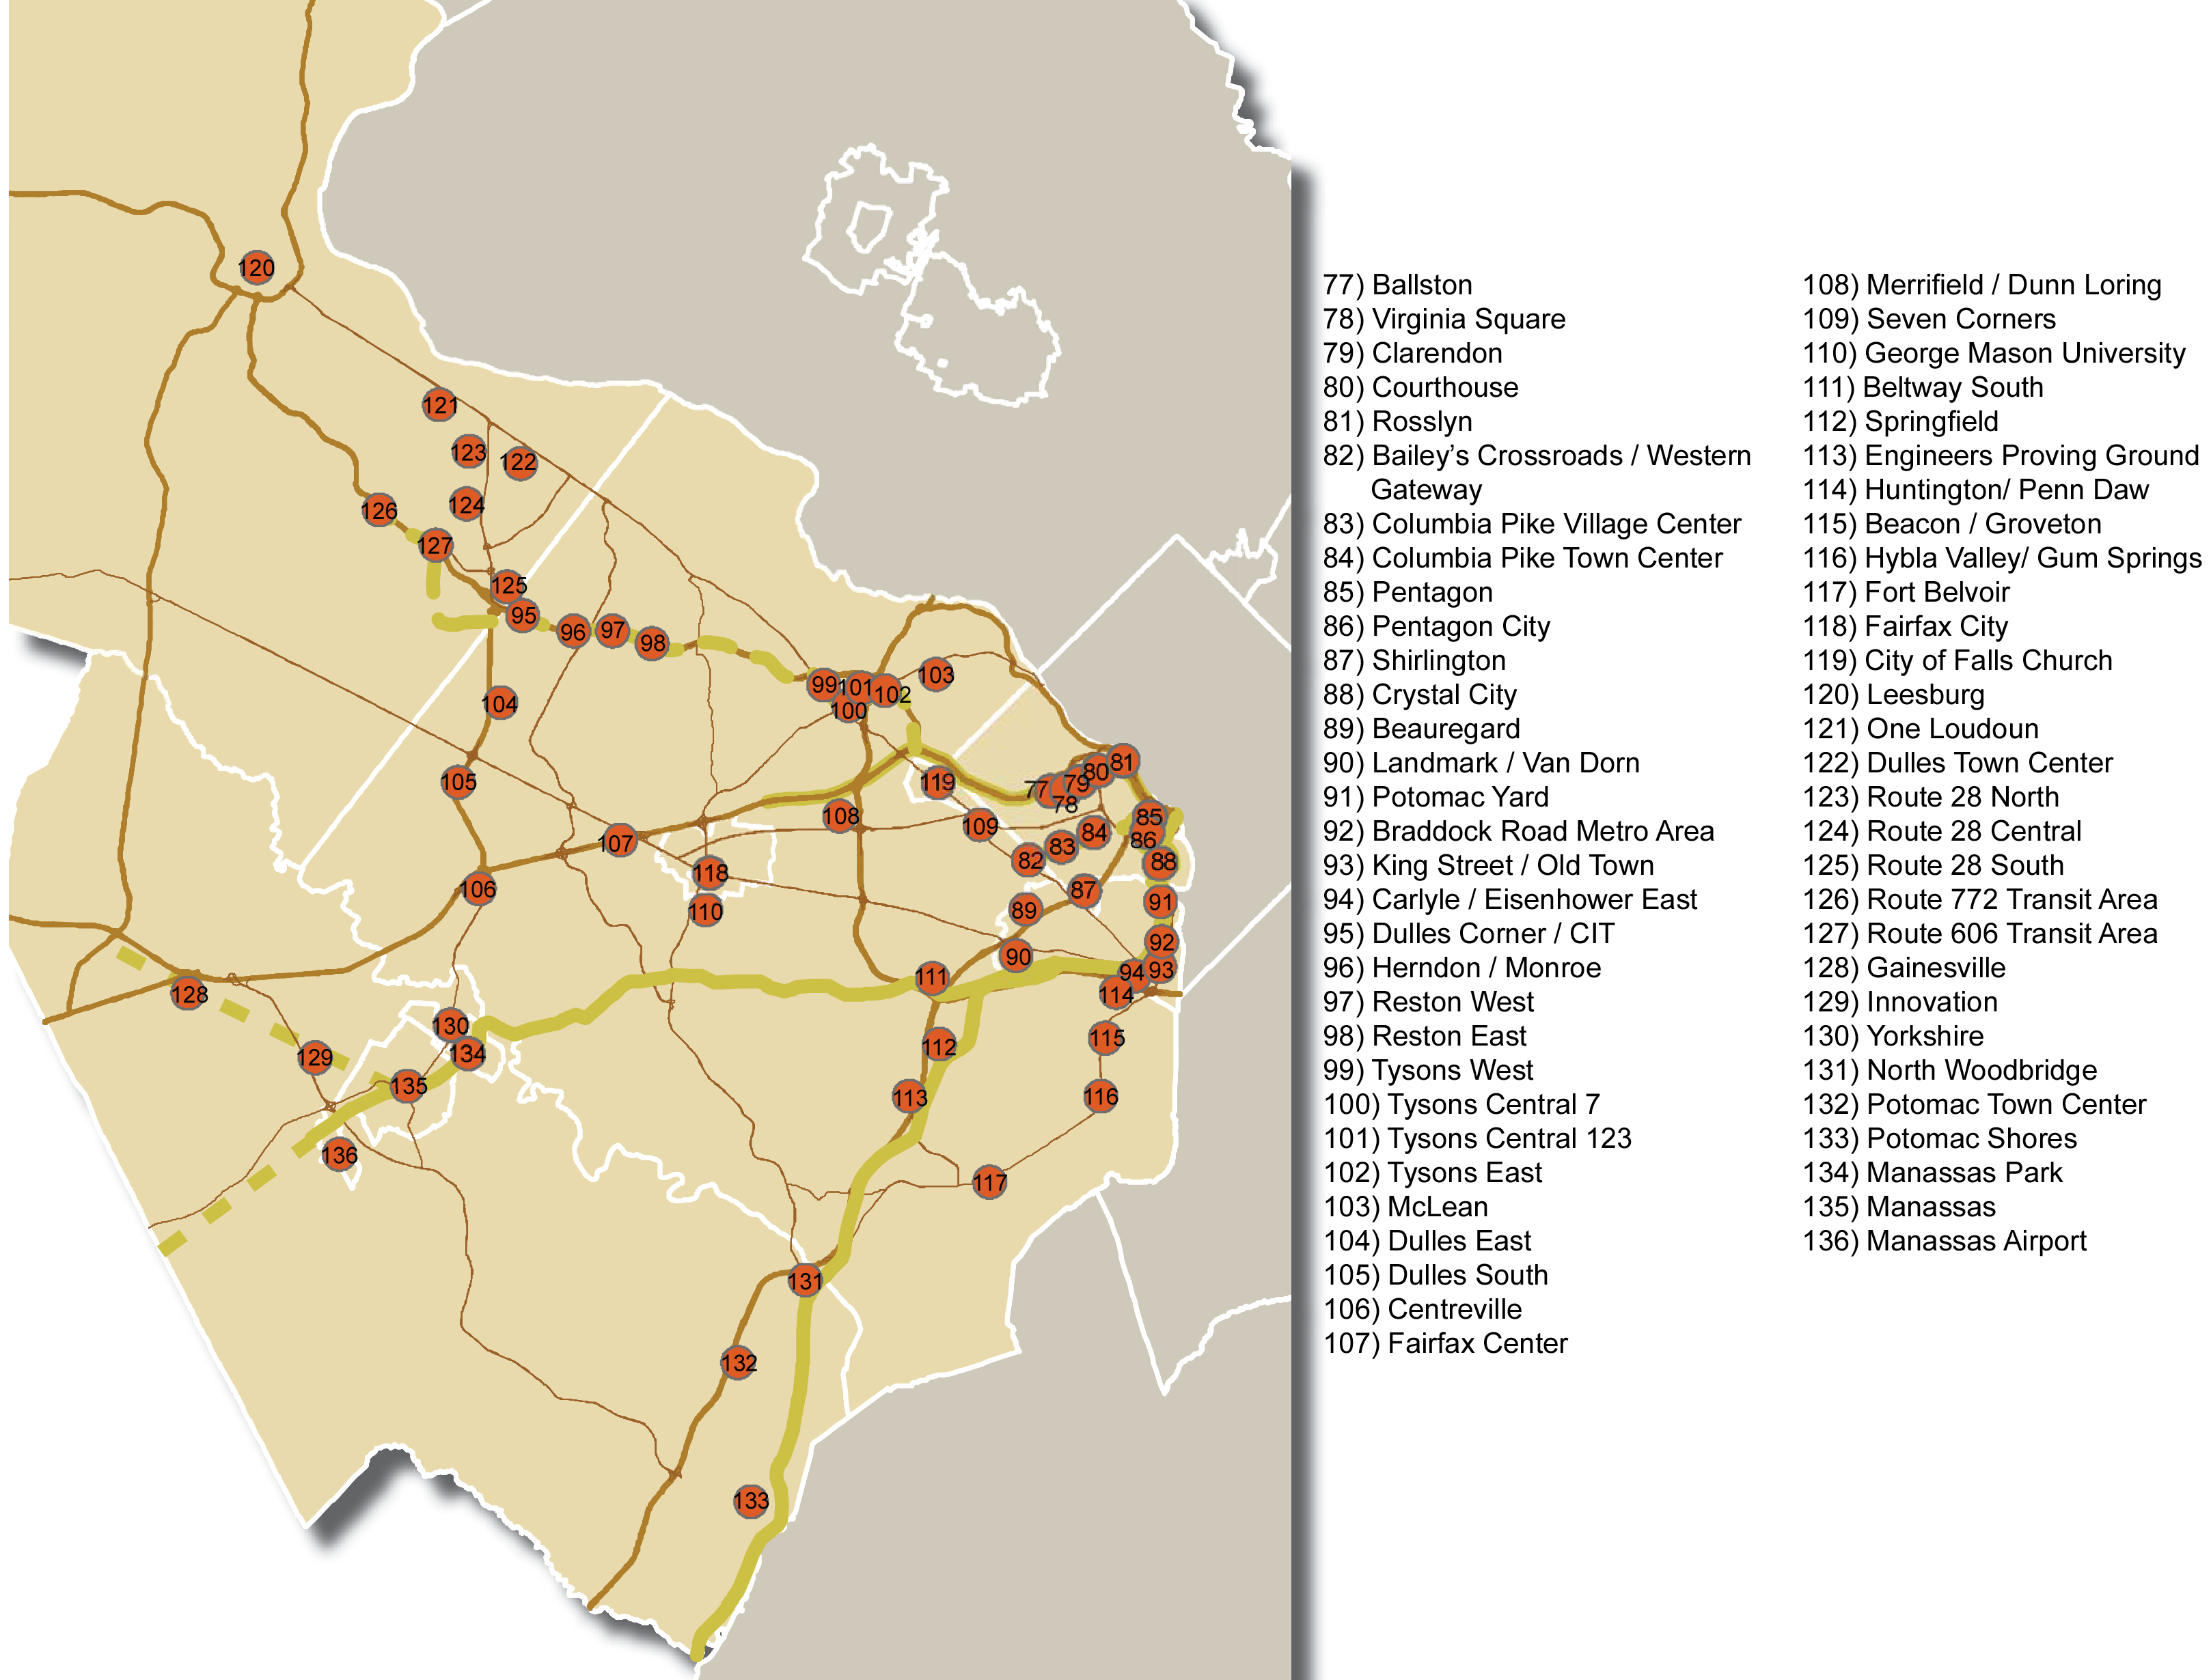
Virginia Centers
Notes:
12

Slide 13
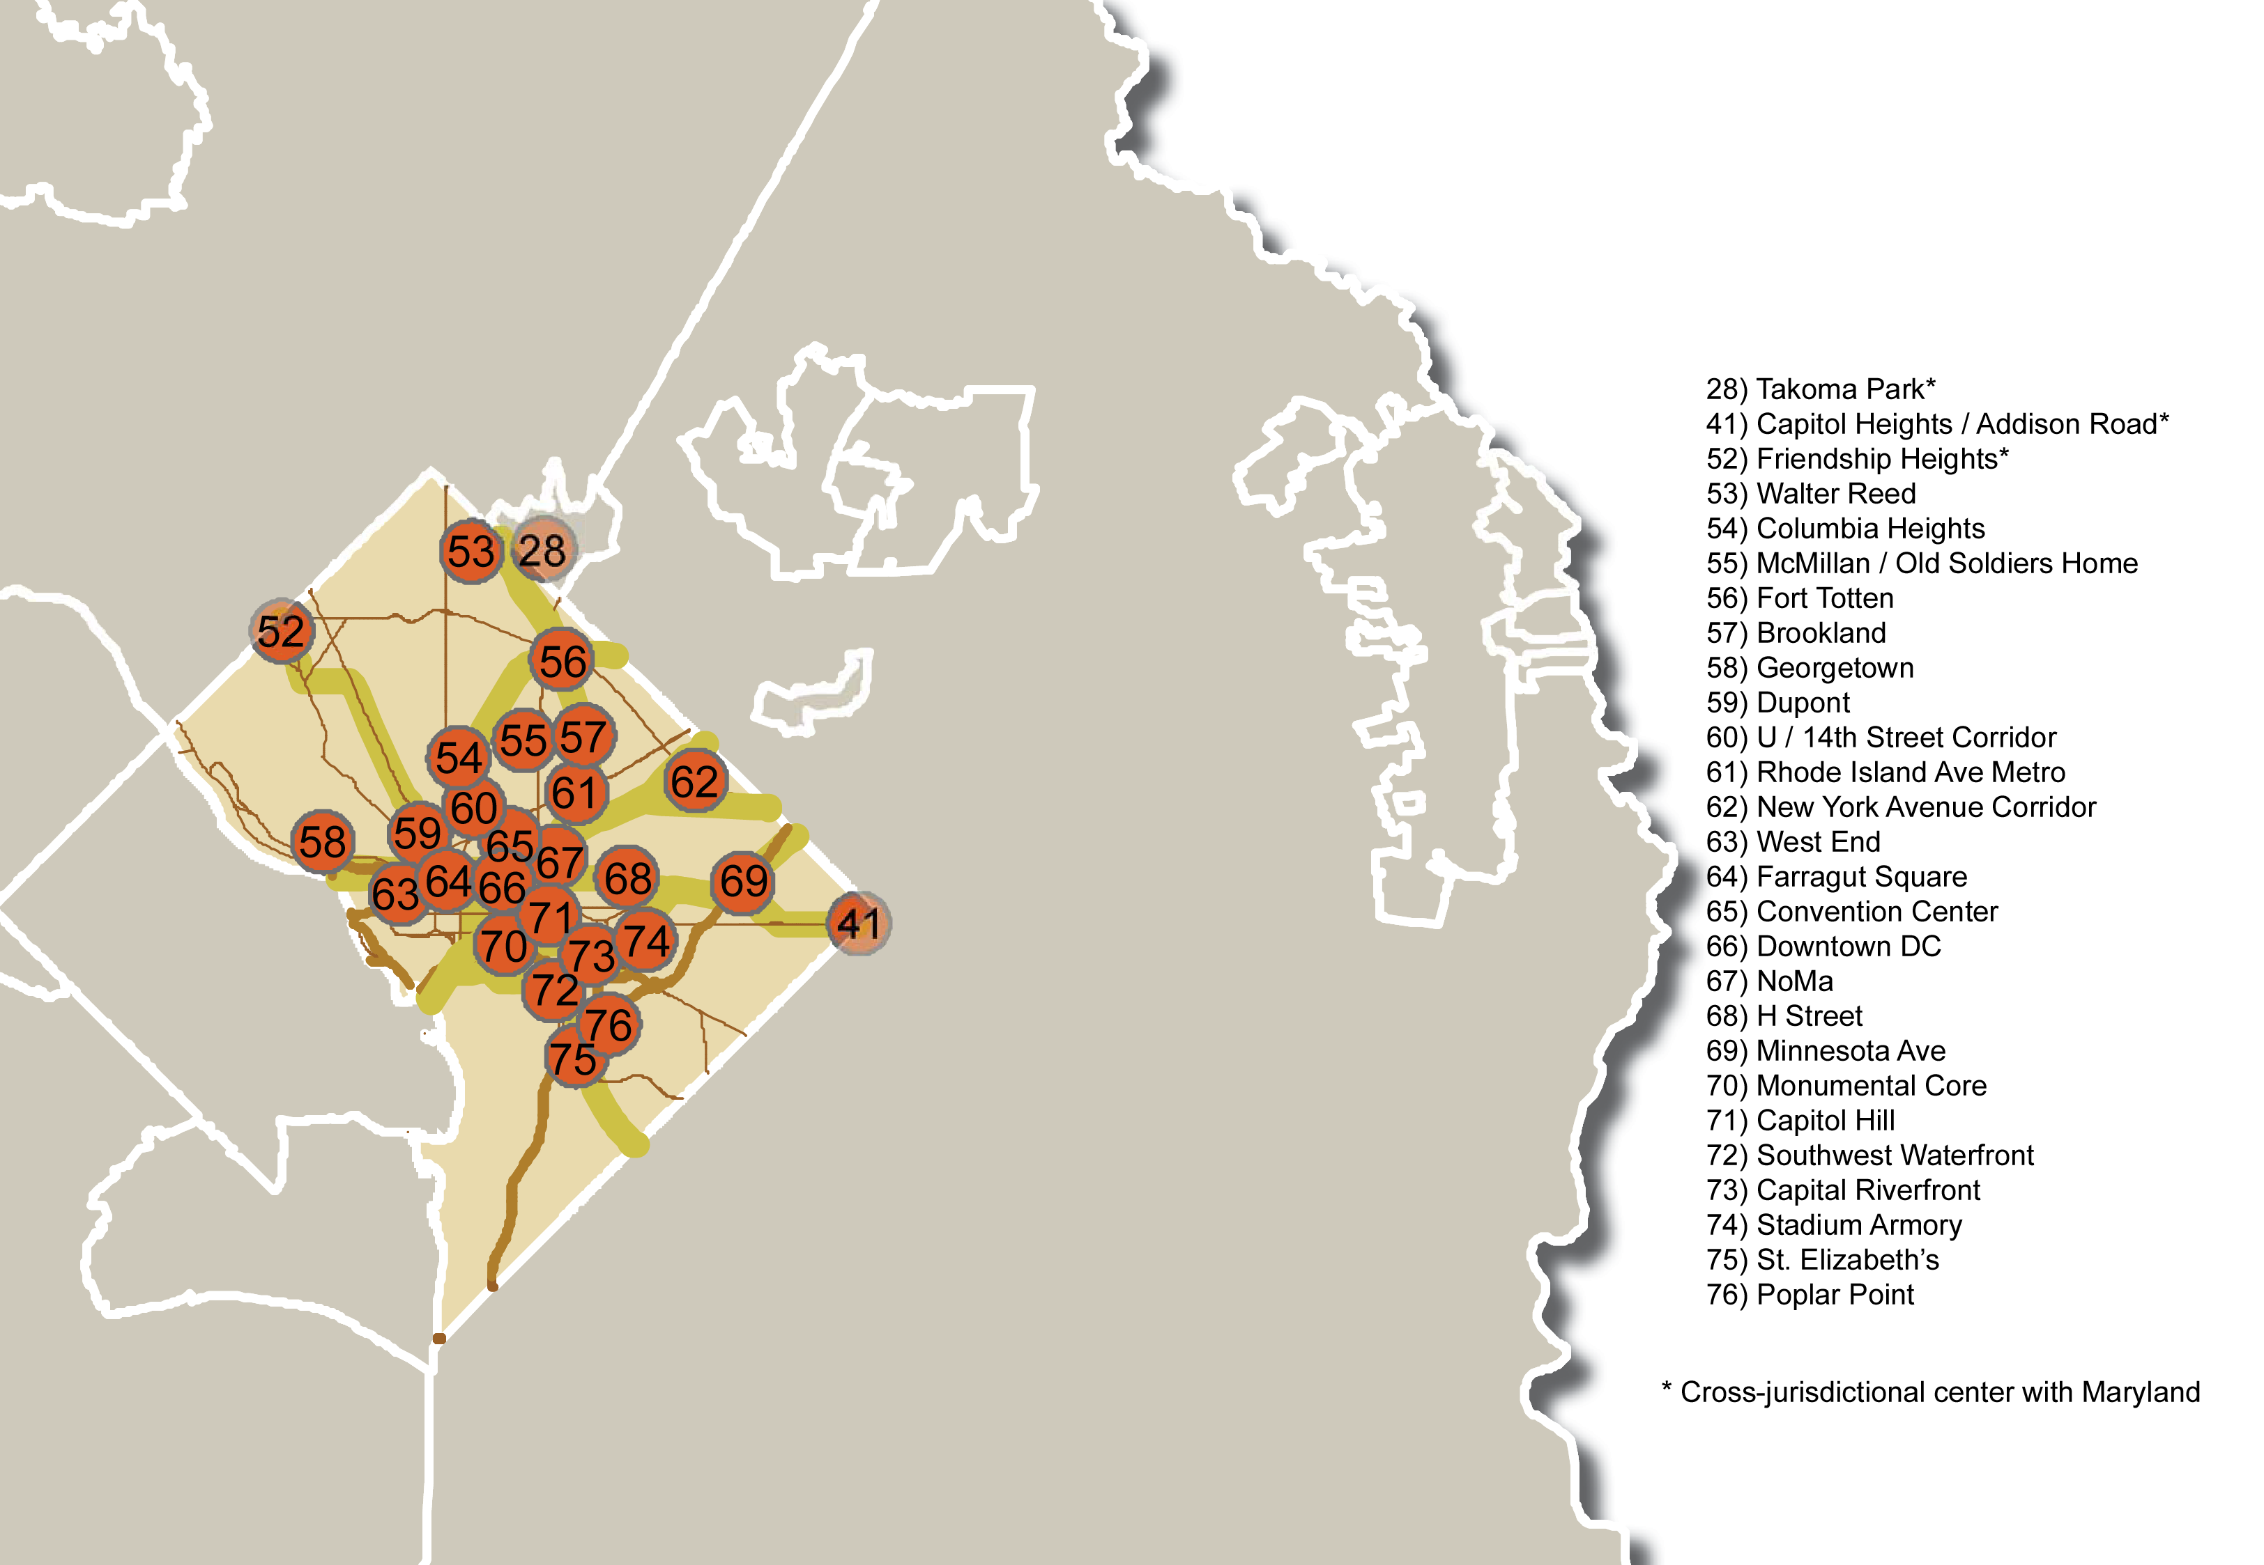
District of Columbia Centers
Notes:
13

Slide 14
Next Steps
September - October:
  Present centers at city/county Council & Board work sessions
  Develop Activity Center technical boundaries
  Launch Activity Center implementation work:
  Strategic Investment Plan
November:
  COG Board approval of Activity Centers
Notes:
14

Slide 15
Outreach Schedule
Council & Board work sessions
Done:
  Manassas
  Takoma Park
  Greenbelt
  Montgomery Co.
  Alexandria
  Frederick Co.
  Charles Co.
  Bowie
Upcoming:
  Today: City of Frederick
  9/25: City of Fairfax
  10/1: Rockville
  10/2: Fairfax Co.
  10/2: Manassas Park
  10/3: Loudoun Co.
  10/9: District of Columbia
  10 /15: Falls Church
  10/16: Arlington
  10/16: College Park
  10/23: Prince George’s Co.
  10/29: Gaithersburg
Notes:
15

Slide 16
2012 Activity Center Update
September 19, 2012
Transportation Planning Board
Sophie Mintier, COG/DCPS Staff
smintier@mwcog.org (202)962-3753
Notes:
16

