Slide 1
Renewable Energy for COG localities
What utilities are doing,
what they should be doing,
and what localities can do in spite of them.
CEEPC Meeting, January 25, 2012
Ivy Main, Virginia Chapter Sierra Club

Slide 2
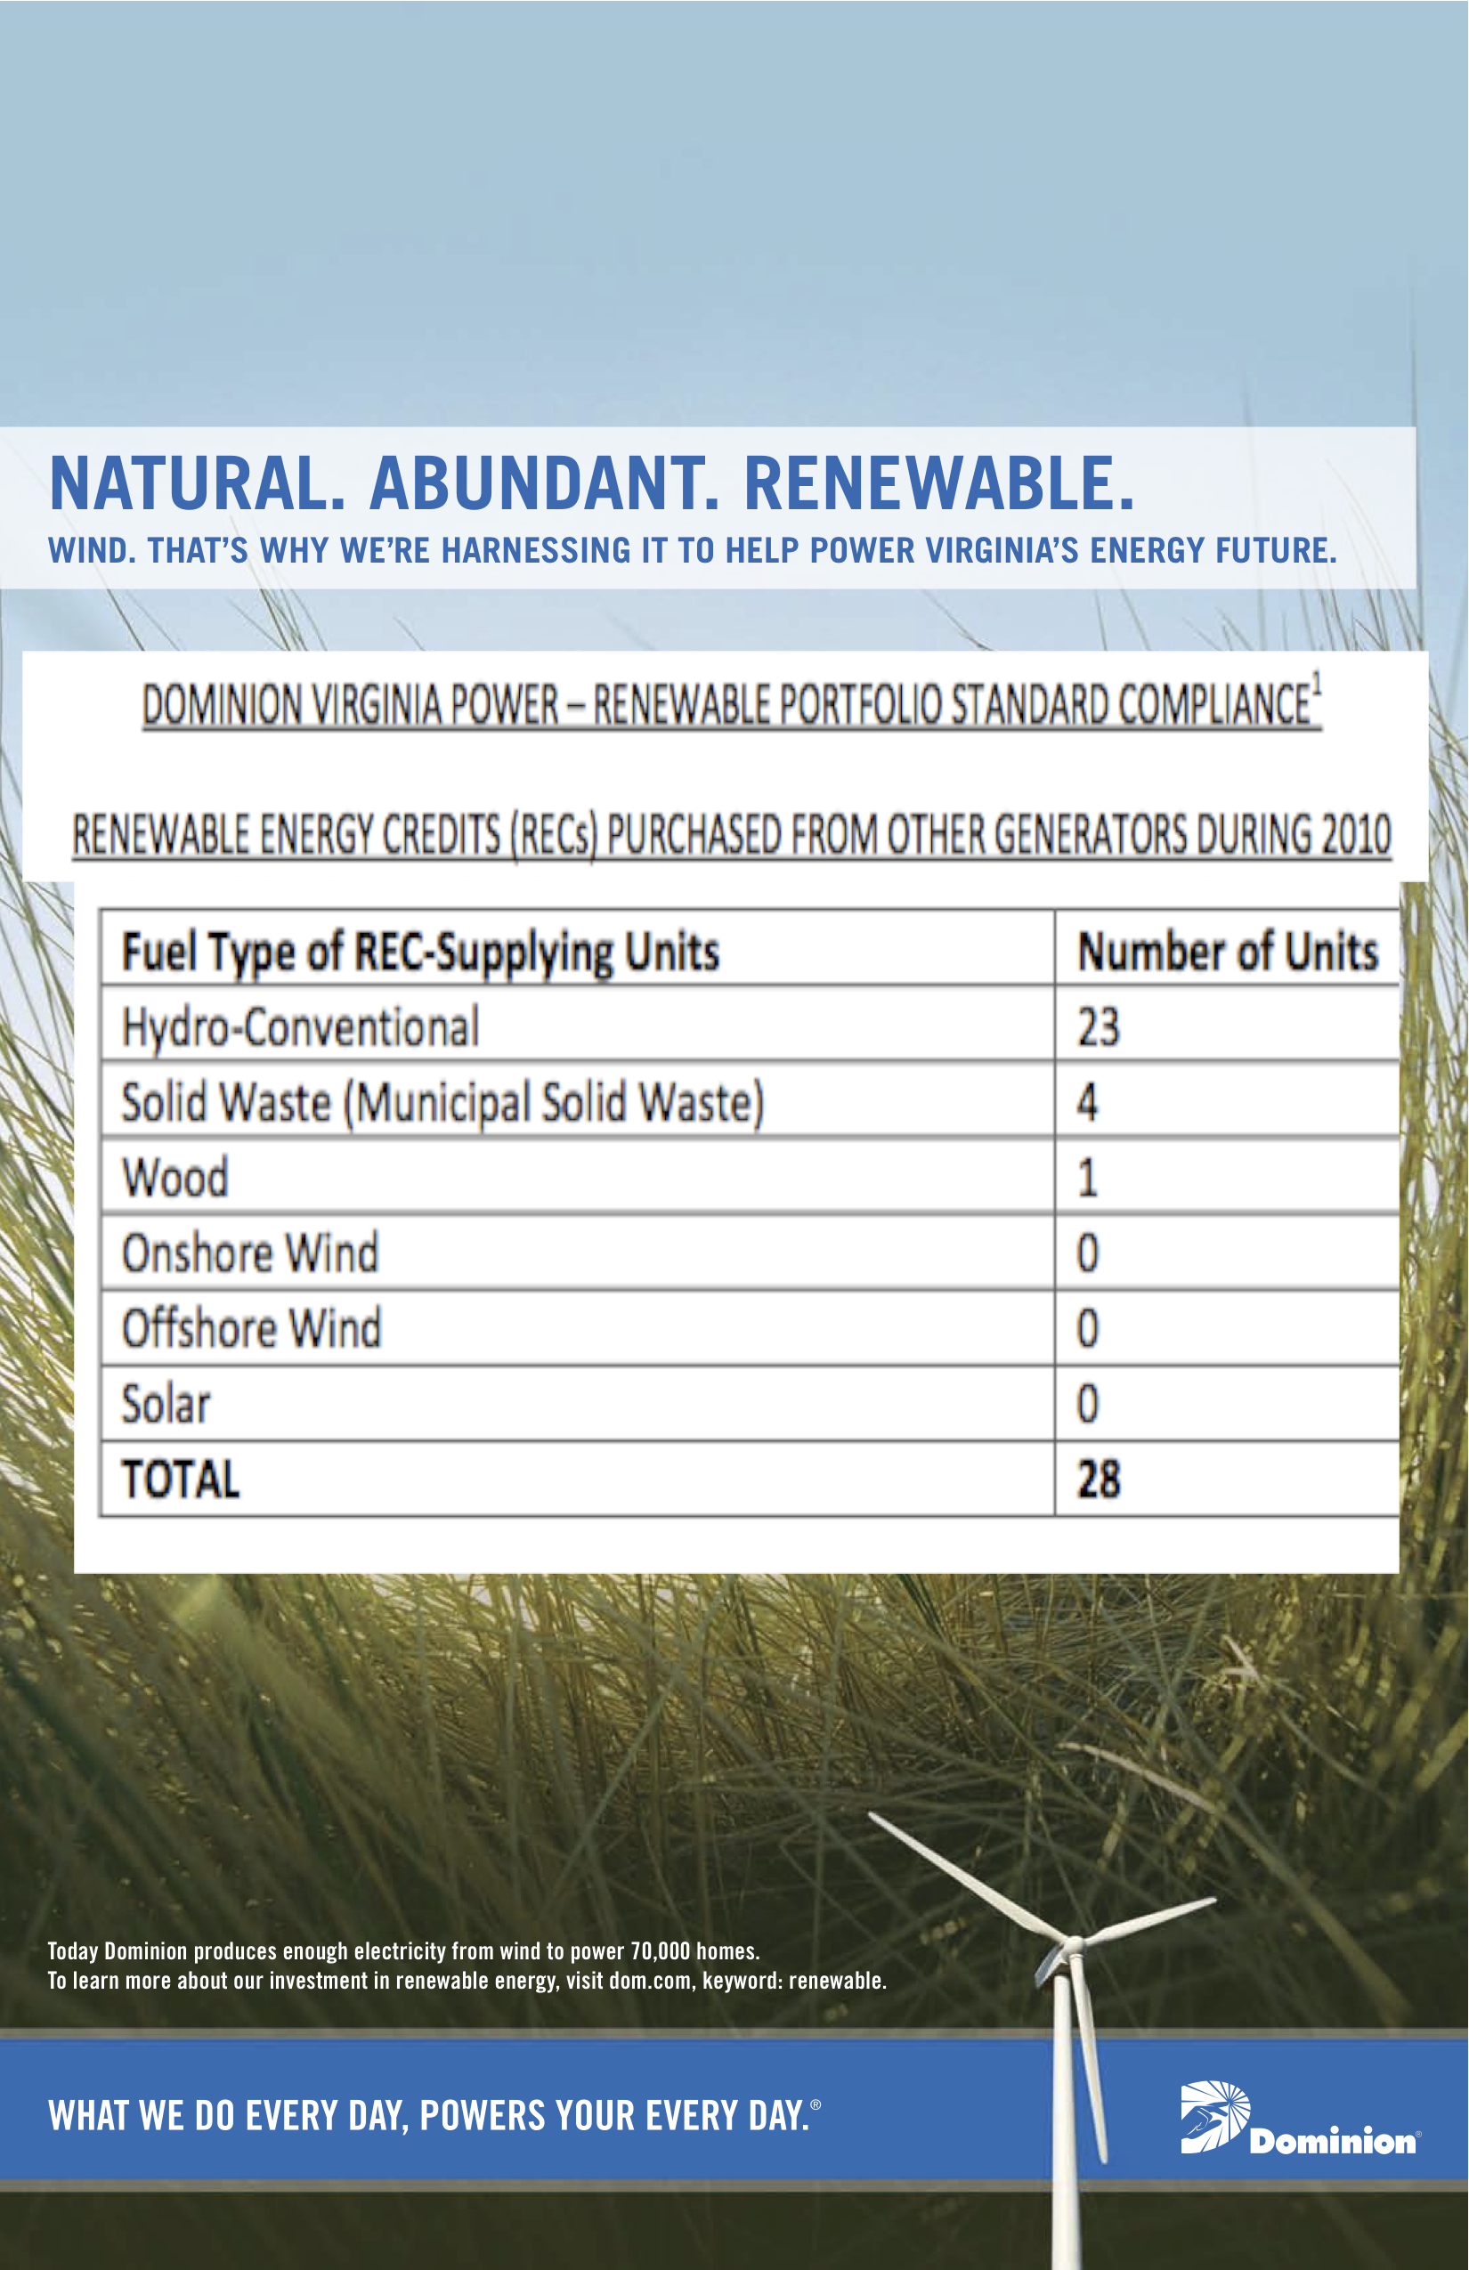
The hype: wind
Virginia’s RPS is broken
The reality: none

Slide 3
What are utilities doing?
Virginia (Dominion Virginia Power):
Voluntary RPS hasn’t created wind or solar
Voluntary Green Power Program uses out-of-state RECs
Dominion hostile to competition
Maryland and DC (Pepco):
MD, DC have good RPS and incentives
Pepco shines by comparison, needs better net metering

Slide 4
What should utilities do?
Support—not oppose—legislative reforms
Finance solar and renewable energy improvements (like they do generators)
Get out of the way of private business solutions
Practice transparency
Work with localities to achieve their goals

Slide 5
What should localities do?
Focus on behind-the-meter strategies: energy efficiency, solar, geothermal
Use financing, solar mapping
Coordinate, streamline permitting
Use orgs like VEPGA to negotiate wind power purchases from utilities
Hold utilities accountable for real progress
Lobby!

