Slide 1
Briefing on the Initiation of the Metropolitan Area Transportation Operations Coordination (MATOC) Program Website and the National Capital Region Web Portal
Presentation to the TPB Technical Committee
Andrew J. Meese, AICP
COG/TPB Staff
January 6, 2012
Item #8

Slide 2
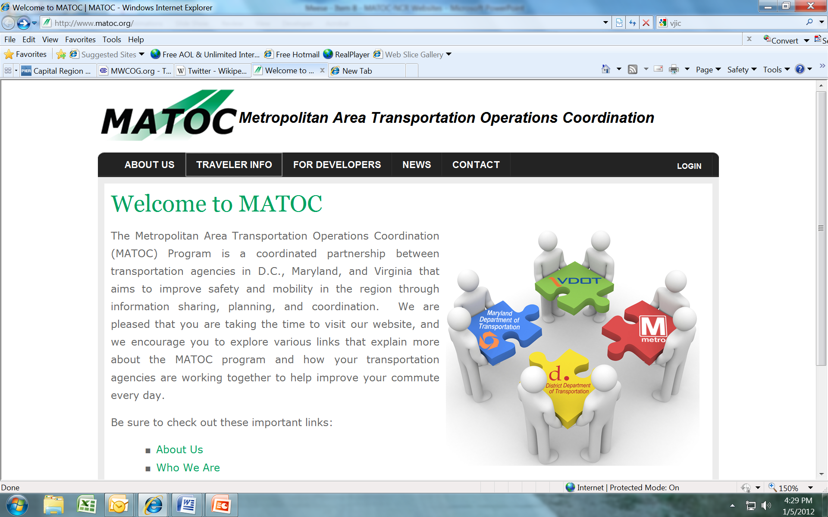
www.matoc.org

Slide 3
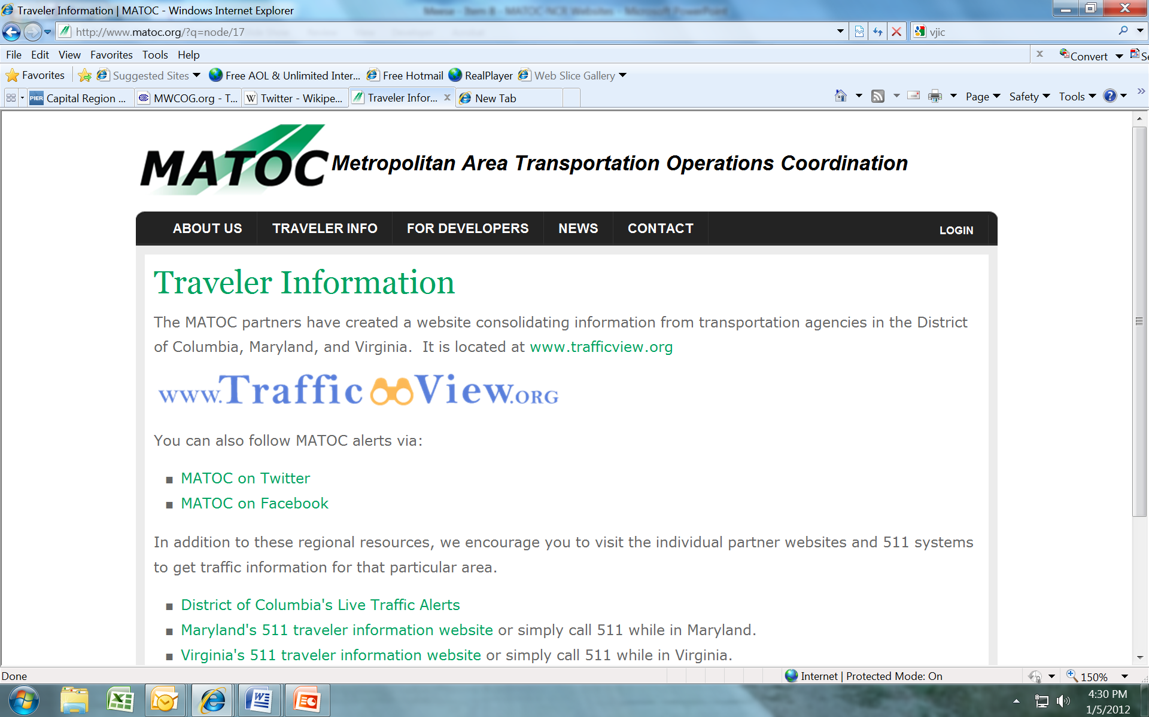
Traveler Information Tab

Slide 4
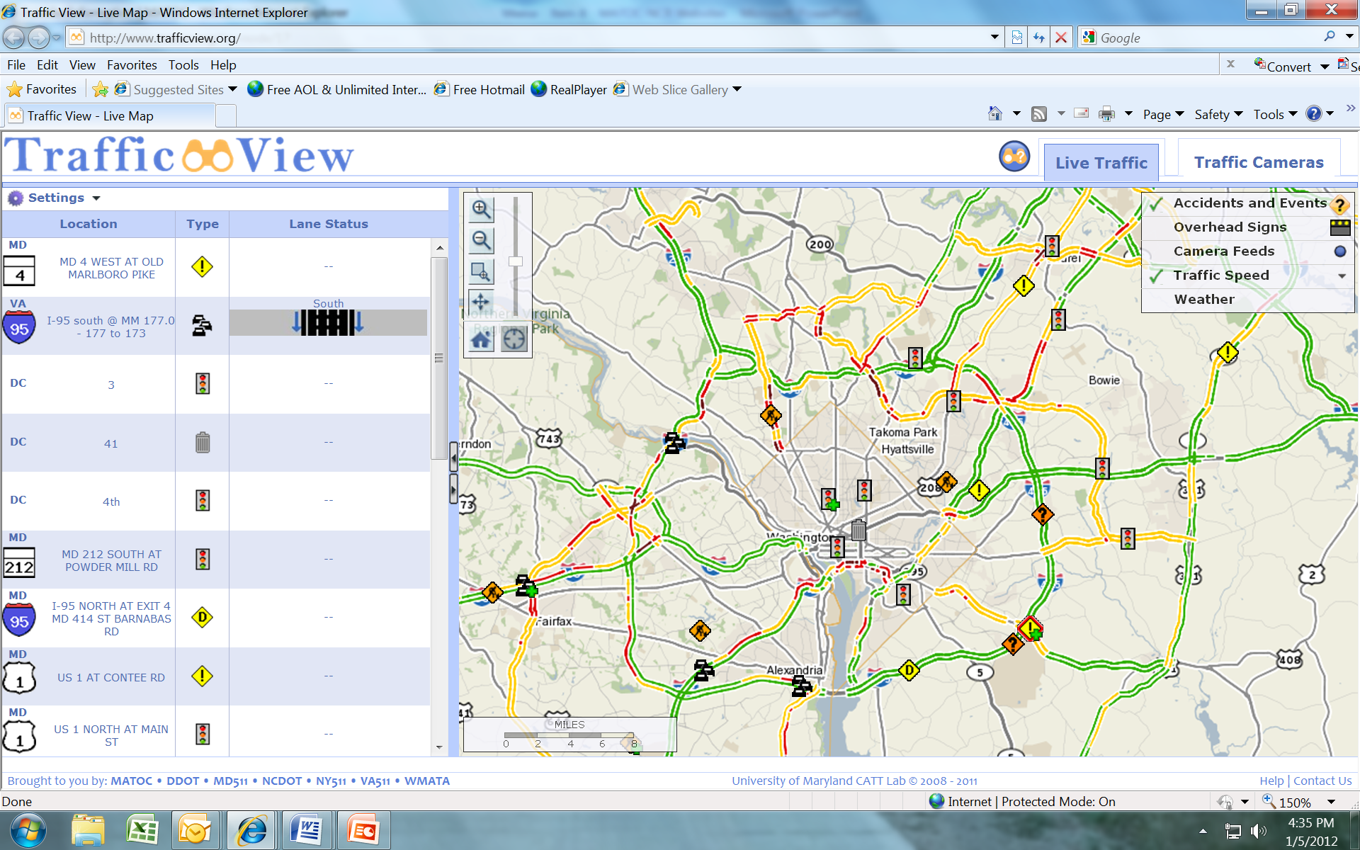
Traffic View

Slide 5
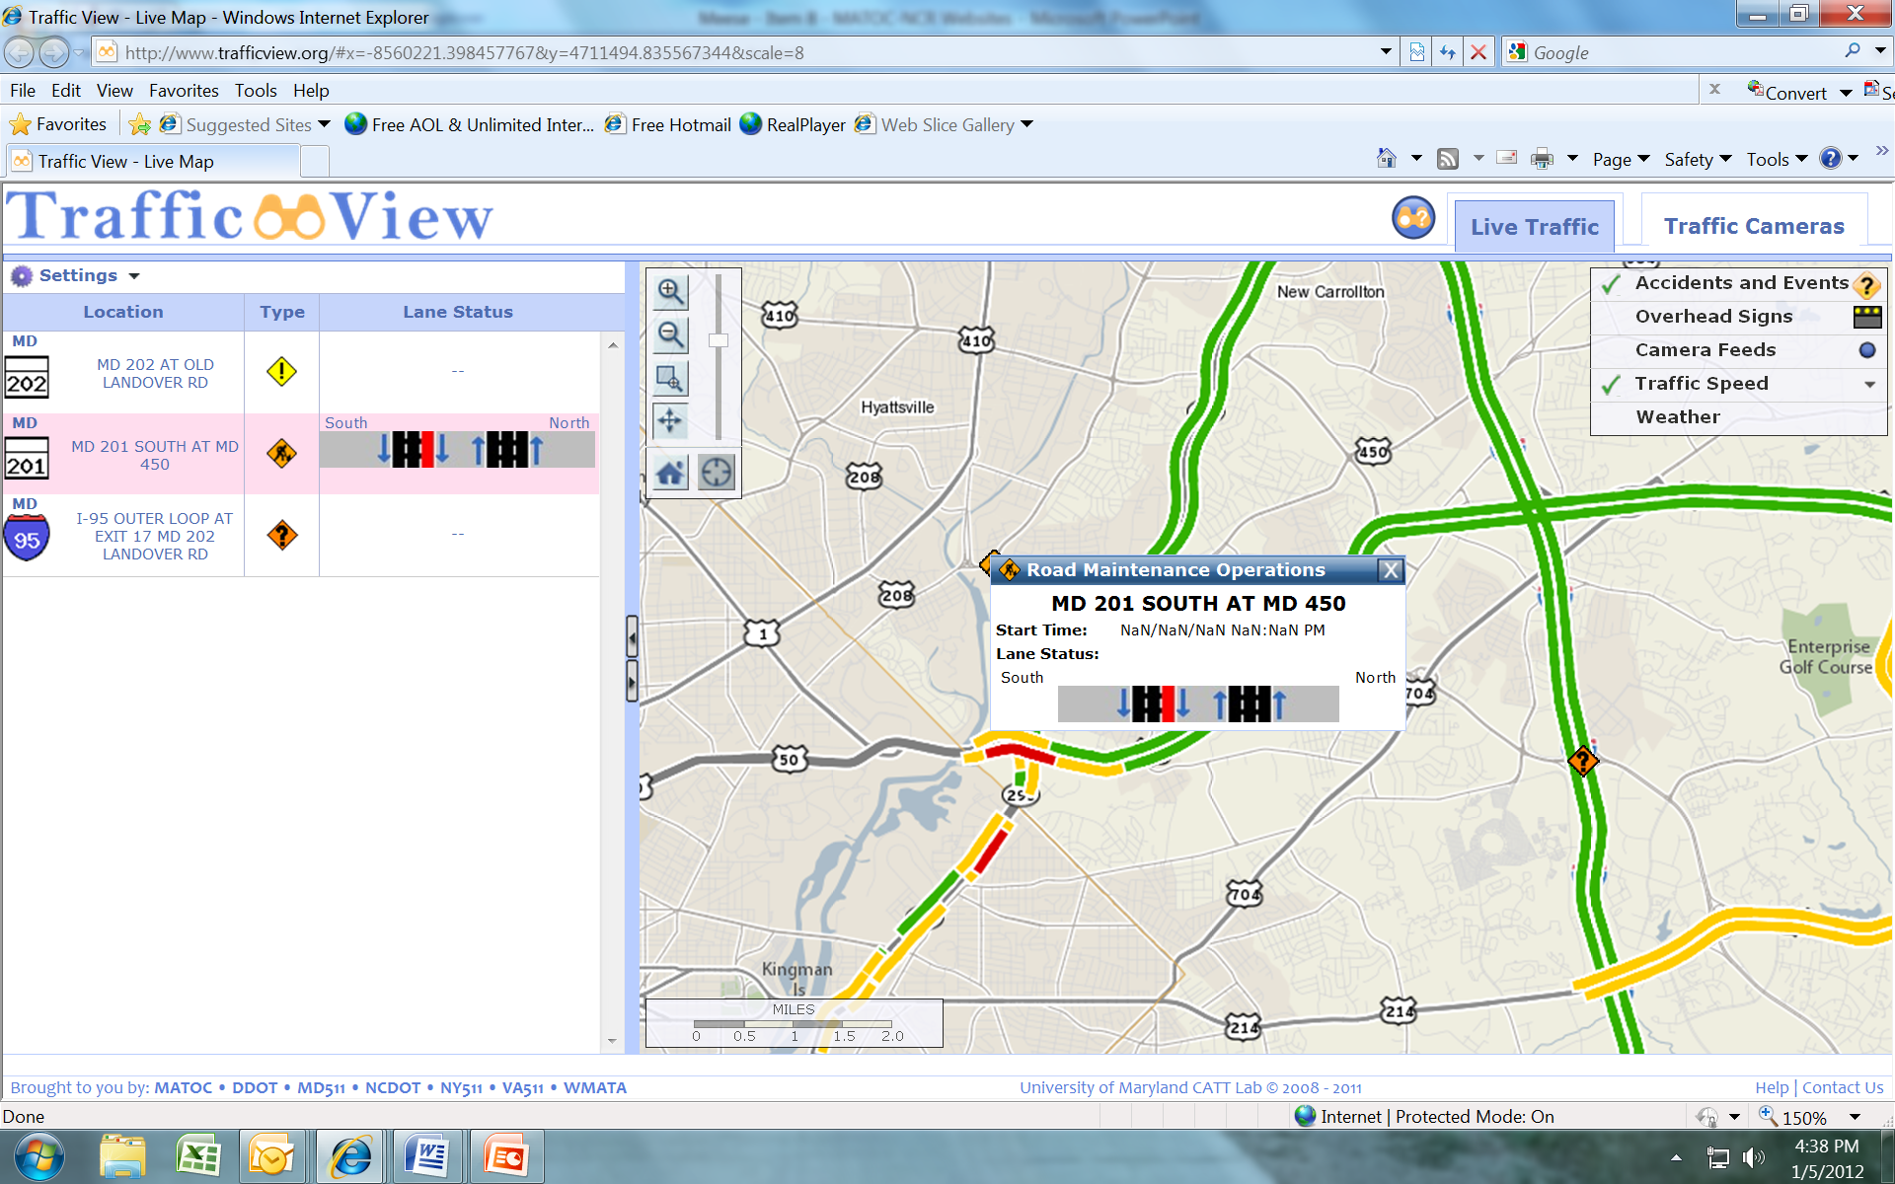
Incident Information Pop-Up Box

Slide 6
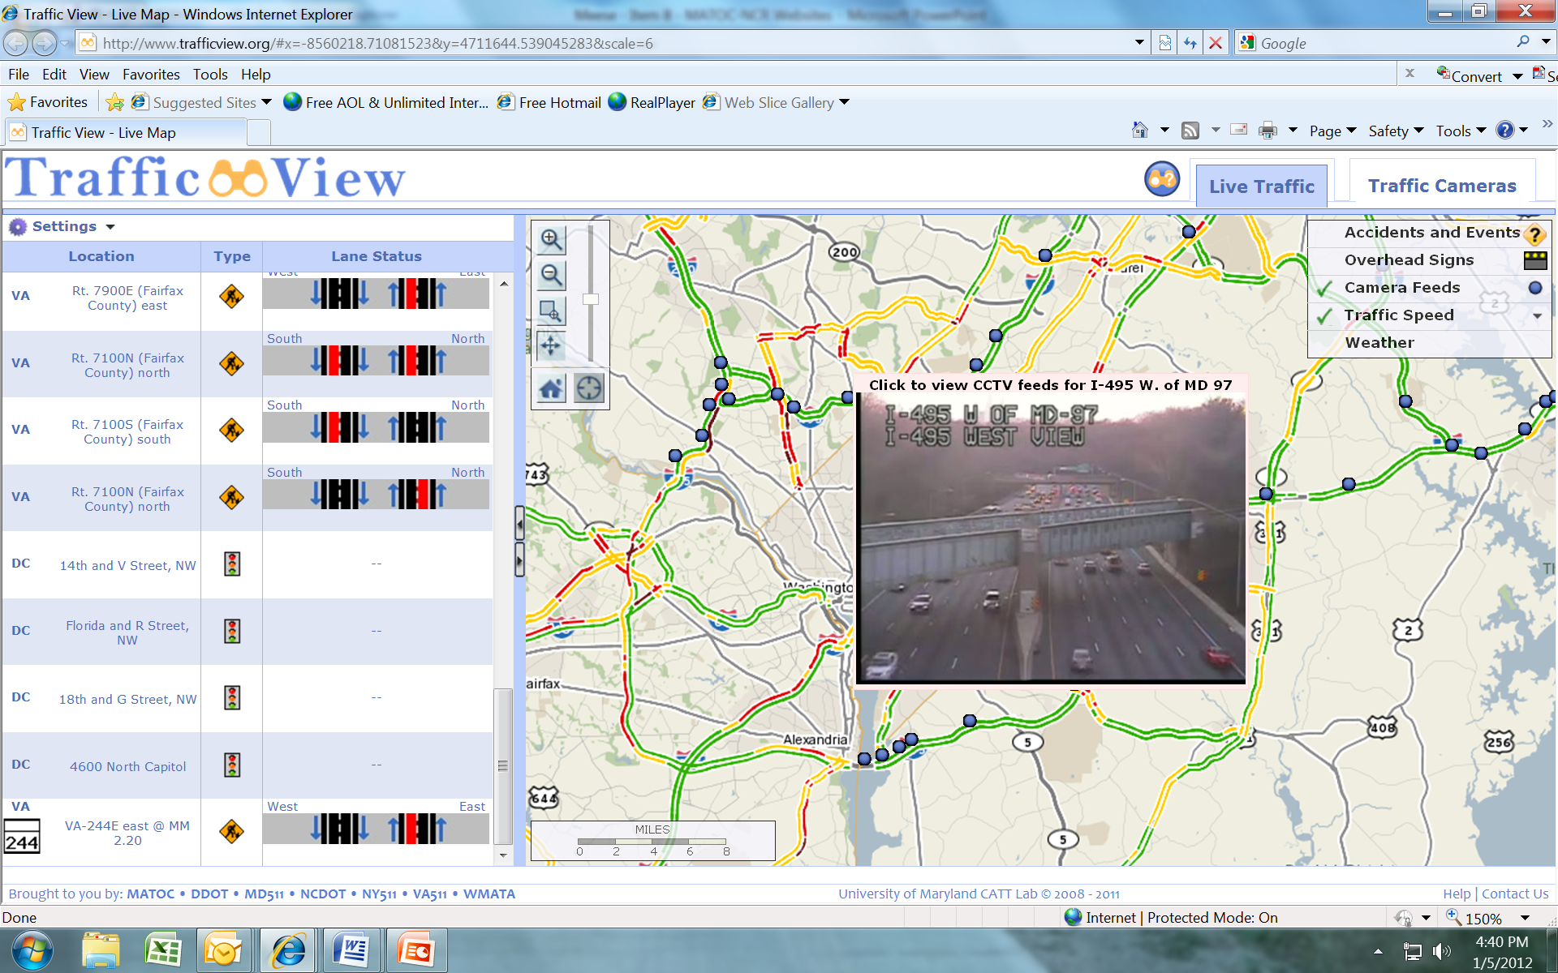
Traffic Camera Pop-Up Box

Slide 7
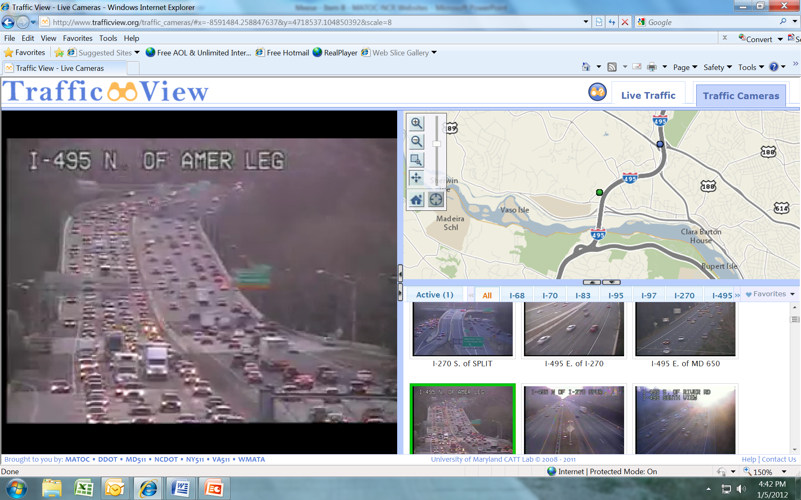
Traffic Camera Page

Slide 8
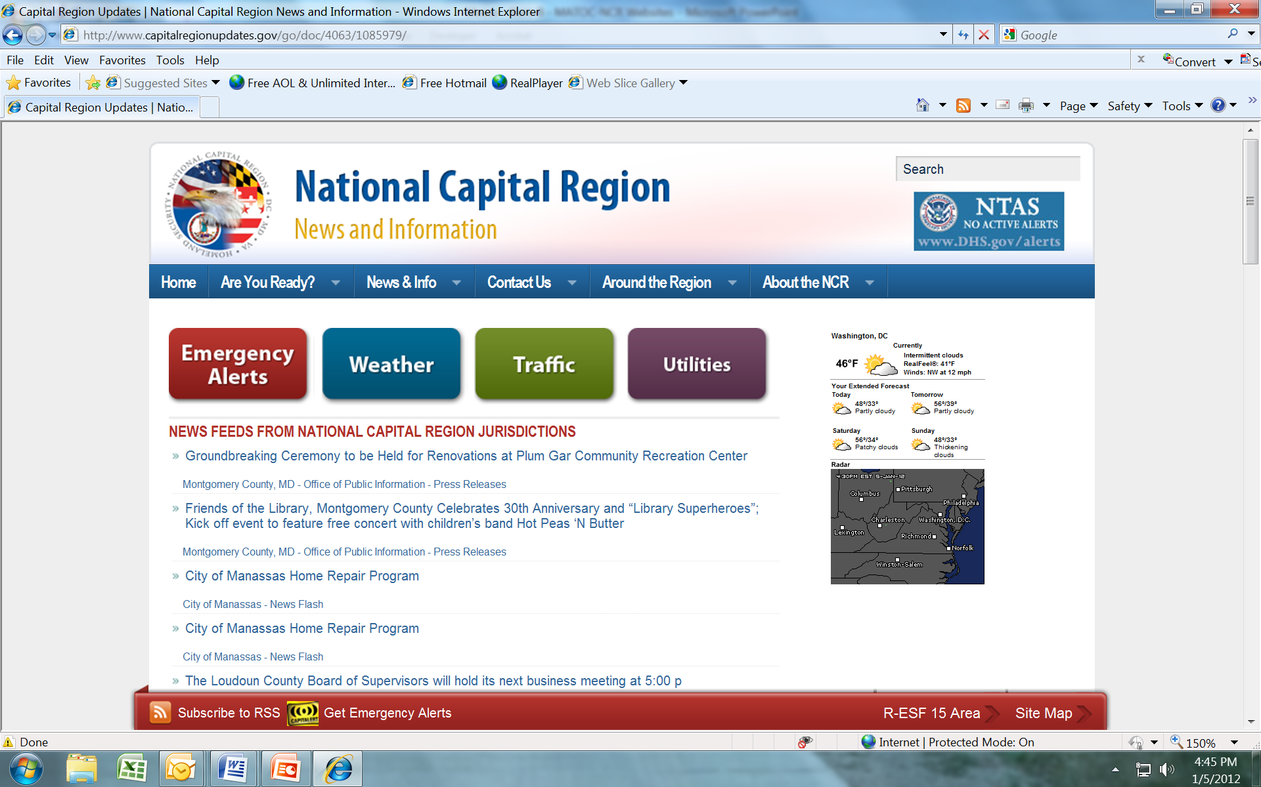
www.CapitalRegionUpdates.gov

Slide 9
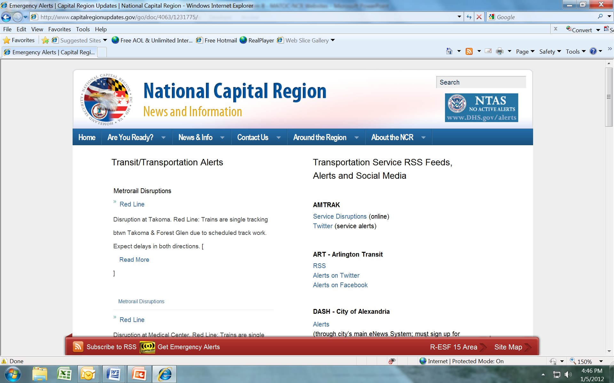
Emergency Alerts Tab

Slide 10
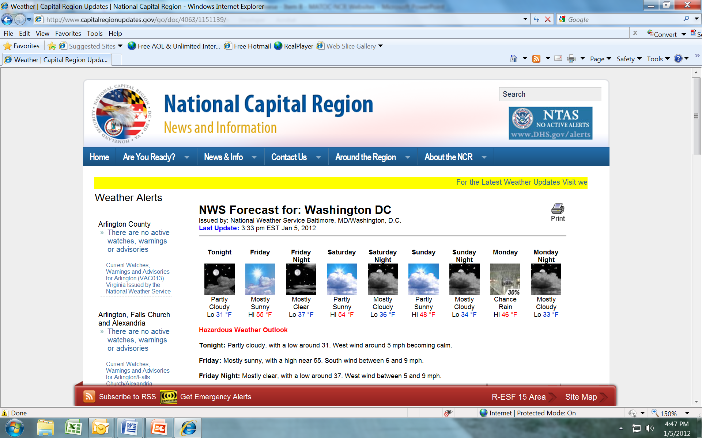
Weather Tab

Slide 11
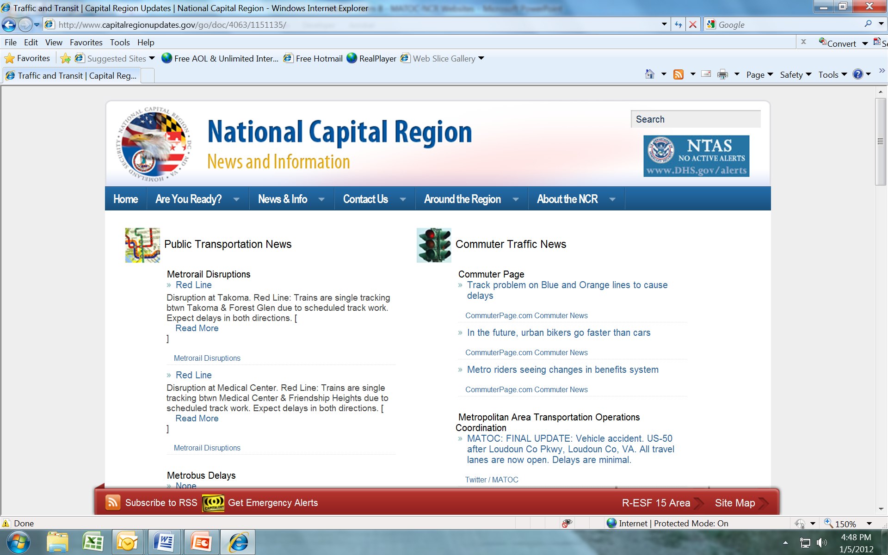
Traffic Tab

Slide 12
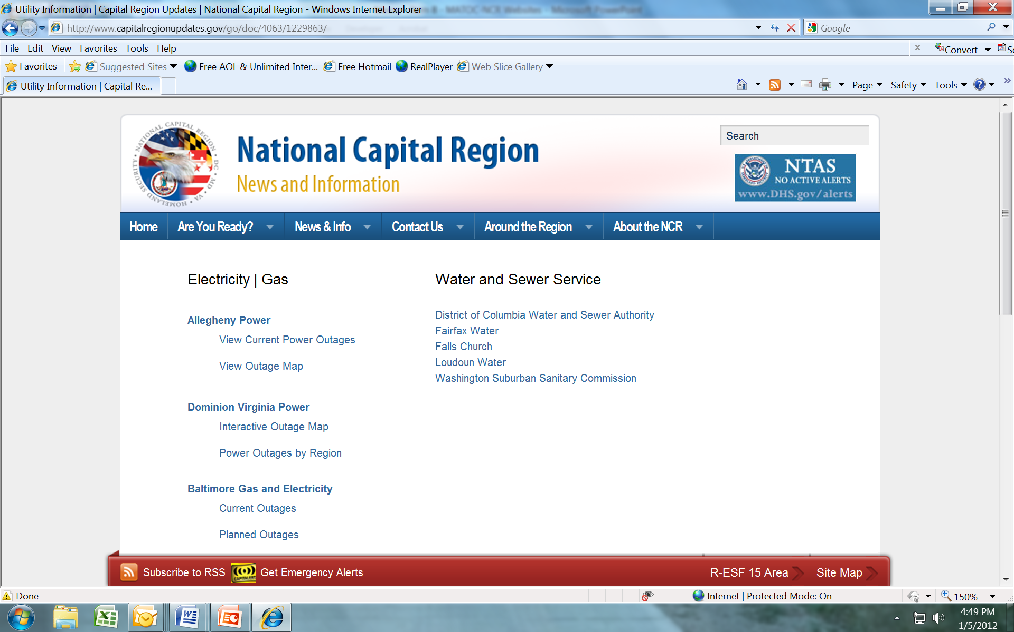
Utilities Tab

Slide 13
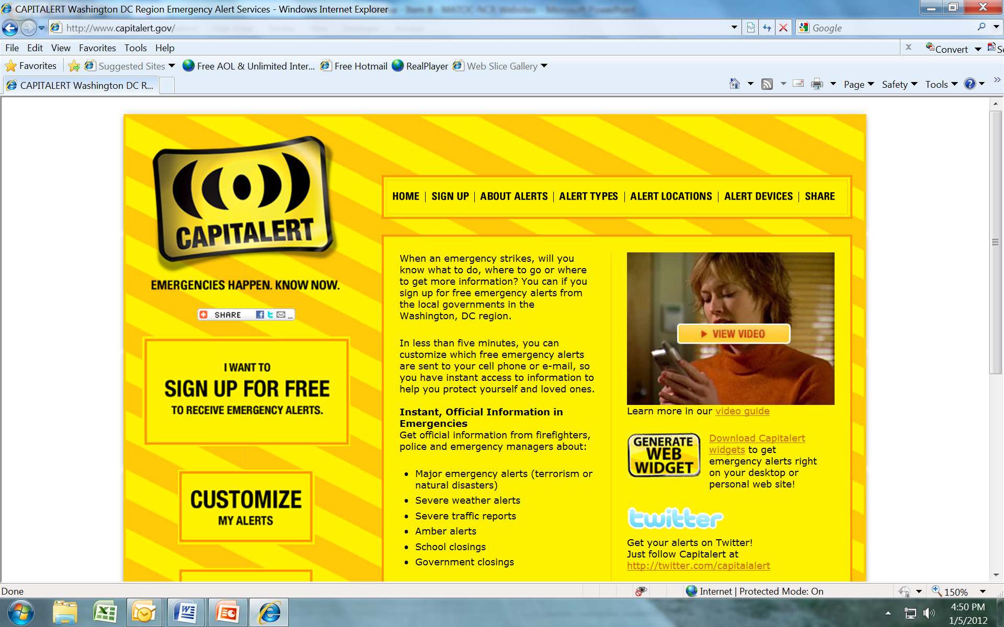
www.capitalalert.gov

