Slide 1





National Capital Region
Geospatial Data Exchange
Progress Meeting
August 31, 2011
1

Slide 2
Agenda
Project Status
  Data inventory
  Testing/staging infrastructure
  Schedule
System Design
  Release schedule
  Demonstrations
    Portal
    ArcGIS Desktop Publish tool
Requirements Clarifications
Notes:
Heidi

Slide 3
Project Status
Recent Deliverables
  Final Requirements
  Draft System Design
  Testing/Staging Infrastructure Installation
Data Inventory
  Email Request
Notes:
Heidi / Kathleen (MOU)

Slide 4
Data Inventory
Received:
City of Rockville, MD
District of Columbia
Fairfax County, VA
Frederick County, MD
Loudoun County, VA
Montgomery County, MD
Prince George’s County, MD
Prince William County, VA
Needed:
Arlington County, VA
City of Bowie, MD
City of College Park, MD
City of Fairfax, VA
City of Falls Church, VA
City of Frederick, MD
City of Gaithersburg, MD
City of Greenbelt, MD
City of Manassas Park, VA
City of Manassas, VA
City of Takoma Park, MD
Town of Bladensburg, MD
Notes:
Bob

Slide 5
Project Status
Testing/Staging Infrastructure
  Hardware installed at Manassas co-location
  Software/Application inventory in progress
Schedule
  Deployment of prototype (50% capability): Sept 6-9
  Round 1 deployment: Oct 7
  Stakeholder Design Meetings (mid-October)
Notes:
Heidi / Kathleen (MOU)

Slide 6
Release Schedule
Prototype
Open hierarchy architecture
Assignment of security level to user and dataset, appropriate mapping for visibility
Creation of special interest groups / temporary entities, assignment of membership
ArcGIS Desktop publication (w/o actual data push)
Support of KML/WMS for Flex Viewer
Served up on existing Touchstone/KCI infrastructure
Deploy ~ September 9

Slide 7
Release Schedule
Round 1
Store login information for secured data feeds
Advanced search capabilities to discover published data feeds
All users to broadcast messages to community
Incorporation of reference coordinate system in metadata
Auto generated emails to users when data feeds about ready to expire
Flex viewer upgrades (member directory, alerts/notifications, manage links)
ArcGIS Desktop publication (fully functional)
Served up on Manassas Co-Lo testing/staging infrastructure
Deploy ~ October 7

Slide 8
Release Schedule
Round 2
NCRnet connectivity
LDAP “ready”
Search capability on historical published data feeds
Auditing and metering
Deploy ~ November 25

Slide 9
NCR Geospatial Data Exchange Portal

Slide 10
Portal Library Structure
Washington DC
  DC OCTO
Maryland
  Maryland Emergency Management Agency
  Maryland GIO
  Montgomery County*
    City of Gaithersburg*
    City of Rockville*
    City of Takoma Park*
  Frederick County*
    City of Frederick*
  Prince George’s County*
    City of College Park*
    City of Greenbelt*
    Town of Bladensburg*
    City of Bowie*
    City of Laurel
Virginia
  Virginia Office of Emergency Management
  Virginia VGIN
  Arlington County*
  City of Alexandria*
  City of Fairfax*
  City of Falls Church*
  City of Manassas*
  City of Manassas Park*
  Fairfax County*
  Loudoun County*
  Prince William County*

Slide 11
DEMONSTRATION

Slide 12
ArcGIS Desktop Publish Tool

Slide 13
Desktop Publish Tool
Input:
ArcGIS MXD map document w/associated data files.
Output:
Dynamic map service on NCR GDE infrastructure.

Slide 14
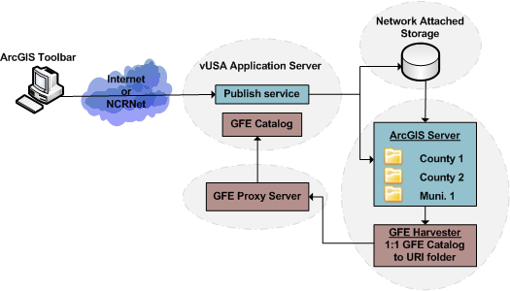
User Interface
ArcGIS Desktop Tools - Workflow
Notes:
Brendan

Slide 15
Desktop Publish Tool
Incorporates:
Feature layers only
Layer symbolization, scale range, labeling (as closely as possible)
Re-projection capability
Extent options
Definition queries
Joins (fields, not actual joined table)
Domains
Group Layers

Slide 16
Desktop Publish Tool
Excludes:
Image layers
Topology/Geometric networks
Relationship classes
Nested group layers

Slide 17
Demonstration

Slide 18
Clarifications
Auditing/Metering
Basemap data for Flex viewer

Slide 19
Questions / Feedback

