Slide 1
Housing affordability planning program (HAPP) awards – Round 3
Funding Recommendations for the COG Board of Directors
Hilary Chapman Housing Program Manager COG Board of Directors October 9, 2024
Agenda Item #10

Slide 2
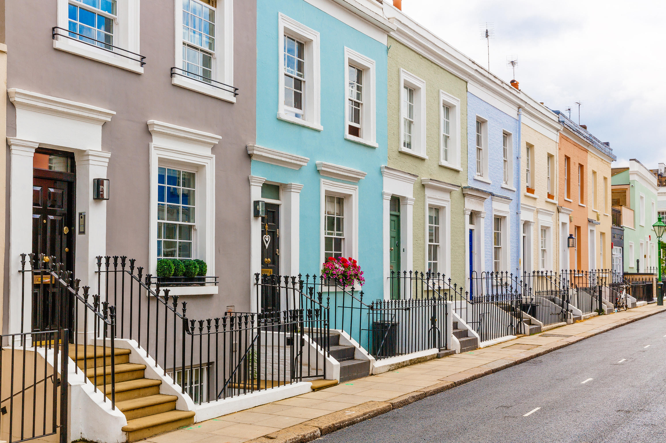
HAPP Grants Background
Established in October 2021 with funds from Amazon’s Housing Equity Fund
Designed to help meet the COG Board’s 2030 Regional Housing Targets
Small, flexible grants up to $75,000 for local governments or non-profit housing developers with support from COG member

Slide 3
HAPP Process & Timeline
Announcement of Round 3 in January 2024
Optional abstract submission process (May 1 – June 3)
Applications due July 1, 2024
Technical Selection Panel convened in September to select grantees
Recommended grant recipients include:
3 from Maryland
3 from the District of Columbia
2 from Northern Virginia
4 non-profit developers and 4 local government proposals selected

Slide 4
Grant Recommendations

Slide 5
Project Name | Jurisdiction & Sponsor | Panel Recommendation
TOD Inclusionary Zoning Feasibility Study | Prince George’s County DHCD | $50,000
5907 Dix Street, NE | Manna, Inc./ District of Columbia | $66,000
West Hyattsville Tenant Protection/Apartment Preservation Feasibility Study | City of Hyattsville, Dept. of Community & Economic Development | $59,000
1518 Residences at Metropolitan AME | Metropolitan AME & D.A. Payne Comm. Devel. Corp. | $65,000
Sagner Ave. Affordable Housing Redevelopment Study | Frederick Co. Div. of Housing | $65,000
Downtown Affordable Housing Study | City of Manassas, Community Development Dept. | $65,000
Big Green Affordable Housing Rehabilitation | L’Enfant Trust / District of Columbia | $65,000
AHC-Goodwill: Advancing Environ. Sustainable & Community Oriented Development | Affordable Homes & Communities / Arlington County | $65,000

Slide 6
TOD Inclusionary Zoning Feasibility Study $50,000 Prince George’s County Department of Housing and Community Development
Inclusionary Zoning (IZ) feasibility study along the Blue, Purple, and Green line Metro corridors to determine whether the existing market can support an IZ strategy
Consultants to conduct study and an accompanying best practices memo from the national capital region and nationwide for IZ strategies along transit corridors
Rendering Depicting Future Outcome at Morgan Boulevard Metro Station (Blue Line Metro Station) in Prince George’s County.

Slide 7
5907 Dix Street, NE $66,000 District of Columbia /Manna, Inc.
30 new affordable condominium units for low and moderate-income families in a neighborhood with very few ownership opportunities
Manna to provide homeownership counseling and downpayment assistance

Slide 8
West Hyattsville Tenant Protection/ Apartment Preservation Feasibility Study $59,000 City of Hyattsville
Feasibility study of full and partial preservation, including funding strategies and implementation process to expand and strengthen affordability for 4 NOAH (Naturally Occurring Affordable Housing)
Over 1,000 tenant households are at risk of displacement if the 4 properties are redeveloped
Desired outcome: Parkview Manor – full preservation (53 apartment homes)

Slide 9
1518 Residences at Metropolitan AME $65,000 District of Columbia/ Metropolitan AME & Daniel Alexander Payne Community Development Corporation
Addition of a residential tower to an existing historic church
28 units for unhoused military veterans
Affordability restrictions at or below 30% AMI
Metropolitan AME is part of a cohort led by Enterprise Community Partners for faith-based organizations to develop affordable housing on their property

Slide 10
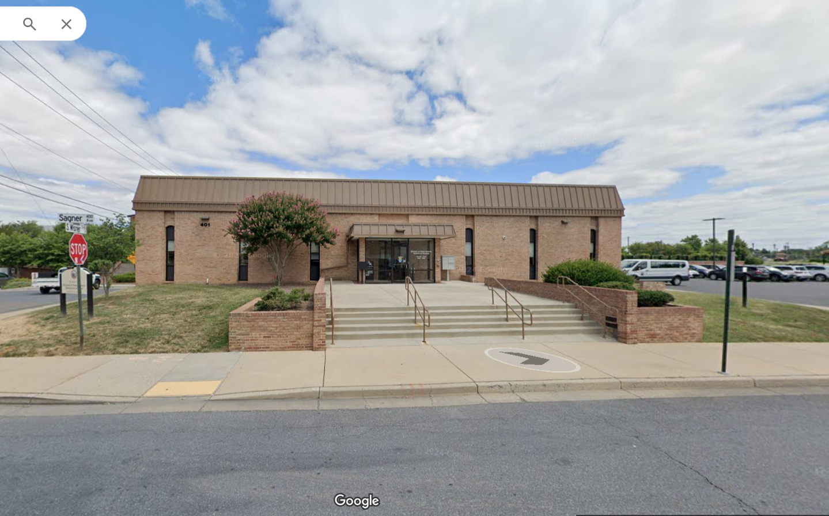
Sagner Avenue Affordable Housing Redevelopment Study $65,000 Frederick County Division of Housing
Feasibility study for a county-owned property in downtown Frederick
Affordable housing for low- and moderate-income housing within walking distance of a transit center and located in an Equity Emphasis Area
Study to inform viability for workforce and/or senior housing at the site

Slide 11
Downtown Affordable Housing Study $65,000 City of Manassas Community Development Department
Study for 2 properties adjacent to and across from the Manassas VRE station (located in an Equity Emphasis Area)
HAPP grant to support a study for the feasibility and configuration of the two properties, their potential affordability levels, and overall impact on the downtown development pattern

Slide 12
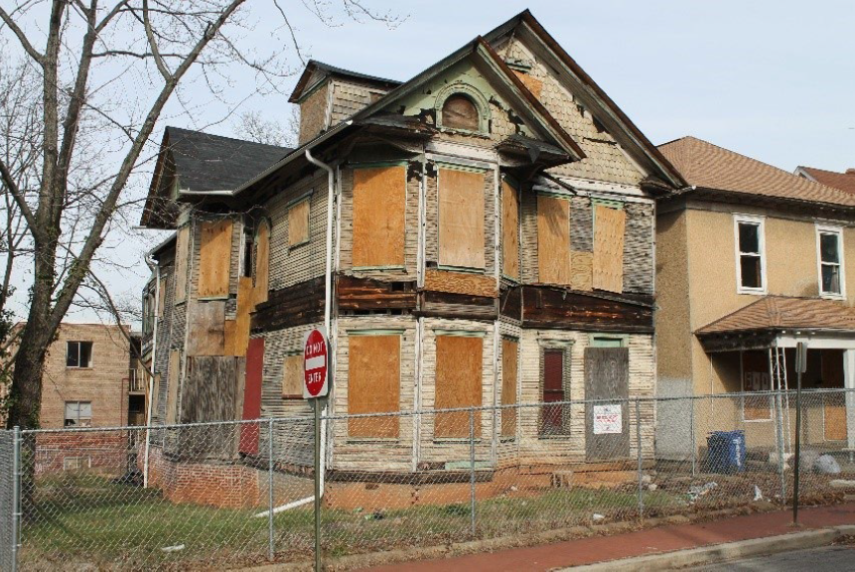
Big Green Affordable Housing Rehabilitation Project $65,000 District of Columbia / L’Enfant Trust
Rehabilitation of a 30+-years vacant blighted historic property “Big Green” into 2 affordable family homeownership units in the Anacostia Historic District neighborhood
Homes will be 3-bedrooms each for families earning 80-100% Median Family Income (monthly housing cost of $2,770 - $3,450 per month)
Estimated sales price below $300K/unit

Slide 13
AHC-Goodwill: Advancing Environmentally Sustainable & Community Oriented Development $65,000 Arlington County / Affordable Homes & Communities (AHC, Inc.)
First co-location of affordable housing with a Goodwill store in the U.S.
128 rental homes for families earning 30%, 50% and 60% AMI
Childcare center integrated into new facility for AHC residents and Goodwill employees
Current conditions (left) and proposed redevelopment (below)

Slide 14
Next Steps
Grant agreements drafted and signed: October – January 2024
Release of Grant Funds: First quarter 2025
Mid-term (6-month) progress report from date of grant disbursement
Final progress reports due 12 months from date of grant disbursement

Slide 15
Hilary Chapman Housing Program Manager Department of Community Planning & Services (202) 962-3346 hchapman@mwcog.org | mwcog.org
777 North Capitol Street NE, Suite 300 Washington, DC 20002

