Slide 1
Transportation Planning Board
Technical Committee Item #3
AIR QUALITY CONFORMITY ANALYSIS
OF THE
2013 CONSTRAINED LONG RANGE PLAN &
FY2013-2018 TRANSPORTATION IMPROVEMENT PROGRAM
DRAFT
June 13, 2013

Slide 3
Travel model validation: background
Travel Model Adopted in 2012: Version 2.3.39
  Calibrated primarily with 2007 information:
    2007/08 Household Travel Survey
    2007 American Community Survey
    2007 traffic counts
    Transit on-board surveys
2010 model validation objectives:
  To evaluate calibrated model results against recent travel data:
    2010 traffic counts
    2010 American Community Survey
    2010 Metrorail electronic counts
    2010 Geographically Focused Household Travel Survey
  To refine the model to improve performance and forecasting ability
Validated travel model used in 2013 CLRP Analysis: Version 2.3.52

Slide 4
Why is 2010 an Important
Validation Year?
VMT and VMT per capita have not followed historic trends since 2007
Potential Reasons
  Effect of Recession
  Fuel Price Volatility
  Growing Internet-based Commerce and Communications
  Telecommuting
  Changing Travel Preferences of the “Millennials” (ages 13-30)

Slide 5
Total US Vehicle-Miles and Vehicle-Miles per Capita
1987-2012
Source: US DOT/FHWA and US Census Bureau
Notes:
"I:\ateam\meetings_conf\techComm\2013-06-07\Copy of 12jantvt.xls"

Slide 6
VMT for the TPB Planning Area 2005–2011
Legend:
Inner Jurisdictions:
DC, Arlington, Alexandria
Suburban Jurisdictions:
Montgomery, Prince George’s, Fairfax
Outer Jurisdictions:
Loudoun, Prince William, Frederick, Charles
Source: VDOT, MDOT, DDOT HPMS data (does not include local roads)

Slide 7
Population for the TPB Planning Area 2005-2011
Legend:
Inner Jurisdictions:
DC, Arlington, Alexandria
Suburban Jurisdictions:
Montgomery, Prince George’s, Fairfax
Outer Jurisdictions:
Loudoun, Prince William, Frederick, Charles
Source: Round 8.2 Cooperative Forecasts-
2007 & 2011 figures are linearly interpolated

Slide 8
VMT per Capita for the TPB Planning Area 2005-2011
Legend:
Inner Jurisdictions:
DC, Arlington, Alexandria
Suburban Jurisdictions:
Montgomery, Prince George’s, Fairfax
Outer Jurisdictions:
Loudoun, Prince William, Frederick, Charles

Slide 9
Validation-related Changes to the Travel Demand Model
Increased non-motorized trip shares in dense-mixed use areas (Area Types 1 and 2)
  Based on comparisons with non-motorized trip shares observed in geographically focused household travel survey
  Applies to non-work purposes only (i.e. did not change work trips)
Refined highway network facility type coding
Improved estimated to observed VMT
    2012 model: 1.04
    2013 model: 1.00
Implemented several other technical adjustments to improve the performance or internal consistency of individual modeling steps

Slide 10
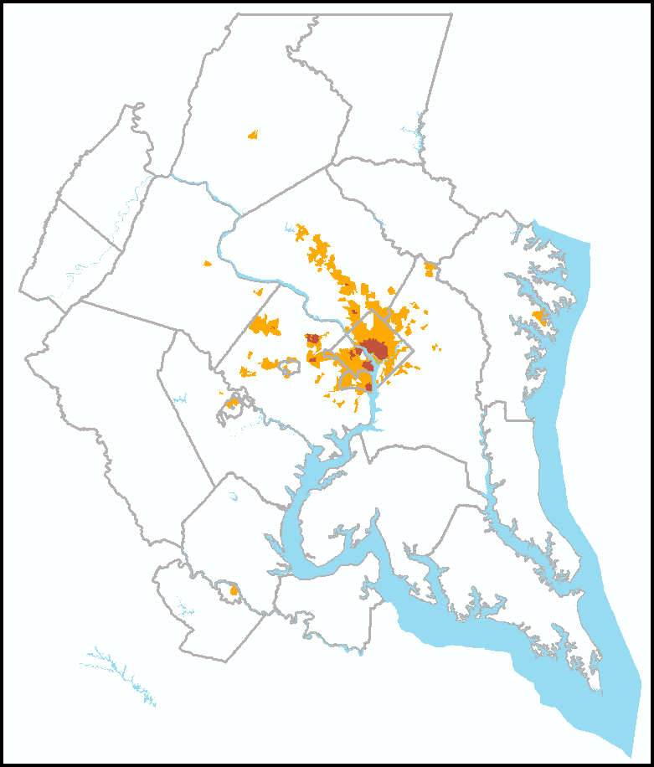
Non-motorized Trip Adjustment in the Travel Demand Model
Area Type 1
Area Type 2
The share of non-work, non-motorized trips in dense mixed use areas has been adjusted upward
map represents the year 2010

Slide 11
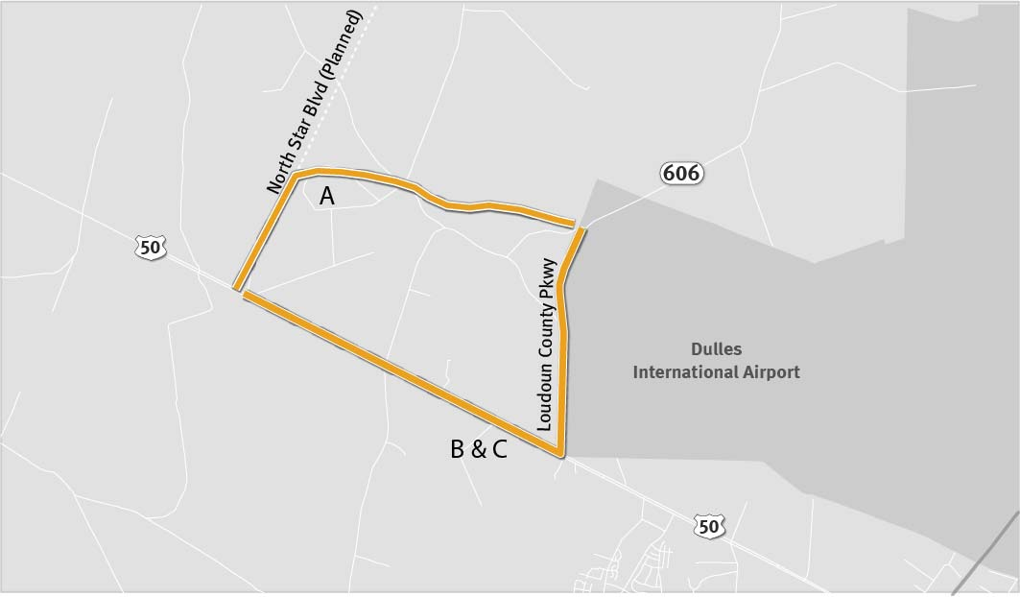
VDOT Dulles Access Improvements Alternatives
 | US 50 | VA 606 (Loudoun County Pkwy) |  | Northstar Blvd.
 | Northstar Blvd. To VA 606 | US 50 to 1.5 miles north of US 50 | 1.5 miles north of US 50 to Dulles Greenway | US 50 (at Northstar Blvd.) to VA 606 (at 1.5 miles north of US 50)
Current Conditions | 4/5/6 lanes, major/principal arterial | 2/4 lanes, minor arterial | 2 lanes, minor arterial | -------------
2013 CLRP (no Dulles access improvements) | 6 lanes, principal arterial | 4 lanes, minor/major arterial | 4 lanes, minor/major arterial | -------------
2013 CLRP VDOT A | 6 lanes, principal arterial | 4 lanes, minor/major arterial | 4 lanes, minor/major arterial | 4 lanes, principal arterial
2013 CLRP VDOT B | 4 lanes, limited access facility + 6 lanes, principal arterial | 4 lanes, limited access facility + 4 lanes, major arterial | 4 lanes, major arterial | -------------
2013 CLRP VDOT C (Loudoun County Comprehensive Plan) | 6 lanes, limited access facility | 8 lanes, limited access facility | 4 lanes, major arterial | -------------

Slide 12
AIR QUALITY CONFORMITY
2013 CLRP & FY2013-2018 TIP
Ozone Season VOC

Slide 13
AIR QUALITY CONFORMITY
2013 CLRP & FY2013-2018 TIP
Ozone Season NOx

Slide 14
AIR QUALITY CONFORMITY
2013 CLRP & FY2013-2018 TIP
PM_{2.5} Precursor NOx

Slide 15
AIR QUALITY CONFORMITY
2013 CLRP & FY2013-2018 TIP
Direct PM_{2.5}

Slide 16
Schedule

