Slide 1

mBike

Slide 2
Outline
Background
Fee Structure
How it Works
Usage Data
Locations
Technology
Bikes Models
Accommodations

Slide 3
mBike Background
Joint UMD/City of College Park RFP issued in April 2015
Received 3 proposals in May: Zagster, Social Bikes and B-cycle
Zagster chosen as the winning vendor
Negotiated 3-year contract
  Total of 15 station locations
  130 bikes non-adaptive bikes
  5 adaptive bikes
  All capital, maintenance and operations costs are included
Launched May 5th, 2016
UMD Costs for 3 years: $187,000 (MDOT Grant) + $46,000 (Grant Match) + $90,000 = $323,000

Slide 4
Fee structure
Membership Based – only members can rent bikes
  One day membership: $6
  One month membership: $25
  Six month membership: $40
  One year membership: $65
Trips under one hour are free Monday thorough Friday
Trips under three hours are free Saturday and Sunday
$3 is charged for every additional hour
$24 is the maximum daily charge

Slide 5
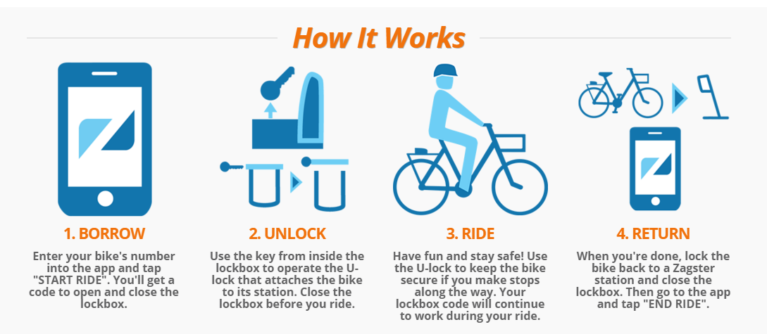
How It Works

Slide 6
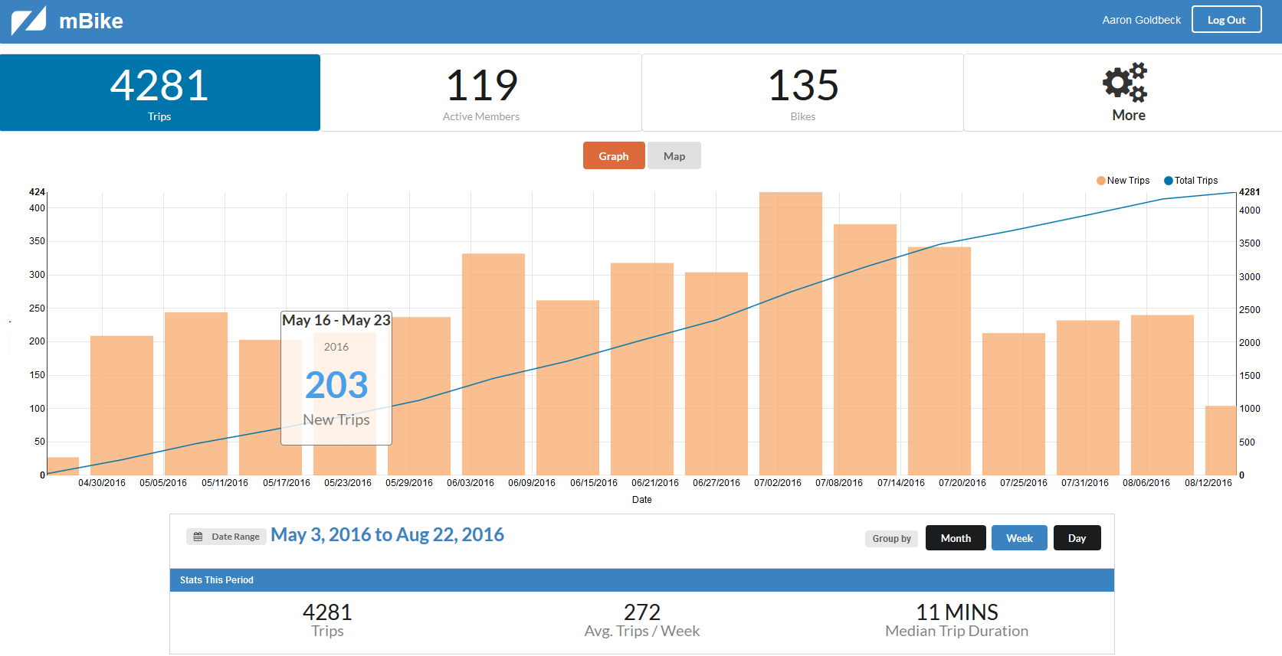

Slide 7
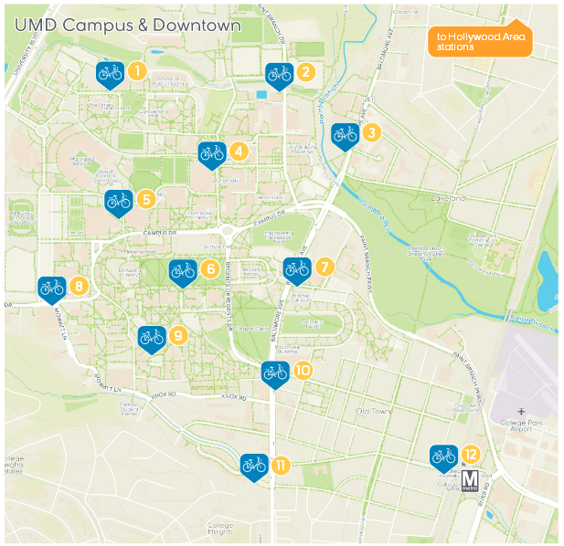
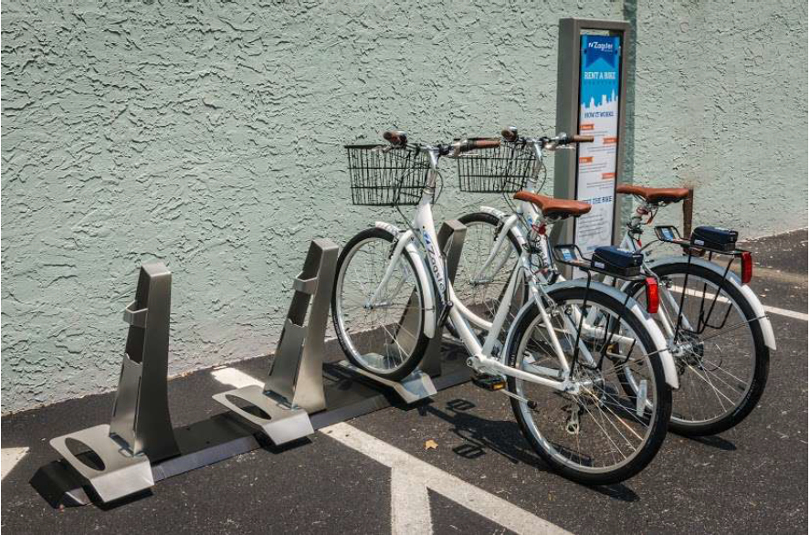
Station Locations

Slide 8
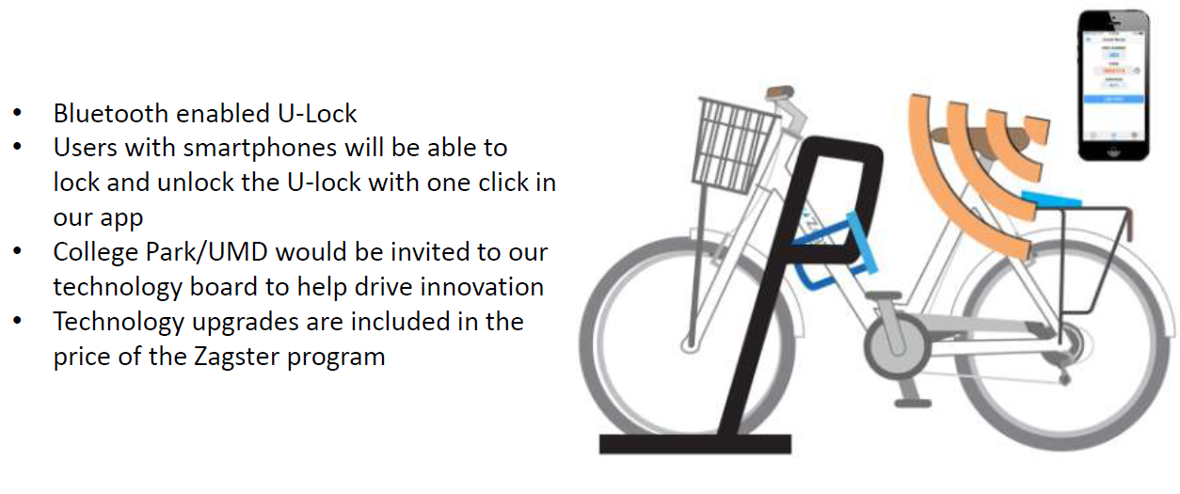
The Technology

Slide 9
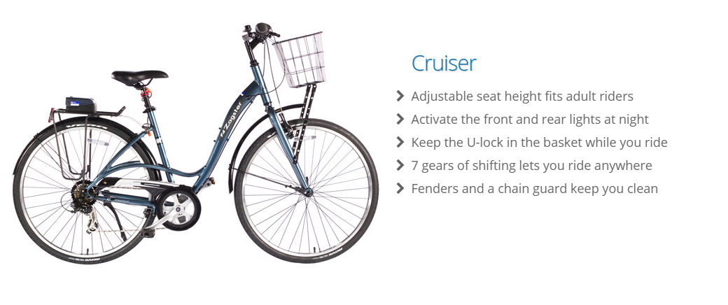
The Bikes- 130 in fleet
STANDARD FLEET BICYCLE

Slide 10
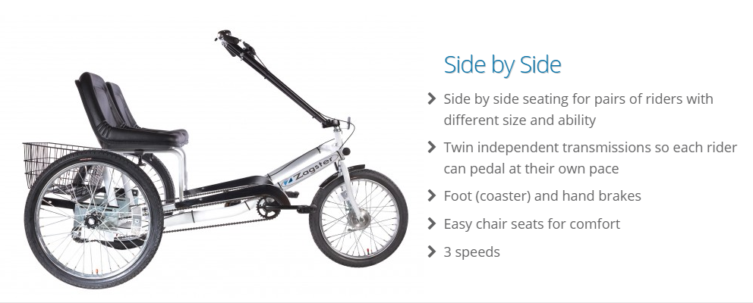
The Bikes- Two in fleet
OPTIONAL BIKES AVAILABLE

Slide 11
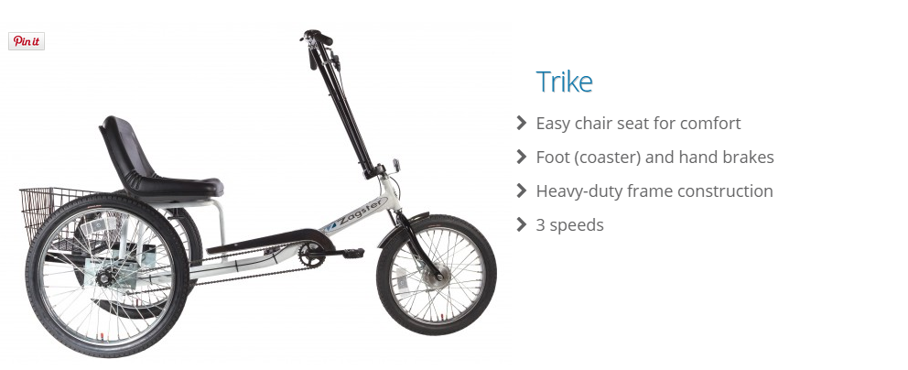
The Bikes – Two in fleet
OPTIONAL BIKES AVAILABLE

Slide 12
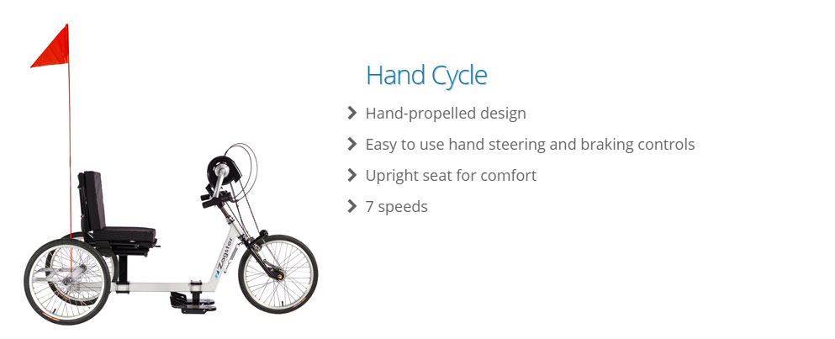
The Bikes – One in fleet
OPTIONAL BIKES AVAILABLE

Slide 13
Accessibility
Adaptive bikes
Low membership fees
Flat overtime rate (rather than scaling overtime rate)
Longer free ride time
Riders can stop mid trip
Bikes can be checked out by text message
Membership can be purchased on any smartphone or computer
Zagster can accommodate other language users though this has not been a part of mBike so far.

