Slide 1
Intelligent Transportation System (ITS)
Program – Arlington County
SPOTS Meeting
June 7, 2018
Amit Sidhaye, PE, PTOE
ITS Program Manager
Arlington County

Slide 2
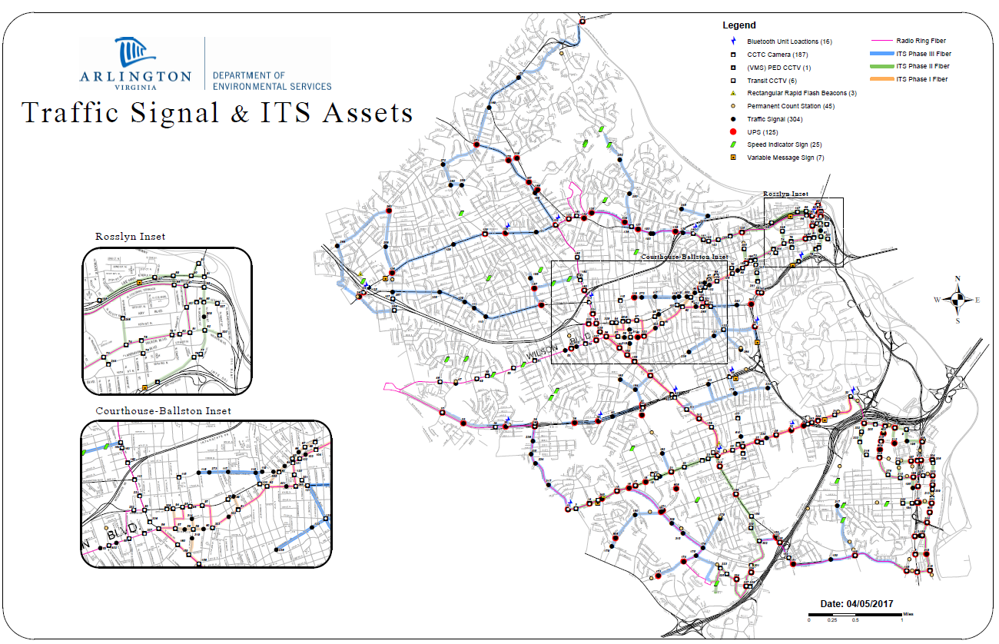
What we do?
296 Signals
220 CCTV
45 Count Stations
8 Variable
Message Signs
16 Bluetooth devices
90 School Flasher
2 Traffic Management Center
7,350 County Owned Streetlights
Notes:
4 engineers, 2 CMs, 10 technicians, 1 Trades manager

Slide 3
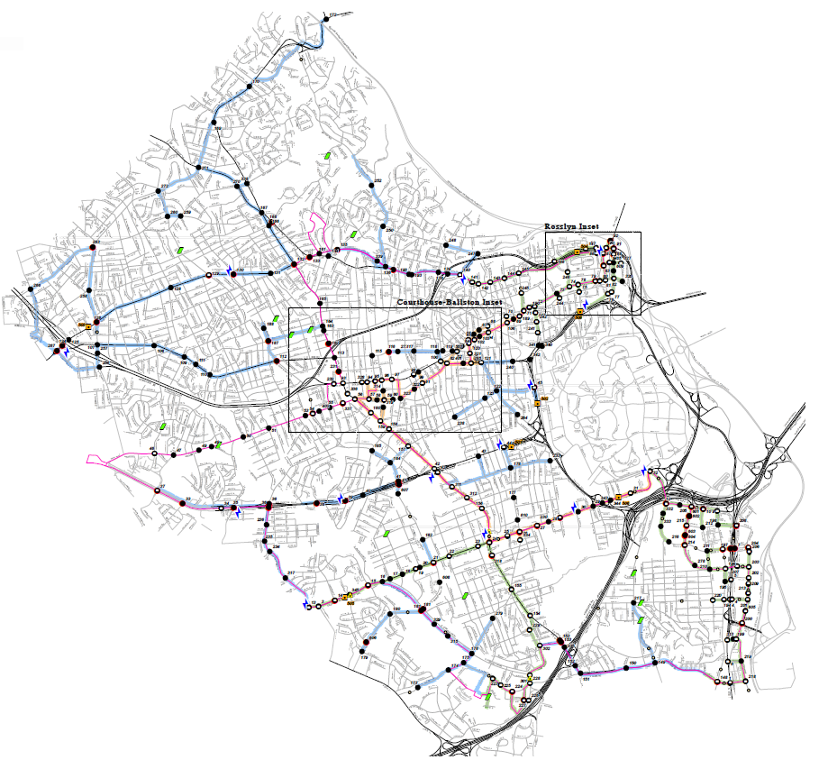
ITS Communication
100% County owned dedicated ITS Fiber (144 strands) with redundancy (~$20M)
Cell communication - School Flashers / Count Stations
RF Communication - Streetlights

Slide 4
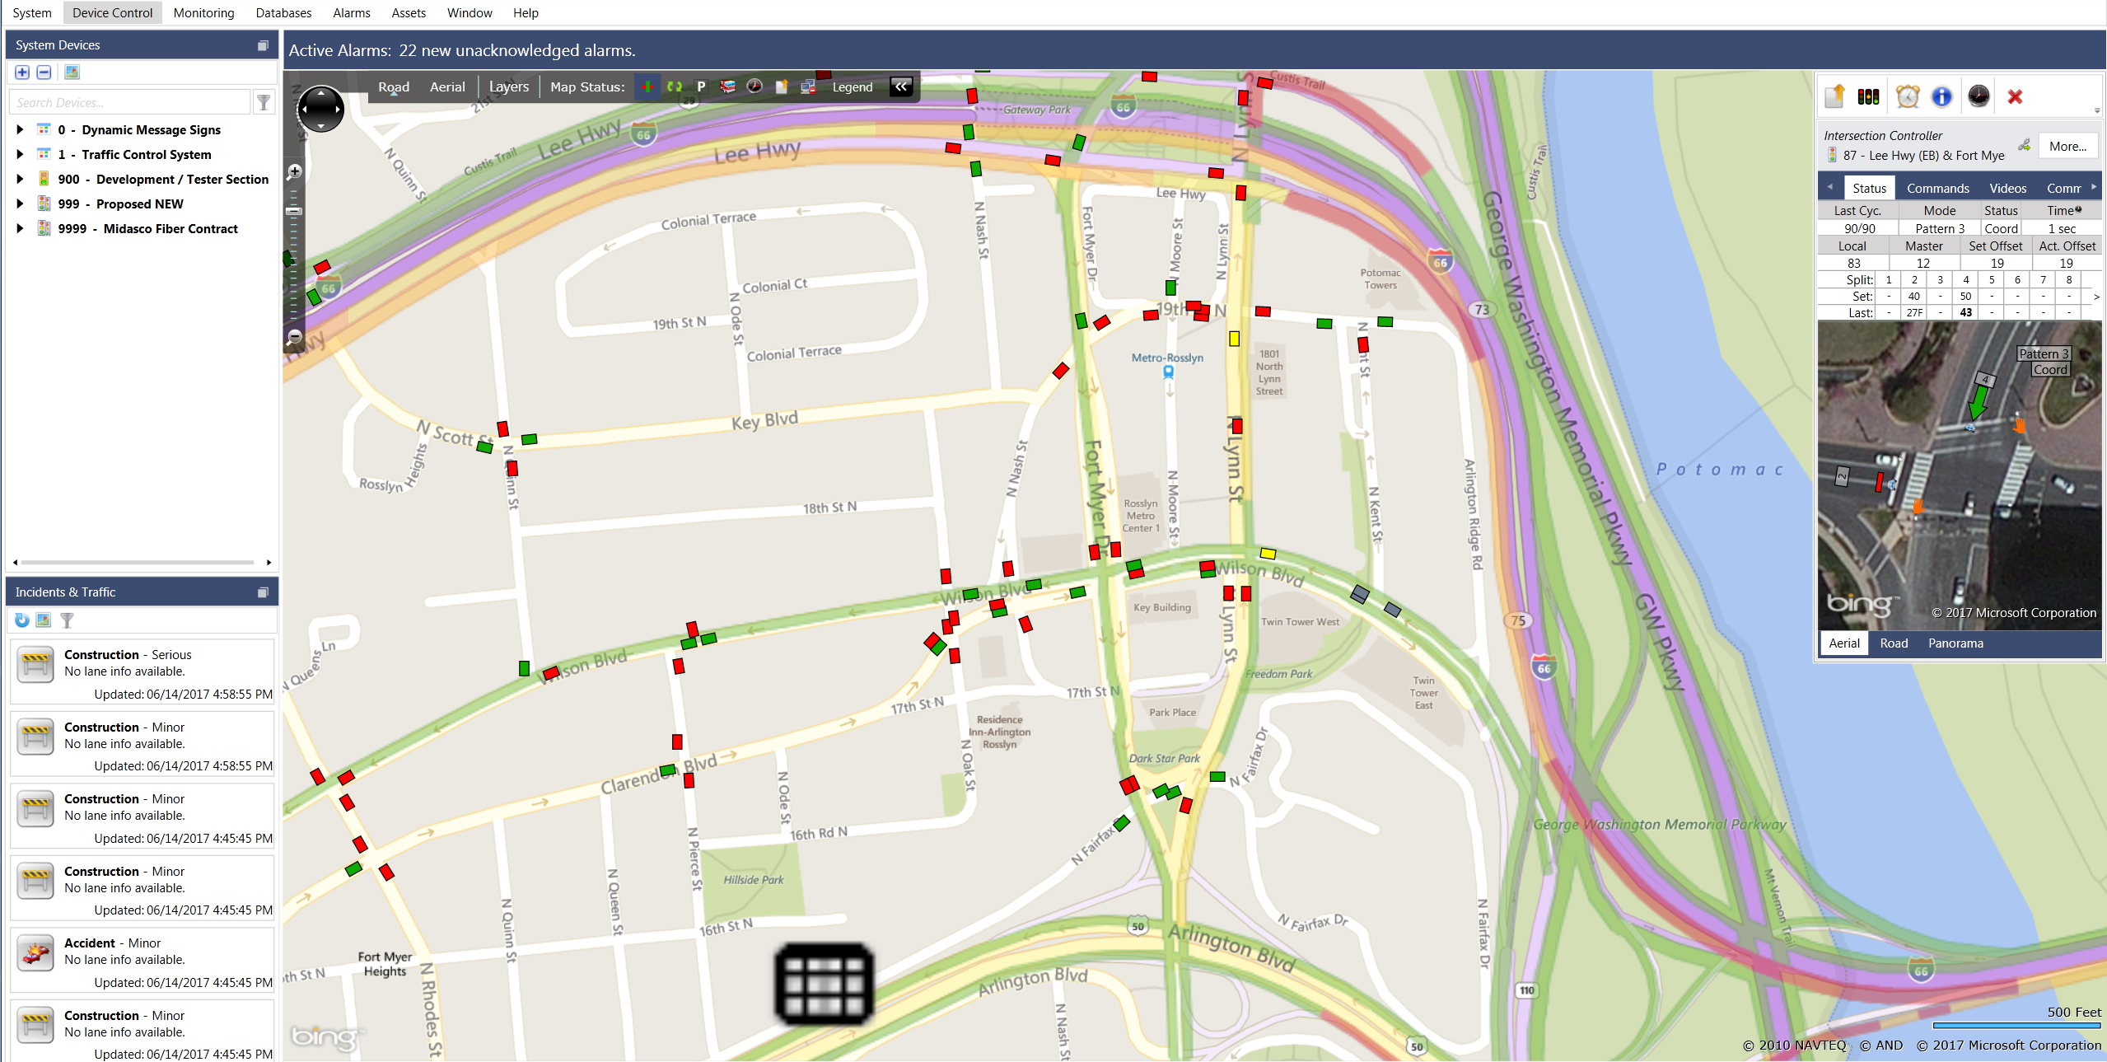
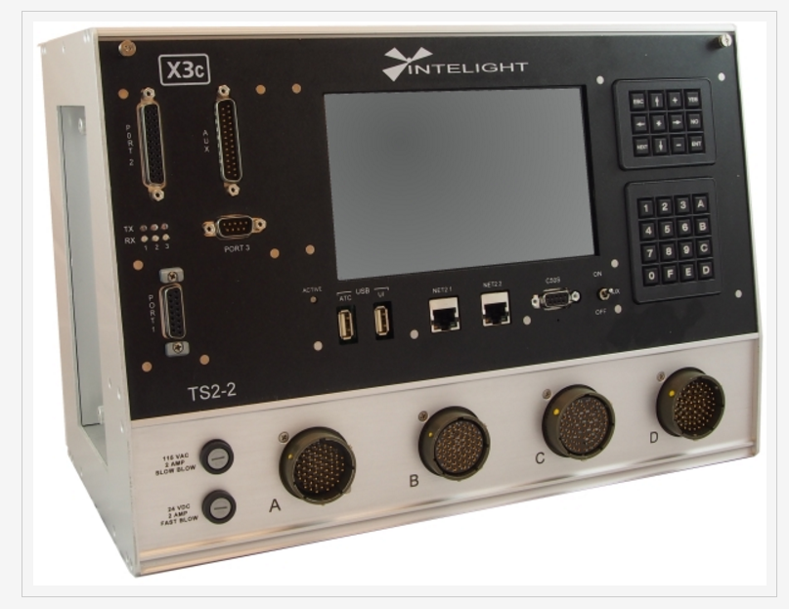
Traffic Signal

Slide 5
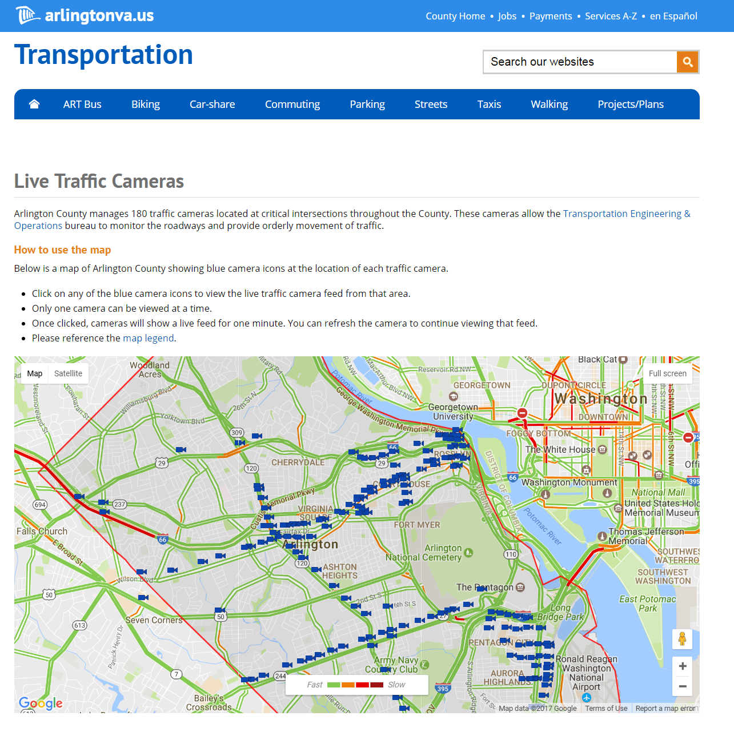
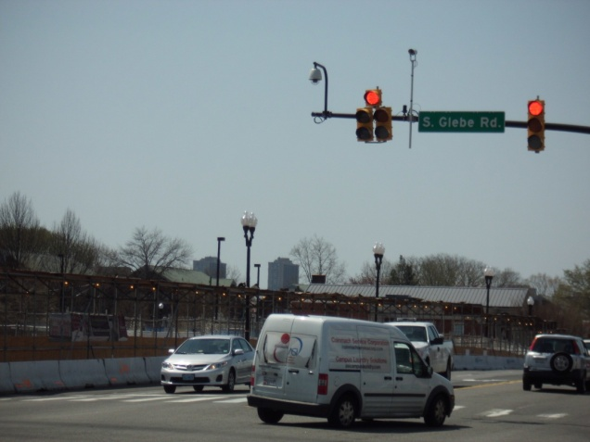
CCTV
220 CCTVs (In planning -100)
Identification of operational issues
Traffic studies
Incident management / response time
Special events
Notes:
Traffic monitoring
Traffic analysis, troubleshoot, identifying

Slide 6
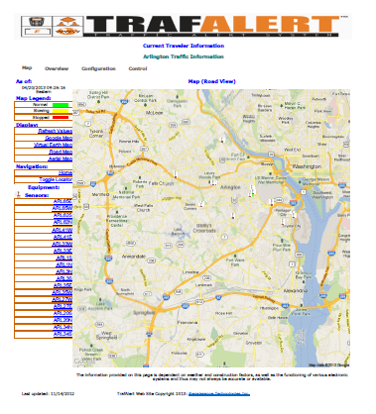
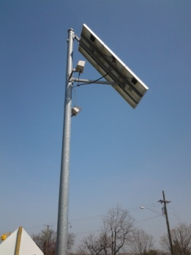
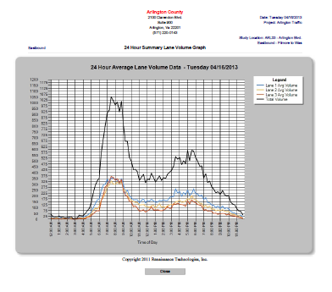
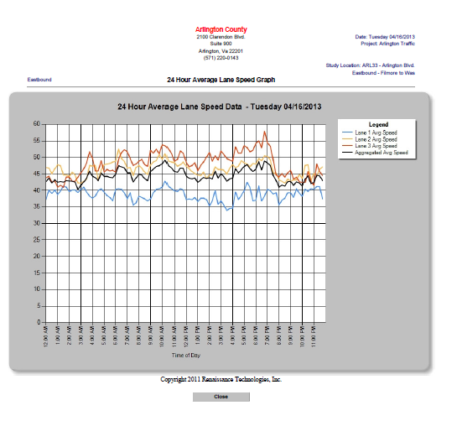
Permanent Count Stations
Real time traffic data collection
      Collect speed, classification and volume
Police enforcement / Citizen complaints
Planning Studies
Notes:
Help us to identify performance of the system
Identify the target areas for enforcement.
Performance evaluation for signal optimization / system, long rang planning

Slide 7
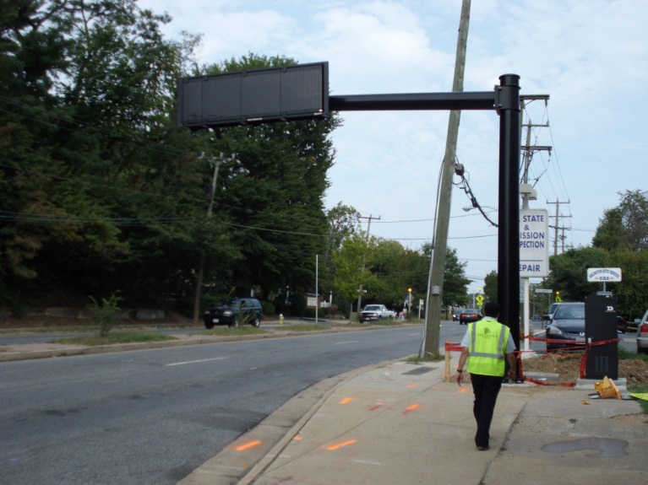
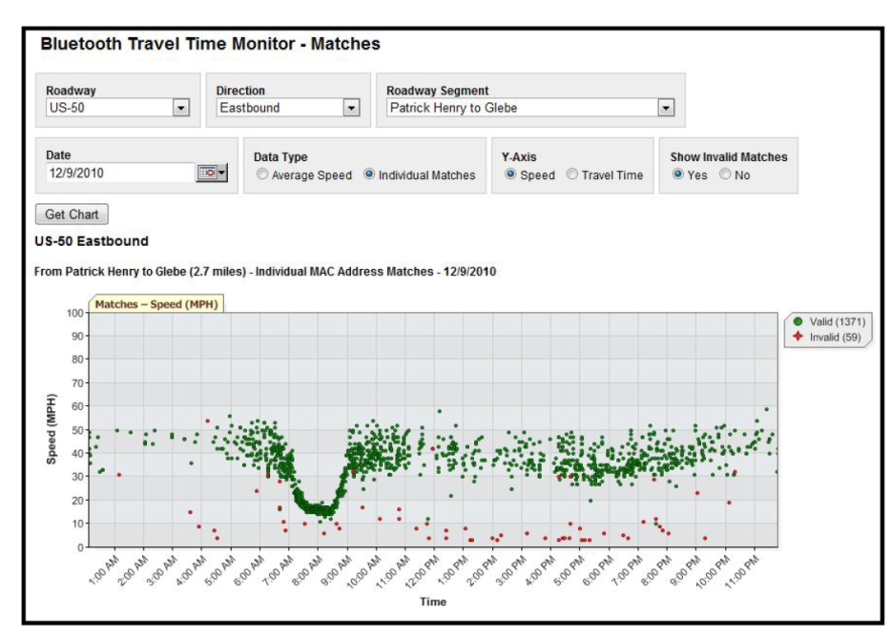
Variable Message Signs (VMS)
    8 VMS locations
      Arlington Blvd.
      Lee Highway
      Columbia Pike
    Real time travel information
    Queue detections / congestion management
    Amber alerts and incident management
Notes:
Balancing capacity promote safety
First urabn travel time system in NOVA
Providing information to make smart choices for drivers

Slide 8
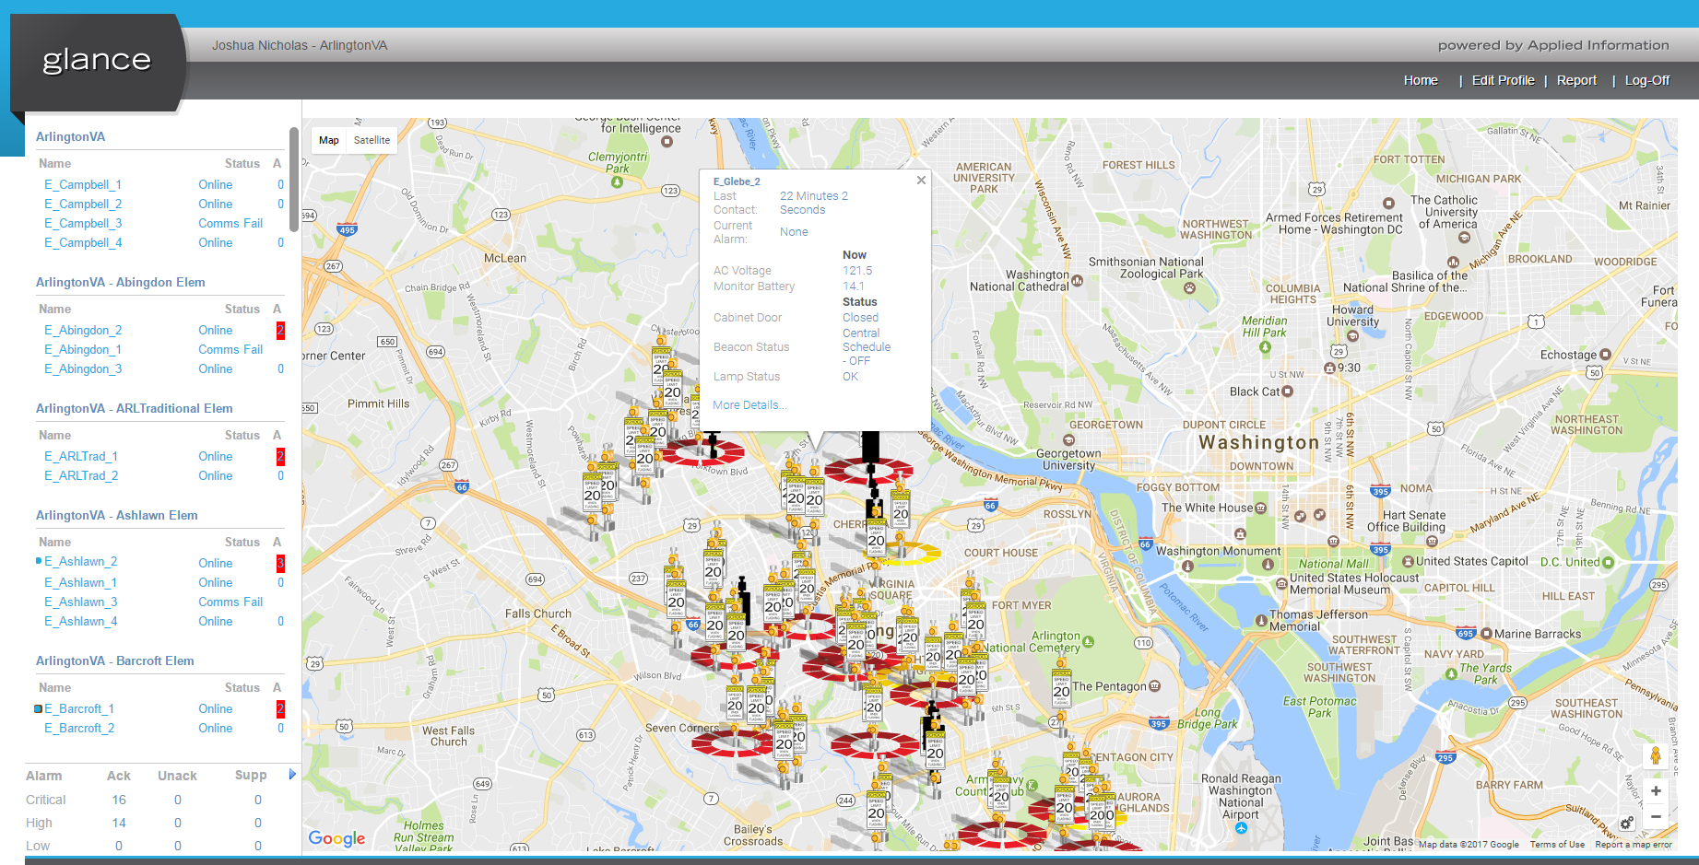
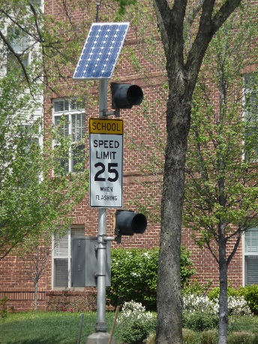
School Flasher

Slide 9
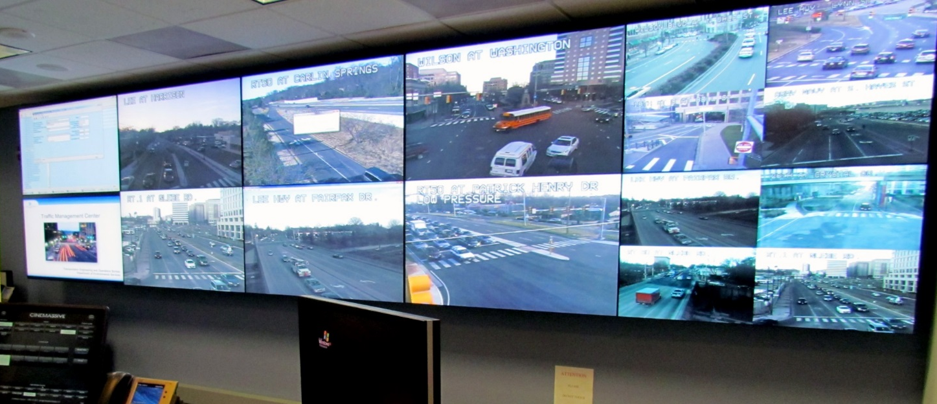
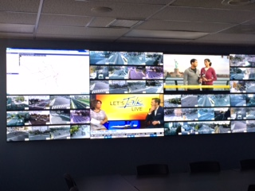
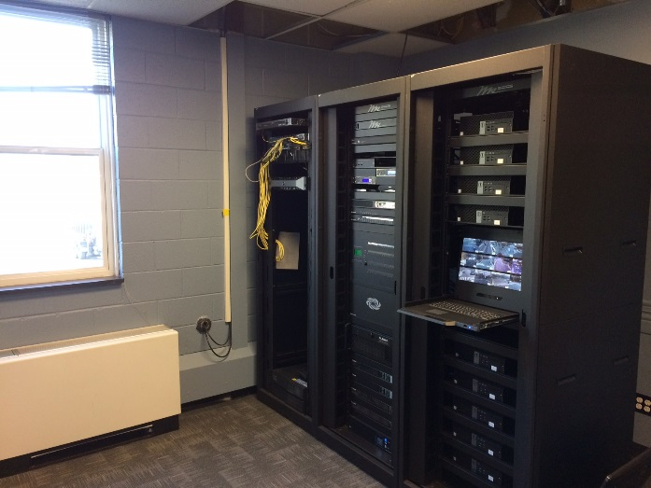
Traffic Management Center (TMC)
CHP
Trades

Slide 10
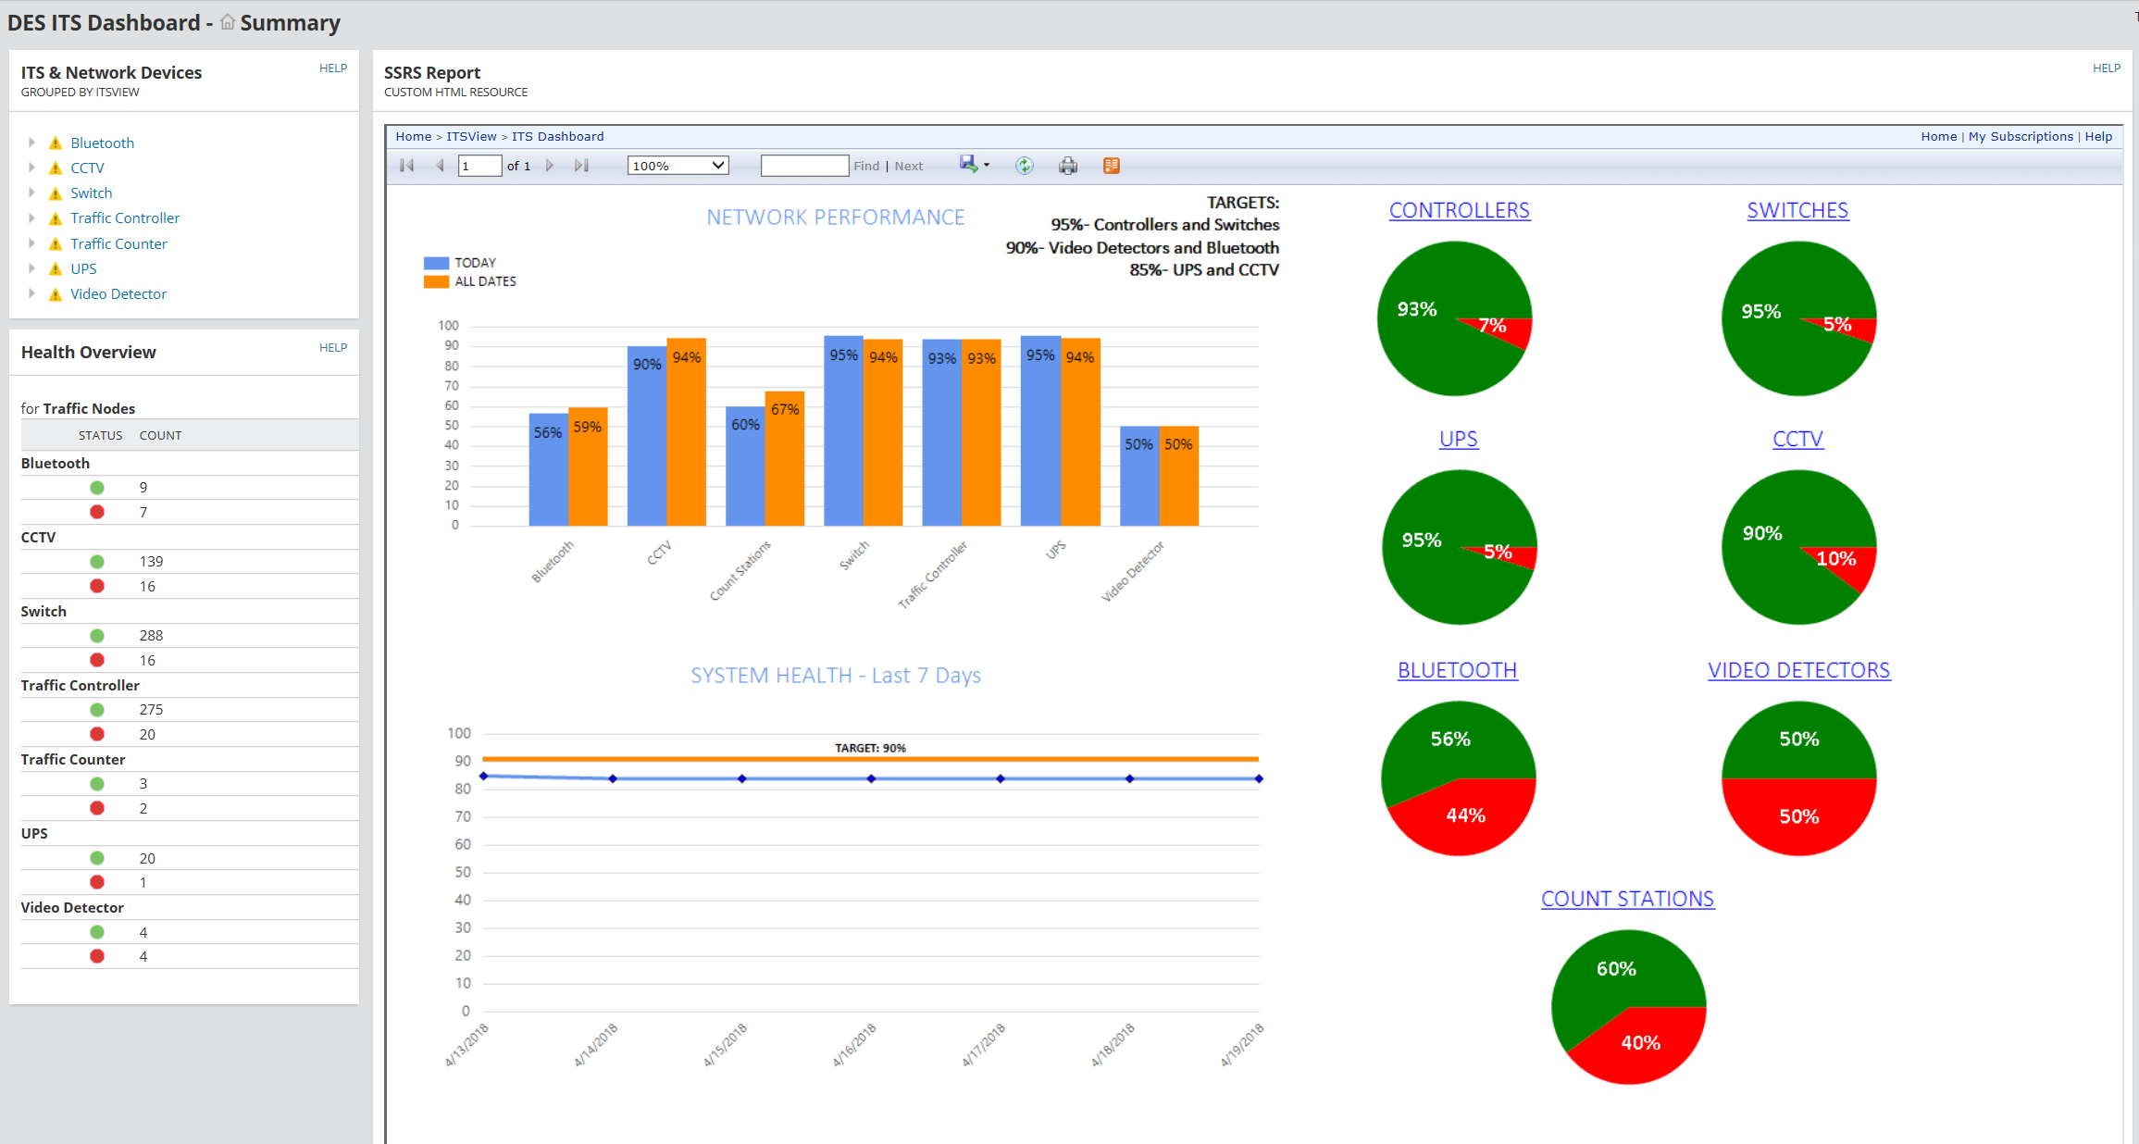
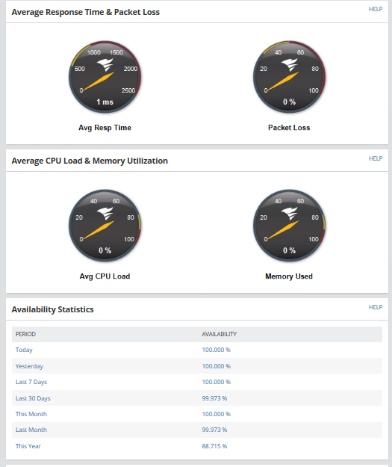
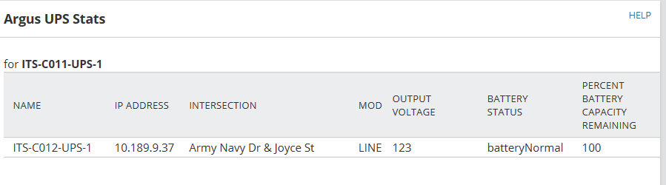
ITS Dashboard

Slide 11
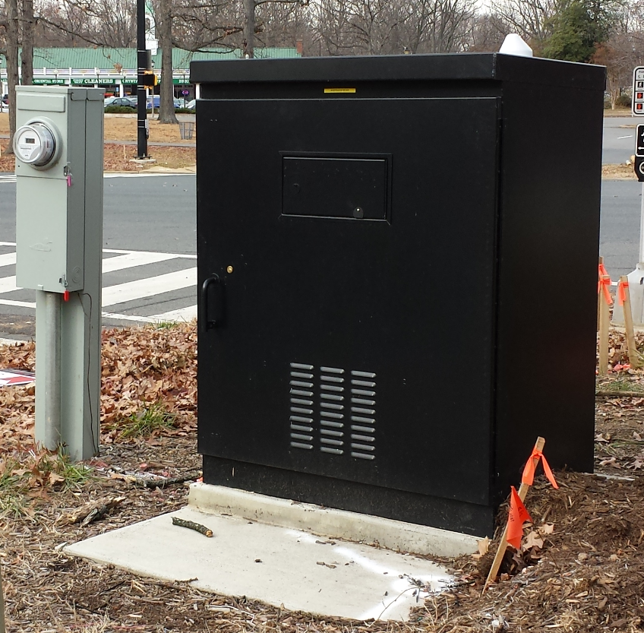
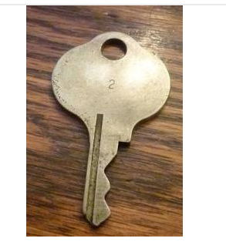
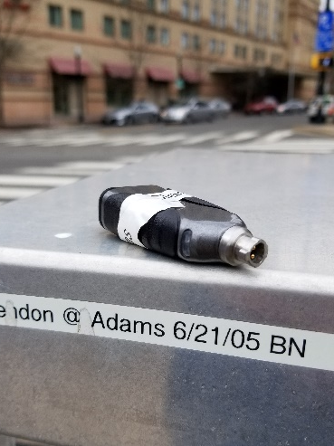
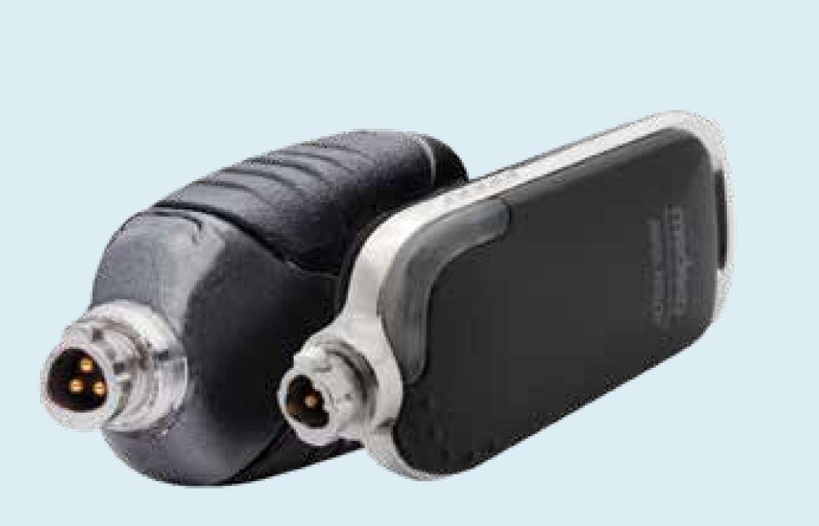
Cabinet Access Control
Working on pilot to secure cabinet
Additional tasks for field staff
SOP for “after hours” emergency work

Slide 12
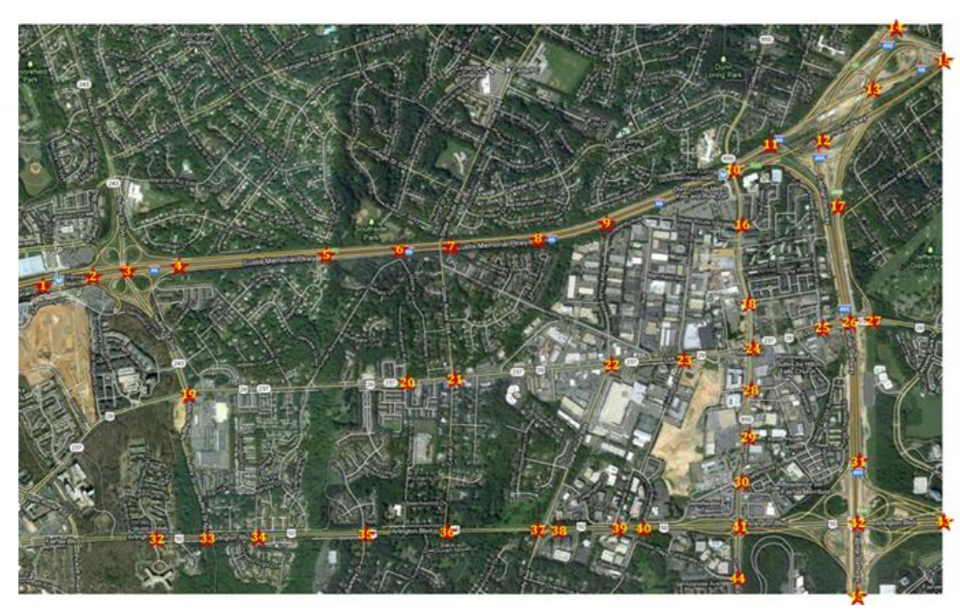
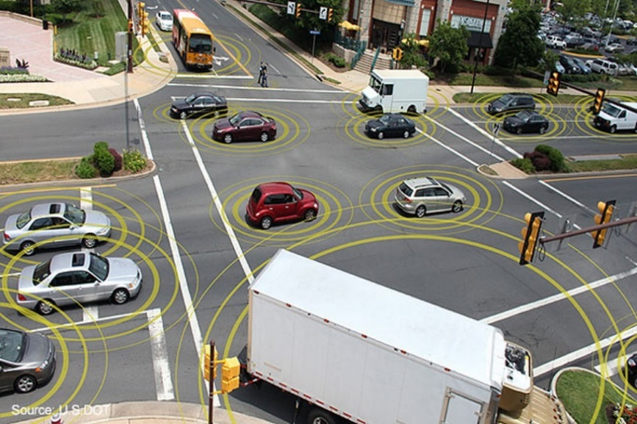
CAV – Connected Automated vehicle
Rt. 50 Corridor with 5 test signals
SPAT and MAP data link to VDOT server

Slide 13
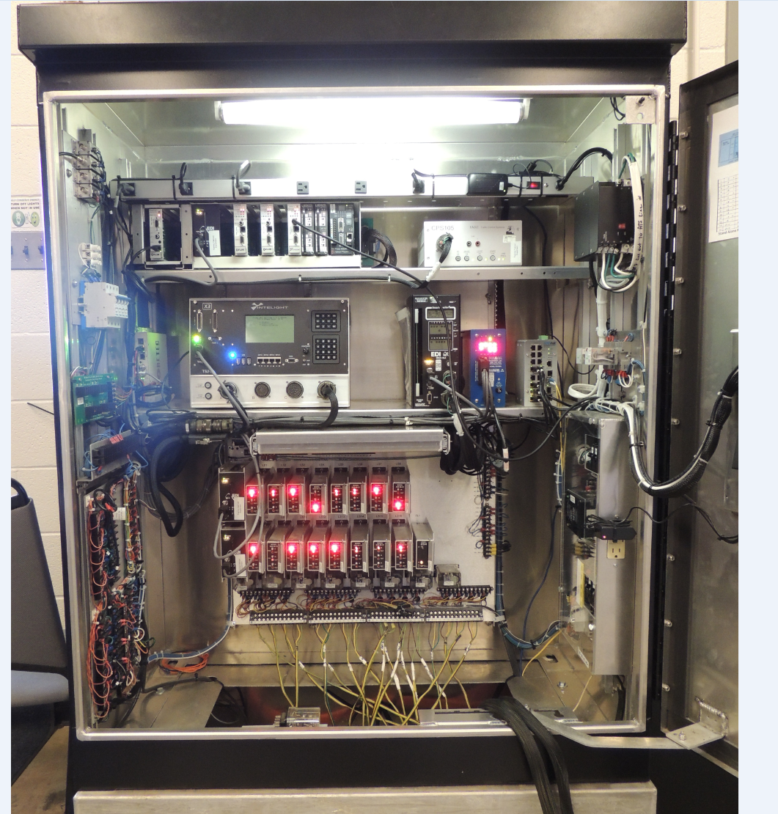
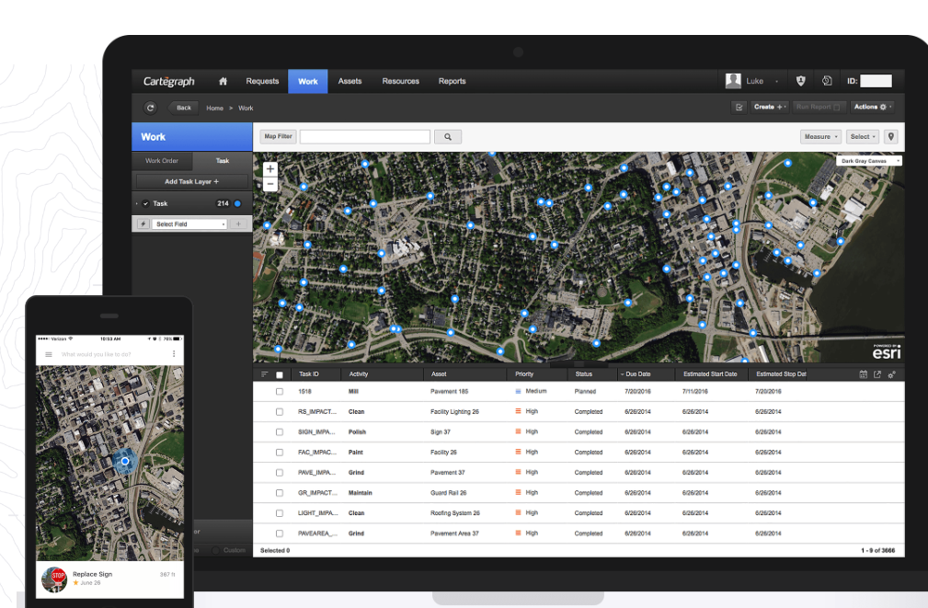
Challenges
Staff training
Asset management

Slide 14
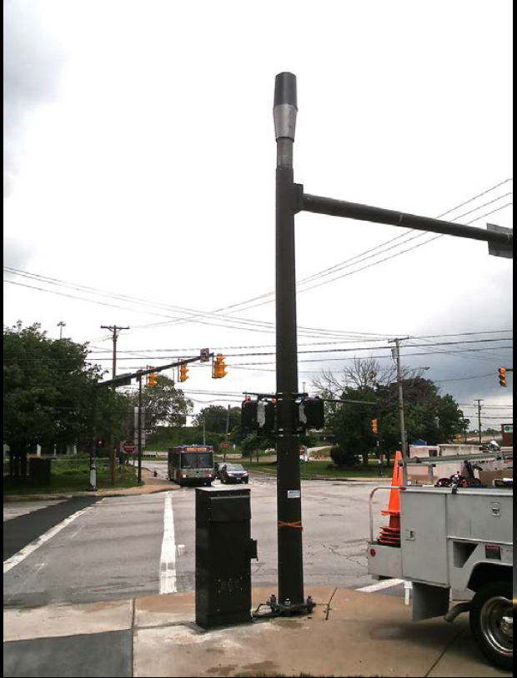
Policy - Small Cell Facilities (SWF)?
Safety of County staff maintaining signal infrastructure
Interference with future connected vehicle attachments
Mast Arm space issue
Power tapping issue

Slide 15
Questions?
Contact
Amit Sidhaye, PE, PTOE
ITS Program Manager
Arlington County
asidhaye@arlingotnva.us
703-228-3730

