Slide 1
REACH A RIDE Enhancements
Website & Procedural Update
Dan Sheehan COG/TPB Staff Stephen Finafrock COG/TPB Staff Access for All Committee March 7, 2019
Agenda Item 2d

Slide 2
Background
Need for a “Regional Clearinghouse” identified in 2009
Primary goal: Connect individuals with special transportation needs with transportation options
Launched in 2011
Website is equipped with Assistive Technology
  JAWS For Windows Screen Reading Software
  NonVisual Desktop Access (NVDA)
  American Foundation for the Blind Certification (AFB)
Toll free number available: 855-732-2427
Agenda Item 2: Reach A Ride Enhancements
March 7, 2019

Slide 3
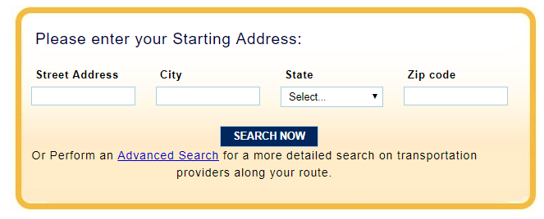
Website Content Overview
Agenda Item 2: Reach A Ride Enhancements
March 7, 2019
Notes:
Currently just over 100 services in the database – but as Stephen will note, we’re looking for some help in cleaning these up.

Slide 4
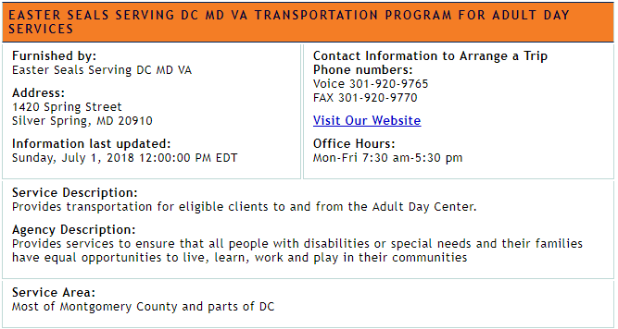
Website Content Overview
Agenda Item 2: Reach A Ride Enhancements
March 7, 2019

Slide 5
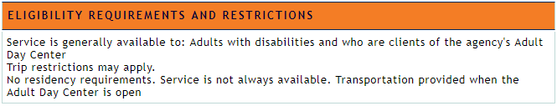
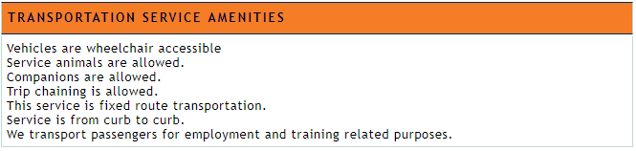
Website Content Overview
Agenda Item 2: Reach A Ride Enhancements
March 7, 2019

Slide 6
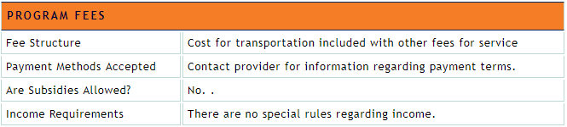
Website Content Overview
Agenda Item 2: Reach A Ride Enhancements
March 7, 2019

Slide 7
Data Integrity Enhancements
Data certification now required by providers
  “Save and Publish”
    All changes made to the listing information are certified to be accurate to the best of the provider’s knowledge
  “Reviewed/No Changes”
    An agency representative has reviewed the data and confirms no changes are necessary
Annual Reminder from COG
  New internal report created
Agenda Item 2: Reach A Ride Enhancements
March 7, 2019

Slide 8
Internal Processes
Call Center Operations
  Staffed Monday – Friday, 9am – 5pm
  English and Spanish language support
  Primary communication via email and telephone
Data Management
  Monthly Data Review
    Staff outreach to providers for data edits/updates
    Staff auditing (calling) listed services to confirm availability
Defunct Providers
  Difficulty in reaching providers
Agenda Item 2: Reach A Ride Enhancements
March 7, 2019

Slide 9
Daniel Sheehan Stephen Finafrock Alternate Commute Programs (202) 962-3287 (202) 962-3385 dsheehan@mwcog.org sfinafrock@mwcog.org | mwcog.org/tpb
Metropolitan Washington Council of Governments 777 North Capitol Street NE, Suite 300 Washington, DC 20002

