Slide 1
INTEGRATING MONITORING AND MODELING DATA FOR WIP DEVELOPMENT Joint COG-NVRC workshop June 18
LATEST NONTIDAL MONITORING NETWORK RESULTS FOR POTOMAC BASIN – Doug Moyer, USGS TRENDS IN THE POTOMAC ESTUARY – Rebecca Murphy, UMCES URBAN WATERSHED STORYLINES – Emily Trentacoste, EPA CBPO
WRTC Meeting – 7/13/18

Slide 2
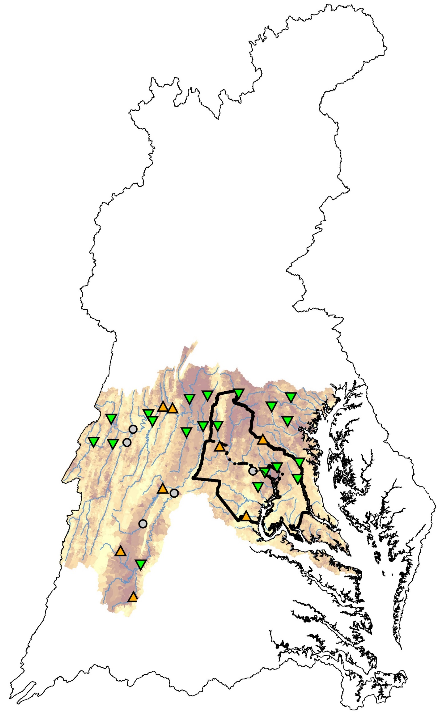
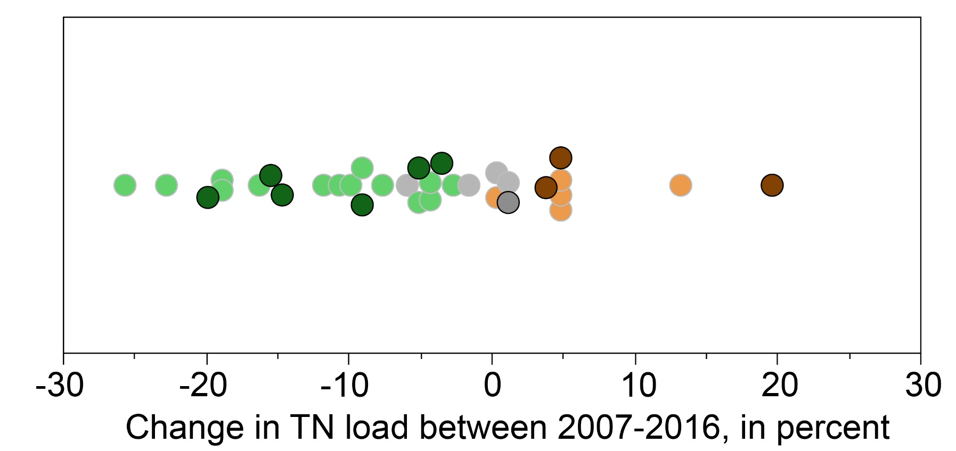

Trends in nitrogen loads result from changing nitrogen inputs or transport
In the most recent ten year period (2007 – 2016)¹:
2002 TN per-acre load²
Low
High
Nitrogen loads (n=33) have improved at 20, degraded at 8, and have no trend at 5 stations².
The median N improvement is 10% and the median degradation is 5%²
Potomac Chain Br
WB Upper Marlboro
Patuxent Bowie
Catoctin Taylorstown
NW Anacostia
Accotink Ck
SF Quantico
Catoctin Middletown
Patuxent Unity
Difficult Run
¹Moyer and others, 2017
²Ator and others, 2011

Slide 3
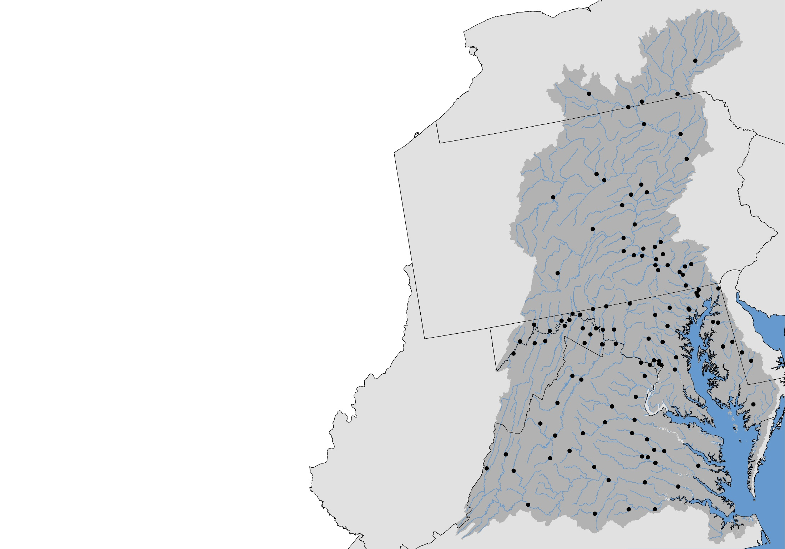
Nutrient and Sediment Results and Management Implications
Website Updated
https://cbrim.er.usgs.gov/index.html
Environmental Setting
Geologic properties are highly variable across the state and may enhance or retard the transport of nutrients and sediment to streams. These properties influence both loads and trends.
Where do we find high loading streams?
TN and TP:
Occur in agricultural and urban areas that receive the largest amount of nutrient inputs
Sed:
Occur in urban, Piedmont headwater streams and streams in agricultural regions from streambank and/or soil erosion and poorly connected floodplains
Effective management practices for reducing nutrients and sediment include:
Nitrogen
Practices that reduce input and prevent groundwater enrichment
Phosphorus
Practices that reduce input and sediment export
Sediment
Practices that reduce upland and streambank erosion and better connects stream with floodplain
Doug Moyer
804-261-2634
dlmoyer@usgs.gov
Jimmy Webber
804-261-2621
jwebber@usgs.gov

Slide 4
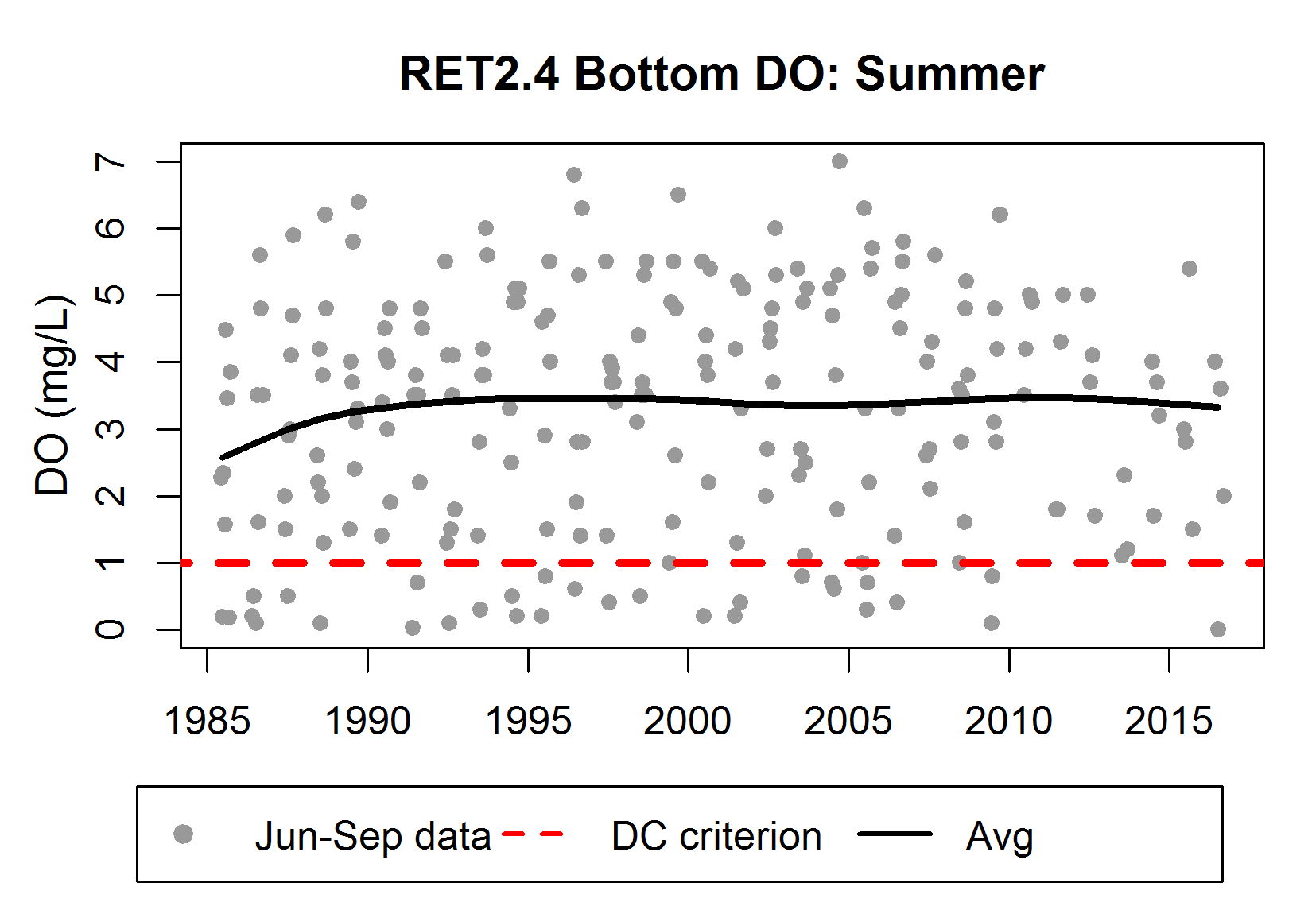
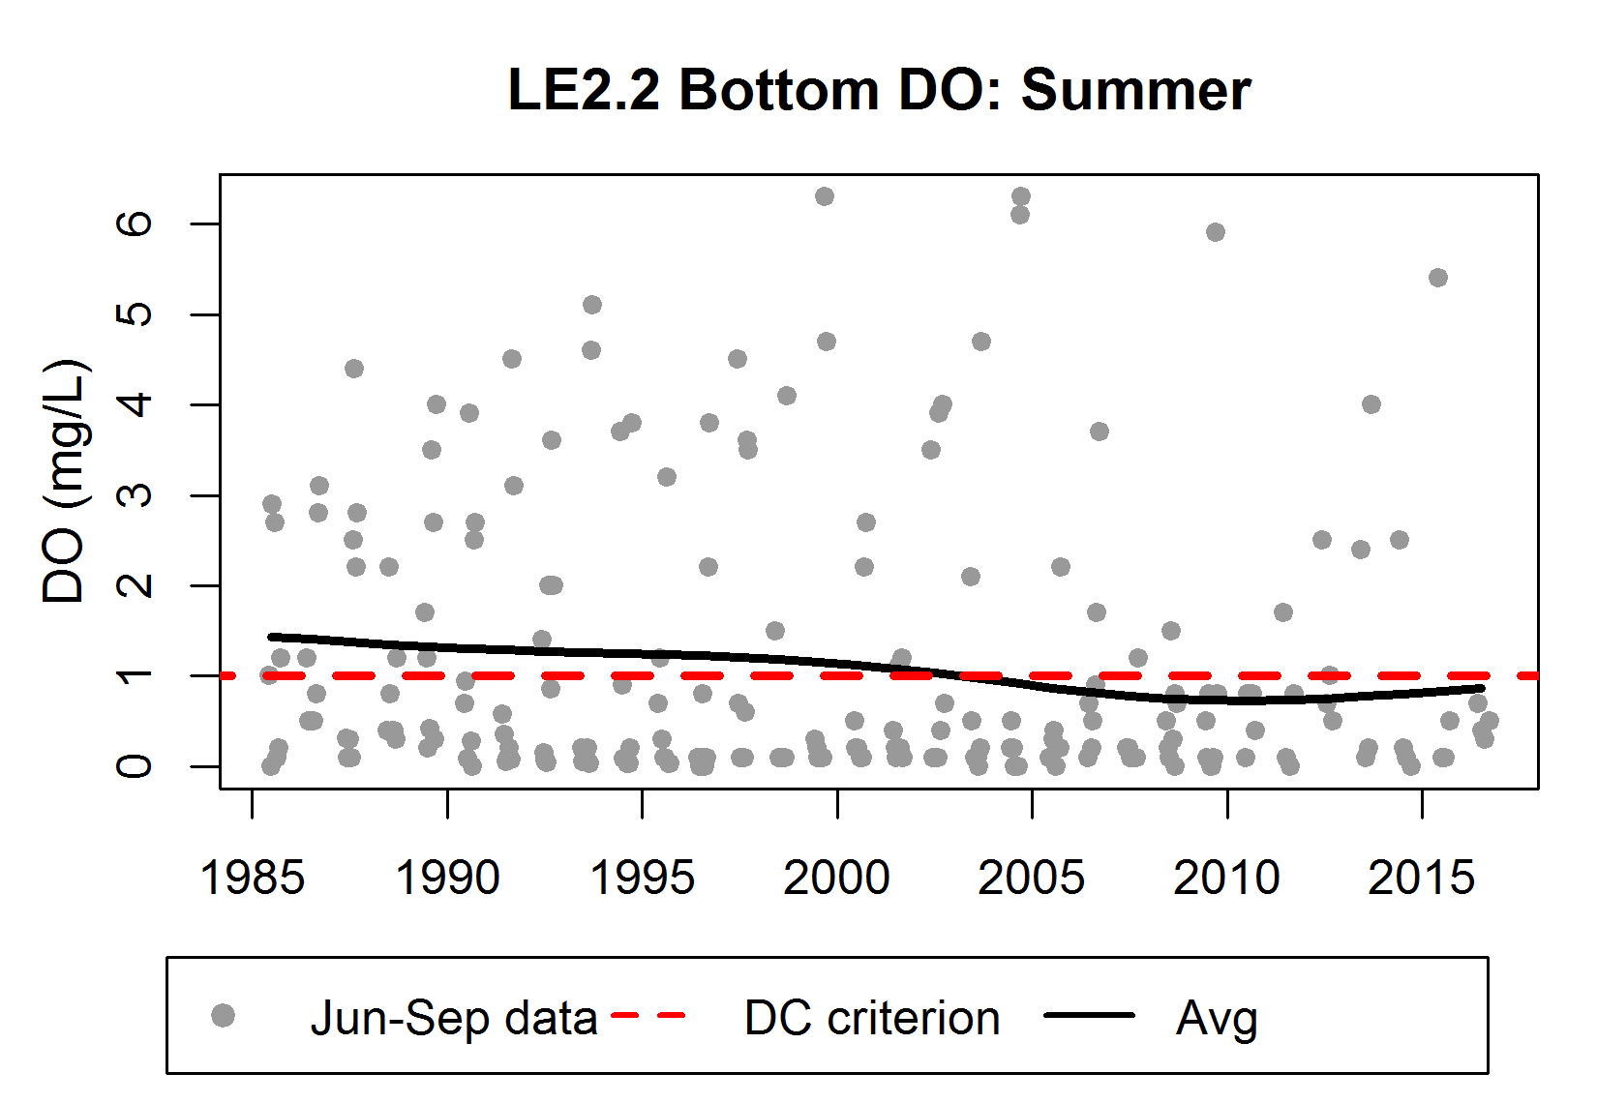
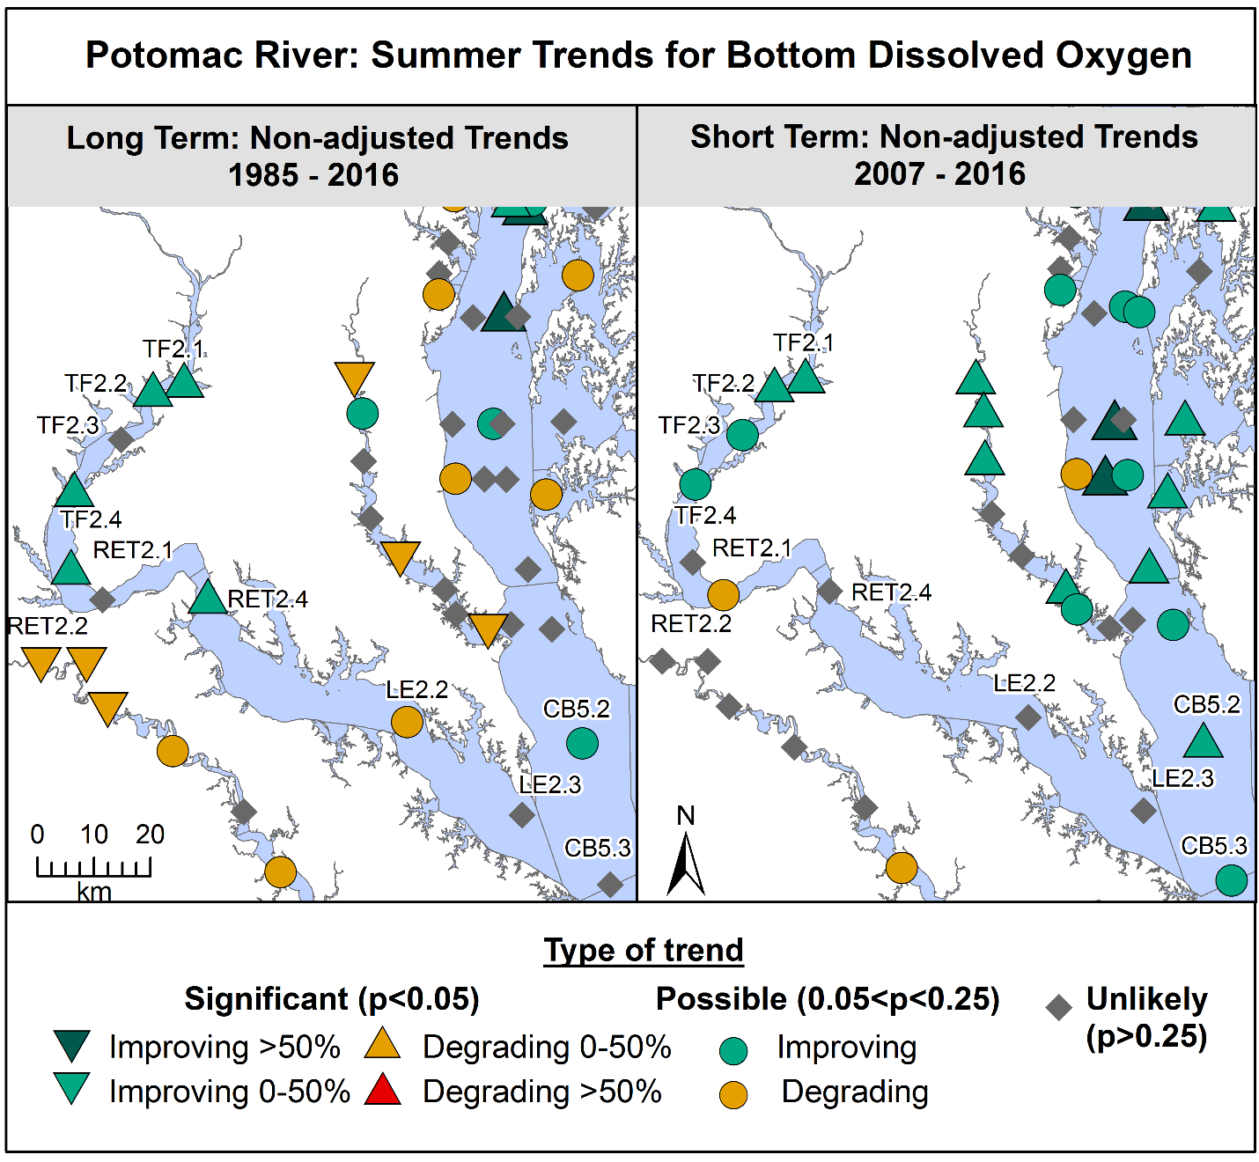
Estuary trends - Murphy
DO: improvements are there, but not big enough yet
Recent years RET2.4 has almost no bottom DO below 1mg/L
Very slight upswings at LE stations
(a bit less, but similar to mainstem stations)

Slide 5
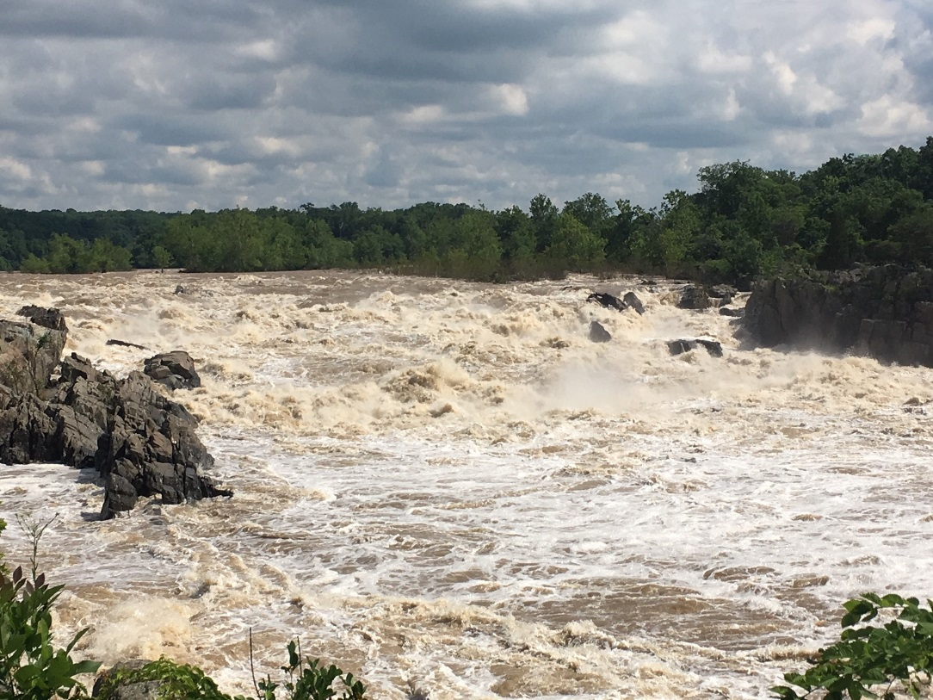
Estuary trends - Murphy
Summary
Nutrient reductions are clear in the Potomac and Anacostia, as major efforts in point source reductions have paid off.
There are some mixed water quality responses to date because of the complexities of an estuary.
To meet all the water quality criteria, nutrient reductions need to continue.
Photo from RMurphy
For more info, contact:
Rebecca Murphy, UMCES at CBP rmurphy@chesapeakebay.net
Jeni Keisman, USGS jkeisman@usgs.gov

Slide 6
Story Lines (Anacostia) - Trentacoste
Sources of nutrient & sediment pollution
Phase 6 Watershed Model,
http://cast.chesapeakebay.net
Stormwater from developed land is the largest source of both nutrients and sediment
Streambank erosion is the major contributor of sediment
Stream erosion is still tied to stormwater runoff

Slide 7
Story Lines (Loudoun County) - Trentacoste
Controlling stormwater is increasingly important as the county develops
Increases in stormwater loads have kept pace with decreases in wastewater and agriculture, so overall loads haven’t decreased as much
Converting forest to urban land will increase nutrient loads, whereas converting farmland to urban land tends to decrease nutrient loads
Phase 6 Watershed Model,
http://cast.chesapeakebay.net

Slide 8
Presentations available on COG web site at:
https://www.mwcog.org/events/2018/6/18/modeling-and-monitoring-workshop-urban-watershed-storylines/
Questions? Contact: Karl Berger kberger@mwcog.org
WRTC Meeting
July 12, 2018

