Slide 1
Social Impact Bonds
Using Performance and External Capital to Drive Investment in Social Outcomes
Metropolitan Washington Council of Governments
Joint Housing Directors (HDAC) and Homeless Services Committee Meeting
September 17, 2015

Slide 2



Today’s Focus
The Challenges
What is a Social Impact Bond (SIB)?
How it Works?
Where are SIBs?
What’s Next?
Questions

Slide 3
Challenges to Addressing Intractable Social Problems
Competing public budget priorities
Tighter public budgets
Difficult to pay for promising new ideas
Difficult to sustain progress

Slide 4

Complex Social Challenges: Recidivism

Slide 5

Complex Social Challenges: Poor School Performance

Slide 6

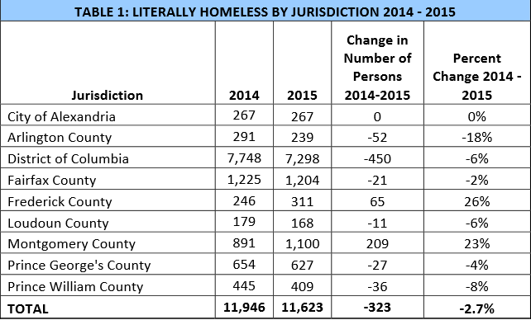
Complex Social Challenges: Homelessness

Slide 7
What is a Social Impact Bond?
Social Impact Bonds (“SIBs”) are a form of pay for success contract that combines government insight, non-profit expertise, private sector funding, and rigorous evaluation to provide preventive social programs and interventions.

Slide 8
How SIBs Work

Slide 9
A Closer Look
Population | Effective Intervention | Community Benefit | Government Savings
Chronically Homeless Individuals and Families | Permanent Supportive Housing | Decreased use of shelters, acute medical services , and corrections | Housing, Medicaid, Correctional facilities
Juvenile and Adult Offenders | Community Re-enrty Program | Decreased recidivism and increased public safety | Correctional facilities, probation and parole costs

Slide 10
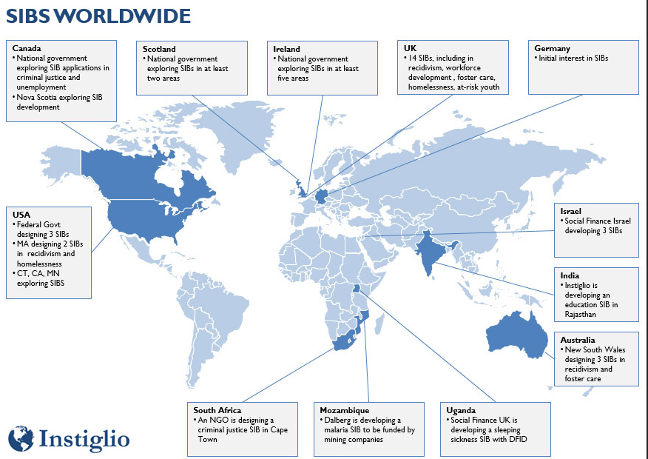
Where are SIBs?
https://orgs.law.harvard.edu/lids/files/2014/02/SIBs-Worldwide-Map.jpg

Slide 11
Offers a Solution to Improving Lives and Communities
Expand community impact by scaling evidence-based preventive programs
Launch broad ranging partnerships between government, community and private funders.
Encourage multi-year funding for successful projects with the opportunity to reinvest cost savings.

Slide 12
What’s Next?
1
Learn: MWCOG Hold Workshops and Panel Discussions
2
Explore: Jurisdictions Explore Feasibility of a Local or Regional Social Impact Bond
3
Act: Set-up and Launch Local or Regional Social Impact Bond

Slide 13
Contact
Renee M. Willis
Vice President for Field and Communications
National Low Income Housing Coalition
Email: rwillis@nlihc.org
Phone: 202.662.1530 x247
Mobile: 202.747.3500
Twitter: @McLeanWillis
Amanda Campbell
Environmental Planner III
Metropolitan Washington Council of Governments
Email: acampbell@mwcog.org
Phone: 202.962.3324

