Slide 1
Proposed work program and budget
Fiscal Year 2024
Clark Mercer COG Executive Director Julie Mussog COG Chief Financial Officer COG Board of Directors May 10, 2023
Agenda Item #10

Slide 2
FY 2024 Budget: Guiding Principles
Staff is presenting a standard, balanced budget, which will position COG to seize new opportunities after a period of belt-tightening during the past few years.
No new programs proposed - continued emphasis on integrated planning (transportation, housing, climate, and equity)
Historical increase in funding for TPB driving some use of undesignated funds
Renewed focus on work environment to ensure members have a dedicated and talented supporting staff team

Slide 3
FY 2024 Budget of $57.5 Million
Operating Funds $44.1 Million
Pass-Through Funds $ 13.2 Million
Other Funds $ .1 Million

Slide 4
Supporting Regional Priorities
COG’s budget supports the following programs:
Transportation Planning - $22.2 million
Transportation Operations - $12.3 million (operating & pass-through)
Water Resources - $4.9 million
Environmental Resources - $4.2 million (operating & pass-through)
Air Quality - $1.1 million
Homeland Security & Public Safety - $9.8 million (operating & pass-through)
Community Planning & Services - $1.7 million
Strategic Initiatives and Member Services - $1.4 million

Slide 5
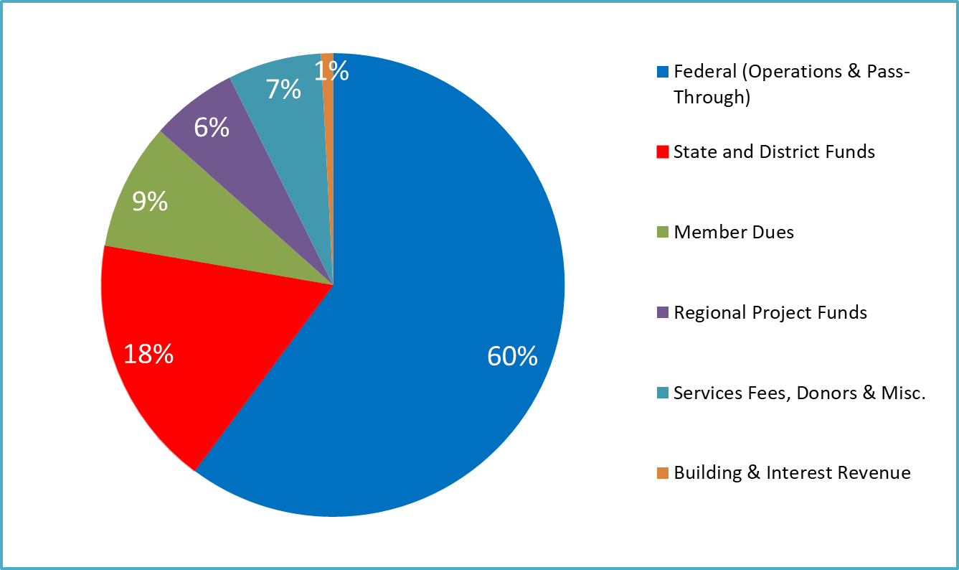
FY 2024 Revenue Sources

Slide 6
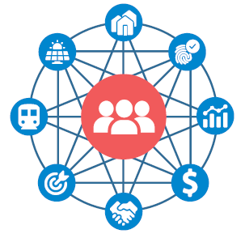
COG Member Benefits
Network: COG regularly connects area leaders
and subject matter experts across disciplines.
Programs: COG provides a wide range of
programs and services for its members,
partners, and residents.
  COG staffs the Transportation Planning
  Board (TPB), which helps ensure all major
  transportation projects receive federal
  funding and approvals.
Research and data: COG staff provide members with data and tools to inform decision-making.
Cooperative purchasing: COG members save money and time through regional bulk purchasing, contracting opportunities.

Slide 7
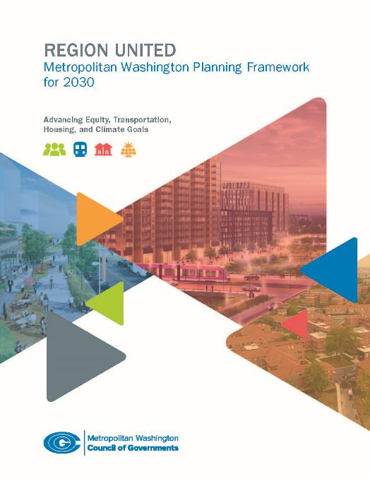
Highlights of FY 2024 Work Program
Region United: Boost members’ efforts to accelerate action on equity, transportation, housing, and climate change goals.
Federal Funding: Help members pursue new opportunities available through Infrastructure Investment and Jobs Act, Inflation Reduction Act, and additional assistance.
Economy: Provide analysis of the long-term impacts of COVID and remote work on the economy, office space, and transit.
WMATA: Support regional efforts to better define service expectations and identify sustainable funding.

Slide 8
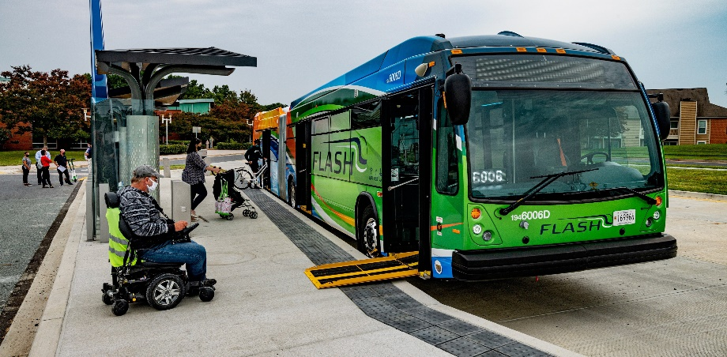
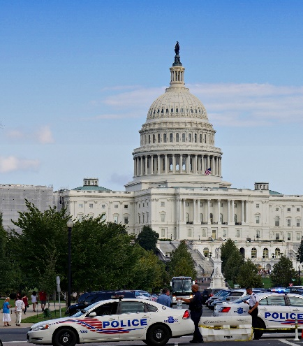
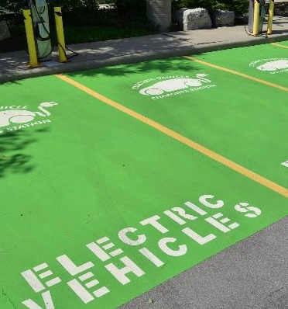
Highlights of FY 2024 Work Program
Visualize 2050: Develop next long-range transportation plan for the region.
Enhanced Mobility: Selection of projects receiving federal funding for older adults, person with disabilities.
Public Safety: Management of cross-jurisdictional info sharing projects.
Electric Vehicles: Support work group planning a consistent regional network.
Air Quality: Affirmation to EPA that the region meets the 2015 ozone standard and can maintain its progress.

Slide 9
Highlights of FY 2024 Work Program
Member Dues Rate Increase of $0.02 from FY 2023 rate
(decided October 2022)
Operating Revenue Increase of $3.1 million or 7.5% over FY 2023 Work Program
  Additional Funding for Existing Programs ($2.5 million - Transportation)
Sub-recipient Pass-Through Increase of $0.2 million or 1% over FY 2023 Work Program
  Anticipating another $2.7 million Amtrak engine re-power project
Reserves Fully Funded

Slide 10
Board-Designated Reserves
Forecast for the fiscal year ending June 30, 2024:
Operating Reserve funded at $5.2 million or 100% of policy target.
Capital Expenditure Reserve will have a balance of $4.8 million, available for leasehold improvements, IT maintenance and upgrades, and office equipment. The 5-Year rolling Capital Expenditure Plan for FY2024 – FY2028 will be presented to the board for consideration at the September 2023 meeting.

Slide 11
Budget Approval Process
October: Board of Directors approves the annual assessment of Member Dues and Regional Fees to be used in developing the Work Program and Budget.
April: Budget and Finance Committee reviews draft Work Program and Budget prepared by Management and recommends approval or modifications.
May: Board of Directors approves or modifies the proposed Work Program and Budget.
July: Work Program and Budget is implemented at the start of the new fiscal year.

Slide 12
Julie Mussog COG Chief Financial Officer (202) 962-3362 jmussog@mwcog.org | mwcog.org
777 North Capitol Street NE, Suite 300 Washington, DC 20002

