Slide 1
REGIONAL TREE CANOPY COMMITTEE
August 2021 Update
Michael Knapp – DPS Urban Forester, Montgomery County MD
Brian M. LeCouteur – Principal Planner / Urban Forester - MWCOG

Slide 2
Regional Tree Canopy Subcommittee
January 2019 - CEEPC Resolution to Broad to form a regional tree committee
February 2019 – Wash COG board endorses establishment of RTCS. Charged with creating policies and recommendations to encourage COG communities to:
  Protect, manage, and expand tree and forest resources
  Strengthen local urban forestry programs
  Inspire the community to take ownership of tree conservation efforts
  Integrating urban forestry into local and regional planning processes
  Monitor the long-term effectiveness of regional tree conservation efforts and programs

Slide 3
Regional Tree Canopy Subcommittee
COG invited 14 participants from various COG Member jurisdictions, plus two NGOs, and COG Staff (17 total)
Original two-year work plan based on recommendations of the 2018 Regional Tree Canopy Management Strategy Report
Deliverables based on what could be accomplished within a two-year timeframe
Kick-off Meeting on June 14, 2019

Slide 4
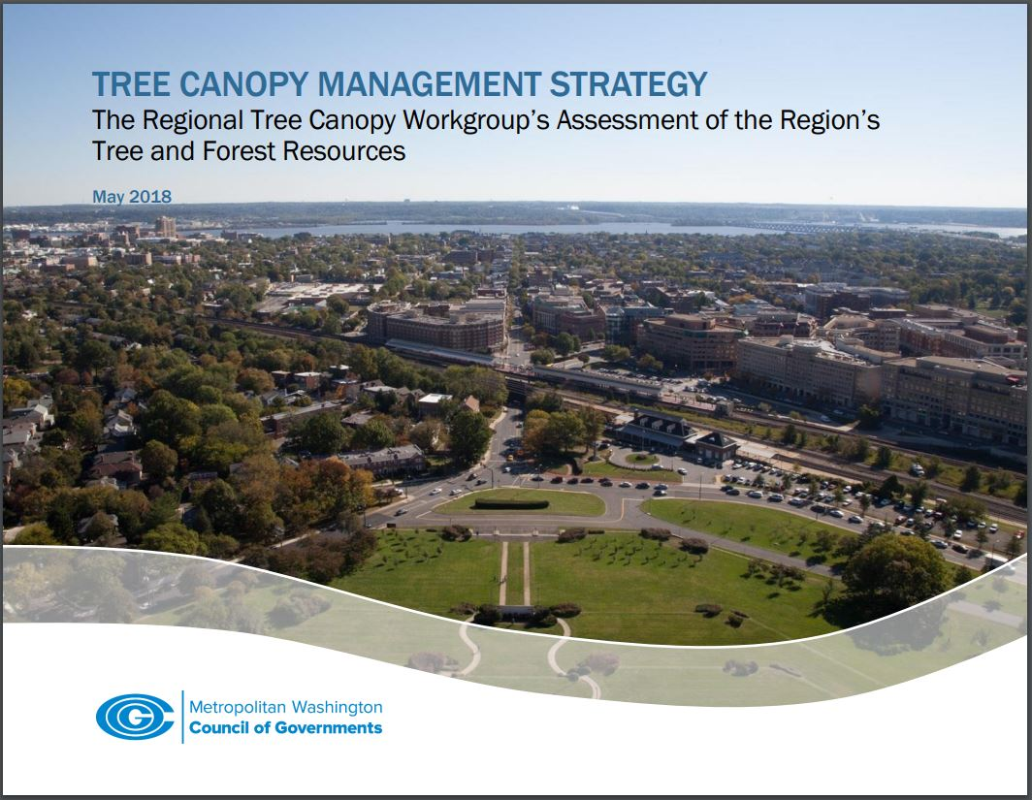
Tree Canopy Management Strategy Report
https://www.mwcog.org/documents/tree-canopy-management-strategy/

Slide 5
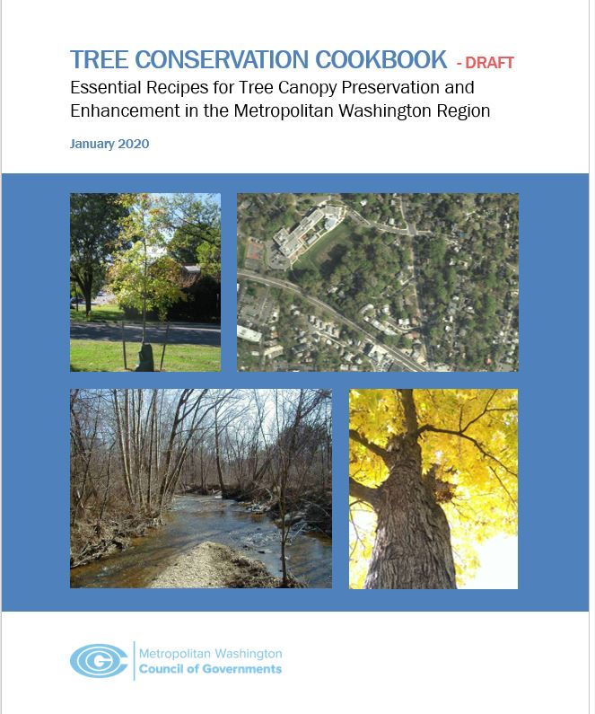
Tree Conservation Cookbook
The Tree Canopy Management Strategy Report included a recommendation to “Examine local tree-related policies and ordinances for opportunities to enhance and strengthen tree preservation and maintenance policies.”
In response, RTCS developed the Tree Conservation Cookbook which provides examples of regulatory and technical language that jurisdictions can consult when strengthening local regulations, policies, and programs.

Slide 6
Tree Conservation Cookbook
Document mimics a cookbook - with contents separated into two categories:
17 Essential Recipes represent “must have” ordinance/policy features
7 Side Dishes represent features that localities may find useful to address specific conditions or concerns

Slide 7
Current RTCS Project
Tree Canopy Goals and Metrics for the Metropolitan Washington Region
  Historic and current tree canopy levels
  Tree canopy targets for land uses
  Tree canopy goals based on human population densities
  A Regional Tree Canopy Goal
  Metrics to evaluate success
  Goals presented as “living” with need to re-evaluate
  2013-14 land cover using NAIP 1-meter imagery

Slide 8
TC targets for land uses (DRAFT!)
Land Use | Examples and notes to consider | Canopy target
Residential, Low | Detached homes, either single-family or duplex. Often the home of most of a jurisdiction's canopy | 60%
Residential, Medium | Attached homes, such as townhomes or single/double story multi-family buildings | 40%
Residential, High | High rise condominiums and apartment buildings | 25%
Commercial, Low | Single or double-story buildings, sometimes with parking lots | 40%
Commercial, Medium | Multi-story buildings, with parking lots or small parking garages | 25%
Commercial, High | High rise commercial. | 20%
Mixed Use | Commercial mixed with residential or other compatible uses | 25%
Industrial, extractive and railway | Manufacturing, quarries/asphalt/concrete plants, railways, and their immediate rights-of-way | 20%
Park, low development | Natural parks with trails, and minimal constructed facilities (nature centers, bathrooms) and arboreta | 80%
Park, Medium development | Passive recreation (cemeteries, gardens, and golf courses) | 40%
Park, High development | Sports fields, paved plazas, heavy traffic urban parks with high density of buildings | 30%
Local Roads | Leading to residential or connecting small residential roads, low speeds | 20%
Arterials | Transportation within a local community, medium speeds | 15%
Freeways and highways | Transportation through communities and states, high speeds | 15%
Airports | Consider buffer tree areas and areas around departure/arrival zones | 10%
Agricultural | Consider stream buffers and road buffers | 25%
Notes: Tree canopy targets assume mature tree canopy levels, and includes coverage of individual and blocks of trees over impervious and pervious surfaces, including ground and rooftop locations
Tree canopy dependent on planting the right tree species for the location - the right tree in the right place - to account for local conditions
Recommended canopy areas include active development areas and associated buffer zones
Disclaimer: These land use categories are not based on zoning types. Local jurisdictions can use their understanding of the community to assign these categories to their zoning categories.

Slide 9
TC goals for population densities (DRAFT!)
Category of Population Density | TC % 2013 | Minimum TC % Recommendation | Tree Canopy Goal Recommendation | Notes
City
Densely Urban City >3,000 / km² | 33.5% | 35% | 40%
Urban/Suburban City >1,500 to 2,999/ km² | 39.2% | 40% | 45%
Suburban City <1,500 / km² | 53.8% | 45% | 55%
County
Densely Urban County > 2,000 / km² | 40.2% | 35 % | 45%
Urban County 1,000 to 2,000 / km² | 56.7% | 45 % | 55%
Urban/Suburban County 300 to 1,000/ km² | 53.3% | 55 % (w/high % AG 5o%) | 60% w/high % AG 55%)
Suburban/Exurban County < 299/ km² | 54.9% | 55% (w/high % AG 5o%) | 65% (w/high % AG 55%)

Slide 10
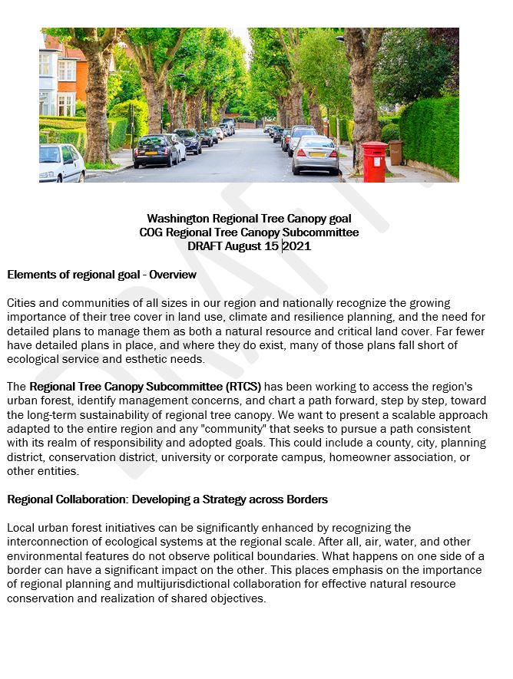
Regional Goal and Metrics

Slide 11
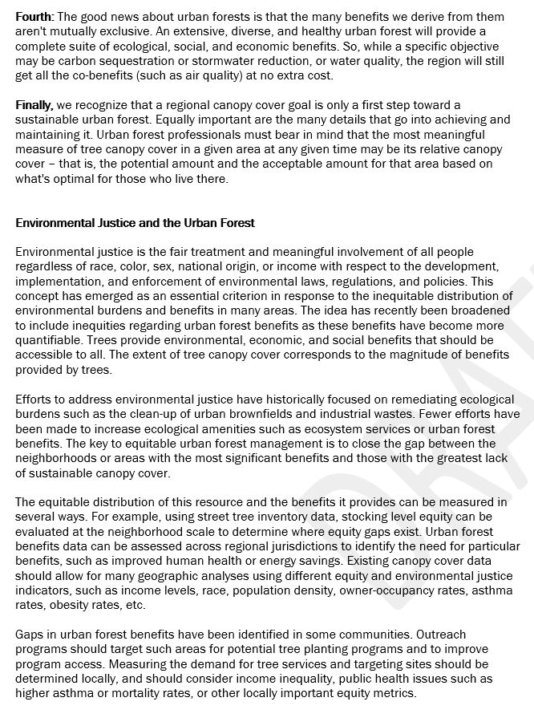
Regional Goal and Metrics

Slide 12
Metrics for the Metro Washington Region
  Percentage of tree canopy/landmass not an end-all-to-be-all
  Qualitative metrics are needed
  Forest health
  Biodiversity
  Income equity
  Levels of environmental, socio-economic services
    Air quality
    Energy conservation in homes
    Ambient air temps
    Carbon sequestration/storage
Regional Goal and Metrics

Slide 13
Upcoming Projects
Report on strategic tree planting programs for local governments
Report identifying practices localities can use to mitigate potential impacts of major storm events on urban trees

Slide 14
Mike Knapp Tree Canopy Management Subcommittee Chair Montgomery County DPS (240) 777-6335 Michael.knapp@montgomerycountymd.gov Brian LeCouteur Principal Environmental Planner Urban Forester / Agricultural Programs Manager (202) 962-3393 blecouteur@mwcog.org | mwcog.org
777 North Capitol Street NE, Suite 300 Washington, DC 20002

