Slide 1

ALEXANDRIA RENEW ENTERPRISES
Our Workforce of the Future
MWCOG | HSPSPC
June 19, 2015
Karen Pallansch
Chief Executive Officer

Slide 2
88,000 job openings in trade, transportation, and utilities
USA Today, June 10, 2015

Slide 3
Introduction
Middle Skill Jobs Are An Economic Driver
Notes:
There is a new term to describe the kinds of jobs the previous slide mentioned – the jobs we need filled in our region, and it’s called “middle skill jobs.” This term, which has been used in the media and if you google it, it’s the hot new term for jobs that require training but less school than a bachelor's degree – they are the kind of jobs we need in this region and are an economic driver for us. They currently make up the largest segment of jobs in the U.S. economy, according to a study done by the State of California. And they are the jobs that are the oil in our infrastructure machine – they help our infrastructure run.

Slide 4
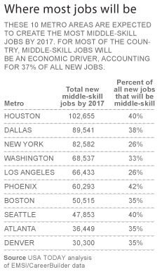

DC Metro #4 in Middle Skill Job Growth
Notes:
The Washington DC metro area is expected to create almost 83,000 middle skill jobs by 2017. Note that the USA Today story notes that these jobs are an economic driver.

Slide 5
Our Challenges
Region needs 33% more middle skill workers
  Occupations require skilled trade and technical workers
  Examples of Middle skill jobs:
    Electrician
    Construction
    Plumber
    Mechanic
    Repairmen/installers
    Machinists
    Operating engineers
    Masons
    Landscaping
    Maintenance

Slide 6
Our Challenges
"These are not minimum-wage jobs. There are so many good jobs. But people don't know how to get to them."
    --Vice President Joseph Biden

Slide 7
Our Challenges
Baby Boomers
  Retiring in droves
  20 percent of current workforce
  Water sector losing up to 50% of workforce by 2020
Notes:
Can we make this three slides with one point on each slide?

Slide 8
Our Challenges
How do we “get” workers to jobs?
  Need training, licensing/certification programs
  Provided by:
    Community colleges
    Apprenticeship programs
    Nonprofit training organizations
    Private career schools
  Plus a regional awareness campaign

Slide 9

1
SUSTAINABLE REGION 2050
PROPSERITY
SUSTAINABILITY
ACCESSABILITY
LIVABILITY
21st Century Skills and Traits

Slide 10
Who Needs Middle Skill Workers?
Water (Drinking water, wastewater, stormwater)
Transportation
Energy
Government buildings
Schools
  …any entity in the COG Infrastructure Report!
Notes:
Could add things like schools

Slide 11
What Skills Are Needed and Shared Across Industries?

Slide 12
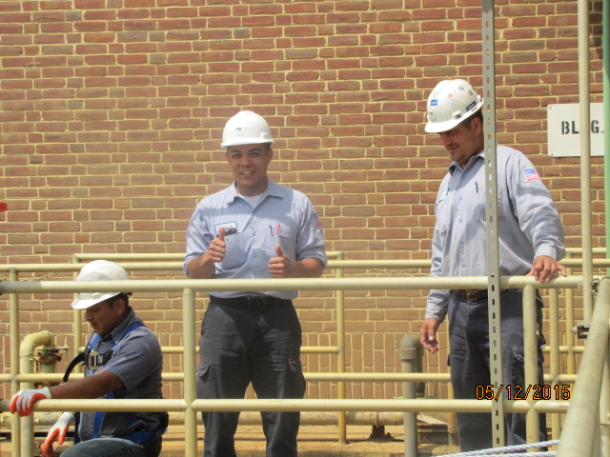
Today’s Water Core Skill Set
Tools
Ethics
Basic electricity
Water treatment basics
Landscaping
Maintenance
Mechanical basics
Plumbing basics
SCADA/Computer
Communications
Customer service
Instrumentation/controls
Project management
Basic budgeting
Public Service basics

Slide 13

2020 Traits
Problem Solving
Judgement
Social intelligence
Novel and adaptive thinking
Cross cultural competency
Computational thinking
New media literacy
Transdisciplinary
Design mindset
Cognitive load management
Virtual collaboration
                Source: Top10OnlineColleges.org
Notes:
What is sense making? Include problem solving, judgement, maybe we should not label this skills but rather needed abilities or better word would be traits because you can be taught them.

Slide 14
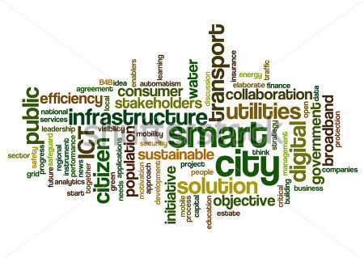
Middle Skills + Traits of 2020 = Earning $$$ in DC Metro Region!

Slide 15
Why Work for Infrastructure?

Slide 16
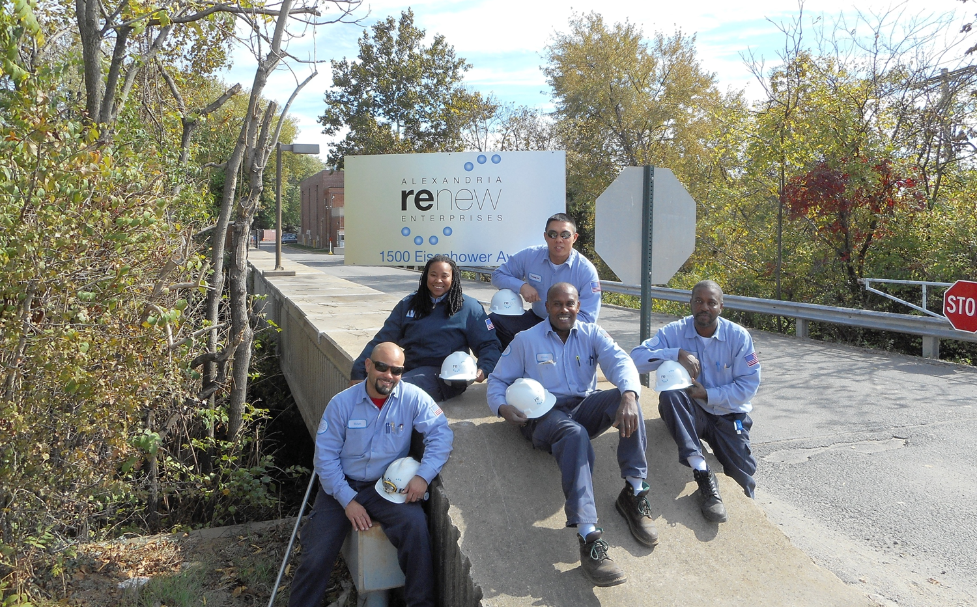
Our Apprentices Say …

Slide 17
Our Apprentices Say …
Stability
Benefits
Science
Protecting Environment
Career Growth
Opportunities to Learn

Slide 18
How to Best Recruit?
Provide and show all career paths
Market jobs to millennials
  Importance
  Teamwork
  Environmentalism
  Making a difference

Slide 19
How to Best Recruit?
Robust training and development
  Functional job
  Any job (basic science, math, ethics)
Develop early knowledgeable awareness of these job opportunities
  In middle and high school

Slide 20
How Do We Train?
Water Examples

Slide 21
Apprentice Program - Water
AlexRenew
  Combination of academics and on the job training
  Waste water systems technician, waste water mechanic, or control systems technician
  Hiring six new apprentices this summer
Notes:
Split WEF to another slide as industry total

Slide 22
Apprentice Program - Water
WEF Wastewater Operator
  Standards developed with DOL
  Six pillars (operations, maintenance, logistics, etc.)
  3520 one the job hours; 480 instruction hours
Notes:
Split WEF to another slide as industry total

Slide 23
Shared Training Programs - Water
South Carolina Environmental Training Center
  State designated training center for SC water and wastewater operators
  Education and on the job training
  Eight companies and utilities participate
  PathWAY program to educate high school students
Notes:
Split these as well

Slide 24
Shared Training Programs - Water
Maryland Center for Environmental Training
  Professional environmental, health, and safety training
  For agencies, businesses, and organizations in region
  Funded by grants, contracts, student tuition
  Provides training at designated sites
  Hundreds of classes; also can develop custom publications and videos
Notes:
Split these as well

Slide 25
Stormwater Opportunities
Prince George’s P3 Stormwater Project
  30 year full life cycle partnership (stable jobs)
  Commitment to using local, small, minority owned businesses doing 30-40% of work
DC Water
  Expanding into Green Infrastructure
  Will require a variety of skillsets to implement and maintain

Slide 26
Regional Solutions
What could a regional solution look like?

Slide 27
Regional Training
Identify regional employment needs
Identify cross cutting skill/trait sets
Identify training partners
  High schools
  Vocational programs
  Community colleges
  Universities
Notes:
Split these as well

Slide 28
Regional Training
Develop recruitment plan
Develop business plan
  Costs, allocation
  Management
  Oversight
Three-year study period

Slide 29
Questions?
Thanks for the opportunity to share ideas for our mutual success

