Slide 1
Health in All Policies
A Vision for the Future
Human Services and Public Safety Policy Committee Metropolitan Washington Council of Governments
November 20, 2015
Washington, DC
Steven H. Woolf, MD, MPH
Center on Society and Health
Virginia Commonwealth University

Slide 2
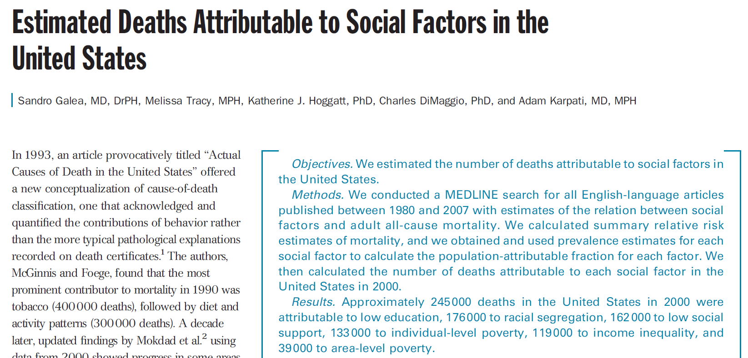


Slide 3
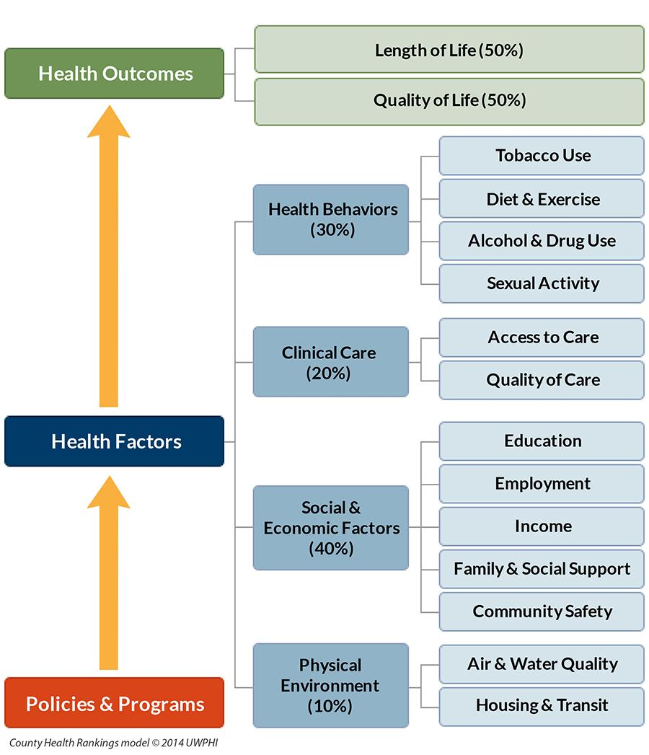


Slide 4
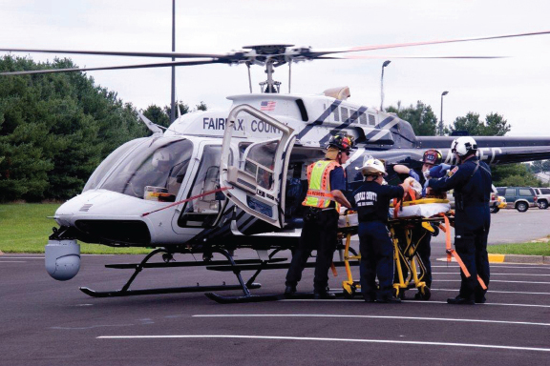

Slide 5

Beyond the Clinical Setting

Slide 6
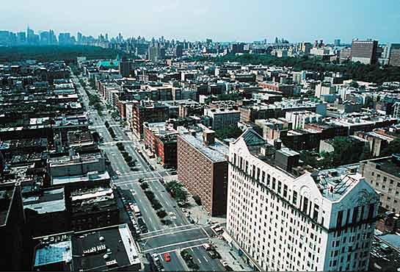

Slide 7
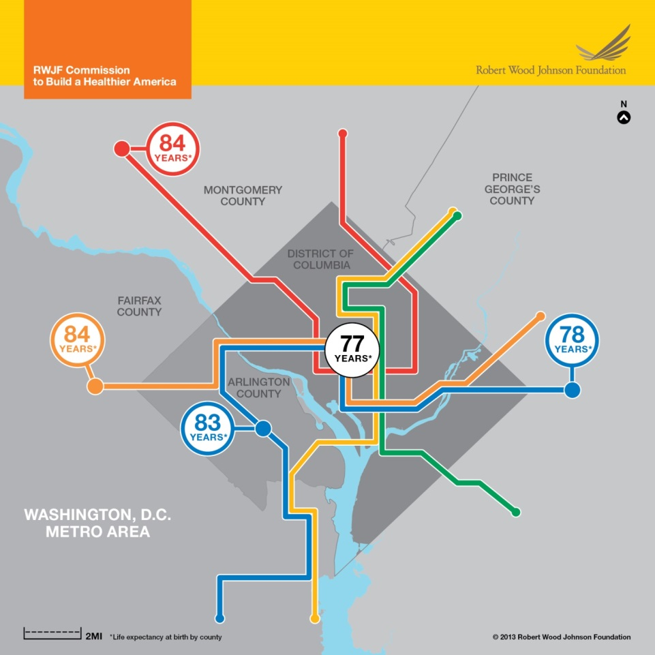
2013 “Metro” Map

Slide 8
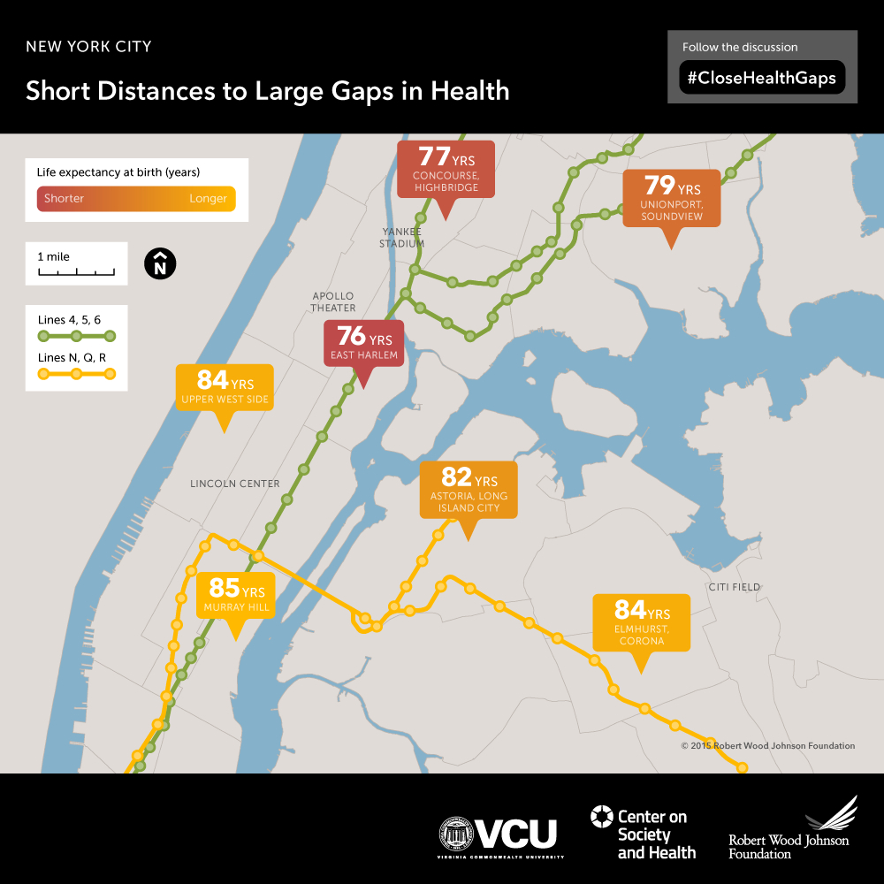

Slide 9
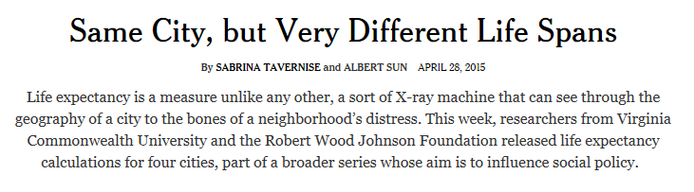
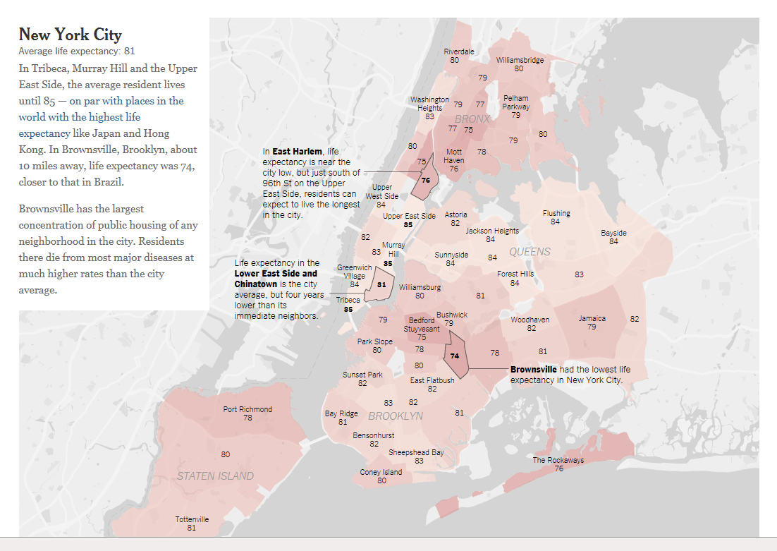

Slide 10
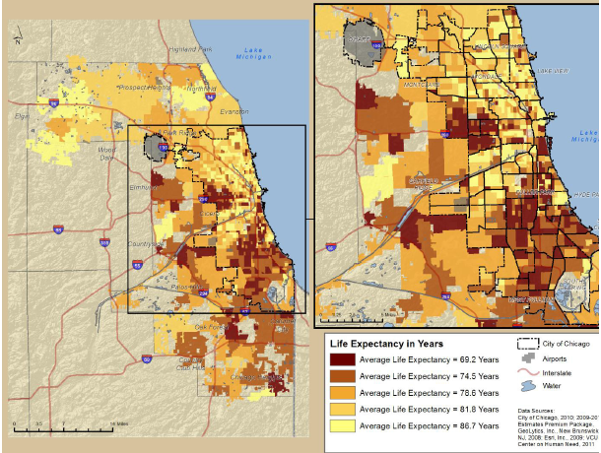
Mapping health outcomes

Slide 11
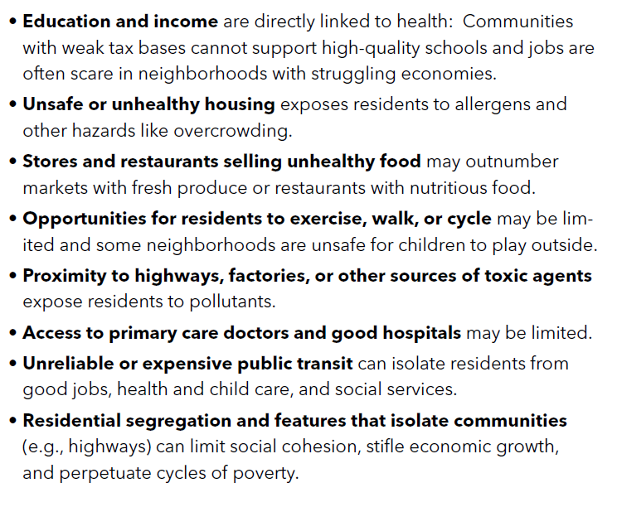
Why the Differences?

Slide 12
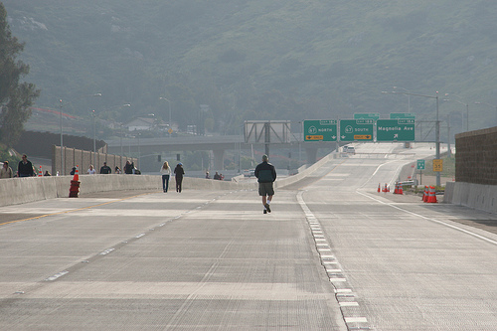

The Built Environment

Slide 13
“Health in All” Policies
Transportation
Land use
Built environment
Taxes
Housing
Agriculture
Environmental justice
Etc.
Health and illness

Slide 14

The Silo Problem of
“Health in All Policies”

Slide 15
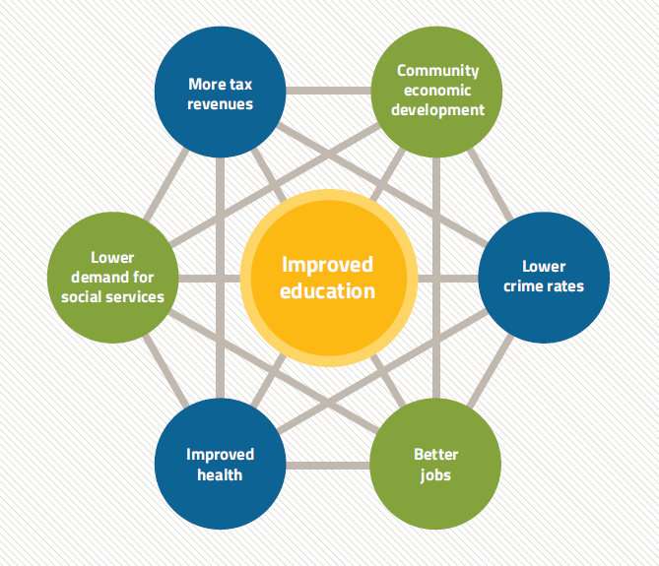
The Return on Investment

Slide 16
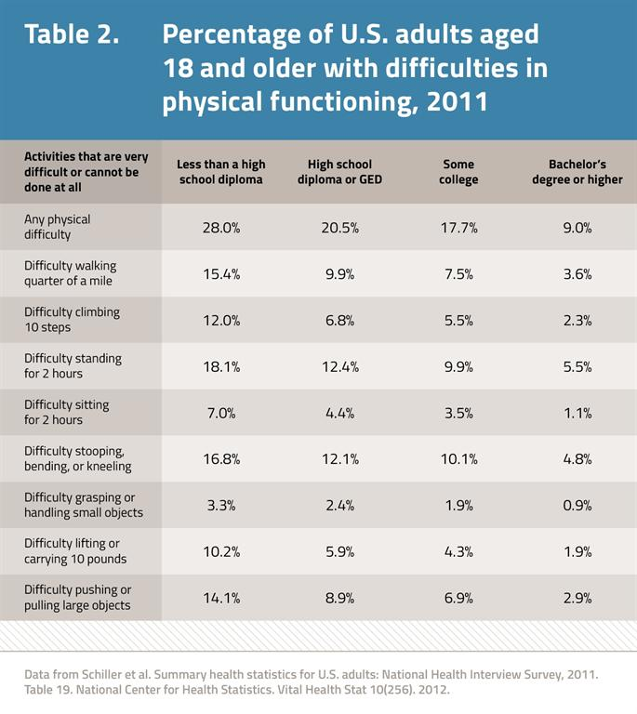
An Employer Perspective
Educated and skilled workforce
Health care costs
Absenteeism
Presenteeism
Decreased workforce productivity

Slide 17
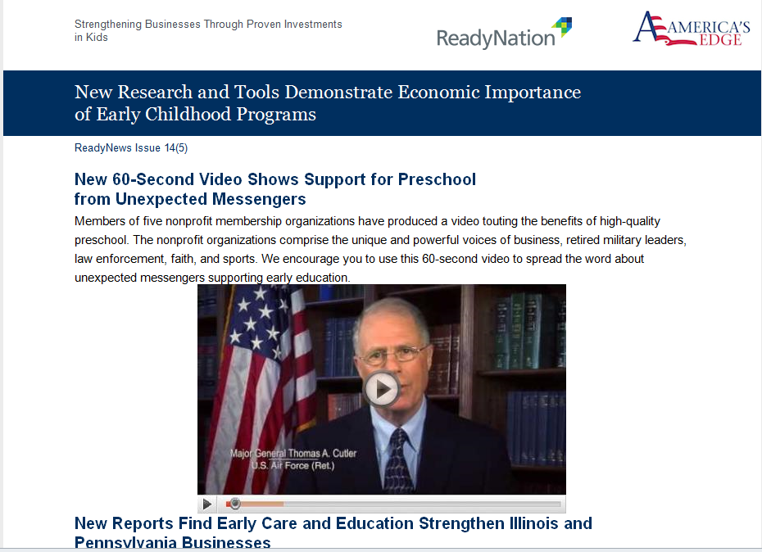


Slide 18

An Investor Perspective

Slide 19
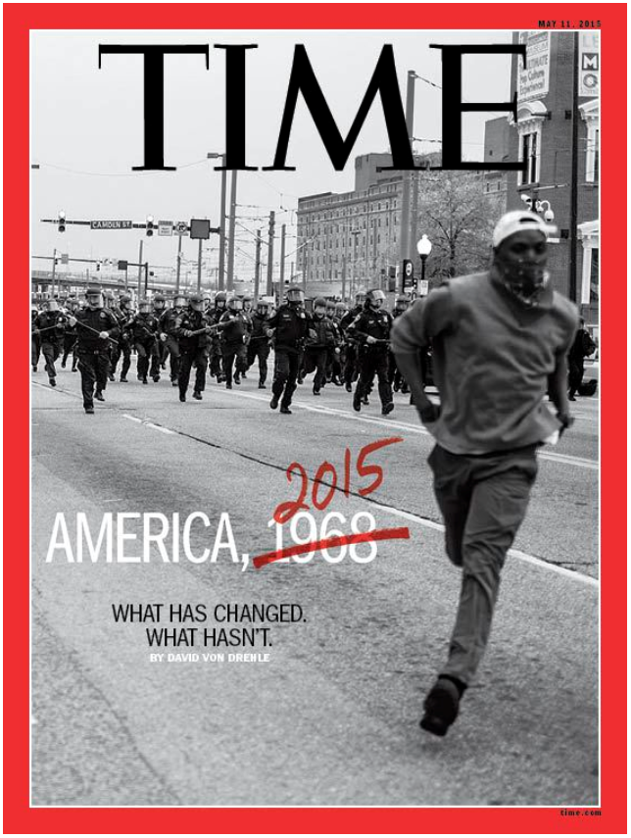

Slide 20
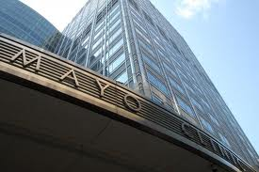
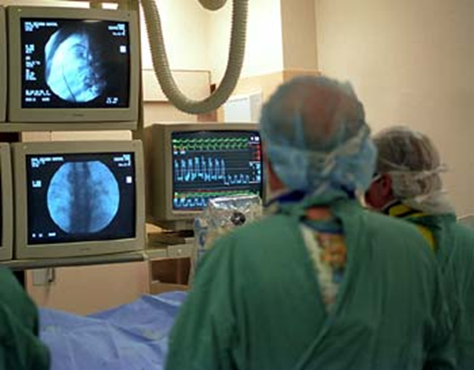


Slide 21
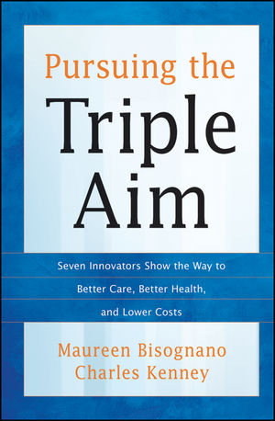
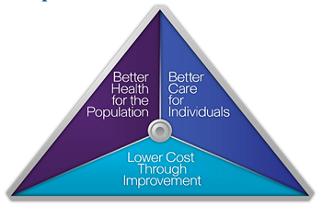

Slide 22
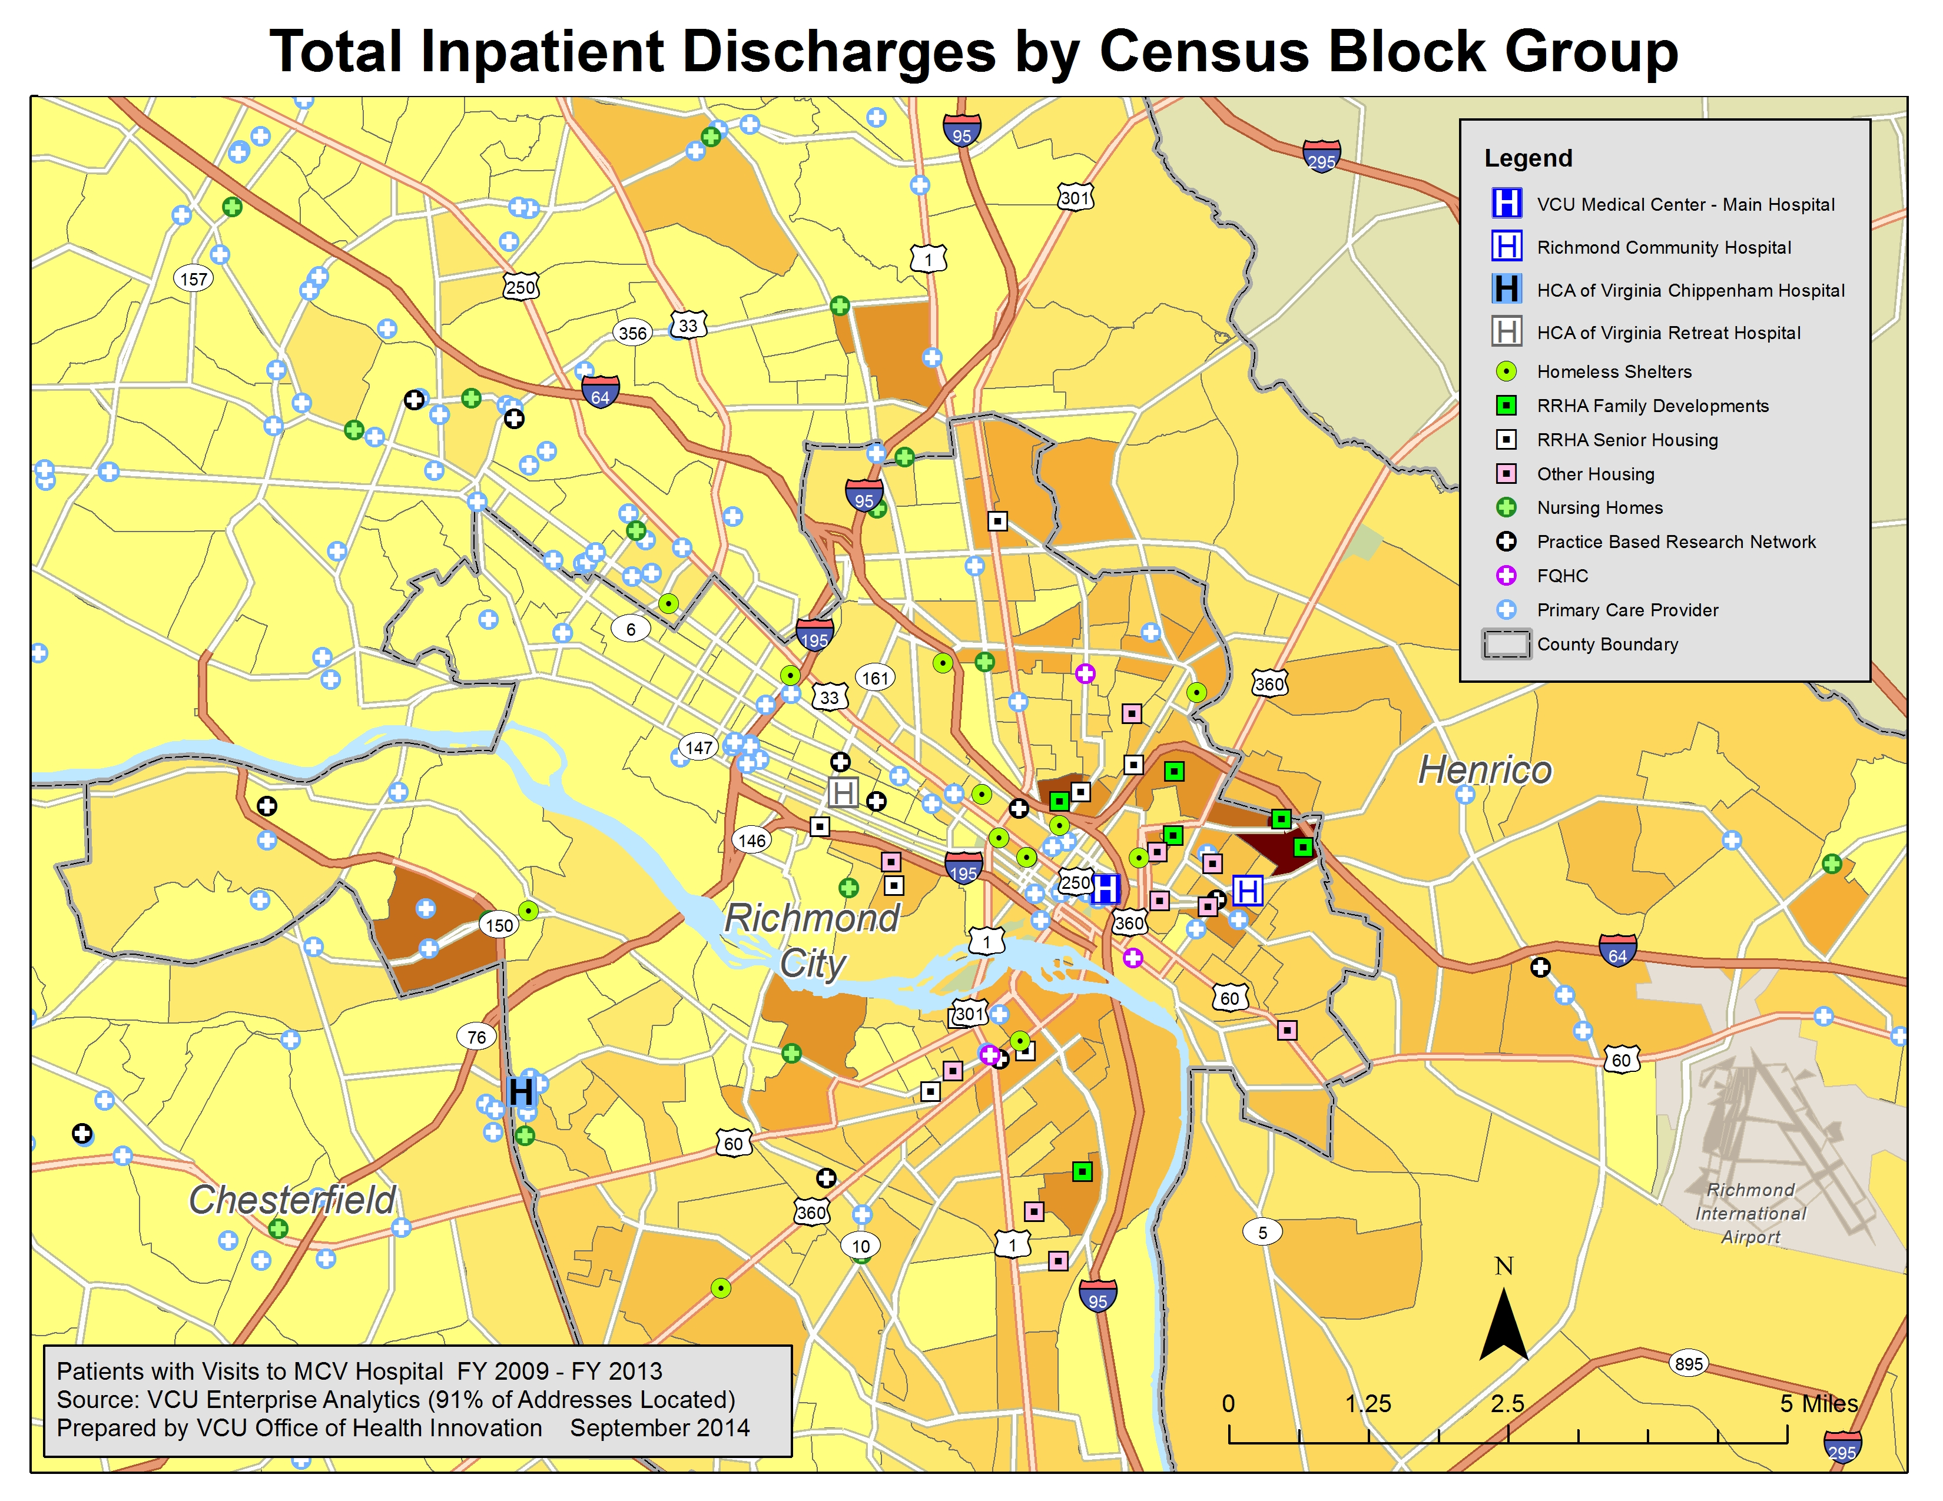

Slide 23
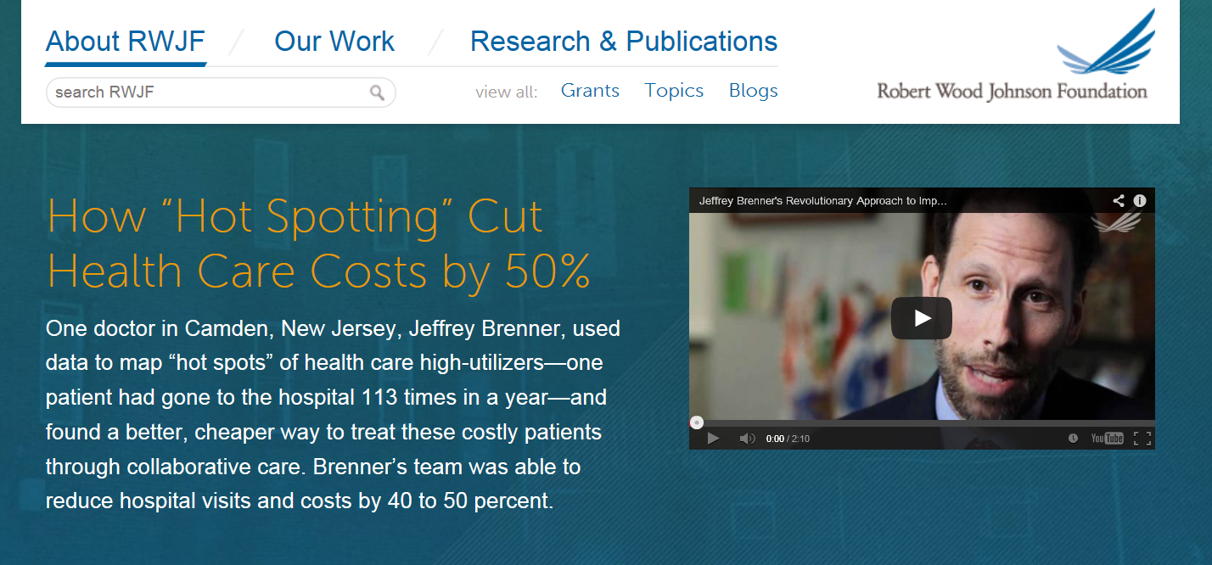

Slide 24
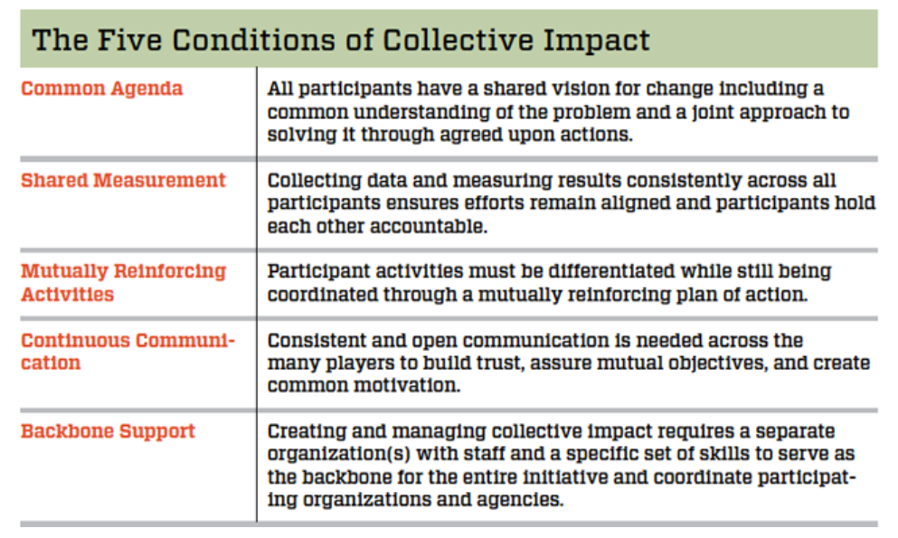
Collective Impact
Kania and Kramer, Stanford Social Innovation Review, Jan 21, 2013

Slide 25


Slide 26
“Live Well San Diego”

Slide 27
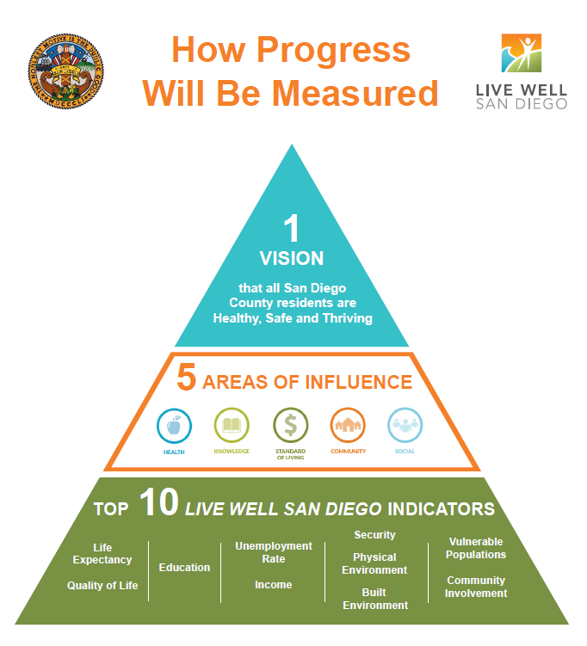

Slide 28
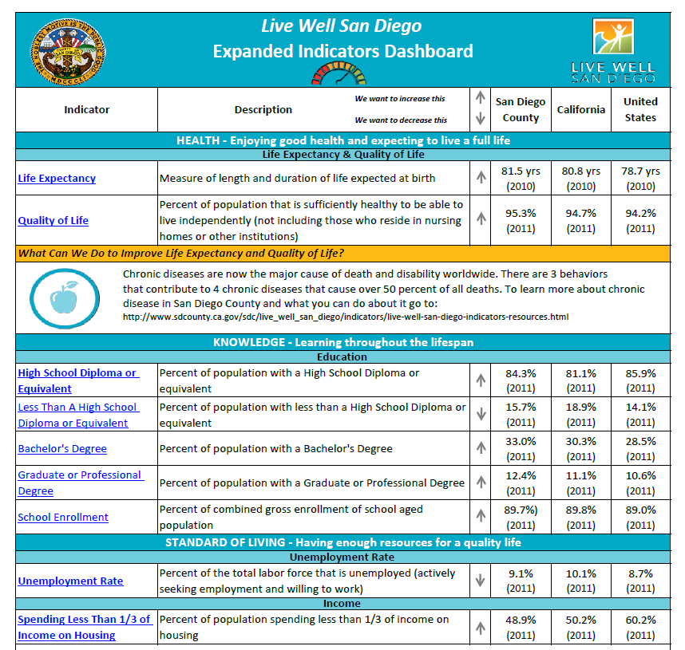

Slide 29


Slide 30
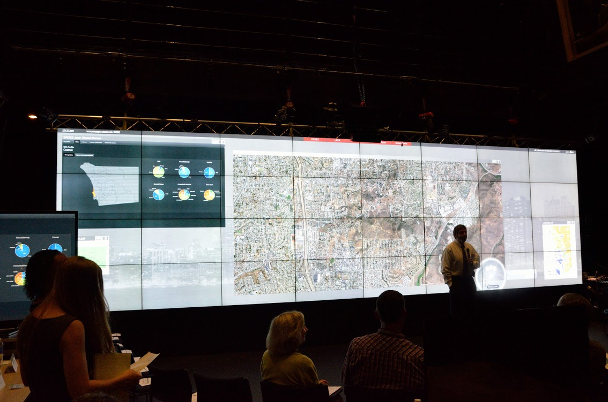

Slide 31
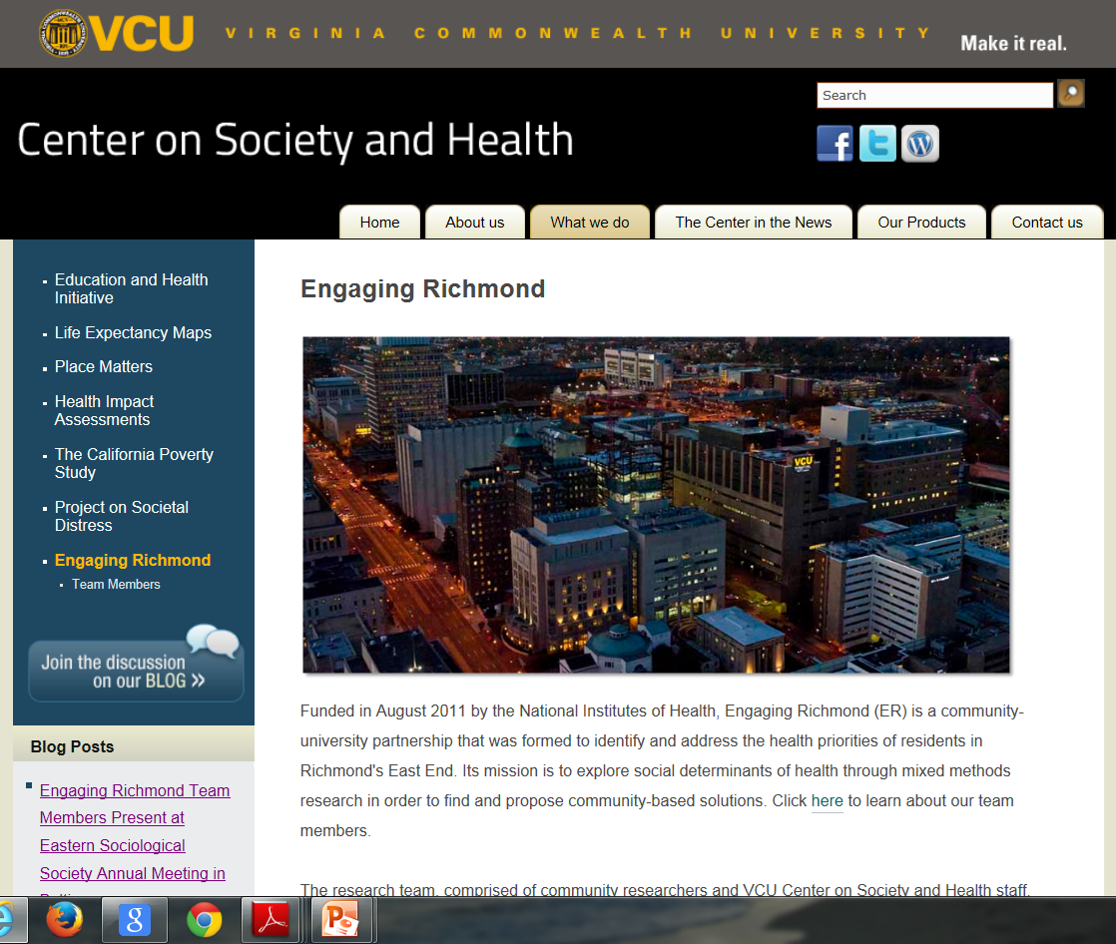
Contact Information
Steven H. Woolf, MD, MPH
Center on Society and Health
Department of Family Medicine and Population Health
Virginia Commonwealth University
804-828-9625
swoolf@vcu.edu
www.societyhealth.vcu.edu

