Slide 1
TDM Marketing Activities Update
Item #5
Ben Boxer
Marketing and Communication Section Chief
Fairfax County Department of Transportation
September 16, 2025

Slide 2
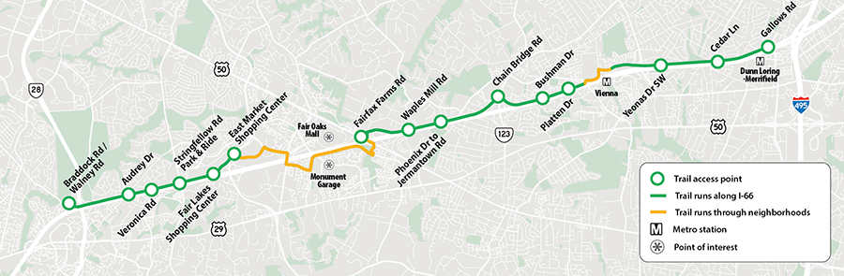
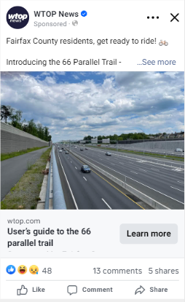

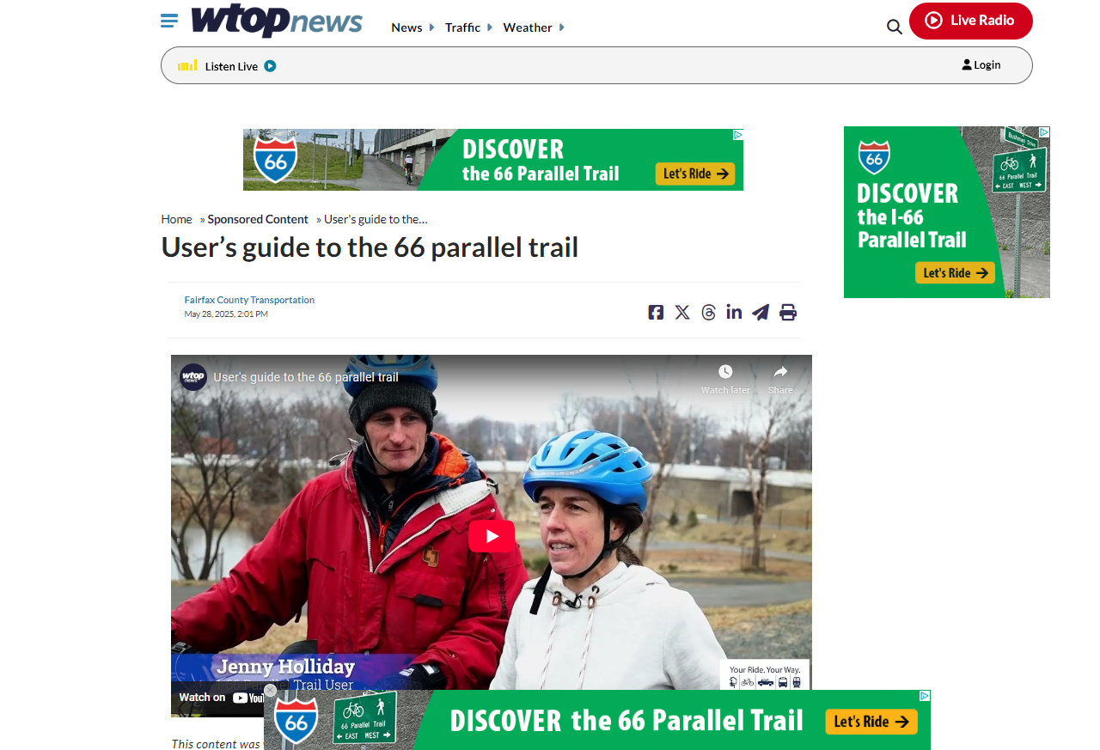
I-66 Parallel Trail
22.5 miles from the Route 28/I-66 Interchange in
Centreville to Gallows Road (Dunn Loring Metro)
Initial awareness campaign drew strong attention;
we expended reach and message with more in-depth
information regarding points of access, navigation, and rider experience
Meta (Facebook) ads drove the most traffic, with 7,225 clicks and a very high CTR of 13.85% — well above industry averages, showing strong audience interest in the content

Slide 3
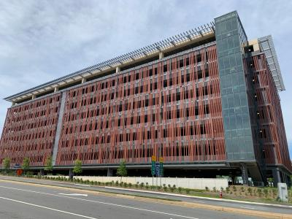
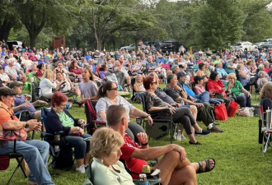
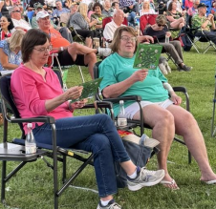
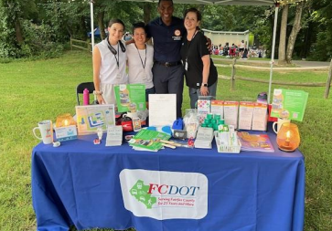
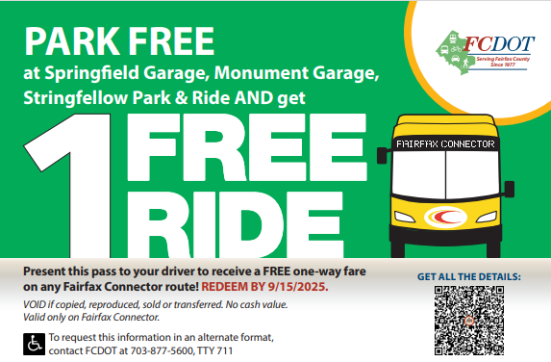
Try Transit: Monument and Springfield Parking Garages
To increase awareness of the amenities (Free Parking, Transit Connections, Bike Storage) available at the county’s new Monument and Springfield Parking Garage and Transit Centers
Attended 6 of the county’s popular Summer Entertainment Series events at locations within range of the facilities
Promotions included a free bus ride or 50% off secure bike room storage membership
Engaged more than 1,000 potential commuters
Awaiting final activation results (deadline mid-September)
Next phase of the campaign will include:
  Movie theatre advertising
  Bus advertising
  Sponsored media content

Slide 4
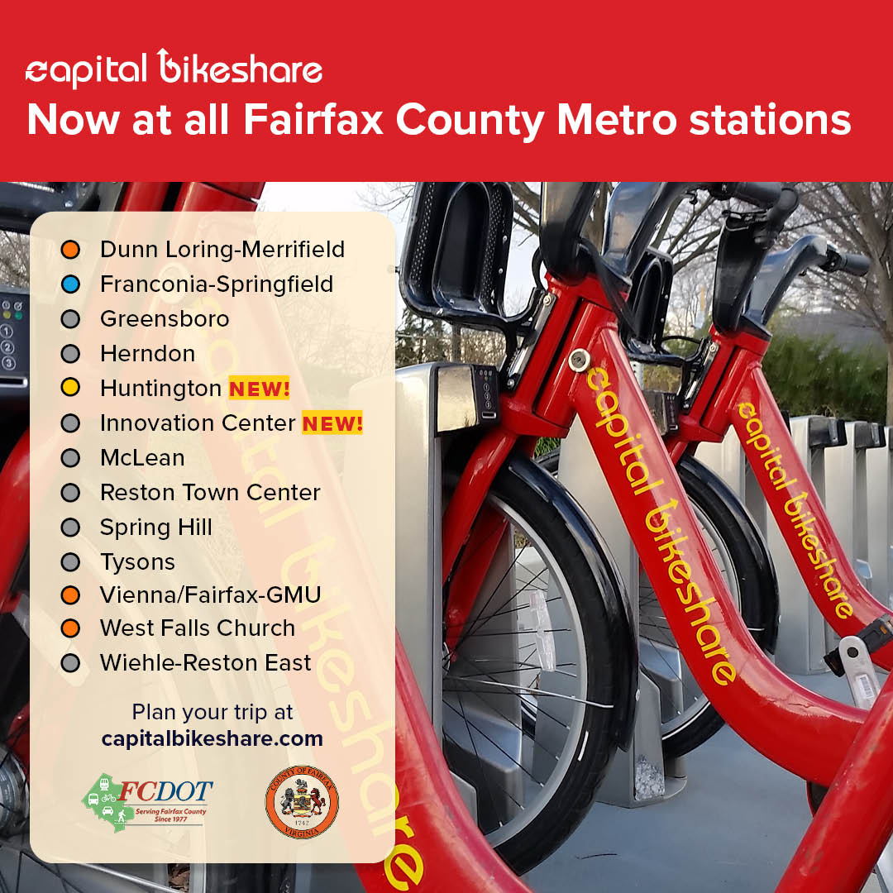

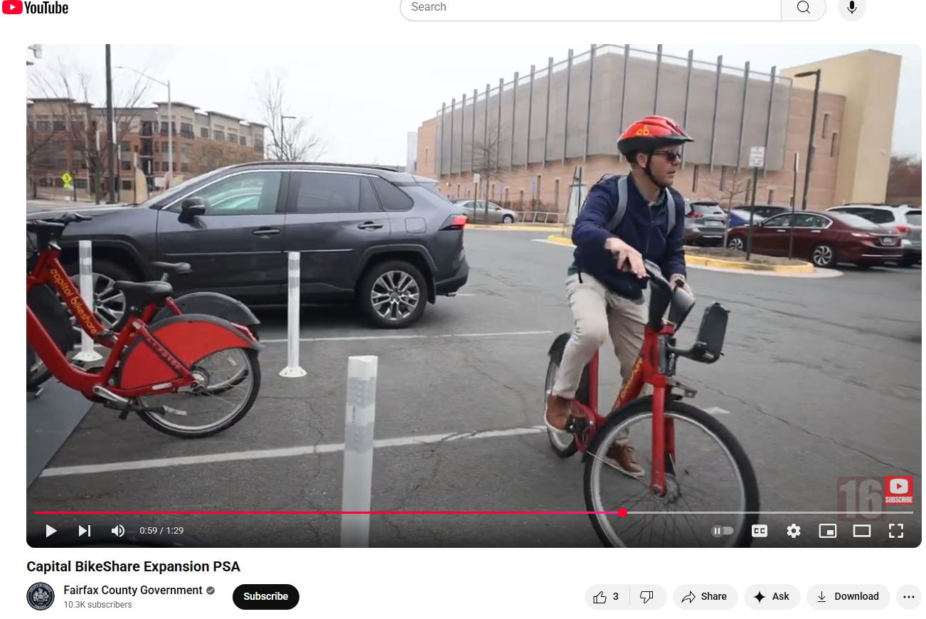
Capital Bikeshare Expansion & Discount
Commemorated the addition of 10 new Capital Bikeshare Stations and 70 e-bikes to the county’s bikeshare fleet
Fairfax County now has 94 stations
Stations at all 13 Metrorail stations in Fairfax County and their surrounding communities.
Compiled a suite of videos, infographics, and news content
In conjunction with this news…
Active Transportation Teams have held 12
pop-up engagement events at Fairfax County Farmers Markets and along trails throughout the county promoting Capital Bikeshare with a coupon for a free ride
Additional events planed throughout the Fall

Slide 5
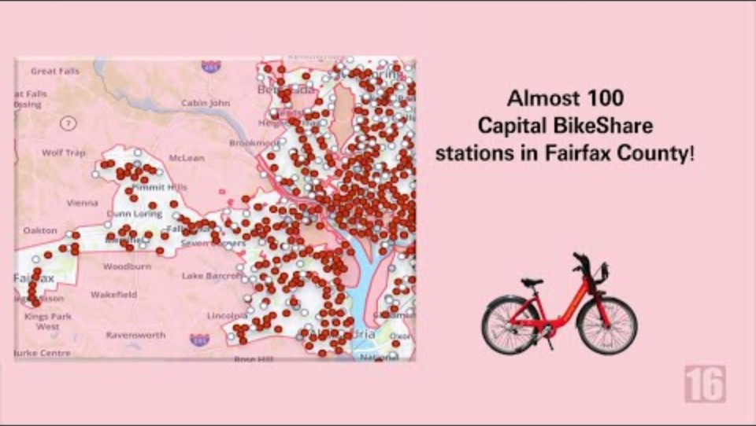

Slide 6
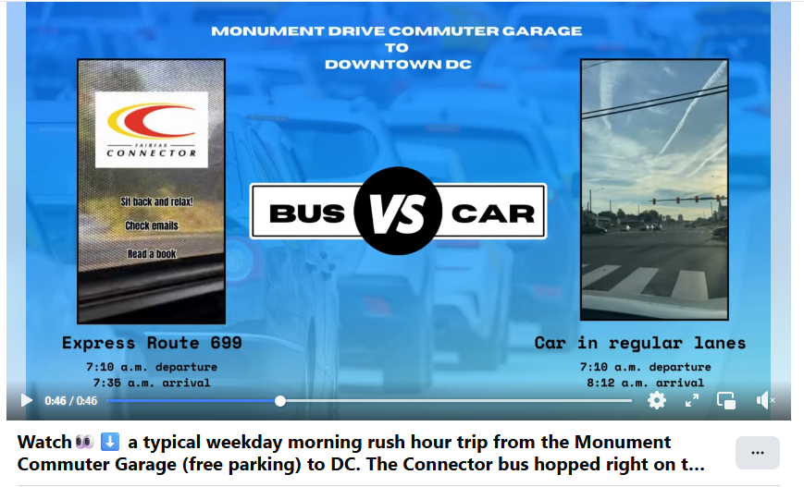
Try Transit Week: Bus Vs. Car Challenge
Coming up…
Second Annual filming. Started last year with Car Free Day
Targeting route 697 with service from Stringfellow Road to D Street in Southwest DC
In addition to time lapse video and tracking departure and arrivals of both vehicles, we’ll be adding rider experience notes as well to showcase the benefit of time afforded by using public transportation
Primarily targeted as a social media campaign

Slide 7
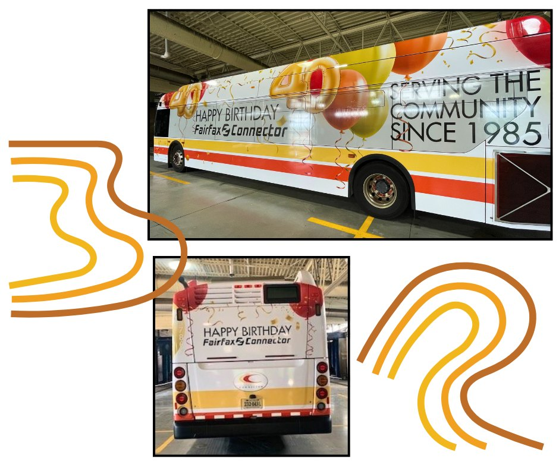
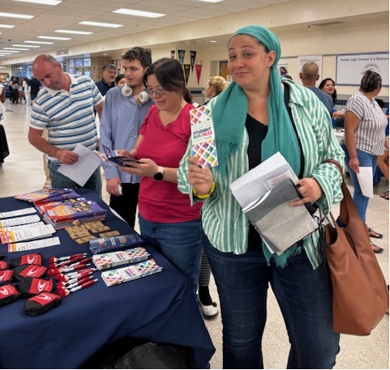
Fairfax Connector
Coming up…
Celebrating 40 Years!
Celebration Ceremony on Oct. 1
Social media campaign
  PSAs
  Interviews with decision makers, operators, maintenance staff
Rider Appreciation Activations
Back-To-School
Participating at area schools back-to-school
nights prompting the student bus pass program
Social media videos, animations
TRIP
Partnering with human service agencies and supervisors offices to promote the Transit Ridership Incentive Program for vulnerable households

Slide 8
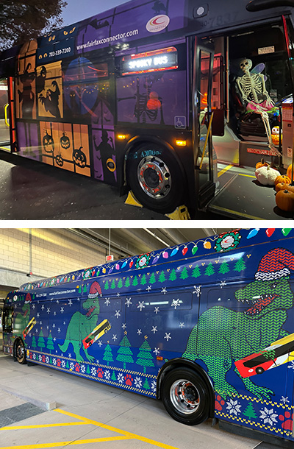
Community Favorite: Themed Buses
Coming UP…
Halloween and Winter Holiday Designs
HUGE positive community engagement
Fun for riders and staff alike
  “Where’s Waldo” effect
Decorated buses are top-draw at several community events, parades throughout the holiday season
FCDOT’s Winterfest event hosted at the Springfield Garage and Transit Center
(Dec. 6)

Slide 9
Ben Boxer
Marketing and Communication Section Chief
Benjamin.Boxer@fairfaxcounty.gov
703-246-5092

