Slide 1
How to Meet Large Scale Renewable Customer Needs
BEEAC Solar Workshop Panel
December 14, 2017

Slide 2


Moving Beyond Energy Efficiency
Climate ambition
is increasing
Energy challenges
are growing
Current approaches
are insufficient
Co-Gen
Storage
Utility Green Tariffs
Energy Efficiency
Demand Side
Management
RECs
Small-scale
Renewables
Concrete goals: science-based carbon goals or carbon neutrality
VA Voters care about climate:
84% of registered voters think elected officials should be doing more to address climate change.*
… and about renewables, too: 81% of registered US voters think the U.S. should use more RE and less fossil fuel**
Electricity is:
Major driver of GHG emissions
Uncertain yet addressable operating expense
Modern growth means increasingly technology and electricity intense
Diverse operations require tailored solutions
Capturing low-hanging fruit through demand reduction and energy efficiency
Fuel switching to natural gas
Small scale onsite renewables (due to space constraints
onsite RE typically covers
only 2-8% of onsite load)
What can municipalities do to meet their commitments and close the climate gap?
* Yale University Program on Climate Change Communication: ‘Politics and Global Warming’, May 2017
** George Mason University Center for Climate Change Communication: ‘Politics and Global Warming’, November 2016
Source: CFR analysis

Slide 3
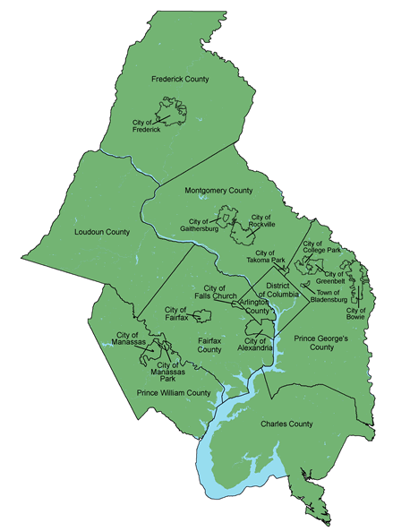
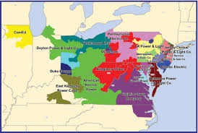
The Regulatory Framework is Key to Identifying Viable Solutions
MWCOG Jurisdiction
PJM Wholesale Market
States – Electricity Retail Regulation
Maryland – deregulated
District of Columbia – deregulated
Virginia – regulated
Region – Electricity Wholesale Regulation
PJM – Independent Systems Operator
FERC regulated

Slide 4

Virginia Focused Effort
Collaborative Renewable Energy Procurement
How Can Northern Virginia Local Governments
Access and Accelerate Large-Scale Renewable Energy?
Sponsored by the Northern Virginia Regional Commission
Advised by CustomerFirst Renewables
Focused on 13 jurisdictions in NVRC
Includes other interested NOVA parties
Want to drive new renewable capacity in VA or at least regional grid
First workshop on December 11th – focus on general concept
Second workshop in late January – focus on risk and economics
Operation of a new project possible at end of 2018 but more likely 2019

Slide 5
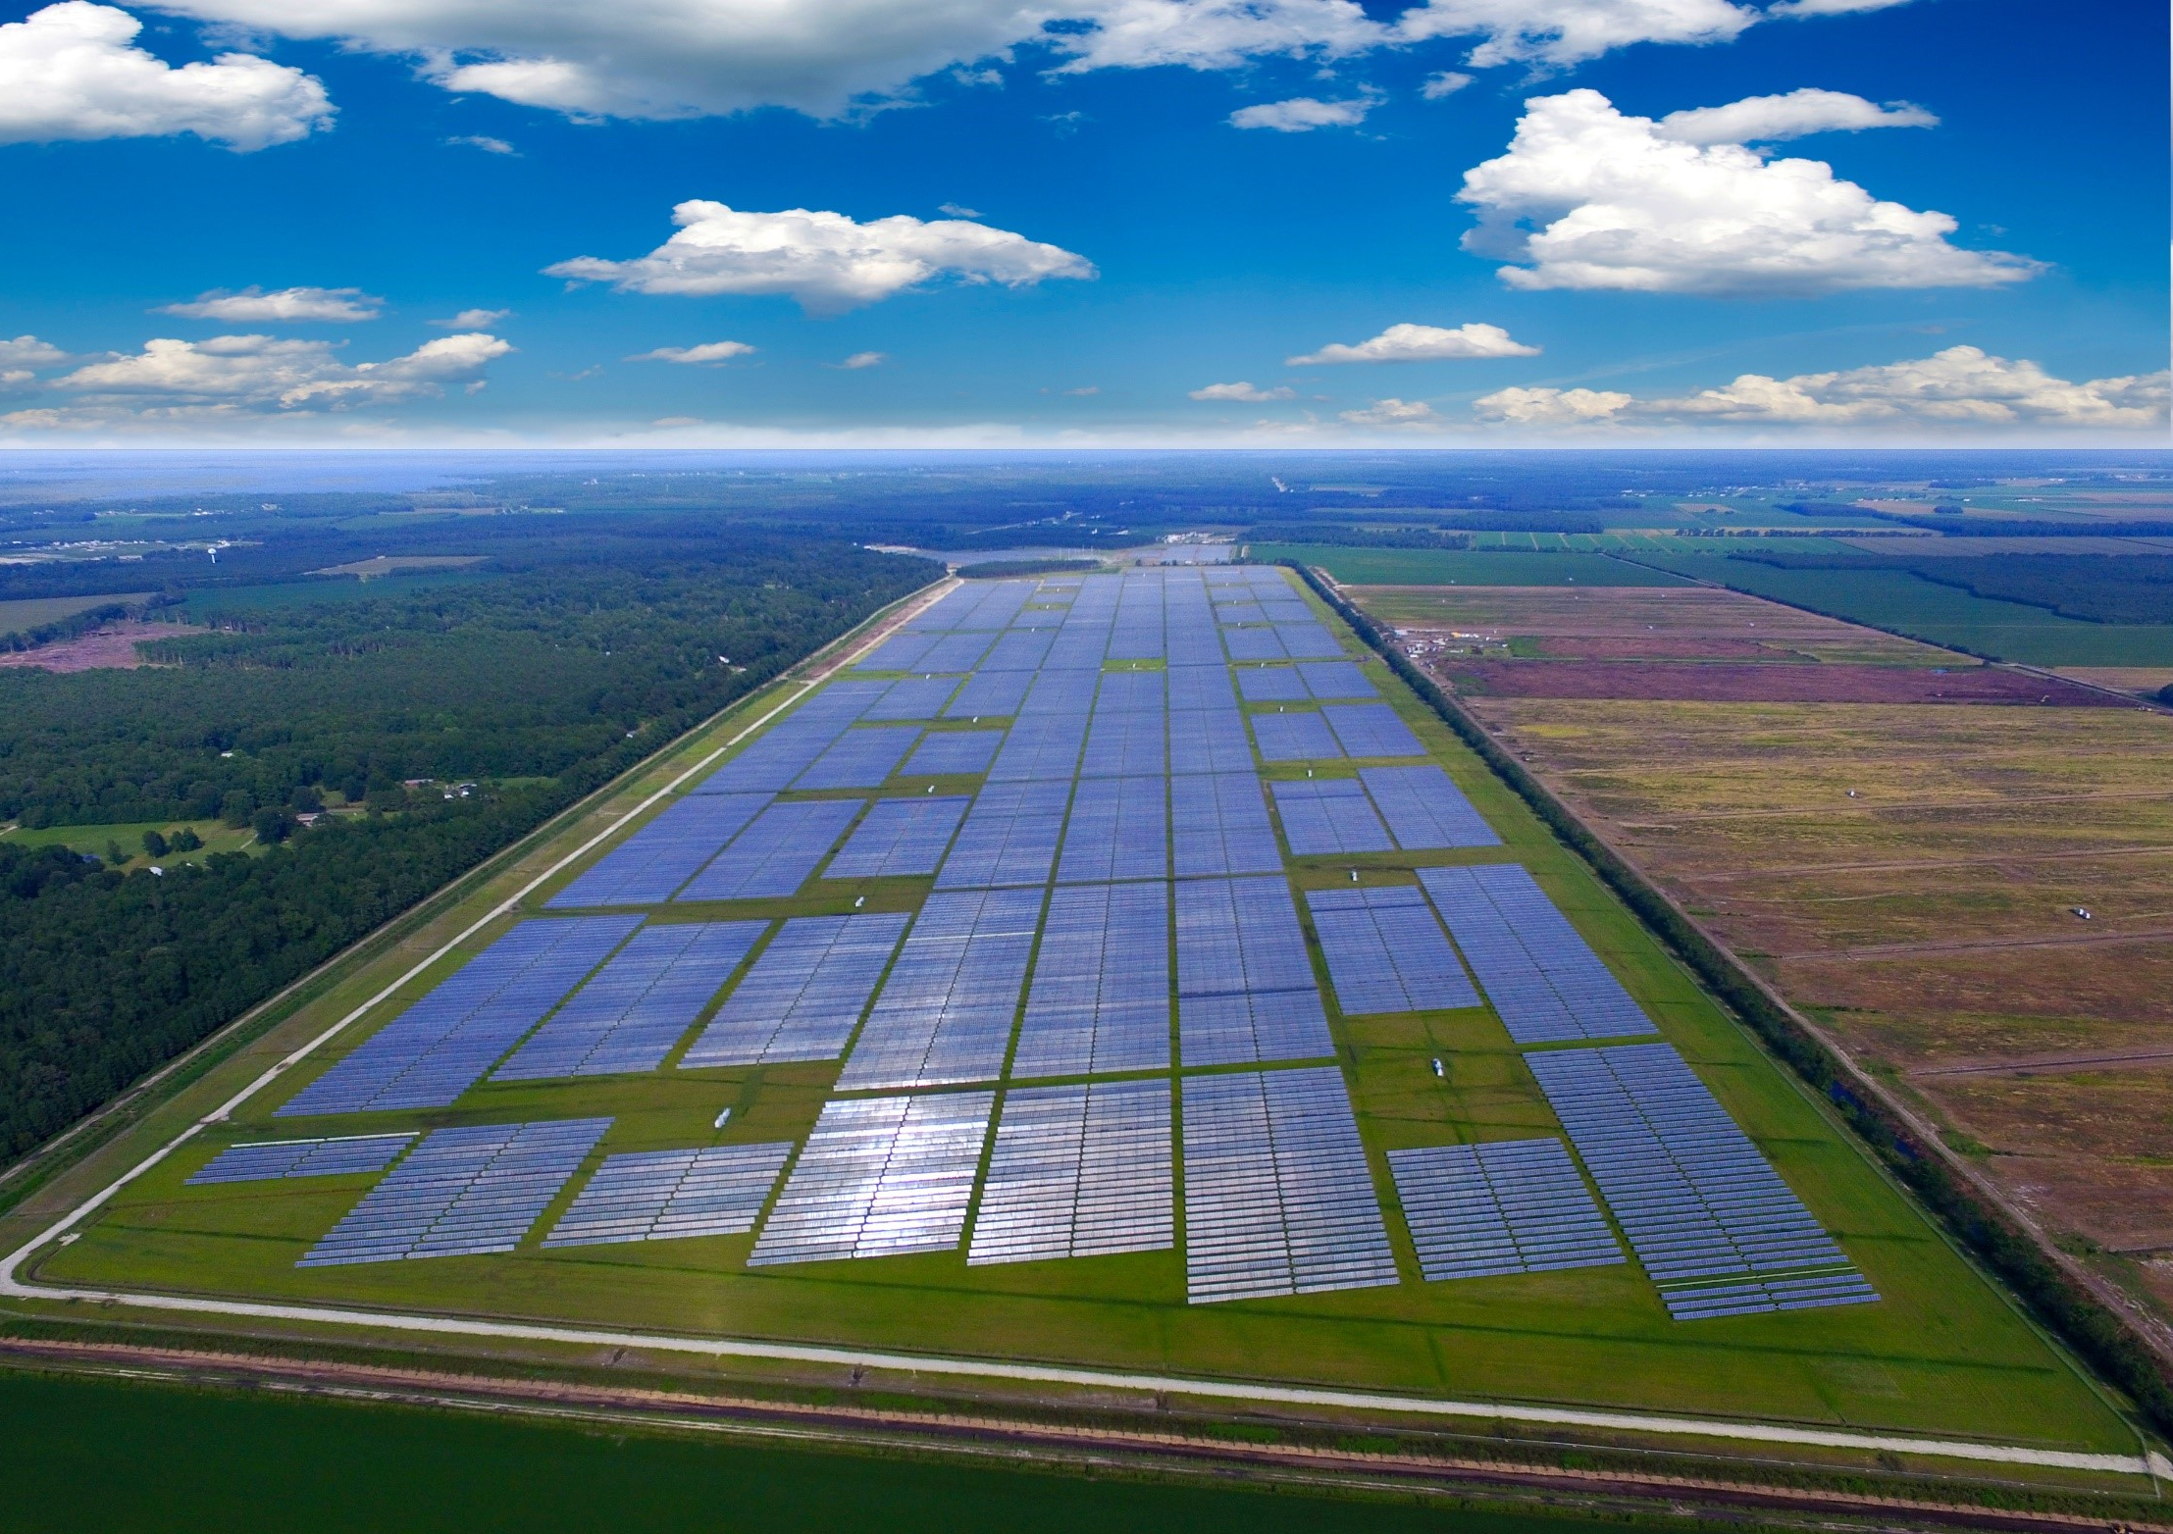
The Aspiration
Reduce GHG emissions in a cost-effective and impactful way
Bundle your purchasing power to access renewable energy at scale
Make renewable energy available to all jurisdictions – large and small – through aggregation
Accelerate greening the grid – drive change without waiting for your utilities
CFR-facilitated client project Summit Farms in NC

Slide 6


High-Level Detail of
LSRE Options in VA
Energy Market Structure:
Regulated retail market; wholesale market part of PJM
Dominion controls 68% of market; Appalachian Power 14%
Focus
 | Onsite
 | Net Metering | Renewable Energy Pilot Program
Structure | Ownership | PPA
Size | <1 MW (per account) | <1 MW
Technology | All RE Technologies | Solar/Wind
Key Factors and Value Drivers | Peak avoidance and cost offset Demand reduction RECs Price hedge | Negotiate structure or fixed rate ITC/PTC, depreciation RECs Price hedge
Relevant Utility/ Provider | Dominion, Appalachian Power | Dominion, Appalachian Power
Onsite or Offsite
Bilateral Arrangement with Utility (Rate MBR) | Community Solar Pilot Program
PPA / Tariff / Ownership | PPA / Ownership
Variable but >5 MW (200 MW cap) | 0.5 – 40 MW
Solar/Wind | Solar
Negotiated structure or fixed rate ITC/PTC, depreciation Land lease rental Revenue share REC share Price hedge | Sell onsite output to utility or buy from projects Owned projects retain RECs Price hedge 4₵ extra cost
Dominion | Dominion, Appalachian Power
Offsite
Dominion Rate CRG* | Dominion Schedule RF* | Indirect Wholesale Solution
Tariff | Tariff | PPA
100% of load (>1 MW) | 100% of load | Customized (>10 MW)
All RE Technologies | All RE Technologies | Solar/Wind
Receive RE delivered from utility No need to change supply strategy RECs Added cost | Receive RECs from new RE projects No need to change supply strategy RECs Added cost | Wholesale revenue Capacity revenue, if available RECs Price hedge
Dominion |  | Third-party developer, wholesale mkt
* Rate filed with VA State Corporation Commission; not yet approved
Source: Utility data and Public Utility Commission filings, CFR analysis; October 2017

Slide 7
Dominion Large Scale Renewable Tariff Options
Schedule MBR (originally Schedule SCR)
Design
  Sign PPA with Dominion for VA RE project
  For existing customers with 5MW+ of peak load (85% load factor)
  Retail rate becomes index (variable)
  to hedge against wholesale market volatility
  Avoids paying a premium for a “fixed” price
Issues
  Dependent on negotiation with Dominion for project and PPA price
  Hedge requires good price correlation between project and index
Schedule RF (pending approval; filed October 2017)
Design
  Negotiate agreement to buy RECs from a new RE project in VA
  Continue paying current Dominion rate
Issues
  Cost additive – no hedge value (still on fixed-price tariff)
  30,000 MWh minimum of new load requirement
  Not integrated with VEPGA procurement vehicle

Slide 8

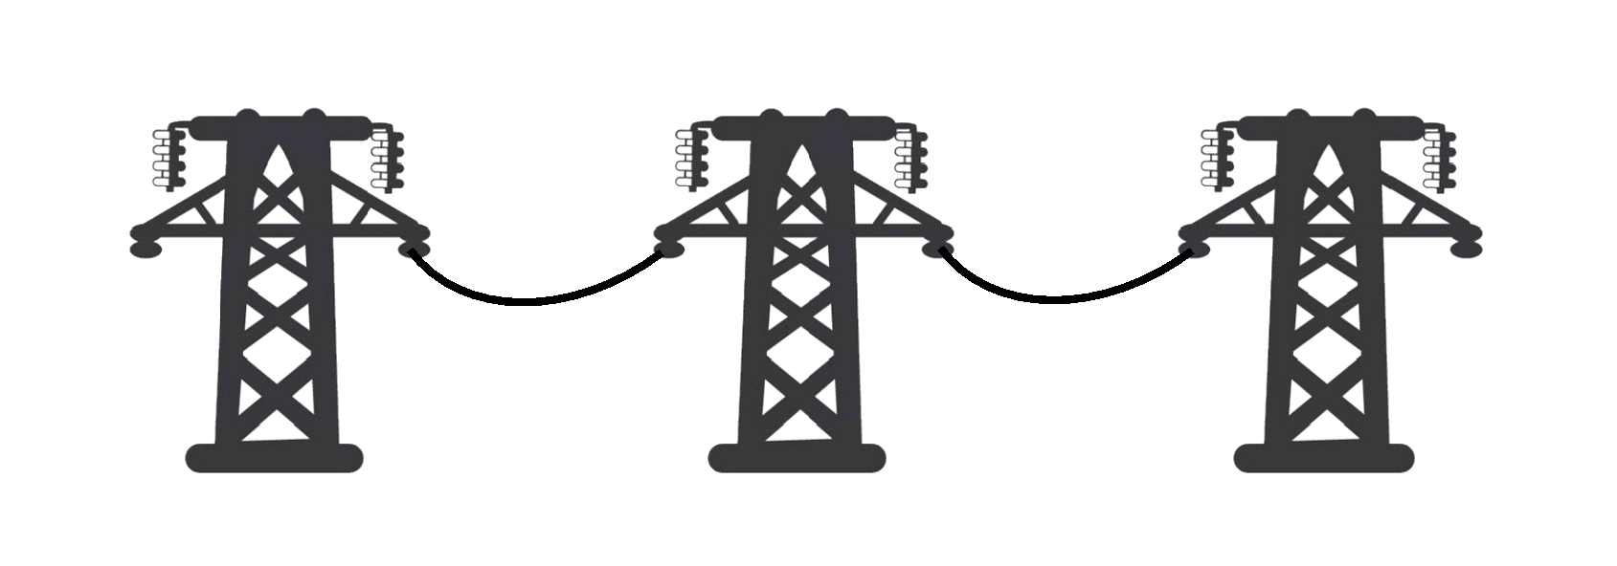
Many Buyers Use PPAs to
Access Attractive Economics
ILLUSTRATIVE
RECs
Money
Electricity
RE Power Purchase Agreement
Wholesale Market Transaction
Federally Regulated (FERC)
3.
RECs
Primary Grid Power Contract
Retail Market Transaction
State Regulated (Virginia SCC)
Offsite LSRE
PPA $
1.
Current Electricity Cost
4.
Customer
Electricity
2.
Electricity
Dominion / NOVEC
3.
LSRE Revenue
Indirect Physical PPA – How it works:
Customer pays developer for RE power per PPA
PJM
Other fees
Power is delivered to the grid at project’s location
Customer (or agent, if customer not FERC-licensed)
takes title of power and RECs;
Power is resold into wholesale market (revenue is determined by local wholesale price)
No change to purchase of power from retail/utility
Source: Recent CFR-led procurements; CFR analysis

Slide 9
Many Buyers Use PPAs to
Access Attractive Economics
ILLUSTRATIVE
RECs
Money
Electricity
RE Power Purchase Agreement
Wholesale Market Transaction
Federally Regulated (FERC)
RECs
Primary Grid Power Contract
Retail Market Transaction
State Regulated (Virginia SCC)
Offsite LSRE
PPA $
$86
$38
Current Electricity Cost
Customer
Electricity
Electricity
Dominion / NOVEC
$41
Rob Leuck
LSRE Revenue
Margin expected to increase as average price of electricity grows over contract life
PJM
Other fees
$38
$1
$41
$2
$1
PPA Cost
Other Cost
Average revenues at LSRE location
RE
Margin
* Current all-in electricity cost based on Commercial Rates for brown power.
** LSRE revenue based on energy and capacity revenues.
Source: Recent CFR-led procurements; CFR analysis

Slide 10
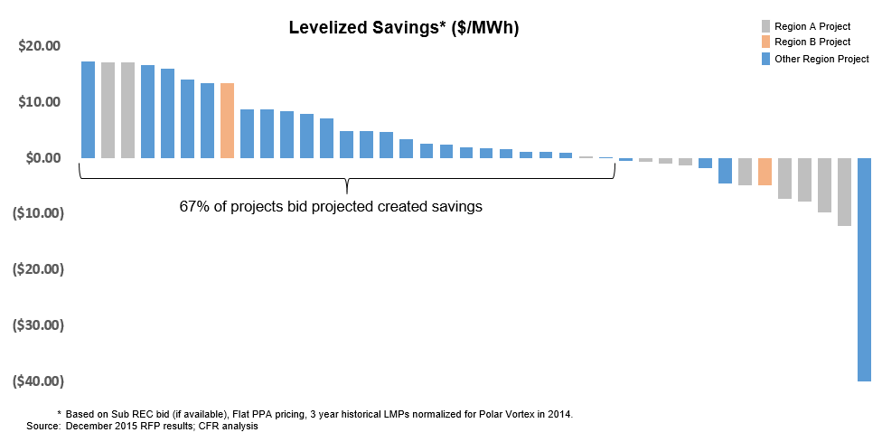
RFP Response:
Inefficiencies and Best Projects
EXAMPLE
Initial economics for bids evaluated for a CFR customer; PPA prices ranged from $15 to $90
The top 5 projects by Levelized Savings had PPA prices in the $16 - $47 range
High market prices, capacity values and other factors make some seemingly expensive projects profitable
The finalist project’s price was reduced further during final negotiations, a 6% reduction
Source: Recent CFR-led procurement; CFR analysis

Slide 11













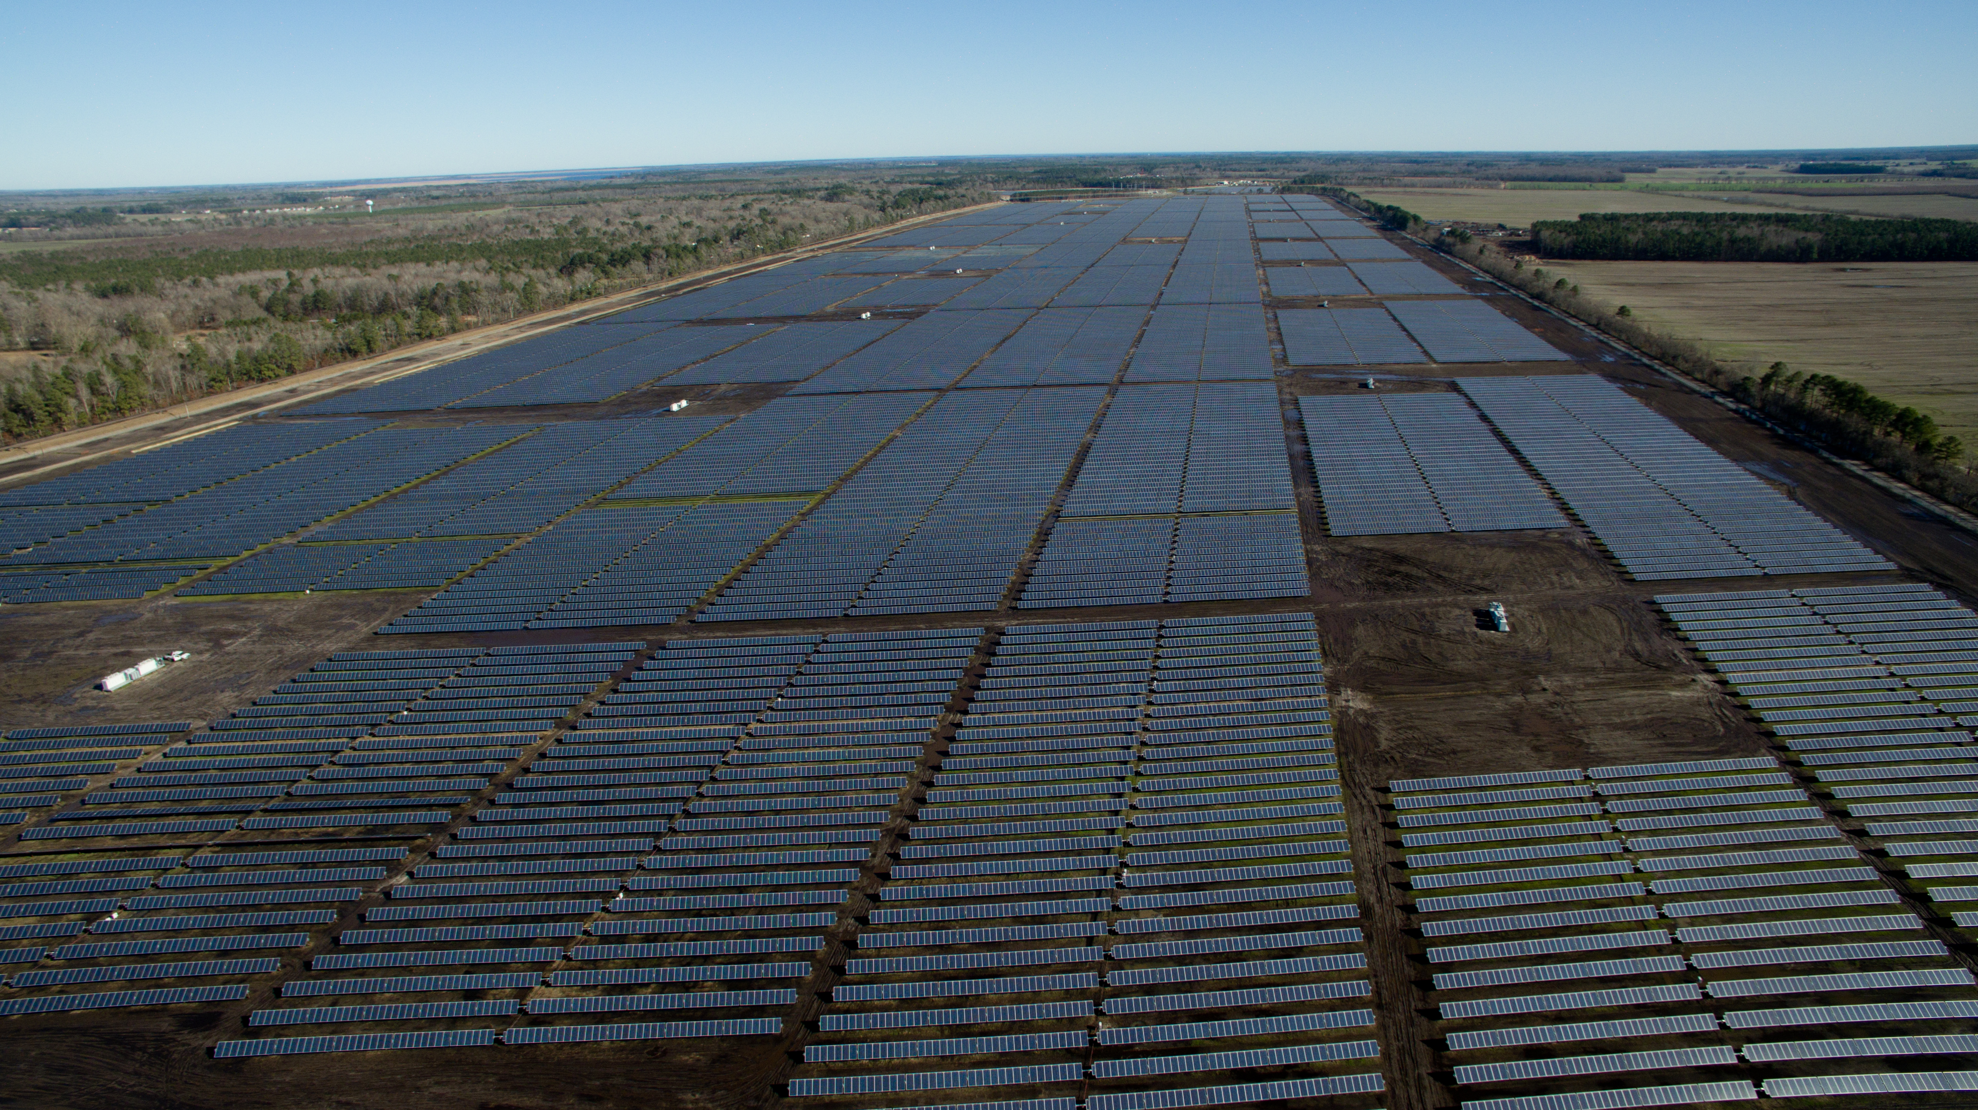






Customer Aggregation Can be
Tailored to Success
Successful Aggregations
Multiple Organizations Single business unit/location
Single Organization Multiple business units/locations
Multiple Organizations Multiple business units/locations
255,000
solar panels
650 acres
146,000 MWh
Power for
~9,700 homes
60MW Summit Farms
Convened by A Better City

Slide 12
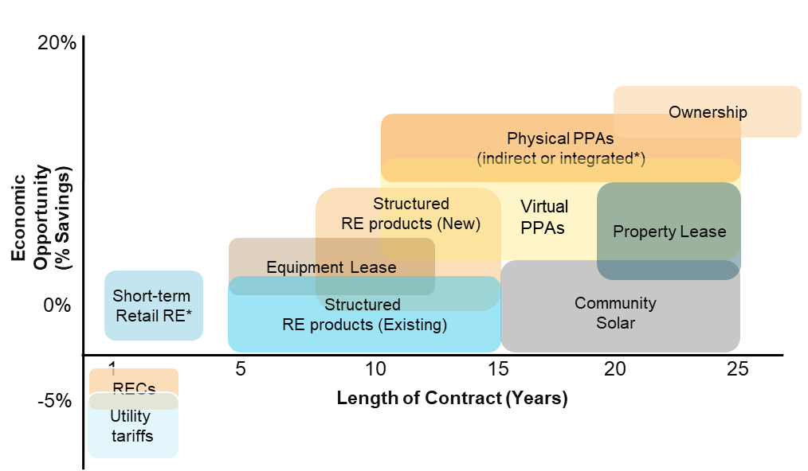
Opportunities in Maryland and DC
Same solutions as in Virginia for offsite PPAs
+
Retail Option
Integration of renewable solution into brown power procurement strategy
Integrated purchasing: With a physical PPA, if the customer is in a deregulated electricity market or engages in a bilateral deal with their utility, the LSRE may be able to be integrated directly into the customer retail supply
Adjust purchasing: If price correlation exists between the market where the LSRE is located and where the customer buys power, a natural hedge occurs, allowing the customer to move away from more expensive fixed price power toward a cheaper index facing procurement strategy

Slide 13









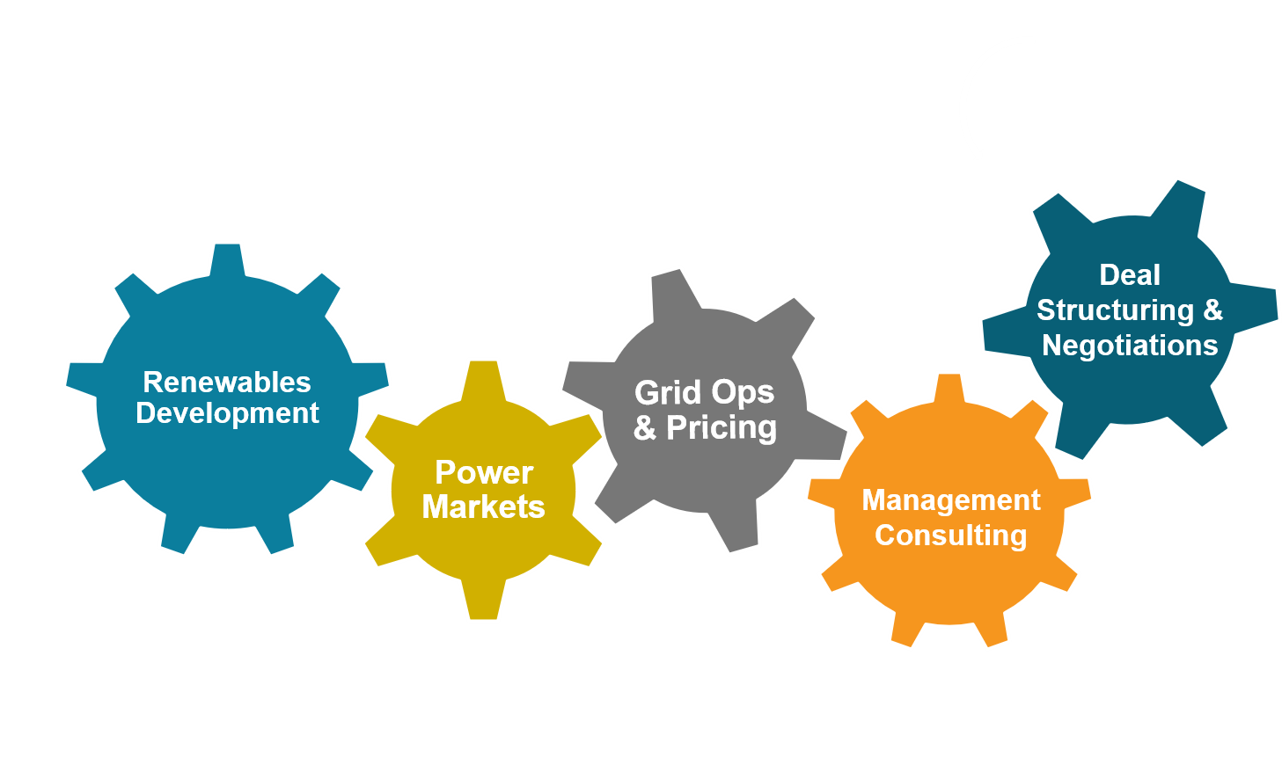











CFR – Who We Are
Renewable Energy Advisory Firm
Team Experience
Founded in 2010 by two former McKinsey & Company energy practice partners; privately-held
Focus 100% on bringing tailored RE solutions to large businesses and institutions across the U.S.
Independent, objective and transparent; technology, developer and project agnostic
Pioneered RE demand aggregation, other services
GSA accredited small business, 23 team members
Mission and core values underpin everything we do to maximize value for our clients
150+ years combined energy experience:
~2,900 MW of renewables
~6,000 MW traditional generation
Deep expertise in corporate strategy, innovation, organizational and operational issues
Advanced capabilities in risk management, financial analysis, and transaction execution
Core Capabilities
Selected Client Examples
Notes:
WF okay’ed by AZ

Slide 14
Thank you!
Niels Crone, VP Business Development
ncrone@customerfirstrenewables.com
Phone: (240) 428-3586
Kevin Rackstraw, VP Customer Solutions
krackstraw@customerfirstrenewables.com
Phone: (240) 449-3109

Slide 15
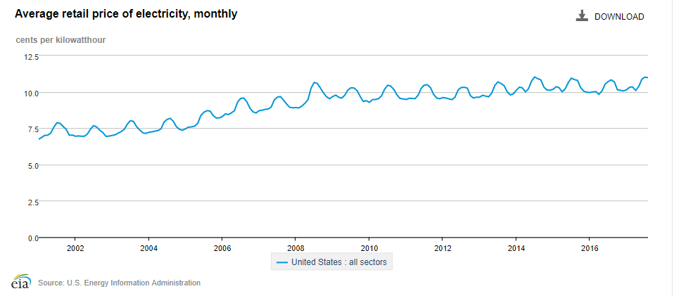
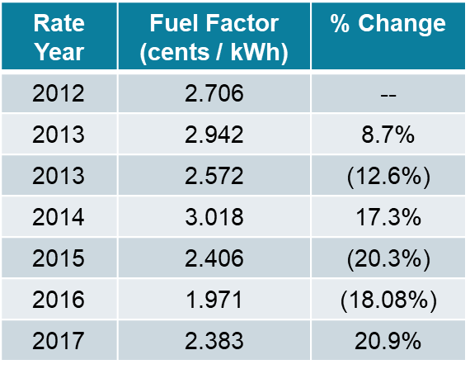
Business as Usual
ILLUSTRATIVE
Illustrative fixed-price ‘blocks’
VA all-sectors average retail rate
VA All Sectors

Slide 16
Robust Risk Management Spans Life of RE Solution
During project analysis
(eliminating risky projects and identifying risks to mitigate)
During contracting
(negotiating strong protections)
During ongoing operations
(exercising risk mitigation options)
Market risk analysis
Fundamental analysis
Probabilistic analysis
Deterministic analysis
Project risk analysis
Project-development review
(regulatory, financing and permitting related)
Negotiation of payout protections for customer
Counterparty analysis
Market risk protections
PPA-price escalators
Developer-provided risk mitigation products
Risk mitigation products from financial institutions
Ongoing solution management
REC swapping
Adjusting existing grid-power portfolio to take advantage of the LSRE hedge value
Source: Recent CFR-led procurements; CFR analysis

Slide 17




MWCOG Has Strong
GHG Reduction Goals
Regional Greenhouse Gas (GHG) Reduction Commitments
  By 2012, reduce GHG emissions to 2005 levels (done)
  By 2020, further reduce GHG emissions by 20% compared to 2005
  By 2050, further reduce GHG emissions by 80% compared to 2005

Slide 18

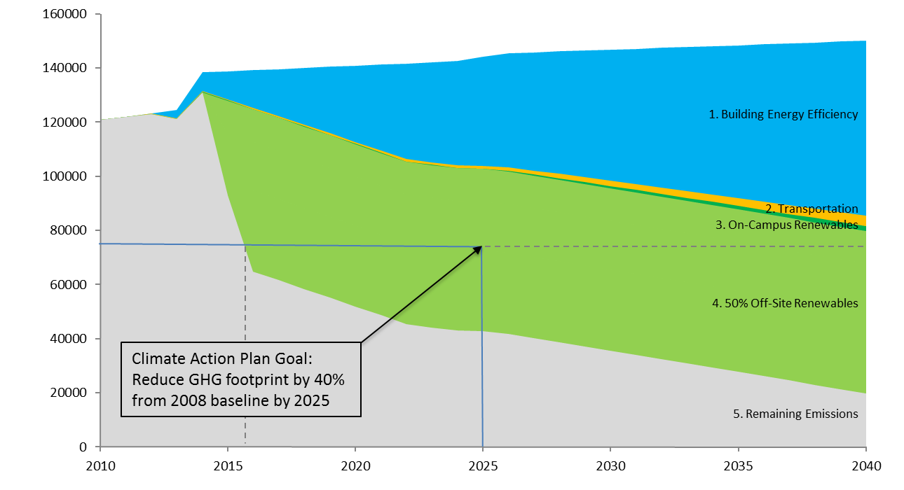
Sustainability:
Breakthroughs in GHG Reduction
CLIENT EXAMPLE
Building efficiency
isn’t enough
Large-scale offsite renewables
allow for achieving carbon neutrality
GW achieved 2025 GHG goal in 2016 while also reducing electricity cost
Source: The George Washington University

Slide 19
Evolving Landscape of Select LSRE Options
ILLUSTRATIVE
20%
0%
-5%
Ownership
Physical PPAs
(indirect or integrated*)
Economic Opportunity
(% Savings)
Property Lease
Growing end-user interest is driving innovation in how LSRE solutions can be accessed
Structured
RE products (New)
Virtual PPAs
Equipment Lease
Short-term
Retail RE*
Structured
RE products (Existing)
Community
Solar
5 10 15 20 25
RECs
Length of Contract (Years)
Utility
tariffs
* Only available in states with deregulated energy markets
Other structures available: bilateral utility agreements, etc.
Source: CFR analysis

Slide 20
The Regulatory Framework is Key to Identifying Viable Solutions
MWCOG Jurisdiction
PJM Wholesale Market
States – Electricity Retail Regulation
Maryland – deregulated
District of Columbia – deregulated
Virginia – regulated
Region – Electricity Wholesale Regulation
PJM – Independent Systems Operator
FERC regulated

Slide 21

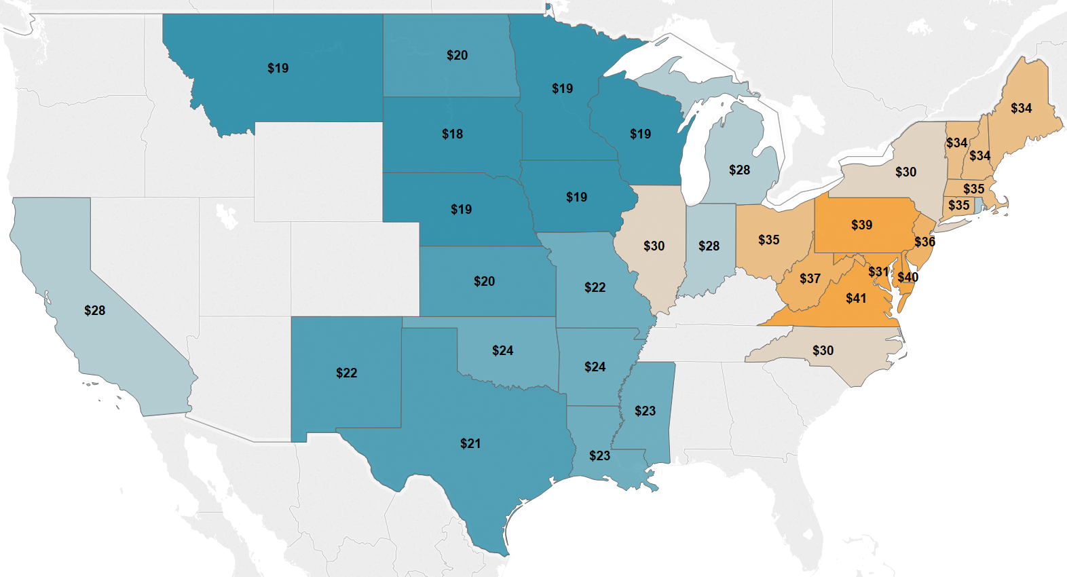

Benefits Exist Where PPA Price is Below Local Wholesale Market Prices
ILLUSTRATIVE
Due to wholesale price differences, an attractive PPA price in one market can lose money in another
d
Potential Solar PPA:
$50 /MWh
d
Potential Wind PPA:
$20 /MWh
d
Potential Wind PPA:
$20 /MWh
d
Potential Solar PPA:
$38 /MWh
1. Prices shown are 2015-2016 Average Wholesale Price ($/MWh); on-peak in PJM, around the clock elsewhere.
2. States without prices are regulated states, where local utilities control market pricing and generation assets.
Source: SNL, CFR analysis

Slide 22
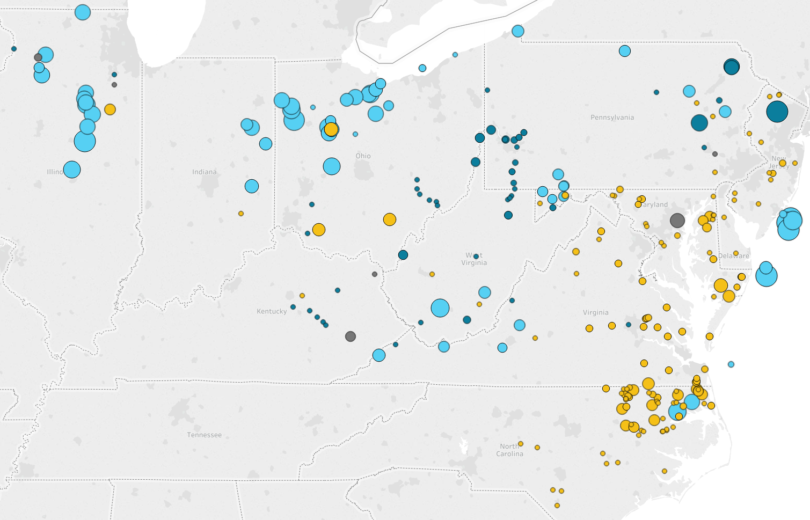
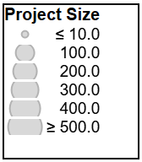
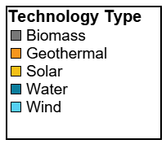
LSRE Projects Under Development in the PJM Grid Region
29,600 MW currently under development (313 projects)
An additional 35,600 MW
is operational (868 projects, not shown here)

