Slide 1
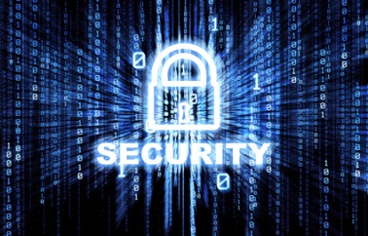


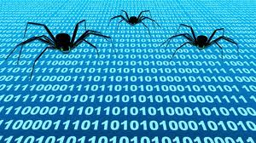







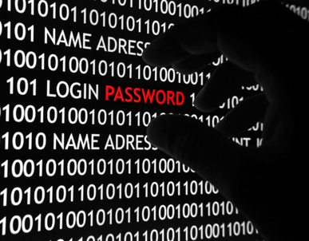
Senior Leaders Seminar 2013
Emergency Preparedness Council Briefing
February 12, 2014
Operation Rankl3 th3 R$ch

Slide 2
Topics
Seminar Overview
Scenario
Focus Areas
Training and Exercises

Slide 3
Seminar Overview
2013 EPC National Capital Region (NCR) Senior Leader Seminar was held on November 1, 2013 at the Walter E. Washington Convention Center, Washington, D.C.
The primary purposes of this year’s seminar were to:
  Raise awareness of cyber risk management, cyber-related information and intelligence-sharing, and other issues related to cyber incident prevention, protection, mitigation, and response.
  Identify key points of a Strategic National Capital Region Cyber Coordination Framework.

Slide 4


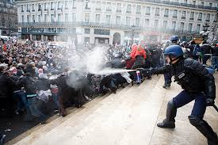
Scenario – Overview
In conjunction with physical protests occurring throughout the National Capital Region, a “hacktivist” group plans to conduct cyber operations against NCR governments in support of the physical protests.

Slide 5
Focus areas for improved regional cyber coordination
NCRnet Program Review
  Conduct a program review of the NCR’s Interoperable Communications Infrastructure (ICI) and the NCRnet.
  Develop roadmap for the NCR ICI Team to enhance and expand participation in the NCRnet.
Optional NCR Jurisdiction Assessments
  Upon specific request, a team from Obsidian Analysis Inc. is available to review individual jurisdiction security management programs.

Slide 6
Focus areas for improved regional cyber coordination
Cyber Protection and Coordination Plan to supplement the Regional Emergency Coordination Plan
  The regional CIO and CISO committees are working with others to develop a Cyber Annex to the NCR Regional Emergency Coordination Plan.
  This document will be ready in May 2014.
Cyber-Protection Implementation Guide
  A team from Obsidian Analysis Inc. is working with the regional CIO and CISO committees to develop an implementation guide with best practices and recommendations for regional Chief Information Officers (CIOs) and Chief Information Security Officers (CISOs).

Slide 7
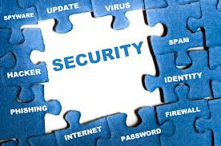
Training and Exercises
Funding has been allocated for a regional cyber security exercise this year.
The exercise will:
  Exercise the regional cyber security framework that is under development;
  Improve regional risk reduction;
  Help insure business continuity; and
  Foster broader adoption and deployment of strong cyber security tools and techniques.

Slide 8
Questions?
Steve Bieber
  Chief, Urban Watershed Programs and Homeland Security
  Metropolitan Washington Council of Governments
  Tel: 202-962-3219
  Email: sbieber@mwcog.org

