Slide 1
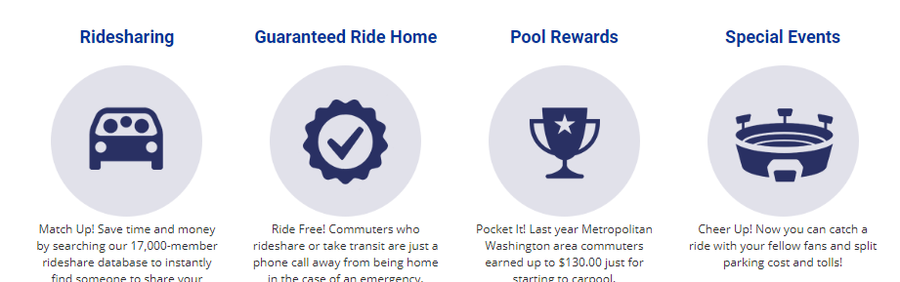
Commuter Connections tdm application
FY 2018 update
ITEM #4
Commuter connections ridematching committee
June 19, 2018

Slide 2
FY 2018 TDM Update – OVERVIEW
COG/TPB staff continued to work on improving address geocoding. Changes at Google and expansion of programs have necessitated code updates
Wildfly Upgrade 8 → 12
Flextime Rewards Program Launch/Congestion Notifications
Custom Employer Pages for DOD/WHS, Reston Hospital Center, American University
GRH Trip Request Function (Admin Console & Commuter Interface)
Special Events Feed for Commuter Dashboard
Bike Routing 2.0

Slide 3
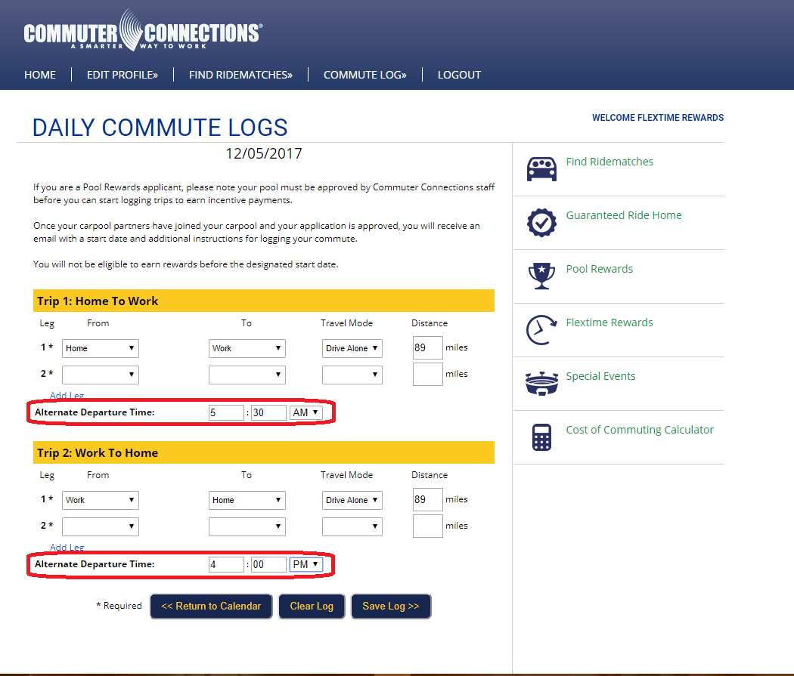
Tdm update – flextime reWARDS
Participants must record their trip data including their alternate trip (flex) time
Participants who successfully record their trip data will be eligible to be entered in an incentive drawing that will include prizes and possibly cash

Slide 4
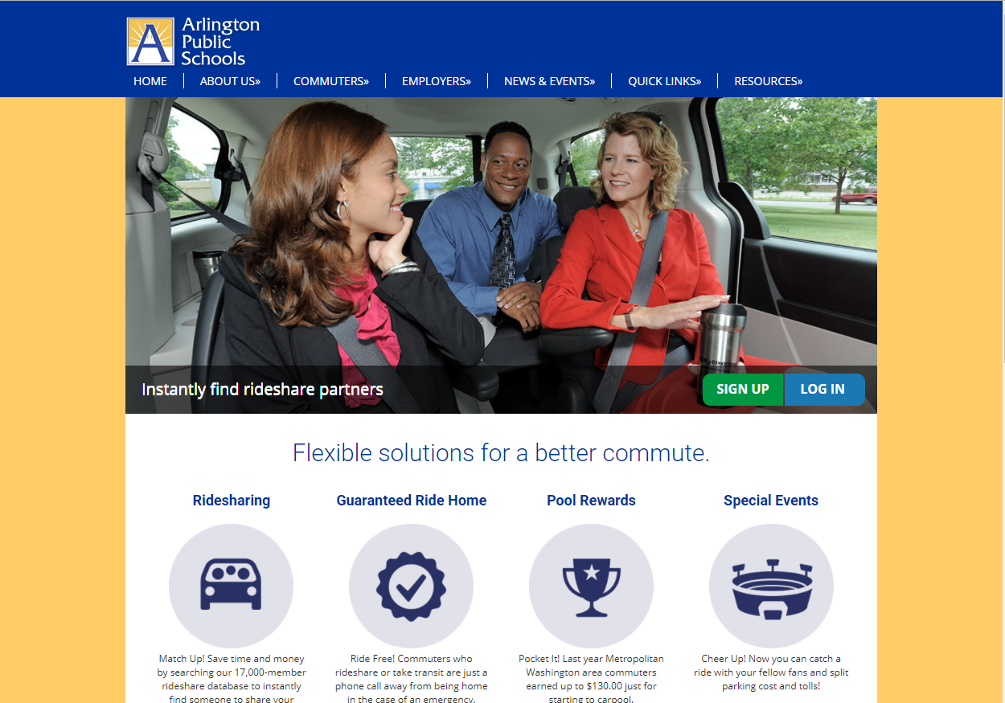
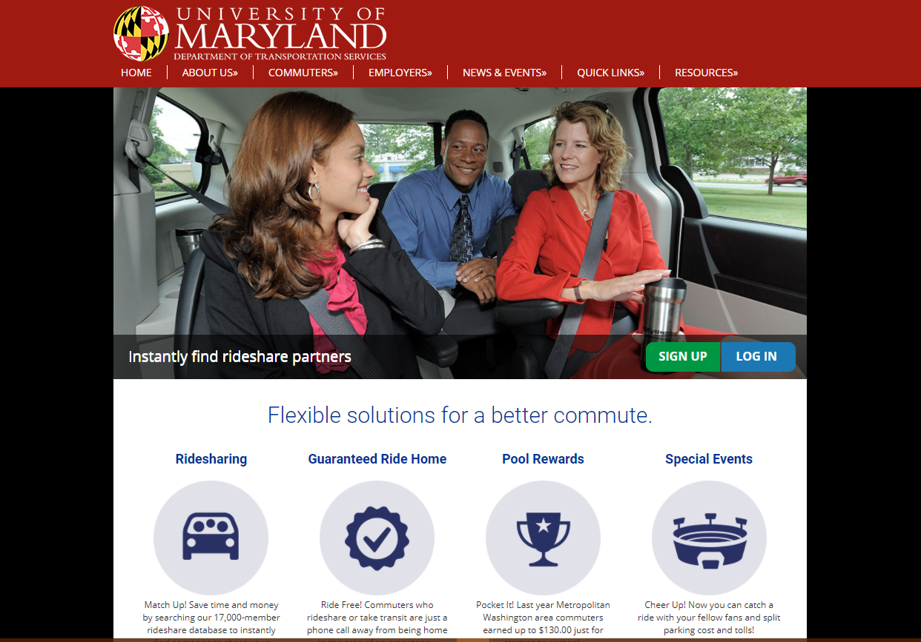
Tdm update – custom employer pages
TDM System now has five custom Employer Pages
Available to Federal Agencies, Universities and large employers (100+)

Slide 5
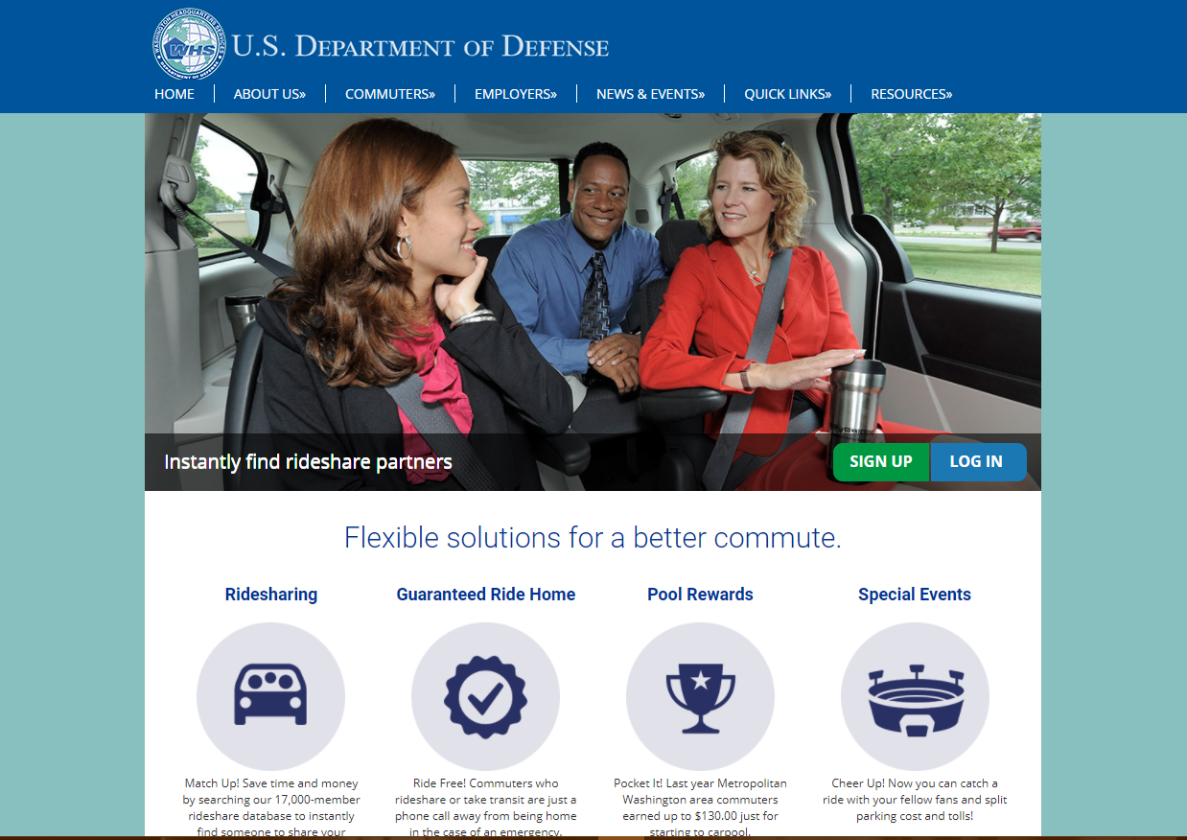
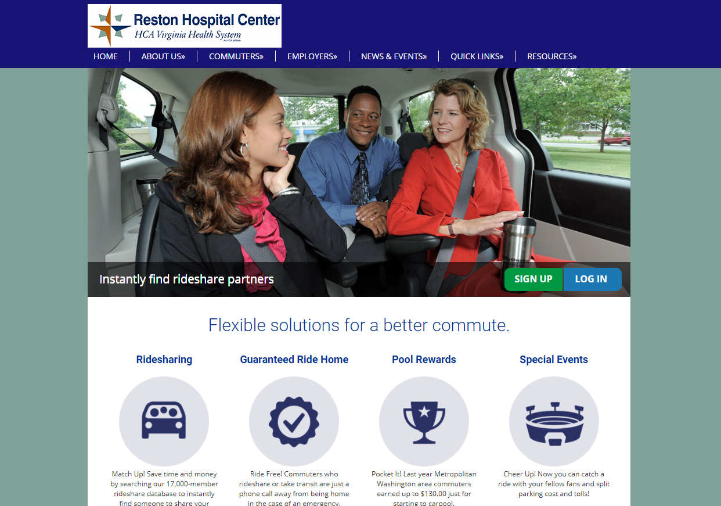
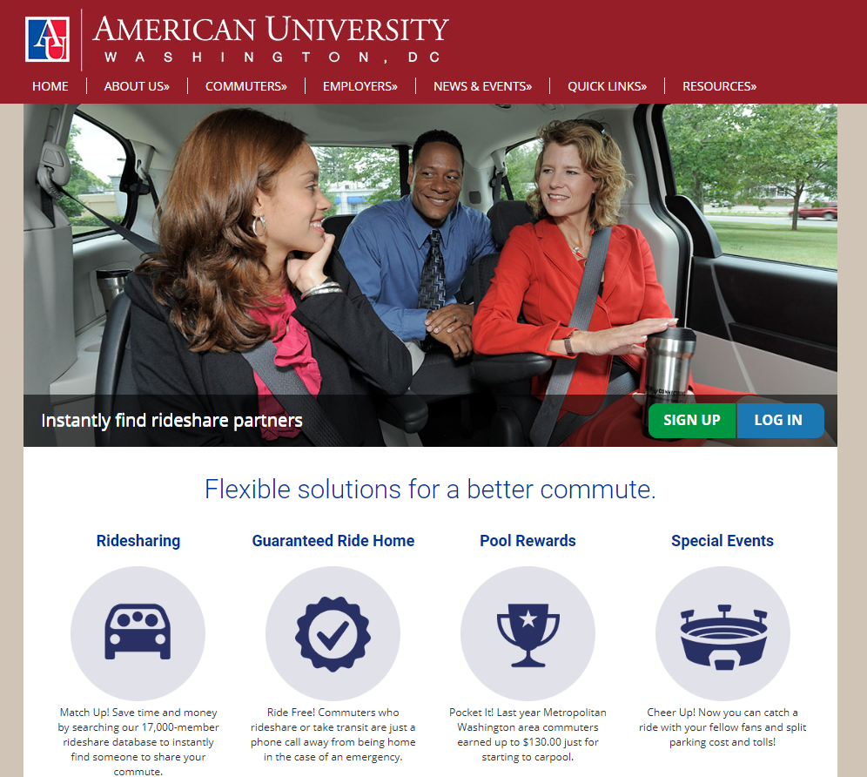
Tdm update – custom employer pages
Most recent additions: DOD/WHS, Reston Hospital Center, American University

Slide 6
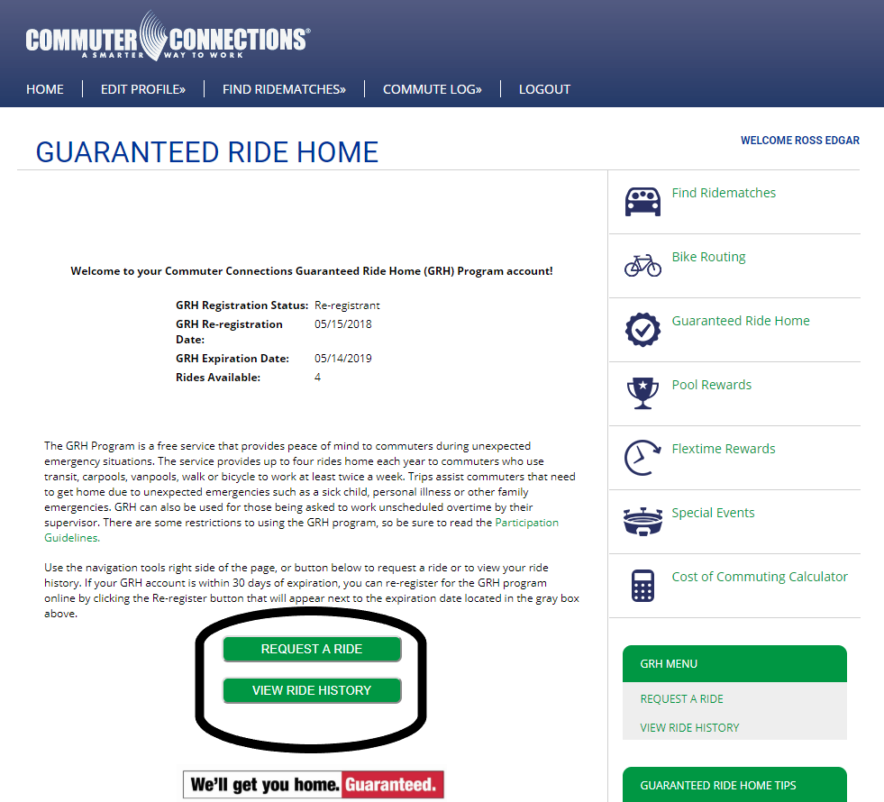
Tdm update – grh trip request (Commuter)
Registered commuters can initiate a GRH trip using the website
Registered commuters will be able to view their past GRH trips
Commuters who are not registered will be guided through the online registration process

Slide 7
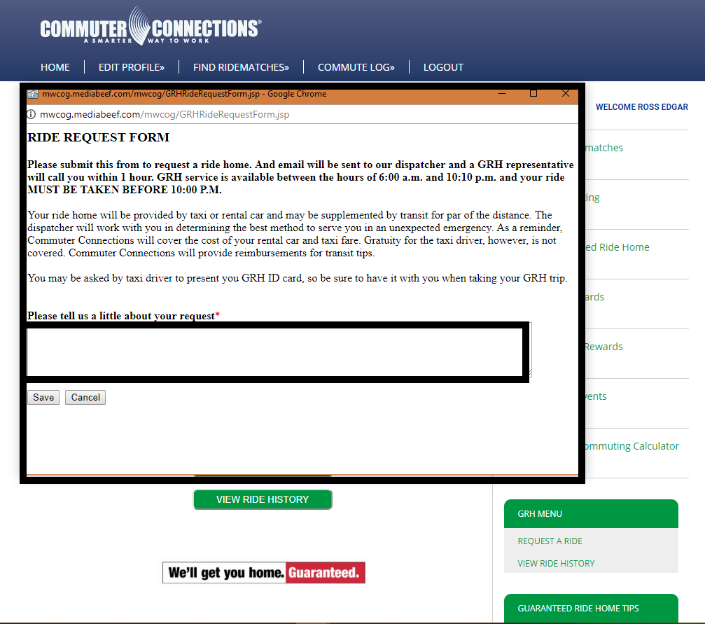
Tdm update – grh trip request (Commuter)
GRH trip request form
Outlines basic guidelines for GRH
Dispatch will then call the commuter to confirm trip details
Outside of normal operating hours, the form will inform commuters the service is closed

Slide 8
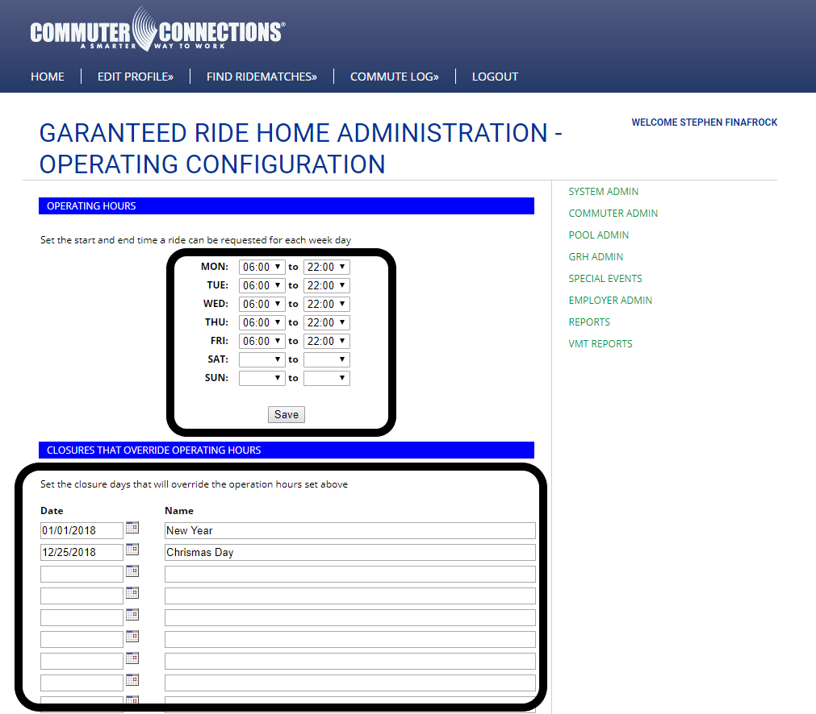
Tdm update – grh trip request (admin console)
GRH Admin Configuration allows operating hour assignment 7 days/week
Calendar override for holidays and government closures

Slide 9
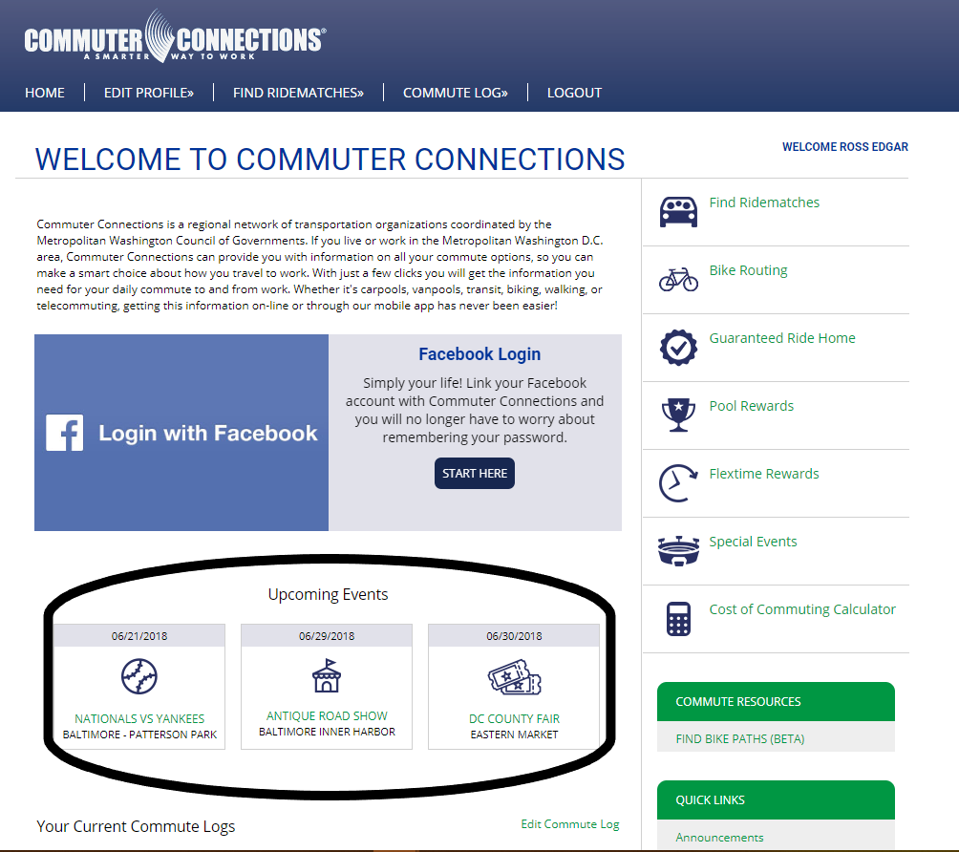
Tdm update – special events feed
Update to commuter dashboard includes a “Special Event Feed,” helping to increase awareness of the feature
Clicking the hyperlink in the feed will allow commuters to add the event to their profile

Slide 10
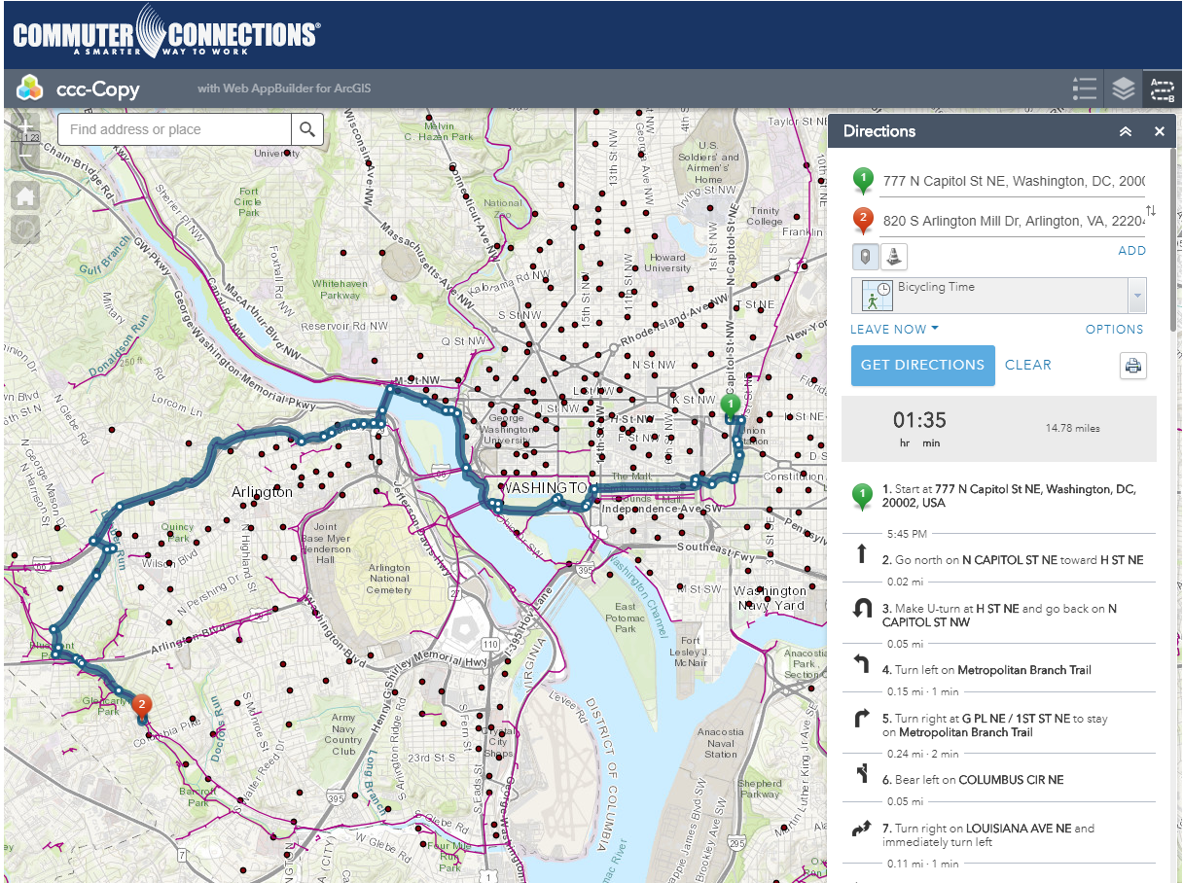
Tdm update – bike routing 2.0
Must have a Commuter Connections account to access
Capital Bikeshare stations included
Point-to-point routing and directions for the entire DC Metro region
Prioritizes bike trails over street network

Slide 11
Questions?
Stephen Finafrock
Commuter Operations Specialist III
Metropolitan Washington Council of Governments
National Capital Region Transportation Planning Board
Washington, DC
(202)962-3385
sfinafrock@mwcog.org

