Slide 1
Maryland phase iii draft wip
COG staff background information WRTC Meeting May 7, 2019

Slide 2
Outline
MD WIP
Schedule
Source Sector Reductions
Potential Comments
COG Staff MD Phase III Draft WIP Presentation
May 7, 2019

Slide 3
Schedule
Draft WIP Posted: April 12, 2019
Public Comment: April 12 - June 7, 2019
Final WIP Posted: August 9, 2019
MDE web page
https://mde.maryland.gov/programs/Water/TMDL/TMDLImplementation/Pages/Phase3WIP.aspx
COG Staff MD Phase III Draft WIP Presentation
May 7, 2019

Slide 4
Wastewater Strategy
Complete ENR for last 8 significant “major” POTWs
  Patapsco by far the largest; includes Frederick City POTW in COG region
Based on achieving average TN effluent discharge concen-tration of 3.25 mg/l
95 % of the wastewater reductions will come from completion of ENR at the Patapsco plant
4.7 million pounds
Source: MDE
COG Staff MD Phase III Draft WIP Presentation
May 7, 2019

Slide 5
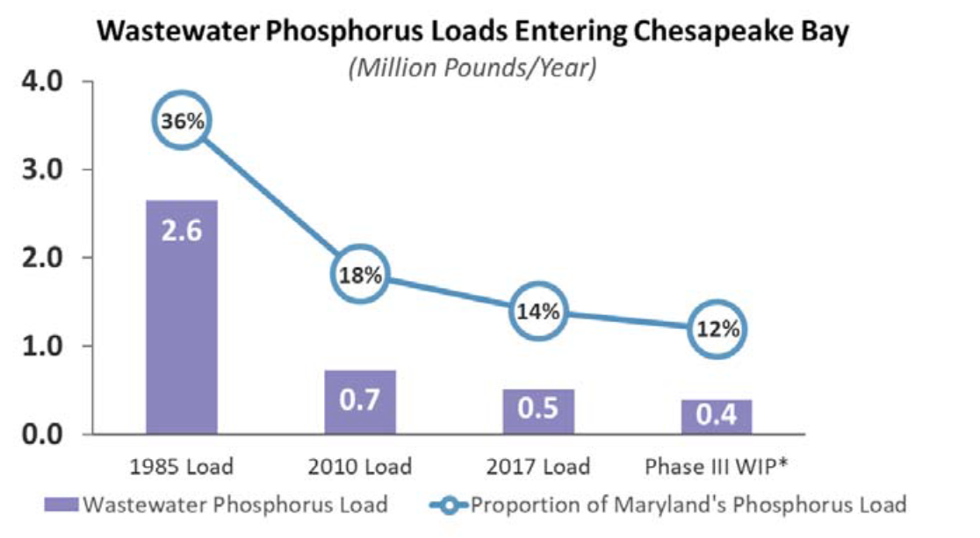
Wastewater Strategy (cont)
Other Actions
Complete ENR upgrades for significant federal and industrial plants
Complete ENR upgrades for 11 smaller POTWS
Continue to incentivize POTW performance below 4 mg/l through O & M grants, Clean Water Commerce Act, trading
Source: MDE
COG Staff MD Phase III Draft WIP Presentation
May 7, 2019

Slide 6
Stormwater Strategy
Core idea:
Implementation will continue well beyond 2025 both for Bay TMDL compliance (as wastewater “surplus” decreases), meeting local TMDL action plans and other drivers
Issue new (MEP-driven) permits for 10 Phase I jurisdictions plus SHA
  Complete original 20 % ISR goal; set new goals based on MEP
  Addresses about 70 % of total statewide impervious area
Continue implementation under Phase II general permits (20 % ISR goal, but no end date for implementation)
  Addresses about 20 % of total statewide impervious area
Continue implementation under Phase II state and federal permits (20 % ISR goal)
Use grant funding for non-permitted urban areas
COG Staff MD Phase III Draft WIP Presentation
May 7, 2019

Slide 7
Agriculture Strategy
Depends on increased implementation of a lot of different practices
  e.g. conservation tillage, manure transport, agricultural drainage management, stream restoration, prescribed grazing, etc.
Proposed by ag stakeholders in each county
Pace of implementation is quite aggressive
1.4 million achieved
4.4 million sought
Source: MDE
COG Staff MD Phase III Draft WIP Presentation
May 7, 2019

Slide 8
N Load Reductions by Source Sector
MDE numbers based on 2017 Progress scenario and 2025 projected loads
Source: MDE
Stormwater reductions based on load assumptions associated with achieving treatment of 2 % of untreated impervious area per year, not a specific BMP input deck
Source: COG
COG Staff MD Phase III Draft WIP Presentation
May 7, 2019

Slide 9
P Load Reductions by Source Sector
MDE numbers based on 2017 Progress scenario and 2025 projected loads
Source: MDE
Stormwater sector would account for 24 % of the total P reductions
Source: COG
COG Staff MD Phase III Draft WIP Presentation
May 7, 2019

Slide 10
Sediment Load Reductions by Source Sector
MDE numbers based on 2017 Progress scenario and 2025 projected loads
Source: MDE
Stormwater sector would account for 69% of the total sediment reductions
Source: COG
COG Staff MD Phase III Draft WIP Presentation
May 7, 2019

Slide 11
Other Issues
Conowingo
To be addressed as part of separate WIP still under development
Proposed Exelon licensing requirements under litigation
Dredging and beneficial reuse pilot underway
Climate change
Not addressed numerically yet; will do so in 2021
Will pursue research on design and siting of BMPs
Growth
Load increases from new growth are built into 2025 modeling scenarios (including increased flow at POTWs – 0.6 percent/year)
Wastewater surplus offsets any load increases
COG Staff MD Phase III Draft WIP Presentation
May 7, 2019

Slide 12
COG Next Steps
CBPC meets May 17
To consider potential WIP comments
Applicable only to MD and VA WIPs; COG will not comment on DC WIP
COG Staff MD Phase III Draft WIP Presentation
May 7, 2019

Slide 13
Potential COG Comments -- MD and VA WIPs
Region has extensive excess reduction from wastewater sources
States likely to use to offset less progress by other sectors
Don’t necessarily object, but should emphasize that excess needed for future growth
  Offsets for our own stormwater first
Source: COG
COG Staff MD Phase III Draft WIP Presentation
May 7, 2019

Slide 14
Potential COG Comments -- MD and VA WIPs
Pace of BMP implementation under stormwater permits should not be driven by Bay TMDL nitrogen reduction requirements
Climate change – Don’t quantify until modeling work estimating impacts is done (2021-2022)
Conowingo – Reiterate need for local voice in deliberations
Growth – Support decision to incorporate 2025 conditions into WIP III framework
COG Staff MD Phase III Draft WIP Presentation
May 7, 2019

