Slide 1

Station Pedshed and Bikeshed Atlas 2.0
September 17, 2024
TPB Bicycle and Pedestrian Subcommittee Presentation

Slide 2
What We’ll Cover Today
Station Pedshed and Bikeshed Atlas
Introduction and Background
Methodology
Examples of Pedsheds and Bikesheds
Resources

Slide 3
Why Atlas 2.0?
Station Pedshed and Bikeshed Atlas

Slide 4


Your Metro, The Way Forward
Station Pedshed and Bikeshed Atlas
Metro’s 2023 Strategic Transformation Plan prioritizes safe and accessible routes to transit for pedestrians and bicyclists.
Our goal is to increase the share of riders who access Metrorail by bicycle from 1.4% in 2024 to 3.5% by 2030.
The Station Pedshed and Bikeshed Atlas 2.0 helps Metro and our partners meet this goal.
  Understand which areas have the best existing non-auto access to stations
  Visualize barriers or gaps in the transportation network
  Identify areas with potential to unlock new ridership
Four goal areas from the Strategic Transformation Plan

Slide 5
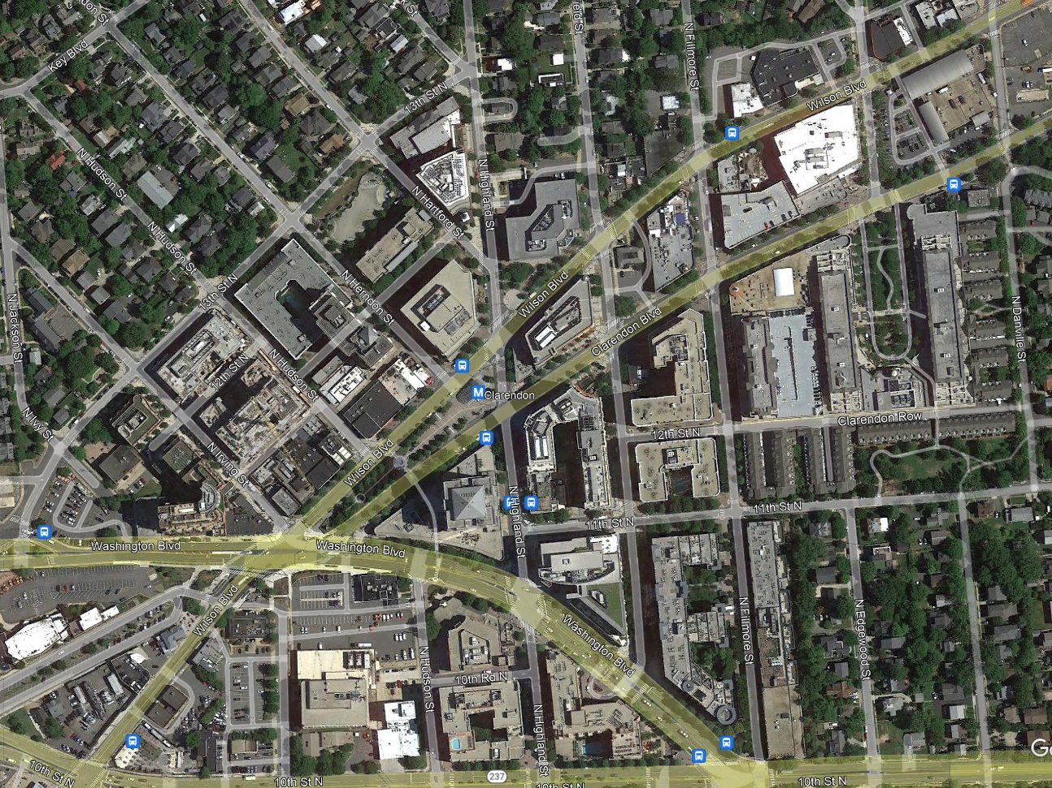
Walking to Metro
Station Pedshed and Bikeshed Atlas
Nearly two-thirds of Metrorail riders already reach their station by walking,¹ but the share of riders accessing Metro by walking can vary drastically by station…
Clarendon – 80% 🚶
¹Mode of access data in this presentation are from the 2022 Metrorail Passenger Survey

Slide 6
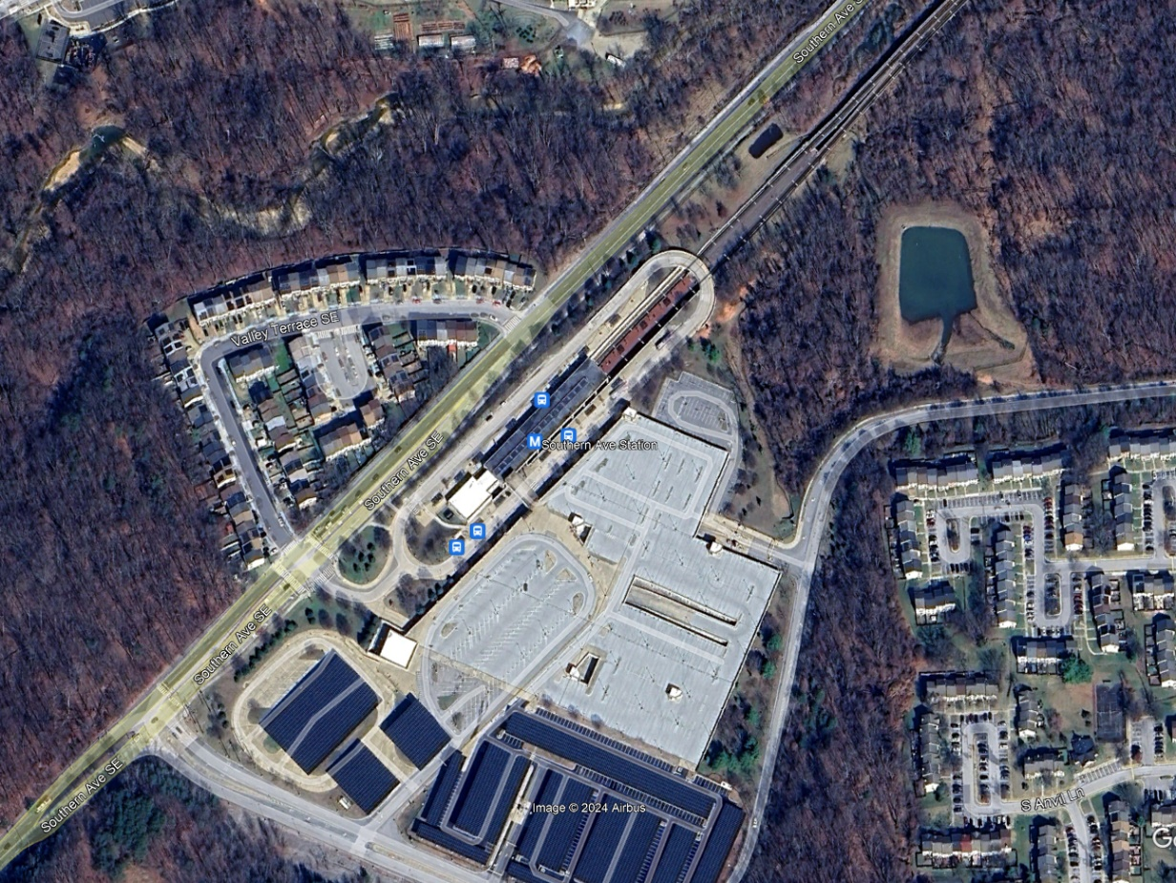
Walking to Metro
Station Pedshed and Bikeshed Atlas
Nearly two-thirds of Metrorail riders already reach their station by walking,¹ but the share of riders accessing Metro by walking can vary drastically by station…
Clarendon – 80% 🚶
Southern Avenue – 9% 🚶
¹Mode of access data in this presentation are from the 2022 Metrorail Passenger Survey

Slide 7
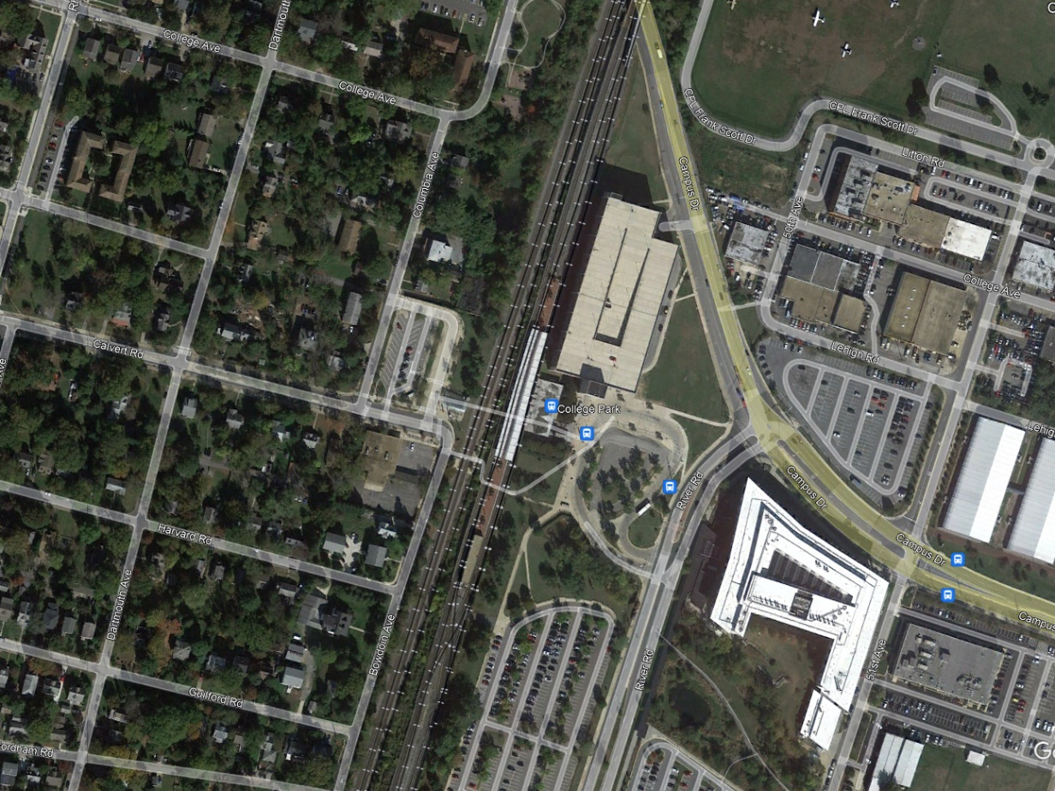
Biking to Metro
Station Pedshed and Bikeshed Atlas
Approximately 2% of Metrorail riders reach their station by bicycle or scooter (personal or shared fleet), but this also varies by station…
College Park-U of Md – 9% 🚴

Slide 8
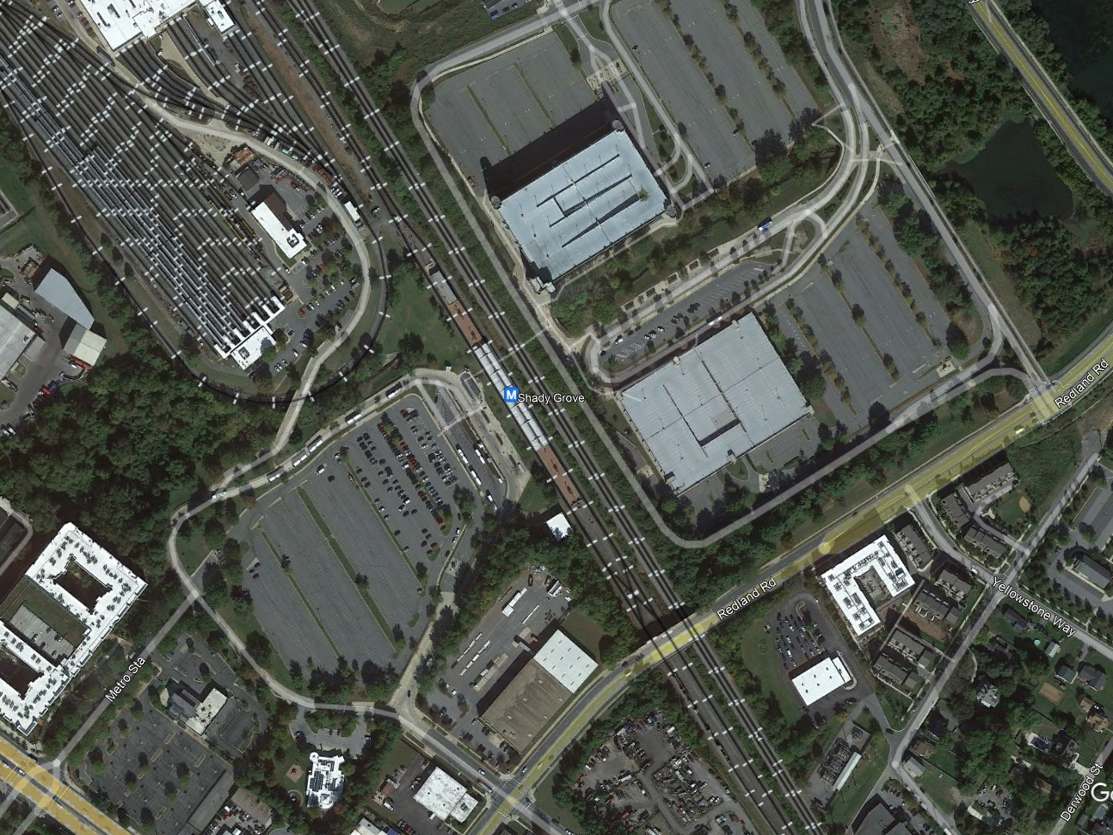
Biking to Metro
Station Pedshed and Bikeshed Atlas
Approximately 2% of Metrorail riders reach their station by bicycle or scooter (personal or shared fleet), but this also varies by station…
College Park-U of Md – 9% 🚴
Shady Grove – <1% 🚴

Slide 9
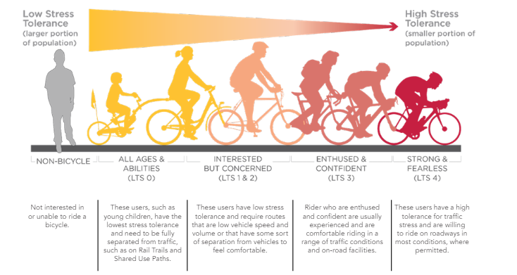
Why the Disparity?
Station Pedshed and Bikeshed Atlas
Many elements influence Metro ridership and mode of access.
  Physical barriers like highways, rivers, and disjointed street and sidewalk networks
  “Traffic stress” from real or perceived safety issues on roads
Pedsheds and bikesheds allow us to visualize the areas—or actual paths—around Metrorail stations that are accessible to pedestrians, bicyclists, and micromobility users.
Level of Traffic Stress (LTS) scoring (Source: Maryland Statewide Bicycle and Pedestrian Master Plan)

Slide 10
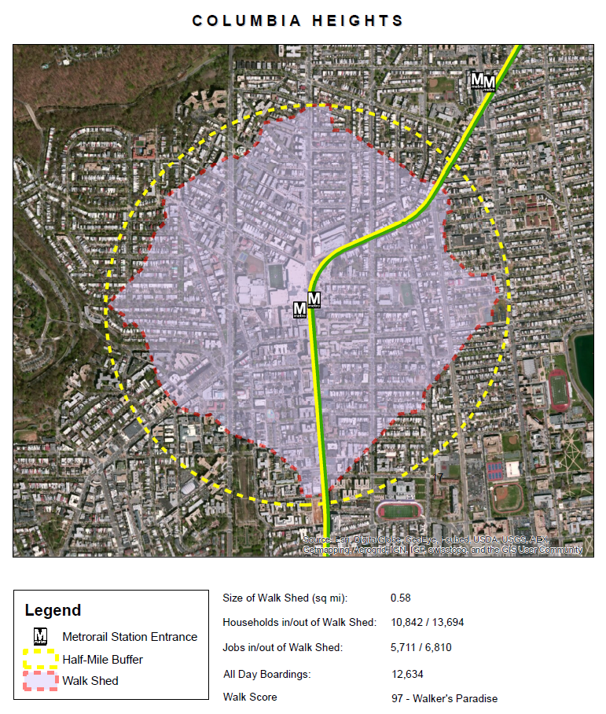
Metrorail Walkshed Atlas 1.0
Station Pedshed and Bikeshed Atlas
Metro debuted its Walkshed Atlas 1.0 in 2015 through the PlanItMetro blog site.
  PDF Report
  Link to GIS files provided in comments
The Atlas has not been updated since, despite the significant levels of development that have occurred over the last decade.
Columbia Heights station in Walkshed Atlas 1.0

Slide 11
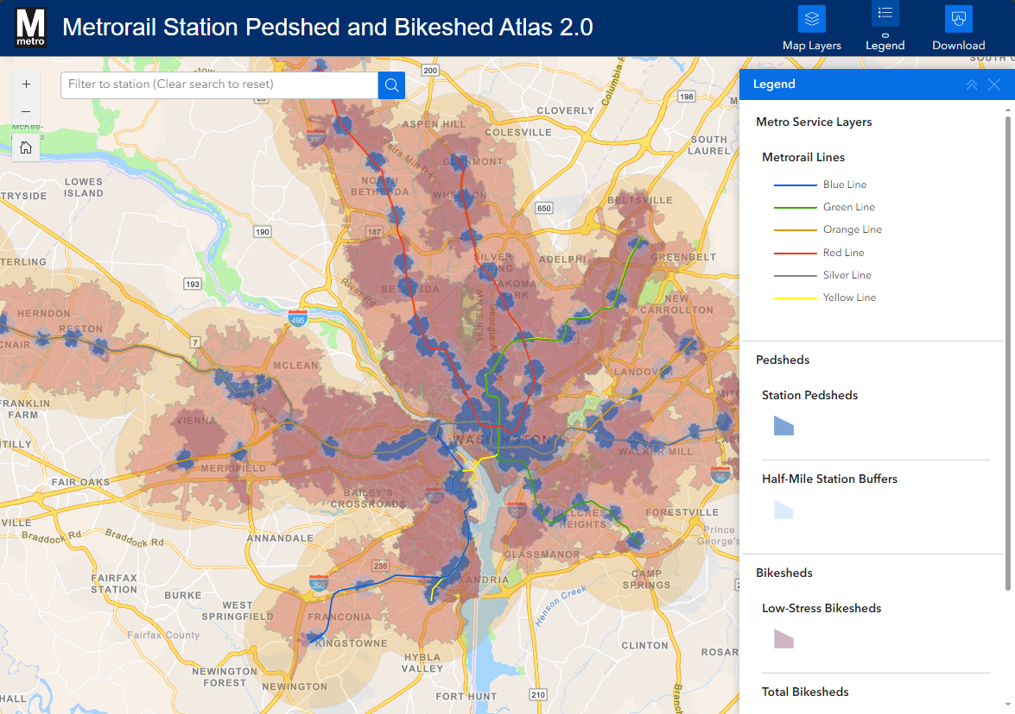
What’s New in Version 2.0
Station Pedshed and Bikeshed Atlas
For the first time at Metro, we have station bikesheds (low-stress and total networks).
New resources include…
  StoryMap
  Interactive web map with GIS data available for download
  Updated PDF report
Interactive Pedshed and Bikeshed Atlas 2.0 Web Map

Slide 12
How We Made the Atlas 2.0
Station Pedshed and Bikeshed Atlas

Slide 13
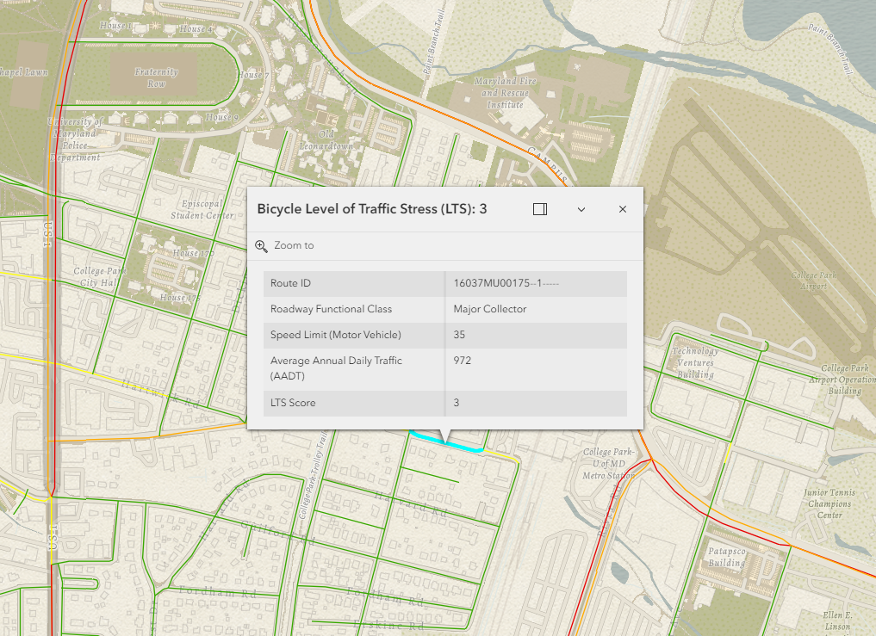
Step 1: Gather Geospatial Data
Station Pedshed and Bikeshed Atlas
For pedsheds, the project team used sidewalk and crosswalk data to establish a sidewalk network.
For bikesheds in DC and Maryland, the team used street-level Level of Traffic Stress (LTS) measures to develop a street network.
For bikesheds in Virginia, where LTS measures were not readily available, we used Functional Roadway Classifications and speed limits as proxies for LTS.
LTS measures near College Park-UMD station from Maryland DOT

Slide 14
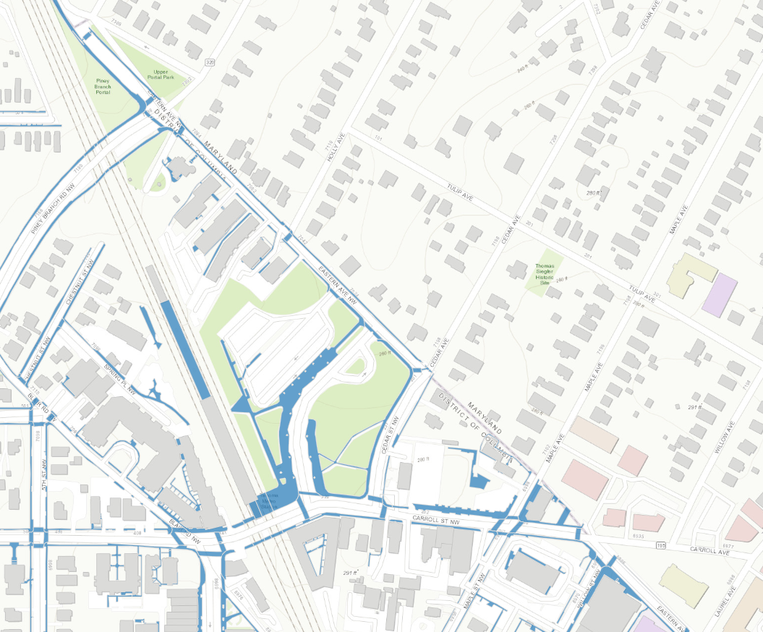
Step 2: Clean and Review Network
Station Pedshed and Bikeshed Atlas
When sidewalks or roads did not line up across jurisdictional boundaries, we manually connected these segments to reflect complete networks.
The team reviewed sidewalk and street networks by comparing it with recent satellite imagery.
DDOT sidewalk data near Takoma station ends at the DC-Maryland line

Slide 15
Step 3: Run Network Analysis
Station Pedshed and Bikeshed Atlas
The analysis generated footprints out from stations along actual paths accessible to pedestrians and bicyclists on suitable infrastructure.
Pedsheds
We used a half-mile distance from the station as the cutoff along the sidewalk network.
Bikesheds
For low-stress networks, we included roads with LTS levels 1 through 3,² up to three miles from a station. In Virginia, our proxy measure included roads with speed limits up to 30 MPH.
For total networks, we included all on-road facilities that could accommodate bicycle travel within three miles from a station.
²LTS levels 1 through 3 include dedicated (e.g., bicycle lane) and shared (e.g., bicycle boulevard) bicycle facilities.

Slide 16
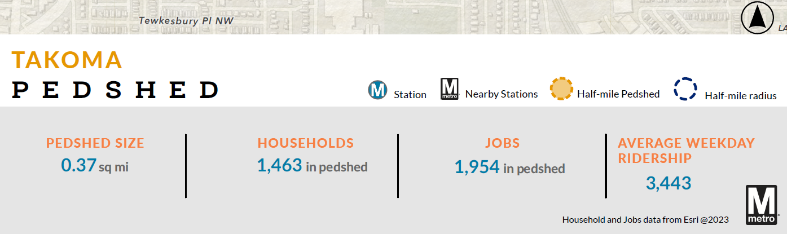
Step 4: Describe Characteristics of Sheds
Station Pedshed and Bikeshed Atlas
The pedshed or bikeshed size is the physical area for the polygon as measured in square miles.
Household and employment totals were obtained from demographic and business location files available from Esri.
Station ridership was obtained from Metro’s Ridership Data Portal.
Example of pedshed characteristics

Slide 17

Methodology Limitations
Station Pedshed and Bikeshed Atlas
The LTS proxy in Virginia likely includes roads not suitable for biking (and excludes facilities that are).
This initial dataset focuses on on-road LTS, which does not include off-road bicycle facilities like multi-use trails. Future iterations of the Atlas will seek to include these facilities.
Across all 98 stations, some connections are likely missing from our data that were not identified in manual review.
Off-road bicycle facilities will be included in future iterations of the Atlas

Slide 18
Examples from the Atlas 2.0
Station Pedshed and Bikeshed Atlas

Slide 19
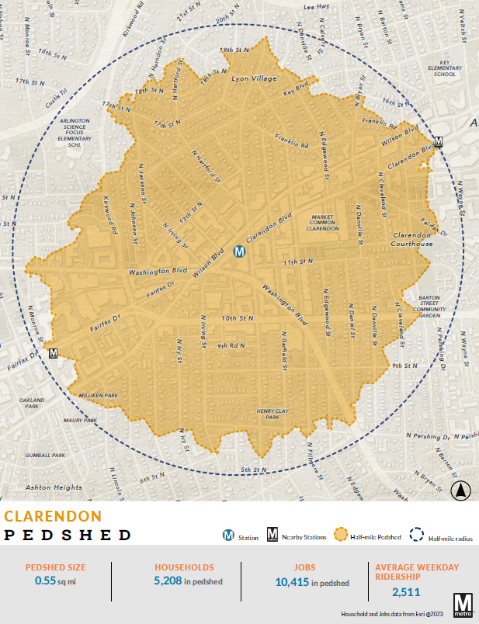
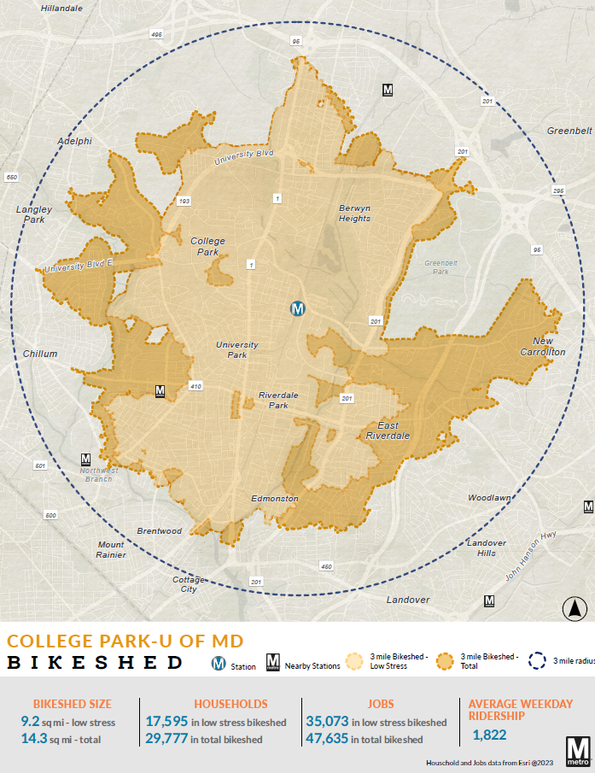
PDF Maps
Station Pedshed and Bikeshed Atlas
½ Mile Radius
3 Mile Radius
½ Mile Shed
3 Mile “Total” Shed
Low-Stress Shed
Station Name and Legend
Shed Characteristics

Slide 20
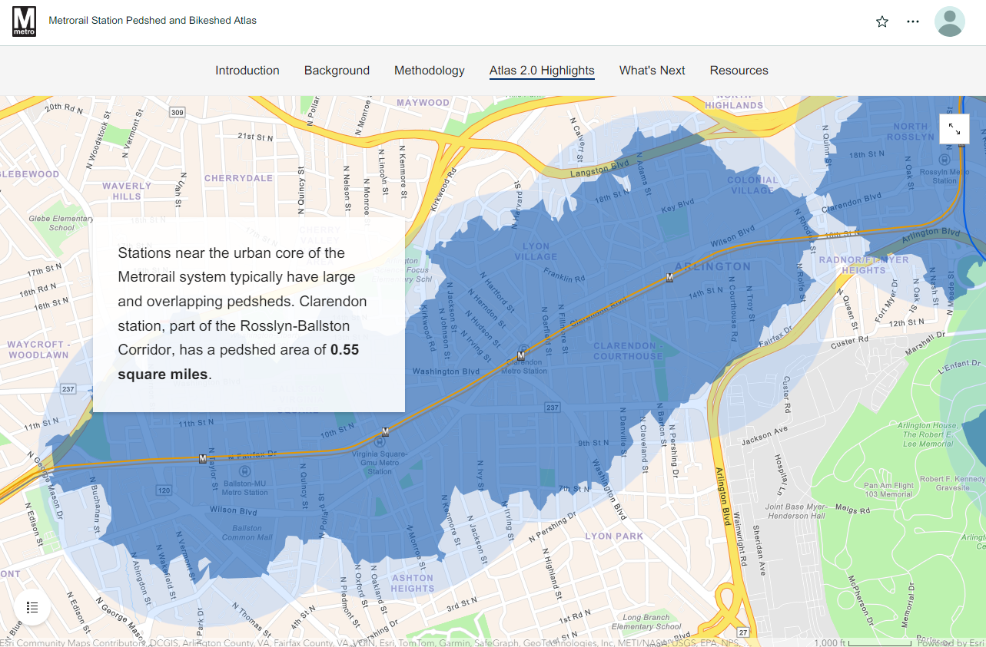
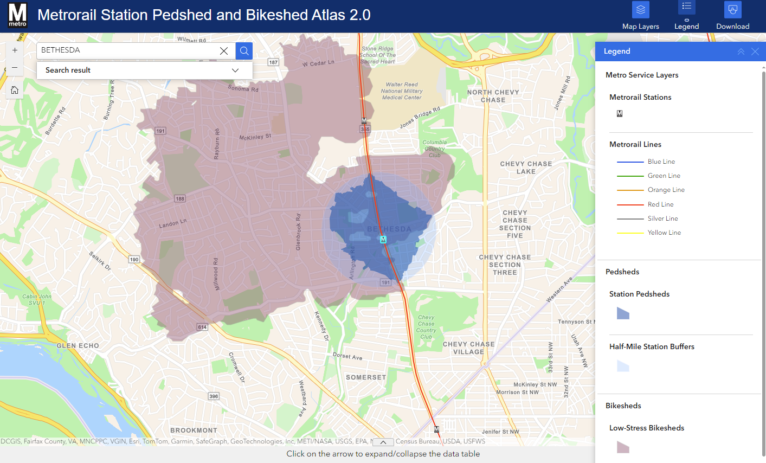
StoryMap and Web Map
Station Pedshed and Bikeshed Atlas
Pedshed and Bikeshed Atlas 2.0 StoryMap
Pedshed and Bikeshed Atlas 2.0 Web Map

Slide 21
Initial Analysis
Station Pedshed and Bikeshed Atlas
As a station’s pedshed size increases, we can generally expect pedestrian mode of access share to increase, as well
We find less of a relationship between bikeshed size and bicycle access
Systemwide Average

Slide 22

Resources
Station Pedshed and Bikeshed Atlas
wmata.com/initiatives/pedshed-and-bikeshed-atlas/

Slide 23
Thank you!
Station Pedshed and Bikeshed Atlas
Project Contacts
Ryan Yowell
Senior Planner
ryowell@wmata.com
Seth Garland
Director of Station Planning
sgarland@wmata.com

